Slide 1
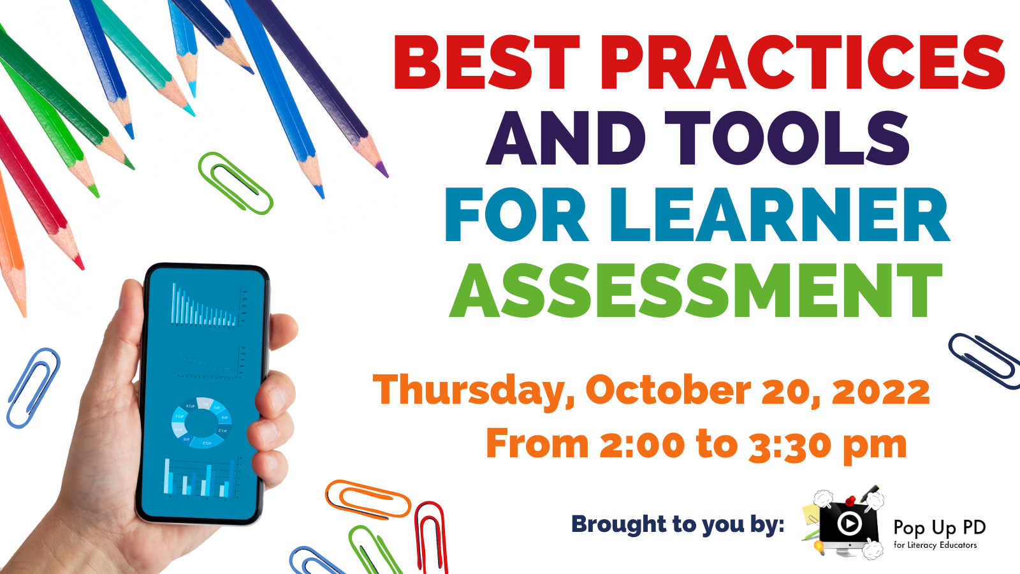

Title of Presentation

Slide 2
Statement of Land Acknowledgement
I would like to begin by acknowledging the Indigenous Peoples of all the lands that we are on today. While we meet today on a virtual platform, I would like to take a moment to acknowledge the importance of the lands, which we each call home.
We do this to reaffirm our commitment and responsibility in improving relationships between nations and to improving our own understanding of local Indigenous peoples and their cultures. From coast to coast to coast, we acknowledge the ancestral and unceded territory of all the Inuit, Métis, and First Nations people that call this land home.

Slide 3
About Pop Up PD for Literacy Educators
free webinar series developed by Ontario’s LBS Regional Networks & the Provincial Support Organizations for Literacy
supports LBS practitioners with presentations on topics important to them
English language webinars presented for LBS practitioners annually since 2015-2016 with French language transcriptions provided by COFA
all webinar presentations, recording links & transcripts here:
  Pop Up PD Resources for LBS Educators
webinar topic ideas welcome at: e-channel@contactnorth.ca

Slide 4
Supporting This Webinar
ASL Translators:
Rebecca Stuckless and Carolyn Lesonsky
Moderating the Chat:
Heather Robinet, Executive Director of the QUILL Learning Network
Technical Support:
Stacey Ornatowski, e-Channel Training Facilitator and Staff Training Specialist, Contact North

Slide 5
About Today’s Presentation
Responding to strong interest from the literacy field in learning more about assessment tools
Based on the results of a provincial survey asking LBS practitioners to share information about their most valuable initial assessment tools
Will expand on those tools to focus on modifying or developing new tools and processes to support learners during the assessment process

Slide 6
Our Panelists
Heather Ferguson from Sioux College
Rick Townend from Fanshawe College
Melissa Friske from the Renfrew County District School Board
Jill Slemon from the London District Catholic School Board
Jessica Moir from the Haldimand Norfolk Literacy Council
Sue Damon from The Literacy Group of Waterloo Region
Sara Gill and Jeimy Martinez Sorto from the Adult Basic Education Association (ABEA)
Monika Jankowska-Pacyna from AlphaPlus

Slide 7


Welcome Heather Ferguson

Slide 8
SkillsMarker
Identify & address skill gaps
Measure skill gains
Compare skill levels to occupational requirements
Compare skill levels to educational requirements
Supplement learning activities using the learning plans
Customize training materials
used by
COLLEGES
SCHOOL BOARDS
NGO’S
& EMPLOYERS

Slide 9


SkillsMarker
English French
https://en.esee.essentialskillsgroup.com/ https://fr.esee.essentialskillsgroup.com/

Slide 10
SkillsMarker Quick Facts
Original name was “ESEE” (Essential Skills for Employment and Education)
Fully online
Administered by the College Sector Committee for Adult Upgrading (CSC)
Updated in 2020 to correspond with the new federal “Skills for Success” Framework (replaced previous “Essential Skills” Framework)
Most widely used Essential Skills/Skills for Success assessment in Canada to date:
  458,275 assessment taken by over 90,000 people
  71,552 assessments taken in the past 12 months
  4,804 assessments taken in the past month
  158 different organizational users

Slide 11
SkillsMarker Quick Facts
Includes separate assessments for reading, numeracy, writing, problem solving, digital skills, and listening
Test administrator can assign one or more of the above assessments to each test taker
Uses HRSDC* 5-level scale and IALS** 500-point scale for scoring
Accurately assesses the essential skills proficiency of test takers using Ontario- centric questions
Produces customized learning plans with free online resources
Available in English and French
Includes embedded American Sign Language (ASL) videos to explain key words
* Human Resources and Skills Development Canada; now Employment and Social Development Canada (ESDC)
** International Adult Literacy Survey

Slide 12
SkillsMarker Quick Facts
Most College LBS/AU programs use SkillsMarker to determine client eligibility and placement
Some have been using it for many years, others more recently (especially with the shift to remote delivery)
Available 24/7/365, anywhere with reliable Internet access
Can be completed using a smartphone
No time limit (unless test administrator chooses to impose one)

Slide 13
SkillsMarker Quick Facts
Can be completed in more than one sitting
Uses psychometrically validated questions
Random test bank
Includes adaptive feature for the Reading assessment
Includes a 6-question “Locator” at the beginning of each assessment (reading, numeracy, etc.) to stream test-takers into appropriate assessment level:
  Test A (level 1 questions only) or
  Test B (level 1, 2, and 3 questions) or
  Exemption (should upgrade before attempting the assessment)

Slide 14
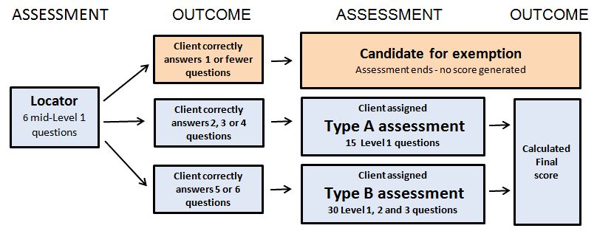
The “Locator” helps to prevent test-takers from proceeding if they do not have adequate reading skills to engage with the assessment.

Slide 15
SkillsMarker Quick Facts
Results are immediately and automatically shared electronically with test takers and the test administrator
Administrator results report provides scores and exemplar tasks that the test-taker can likely perform
Learning plans list free learning activities and are customized to the test-taker’s results

Slide 16
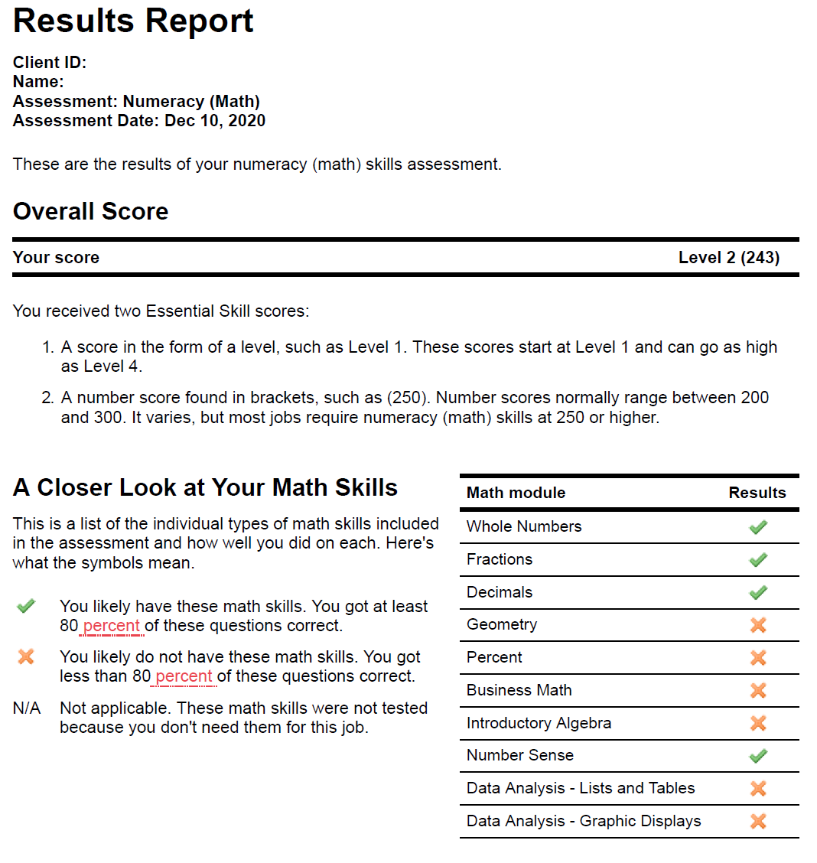
Sample Results Report
Numeracy (Math)
Page 1

Slide 17
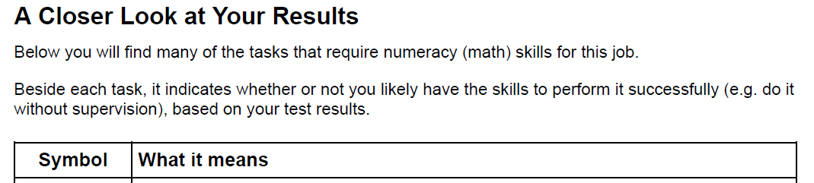
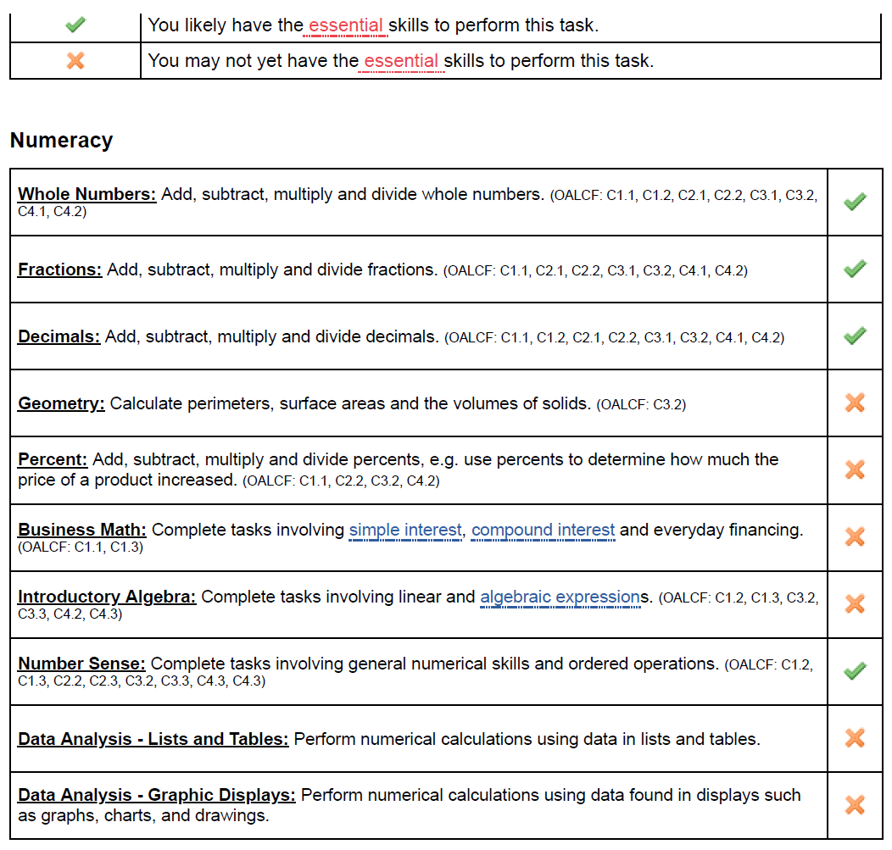
Sample Results Report
Numeracy (Math)
Page 2
Correlations to OALCF are included

Slide 18

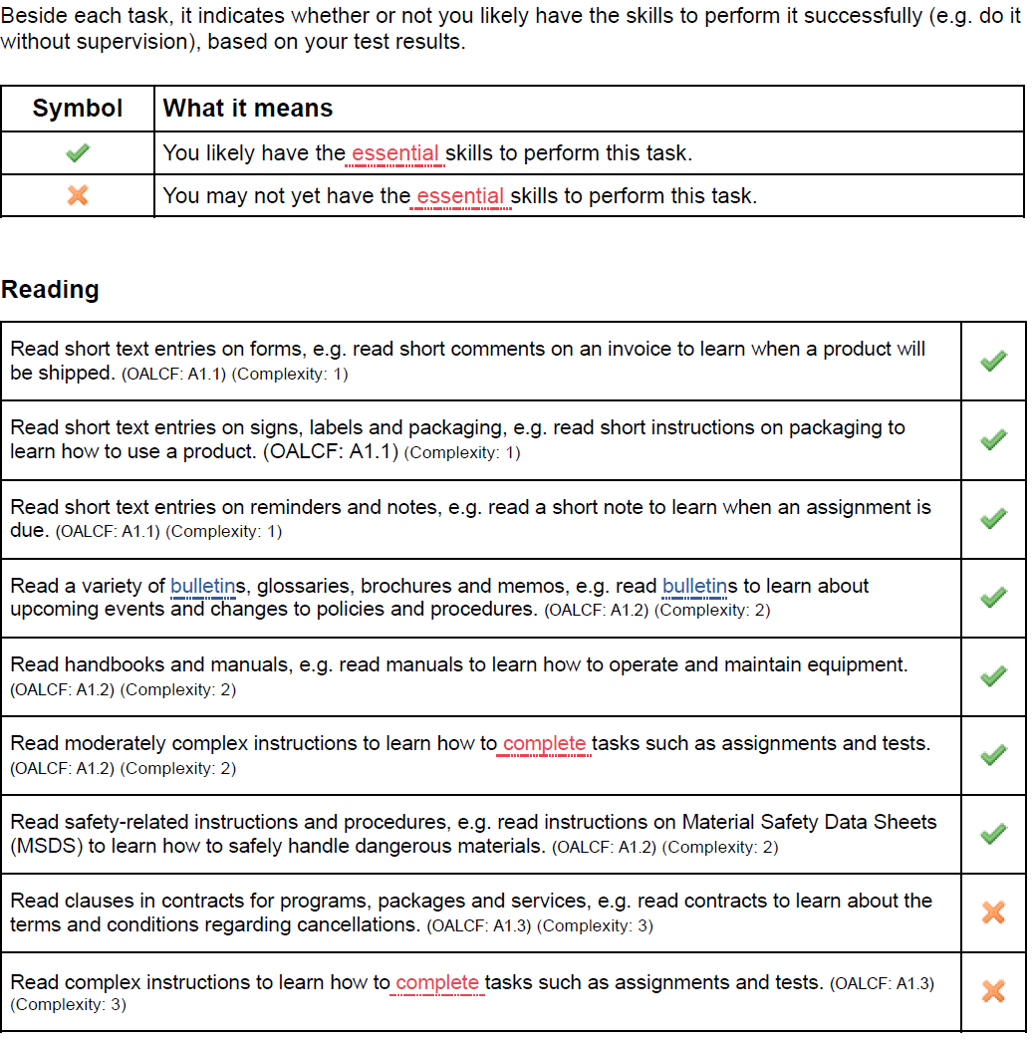
Sample Results Report
Reading
Page 2
Correlations to OALCF are included

Slide 19
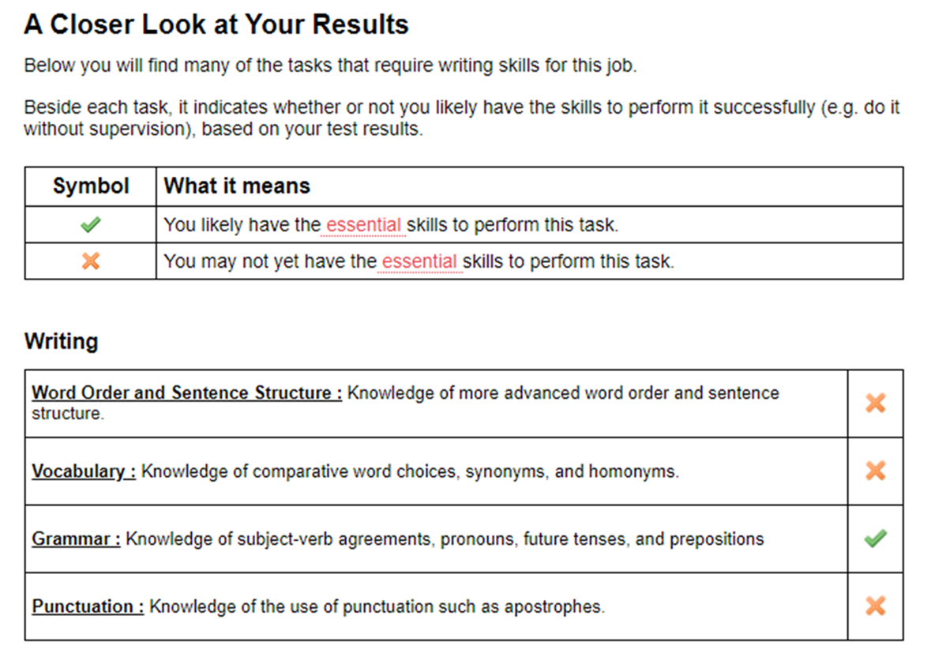
Sample Results Report
Writing
Page 2

Slide 20
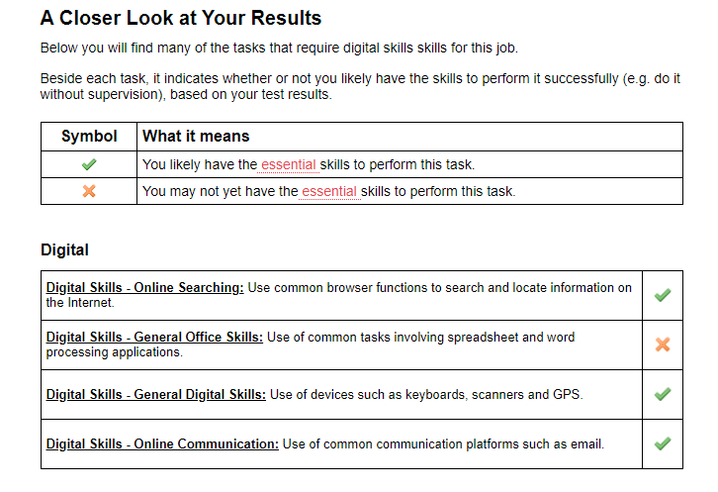
Sample Results Report
Digital Skills
Page 2

Slide 21
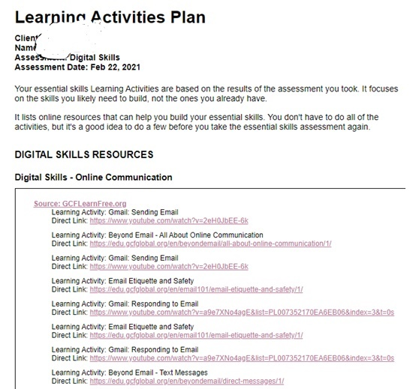
Learning Activities Plan
Client:
Name:
Assessment: Digital Skills
Assessment Date: Feb 22, 2021
Sample Learning Activities Plan
Digital Skills

Slide 22
SkillsMarker Quick Facts
Free for use by college LBS providers as part of the support provided by CSC
Other college users must purchase vouchers (PayPal or credit card online)
Non-college LBS providers and external organizations must also purchase vouchers
$35 per test-taker (one voucher) provides a pre- and post-test for each of the 6 assessments: reading, numeracy, writing, problem solving, digital skills, and listening
Volume pricing is available in increments of 50
Questions? Contact info@cscau.com

Slide 23

Welcome Rick Townend
Face-to-face diagnostics based on the OALCF
The Math Booster Diagnostic for pre-apprentices
Informal evaluation through casual conversation

Slide 24
Objective to Diagnostic Testing
It must match established measures for the OACLF
It must accurately gauge the academic or problem solving skill set being tested
It meets the Ministry’s mandate in making judgements on opening a Learner Plan
It cannot be the sole source of information in making a judgement.
It should not be the only way a candidate can be tested
i.e. Skills Marker / Face to Face

Slide 25
Samples
For LBS Entry
Skills Marker – Electronic
Face To Face
School of Nursing Bootcamp
Self Assessment – Study Skills
LiUNA – 1059
Numeracy Targeted from the Apprenticeship Standards

Slide 26
How Our LBS Program Works
Level 1
Level 2
Level 3
ACE
Referred out------- Math Booster L1 Math L2 English
12 weeks (3months)
English
Math
LBS
12 weeks (3 months)
Math
English
Computers
SMSD
8 weeks (2 months)

Slide 27
Test
You have 3 hours to complete both parts of the test:
English
Math
Rules
No Talking
No Calculators
No Cell Phones
No Dictionaries

Slide 28
Good luck!

Slide 29


Welcome Melissa Friske
OSIT - Ontario Skills Inventory Tool
ESKARGO - Embedded Skills, Knowledge and Attitudes Reference Guide of Ontario
Reverse Binder

Slide 30
Learner Assessment
Important to Remember: LBS Practitioners are subject matter experts on the skills and tasks required for learner success in their selected goal path.
Questions to address:
How do we train new LBS instructors in understanding Competencies, Skill requirements, Tasks and selection of the right Assessment Tools for learners?
How do we provide proof to our funder, in respect to initial and ongoing assessments, in a language that they will understand?

Slide 31
OSIT
Online Assessment Tool
The tool was developed to provide an online option for assessing clients’ skills and aptitude of their skills
Our program started to use this tool when we moved to remote delivery during the pandemic. It was a way to address the inability to do a paper based assessment.
Share link to students to complete the assessment and then assessor can go into the administration site and determine the competency levels, add comments and print results to share with appropriate staff.

Slide 32
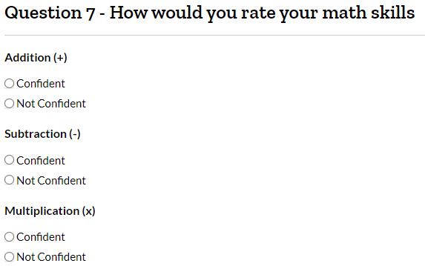
OSIT
Skills assessment in Competencies A, B, and C.
It generally takes 20-40 minutes to complete and is meant to give an idea of skills, but is not a comprehensive assessment.
Only tests the skills that the learner has said they are confident in, therefore allowing for success(not testing skills they select as “Not Confident” in)
Pros-user friendly, concise, built in confidence booster for learners
Cons-the results are in a 3 page format, so it has been a harder sell to instructors used to a traditional initial assessment(multiple pages of skills assessment)

Slide 33
ESKARGO
The ESKARGO allows practitioners to identify the embedded knowledge, skills and attitude for successful task completion; this information forms the basis for instruction and learning activities selection
Checklist of skills and knowledge required in each of the 6 competencies, divided by levels 1-3, includes readiness(pre-1)
Helps LBS practitioners make decisions on:
  What to teach for specific tasks
  What tasks might be appropriate based on the learner’s skills development
  https://cesba.com/wp-content/uploads/2020/10/ESKARGO-Initial-Skills-Assessment-with-answer-key.pdf
  This link will show a practitioner the steps involved in selecting a task and then identifying the skills, knowledge and attitudes that are required for successful completion

Slide 34
ESKARGO
Primary Purpose is to create links between skills and tasks.
How we use it at RCDSB?
Once initial intake skills assessment is complete, the assessor will attach the checklists for Reading, Writing and Numeracy with skills checked off that were proven in assessment
Instructor now has an identifier on what skills need to be taught in order to complete OALCF tasks for selected goal path
Pros: Excellent tool for new LBS practitioners to build capacity for working with a task-based approach, easy to use, valuable to explain to funders or others(internal organization members) what skills are connected to each level and how we utilize a task based approach
Cons: Some new instructors find it overwhelming when trying to link skills to tasks and the proper selection of Milestones

Slide 35
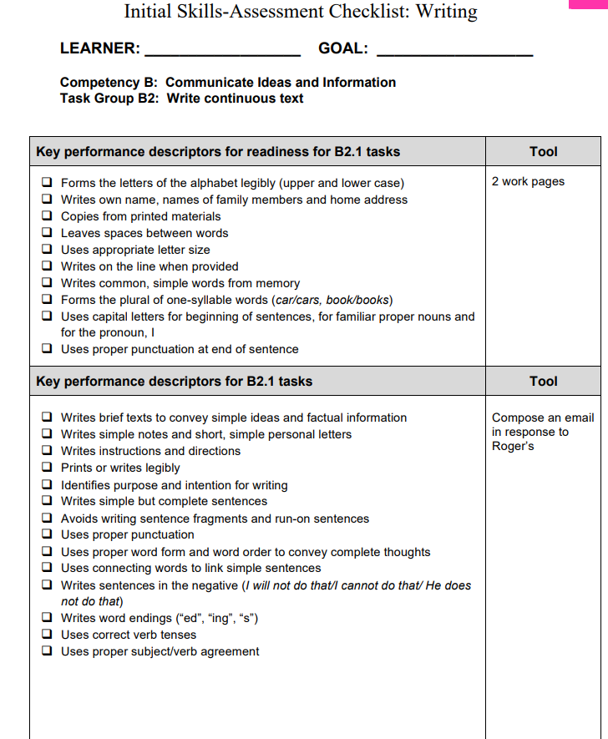
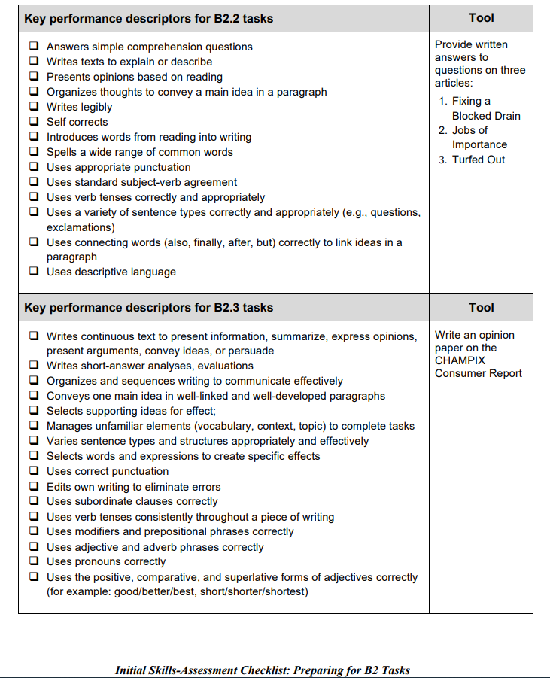

Slide 36
Reverse Binder
This was developed as a result of a workshop a few years ago.
Each Culminating Task has a page
Task Groups/Levels of Culminating Task are identified
Associated Milestones are listed
Assessment Activities from Literacy Northwest and Quill are listed.
How do we use it at RCDSB?
Instructor will work backwards by selecting Milestones to place in learner plan.
Skill development will occur with learner
Assessment Activities from L.N. and Quill, that correspond to the task group, will be selected as practice.
When instructor feels mastery has occurred, the milestones will be delivered during training(often 4-5)
Culminating Task completed when transitioning out of LBS

Slide 37
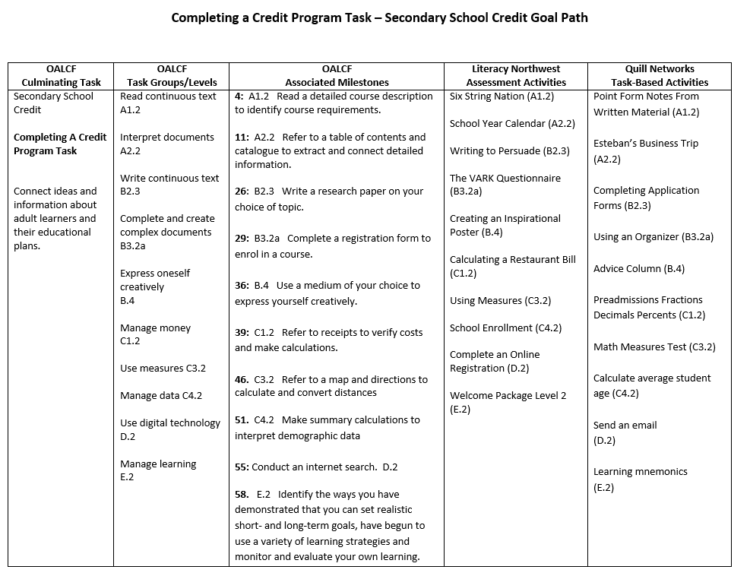
Sample

Slide 38

Welcome Dr. Jill Slemon
Learning Styles Task
Reading and Writing Tasks
Arithmetic/Mathematics Tasks

Slide 39
Advantages of Diagnostic Tasks
Establishes baseline of performance, identifies needs
Ties learning outcomes to specific tasks, strategies, and goals
Introduces relevant person-centred learning
Allows improvement of tasks based on observation and feedback

Slide 40
Learning Styles Task
Set of questions measuring preferences of learning (Yes/No Questions)
  By Seeing (Visual)
  By Hearing (Auditory)
  By Doing (Kinesthetic)
  By Computer (Tasks done online)
If answers questions as Yes, these styles may be preferences.
Always check this with learners during the debrief (“How do you think you learn best?”)

Slide 41
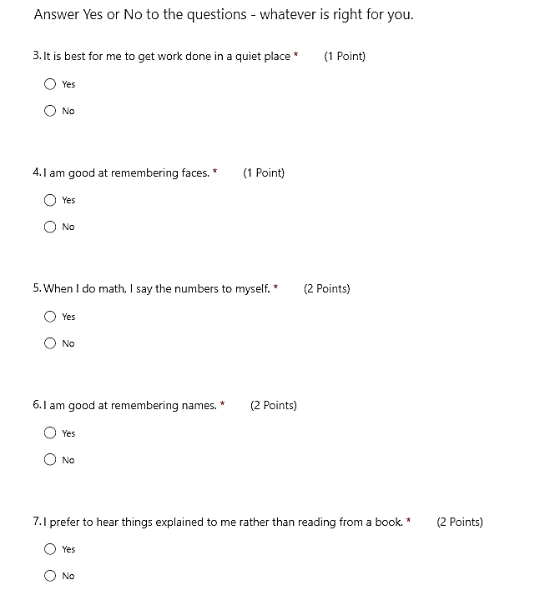
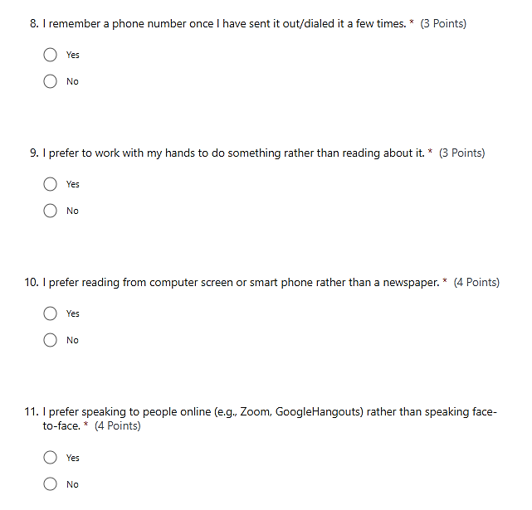

Slide 42
Identify preferences and strategies on learning plan. Include strategies people identified during debriefing.
By Doing – Organizing notes, computer, rehearsal, to-do-lists, review written log, flow charts
By Seeing – Highlight notes, graphic organizers, pictures, rehearsal, headings, Split-page method, flow charts
By Hearing –Taped texts, mini-lessons, verbal feedback, ask questions, You tube, audio books, mnemonic devices
By Computer – TED Talks, audio stories, talking texts, form aids, graphics.

Slide 43
Reading and Writing Tasks - Pattern
Reading
Written permission to use any copyrighted material (or use material from groups that gives consent for educational purposes)
TED Talks – Provide citation, source, hyperlink
Questions
Locate basic facts
Proper sequencing of information
Understanding specialized vocabulary
Tone of story*
Main idea of story (gist)*
Writing
5-7 sentences – well-written paragraph – question based on the reading

Slide 44
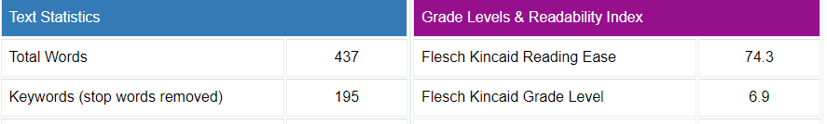
TED Talks Transcripts
Transcripts from presentations or website: Copy and paste text to identify readability
Readability:
Readability Checker - Check Readability Score of your text (editpad.org)
Flesch Kincaid Grade Level

Slide 45
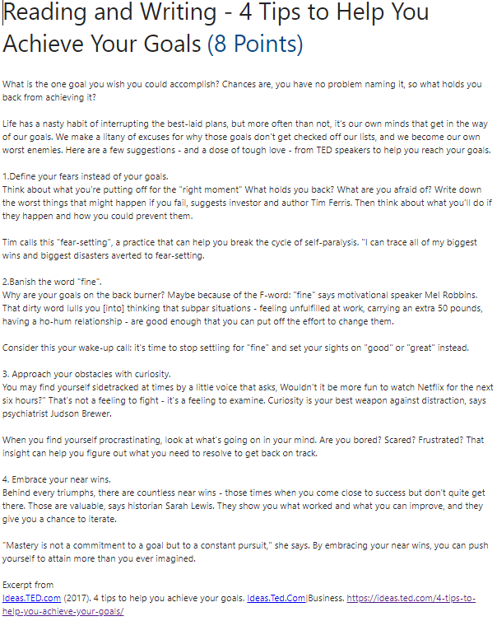

Slide 46
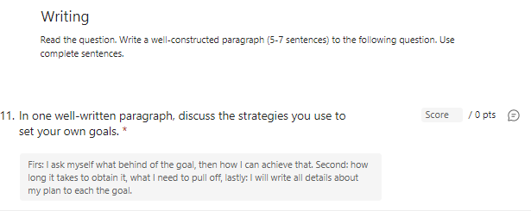
Writing Task
Writing samples, levels, training plans sent to instructors as well as key case notes (also entered in Case Notes database)

Slide 47
Arithmetic/Mathematics Task
Our adults prefer pencil-to-paper tasks for math
  Microsoft Quiz is not the most effective way to assess learners
  We ask in the debrief what calculations they do in a day (tell time, estimate, calculate tax, estimate change, etc.), what subject work they did in school, and what they want to learn)
Recommended:
  Baseline in-class task allows teacher to observe students.
  If learners are studying online, instructors have them submit paperwork for review to decide what strategies they use to solve problems and correct as needed.

Slide 48

Welcome Jessica Moir
Modifying initial screening tools to include elements of ABEA’s learning challenges assessment
How to carefully ask potentially sensitive or volatile questions during intake
The Common Assessment Tool created by Literacy Northwest (LNW)

Slide 49


Pop Up PD: Best Practices and Tools for Learner Assessment

Slide 55

Welcome Sue Damon
CAMERA & SARA
Two assessment tools we use at The Literacy Group of Waterloo Region

Slide 56
CAMERA - Communications and Math Employment Readiness Assessment
A standardized diagnostic tool created by Preparatory Training Programs of Toronto (PTP) https://ptp.ca - Canadian!
Designed for learners on the Employment goal path
Draws on authentic workplace documents - task-based assessment
Tests both occupationally specific skills and Essential Skills
Assesses four competencies (Reading, Writing, Document Use, Numeracy)
Clear guidelines provided for administering and scoring the assessments
Placement test: Locates client at one of three stages that correlate with ES/OALCF levels
Stage tests: Two Forms (A & B) at each Stage (1, 2 and 3) can be used to measure progress
Testing option available for learners with lower literacy levels

Slide 57
How we have been using CAMERA
Referral tool: Our Network, Project Read, is funded by OW to provide literacy assessments for OW clients. They use CAMERA to make appropriate referrals to the various LBS/AU agencies in our region.
The CAMERA assessments provided by Project Read give us a rough idea of skill levels, whether there might be learning disabilities or intellectual. disabilities, and a starting point for our own more in-depth assessments.
We have used CAMERA for pre- and post-training assessments of clients in fee-for-service programs to provide evidence of training effectiveness.
CAMERA can be used to measure learner progress, but we have not used it in that way, primarily because it is a paper-based assessment, and we switched to digital assessments when COVID arrived on the scene. (I finished my CAMERA training in March 2020.)

Slide 58
Sample Report from Project Read Based on CAMERA Assessment
Find and Use Information Competency assessed at OALCF Level 1 in Reading and Level 3 in Document Use
Read short texts to locate a single piece of information (A1.1)
Identified the main idea in brief texts (A1.1)
Scanned to locate specific details (A2.1)
Used layout to locate information in document (A2.3)

Slide 59
Sample Report from Project Read Based on CAMERA Assessment
Communicate Ideas and Information Competency assessed at OALCF Level 1
Spoke clearly in a focused or organized way (B1.1)
Repeated or questioned to confirm understanding (B1.1)
Wrote simple texts to request, remind or inform (B2.1) Task 2: “I will be in a meeting 30 minits so will be back after!”
Conveyed simple ideas and factual information (B2.1)
Used highly familiar vocabulary (B2.1)
Used layout to determine where to make entries in document (B3.3)

Slide 60
Sample Report from Project Read Based on CAMERA Assessment
Understand and Use Numbers Competency assessed at an undetermined OALCF Level
Did not complete numeracy task: purchase order
Did not correctly answer embedded numeracy math tasks

Slide 61
Limitations
Does not provide robust assessment of skills. Furnishes a rough estimate of skill levels in the 4 competencies measured, but does not give sufficient information for learner plan development or selection of learning resources. Additional assessment is required for those purposes.
Geared to learners on Employment pathway
Paper-based, so it can’t be used for remote assessment

Slide 62
SARA: Study Aid and Reading Assessment
Initially designed as a reading assessment for students in Grades 3-12
Researchers at the University of Memphis (led by John Sabatini, Distinguished Research Professor, Institute for Intelligent Systems and Department of Psychology) are in the process recalibrating the SARA for use with adult literacy students
The Literacy Group is a pilot site for the SARA
More adult-learning pilot sites are currently being sought
The SARA is a Web-based assessment that is simple to administer (send the learner a link, a user name, and a password by email) and provides detailed information on a learner’s reading strengths and weaknesses

Slide 63
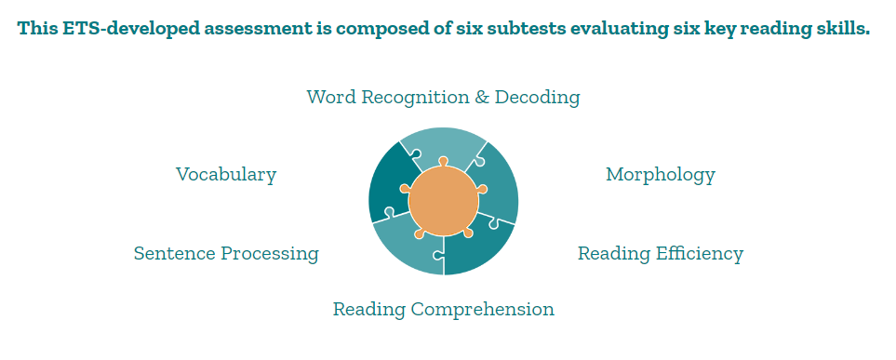
This ETS-developed assessment is composed of six subtests evaluating six key reading skills

Slide 64
How we use the SARA at The Literacy Group…

Slide 65
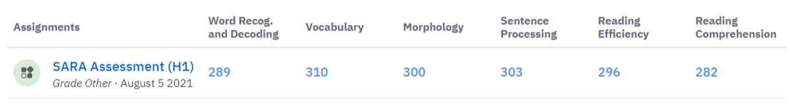
1. We use the SARA to determine whether our program is appropriate for a particular client
This client scored high across the board on a Level 3 assessment, and since we work primarily with Level 1 learners, our program would not be appropriate for her.

Slide 66
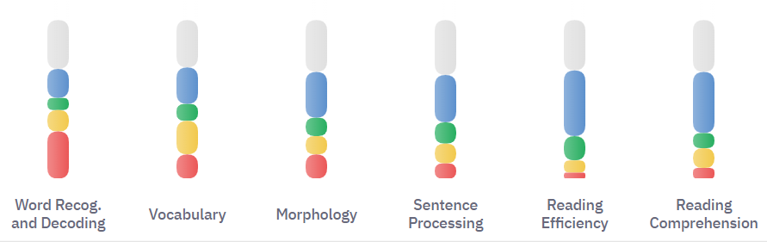
2. We use the SARA for program development
When we saw the data on our students’ overall performance, we recognized that we needed to strengthen our phonics instruction.

Slide 67
3. We use the SARA data to identify individual students’ reading strengths and weaknesses for learner plan development.
The following slides show what kinds of data the SARA provides.

Slide 68
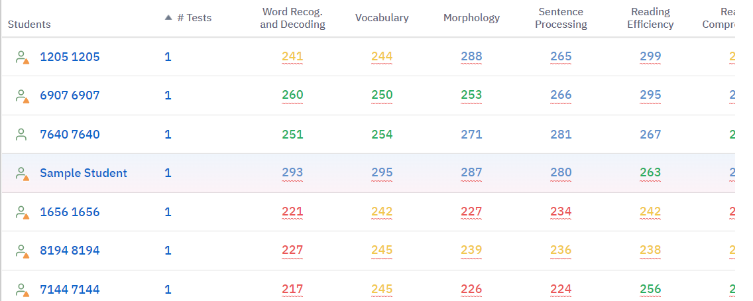

Slide 69
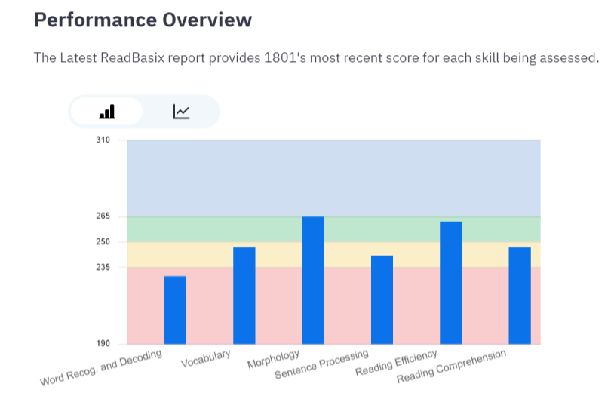

Slide 70
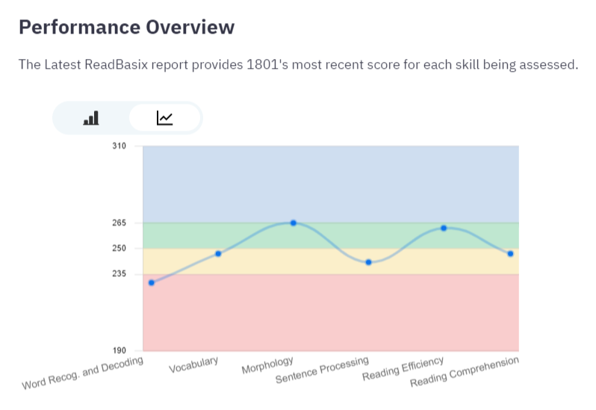

Slide 71
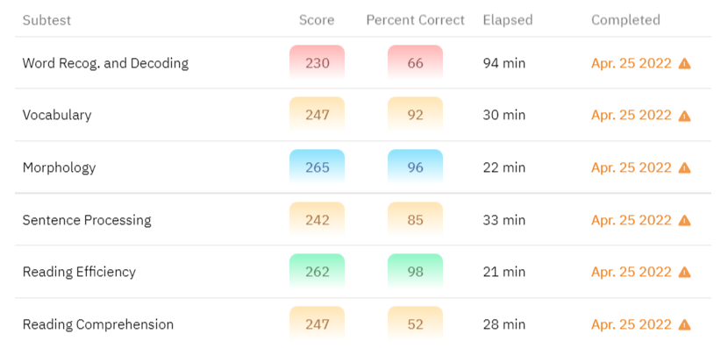

Slide 72
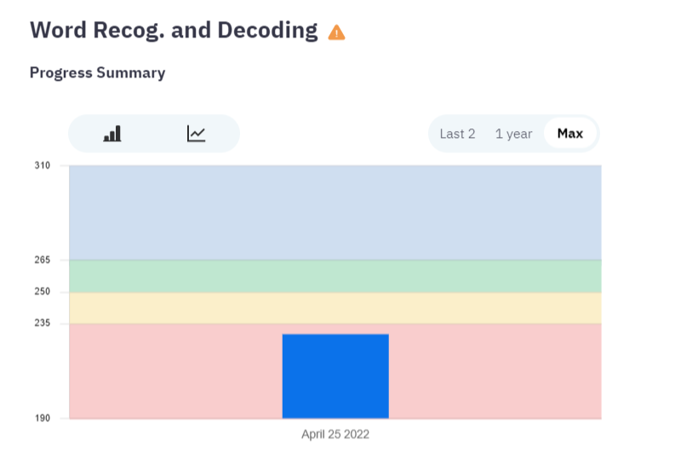

Slide 73
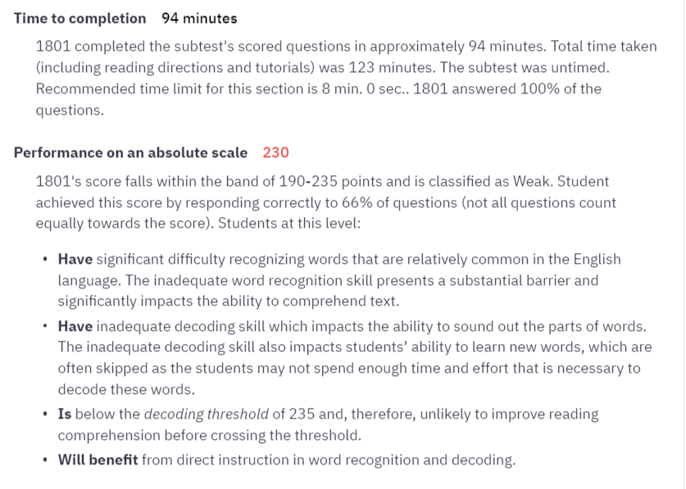

Slide 74
The information we get from SARA tells us…
What skills a learner needs to work on, and with what priority
What learning resources could be used with the learner
What learning format(s) might best suit the learner: 1-1 instruction, group instruction (which group?), independent online learning, hybrid learning…

Slide 75
Along with the SARA come helpful recommendations for building skills…

Slide 76
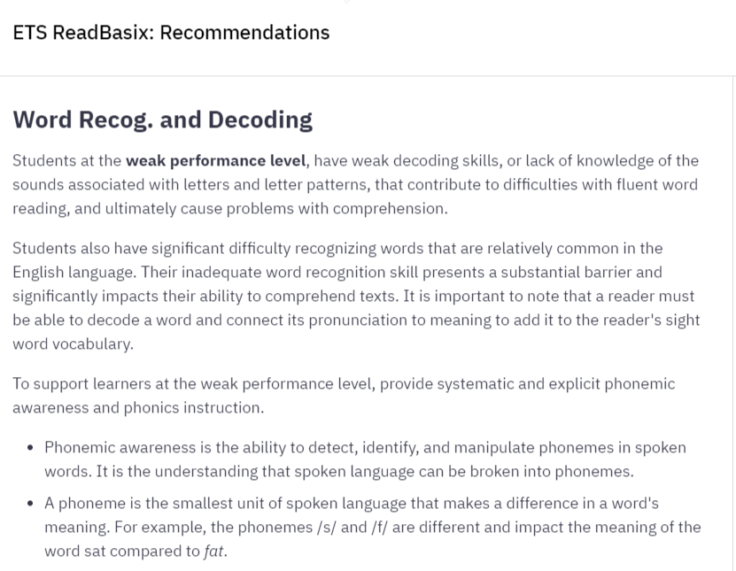

Slide 77
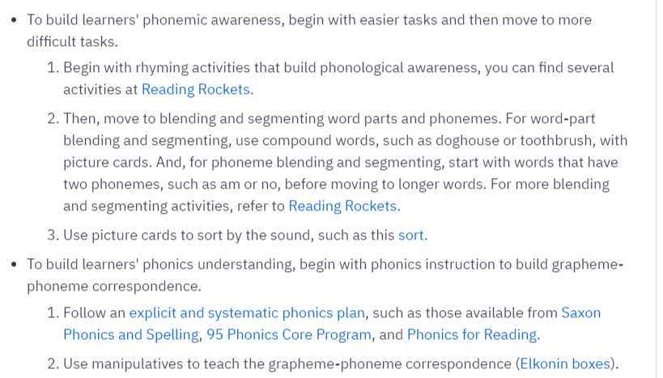

Slide 78
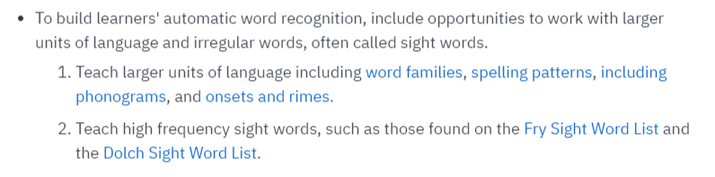
Since some of the suggested resources are geared toward younger learners, TLG has compiled lists of adult-friendly online resources that address the 6 reading competencies.

Slide 79
4. We use SARA to measure learner progress in reading
SARA has assessments at 3 levels (Low, Medium, High)
These levels correspond roughly to ES/OALCF Levels 1, 2 and 3
There are two tests at each level, so progress can be measured quantitatively
Let’s look at Learner 2433’s progress:

Slide 80
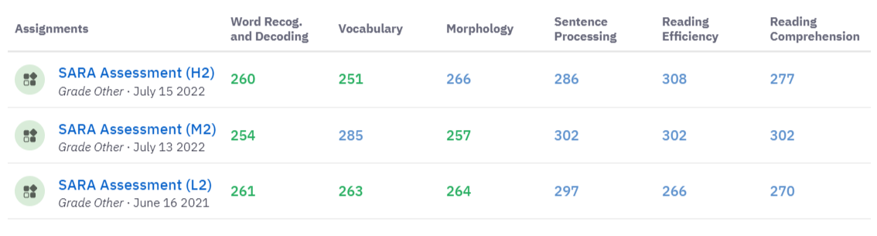

Slide 81
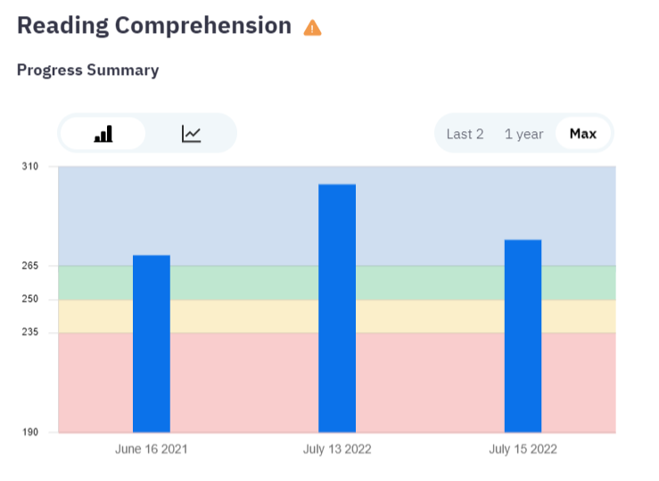

Slide 82
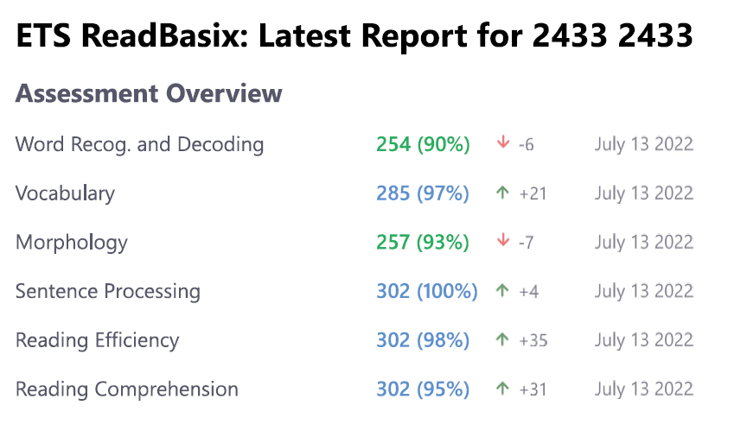

Slide 83
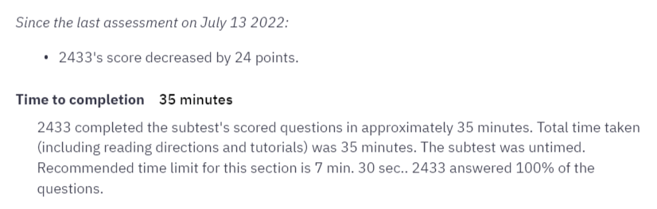

Slide 84
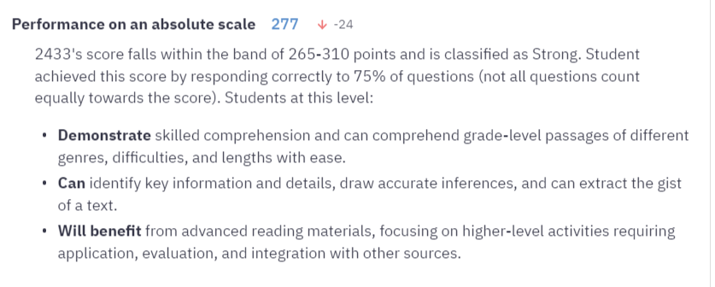

Slide 85
5. We use the SARA to confirm that a learner is ready for next steps
Based on Learner 2433’s SARA performance, we feel that the learner is ready for a program in our region that offers next-level skills upgrading.

Slide 86
Benefits of the SARA to the learner…
Learners receive instruction appropriate to their needs, which increases the likelihood of success.
Learners can see their progress in a data-based visual format, which boosts student confidence and motivation. Learners know which of their skills have improved, and which skills they could continue to work on. They can see that their hard work is paying off.

Slide 87
To participate in the SARA research project by becoming a pilot test site (and receive free access to this assessment tool)…
Contact Halle Smith, Research Coordinator, Department of Psychology and Institute for Intelligent Systems, University of Memphis
Email: esmith42@memphis.edu
Tell Halle you heard about the SARA from The Literacy Group!

Slide 88

Welcome Sara Gill and Jeimy Martinez Sorto
The Educational Planning Assessment Tool (EPAT)

Slide 89
The Adult Basic Education Association (ABEA) is the adult learning network in Hamilton. We support people with their educational and employment goals.
We offer
  information and referrals
  educational planning assessments
  outreach to clients or staff teams
We act as the central referring agency for adult education in our region.
What is the Adult Basic Education Association?

Slide 90

Educational Planning Assessment Tool (EPAT)
For people who are unsure of their skills and need to retrain, get pre-requisites or complete high school credits.
Uses Skills for Success tasks and provides clients with a detailed educational action plan.
Can be completed in-person or virtually, one-to-one or group settings.
1
2
3

Slide 91
Process
1
Comprehensive background interview over the phone and career quizzes.
Activities – employment-related tasks – reading and math and a writing activity.
Report review and follow-up.
2
3

Slide 92
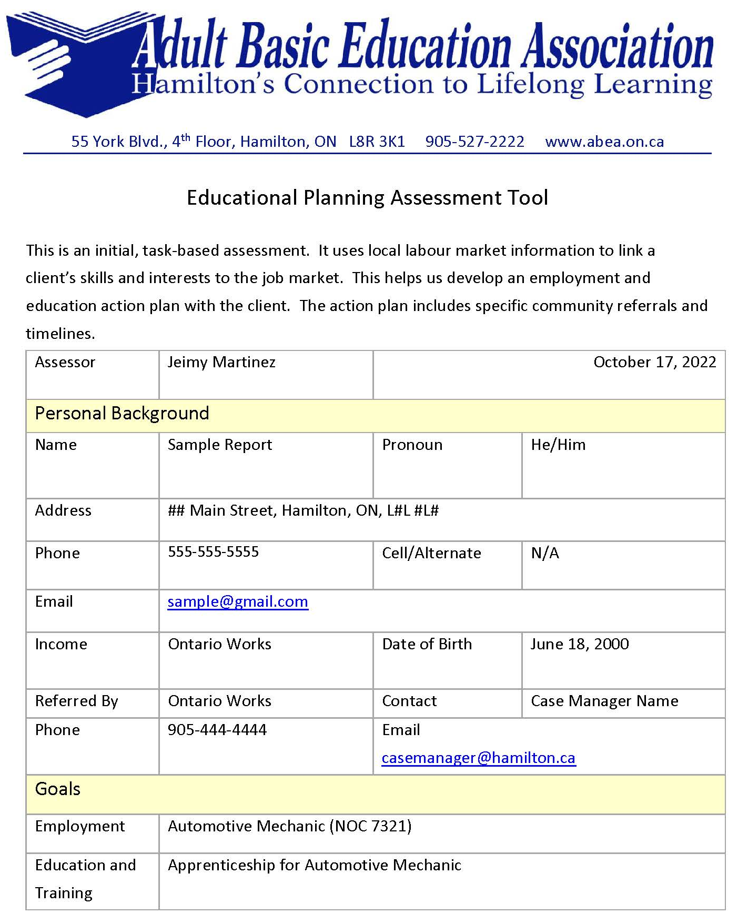
(Sample EPAT)

Slide 93
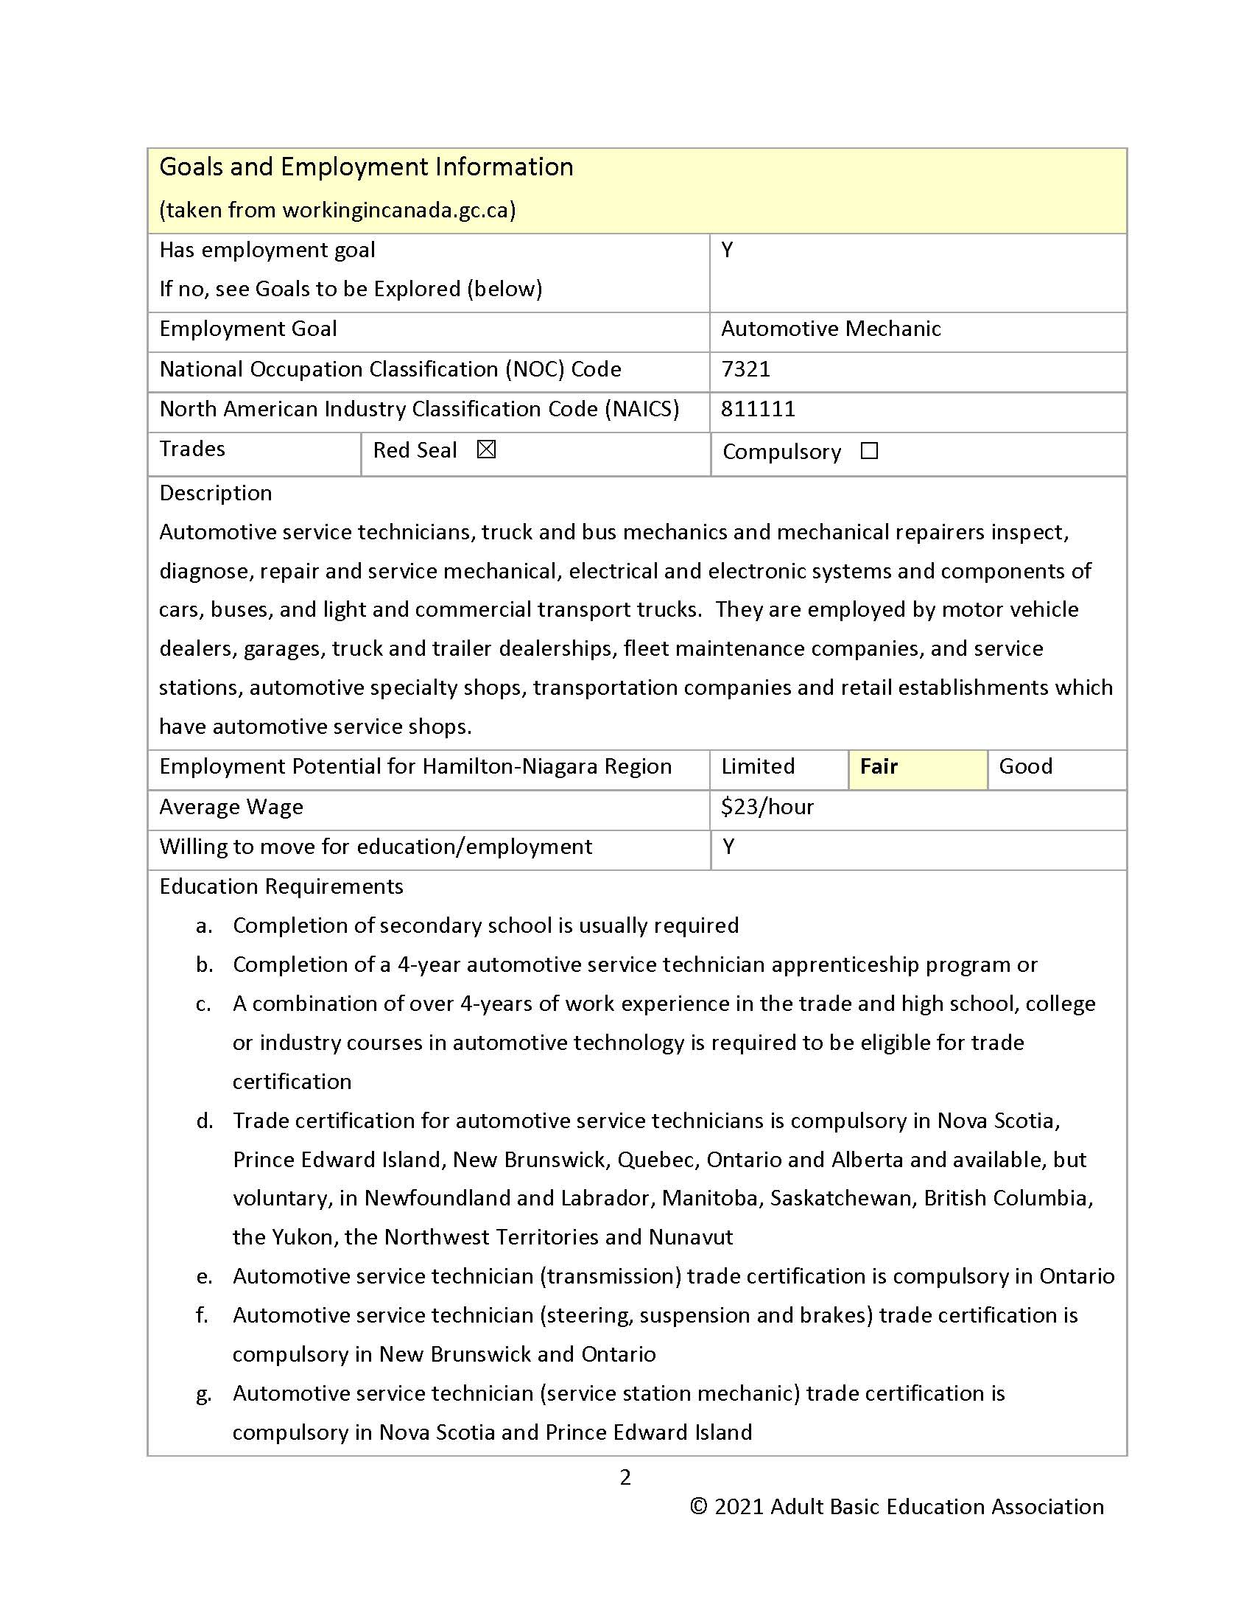
(Sample EPAT)

Slide 94
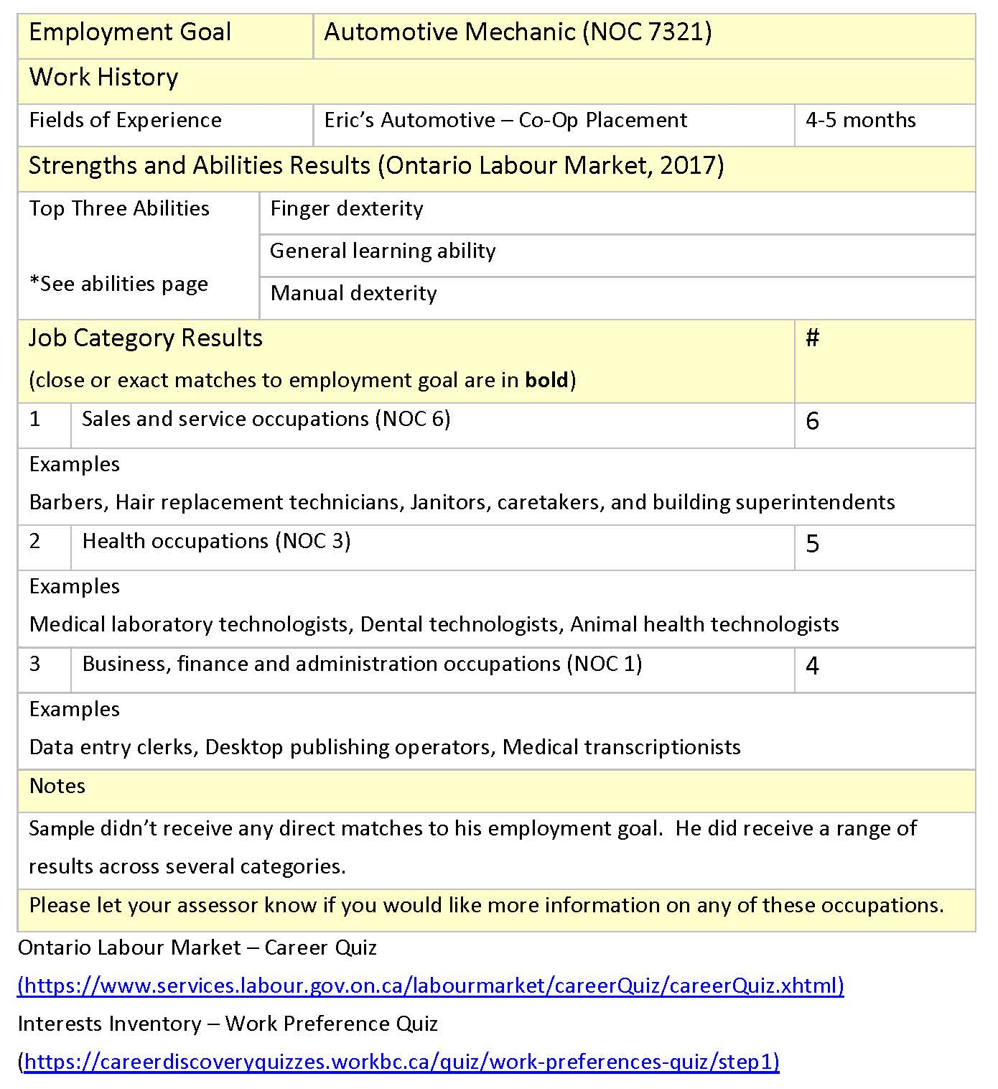
(Sample EPAT)

Slide 95
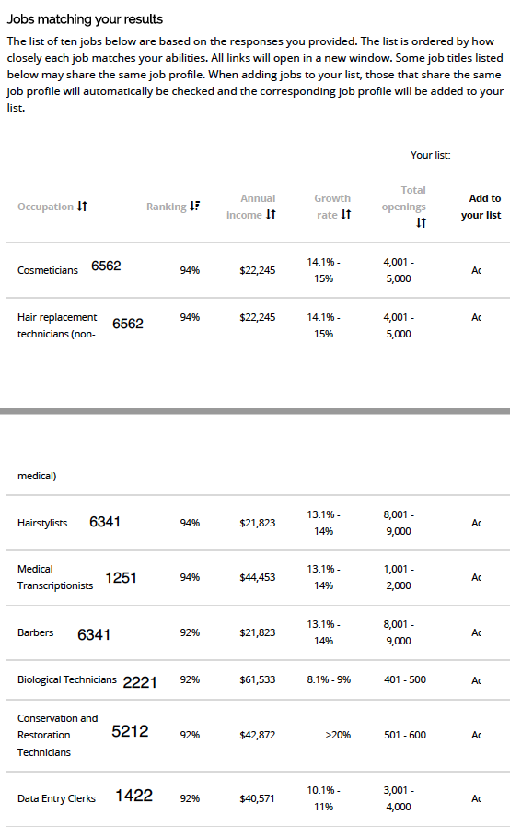
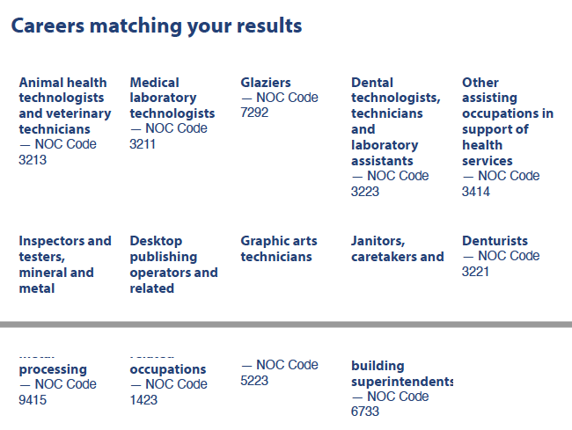
Work Preference Quiz
Ontario Labour Market Quiz

Slide 96
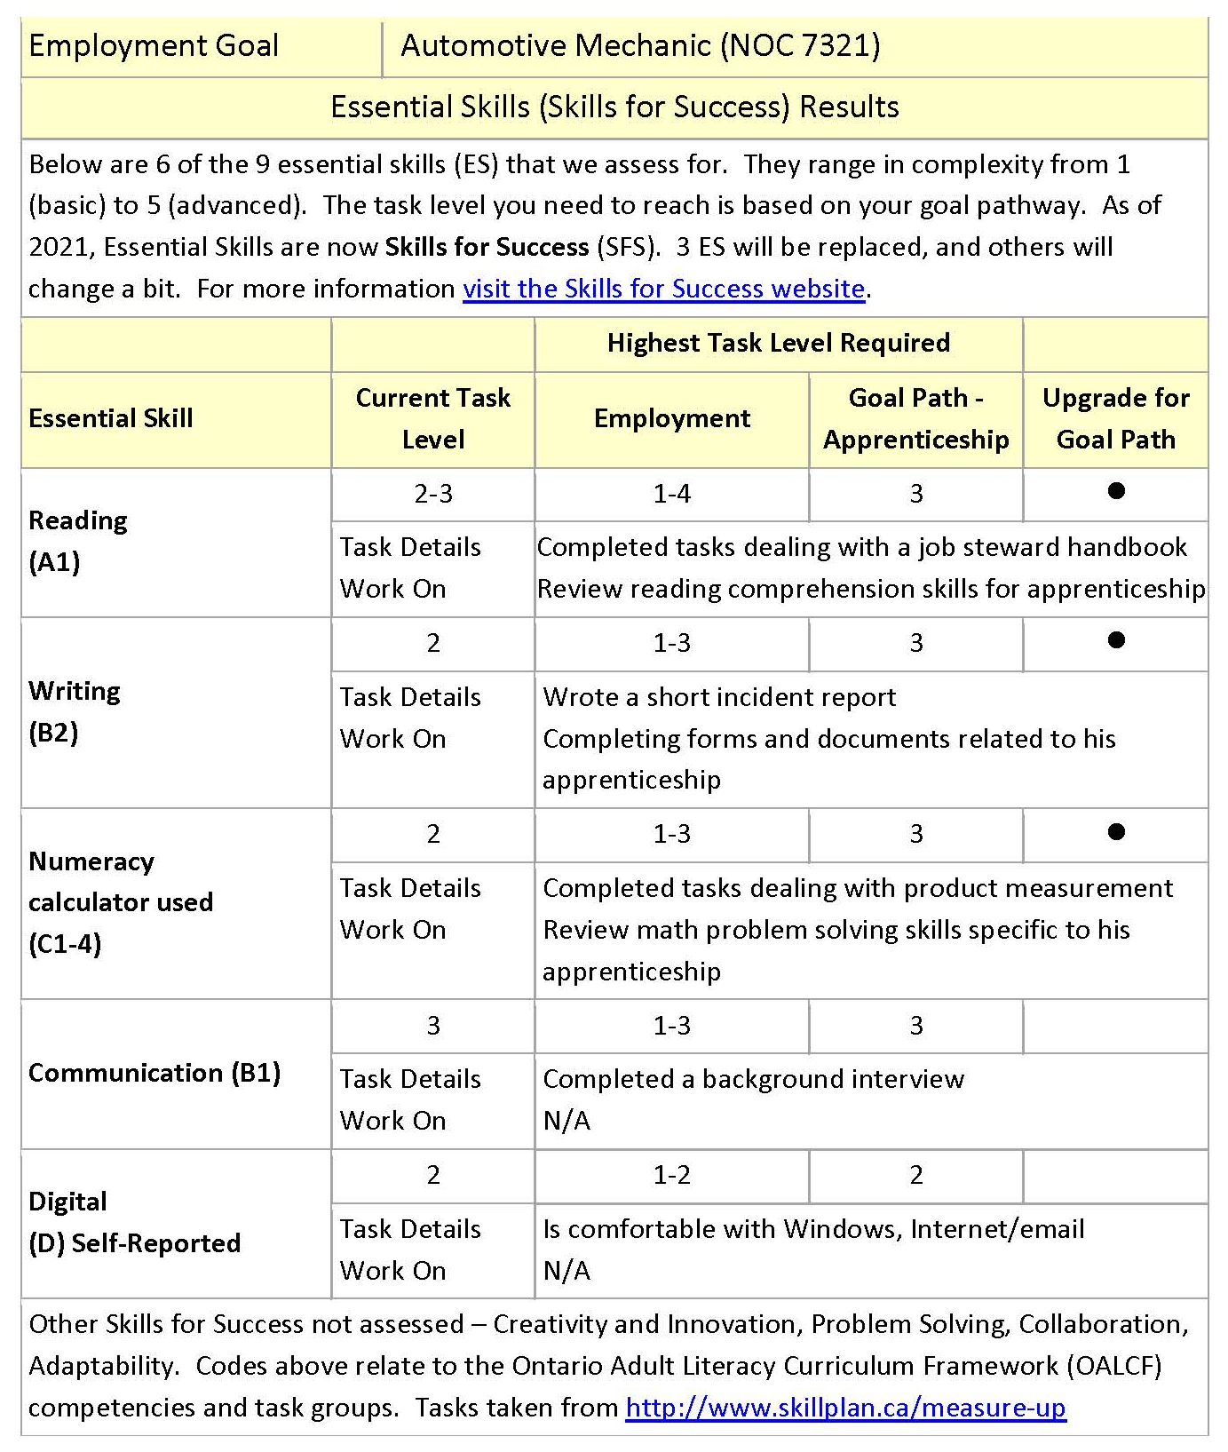
(Sample EPAT)

Slide 97
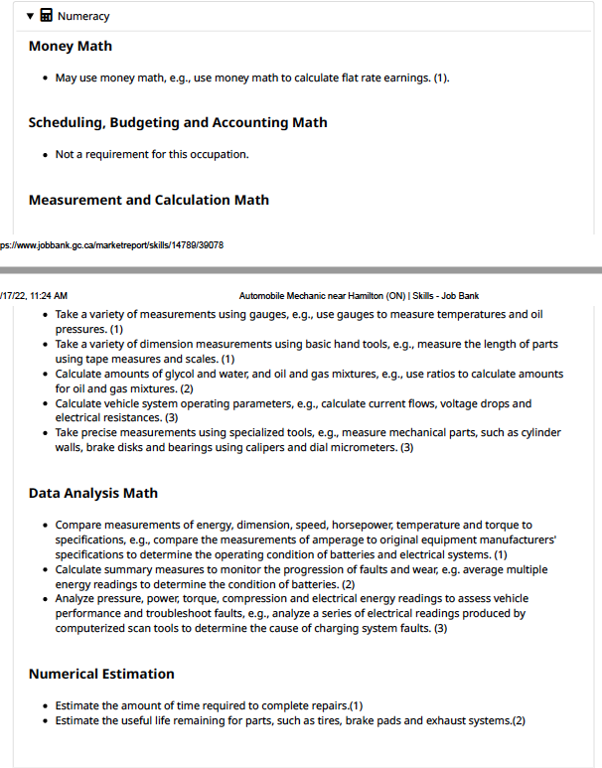
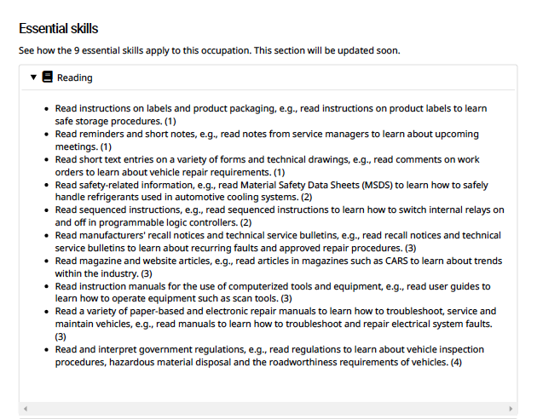
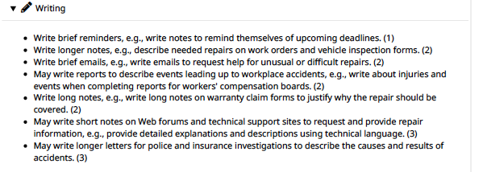
Skills tasks for Automotive Mechanic
Numeracy Tasks
Reading Tasks
Writing Tasks

Slide 98
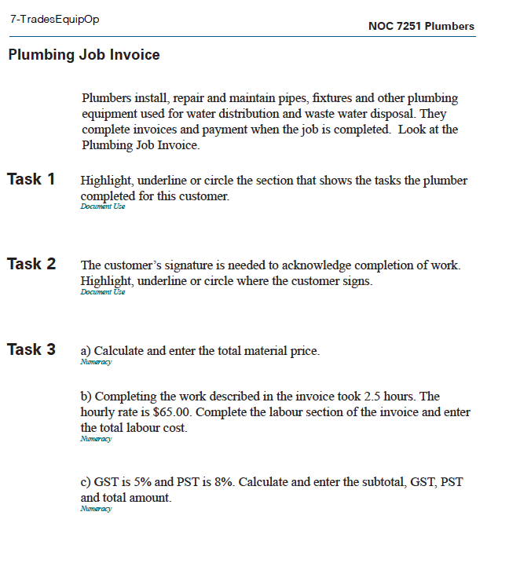
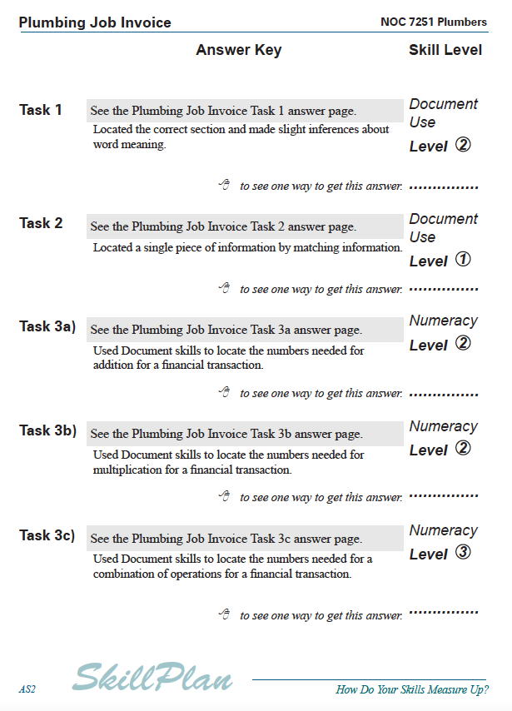
Activities
Answer Sheet

Slide 99
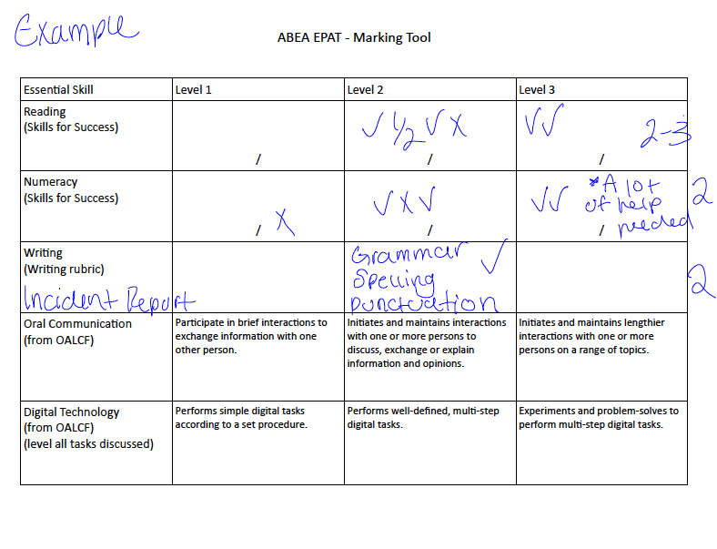
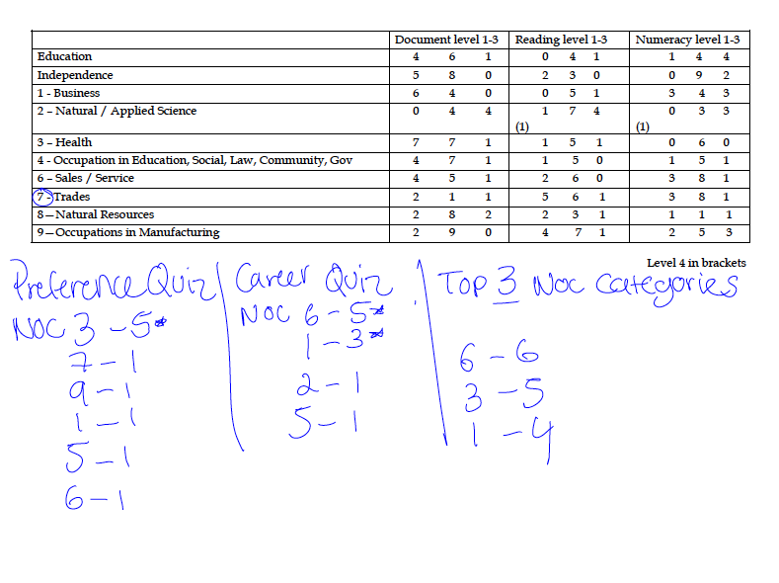
EPAT Rubric

Slide 100
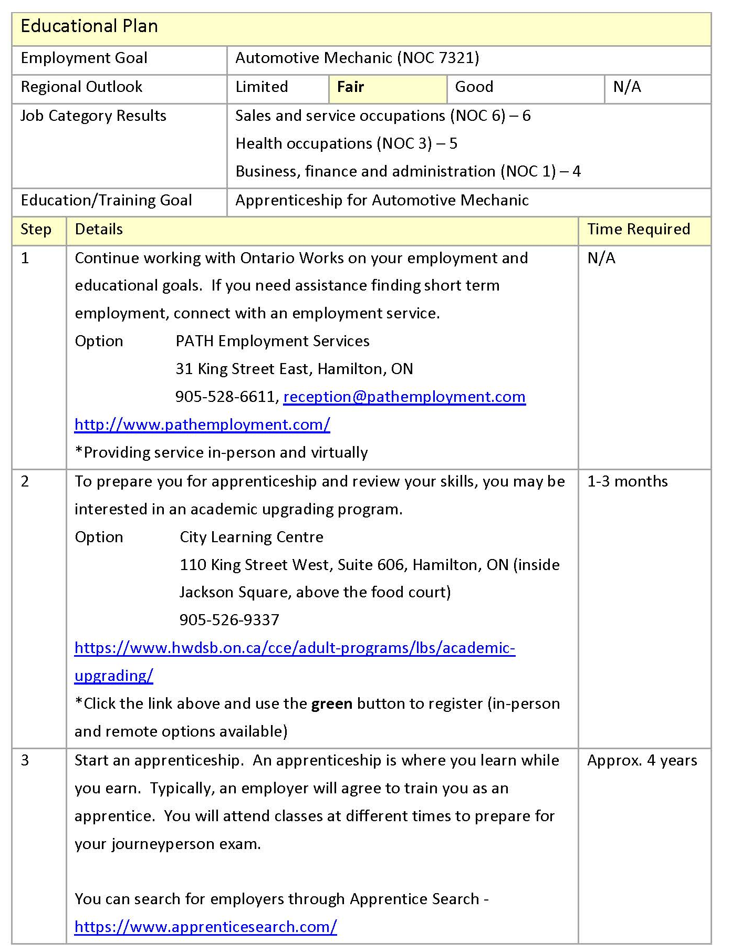
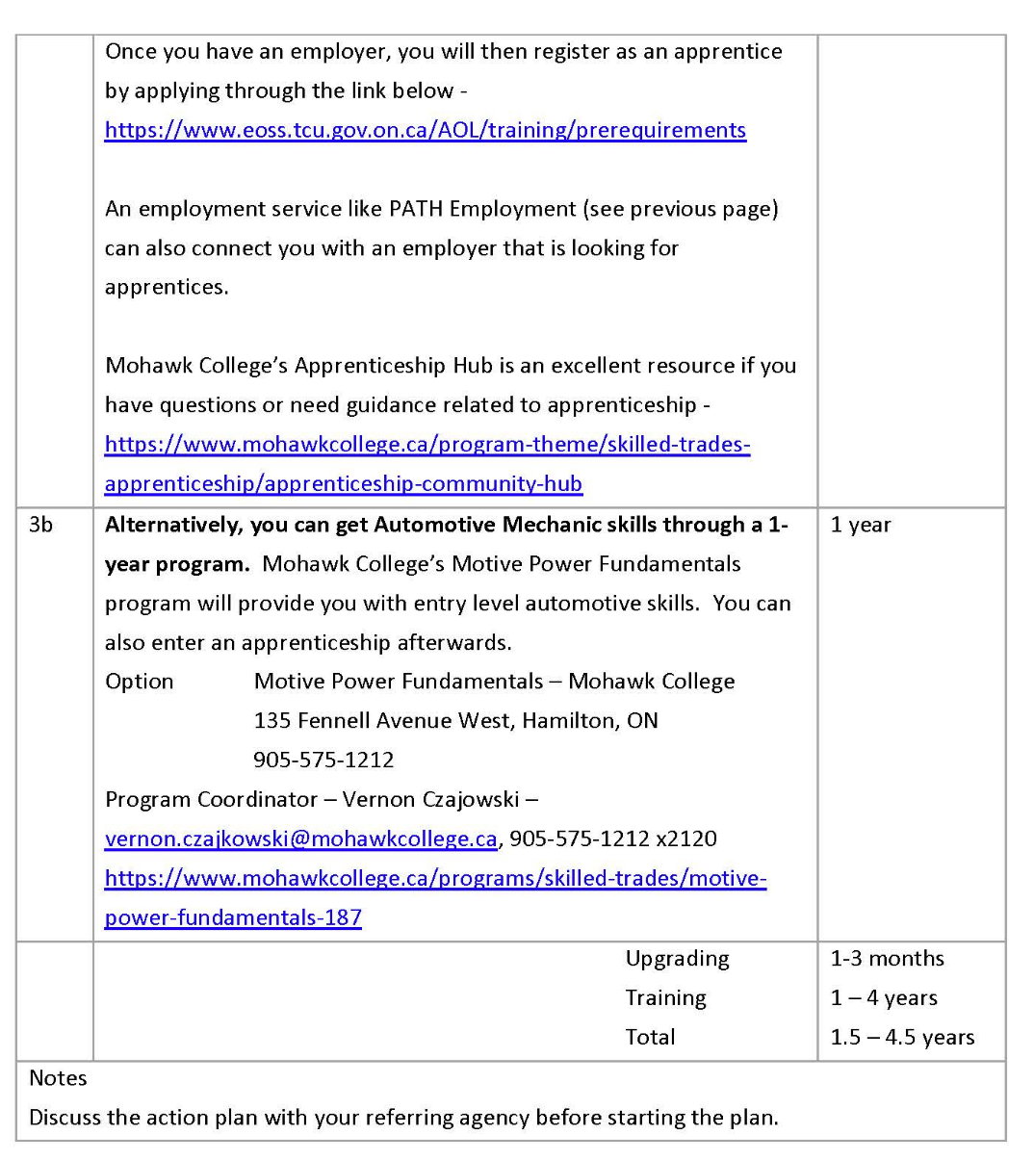
(Sample EPAT)

Slide 101







Do you have more questions?
Contact Jeimy
pathways@abea.on.ca
905-527-2222 x 2
289-275-1685
www.abea.on.ca
@abeahamilton

Slide 102

Welcome Monika Jankowska-Pacyna
The services AlphaPlus offers to help front-line programs use technology to develop and execute assessments
Creating customized assessments using Google Sheets and Google Forms for ease of use and accessibility

Slide 103


What we do
Training & resources

Slide 104



Customized Assessments
1. When working with Bob Rumball Centre for the Deaf, we added thumbs up and down and/or video instructions to Google Forms to make things easier and a bit more visual for participants.
Example 1
Example 2

Slide 105



Customized Assessments
2. When working with Simcoe County District School Board, we used Google Sheets to replicate paper forms that instructors were used to, and we made them fillable. Of course learners had to use some digital skills and some questions had to be adapted a bit but they worked pretty well. We also used this approach to generate Learner Plans that could be updated by learners.
Link to Math assessment
Link to Upgrading Plan
Email monika@alphaplus.ca if you would like your own copy

Slide 106

Coming up at
Virtual Showcase 2022 - 4th session on November 15 (App-palooza!)
Wayfinders Community Gabfests - next meeting on October 24
eNet - next round starts on October 25
Digital Inclusion Playbook - The Digital Inclusion Playbook contains information, ideas and strategies to support digital inclusion activities.
monika@alphaplus.ca alphaplus.ca 1-800-788-1120 x 117

Slide 107
Links and Resources
Webinar resources:
    English: https://e-channel.ca/practitioners/pop-pd-resources
    French: https://apprentissageenligne.ca/formateurs/programme-afb-ressources-de-la-communaute-de-pratique-en-ligne
Webinar evaluation: https://tinyurl.com/bd3b825y
Register for one of our remaining 3 webinars: https://learningnetworks.ca/resources-publications/popuppd/

Slide 108




Thank you!
And you!

