Slide 1
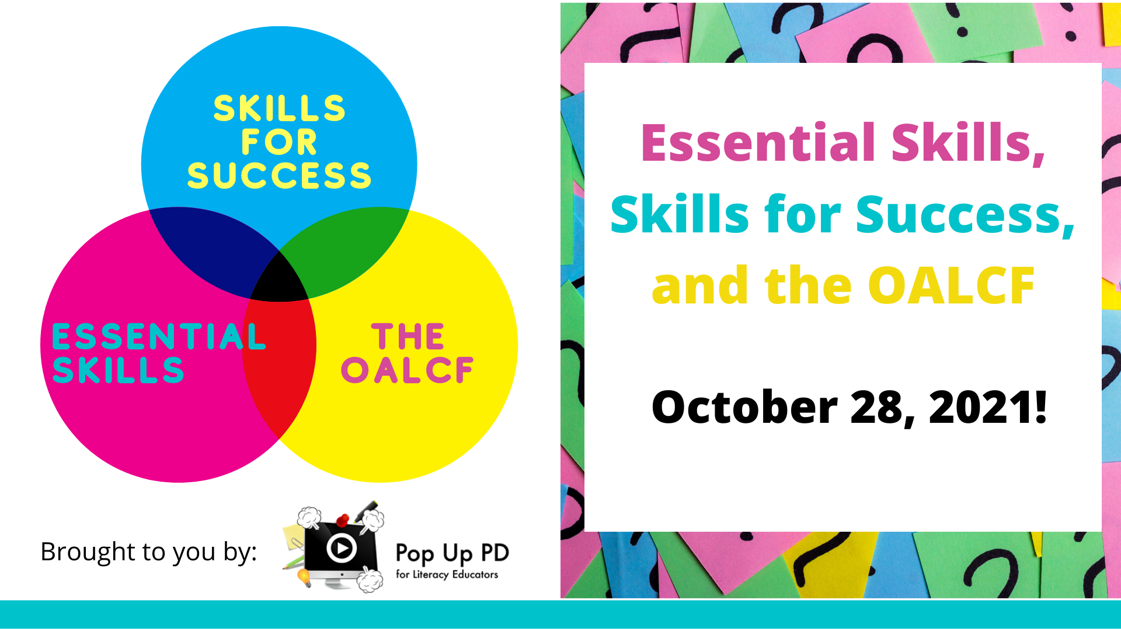

Webinar Title
((DATE))

Slide 2
About Pop Up PD for Literacy Educators
free webinar series developed by Ontario’s LBS Regional Networks, Sectors, & the Provincial Support Organizations for Literacy
supports LBS practitioners with presentations on topics important to them
English language webinars presented for LBS practitioners annually since 2015-2016; French language transcriptions are available on COFA’s website!
all webinar presentations, recording links & transcripts here:
  https://e-channel.ca/practitioners/pop-pd-resources
webinar topic ideas welcome at: e-channel@contactnorth.ca

Slide 3
Today’s Webinar…
Historical Overview of the Ontario Adult Literacy Curriculum Framework (OALCF)
OALCF Components
History of Essential Skills
Connection between the OALCF and Essential Skills
Skills for Success and the Connection to the OALCF

Slide 4

Historical Overview of the Ontario Adult Literacy Curriculum Framework (OALCF)
The OALCF was part of the 2007 Ontario Plan which stated that under a Smarter Ontario, Ontario would work together with the college sector and non-profit groups to design and deliver an adult literacy curriculum.
First Phase: 2008-2009
Second Phase: 2009-2010
Final Development Phase: 2010-2011
Notes:
These phases included the pilot project where agencies from across the province, representing all streams and sectors provided feedback on the first draft of the OALC Framework Competency and Guideline Component.
The field was involved in all of the development work related to the Initiative through a series of funded projects by support and service organizations.

Slide 5
The LBS program helps adults develop and apply communication, numeracy and digital skills to achieve their goals…..The program is divided into four cultural streams that are customized for Anglophone, Deaf, Francophone and Indigenous learners….The program helps learners reach goals of employment, post-secondary education, apprenticeship, secondary school credit, and independence. Programming is designed to help learners progress from developing skills to applying those skills to achieve their goals.
LBS: Service Provider Guidelines p.6, last accessed October 26, 2021
Notes:
Current program guidelines overview

Slide 6

The OALCF was developed to strengthen and support
Literacy and Basic Skills programming in Ontario.

Slide 7
What is the Ontario Adult Literacy Curriculum Framework (OALCF)?
Multi-part framework
Tools to strengthen existing programming
Provides a foundation
Learner-centred
Goal-directed
Transition-oriented
Task-based learning approach
The purpose of the OALCF is to improve the transitions of adults through Employment Ontario (EO) and the broader education and training system.
The OALCF is a broad term that refers to all the features of delivering a competency-based program.
Notes:
It provides direction to service providers on how to deliver learner-centred, transition-oriented programming that is based on adult education principles. It includes informal and standard assessment activities, goal path descriptions, task-based programming and assessment and a focus on program planning and completion and learner transitions. The OALCF links the LBS program to the requirements of employers, educational and training service providers, and community partners in an easy to understand way and furthers the Employment Ontario Service Promise of building a highly skilled, highly educated workforce in Ontario.
The OALCF includes features of competency-based programming with four main components:
Competencies
Assessment
Learner transitions to goal paths related to work, further education and training, or independence
Learning materials

Slide 8
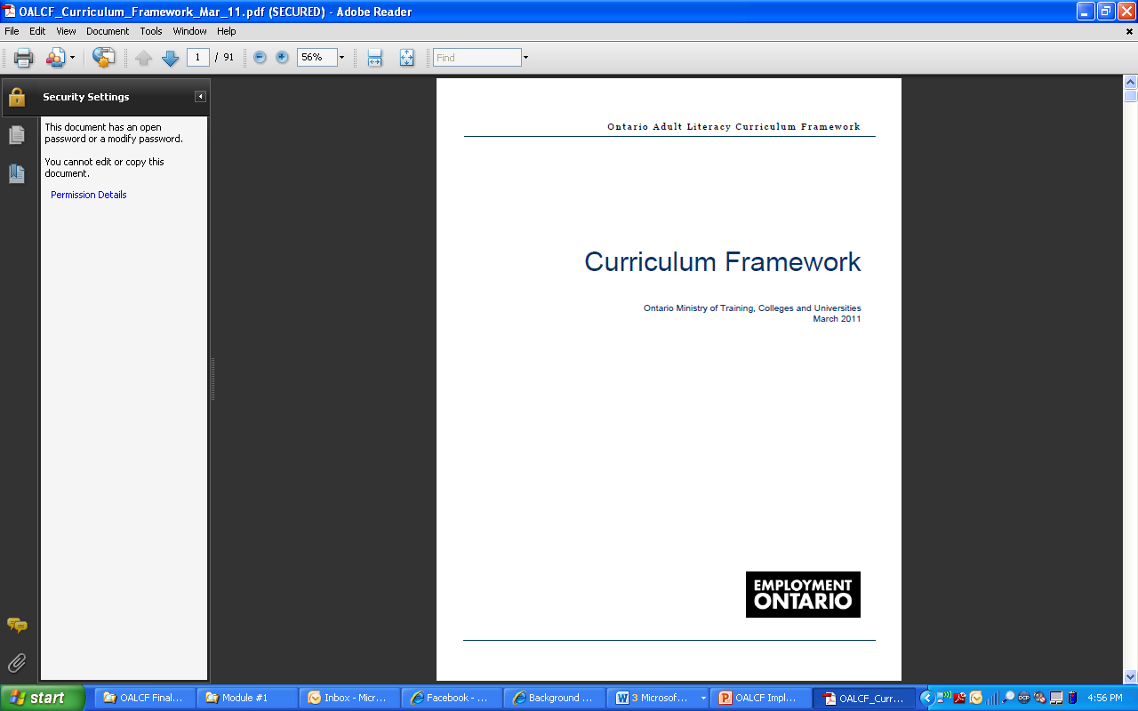
The Curriculum Framework is the core of the OALCF
Notes:
Defines the scope of learning in Ontario’s adult literacy programs.
Provides common criteria against which learning can be articulated.
Focuses on the performance of realistic tasks related to learners’ goals.

Slide 9

The Curriculum Framework was designed to help practitioners make clear connections between literacy development and the real-life tasks learners perform in work, learning and community contexts.
The Curriculum Framework provides a common language and criteria for learning regardless of learners’ goals, backgrounds and interests.
Notes:
The OALCF provides an accountability framework for the assessment of literacy use.
The OALCF is focused on the application of learning and it is not intended to provide all details of literacy development.

Slide 10
The Curriculum Framework supports the development of skills, knowledge and behaviours or COMPETENCIES that adults need to fulfill their responsibilities at work, in the community and in learning situations.
Notes:
It goes beyond literacy instruction, as discrete skills building focuses on the interaction of skills, knowledge and behaviours that reflect learners’ goals and interests.

Slide 11
The Curriculum Framework uses six broad competencies to organize learning content.
A. Find and Use Information
B. Communicate Ideas and Information
C. Understand and Use Numbers
D. Use Digital Technology
E. Manage Learning
F. Engage with Others
Engage with Others
Find and Use Information
Understand and Use Numbers
Communicate Ideas and Information
OALCF
Manage Learning
Use Digital Technology
Notes:
The term “Curriculum Framework” refers specifically to the six competencies that organize learning content and describes proficiency using three levels of performance.

Slide 12

The OALCF competencies were established by synthesizing responses from the literacy service providers in Ontario to the question, “What should learners learn in literacy programs?”
Notes:
Development team members representing the interests of learners in Francophone, Deaf, Indigenous, and Anglophone programs, in addition to representatives from community-based, school board and college service providers each independently identified potential competencies. Through discussion, the team reached consensus on the set of competencies that would comprise the Framework.

Slide 13
Why “competencies”?
Competency-based education is characterized as an approach focused on the achievement of competencies rather than isolated skills. In achieving competencies, learning extends beyond skill attainment to also incorporate knowledge and behaviours.
Within a competency-based approach, it is the interaction of skills, knowledge and behaviours, as well as learners’ understanding of how to employ their skills, that contributes to learners being able to perform tasks.
Competency-based education articulates success in many ways, but always key is the learners’ abilities to demonstrate success against the standards set by the framework.
New Zealand Ministry of Education. Tertiary Educational Learning Outcomes Policy National Office. Key Competencies in Tertiary Education New Zealand: Discussion Document. 1995.
Notes:
Competency-based learning includes all aspects: skills, knowledge, and behaviours
It also includes specific tasks that provide the learning context
Competency based learning involves relationships with the other competencies
Competency based learning supports a learner’s ability to adapt and apply to new contexts

Slide 14





Competencies
Represent the full range of skills, knowledge and behaviours adult literacy learners can expect to enhance while participating in literacy programming.
Are context free - they are broad, generic categories that apply to all learners
Allow programming to be contextualized to learners’ goals.
Notes:
The new competency-based curriculum framework helps practitioners and learners make clear connections between literacy development and the real-life tasks learners perform in work, learning, and community contexts.

Slide 15
Competencies are integral to completing any task.
Competencies are used in combination with other competencies.
The concept of competencies implies a broader concept than the term generic skills.
New Zealand Ministry of Education. Tertiary Educational Learning Outcomes Policy National Office. Key Competencies in Tertiary Education New Zealand: Discussion Document. 1995.
Notes:
Highlight each point.
Adapted from: New Zealand Ministry of Education. Tertiary Educational Learning Outcomes Policy National Office. Key Competencies in Tertiary Education New Zealand: Discussion Document. 1995.

Slide 16

The Curriculum Framework can be used to guide:
  Program development
  Assessment
  Instruction
Notes:
Highlight each point.

Slide 17
Essential Skills
Work
Learning
Life
Essential Skills were the original foundational skills identified as integral to successful participation in the Canadian labour market.
"enabling" skills that help people perform tasks required by their jobs
skills that provide workers with a foundation for learning other skills
skills that enhance the ability to adapt to change
skills people use to carry out a wide variety of everyday life and occupational tasks
skills needed for work, learning and life

Slide 18
NINE Original Essential Skills
Reading
Document use
Writing
Numeracy
Oral communication
Working with others
Thinking
Computer Use
Continuous learning

Slide 19
A brief history of Essential Skills
1971–1993
Canadian Classification and Dictionary of Occupations (CCDO) was developed in Canada
1993
The National Occupational Classification (NOC) replaced the CCDO
1993–1994
Government of Canada launched the Essential Skills Research Project (ESRP)
1995–1997
Pilots and data collection for the Essential Skills Profiles
1998
Writing of the Profiles commenced
Notes:
The first step of the ESRP was to draft the framework that included the list of nine essential skills, the complexity rating scales and the approach to data collection for the profiles. The main purpose was to support curriculum development and training for the current occupations in the NOC. Arthur de W. Smith’s work from the 1970’s on identifying generic skills for occupational training was used as the starting point for this work. An worldwide literature review also informed the work as well as integration with the International Adult Literacy Survey.

Slide 20
Essential Skills Research Project (ESRP)
Human Resources and Social Development (HRSD, now Employment and Social Development Canada ESDC) wanted to improve economic performance and labour market outcomes by encouraging training.
The project:
identified Essential Skills needed for work, learning and life
answered the questions, “Training for what?” and how an individual knows if he or she has the skills needed for the job he or she wants
involved more than 3000 interviews across Canada with people in 180 occupations were conducted
developed ways to talk about Essential Skills by using the information from the interviews and adapting scales from the International Adult Literacy Survey IALS and Canadian Language Benchmarks
Notes:
Source: Douglas College: ESKL 2301 Module 2

Slide 21
ESRP Key findings
Different occupations require different skill sets and skill levels
Increasing skill levels helps people maintain jobs during transitional times
Education level does not always equate to skill level
Literacy skills are on a continuum and need to be used or they can be lost
Notes:
Source: Adapted from Douglas College: ESKL 2301 Module 2

Slide 22
How are Essential Skills Used?
They are used in performing tasks required for a job.
Different combinations
Different applications
Every occupation
Acquire and apply other skills
Adapt to change
Notes:
Workplace essential skills are the foundation skills everyone uses while performing the tasks required for their jobs.
There were originally nine skills that were identified as essential in the workplace. All nine are used in different combinations, in different applications, in every occupation. They're the foundational skills you rely on to carry out your work tasks and they're the building blocks you use to learn new ones. They're essential to your success.
The nine essential skills are the key to acquiring and applying all other skills. Whether you're planning to implement a new process, reviewing training effectiveness or experiencing issues in the workplace that are hard to define, viewing everything through an essential skills lens is critical to moving forward.

Slide 23
What is complexity?
Ratings look at different dimensions for each skill on a 4 or 5 point scale
Complexity levels are assigned to example tasks that would be performed by a worker in a job
Notes:
Proficiency in each Essential Skill was measured with a specific complexity rating. These ratings were developed to identify the difference in skill requirements among occupations and the underlying constructs applicable to learning strategies.
The complexity rating considers different “dimensions” of the skill on a four or five point scale, integrating the information into a single number to provide an overall rating.
Complexity levels from 1 (basic tasks) to 4 or 5 (advanced tasks) are then assigned to example tasks performed by a worker in a specific job.
Source: ESKL 1001 Module 2

Slide 24
General Complexity in Essential Skills- An Example
Level 1 Locate and Use | Level 2 Locate and Cycle | Level 3 Locate, Cycle and Integrate | Level 4 Apply prior knowledge, locate, cycle and integrate | Level 5 Apply prior knowledge, locate, cycle, integrate and generate
Pet groomers read items in supply catalogues and purchasing flyers. | Kitchen helpers read safety precautions relating to fire hazards in the kitchen. | Branch managers may refer to several human resource manuals to locate and integrate information on topics such as pay scales and job descriptions. | Court clerks select information from various Acts to assist Justices of the Peace in cases where clarity of jurisprudence is required. The Acts contain complex legal terminology. | Assistant business managers in labour unions read adjudication decisions that have established jurisprudence for pending grievances which are to go to adjudication. The legal wording has specific and complex implications for specific cases.

Slide 25
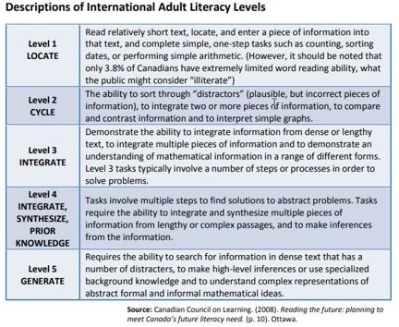
Essential Skills scales draw from IALS research
Notes:
You can see how general ES complexity draws from IALS research in this table.
Source: Douglas College ES Assessment, Interpretation, and Application Module 4

Slide 26
The primary purpose of the Curriculum Framework is to support adult learning.
It is consistent with the interpretation of the Essential Skills complexity scales but is not organized by the nine Essential Skills
It does not draw exclusively from Essential Skills for its conceptualization of all levels

Slide 27
OALCF & Essential Skills
OALCF skills organized
into competencies
Essential Skills
organized by skill domain
Notes:
The Curriculum Framework departs from the Essential Skills framework – moves away from using the skill domains established by the Essential Skills framework and adopts instead a system where learning is organized and articulated to competencies and task groups.

Slide 28
OALCF
Focuses on how learners use
skills outside literacy programs
Competency-based
Task-based
Notes:
Focus is on how learners use their abilities to accomplish tasks outside a learning context.

Slide 29
Complexity in the OALCF
The OALCF uses three levels to describe a learner’s proficiency
Informed by the same factors that drive complexity at Essential Skills levels 1, 2, and 3
The OALCF scale is consistent with the interpretation of the Essential Skills complexity scales for several Essential Skills
Notes:
The OALCF uses three levels to describe a learner’s proficiency.
Informed by the same factors that drive complexity at Essential Skills levels 1, 2, and 3 – the features include the extent to which the context is familiar and factors that make text and tasks increasingly complex. OALCF developers relied heavily on the ES research and scales in the development of the OALCF.
The OALCF scale is consistent with the interpretation of the ES complexity scales for several ES but it departs from the ES framework because it has a different purpose- to support adult learning. It does not draw exclusively on the ES for the conceptualization of levels.
The OALCF is organized by competencies, instead of skills

Slide 30
OALCF & Essential Skills (ES)
OALCF
levels 1, 2, 3
Essential Skills
levels 1, 2, 3
=
The levels relate to the task, not the learner.
Notes:
Complexity levels in the ES were developed to address the differences in skill needs between occupations. The OALCF has a broader application than ES.
The Essential Skills scale describes five levels of task complexity
The OALCF curriculum framework addresses the first three levels
The decision to include only levels 1, 2 and 3 was informed by International Adult Literacy Survey (IALS) findings, which indicates that adults with level 3 skills can meet most of the Essential Skills demands of daily life and transfer their learning more easily from one context to another. For programming purposes, there may be tasks practitioners choose to carry out with their learners that rate beyond level 3. The focus of the Curriculum Framework remains on the three levels indicative of foundational literacy and numeracy needs.

Slide 31
OALCF - 3 levels of Proficiency
Informed by factors the drive complexity at Essential Skills levels 1, 2 and 3
Differs from Essential Skill as its primary purpose is to support adult learning
Is supplemented with task and performance descriptors in addition to those drawn from ES complexity

Slide 32

Questions so far?

Slide 33

Part 2: “Skills for Success”
Thank you, Robyn, for the great overview of the OALCF and the original Essential Skills framework!
In the second part of today’s webinar, we’ll look at the federal government’s brand new “Skills for Success” framework and how it relates to the OALCF.
This Photo by Unknown Author is licensed under CC BY-SA-NC

Slide 34
Remember the history? Time for an update!
1971–1993
Canadian Classification and Dictionary of Occupations (CCDO) was developed in Canada
1993
The National Occupational Classification (NOC) replaced the CCDO
1993–1994
Government of Canada launched the Essential Skills Research Project (ESRP)
1995–1997
Pilots and data collection for the Essential Skills Profiles
1998
Writing of the Profiles commenced
Notes:
The first step of the ESRP was to draft the framework that included the list of nine essential skills, the complexity rating scales and the approach to data collection for the profiles. The main purpose was to support curriculum development and training for the current occupations in the NOC. Arthur de W. Smith’s work from the 1970’s on identifying generic skills for occupational training was used as the starting point for this work. An worldwide literature review also informed the work as well as integration with the International Adult Literacy Survey.

Slide 35
NINE Original Essential Skills
Reading
Document use
Writing
Numeracy
Oral communication
Working with others
Thinking
Computer Use
Continuous learning

Slide 36

Essential Skills are the ‘Velcro’ to which all other education and training ‘sticks’.

Slide 37


Slide 38

From the Skills for Success website:
Source:https://www.canada.ca/en/services/jobs/training/initiatives/skills-success.html

Slide 39
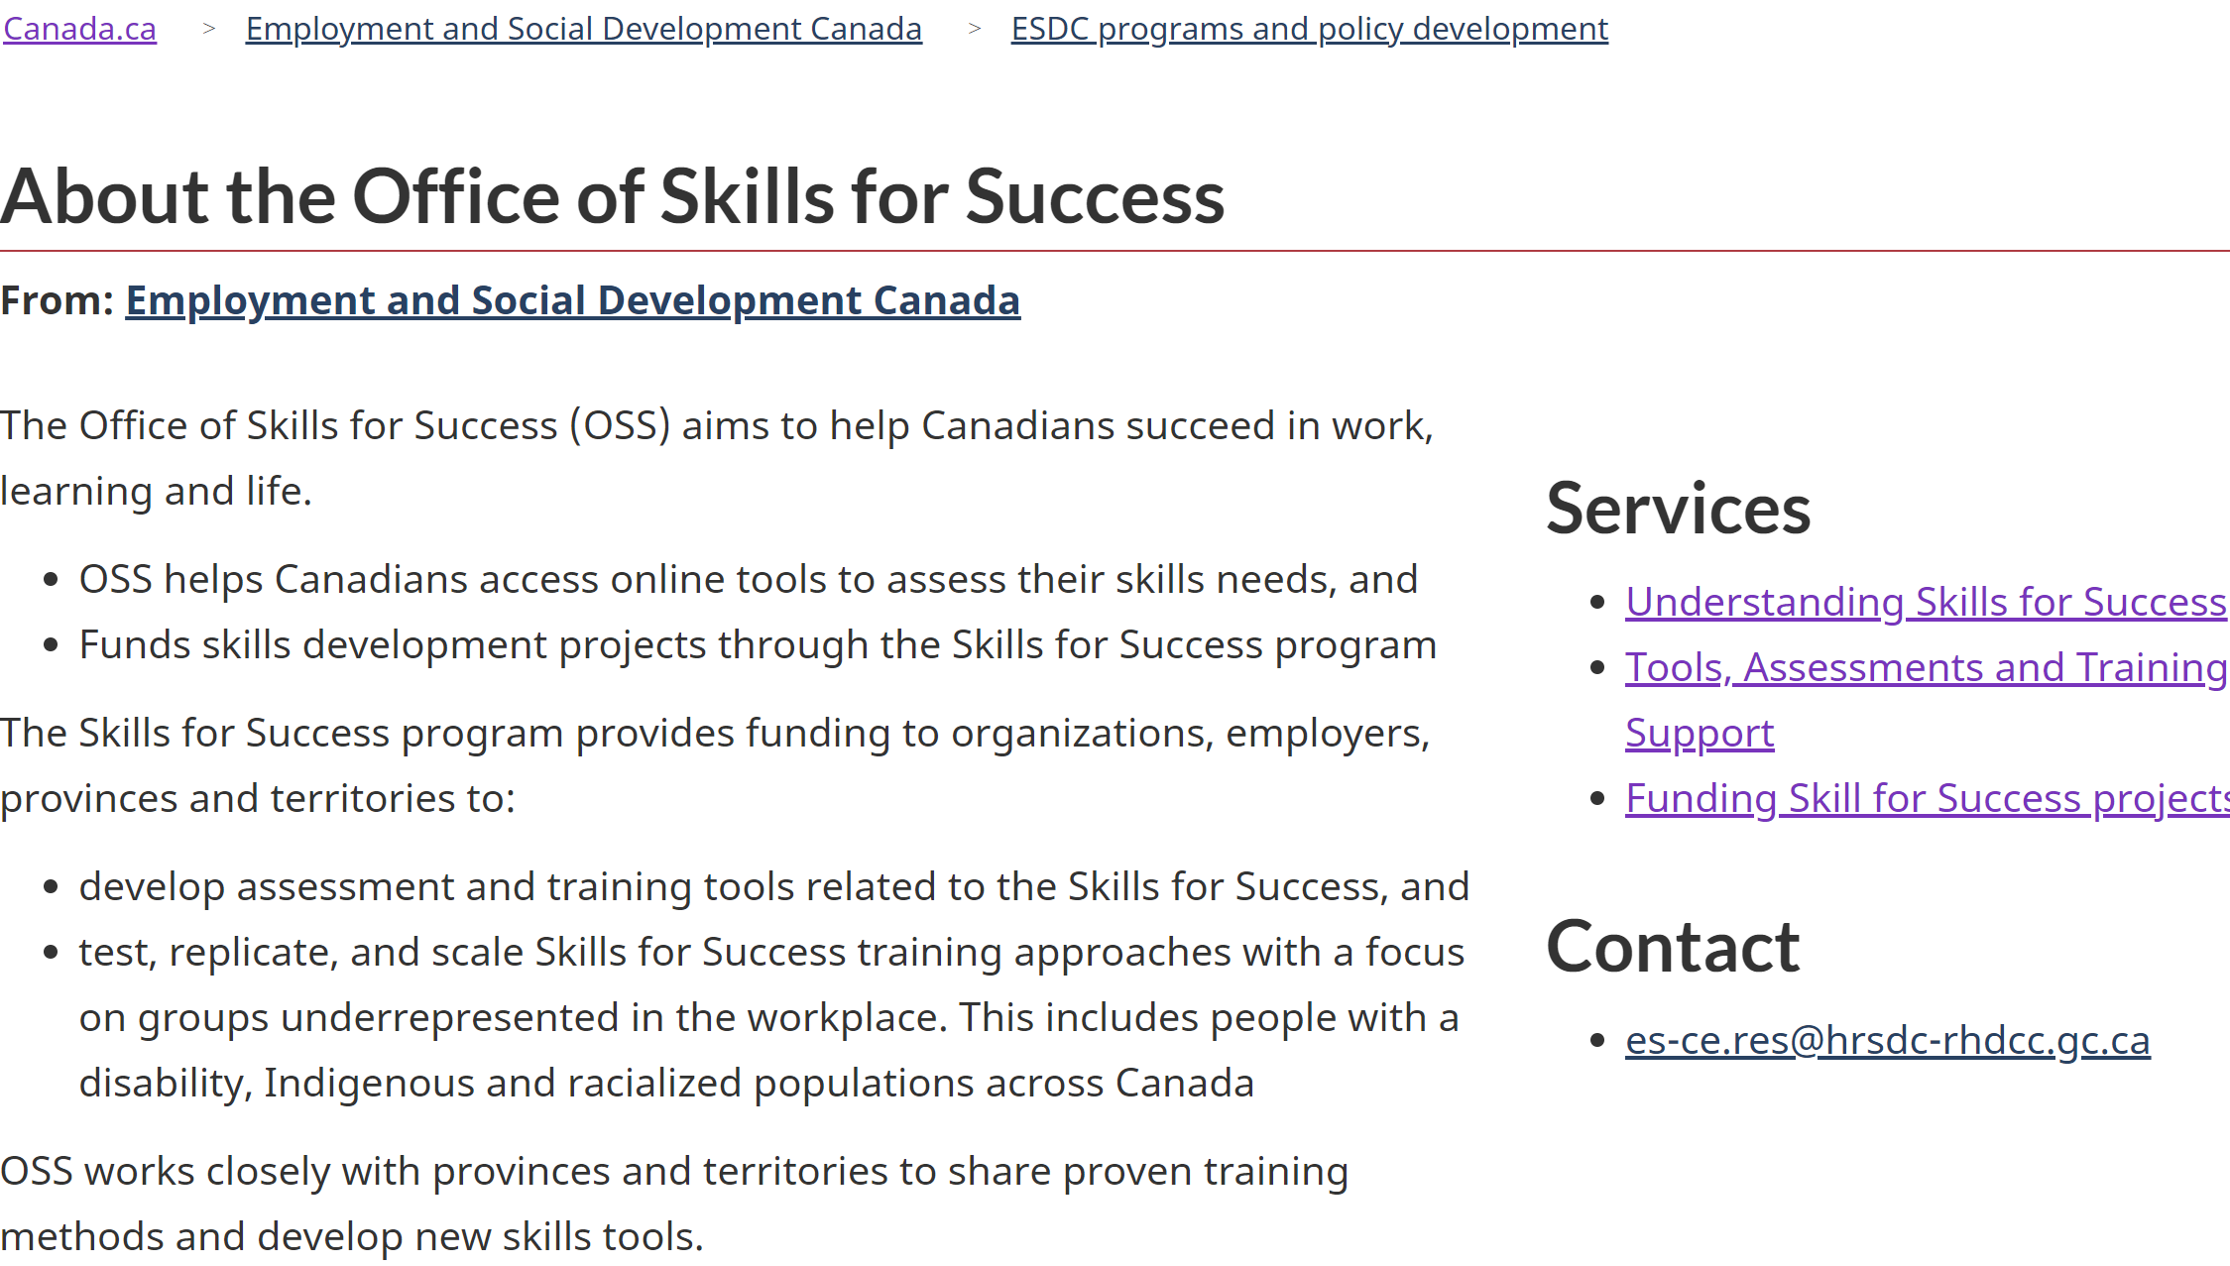
From the Skills for Success website:
Source: https://www.canada.ca/en/employment-social-development/programs/literacy-essential-skills.html

Slide 40
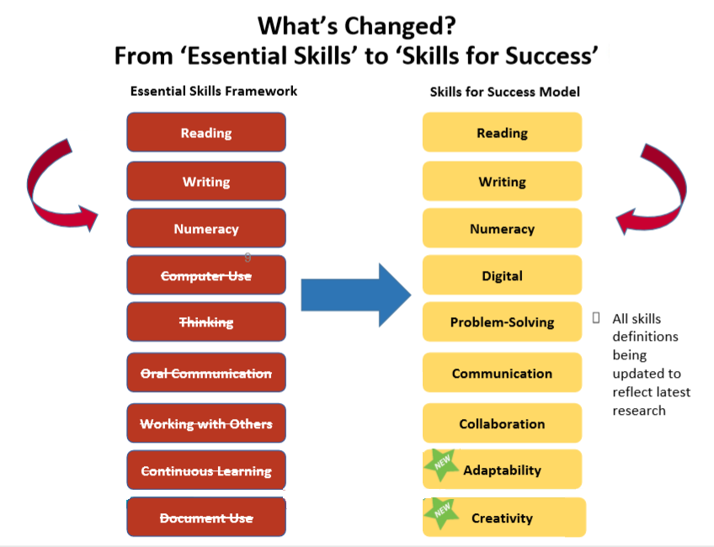

Slide 41
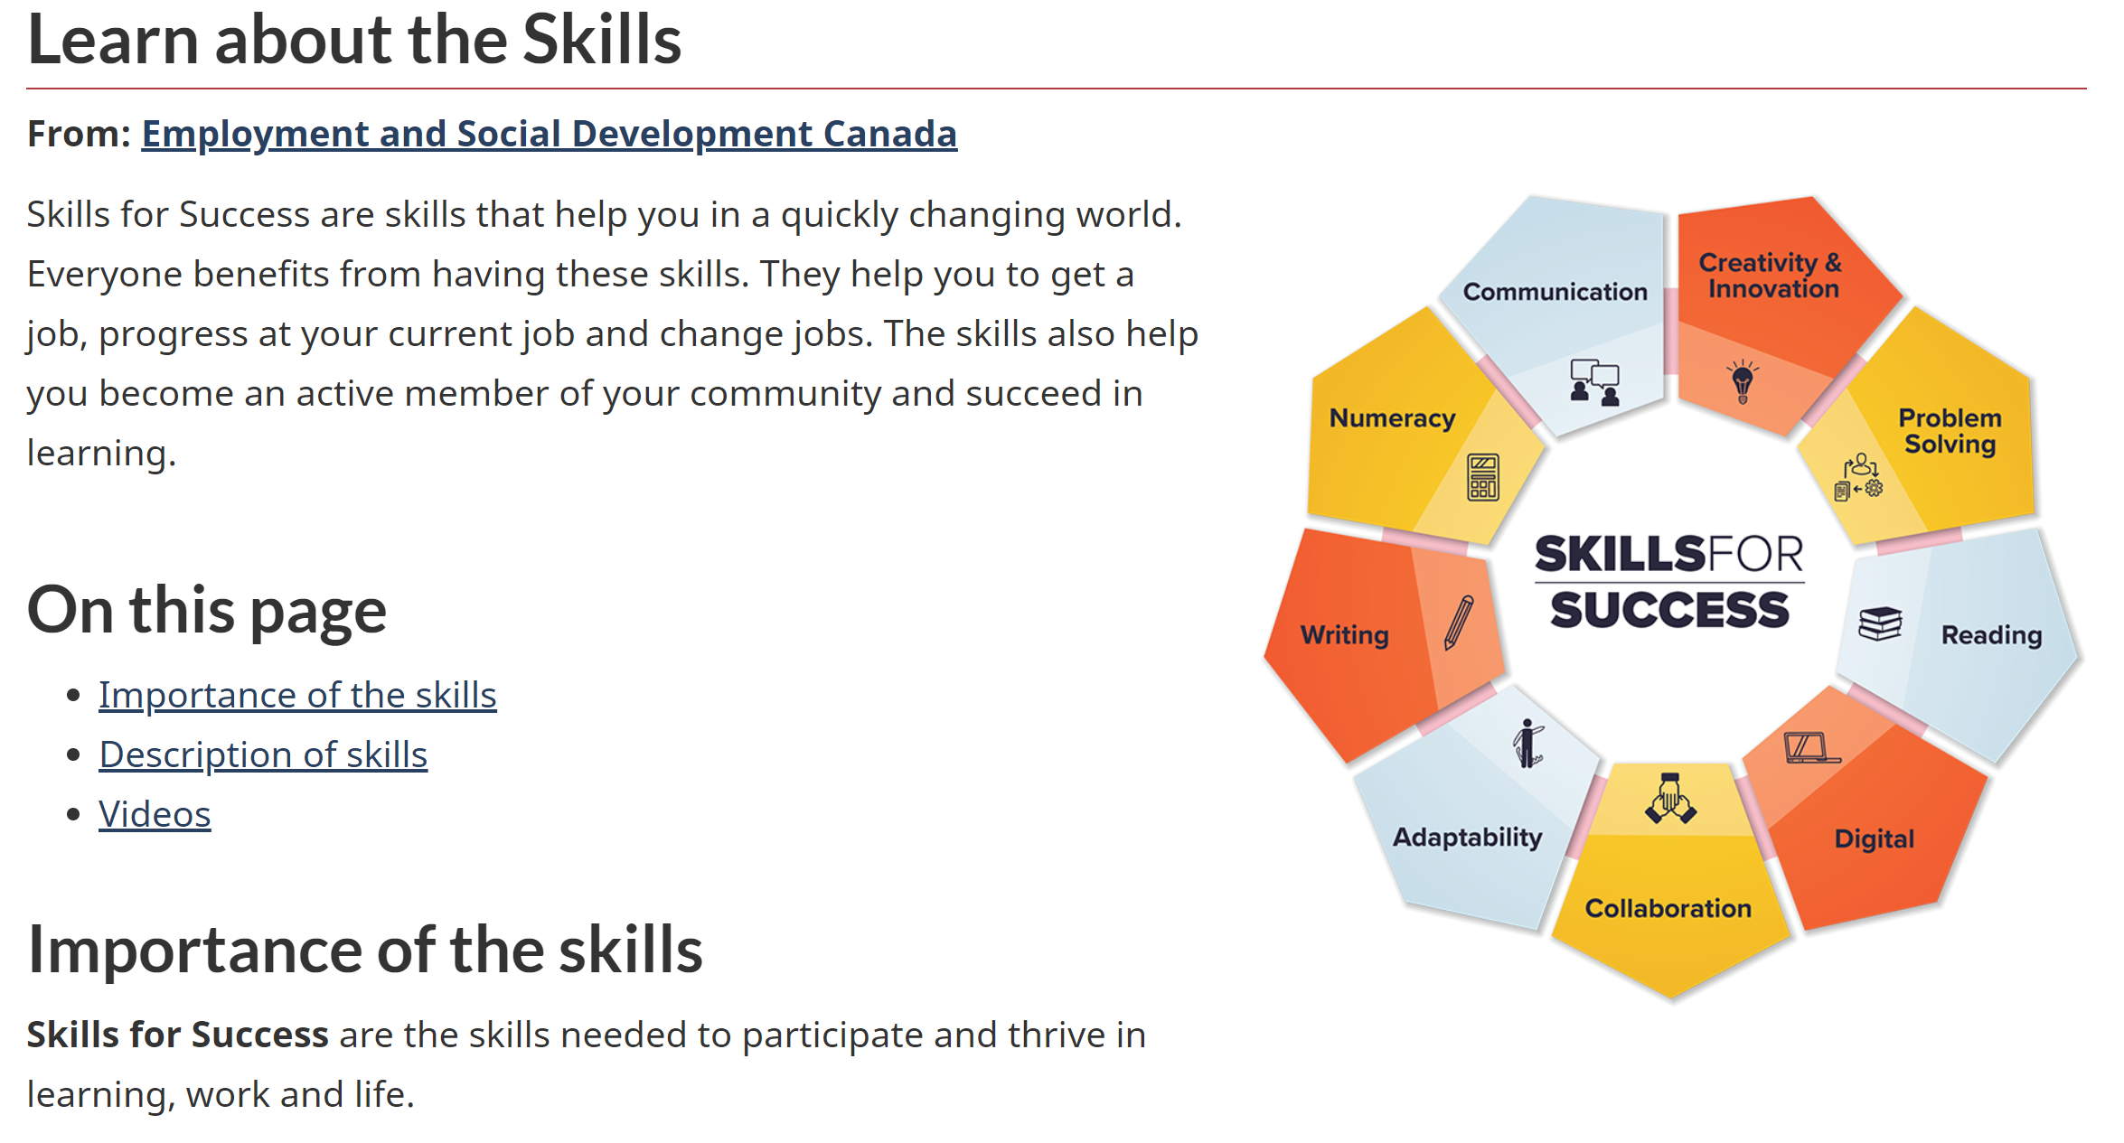
From the Skills for Success website:
Source: https://www.canada.ca/en/services/jobs/training/initiatives/skills-success/understanding-individuals.html

Slide 42
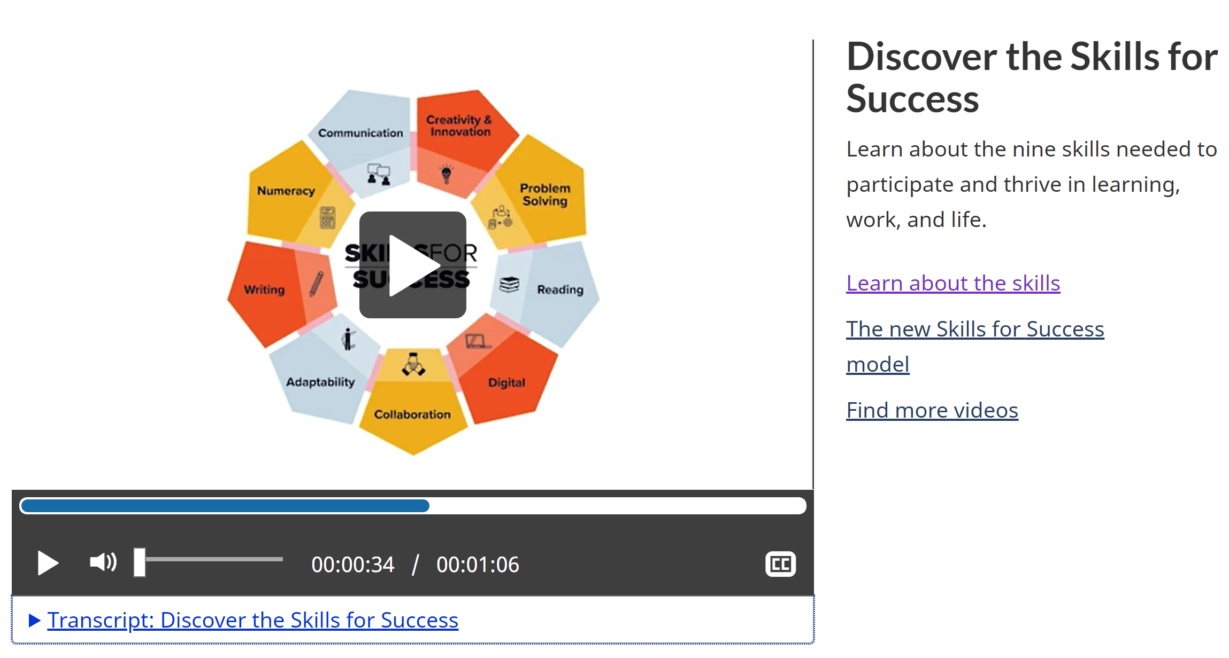

Slide 43

The information on the next few slides is adapted from a 2020 presentation provided by the former “Office of Literacy and Essential Skills” (OLES) within Employment and Social Development Canada.
OLES has now been rebranded as the
“Office of Skills for Success” (OSS)

Slide 44
Renewal of Essential Skills Framework is based on the following criteria…
  Transferable: applicable across all jobs and within a variety of contexts
  Teachable: applied to learning or training context and linked to labour market outcomes
  Assessable: quantitative/qualitative, demonstrable, measurable, comparable, consistent
  Recognized: by Canadian and International research for influencing outcomes

Slide 45

Why is it important to update the original ES Framework?
Type your thoughts into the chat…

Slide 46

Workers with low foundational skills are at risk of job loss and difficulty re-entering the labour market
  More than 45% of workers have literacy and numeracy skills at Level 2 or below on a five-point scale (OECD PIAAC)
Technological advancements putting a premium on foundational and social-emotional skills to adapt and thrive
  For new hires, 67% of employers want soft skills, while 52% want technical skills
Employers decreased employee skills investments by 40% from 1990-2010
  Training is most focused on higher skilled workers
  Employed, low-skilled workers would benefit from upskilling/ reskilling
The labour market is evolving…
Notes:
As these findings show, the labour market is evolving in a variety of ways.
In the importance of foundational skills that a wide proportion of Canadians continue to struggle with, and social-emotional or “soft” skills that employers require, and the relatively low level of investment in skills training by businesses – there are pressing challenges in the Canadian labour market, which has already been challenged by the pandemic.
Also, just a note on the soft skills research (67% of employers…):
This comes from a Government of Canada Advisory Council on Economic Growth 2017 report https://www.budget.gc.ca/aceg-ccce/pdf/learning-nation-eng.pdf
The research refers to employers across all major sectors
Multiple national and international research surveys, such as the World Economic Forum’s Future of Jobs report, found similar results in publications from recent years

Slide 47

Social-emotional skills, also known as soft skills, are those required for effective social interaction.
These skills interact with each other, are inclusive, can be adapted to different situations
There is no consensus on which social-emotional skills are most important, and the Skills for Success framework will be flexible with respect to different learning, work and life contexts.
Importance of social-emotional skills
Notes:
Our new model for Essential Skills will be adaptable, acknowledging that there is no single, rigorous consensus on the most important set of social-emotional skills.
The renewed ES model will be flexible and holistic in order to:
-demonstrate individuals’ skills assets and areas for improvement
-be future-fit, help people to respond to disruption, and to foster inclusivity

Slide 48

Help workers target the right skills to take advantage of new and emerging opportunities as part of upskilling/reskilling strategies
Support the inclusion of vulnerable groups to get the skills needed to adapt to labour market changes
Facilitate entry of individuals facing skills barriers into skilled trade occupations
Meet anticipated increased demand for digital skills with enhanced guidance for that skill-set
Address enduring gaps in foundational skills and respond to demands for new tools and supports to build social-emotional skills
Impact of Skills for Success on workers and the changing labour market
Notes:
Canadians need a combination of skills to adapt and succeed at work – the renewed approach will provide a broad direction

Slide 49

  Skills for Success will be an adaptable and flexible model that appreciates the diversity of people through an inclusion lens
  Recognizes interplay of access to opportunities and identity factors e.g., gender, (dis)ability, age, race, culture, class, sexual orientation, etc.
  Empowers individuals and employers by providing direction to and for workers who are more frequently left behind, e.g., Indigenous people, persons with disabilities, and newcomers
Inclusivity and the Skills for Success
Notes:
Adaptability and inclusivity forms the core of the renewed approach – which can be adapted by stakeholders to make an “inclusion lens” real in their workplaces

Slide 50

Summary of the Changes
Soft skills such as creativity, collaboration, and adaptability are being added
Document use is being removed… elements being shifted to reading, writing, numeracy, and digital skills
Skills are being relabeled:
  Computer use to digital skills
  Working with others to collaboration
  Oral communication to communication
  Thinking skills to problem solving
  Greater focus on soft skills/social-emotional skills and technology use

Slide 51
What does this mean for the OALCF?
Nothing at this time in terms of the use of the OALCF in LBS.
The OALCF competencies are broad enough to integrate with the new Skills for Success.

Slide 52
Possible connections to the OALCF Competencies?
A. Find and Use Information
B. Communicate Ideas and Information
C. Understand and Use Numbers
D. Use Digital Technology
E. Manage Learning
F. Engage With Others

Slide 53
Some Possible connections to the OALCF?
Reading
Writing
Digital
Creativity
Communication
A. Find and Use Information

Slide 54
Some Possible connections to the OALCF?
Reading
Writing
Digital
Creativity
Collaboration
Communication
B. Communicate Ideas and Information

Slide 55
Some Possible connections to the OALCF?
Reading
Problem Solving
Digital
Creativity
Collaboration
Writing
C. Understand and Use Numbers

Slide 56
Some Possible connections to the OALCF?
Reading
Writing
Digital
Creativity
Collaboration
Adaptability
Problem Solving
Numeracy
D. Use Digital Technology

Slide 57
Some Possible connections to the OALCF?
Reading
Writing
Digital
Creativity
Collaboration
Adaptability
Problem Solving
E. Manage Learning

Slide 58
Some Possible connections to the OALCF?
Reading
Communication
Digital
Creativity
Collaboration
Adaptability
Problem Solving
F. Engage With Others

Slide 59

Summary
The original Essential Skills framework developed by the federal government in the 1990s is being retired. It has been replaced with the new “Skills for Success” framework.
The OALCF focuses on how learners use skills outside literacy programs; it is broad enough to integrate the redefined “Skills for Success”.
Nothing changes at this point in the use of the OALCF to organize the large variety of content and curricula delivered by LBS programs across the province.

Slide 60

Thank you for participating in today’s webinar!
Please complete the evaluation using the link
in the chat.
Questions?

Slide 61

The must haves...
Webinar evaluation: https://surveys.oalcf-echannel-repository.ca/s3/Pop-UP-PD-21-22-Web-3-Essential-Skills-and-the-OALCF-Connection
Register for future webinars at: https://learningnetworks.ca/resources-publications/popuppd/
Webinar resources:
English https://e-channel.ca/practitioners/pop-pd-resources
French https://apprentissageenligne.ca/formateurs/programme-afb-ressources-de-la-communaute-de-pratique-en-ligne

Slide 62
Thank you and acknowledgements
Members of the Pop Up PD for LBS Educators committee:
Contact North for technical support.
Deaf Literacy Initiative for providing ASL interpretation.
COFA for translating the webinar for the Francophone agencies.
And
Adult Education Association (ABEA), College Sector Committee (CSC), Literacy Link Niagara (LLN), Literacy Link South Central (LLSC), Literacy Northwest (LNW), QUILL Learning Network, Tri-County Literacy Network (TCLN).

