Slide 1
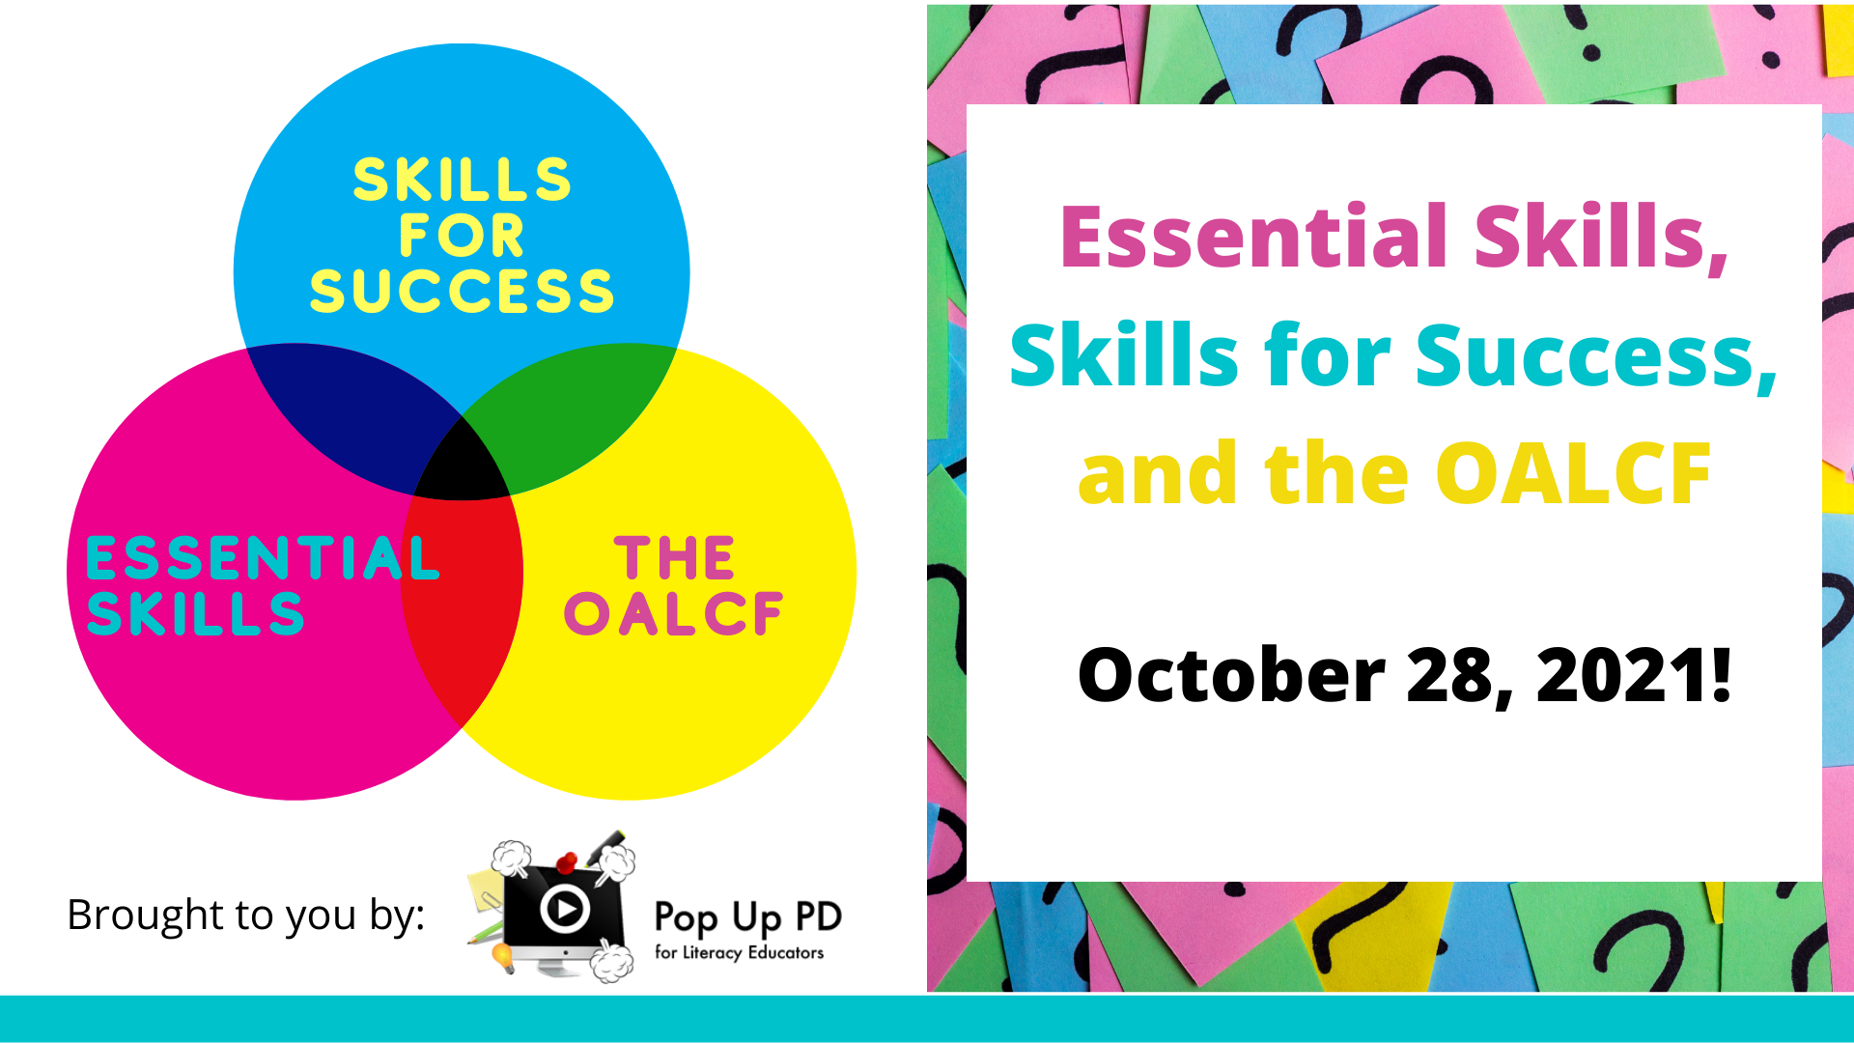

Webinar Title
((DATE))
Notes:
Sarah Stocker: This afternoon, I would like to begin with a land acknowledgement. We would like to begin by acknowledging the Indigenous peoples of all the lands that we are on today. While we meet today on a virtual platform, we would like to take a moment to acknowledge the importance of the lands which we each call home. We do this to reaffirm our commitment and responsibility in improving relationships between nations and to improving our own understanding of local Indigenous peoples and their cultures. From coast to coast to coast, we acknowledge the ancestral and unceded territory of all the Inuit, Métis and First Nations people that call this land home.
And now it’s my pleasure to introduce this afternoon’s panelists. We have Barb Glass and Robyn Cook-Ritchie presenting today. Barb’s teaching career began in 1990 in the York Region District School Board. She relocated to North Bay and spent 23 years at Canadore College teaching and coordinating adult upgrading and pre-apprenticeship programs. Subsequently, Barb held management positions at Conestoga College and Niagara College in the areas of access programing, upgrading and Pathways. In 2016, Barb began her current position as Executive Director of the College Sector Committee.
Robyn Cook-Ritchie is the Executive Director at Laubach Literacy Ontario. Her consulting company, RCR Consulting, has focused on adult literacy for the past two decades, working with literacy organizations across the province on research and development projects and practitioner training. Robyn also coordinates the Literacy and Basic Skills and language instruction for newcomers to Canada programs at the Grand Erie District School Board.
It’s now my pleasure to turn over the presentation to Robyn.

Slide 2
About Pop Up PD for Literacy Educators
free webinar series developed by Ontario’s LBS Regional Networks, Sectors, & the Provincial Support Organizations for Literacy
supports LBS practitioners with presentations on topics important to them
English language webinars presented for LBS practitioners annually since 2015-2016; French language transcriptions are available on COFA’s website!
all webinar presentations, recording links & transcripts here:
  https://e-channel.ca/practitioners/pop-pd-resources
webinar topic ideas welcome at: e-channel@contactnorth.ca
Notes:
Robyn Cook-Ritchie: Thank you, Sarah. Welcome, everyone, to today’s presentation. I’m going to be talking about OALCF and Essential Skills, and then I will turn it over to Barb who will talk to you about the new Skills for Success and the connection to OALCF.
Before we get started, I want to tell you a bit about the Pop Up PD for Literacy Educators. This is a free webinar series that has been developed by Ontario’s regional networks, sectors, and provincial support organizations. The idea behind pop up webinars is to support practitioners with presentations on topics that are important to them. English-language webinars have been presented annually since 2015/16, and French-language transcriptions are available on COFA’s website. There is a link on the slide where you can access all of the recording links and transcripts. Webinar topic ideas for the next fiscal year are always welcome to be sent to E-Channel; the address is also on the slide.

Slide 3
Today’s Webinar…
Historical Overview of the Ontario Adult Literacy Curriculum Framework (OALCF)
OALCF Components
History of Essential Skills
Connection between the OALCF and Essential Skills
Skills for Success and the Connection to the OALCF
Notes:
In today’s webinar, we’re going to start out with an historical overview of the Ontario Adult Literacy Curriculum Framework. From here on out, I’m going to call it the OALCF because it’s quite a mouthful to say the whole thing every time. We’re going to do a brief overview of the components of OALCF. I’m going to talk a bit about the history of Essential Skills, and the connection between Essential Skills and the OALCF, and then we’re going to get into the new Skills for Success and the connection to the OALCF.

Slide 4

Historical Overview of the Ontario Adult Literacy Curriculum Framework (OALCF)
The OALCF was part of the 2007 Ontario Plan which stated that under a Smarter Ontario, Ontario would work together with the college sector and non-profit groups to design and deliver an adult literacy curriculum.
First Phase: 2008-2009
Second Phase: 2009-2010
Final Development Phase: 2010-2011
Notes:
Historically, the OALCF was part of a 2007 plan in Ontario that stated, under a smarter Ontario, Ontario would work together with the College Sector, and all the other noon-profit groups and other groups supporting literacy across the province, to design and deliver an adult literacy curriculum. There were three major phases in this initiative. The first phase started in 2008, and the final phase wrapped up in 2011. The phases include a pilot project where agencies all across the province, representing all of the different streams and sectors, provided feedback on the first draft of the framework. The field was involved in the development work related to the initiative through a series of funded projects by support and service organizations across the province, and those organizations were involved in all three of those phases.

Slide 5
The LBS program helps adults develop and apply communication, numeracy and digital skills to achieve their goals…..The program is divided into four cultural streams that are customized for Anglophone, Deaf, Francophone and Indigenous learners….The program helps learners reach goals of employment, post-secondary education, apprenticeship, secondary school credit, and independence. Programming is designed to help learners progress from developing skills to applying those skills to achieve their goals.
LBS: Service Provider Guidelines p.6, last accessed October 26, 2021
Notes:
This definition that I have on the slide comes out of our current LBS Service Provider Guidelines. It has been the same definition, more or less, for the last 10 years with some tweaks here and there. What’s important to note is that the LBS program is meant to help adults develop and apply communication, numeracy and digital skills to be able to achieve their goals. The program is divided into four cultural streams that are customized for Anglophone, Deaf, Francophone and Indigenous learners. The program is meant to help learners reach their goals related to five different goal paths. Those goal paths are employment, post-secondary education, apprenticeship, secondary school credit, and independence. Programming is designed to help learners progress from developing the skills they need to being able to apply those skills in order to achieve their bigger goals that they have.

Slide 6

The OALCF was developed to strengthen and support
Literacy and Basic Skills programming in Ontario.
Notes:
When the OALCF was developed, it was developed to strengthen and support the programming that were already in place in Ontario. It wasn’t meant to replace it, it was meant to strengthen what we were already doing in the province prior to the OALCF. If you have been around for a long time, you will remember something called the Validation Draft (more commonly referred to as The Matrix). That was the system we used before. It was a five-level system and was basically the K to Grade 12 curriculum broken down into skills. When the OALCF development work was done, it was the first time that something was built from the group up for adult literacy learners in the province.

Slide 7
What is the Ontario Adult Literacy Curriculum Framework (OALCF)?
Multi-part framework
Tools to strengthen existing programming
Provides a foundation
Learner-centred
Goal-directed
Transition-oriented
Task-based learning approach
The purpose of the OALCF is to improve the transitions of adults through Employment Ontario (EO) and the broader education and training system.
The OALCF is a broad term that refers to all the features of delivering a competency-based program.
Notes:
So what is the OALCF? It’s a multi-part framework. It’s a set or collection of tools that were meant to strengthen existing programming. It was meant to provide a solid foundation upon which programming could be developed. It’s learner-centre, goal-directed, transition-oriented, and it uses a task-based learning approach. The purpose of the OALCF was to improve transition of adults through Employment Ontario and the broader education and training system. When we talk about the OALCF, we’re talking about a broad term that refers to all of the features of delivering a competency-based program.

Slide 8
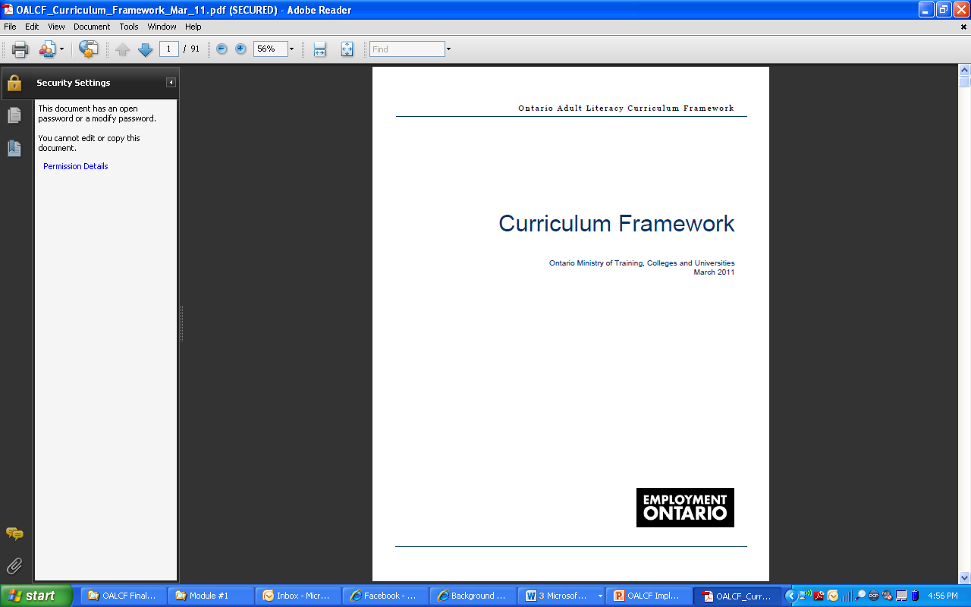
The Curriculum Framework is the core of the OALCF
Notes:
The curriculum framework document is the core of the OALCF, so there’s a lot of supporting documents, but this is the core, the framework piece. It defines the scope of learning in Ontario’s adult literacy programs. It’s meant to provide some common criteria against which learning can be articulated. It focuses on the performance of realistic tasks that are related to the learners’ goals, so the focus is on tasks not skills. But of course we know that you need to develop skills in order to be able to complete tasks, so it’s not that we don’t do skill development in LBS, it’s just that the focus of our framework is at the level of the tasks that learners need to be able to do.

Slide 9

The Curriculum Framework was designed to help practitioners make clear connections between literacy development and the real-life tasks learners perform in work, learning and community contexts.
The Curriculum Framework provides a common language and criteria for learning regardless of learners’ goals, backgrounds and interests.
Notes:
The curriculum framework was designed to help practitioners make clear connections between what they do in literacy class or 1-on-1 or however it is being delivered, and then the real life tasks that learners perform when they go out to work, when they are in other learning environments, or when they are out in the community. The framework provides a common language and criteria for learning, regardless of what the goals, backgrounds or interests of the learners are. It is meant to give a foundation or an accountability framework for the assessment of literacy. It’s focussed on the application of learning. It’s not intended, however, to provide all the details of literacy development. It doesn’t provide all those skills development pieces. It’s meant to focus on how, once you have those skills, you apply them in real life, whether it be work, learning, or in the community.

Slide 10
The Curriculum Framework supports the development of skills, knowledge and behaviours or COMPETENCIES that adults need to fulfill their responsibilities at work, in the community and in learning situations.
Notes:
The Curriculum Framework supports the development of skills, knowledge and behaviours, otherwise known as competencies, that adults need so that they are able to fulfill their responsibilities at work, when they are out in the community, or when they are in other learning environments such as secondary school, post-secondary skills training – all of those different environments that they may move on to after they are engaged with a literacy program. It goes beyond literacy instruction as discrete skills building focuses on the interaction of skills, knowledge and behaviour that reflects the learners’ goals and interests. It’s not just about the skills they are learning, it’s how those skills work together with prior knowledge and behaviour, and how that support the learners’ goals.

Slide 11
The Curriculum Framework uses six broad competencies to organize learning content.
A. Find and Use Information
B. Communicate Ideas and Information
C. Understand and Use Numbers
D. Use Digital Technology
E. Manage Learning
F. Engage with Others
Engage with Others
Find and Use Information
Understand and Use Numbers
Communicate Ideas and Information
OALCF
Manage Learning
Use Digital Technology
Notes:
The Curriculum Framework itself uses six very broad competencies to organize learning content. Those six competencies are find and use information, communicate ideas and information, understand and use numbers, use digital technology, manage learning, and engage with others.

Slide 12

The OALCF competencies were established by synthesizing responses from the literacy service providers in Ontario to the question, “What should learners learn in literacy programs?”
Notes:
Those competencies were established by synthesizing responses from literacy service providers across Ontario. The question was, “what should learners be learning in literacy programs”. That was the broad question that was asked, and that fed into the development work and the competencies that came out of that work. All of the streams and sector organizations from the province were involved in the process of identifying these six broad competencies that answered that question about what learners should be learning in literacy programs. As you can see, the competencies go beyond the traditional idea of reading, writing and numeracy as we would traditionally think of literacy. The development team members representing the interests of learners in Francophone, Deaf, Indigenous and Anglophone programs, in addition to representatives from community-based, school board and college service providers all came up with the competencies. This was the process; they came together in a large team environment over a lot of time and worked on all of these concepts until they reached consensus on the set of competencies that would end up comprising the OALCF Curriculum Framework.

Slide 13
Why “competencies”?
Competency-based education is characterized as an approach focused on the achievement of competencies rather than isolated skills. In achieving competencies, learning extends beyond skill attainment to also incorporate knowledge and behaviours.
Within a competency-based approach, it is the interaction of skills, knowledge and behaviours, as well as learners’ understanding of how to employ their skills, that contributes to learners being able to perform tasks.
Competency-based education articulates success in many ways, but always key is the learners’ abilities to demonstrate success against the standards set by the framework.
New Zealand Ministry of Education. Tertiary Educational Learning Outcomes Policy National Office. Key Competencies in Tertiary Education New Zealand: Discussion Document. 1995.
Notes:
So why competencies? There are many reasons why competency-based learning includes all aspects. It includes skills, but it also includes knowledge and behaviour. It also includes specific tasks to provide learning context for learners. Competency-based learning involves relationships with other competencies, and it also supports a learner’s ability to adapt and apply what they have learned to new contacts. It’s an approach that’s focused on the achievement of competencies, rather than just isolated skills. It doesn’t mean that people don’t have to attain those skills. You need to have those skills, and you need to be able to bundle them together to achieve the competencies. With this type of an approach, there is an interaction of skills, knowledge and behaviours as well as learners’ prior knowledge and understanding of how to use the skills. This helps learners be able to perform tasks. Competency-based education can articulate success in many different ways, but it’s always key that the learner is able to demonstrate success against the standards out in the framework.

Slide 14





Competencies
Represent the full range of skills, knowledge and behaviours adult literacy learners can expect to enhance while participating in literacy programming.
Are context free - they are broad, generic categories that apply to all learners
Allow programming to be contextualized to learners’ goals.
Notes:
Competencies represent a full range of skills, knowledge and behaviours adult literacy learners can expect to enhance while they are participating in literacy programming. They are context free; by that, they are meant to be broad, generic categories that apply to all learners, but they allow learning to be contextualized to learners’ specific goals that they bring to programming.

Slide 15
Competencies are integral to completing any task.
Competencies are used in combination with other competencies.
The concept of competencies implies a broader concept than the term generic skills.
New Zealand Ministry of Education. Tertiary Educational Learning Outcomes Policy National Office. Key Competencies in Tertiary Education New Zealand: Discussion Document. 1995.
Notes:
In the OALCF, competencies are integral to completing any task. Competencies are almost always used in combination with other competencies, so they interconnect in some way. Communicate for example: communicate ideas and information and find and use information are often interconnected in the actual tasks that you do. The concept of competencies implies a much broader concept just the term “generic skills”

Slide 16

The Curriculum Framework can be used to guide:
  Program development
  Assessment
  Instruction
Notes:
The idea behind the framework is that it can be used to guide or support program development, assessment, and instruction. Keeping in mind that it is a framework, it doesn’t have everything in it. It is meant to give you the foundation, or the basis upon which you can do some program development, you can create assessment tools, and you can provide instruction to learners. You are able to reflect back on the framework as your foundation piece.
That’s a quick overview of the Curriculum Framework and what the intent was when it was developed. It has been around for a few years, and it is integrated into literacy programming.
I’m now going to walk you through Essential Skills and the interconnection between Essential Skills and the OALCF.

Slide 17
Essential Skills
Work
Learning
Life
Essential Skills were the original foundational skills identified as integral to successful participation in the Canadian labour market.
"enabling" skills that help people perform tasks required by their jobs
skills that provide workers with a foundation for learning other skills
skills that enhance the ability to adapt to change
skills people use to carry out a wide variety of everyday life and occupational tasks
skills needed for work, learning and life
Notes:
Essential Skills were the original foundational skills that were identified as integral to successful participation in the Canadian labour market. That’s an important distinction to know. The Essential Skills were built on the skills people needed in order to participate in various types of employment. They are a broad set of foundational skills, and they do have applicability across work, learning and life. The idea is that having the skills in place allows you to adapt and use them in other contexts, in particular in other learning environments and just in life in general.
They are enabling skills that help people perform tasks required by their jobs. They are skills that provide workers with a foundation for learning other skills. They are skills that enhance the ability to adapt to change. They are skills that people use to carry out a wide variety of everyday life and occupation tasks. They are skills needed for work, learning and life. When I talk about Essential Skills, I am talking about the original set of Essential Skills. Later on in the presentation, Barb will walk you through the new Skills for Success, which is replacing Essential Skills in Canada. It’s good to have a basis in the original nine Essential Skills, because there is a clear connection.

Slide 18
NINE Original Essential Skills
Reading
Document use
Writing
Numeracy
Oral communication
Working with others
Thinking
Computer Use
Continuous learning
Notes:
Those nine original essential skills are reading, document use, writing, numeracy, oral communication, working with others, thinking, computer use, and continuous learning.

Slide 19
A brief history of Essential Skills
1971–1993
Canadian Classification and Dictionary of Occupations (CCDO) was developed in Canada
1993
The National Occupational Classification (NOC) replaced the CCDO
1993–1994
Government of Canada launched the Essential Skills Research Project (ESRP)
1995–1997
Pilots and data collection for the Essential Skills Profiles
1998
Writing of the Profiles commenced
Notes:
Essential Skills have a long history, and think it’s interesting to understand where they came from, because you are going to be familiar with some of these pieces. From 1971 to 1993 in Canada, we had something called the Canadian Classification and Dictionary of Occupations. That was developed in Canada specific to Canadian occupations. In 1993, the National Occupational Classification replaced the CCDEO. That’s the “NOC” that we talk about. Most people who work in literacy have had to use NOC codes that link to specific occupations.
In 1993, the government launched the Essential Skills Research Project, the ESRP. The first step of that project was to draft a framework that included a list of the nine Essential Skills that I went over in the previous slide. It also included complexity rating scales and an approach for data collection to make the Essential Skills profile. The main purpose of this project was to support curriculum development and training for all of the occupations that were outlined in the NOC. A lot of research went into this, and a man named Arthur D.W. Smith did a lot of work in the 1970s on identifying generic skills for occupational training, and that was the starting point for this work. They also did a worldwide literature review, and they integrated information from the International Adult Literacy Survey.
Between 1995 and 1997, there were pilots and data collection for the Essential Skills profiles, and in 1998 they started writing those. The profiles profile a particular occupation and outline all of the different Essential Skills that someone requires or would need to be successful in that occupation.

Slide 20
Essential Skills Research Project (ESRP)
Human Resources and Social Development (HRSD, now Employment and Social Development Canada ESDC) wanted to improve economic performance and labour market outcomes by encouraging training.
The project:
identified Essential Skills needed for work, learning and life
answered the questions, “Training for what?” and how an individual knows if he or she has the skills needed for the job he or she wants
involved more than 3000 interviews across Canada with people in 180 occupations were conducted
developed ways to talk about Essential Skills by using the information from the interviews and adapting scales from the International Adult Literacy Survey IALS and Canadian Language Benchmarks
Notes:
What they wanted to do with this project was to improve economic performance and labour market outcomes by encouraging training. The project identified those Essential Skills needed for work primarily, but also that were adaptable to learning and life. It answered the question, “training for what?” and how an individual would know if they had the skills needed for a particular job.
The project involved almost 3000 interviews across Canada, and it looked at 180 different occupations. They developed ways to talk about Essential Skills by using information from those interviews. They adapted scales from the International Adult Literacy Survey – IALS – and ftom Canadian Language Benchmarks.

Slide 21
ESRP Key findings
Different occupations require different skill sets and skill levels
Increasing skill levels helps people maintain jobs during transitional times
Education level does not always equate to skill level
Literacy skills are on a continuum and need to be used or they can be lost
Notes:
They found that different occupations require different skills sets and different skill levels. Increasing skills levels or providing training helps people maintain jobs, especially during transitional times. This point is quite important right now, because we are living through a very historic transitional time, in terms of COVID of course, but also in terms of increasing digitization in so many different occupations.
Education level doesn’t always equate to skill level when it comes to performing certain tasks. Someone might have a secondary school credit level, but they might not have the skills they need to performance or work in an entry level job. It depends on the occupation and the skills required. This project took a close look at what different occupations across Canada require.
They also found that literacy skills are on a continuum, and they need to be used or they can be lost. We do know that in LBS, because we see it all the time. People come into our programs with skill gaps or losses because they haven’t used the skills in a while.

Slide 22
How are Essential Skills Used?
They are used in performing tasks required for a job.
Different combinations
Different applications
Every occupation
Acquire and apply other skills
Adapt to change
Notes:
Workplace essential skills are the foundation skills everyone uses while performing the tasks required for their jobs. There were originally nine skills that were identified as essential in almost every workplace. All nine are used in different combinations, in different applications, in almost every occupation. They're the foundational skills you rely on to carry out your work tasks, and they're the building blocks you use to learn new ones. They're essential to your success.
The nine Essential Skills are the key to acquiring and applying all other skills. They were identified as quite critical, and that’s why we’re going through this to give you an historical idea of where they came from and how they were developed over time

Slide 23
What is complexity?
Ratings look at different dimensions for each skill on a 4 or 5 point scale
Complexity levels are assigned to example tasks that would be performed by a worker in a job
Notes:
Proficiency in each Essential Skill was measured with a specific complexity rating. The complexity rating considers different “dimensions” of the skill on a four or five point scale. Complexity levels are assigned to example tasks that will be performed by a worker on the job. These ratings were developed so that you could identify differences and skill requirements among different occupations and the underlying constructs applicable to learning strategies. The complexity rating considers different dimensions of a skill on the point scale, and it integrates information into a single number to provide an overall rating. Complexity levels from “1”, which would be basic tasks, to “4” or “5”, which will be more advanced tasks, are then assigned to specific example tasks that somebody would do on a job.
When you look at an Essential Skills profile and the different skills that are required, it tells you if you need, for example, Reading Text Level 3 which would be at complexity level 3.

Slide 24
General Complexity in Essential Skills- An Example
Level 1 Locate and Use | Level 2 Locate and Cycle | Level 3 Locate, Cycle and Integrate | Level 4 Apply prior knowledge, locate, cycle and integrate | Level 5 Apply prior knowledge, locate, cycle, integrate and generate
Pet groomers read items in supply catalogues and purchasing flyers. | Kitchen helpers read safety precautions relating to fire hazards in the kitchen. | Branch managers may refer to several human resource manuals to locate and integrate information on topics such as pay scales and job descriptions. | Court clerks select information from various Acts to assist Justices of the Peace in cases where clarity of jurisprudence is required. The Acts contain complex legal terminology. | Assistant business managers in labour unions read adjudication decisions that have established jurisprudence for pending grievances which are to go to adjudication. The legal wording has specific and complex implications for specific cases.
Notes:
This is a general example of complexity in Essential Skills. At Level 1, somebody is locating and using information, so in this example, pet groomers read items in supply catalogues and purchasing flyers. At Level 2, they are locating and cycling information. Kitchen helpers read safety precautions relating to fire hazards in the kitchen, for example. At Level 3, you are starting to actually integrate information, so you are still locating and cycling, but you are also integrating. An example of that would be branch managers at a bank may refer to several human resource manuals to locate and integrate information on topics such as pay scales and job descriptions. You’re not just finding information, you’re also starting to integrate the information to make decisions or generate new information. At Level 4, you’re doing all of those things, but you’re also starting to apply prior knowledge. For example, court clerks collect information from various Acts to assist Justices of the Peace in cases where clarity of jurisprudence is required. The Acts that they are actually reading and selecting are complex legal documents with complex terminology. They have some background information to be able to understand that terminology and bring the correct information. At Level 5, you’re starting to generate new things: you’re doing everything you did in the first four levels but also generating. For example, assistant business managers in labour unions might read adjudication decisions that have established jurisprudence or law for pending grievances which are to go to adjudication. The legal wording has specific and complex implications for specific cases. As the levels increase, the complexity also increases.

Slide 25
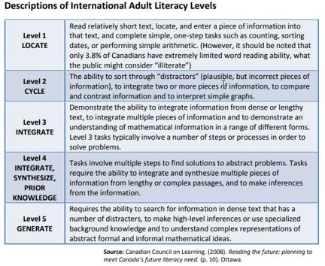
Essential Skills scales draw from IALS research
Notes:
Essential Skills scales draw from the International Adult Literacy Survey research. I’m not going to go through this – I put it in as an example so you can see. The language is very similar: at Level 1, you are locating; at Level 2, you are cycling; at Level 3, you are integrating; at Level 4, you are integrating, synthesizing and using prior knowledge; at Level 5, you are also generating. There is a clear connection between the Essential Skills scales and the IALS research.

Slide 26
The primary purpose of the Curriculum Framework is to support adult learning.
It is consistent with the interpretation of the Essential Skills complexity scales but is not organized by the nine Essential Skills
It does not draw exclusively from Essential Skills for its conceptualization of all levels
Notes:
I’m going to flip back to the Curriculum Framework now. I’m going to try to explain the connection to the Essential Skills. The primary purpose of the Framework is to support adult learning. Remember that the original purpose of the Essential Skills revolved around occupations and identifying tasks in occupations and skill levels. The OALCF Curriculum Framework is consistent with the interpretation of the Essential Skills complexity scales, but it’s not organized by those nine Essential Skills. It doesn’t draw exclusively from Essential Skills for its conceptualization of the different levels. There are some very clear connections, and there are some additional pieces that were put in place because the purpose is different, i.e., to support adult learning.

Slide 27
OALCF & Essential Skills
OALCF skills organized
into competencies
Essential Skills
organized by skill domain
Notes:
For example, OALCF organizes skills into competencies, whereas Essential Skills are organized by specific skill domains. The Curriculum Framework departs a bit from the Essential Skills Framework and moves away from using skill domains established under that system. Instead, it adopts a system where learning is organized and articulated to competencies and task groups.

Slide 28
OALCF
Focuses on how learners use
skills outside literacy programs
Competency-based
Task-based
Notes:
The OALCF focuses on how learners use skills outside of literacy programs. It is competency-based and it is also task-based. The focus is on using what you learn in the program to do tasks outside of the program. It does support work skill, but it also support other things like life and moving on to other education.

Slide 29
Complexity in the OALCF
The OALCF uses three levels to describe a learner’s proficiency
Informed by the same factors that drive complexity at Essential Skills levels 1, 2, and 3
The OALCF scale is consistent with the interpretation of the Essential Skills complexity scales for several Essential Skills
Notes:
The complexity in the OALCF is based on three levels. It uses three levels to to describe a learner’s proficiency. Those three levels are informed by the same factors that drive complexity at Essential Skills levels 1, 2 and 3. The features include the extent to which the context is familiar and factors that make text and tasks increasingly complex.
When the OALCF was developed, the researchers relied heavily on the Essential Skills research and the scales that were used. So it is consistent with the interpretation of Essential Skills complexity scales for several of the Essential Skills.

Slide 30
OALCF & Essential Skills (ES)
OALCF
levels 1, 2, 3
Essential Skills
levels 1, 2, 3
=
The levels relate to the task, not the learner.
Notes:
Essentially, OALCF Levels 1, 2 and 3 are equivalent or are linked to the Essential Skills Levels 1, 2 and 3.
Remember that in the Essential Skills, levels were developed to address differences in skills needed between occupations. The OALCF has a broader application than that. The Essential Skills scales developed describe five levels of complexity whereas the Curriculum Framework only addresses the first three levels. If you want the reason why that is, it’s because the decision to include only those first three levels was informed by the International Adult Literacy Survey findings which indicate that adults who can do skills or tasks at Level 3 can meet most of the Essential Skills demands of daily life and transfer their learning easily from one context to another. For programming purposes, there may be tasks that practitioners choose to carry out with their learners that actually go beyond Level 3, because that might make sense for some learners with some of their goals, but the Framework really focuses on thise first three levels that are indicative of foundational literacy and numeracy needs.

Slide 31
OALCF - 3 levels of Proficiency
Informed by factors the drive complexity at Essential Skills levels 1, 2 and 3
Differs from Essential Skill as its primary purpose is to support adult learning
Is supplemented with task and performance descriptors in addition to those drawn from ES complexity
Notes:
To bring it all back together, the OALCF has three levels of proficiency. It’s informed by the factors that drive complexity at Essential Skills Levels 1, 2 and 3. It differs from Essential Skills as its primary purpose is to support adult learning. It is supplemented with task and performance descriptors in addition to those drawn from Essential Skills complexity.

Slide 32

Questions so far?
Notes:
Does anyone have any questions? This is the midpoint in the presentation, and Barb will be taking over for the second half of the webinar.

Slide 33

Part 2: “Skills for Success”
Thank you, Robyn, for the great overview of the OALCF and the original Essential Skills framework!
In the second part of today’s webinar, we’ll look at the federal government’s brand new “Skills for Success” framework and how it relates to the OALCF.
This Photo by Unknown Author is licensed under CC BY-SA-NC
Notes:
Barb Glass: Thank you very much, Robyn.
There is a question in the chat asking to clarify the difference between competencies and skills domains.
Robyn Cook-Ritchie: There are nine Essential Skills, and there are six competencies. The OALCF has six competencies, the Essential Skills framework identifies nine different skill domains.
There is also a question about the Ontario Skills Passport. The website assisted with training plan development, but it’s no longer up and running. Will the new Skills for Success be available similar to what used to be available for training plan development? We will leave that question for after we talk about Skills For Success.
Barb Glass: Robyn, thank you for that overview. I’ll move on to the new pieces of what we can expect in the Skills for Success framework.

Slide 34
Remember the history? Time for an update!
1971–1993
Canadian Classification and Dictionary of Occupations (CCDO) was developed in Canada
1993
The National Occupational Classification (NOC) replaced the CCDO
1993–1994
Government of Canada launched the Essential Skills Research Project (ESRP)
1995–1997
Pilots and data collection for the Essential Skills Profiles
1998
Writing of the Profiles commenced
Notes:
I’m going to start by refreshing your memory from a few minutes ago with a couple of the things that Robyn mentioned. It’s hard to believe that the Essential Skills research project is 30 years old! So it’s high time for an update. We’ll talk a bit more about some of the reasons behind the federal government’s decision to proceed with updating the Essential Skills framework.

Slide 35
NINE Original Essential Skills
Reading
Document use
Writing
Numeracy
Oral communication
Working with others
Thinking
Computer Use
Continuous learning
Notes:
Again, just to refresh your memory, Robyn identified the nine original Essential Skills that were developed. In the new Skills for Success framework, there are still nine, but some of them have been renamed and/or redefined.

Slide 36

Essential Skills are the ‘Velcro’ to which all other education and training ‘sticks’.
Notes:
You might have heard this expression in other presentations over the years. I still like this analogy whether they are called Essential Skills, Foundational Skills or Skills for Success – they are indeed the Velcro to which all other training and education sticks. So any of us – learners, employees, instructors or at any time in our daily life – if we have stronger Essential Skills, we will be more likely to be successful at other kinds of training and education. It stands to reason when you think about some of the simpler Essential Skills such as reading, writing and numeracy. If those skills are stronger, then we are better able to engage in other kinds of training and education, and employment.

Slide 37
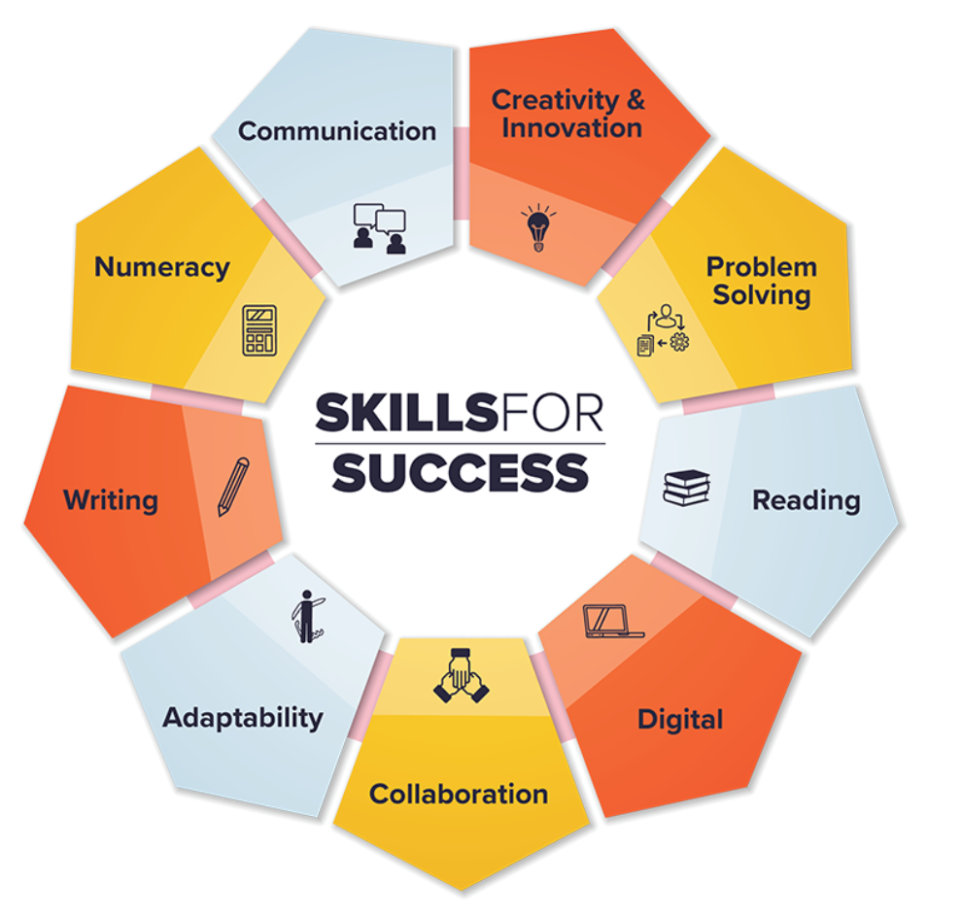
Notes:
Announcing the new Skills for Success! This graphic is from the federal government’s website. I’ll be showing you a bit more that website in a few minutes. There’s some interesting differences in the way this graphic presents the new Skills for Success. For example, they are presented as a circle rather than as a list. I think that has interesting implications for both education and work as well as life in that there aren’t firm start and stopping points, but rather they work together as a group of skills to help all of us improve our ability to engage in work, learning and life. That part hasn’t changed.
Starting from the top, we have communication, numeracy, writing, adaptability, collaboration, digital, reading, problem solving, creativity and innovation.

Slide 38

From the Skills for Success website:
Source:https://www.canada.ca/en/services/jobs/training/initiatives/skills-success.html
Notes:
Some of you may have already had a look at the federal government’s new website. Formerly, it was the Office of Literacy and Essential Skills website, and now it’s the Skills for Success website. This is the landing page. I’ve placed the link at the bottom, but you can always Google “Skills for Success” to find it if you want to have a look at the site.
I think it’s interesting to look at the statement on this page. It is still really fundamental to all of the things that Robyn told us about the original Essential Skills research project and the impetus for creating and using those nine Essential Skills. ”Skills for Success provide Canadians with everyday skills needed for work, learning and life.” That emphasis on those three dimensions is still at the forefront. “Improving them will help you succeed in today’s and tomorrow’s workplace”. There is a bit more emphasis on the workplace piece, but it’s always important to recognize that there are meaningful connection to work, to learning and to life.

Slide 39
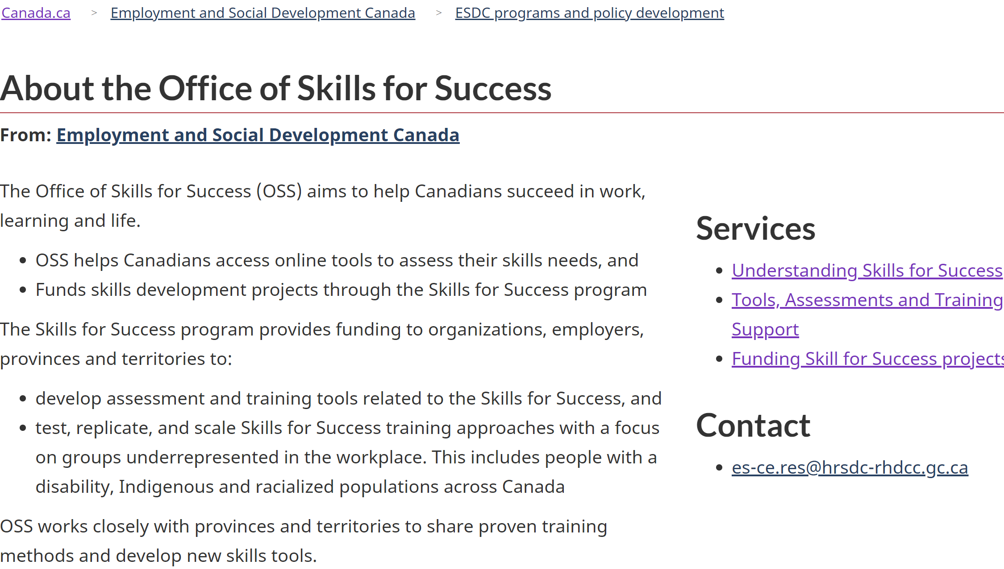
From the Skills for Success website:
Source: https://www.canada.ca/en/employment-social-development/programs/literacy-essential-skills.html
Notes:
Here’s a bit from the website about the new Office of Skills for Success. There are a few different services listed, not unlike what they used to be although they may have different names. I won’t spend too much time on the website piece, but you can certainly visit it later to take a look at it.
Whenever we have LBS providers and support organizations in a room, funding is always of interest. So although there is no call for proposals at this time for Skills for Success projects, you could check back here every so often to check. There is a place on the Training Support link where service providers or organizations can apply to be included as a resource on that list, which may be of interest to some of the people on line with us today.
Something that we’ll talk about a bit later is where it says “training approaches with a focus on groups underrepresented in the workplace”. That is a theme that does occur repeatedly throughout the Skills for Success information and which was less prevalent in the original Essential Skills framework. It’s always important to keep in mind that this is a federal approach as was the Essential Skills research project originally, and provinces and territories can choose to use this framework in the way that is most appropriate for workforce development programs and projects in their areas. This isn’t something that is mandated, it’s provided as a resource and a set of tools to the provinces.

Slide 40
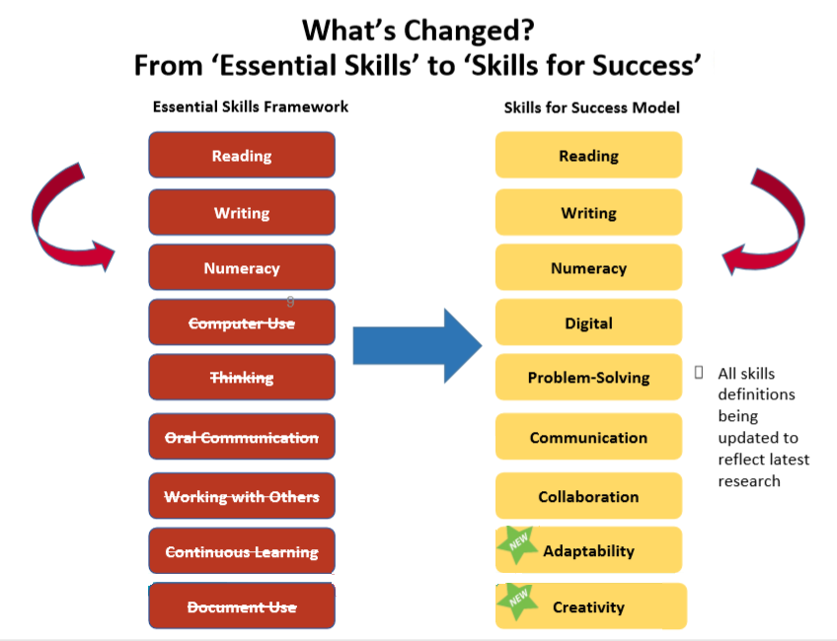
Notes:
So here’s the comparison chart. What haws changed in terms of the actual skills from the Essential Skills framework to the Skills for Success framework can be seen here.
Reading has stayed as reading as have writing and numeracy. Not surprisingly, computer use has been renamed as digital. Thinking has been renamed and redefined as problem solving. Oral communication is now more broadly known as communication. Working with others is now collaboration, which I think is a neat term to include as the name of a skill. Continuous learning has been folded into a newly named skill called adaptability. Document use hasn’t been directly translated as creativity, but creativity has been added, and document use has been removed as a discrete Essential Skill.
As I mentioned earlier, all of the definitions related to these skills have been updated.

Slide 41
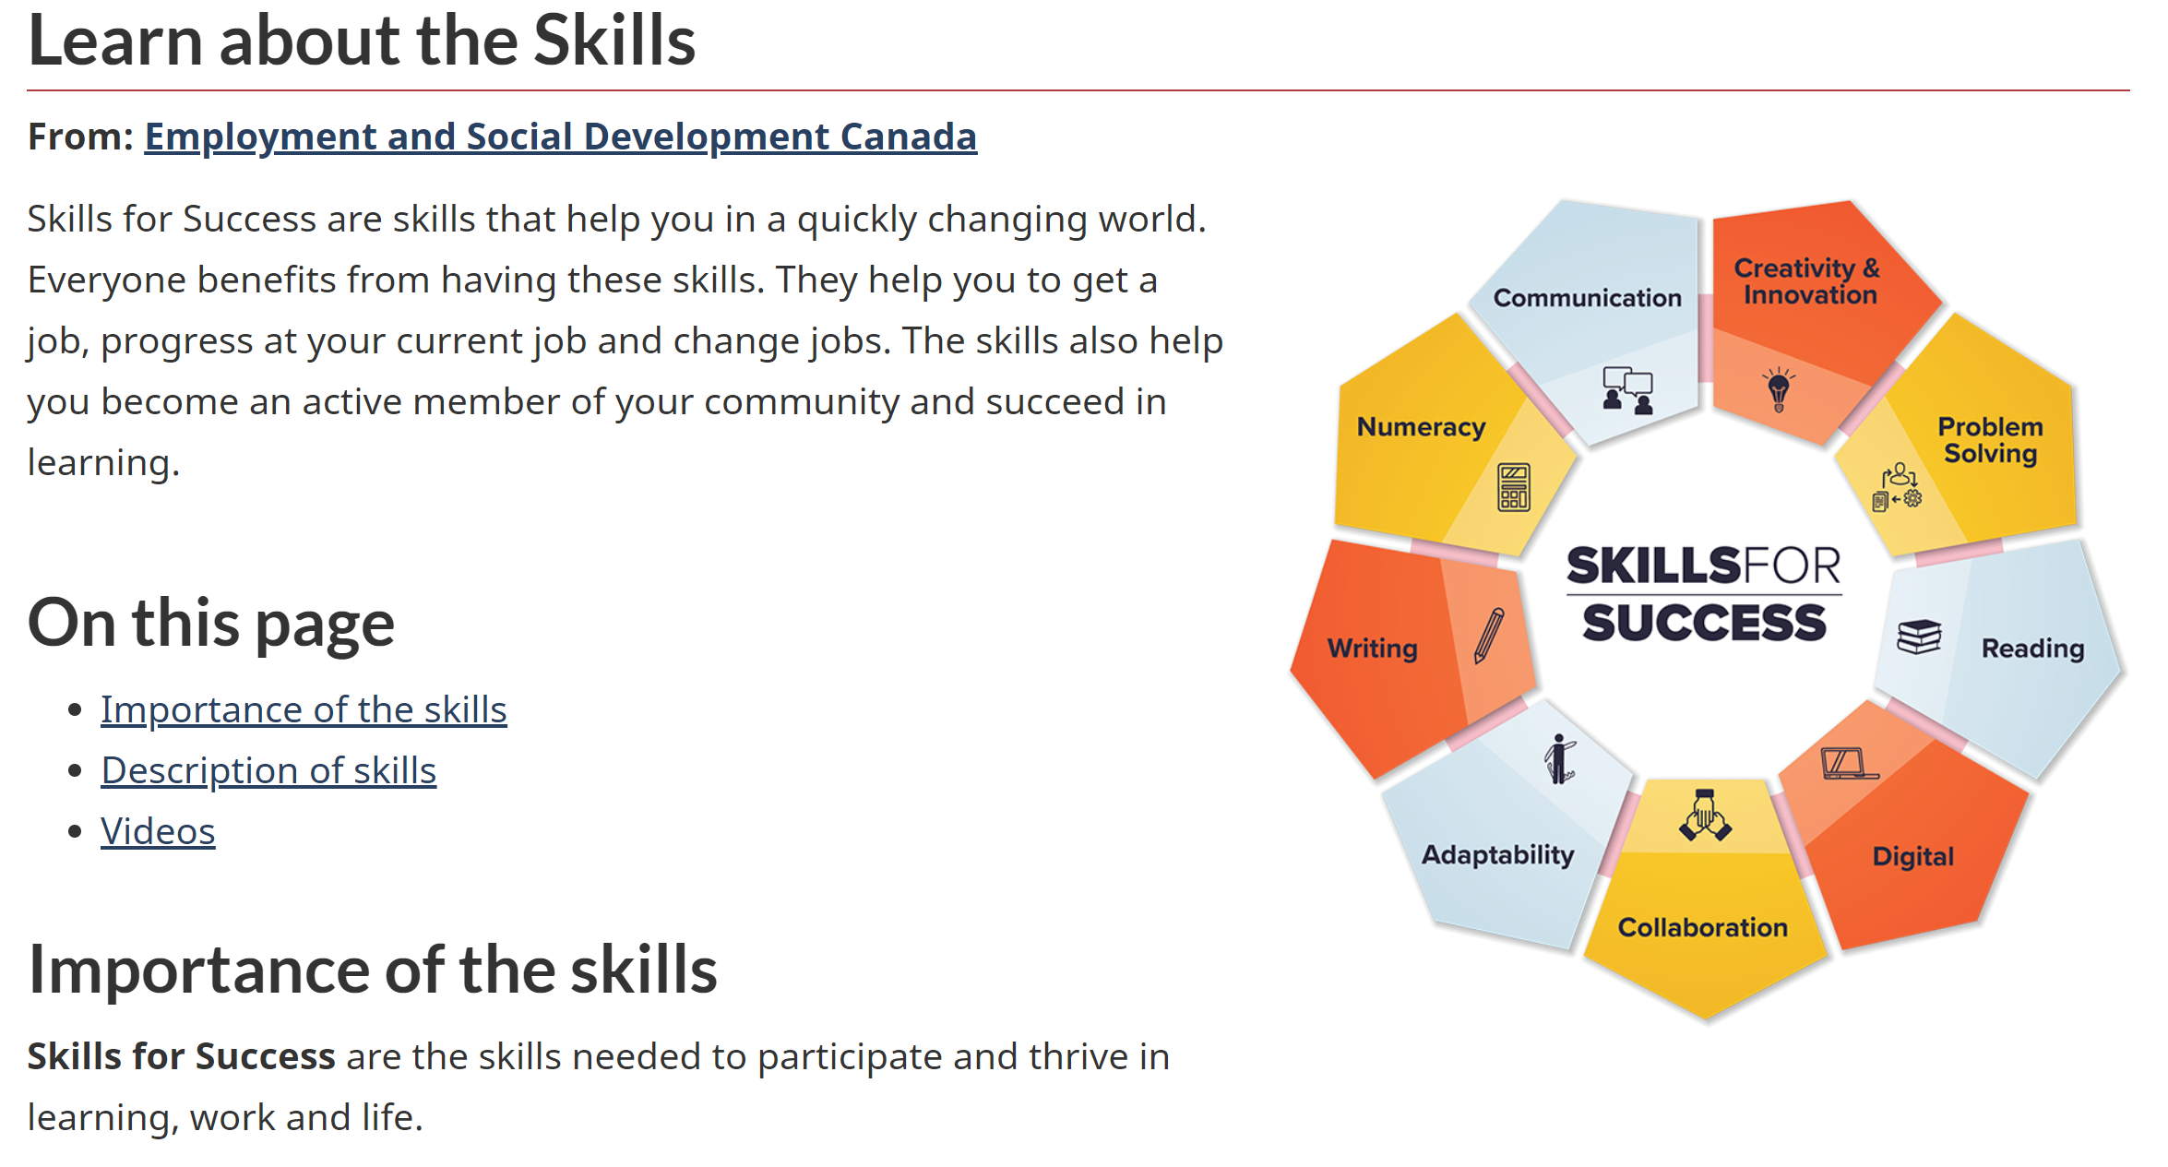
From the Skills for Success website:
Source: https://www.canada.ca/en/services/jobs/training/initiatives/skills-success/understanding-individuals.html
Notes:
Here is one more slide from the website to highlight a few more features that you might want to have a look at when you have time. This is very much like some of the information that appeared on the old Essential Skills website, such as information about the importance of the skills, descriptions of them, and some video information. Once again, they reiterate that Skills for Success are the skills needed to participate and thrive in learning, work and life.

Slide 42
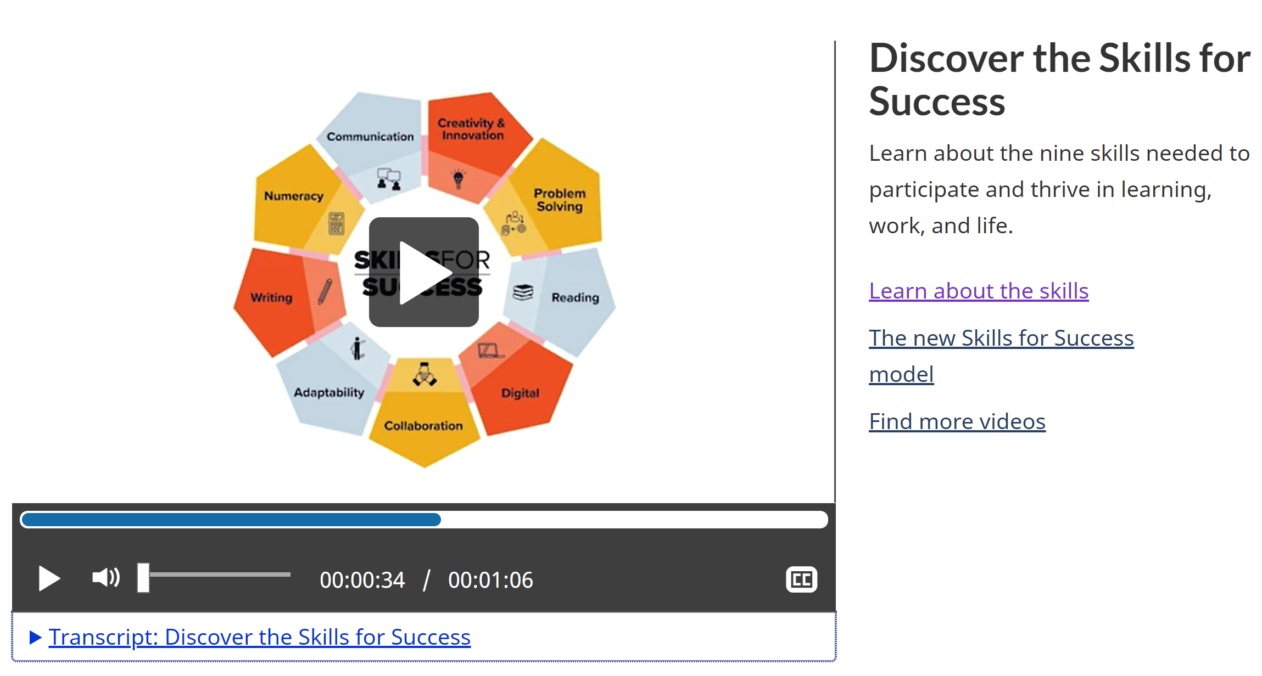
Notes:
There is a short video, and there is a transcript available too. You might want to use this in your own work or presentations. I think it’s a good video.

Slide 43

The information on the next few slides is adapted from a 2020 presentation provided by the former “Office of Literacy and Essential Skills” (OLES) within Employment and Social Development Canada.
OLES has now been rebranded as the
“Office of Skills for Success” (OSS)
Notes:
I’ll let you read this.
Last year, we did a Pop Up PD webinar where we had some representatives from the Office of Literacy and Essential Skills. They gave us a preview of the Skills for Success framework. But because it had not yet been publicly launched, there was a limited amount that they were able to share in the webinar. I went back to some of the slides that they presented and adapted them a bit for today’s presentation, so some of these slides may seem a bit familiar to you.

Slide 44
Renewal of Essential Skills Framework is based on the following criteria…
  Transferable: applicable across all jobs and within a variety of contexts
  Teachable: applied to learning or training context and linked to labour market outcomes
  Assessable: quantitative/qualitative, demonstrable, measurable, comparable, consistent
  Recognized: by Canadian and International research for influencing outcomes
Notes:
The renewal of the Essential Skills framework is based on the following criteria that the Office of Skills for Success has identified.
The skills should be transferrable. We all talk a lot about transferrable skills, especially those of us who work directly with job seekers. As LBS educators, we think a lot about having teachable skills and applying them to the context that relates to the learner’s goal, The skills must be assessable, i.e., measurable. The fourth criterion is that they are recognized by Canadian and international research for influencing outcomes.
A large thrust of the federal government’s work in Essential Skills and now in Skills for Success has been about research and trying to ensure that there is applicability and understanding of research outside of Canada when it comes to the use of the framework, either the new one or the old one.
There is a question in the chat that asks if there is a guide, similar to the Reader’s Guide, for the Skills for Success. I don’t think it’s available yet. I would guess that it may be available in the future. I didn’t seen anything specifically on the website, but if anyone has, please let me know.
There is another question asking if they are eliminating the levels. No, the levels are still there. More information is pending, so there isn’t too much on the website yet.

Slide 45

Why is it important to update the original ES Framework?
Type your thoughts into the chat…
Notes:
Let’s take a moment and think about what might have been the impetus or reason to change this. Why do you as an educator, consultant, etc. think it’s important to have a 30-year old framework updated?
There is a comment in the chat that we need to consider 21st century skills. Absolutely.
Someone else mentions the job market and expectations have evolved. Most definitely.
Someone notes that more studies have been done about how people learn and what skills are important to not only children’s learning but also to continued adult learning. Absolutely.
Someone mentions changing times and more need for adaptability and creativity in the workplace. Employers are looking for more soft skills.
Things have changed in 30 years, so this needs to change too. We need to offer relevant training and support to people in our communities.
Someone notes that the new skills titles are much more relatable for learners who need to upgrade soft skills.
We need to adapt to the ever-changing learning and digital landscape.
There is a focus on building relationships and how they are foundations of life skills. That’s an interesting comment.
The new workplace environment, such as working from home. The Skills for Success development work started long before COVID, but this is an interesting point about the new realities and how that necessitates different skills.
Thank you for weighing in that with some important comments. I think you will see a lot of your comments echoed in the rest of today’s presentation.

Slide 46

Workers with low foundational skills are at risk of job loss and difficulty re-entering the labour market
  More than 45% of workers have literacy and numeracy skills at Level 2 or below on a five-point scale (OECD PIAAC)
Technological advancements putting a premium on foundational and social-emotional skills to adapt and thrive
  For new hires, 67% of employers want soft skills, while 52% want technical skills
Employers decreased employee skills investments by 40% from 1990-2010
  Training is most focused on higher skilled workers
  Employed, low-skilled workers would benefit from upskilling/ reskilling
The labour market is evolving…
Notes:
Many of the comments in the chat referred to the concept of an evolving labour market. We have seen some of these points in presentations, research and articles. We work every day with people who have low foundational skills and who may have difficulty finding and retaining work. We have seen the statistic that more than 45% of workers have literacy and numeracy skills at Level 2 or below. We live this every day in our work.
The second bullet also relates to some of the comments in that technology has changed, and the workplace has changed. The demand for digital competence has changed. There is an additional comment that people now expect different things from both their employees and their employers.
Some of us may have seen or read some stats related to the second bullet around new hires. We also hear this anecdotally. Employers want people that have soft skills. They want people who can learn on the job, who can communicate and collaborate with others. Many employers note that if you give them people like that, they will teach them the technical skills. Having said that, of course, there are many jobs that definitely require some technical skills coming in, but 67% is a large number when you consider the employer’s focus on soft skills.
The third bullet is kind of a downer, but it’s something that many of us have seen. Employers have decreased skills investments in their employees over the 20 year period from 1990 to 2010. It would be interesting to see what that looks like between 2010 and 2020, because I think we aware that it is difficult for employers to engage in training.
Someone has asked for the sources of these stats. They are from the Office of Literacy and Essential Skills, although I don’t have their exact source, but I assume they come from Stats Can research or workforce development research by the federal government.

Slide 47

Social-emotional skills, also known as soft skills, are those required for effective social interaction.
These skills interact with each other, are inclusive, can be adapted to different situations
There is no consensus on which social-emotional skills are most important, and the Skills for Success framework will be flexible with respect to different learning, work and life contexts.
Importance of social-emotional skills
Notes:
Many of you mentioned this a few minutes ago: soft skills or social-emotional skills as they are now being branded in this particular framework. They are increasingly important. It is also important to be able to adapt one’s social-emotional skills to different situations. For example, are you interacting with a client or your peers, are you in a meeting or are you out in the community doing a presentation, are you a front-line sales associate – all of those roles require different types of interactions and different types of social-emotional skills.
The third bullet is interesting. There is no consensus on which of the social-emotional skills are the most important, so the Skills for Success framework, according to the federal government, is flexible with respect to different learning, work and life contexts.

Slide 48

Help workers target the right skills to take advantage of new and emerging opportunities as part of upskilling/reskilling strategies
Support the inclusion of vulnerable groups to get the skills needed to adapt to labour market changes
Facilitate entry of individuals facing skills barriers into skilled trade occupations
Meet anticipated increased demand for digital skills with enhanced guidance for that skill-set
Address enduring gaps in foundational skills and respond to demands for new tools and supports to build social-emotional skills
Impact of Skills for Success on workers and the changing labour market
Notes:
Here is a bit more about the impact of the Skills for Success on workers in the labour market. I would say that these bullets are like a wish list of the Office of Skills for Success regarding what they hope will be the outcomes and implications of the new framework.

Slide 49

  Skills for Success will be an adaptable and flexible model that appreciates the diversity of people through an inclusion lens
  Recognizes interplay of access to opportunities and identity factors e.g., gender, (dis)ability, age, race, culture, class, sexual orientation, etc.
  Empowers individuals and employers by providing direction to and for workers who are more frequently left behind, e.g., Indigenous people, persons with disabilities, and newcomers
Inclusivity and the Skills for Success
Notes:
Another focus of the Skills for Success framework which really wasn’t mentioned or highlighted in the Essential Skills framework is the attempt to appreciate diversity and inclusion. As it says in the second bullet, the interplay of access to opportunities and identity factors. The third bullet is empowering individuals and employers to help support some of those underrepresented groups of employees or learners who are more frequently “left behind”. It remains to be seen whether the new framework will achieve these goals, but here they are.
There is a comment in the chat that this is very supportive of an increasing immigrant workforce and an increasingly diverse workforce.

Slide 50

Summary of the Changes
Soft skills such as creativity, collaboration, and adaptability are being added
Document use is being removed… elements being shifted to reading, writing, numeracy, and digital skills
Skills are being relabeled:
  Computer use to digital skills
  Working with others to collaboration
  Oral communication to communication
  Thinking skills to problem solving
  Greater focus on soft skills/social-emotional skills and technology use
Notes:
Here is a summary of the changes from the Essential Skills framework to the Skills for Success framework. The soft skills have been updated and renamed. Document use is no longer a discrete skills, and the elements of document use are shifted into reading, writing, numeracy, and digital skills. We have the relabelled or renamed skills that I showed you on the comparison list. And there is greater focus on the social-emotional skills and technology.
There is a comment in the chat that change is the norm – that relates well with the graphic on the slide, “learn to change, change to learn”

Slide 51
What does this mean for the OALCF?
Nothing at this time in terms of the use of the OALCF in LBS.
The OALCF competencies are broad enough to integrate with the new Skills for Success.
Notes:
Let’s bring it back a bit to the OALCF and how the new framework may or may not mean different things for the OALCF, Really, it doesn’t change anything at this time. The OALCF is still the same as it was when it was developed and released ten years ago. Robyn mentioned about the broadness of the OALCF competencies, and as we all know, they are very broad. So whether we are talking about the old Essential Skills or the new Skills for Success, the OALCF is broad enough to integrate with either.

Slide 52
Possible connections to the OALCF Competencies?
A. Find and Use Information
B. Communicate Ideas and Information
C. Understand and Use Numbers
D. Use Digital Technology
E. Manage Learning
F. Engage With Others
Notes:
Let’s spend the last few minutes bringing things back to the OALCF to look at a few connections that we might be able to articulate today.
There’s a comment in the chat that the social-emotional skills have also been labelled as social-emotional relational skills. I really like term “relational” because it does imply communication with others more overtly.

Slide 53
Some Possible connections to the OALCF?
Reading
Writing
Digital
Creativity
Communication
A. Find and Use Information
Notes:
We could take any of the six OALCF competencies and create these bubbles as to where the Skills lor Success could integrate with them. The next few slides are just that. We won’t spend a lot of time talking about each one individually, but the purpose of the next few slides is to help make that connection between the very broad competencies of the OALCF and where some of the Skills for Success can integrate with or relate to the OALCF. We could have done this with the old Essential Skills too. In the next few slides, there is no correlation between the size of these bubbles and their level of importance.
In “find and use information”, we would probably all agree that these are some of the Skills for Success that would be integrated into this competency.

Slide 54
Some Possible connections to the OALCF?
Reading
Writing
Digital
Creativity
Collaboration
Communication
B. Communicate Ideas and Information
Notes:
Competency B is “communicate ideas and information”. I put in “collaboration” here. It could also be used in “find and use information”. Digital skills, creativity, and of course reading and writing because they are fundamental.

Slide 55
Some Possible connections to the OALCF?
Reading
Problem Solving
Digital
Creativity
Collaboration
Writing
C. Understand and Use Numbers
Notes:
Understand and use numbers. I have included problem solving here, but that could certainly relate to many competencies.

Slide 56
Some Possible connections to the OALCF?
Reading
Writing
Digital
Creativity
Collaboration
Adaptability
Problem Solving
Numeracy
D. Use Digital Technology
Notes:
Digital Technology. I put eight skills here, but the ninth one would also probably apply because, as we all know, the use of digital technology incorporates so many areas of skill.

Slide 57
Some Possible connections to the OALCF?
Reading
Writing
Digital
Creativity
Collaboration
Adaptability
Problem Solving
E. Manage Learning
Notes:
Manage learning. These are the bubbles I attached for this presentation. I didn’t include communication, but it is almost implicit in any of them.

Slide 58
Some Possible connections to the OALCF?
Reading
Communication
Digital
Creativity
Collaboration
Adaptability
Problem Solving
F. Engage With Others
Notes:
Engage with others. Certainly, one need some adaptability when engaging with others. We talked about that in different contexts in the workplace and in learning and in relationships.

Slide 59

Summary
The original Essential Skills framework developed by the federal government in the 1990s is being retired. It has been replaced with the new “Skills for Success” framework.
The OALCF focuses on how learners use skills outside literacy programs; it is broad enough to integrate the redefined “Skills for Success”.
Nothing changes at this point in the use of the OALCF to organize the large variety of content and curricula delivered by LBS programs across the province.
Notes:
We’re almost at the end of the presentation, so just to summarize how Robyn’s half of the presentation dovetailed into the second half.
The original Essential Skills framework was developed in the 90s, 30 years ago. It is now retired in terms of the federal government’s use of it. It has now been replaced with Skills for Success.
We talked about how the OALCF had a relationship with, and some methodologies associated with, the Essential Skills framework and the Essential Skills research project. In Robyn’s half of the presentation, she focussed on how the Essential Skills are used outside of literacy programs in work, learning and life as opposed to the more employment and workplace focus of the Essential Skills.
As I noted a few minutes ago, nothing changes with the OALCF. It’s a broad framework, and we can integrate the Skills for Success. That leads into the last point on the slide: there is no prescribed curriculum that we as service providers have to deliver. We have all kinds of different curricula and content. We have to have that huge variety to meet the needs of a huge range and scope of learners to whom we deliver LBS education. The OALCF is a broad assessment and reporting framework. Any curriculum can be mapped to the OALCF to a greater or lesser degree, but right now nothing changes in the OALCF. It’s purpose is still the same.

Slide 60

Thank you for participating in today’s webinar!
Please complete the evaluation using the link
in the chat.
Questions?
Notes:
We’ll just check back in the chat. There is a question about the NOC changing to align with the Skills for Success. Yes, but it isn’t done yet or at least not released in a format that we can access readily.
Thank you for the positive comments in the chat.
Heather Robinet: Thanks, Barb. Thanks to everyone for attending today’s webinar and especially to Barb and Robyn for a great history of the Essential Skills and OALCF and showing us where the next direction will be and how all three of those things can tie together. Thank you also to our interpreters today for a great job. We appreciate your efforts.

Slide 61

The must haves...
Webinar evaluation: https://surveys.oalcf-echannel-repository.ca/s3/Pop-UP-PD-21-22-Web-3-Essential-Skills-and-the-OALCF-Connection
Register for future webinars at: https://learningnetworks.ca/resources-publications/popuppd/
Webinar resources:
English https://e-channel.ca/practitioners/pop-pd-resources
French https://apprentissageenligne.ca/formateurs/programme-afb-ressources-de-la-communaute-de-pratique-en-ligne

Slide 62
Thank you and acknowledgements
Members of the Pop Up PD for LBS Educators committee:
Contact North for technical support.
Deaf Literacy Initiative for providing ASL interpretation.
COFA for translating the webinar for the Francophone agencies.
And
Adult Education Association (ABEA), College Sector Committee (CSC), Literacy Link Niagara (LLN), Literacy Link South Central (LLSC), Literacy Northwest (LNW), QUILL Learning Network, Tri-County Literacy Network (TCLN).
Notes:
Thanks also to the members of the Pop Up PD committee and to those that help behind the scenes to respond to questions as the webinar takes place. Thanks to COFA for translating the webinar.
Thank you for attending. I trust it was a useful session today.

