Slide 1
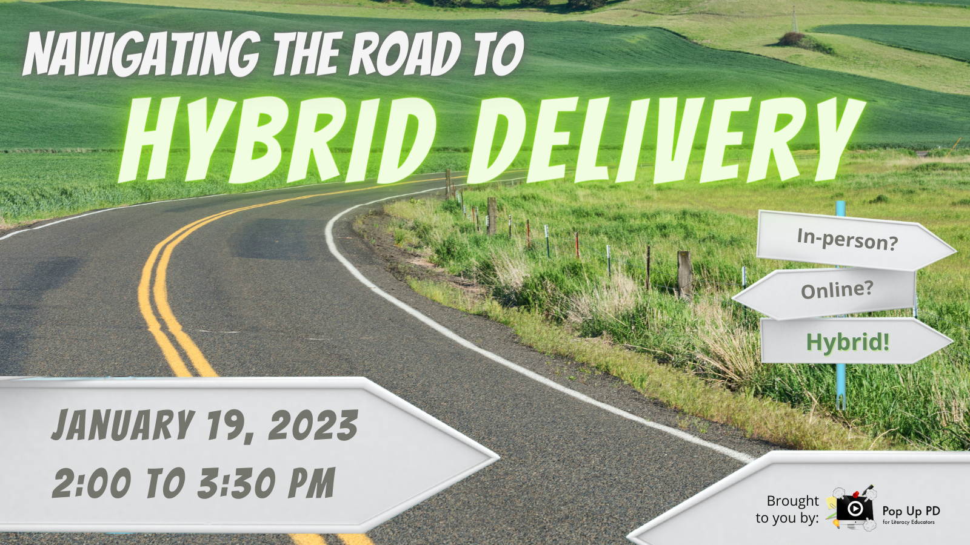

Slide 2
Statement of Land Acknowledgement
I would like to begin by acknowledging the Indigenous Peoples of all the lands that we are on today. While we meet today on a virtual platform, I would like to take a moment to acknowledge the importance of the lands, which we each call home.
We do this to reaffirm our commitment and responsibility in improving relationships between nations and to improving our own understanding of local Indigenous peoples and their cultures. From coast to coast to coast, we acknowledge the ancestral and unceded territory of all the Inuit, Métis, and First Nations people that call this land home.

Slide 3
About Pop Up PD for Literacy Educators
free webinar series developed by Ontario’s LBS Regional Networks & the Provincial Support Organizations for Literacy
supports LBS practitioners with presentations on topics important to them
English language webinars presented for LBS practitioners annually since 2015-2016; French language transcriptions coming soon!
all webinar presentations, recording links & transcripts here:
  Pop Up PD Resources for LBS Educators
webinar topic ideas welcome at: e-channel@contactnorth.ca

Slide 4
Our Panelists
Lisa McArthur, Program Manager, The Literacy Group
Lori Sheppard , Team Leader, and Brenda Ryan, LBS Instructor, Lambton Kent District School Board
Bradie Granger, Chair of Schools of Justice & General Studies, Cambrian College of Applied Arts & Technology
Jane Tuer, Executive Director, Project READ Literacy Network

Slide 5


Panelist:
Lisa McArthur
Program Manager
The Literacy Group

Slide 6
TLG Hybrid Summary
Quick rundown of TLG’s Hybrid experience:
Organizational
Wider Community
Learners
Computer Training
Tutors
Professional Development
Investments in Tech

Slide 7
Organizational
Staff huddle
Coordinator Meetings
Board Meetings
Events (Learner Celebration was fully Hybrid)
Offering services face-to-face and online, e-channel and our own sync/async programming
Training to transition from face-to-face to online for those who want it
Multiple pro-Zoom (8) accounts to host simultaneous meetings across all aspects TLG.
Laptops, phones, desktops, smartboards, projectors

Slide 8
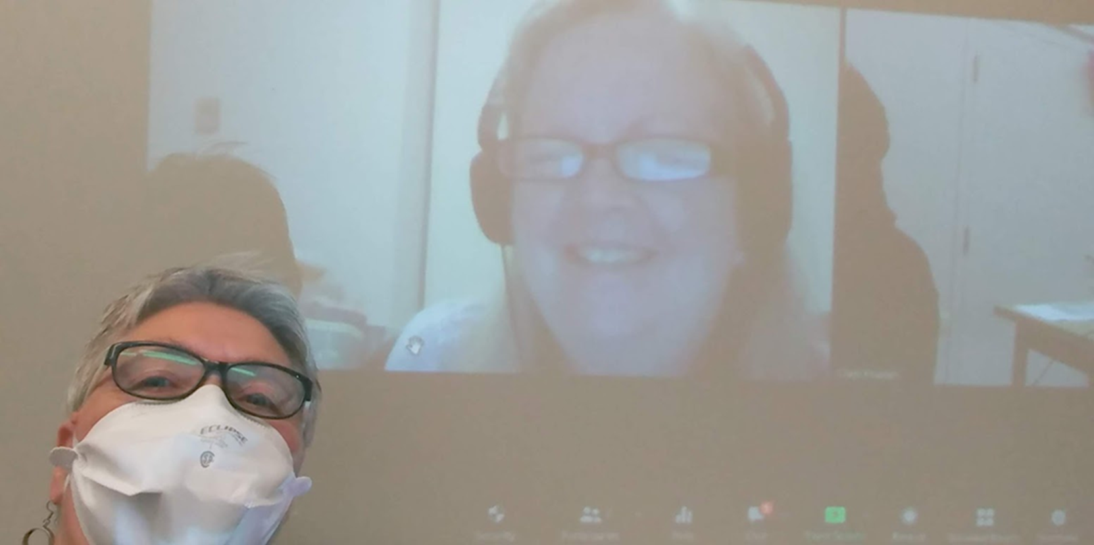
Learner Celebration Event

Slide 9
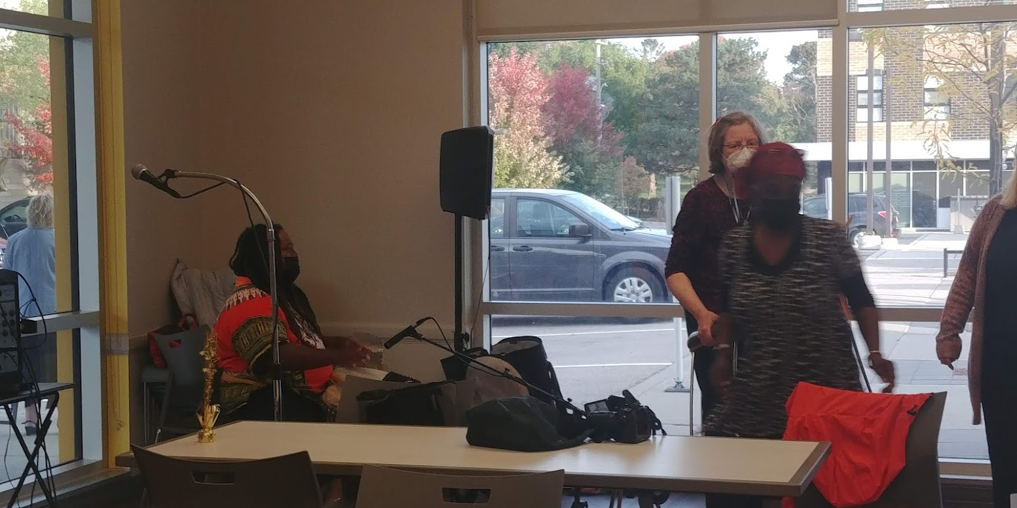
Learner Celebration Event

Slide 10
Wider Community
Partnering with other orgs who may not have access or capacity to create online resources
Providing training and resources (free and/or small cost)
Hosting a library of resources to share with LBS in Google Drive
Will share internal documents (forms, templates etc…)
Our Learner Portal is free to everyone
Learner Portal updates coming with more game-based learning options

Slide 11
Learners
Intake
Teaching
Assessment including Milestones and Culminating tasks
Staff and tutors
One-to-one and groups
Core and Modular
  Zoom, face-to-face, digital, on paper, google forms, fillable PDFs
  TLG Learner Portal - AlphaPlus mentoring
  Hybrid for groups of learners, single learners and within a program
  Learners can come into TLG and zoom into any of our classes using our hardware and internet
  OneRoof and Customer Service Hybrid

Slide 12
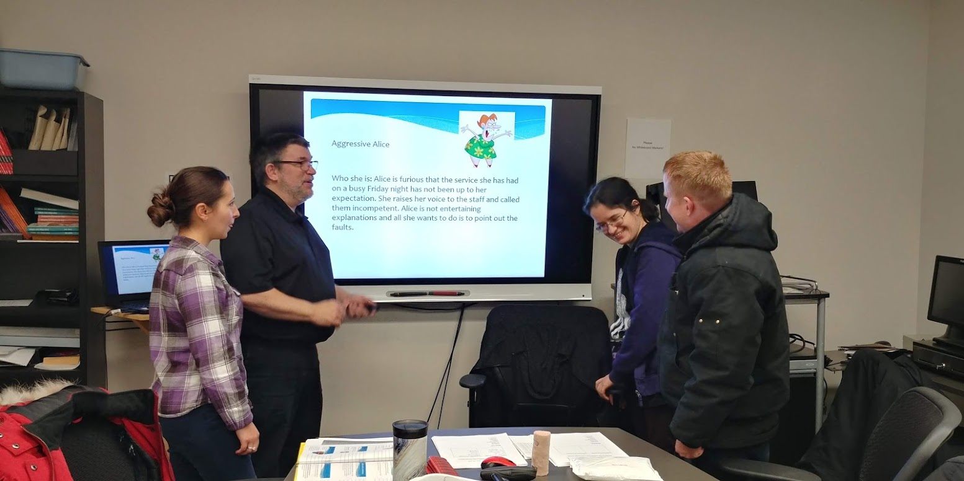
Feb 2020

Slide 13
Computer Training
Intake in person or online
Teaching in person or online
Learners who can transition quickly to online do so to increase flexibility of schedule
Learners who can transition also get the benefit of using training supports for hardware
It also prepares them to transition to E-Channel when they are ready
Those who need in-person for the duration, get in-person for the duration
Assessment including Milestones and Culminating tasks
Staff working in person** and volunteers working online—Explore contracts
One-to-one and groups (of 3 max)
Northstar Digital Assessments both in person and online

Slide 14
Tutors
Streamlined application process with all documents available online
Zoom interviews with two staff
Expanded Volunteer roles to capitalize on skills, availability and interest (9 separate roles)
  Zoom, face-to-face, digital, on paper, google forms, fillable PDFs
  Contact North & in-house TLG online training
  Encouraging virtual PD that would normally only be available to staff
  Develop Google Sites with set curriculum that allows tutors access to standardized and curated resources
  All Tutor intake is available face-to-face and on paper (AODA) however, all learner plans involve blended learning, so there is an expectation for tutors engage in some digital learning and tutoring.

Slide 15
Professional Development
We have been providing lots of PD internally, to tutors, to other orgs and other LBS
Receiving PD from LNO, Contact North, AlphaPlus, Decoda
Encourage tutors to participate rather than us have to retrain
Change management training/consortium for Chris and Lisa (CRITICAL)
Allocating staff to sit on committees and round-tables rather than management alone

Slide 16
Organizational Investment in Tech
AlphaPlus mentoring—If you haven’t taken advantage of them DO IT NOW
If you don’t have the capacity to engage a tech company to do your servicing and IT find a way to join forces with someone else in your network
Engage volunteers with tech knowledge and interest and contract them if you can
Teaching online---Use a second screen—you will never go back to a single one
Looked at the Meeting OWL—still not convinced it is good for teaching

Slide 17
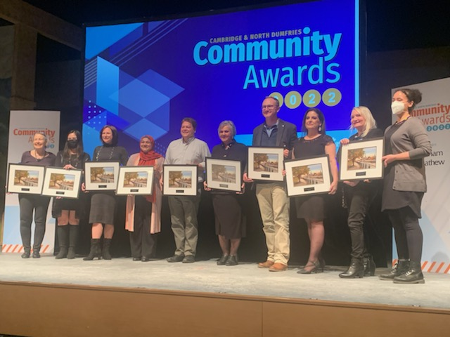
Innovation in Learning Award 2022

Slide 18
Panelists
Lori Sheppard , Team Leader, Lambton Kent District School Board
Brenda Ryan, LBS Instructor, Lambton Kent District School Board

Slide 19

HYBRID LBS DELIVERY
Intake and Assessment
    1st welcome email contains links to intake forms via google forms
    2nd email has the school board registration forms if not already completed (which are necessary to be enrolled in the school board’s e-learning platform
    Forms are saved in student’s digital file
    Most students do come in-person for PRF and signatures
    LP is dated when they log in to the upgrading platform
Notes:
Potential question may be – follow up re SIN and avoiding emails about SIN etc
First emails for intake are followed up

Slide 20
Hi_______________ ,
My name is, and I am one of the Intake Instructors of the Upgrading Program at____________________(Alternative & Continuing Education Centre).
We offer free, online and in person upgrading program in math, writing, reading, goal setting/manage learning and computers. Each subject is self-paced, so you can work on your own schedule. Each subject is also monitored by a teacher who can help you with the course and answer questions. Many students find our upgrading programs helpful to work on important skills like sentence structure, essay writing, or to refresh their math skills such as decimals and fractions.
Depending on your educational goals, upgrading can help you prepare for the PLAR Tests (Grade 9/10), prepare to take a high school credit course, or to prepare you for a Trades/Apprenticeship test. Below are 5 assessments to see where your skills are and once that is returned to us, we could enroll you in the subject(s) you need and connect you with a teacher.
Please let me know when you have completed the following assessments.
Please complete the following math assessment, without using a calculator.
MATH
Please write a long paragraph as a sample of your writing.
WRITING
Please read this short story and answer the questions in complete sentences.
READING
This assessment is asking questions about how you manage your time and setting goals:
MANAGE LEARNING
This is a survey of what you know about computers and what you would like to learn:
COMPUTERS
Notes:
Example intake email sent to student - may be registering fully online or have been in to register at the centre

Slide 21
Assessment in Hybrid
Model
    Initial assessments are set up as google forms which get submitted as soon as they are completed
    Ongoing assessments are set up as quizzes or assignments in Brightspace
    Milestone tasks are set up as activities in Brightspace
    Students can transition between online platform to in-person at any point
    Milestones and learning tasks can be delivered in either mode

Slide 22
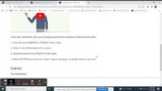
Hybrid Upgrading Online
Brightspace Platform Video
Notes:
MS 14 is versatile!

Slide 23
Engagement Tools
Subject: Assignment Submission: Budgeting Video Assignment
CAUTION: This email originated from outside of the organization. Do not click links or open attachments unless you recognize the sender and know the content is safe. Please contact the Helpdesk if you are unsure.
Assignment Submission Complete:
Submission ID: 83807795
Course Offering Code: EL_OTH_SNB_Measurement-08_993034_1920
Course Offering Name: Upgrading - Understand and Use Numbers
Assignment: Budgeting Video Assignment
User: Lori Sheppard
Lori Sheppard
This email is to confirm that your submission to assignment folder Budgeting Video Assignment was successful.
Submission ID: 83807795
Received: Tuesday, November 29, 2022 9:41 AM EST Org Unit: Upgrading - Understand and Use Numbers
File(s): Budgeting Video Assignment-Nov 29, 2022 941 AM.html (23 Bytes)
Notes:
Instructors receive immediate notification when a learner has completed a task/activity in the online platform

Slide 24
Exit Methods
  Exit is determined with the learner
  When learner completes all the competencies listed in the learning plan, just like in person, the learner exits – credit, employment, apprenticeship, independence, post-secondary
  If the learner has not logged in within two to three weeks: check in email, phone contact to determine if learner needs to transition to in-person
  Offering video chat – Teams, Zoom, Google Meet

Slide 25
Challenges and Benefits
Challenges | Benefits
Not as much teacher contact Decreased personal rapport building with learners Learners have a hard time creating a routine/time management Some students don't communicate/ask questions/follow through Expected teacher availability 24/7 | -Meets the needs of more learners: remote location, working, home- bound -Students can work around schedules (night owls!) -Videos are a great resource (Khan Academy) -Instructors are still available to help -Instructor led videos Inserting vast variety of resources Instructors can transition with learners through both online and in-person
Notes:
Emails – out of office emergency numbers etc answered the challenge of the 24 – 7 , Intelligent agents in the platform, racking sheets for instructors

Slide 26
Learner Experience
“The upgrading program has benefited me in a way to get me prepared for my senior college level math courses. Being able to do it online has been greatly beneficial to me because I have been able to stay at home with my children. Also, not being able to make it to Sarnia has kept me from doing this program in the past. I am thankful for this program.”
Katie Bell

Slide 27
Panelist
Bradie Granger, Chair of Schools of Justice & General Studies, Cambrian College of Applied Arts & Technology

Slide 28
Hybrid Delivery at Cambrian College
Cambrian College is medium sized college in Sudbury, Ontario with two satellite campuses nearby
Academic Upgrading supports 200 learners at any given time moving towards post-secondary education, apprenticeship or employment pathways
We are the largest city geographically in Ontario with many surrounding rural areas as you can imagine the northern geography of the province
The pandemic moved us along at lightning speed in regards to hybrid delivery
Hybrid delivery made possible by digitizing Intake through Completion

Slide 29
It Takes a Village
All course material available in multiple modes – textbook, digital, accessible (text to speech/large print), online
Faculty available online, virtual, email, in person
Advising, Intake and Support available in person, by phone/email, Zoom/Teams
Workshops and other events available live in person or via remote platform Moodle afterwards
Centralized Inboxes and Communication processes
Digitized processes for PRF’s, referrals, withdrawals, completions, Milestones, Culminating Activities, Exit Surveys, etc…

Slide 30
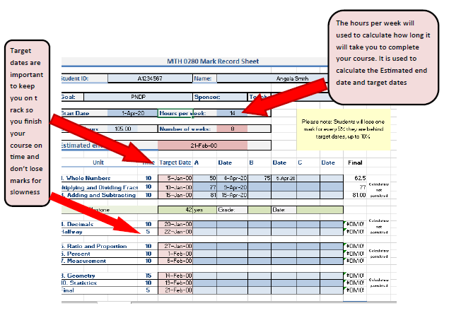
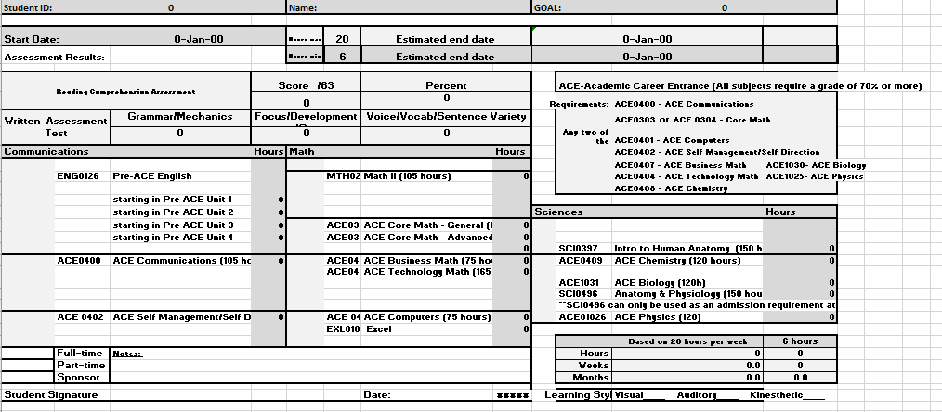
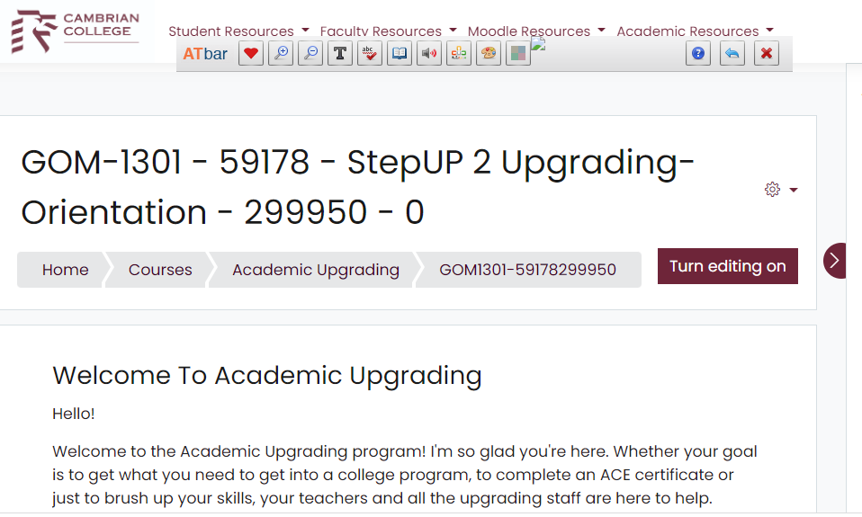
Hybrid Content

Slide 31
Panelist
Jane Tuer, Executive Director, Project READ Literacy Network

Slide 32
The “How To” of Hybrid Meetings
Literacy Network Durham Region
Literacy Network Northwest
Project READ Literacy Network

Slide 33
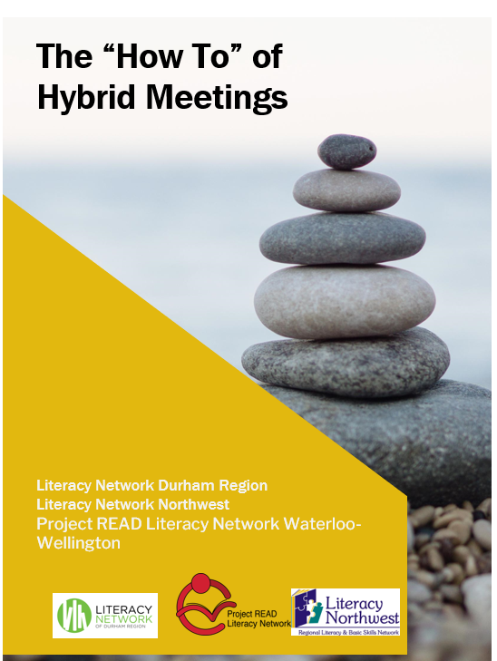
https://projectread.ca/tools-and-resources/practitioner-resources/publications/

Slide 34
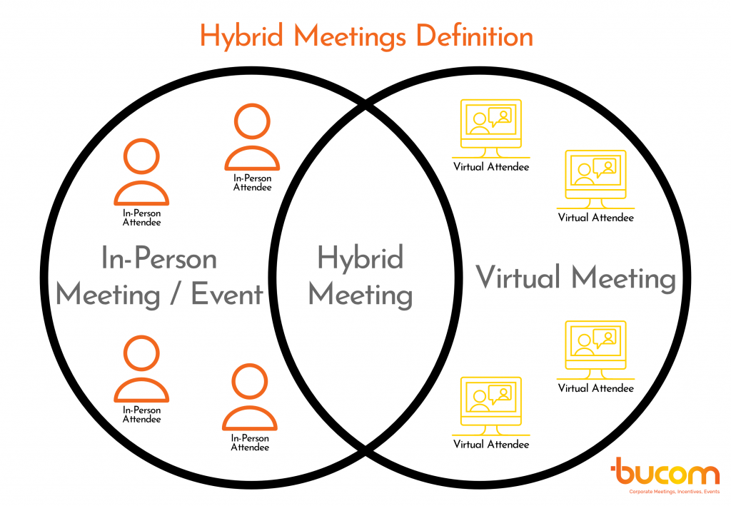
Definition of Hybrid Meetings
Hybrid meetings are meetings or events that feature at least one group of in-person/face-to-face attendees connecting virtually with other meeting attendees. These meetings are always synchronous.

Slide 35
Surveyed the support networks
Over 2/3 had not run hybrid meetings
Less than ¼ do not plan to run hybrid meetings
For those that had run hybrid meetings:
40% found in-person and online felt engaged
40% found in person were engaged and online found it more challenging
20% in-person and online both found it more challenging

Slide 36
Best Practices
Determine purpose and style
Identify moderator/Bridge moderator/Technical Support
Equipment
Send agendas out ahead
Create structure
Share documents ahead
Inform everyone they are being recorded
Reduce audio feedback/eliminate background noise
Participants (don’t multi-task)
Evaluate

Slide 37
Best Technologies for Hybrid Meetings
Platforms
Cameras
Microphones
Monitors

Slide 38
Budget
Low – 0 to 100 Participants
Medium
High

Slide 39
Thank you
Happy Hybridation!!!!
Questions?

Slide 40

Thank you!
Webinar resources: Pop Up PD Resources for LBS Educators
Webinar evaluation: https://tinyurl.com/4zybjbvb

