Slide 1
Webinar Title
((DATE))
Notes:
Barb Glass: Good afternoon everyone. It is wonderful to be online with you all today. I am grateful that we have a chance to connect through our Pop Up PD webinar series. This is the final webinar in the series for this 2021-2022 fiscal year. We hope that we will be able to bring you more webinars in the future.
Today, we are going to talk about and learn about this concept of micro-credentials that we are hearing more about in the educational landscape, not only in Ontario but elsewhere as well.
When we wrote the workshop description, we used the W-5 approach: who, what, when, where, why. We will address those questions around who delivers and where. In a minute, I will share the general organization of today’s webinar, but we will first take care of some housekeeping item.

Slide 2
About Pop Up PD for Literacy Educators
free webinar series developed by Ontario’s LBS Regional Networks, Sectors, & the Provincial Support Organizations for Literacy
supports LBS practitioners with presentations on topics important to them
English language webinars presented for LBS practitioners annually since 2015-2016; French language transcriptions are available on COFA’s website!
all webinar presentations, recording links & transcripts here:
https://e-channel.ca/practitioners/pop-pd-resources
webinar topic ideas welcome at: e-channel@contactnorth.ca
Notes:
As I mentioned, this is the final webinar in this year’s series. Many of you have probably attended others. I wanted to thank Sarah Stocker for providing technical support, and I would also like to welcome our two ASL interpreters today, Rebecca and Caroline.
On the screen now is our “about” screen that we show at every session. As always, if you do have ideas about webinar topics, please send an email. We are always looking for timely and interesting topics, and we’ll be planning for next year soon!

Slide 3
1. Welcome and Land Acknowledgement
2. What is a micro-credential (MC)?
3. Micro-credential Q and A – 7 Topics
4. Trends – Internationally and in Canada
5. Trends/Next Steps in Ontario
6. A Few Thought on LBS
7. Questions and Summary
Outline for Today’s Webinar
Notes:
Briefly, this is an outline of how we are going to attack this topic today. We’re in the middle of #1 now! We’ll also talk about the many different definitions of micro-credentials, then have a Q&A. Because this is such a huge and emerging topic, we’ll also look at what is going on around the world in terms of micro-credentials and then zone back in to what’s going on in Ontario. We’ll bring in some thoughts on LBS at the end, and finish up with questions and a summary.
I encourage you to ask any questions throughout the webinar. I will keep an eye on the chat along with my colleagues Gay from Literacy Niagara and Heather from QUILL network, who are here with me today as co-moderators and facilitators. Between us, we will be happy to address your questions in the chat.
Just before we get into the agenda, I do want to mention that the topic of micro-credentials is very broad, so this is largely an informational webinar. There are a couple of times when I will ask you to type some thoughts into the chat, but I just want you to be aware that there is a fair bit of information that I have tried to piece together in a coherent way. You’ll also see that there are a lot of sources referenced throughout the webinar, because there is so much information available on micro-credentials that there is no reason for me to recreate anything. It is best to go to some of the sources who are becoming experts in the field, so most of what I am going to share with you today is a compendium of a lot of different pieces of information.

Slide 4
I would like to begin by acknowledging the Indigenous Peoples of all the lands that we are on today. While we meet today on a virtual platform, let’s take a moment to acknowledge the importance of the lands, which we each call home. We do this to reaffirm our commitment and responsibility in improving relationships between nations and to improving our own understanding of local Indigenous peoples and their cultures. From coast to coast to coast, we acknowledge the ancestral and unceded territory of all the Inuit, Métis, and First Nations people that call this land home.
Notes:
As we get into the formal part of the webinar, I would like to begin by acknowledging the Indigenous Peoples of all of the lands that we are on today, and we are on many different Indigenous lands across the province. While we meet today on a virtual platform, let’s take a moment to acknowledge the importance of the lands which we each call home. We do this to reaffirm our commitment and responsibility in improving relationships between nations and to improving our own understanding of local Indigenous peoples and their cultures. From coast to coast to coast, we acknowledge the ancestral and unceded territory of all the Inuit, Métis, and First Nations people that call this land home.

Slide 5
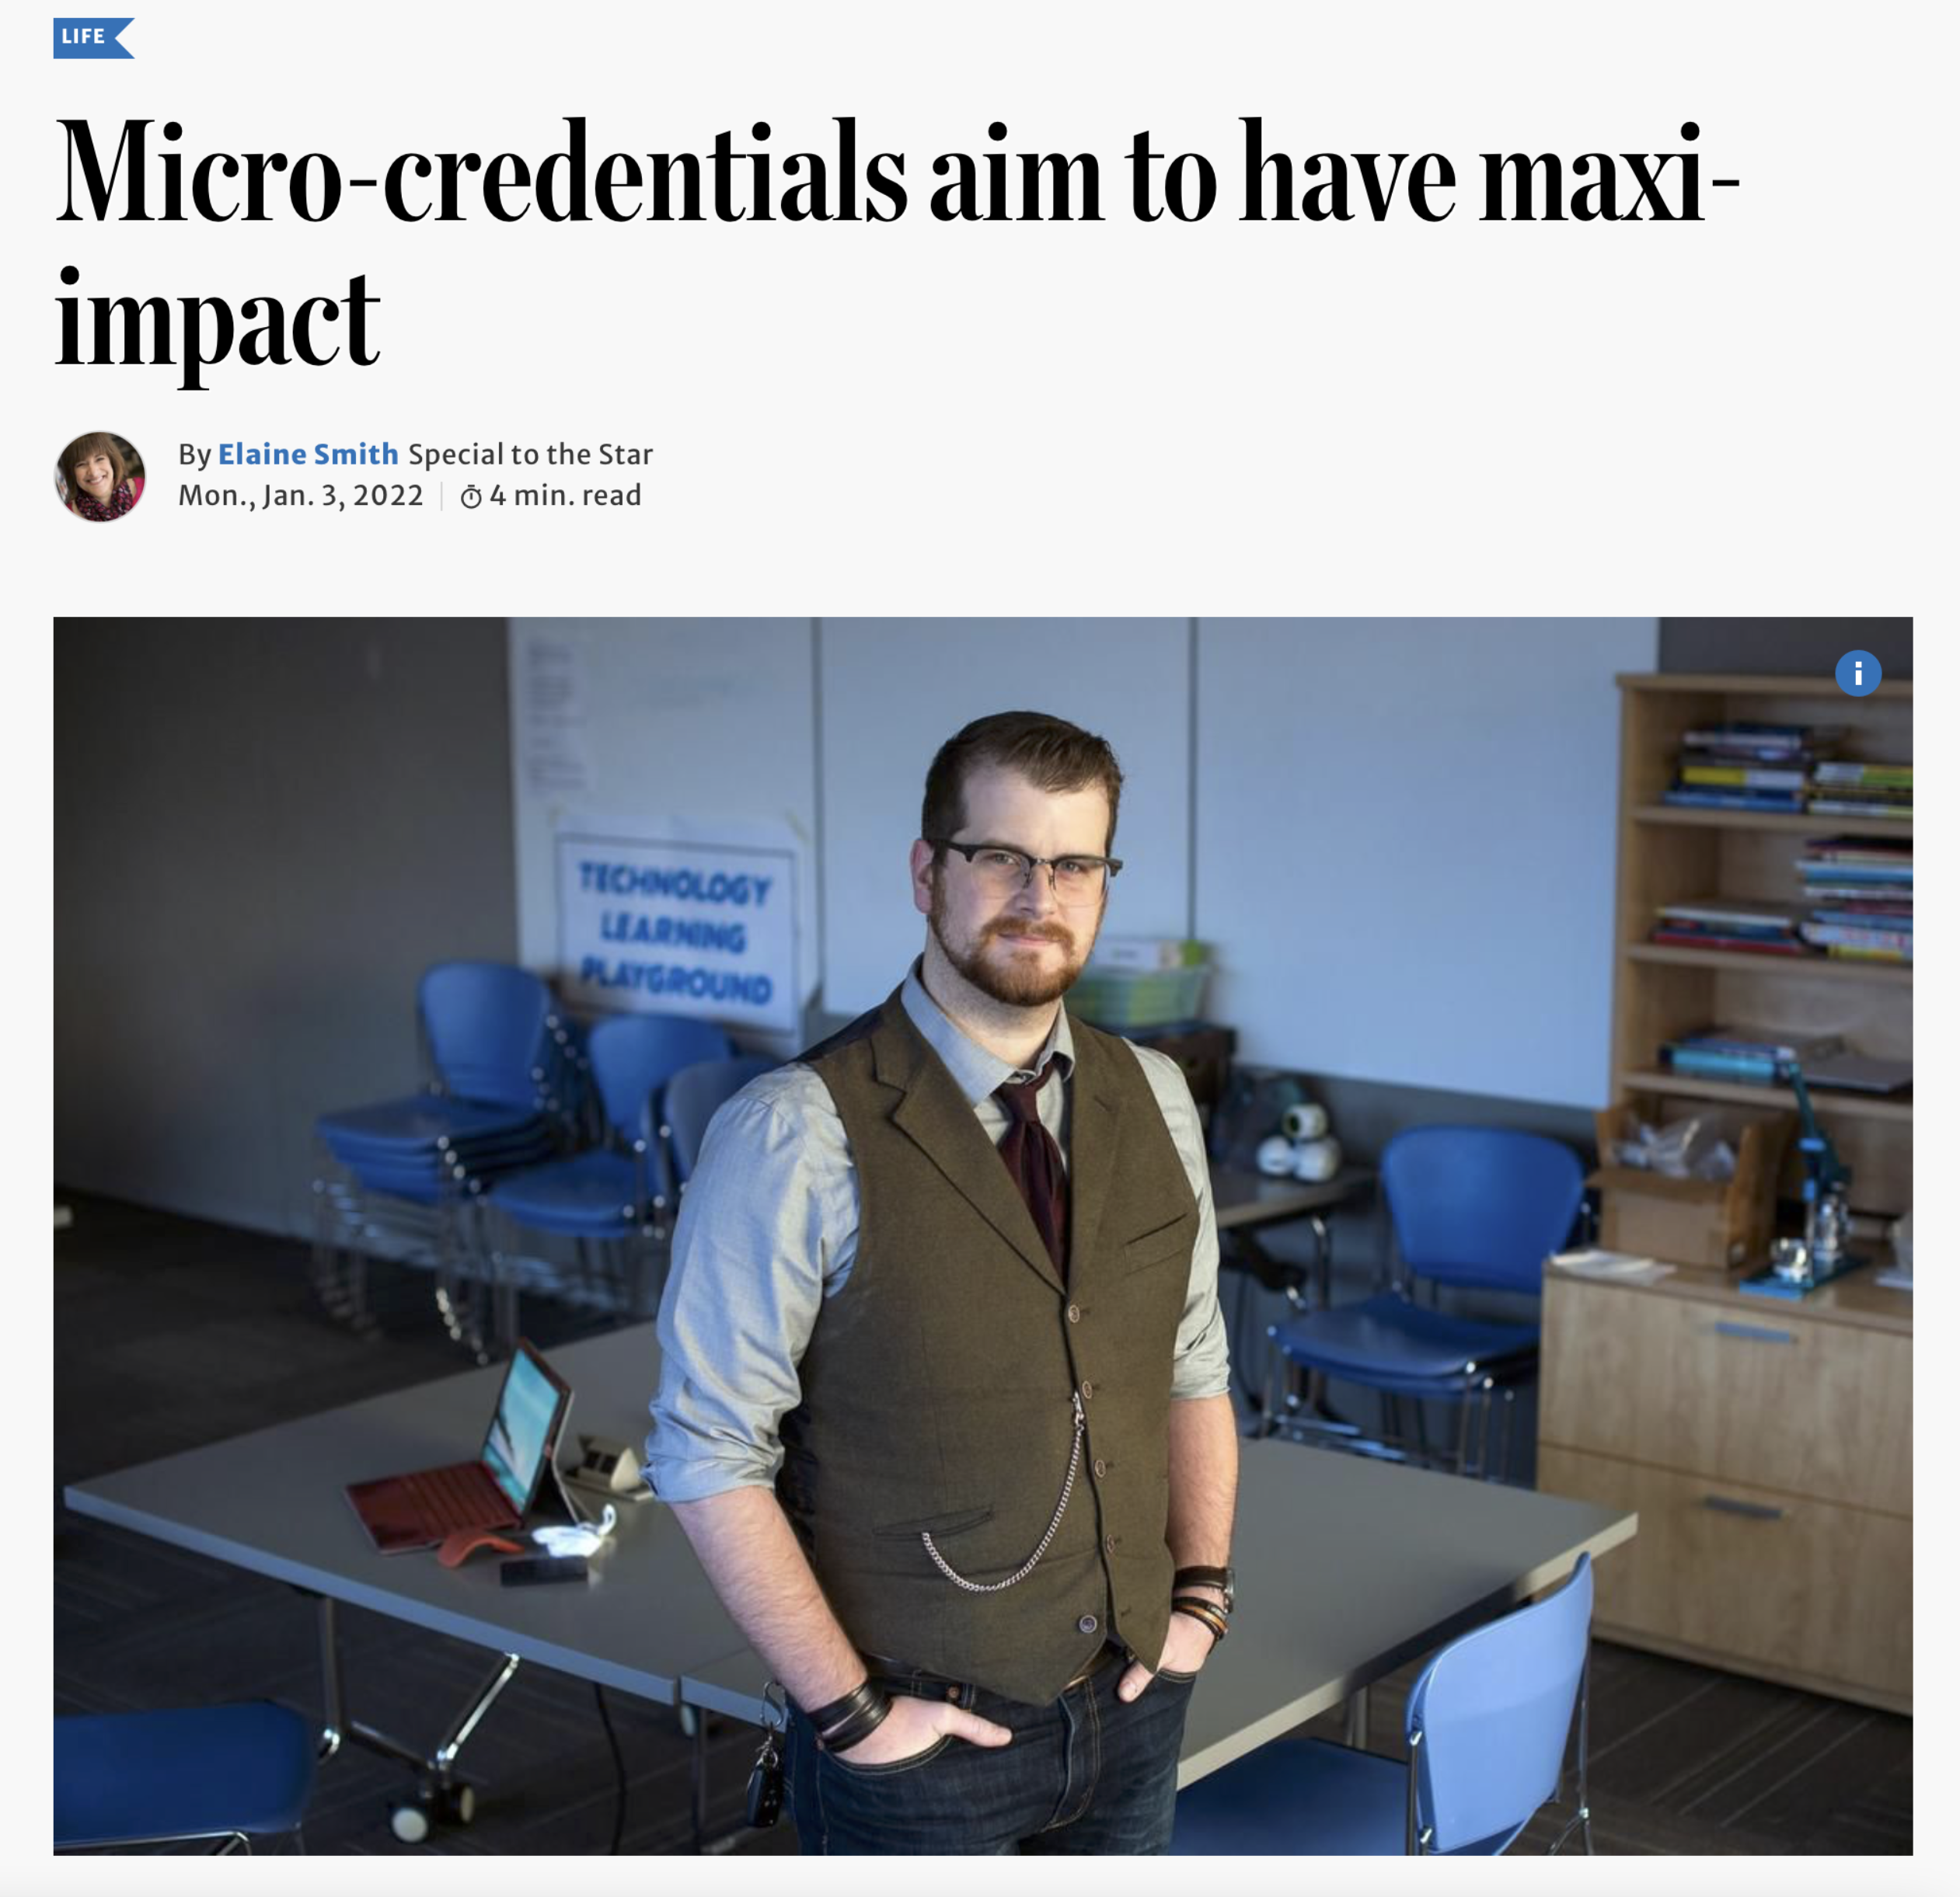
Micro-credentials are in the news! Toronto Star, December 28, 2021 “Why not do it, put it on my resumé and incorporate it into my teaching practice as best I can?” asked Hance. “Education is headed toward these new ideas, so let’s get on board. It could be the difference when it comes to getting a job.”
Micro-credentials aim to have maxi-impact by Elaine Smith, The Toronto Star, December 28, 2021
https://www.thestar.com/life/2022/01/03/micro-credentials-aim-to-have-maxi-impact.html
Notes:
Micro-credentials have been in the news, and you may have seen a few things in the news lately. I have pulled out a couple of articles, one of which I will reference at the beginning and the other a bit later on. They are quite recent. This one is from The Toronto Star and appeared in December 2021. It talks about some of the practical impacts of micro-credentials. The person interviewed for the article is a recent grad from Teacher’s College doing his teacher training, and he decided to take a micro-credential in computer coding. One of his quotes from the article is “Why not do it, put it on my resume and incorporate it into my teaching practice as best I can? Education is headed toward these new ideas so let’s get on board. It could be the difference when it comes to getting a job.”
By way of context, these first few slides are meant to place micro-credentials in our minds in the way the public might be seeing them. We as educators might be seeing them a different way.
I also wanted to mention that you will see the term “micro-credentials” with the hyphen, without the hyphen as one word, and you’ll also see it as two separate words. As a newer term in the English language, people are still trying to nail down the correct spelling. It reminds me of ”post-secondary” which you see spelled different ways. So they aren’t typos if you see it spelled differently on the slides, I have kept it true to the spelling in the original source.

Slide 6
Micro-credentials are in the news! MacLean’s, October 26, 2021 “Spanning a range of skills and industries, microcredentials cover everything from data literacy and computer-aided design to reading blueprints and advanced wilderness first aid. Length is one major feature that distinguishes microcredentials—which run eight to about 200 hours—from other types of courses, though some educators think the way they’re assessed is a more important factor. Misheck Mwaba, president and CEO of Bow Valley College, says the fact that employer-defined competencies are used by post-secondary institutions in evaluating student performance is critical. “Without authentic assessment, there is no microcredential,” says Mwaba.
https://www.macleans.ca/education/microcredentials-a-mini-guide-to-the-micro-college-course-market/
Notes:
This next article is from MacLean’s, and it’s a mini guide to the micro college course market. I pulled a quote: “Spanning a range of skills and industries, microcredentials cover everything from data literacy and computer-aided design to reading blueprints and advanced wilderness first aid.” (That’s something I haven’t heard of)
“Length is one major feature that distinguishes microcredentials—which run eight to about 200 hours—from other types of courses, though some educators think the way they’re assessed is a more important factor. “ (We’ll talk more about assessment later)
Misheck Mwaba, president and CEO of Bow Valley College in Alberta, says the fact that employer-defined competencies are used by post-secondary institutions in evaluating student performance is critical. “Without authentic assessment, there is no microcredential.” Some of you might remember Misheck. He was a Dean at Niagara College, and I worked with him when I was there. It was interesting to see him named and quoted in a couple of these articles. Hi statement, “Without authentic assessment, there is no microcredential” is a key feature that we will look at today.
I apologize for the small print on some of these slides, but with screenshots, it can be hard to make the print a bit bigger

Slide 7
2. What is a micro-credential (MC)?
Notes:
Let’s delve into this big, somewhat open-ended question about what is a micro-credential. I am going to share a few definitions from sources in Ontario, and you will see that there are some common pieces and some slightly different pieces as we work through the definitions.

Slide 8
What is a micro-credential?
(There are MANY definitions and descriptions…)
What are some words or terms you would use to describe the concept of micro-credentials?
Type into the chat!
Notes:
Here is one of the places where I will invite you to share your thoughts in the chat. When you think of micro-credentials – and there is no wrong answers here – what are some of the words that come to mind to describe a micro-credential?
People are adding their thoughts to the chat: short program, module, condensed, short, quick, focussed, timely, no frills certification, short recognized course, short term training, short term practical courses, great start, immediately applicable, industry specific, professional, short course with credit, mini course, PD, skills blast, rapid training, certificate at the end based on practical skills, recognition.
Maybe we don’t really need this webinar, because I think you have a good idea of what micro-credentials are! It’s wonderful to see that we have some basis of knowledge and a bit of familiarity in our audience today with what micro-credentials are. It’s really hard to have not yet run across something to do with micro-credentials in this last couple of years if one is an educator, at whatever level. Thanks for sharing your thoughts.

Slide 9
Definitions from…
Government of Ontario (Ministry of Colleges and Universities)
Higher Education Quality Council of Ontario (HEQCO)
e-Campus Ontario
Contact North|Contact Nord
Watch for common phrases or features…
Notes:
I will share some definitions with you from four organizations in Ontario: the Ontario government, the Higher Educational Quality Council of Ontario, e-Campus Ontario and Contact North. As we walk through those definitions, keep an eye out for some of the common phrases or features, some of which you identified in the chat. There is definitely overlap, but it’s interesting how the definitions are slightly different depending on the context, especially of the organization. None or specifically wrong or right, they are just a little different.
I will tell you about each organization briefly so you understand their context.

Slide 10
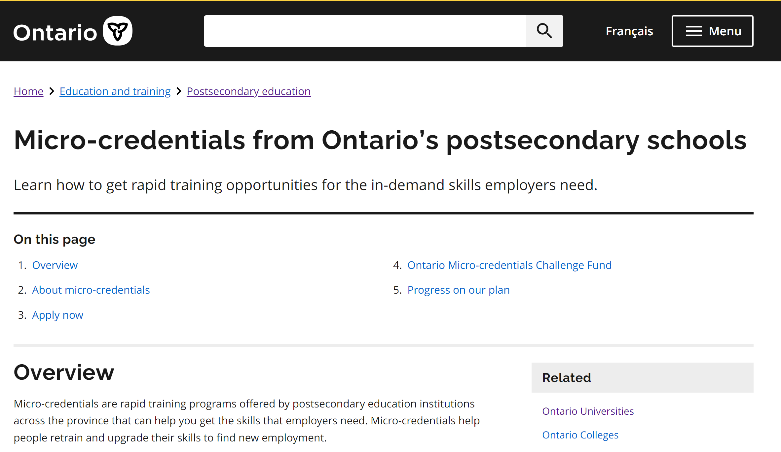
Notes:
Of course we understand the context of the Ontario government. This is their public-facing micro-credentials site. Currently, the Ministry of Colleges and Universities, along with the Ministry of Labour, Training and Skills Development, is embarking on a micro-credential strategy. I will provide you with a bit more information about the actual strategy at the end, but here is the government’s definition.

Slide 11
Ontario Government’s definition:
Micro-credentials are rapid training programs offered by postsecondary educational institutions across the province that can help you get the skills that employers need.
Micro-credentials help people retrain and upgrade their skills to find new employment.
https://www.ontario.ca/page/micro-credentials-ontarios-postsecondary-schools
Notes:
Micro-credentials are rapid training programs offered by postsecondary educational institutions across the province that can help you get the skills that employers need. Micro-credentials help people retrain and upgrade their skills to find new employment.
I’m not making any judgments here, I’m just providing some alternate definitions.

Slide 12
Notes:
Next we have HEQCO which is a government-funded organization, and I’m going to read a statement that appears on the “about us” portion of their website. HEQCO was created through the Higher Education Quality Council of Ontario Act 2005, so they are a legislated organization. “HEZCO is an agency of the Ontario Government that brings evidence-based research to the continued improvement of the post-secondary education system in Ontario.”
HEQCO has a lot of irons in the fire when it comes to micro-credentials.

Slide 13
HEQCO’s definition:
A micro-credential is a representation of learning, awarded for completion of a short program that is focused on a discrete set of competencies (i.e., skills, knowledge, attributes), and is sometimes related to other credentials.
https://heqco.ca/pub/making-sense-of-microcredentials
Notes:
Here is their definition, which is a bit different from the government’s. ”A micro-credential is a representation of learning, awarded for completion of a short program is is focused on a discrete set of competencies (i.e., skills, knowledge, attributes) and is sometimes related to other credentials.” What’s interesting in this definition is that they bring in the notion of micro-credentials sometimes relating to other credentials, which is very true.

Slide 14
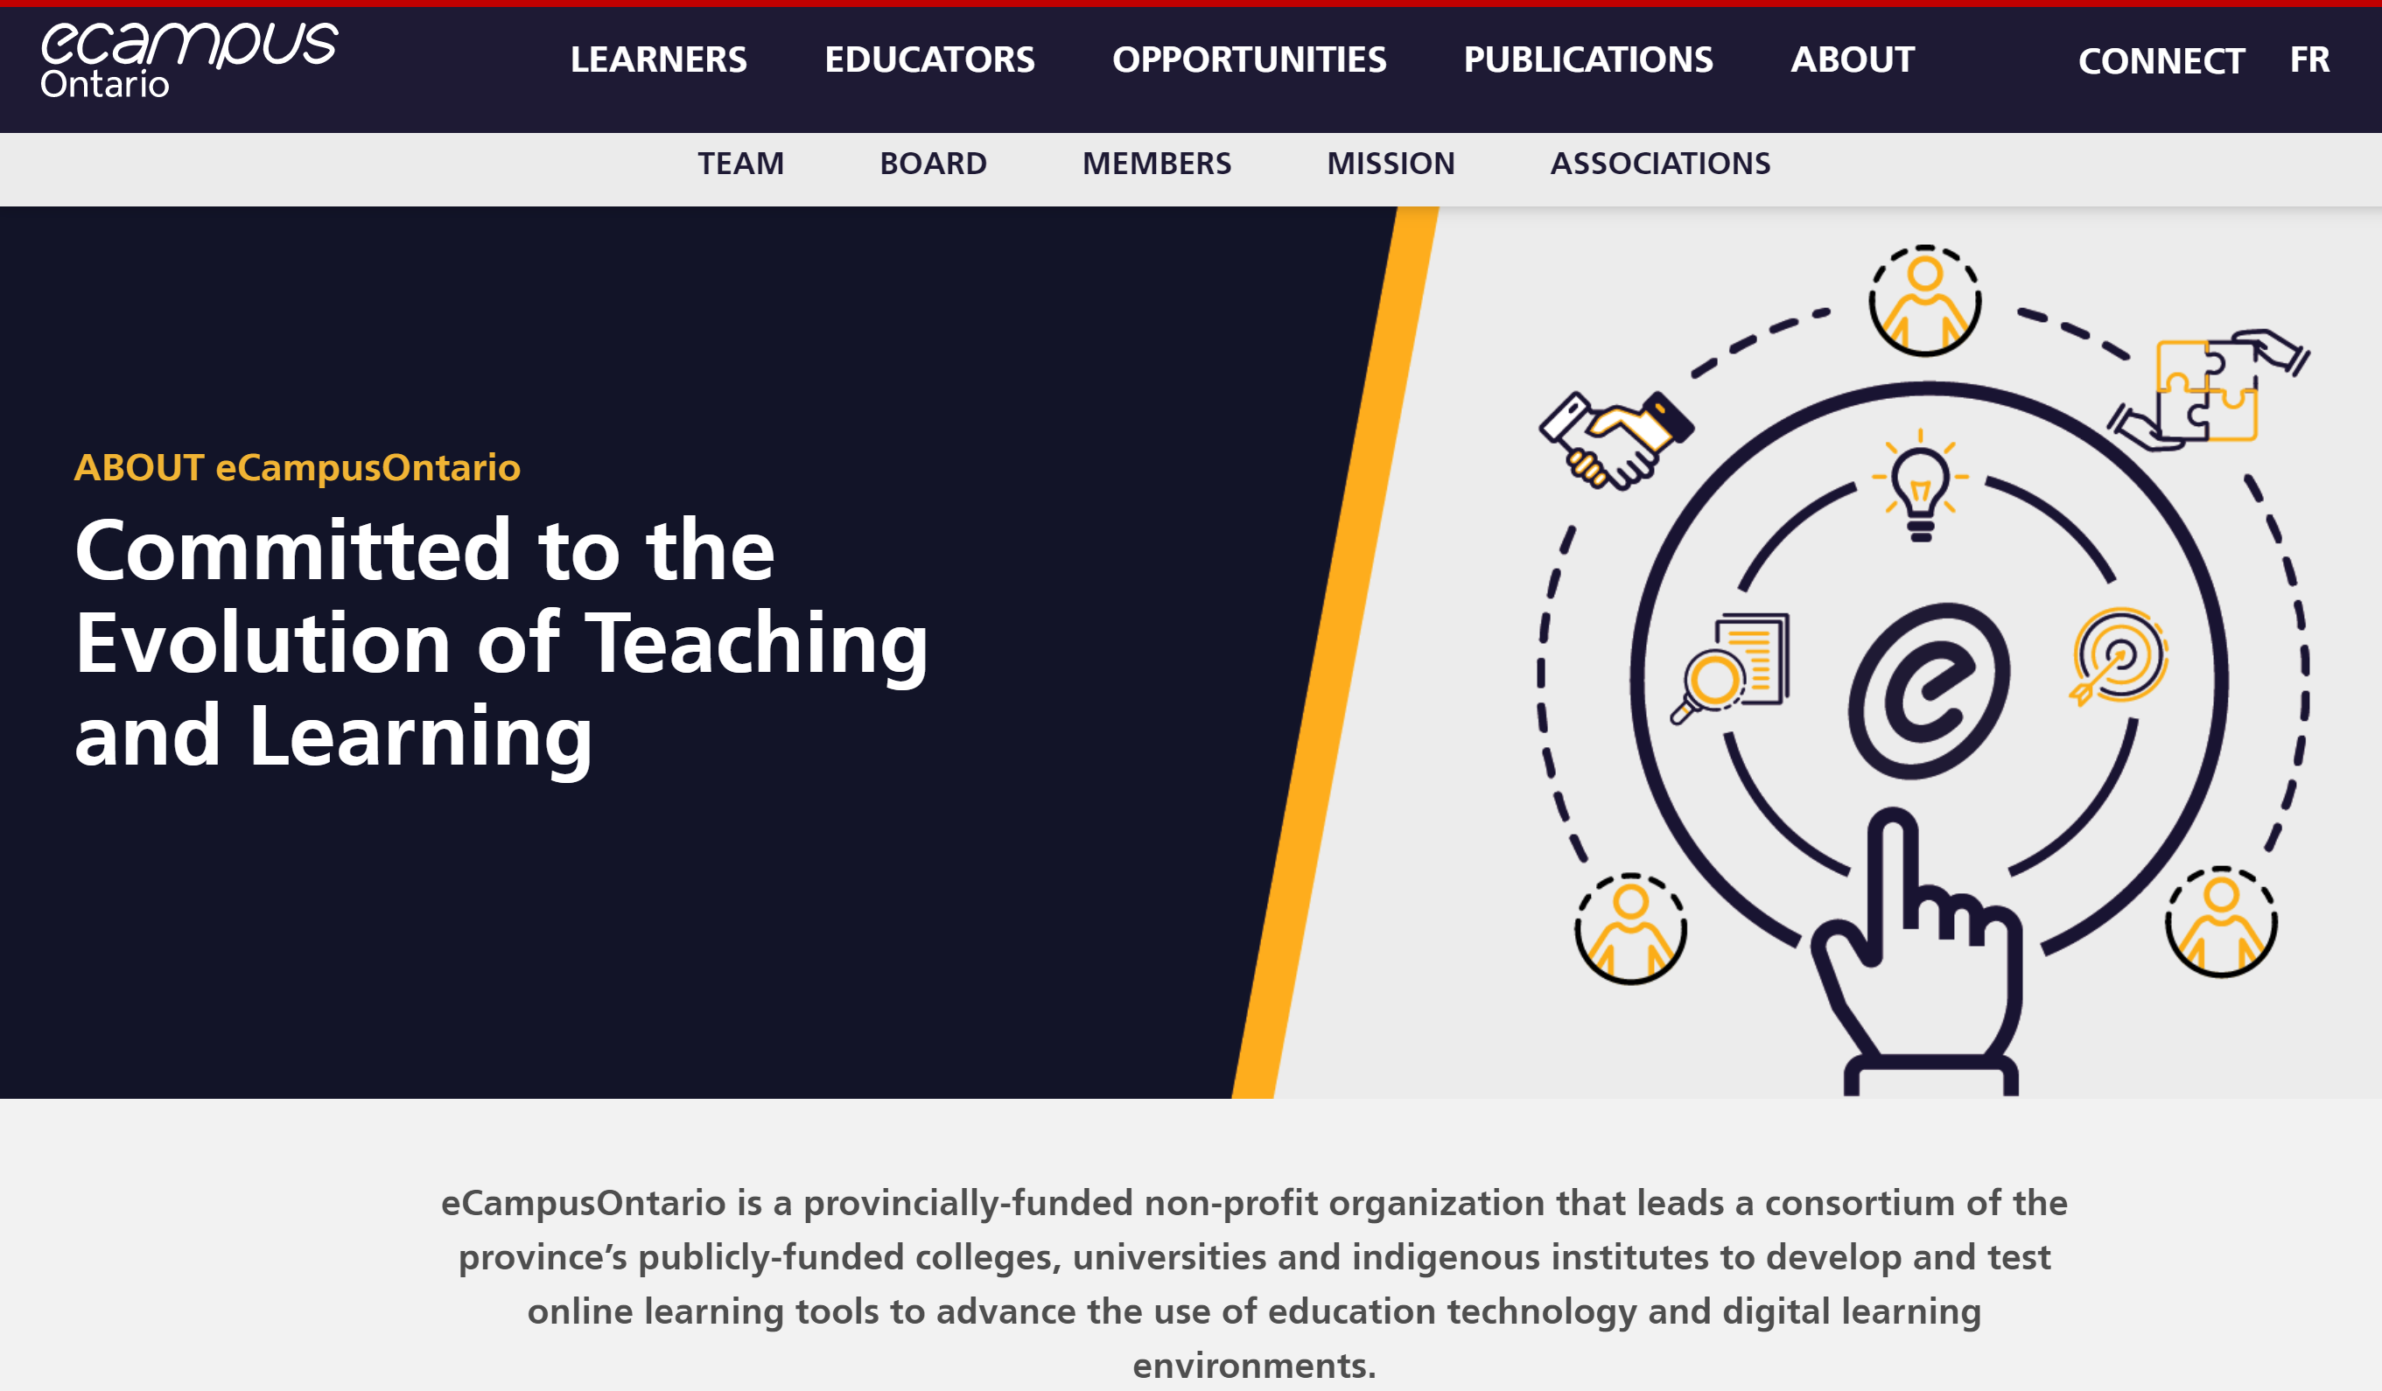
Notes:
Next up on our definitions stage is eCampus Ontario. eCampus is also a government-funded organization in, and I’ll read just a bit about them from their “about” statement. “eCampus Ontario is a provincially funded non-profit organizations that leads a consortium of the province’s publicly funded colleges, universities and Indigenous institutes to develop and test online learning tools to advance the use of educational technology and digital learning environments.” That’s the sentence that you can see in small print at the bottom.

Slide 15
eCampus Ontario’s definition:
A micro-credential is a certification of assessed learning associated with a specific and relevant skill or competency. Micro-credentials enable rapid retraining and augment traditional education through pathways into regular postsecondary programming.
https://www.ecampusontario.ca/micro-certifications/
Notes:
So what eCampus Ontario has to say is the following: ”A micro-credential is a certification of assessed learning associated with a specific and relevant skill or competency. Micro-credentials enable rapid retraining and augment traditional education through pathways into regular post-secondary programming.”
It’s interesting to see these three different definitions. We will share Contact North’s definition a bit later.

Slide 16
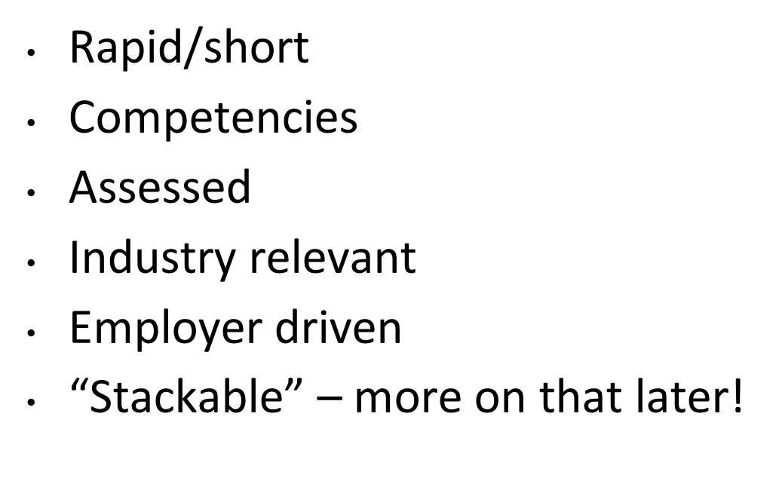
Some common features in the definitions?
Notes:
What are some of the common features that you saw in those definitions? Some of them might be the same things that you already typed into the chat, but feel free to mention them again if anything different struck you or some of the things you saw repeated in those definitions.
This is what I am seeing in the chat: rapid training, competency-based, lots of mention of training, skills-based enhanced learning needed by employers, learning new skills connected to post-secondary, assessed, credential training, discrete relating to size
This all builds on what you typed into the chat earlier in terms of what you were already aware of in terms of micro-credentials. I have also included a few on the slide.
One thing that they didn’t talk too much about except for the HEQCO definition, was the notion of building on other credentials, which we talk about as being “stackable”.
There is a comment about the focus being on post-secondary to the omission of others. It’s true that in Ontario, the focus right now on micro-credentials in terms of government funding is toward post-secondary institutions, while we know in reality that many other organizations also deliver micro-credentials, and we’ll address that a bit more in a few minutes.

Slide 17
Contact North/Contact Nord provides a great summary:
There is no absolute definition for micro-credentials in Canada or anywhere else…these components are, however, widely recognized as key characteristics of micro-credentials:
https://teachonline.ca/tools-trends/ten-facts-you-need-know-about-micro-credentials
Notes:
Our friends at Contact North have a number of micro-credential articles on their site, and interestingly, one way that they start their definition is that there is no absolute definition for micro-credentials in Canada or anywhere else. These components are, however, widely recognized as key characteristics of micro-credentials. I’ll share what those key characteristics are in a minute, but first of all I want to take a minute for anyone that’s not familiar with Contact North to introduce who they are.

Slide 18
Notes:
Contact North has been around for a long time. The description from their “about” page is as follows: “As Ontario’s community-based bilingual distance education and training network, Contact North/Contact Nord helps underserved residents in 1,300 small rural, remote, Indigenous and Francophone communities access education and training without leaving their communities.” If you have been around as long as I have, you will remember some of the Contact North audio and video conferencing classrooms that appeared in many of our schools, colleges and universities. You might have taken courses through the Contact North network – I know I did! Moving with the times, Contact North has also moved into the realm of supporting more online delivery. They don’t offer courses, but they are a technology support provider. You might also be familiar with Contact North as the LBS eChannel support organization and, in terms of LBS, Contact North is also the host of the OALCF repository where our culminating tasks and milestones are stored. Contact North has a significant role in LBS as well.

Slide 19
Contact North/Contact Nord provides a great summary:
There is no absolute definition for micro-credentials in Canada or anywhere else…these components are, however, widely recognized as key characteristics of micro-credentials:
https://teachonline.ca/tools-trends/ten-facts-you-need-know-about-micro-credentials
Notes:
So back to their summary of micro-credential features …

Slide 20
A skills and competency-based focus for learning rather than time.
Short and focused on a narrow range of skills and competencies.
Competency is assessed as a demonstrable skill or behaviour, varying across micro-credentials.
Quality is assured through peer and industry review.
Industry recognized. Many micro-credentials are co-developed with industry or based on statements from industry organizations about the skills and competencies they’re looking for.
https://teachonline.ca/tools-trends/ten-facts-you-need-know-about-micro-credentials
Notes:
Theirs is not so much a definition but rather a set of points:
A skills and competency-based focus for learning rather than time
Short and focused on a narrow range of skills and competencies
Competency is assessed as a demonstrable skill or behaviour, varying across micro-credentials. (Obviously it varies, because micro-credentials are hugely varied.)
Quality is assured through peer and industry review (back to the concept of industry support)
Industry recognized. Many micro-credentials are co-developed with industry or based on statements from industry organizations about the skills and competencies they are looking for.

Slide 21
https://teachonline.ca/tools-trends/ten-facts-you-need-know-about-micro-credentials
Notes:
I’d like to direct you to TeachOnline.Ca on Contact North’s main site. As I mentioned before, they have a number of different articles, webinars, and recorded sessions around micro-credentials, among many other things. I especially wanted to draw your attention to this article, “Ten Facts You Need to Know About Micro-Credentials” because, in fact, a fair bit of the content in some of the slides that you will see from here on in is drawn from this article. It’s a really nice read. It takes maybe about ten minutes to read through it, and it’s really an excellent introduction to micro-credentials, and that’s why I decided to pull a lot of pieces out of it for today’s session. The link is here, but you can go to teachonline.ca, and you can just type “micro-credentials” in to the search, and you will come up with links to many of their micro-credential articles.

Slide 22
MC examples from our own backyard!
Notes:
We talked about the what and the definition and features of micro-credentials, so now we will talk about some examples from our own country and province. This won’t be exhaustive but rather just a bit of a taste of some examples of micro-credentials that are currently around.

Slide 23
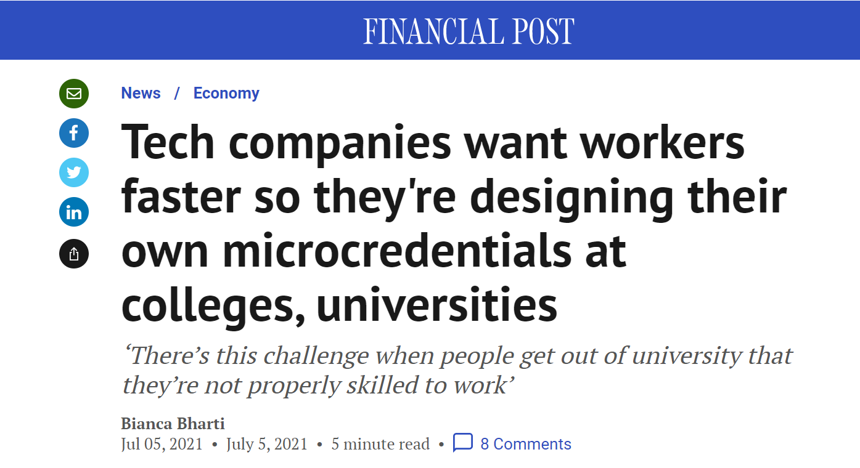
“The traditional education system and the digital economy were operating at different speeds.
This issue pushed CEO Guillaume Bazinet to come up with a solution that is being echoed in many post-secondary institutions across the country: industry players are helping universities and colleges design programs and microcredentials to ensure students are up-to-date with the skills or software that are in vogue in the sector.”
https://financialpost.com/news/economy/tech-companies-want-workers-faster-so-theyre-designing-their-own-microcredentials-at-colleges-universities
Notes:
I want to go back once more to a short article to give a little more context to what some of the public-facing pieces around micro-credentials are telling us. This is a Financial Post article referencing tech companies who want workers faster, so they are designing their own micro-credentials. Some tech companies and others design their micro-credentials internally; others design them with colleges and universities, because that tends to give them broader applicability and perhaps broader enrollment. The tech sector is one where micro-credentials really have been around for quite a long time. Short little pieces of skill-based training to help tech and IT workers stay current in their fields. It’s similar in the manufacturing sector because tech changes often happen fairly quickly in manufacturing.
“The traditional education system and the digital economy were operating at different speeds. This issue pushed CEL Guillaume Bazinet to come up with a solution that is being echoed in many post-secondary institutions across the country. Industry players are helping universities and colleges design programs and micro-credentials to ensure students are up-to-date with the skills or software that are in vogue in the sector.”
That doesn’t mean it’s only colleges and universities delivering them, but there are more and more of those partnerships between industry and post-secondary institutions to develop and deliver micro-credentials.
Gay Douglas: I just want to flag a very interesting comment in the chat.
Barb Glass: (reading) “The industry buy-in piece is critical as employers are still hanging their hat on Grade 12 OSSD, GED, etc. which we all know could mean a variety of skills and competencies. If industry doesn’t recognize micro-credentials, there is almost no reason to have them in LBS.” I think that is a very timely and astute comment. We all know that we can provide different sources of upskilling and upgrading and some very employer-drive training in LBS that will really stand up well for our learners when they get into employment. Just having that piece of paper with the old traditional Grade 12 OSSD or GED or a certificate or whatever it is just doesn’t necessarily cut it. Thanks for that comment.

Slide 24
Notes:
Here’s an example from Mohawk College. Yes, I am from the College Sector; I am not trying to put a plug in for the colleges, but it is true that in Ontario a lot of development is going on at the colleges and universities around micro-credentials, and so I wanted to draw your attention to some of it.
This is a nice statement about Mohawk College’s view of micro-credentials. I like their comment at the end: “Some micro-credentials are stackable and can be combined to lead to a larger clustered credential”. That keeps infusing itself into our discussion today.

Slide 25
Notes:
These are a couple of examples of what Mohawk is offering that I pulled from their website. Here’s a micro-credential in footcare management. As you can read, it’s designed for RNs (registered nurses) or RPNs (registered practical nurses) as an additional qualification that they could use in their practice.
Completely changing gears, I pulled out another example of remotely piloted aircraft ground school. Do you want to know how to operate a drone? There is a micro-credential for that. It links to the industry: it prepares learners to challenge the Transport Canada Basic or Advanced Drone Operator Exam.

Slide 26
https://ontariotechu.ca/microcredentials/what-are-microcredentials/index.php
Notes:
Here is another example, this time from OntarioTech University, formerly known as the University of Ontario Institute of Technology. They are also delving deeply into micro-credentials, and I like their definition: “a portable communication tool that represents evidence of your skills for employers, educators and peers.”

Slide 27
3. Micro-credential Q and A – 7 topics
Notes:
We’ll pause here for a moment, and then we’ll talk more about the features of micro-credentials which I have arranged around seven sub-topics.
I am checking the chat, but I don’t see anything there just yet.

Slide 28
7 Topics:
1. Who is the target audience for MCs?
2. Who develops MCs?
3. How are MCs delivered?
4. How are MCs assessed?
5. How are MCs documented?
6. How are badges different from MCs?
7. What does ‘stackable’ mean?
Notes:
Let’s move on to sub-topics. We can talk about the target audience. We’ve touched on a few of these things as we have been discussing so far. Who develops micro-credentials, how are they delivered, assessed and documented? We hear a lot about badges, so we should touch on that. And we will come back to the term “stackable” which we have encountered a few times today.

Slide 29
Unemployed or laid-off individuals who need in-demand skills to obtain employment
Under-employed individuals who want or need to upskill to improve job opportunities
Contract/on-call workers who want to learn new/complementary, in-demand skills
1. Who is the target audience for MCs?
https://teachonline.ca/tools-trends/ten-facts-you-need-know-about-micro-credentials
Notes:
The Who. You could probably have told me this. I’m summarizing it for the benefit of anybody that might not be quite as familiar with micro-credentials. Obviously, people who are unemployed or laid off can access micro-credentials to a really good advantage, probably more so in some sectors than others. We also work in LBS and other areas with lots of underemployed individuals who want or need to upskill to improve their job opportunities. An interesting one that I hadn’t really thought of but makes perfect sense is this third one that I came across in some of the research: in the current economy there are so many more contract and short-term workers than there ever were before, either because they choose to work in that form or just because it is harder to get long-term permanent full-time jobs in the current labour market. For contract workers, on-call workers, casual workers who want to learn new skills and/or enhance themselves so they have greater capacity as a contractor, micro-credentials could help them as well.

Slide 30
2. Who develops MCs?
Colleges, universities, institutes, training providers
Professional associations, e.g. Institute of Management Accountants
Companies/employers, e.g. Microsoft, Google, RBC, Spotify
Massive Open Online Courses (MOOCs)
https://teachonline.ca/tools-trends/ten-facts-you-need-know-about-micro-credentials
Notes:
Who develops them? We have touched on this, but colleges, universities, institutes, other training providers, the education sector develops them. So do professional associations. Some of these have been around for a very long time, for example, The Institute of Management Accountants has their own micro-credentials. Lots of companies and employers have micro-credentials, either available internally as part of their own in-house training program or possibly available to people like you and I who might want to engage with their micro-credentials. A fourth area of development is with the MOOCs as they are called – the Massive Open Online Courses. Many of them have some kind of a certification attached to them.
There is a comment in the chat that micro-credentials are great for folks who are working full time and can’t take months off to go back to school. Yes! And, they are a lot cheaper when it comes to tuition.
Continuing on the topic of who develops them, think back to early years of Microsoft. Microsoft has had certifications that any of us could have taken over the years. We still can. I remember A Plus certification in the tech sector. We can even think of things like SmartServe, WHMIS, fall arrests, AODA Compliance and some of the things we have done in our own organizations or have done ourselves for our jobs. Those are some really early examples of industry-specific micro-credentials. They have taken off recently because of the way both the economy and the labour market are currently developing. To go back to the point made in the chat, because some traditional certifications don’t necessarily give employers what they want or need in their employees. I think that goes even beyond talking about a high school diploma or a GED, it also refers to simple secondary programs where people don’t necessarily always learn more hands-on skills that employers are looking for.
There is a question in the chat asking if MOOCs are recognized. Some are and some aren’t. It depends on who has developed and offered the MOOC.
There is a comment in the chat that the Microsoft Word 2016 free online tutorials have been extremely beneficial to many learners. That’s a good point. I think many of us have been able to help our learners access those. There are so many good free tutorials around digital skills, not just with Microsoft but with other providers as well.

Slide 31
3. How are MCs delivered?
Fully online (majority)
Hybrid
In-person
Frequent start dates
https://teachonline.ca/tools-trends/ten-facts-you-need-know-about-micro-credentials
Notes:
Our third feature is how are they delivered. I think probably many micro-credentials are delivered fully online. In fact, I would say the majority because that’s part of what the desirable features of a micro-credential are, i.e., the fact that they can be accessed online. Some topics don’t lend themselves to online delivery, for example, micro-credentials that relate to construction, to manufacturing or to health care. Some of those need to have an in-person or hands-on component. Some do have hybrid delivery of micro-credentials, and some may require in-person assessment, so there is a big mix of how they are delivered, but the majority are currently fully online with just a small in-person component in some cases.
As we have all seen in LBS in these last few years, there are a lot of people who are not comfortable working and learning online, but there are a lot who are. Micro-credentials can often help those folks who are comfortable and have the digital skills to engage with online micro-credentials.

Slide 32
4. How are MCs assessed?
Assess competencies – what the learner can do, not how much time is spent learning
Often requires different assessment strategies than in traditional courses
https://teachonline.ca/tools-trends/ten-facts-you-need-know-about-micro-credentials
Notes:
We spoke briefly about assessment and the fact that with micro-credentials it must address what the learner can do, not how much time is spent learning. It’s a competency model, not a time-based model. That sometimes requires a different view of assessment, and I say this especially for post-secondary institutions – and no disrespect at all to our university colleagues – but I think the midshaft is perhaps the most challenging in the university sector when it comes to looking at the type of assessment and competency-based assessment that is needed in assessing micro-credentials to make sure they are delivering what they say they are delivering and to make sure that the learner is acquiring what the micro-credential is actually all about.
I think back to something I think we are all familiar with. Think about CPR First Aid training. Many of us have attended CPR First Aid training with St. John’s Ambulance or another organization. We never thought of that as a micro-credential 20 or 30 years ago, but really it is. It will be really hard to assess through online only or with paper and pen if I can resuscitate somebody with CPR. I think that’s a really concrete example of a micro-credential where one has to demonstrate one’s skill in order to achieve the competencies.

Slide 33
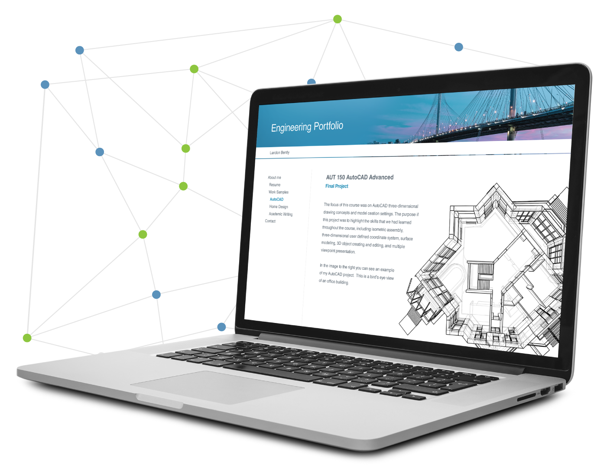
5. How are MCs documented?
MCs or badges can be posted to a learners ‘digital wallet’ or e-portfolio
Learners control access to their “digital wallet”
In Canada, college and universities have agreed to gradually move to using digital MC credentials
Some already have MCs recorded on a postsecondary transcript
https://teachonline.ca/tools-trends/ten-facts-you-need-know-about-micro-credentials
Notes:
The way that micro-credentials are documented is a bit of an interesting discussion, and I will say it’s evolving in Ontario and in Canada right now. For the most part, the intention is that a micro-credential or a badge – we’ll talk more about badges in a minute – can be posted to a learner’s digital wallet or e-portfolio. They are intended to be not necessarily a paper-based evidence of completion, but a digital evidence of completion. Just like we all control access to our own wallets with money in them, we as learners would also control access to our digital wallet or e-portfolio. The deposits that are made into the digital wallet are the completed micro-credentials or badges that we earn.
In Canada, our post-secondary institutions – colleges, universities and Indigenous institutes – have agreed to start trying to move toward using digital micro-credential credentials.
Some post-secondary institutions are now having the capacity and the ability to actually record micro-credentials on a post-secondary transcript. I will say that is not very common yet, but I think we will see more of that.
An interesting feature about the digital wallet is that as a job seeker, I can take pieces in and out of my digital wallet so that when I present it to an employer, I can make sure that my most relevant badges are there for that employer. I can also remove outdated ones. It’s a repository, but it stays with the learner.

Slide 34
6. How are badges different from MCs?
Micro-credentials are:
related to a formally approved or accepted set of standards or competencies
taught by a teacher or mentor who is accountable for ensuring that the student learns and demonstrates the expectation for awarding the MC
“Badges can be awarded informally for anything, by anyone. There is value in learning the specific skill or knowledge related to the badge.”
https://teachonline.ca/tools-trends/ten-facts-you-need-know-about-micro-credentials
Notes:
In my research for this session, I learned about how badges are different from micro-credentials. Micro-credentials, as we have been talking about this whole time, are all linked back to an approved or accepted set of standards or competencies, largely driven by employers or by industry need. They have to be taught by a teacher or facilitator or mentor who is accountable for ensuring that the learners in that micro-credential are learning what they say they are learning and they can demonstrate their learning in order to be awarded the micro-credential.
There is a comment in the chat: “My first experience with badging/digital credentials was Northstar Digital. They had a badge that could be posted to Mozilla, which I thought was pretty cool. I know LinkedIn has something similar.” Yes, LinkedIn Learning does have a lot of micro-credentials embedded in their organization as well. I’m familiar with Northstar Digital, and I agree that there is a lot of nice things available there. It’s interesting that it could be posted to Mozilla. I don’t have a digital wallet or an e-portfolio – I probably will at some point – but I’m interested in that concept and learning more about it.
Badges are a little less formal. This is a direct quote from the article I mentioned earlier from Contact North: “Badges can be awarded informally for anything, by anyone. There is value in learning the specific skill or knowledge related to the badge.” The credential piece of micro-credentials is partly what distinguishes it from a badge.
Here is another comment from the chat: “Our agency has a badge from Census Canada for being a community partner.” That’s a neat thing. I haven’t heard of that before. I love learning these new tidbits of information about what is available. I learned something else about badges …

Slide 35
Notes:
The badge actually contains data about the credential. It’s not just a picture posted in your wallet. It contains information about the criteria you met, what are you now competent in, where you received the badge, the alignment to any professional or industry standards that might exist, and when it expires. Some credentials, such as the St. John’s Ambulance CPR First Aid example, expires after a certain length of time. The data inside the badge is called metadata, and it’s easy for employers to access it when looking at an e-portfolio because they can click on the badge and see this information. That was one of my new learnings.
There is a question in the chat asking if you need a badge reader to access that data. I actually don’t know the answer to that, because I don’t have any badges that I can try to read. If anyone knows, please enter it into the chat.

Slide 36
7. What does “stackable” mean?
MCs used together to gain additional certifications and/or admission to other education/training
Take “small chunks” of learning at a time – less commitment and expense
Helpful in industry where employees could take MCs that are for advancement or upskilling
Canadian organizations are exploring how to make MCs stackable and transferable across institutions
https://teachonline.ca/tools-trends/ten-facts-you-need-know-about-micro-credentials
Notes:
Our seventh of seven sub-topics is the notion of stackable credentials. So what does stackable mean? It’s exactly what you think it means. It means that you can ideally take micro-credentials and bundle them together or stack them up to either get a bigger micro-credential or to lead toward a certificate or to get advanced standing in a post-secondary college certificate diploma program or a university degree. The notion of micro-credentials being stackable and bundled together is a really important piece of the usefulness of them.
What is also interesting is that some post-secondary institutions are pulling courses out of, for example, a certificate diploma degree program and delivering them as micro-credentials and perhaps packaging two or three of them together to make a mini credential and then, if a student or learner decides they would like to take the full program, then they have a leg up because they have already taken a couple of courses as micro-credentials that will now count toward their post-secondary learning. They may not use it for that purpose, but it is a concept around micro-credentials that I think can help lead some learners who wish to pursue more than just a micro-credential into post-secondary education. I’m guessing that employers also do it that way. They probably have micro-credentials that they have created for their staff and employees that can be bundled together to get additional in-house certification. I’ll give you a couple of examples of those a bit later on.

Slide 37
4. Trends –
Internationally and in Canada
Notes:
Let’s talk about the broader picture of micro-credentials. I think it’s always important as educators that we try to keep educating ourselves not only about what’s happening in our own backyards, but also being aware about some of these really broad issues and topics and what is going on in the rest of the world, especially if we in our jurisdictions aren’t necessarily leaders, and we might be able to learn from jurisdictions that are leaders.

Slide 38
Micro-credentials
Notes:
With that in mind, we’ll take a tour of a few places in the world where micro-credentials are perhaps a bit further down the road than we are. I would say as a preview that one of the most advanced countries when it comes to micro-credentials is New Zealand.

Slide 39
International trends – New Zealand
New Zealand recognized as early adopter and world leader
Introduced in 2018
Unique model includes centralized regulation and standards by NZ Qualification Authority
“A micro-credential certifies achievement of a coherent set of skills and knowledge; and is specified by a statement of purpose, learning outcomes, and strong evidence of need by industry, employers, and/or the community.”
https://www.nzqa.govt.nz/providers-partners/approval-accreditation-and-registration/micro-credentials/#heading2-0
Notes:
New Zealand was really fast out of the gate in terms of their work with micro-credentials. They spent a considerable amount of time planning ahead, and they have an interesting model because they have a national standard, what they call the NZ Qualification Authority that is responsible for maintaining the standards of their micro-credentials. They have their own definition of micro-credential in that it “certifies achievement of a coherent set of skills and knowledge; and is specified by a statement of purpose, learning outcomes, and strong evidence of need by industry, employers, and/or the community”. All of the same things we have been saying, but worded a bit differently.
Going back to the chat with relation to the question about reading badges, someone has responded that it depends. Some are open badges which are readable with a click, others are closed and need another type of reader. Check openbadges.org. Thanks!

Slide 40
In New Zealand, 100th MC approved in 2020
Barista Training and Customer Service
Applied Payroll
Chainsaw Use in Forestry Production
Alcohol and Food Safety Compliance
Upselling for Hospitality and Tourism
Workplace Digital Literacy: Interface between smart devices and digital platforms
Digital Marketing
Notes:
New Zealand had its 100th micro-credential approved in 2020. On the screen, you can see some examples of some of the micro-credentials in their nationally recognized and nationally developed micro-credentials. There are quite a variety. The Chainsaw Use in Forestry one really brings me back, as someone living in Northern Ontario, to when I first arrived in Northern Ontario and Sawmill Operator was a course that many of our learners enrolled in, because the forestry industry was very big here at the time. They were essentially doing micro-credentials in logging and forestry techniques way back then, but nobody ever called them micro-credentials.
There is a comment in the chat that this list is excellent and has LBS written all over it. There is another comment that digital literacy is a popular one in Canada although digital skills are needed in all industries now. That’s absolutely true, and we have certainly seen evidence of that in the past two years.

Slide 41
International Trends - European Union
EU commissioned a micro-credentials report, completed in 2020 and to be implemented by 2025, which recommended
A shared definition, common to all sectors
Common characteristics and
A roadmap of actions
Intended to boost adult learning, higher education institutions will offer short courses in a comparable manner, ensuring agreed upon quality standards and facilitating recognition and portability
https://education.ec.europa.eu/sites/default/files/document-library-docs/european-approach-micro-credentials-higher-education-consultation-group-output-final-report.pdf
https://www.researchprofessionalnews.com/rr-news-europe-universities-2021-12-eu-approved-micro-credentials-proposed-to-boost-adult-learning/
Notes:
Now let’s look at the European Union which is a group of countries, which is obviously even more challenging They are trying to pull together some micro-credentials research and implement a strategy by 2025. You can see some of their characteristics of micro-credentials that they are trying to achieve. Their purpose statement is that as they try to “boost adult learning, higher education institutions will offer short courses in a comparable manner, ensuring agreed upon quality standards and facilitating recognition and portability”. This isn’t really anything different than what we have been hearing, but it is interesting that the EU is attempting to do this as a whole.

Slide 42
International Trends – United States
Many examples including:
State University of New York (SUNY) public system - Adopted in 2018, 400 MCs now available at 27 campuses in 60+ disciplinary areas
University of Denver – private university offering three MCs in coding, teaching excellence and high-performance leadership
Hundreds of thousands of MC-type offerings in the U.S.
https://www.suny.edu/microcredentials/ and https://www.du.edu/registrar/academic-programs/micro-credentials-badges
Notes:
Looking at our neighbours to the south, it’s a huge country with a huge population so they have a very complex landscape around both education and micro-credentials. They have academic providers delivering micro-credentials: colleges, universities, schools, etc. They also have non-academic providers just like we do here in Canada: industry associations, professional associations, non-profits, etc. Just a few examples include at the State University of New York, there are now 400 micro-credentials at 27 campuses in 60 or more disciplines. Another example is from the University of Denver which is a private university offering three micro-credentials in coding, teaching excellence, and high-performance leadership. There are literally hundreds of thousands of micro-credential type offerings in the US at this time.
There is a comment in the chat that the EU strategy also enhances access, which it does.

Slide 43
Trends in Canada
Universities and Colleges are increasing their MC offerings
University of Toronto 29 MCs, broad range of topics
Royal Roads University - 5 main MCs including Supervisory Skills, Leading Projects and Mineral Exploration Field Assistant
Camosun College – Clean Energy, Efficient Building
Bow Valley College – IBM Skills Academy
https://learn.utoronto.ca/programs-courses/unique/micro-courses-and-micro-credentials
https://pcs.royalroads.ca/micro-credentials-2
https://www.macleans.ca/education/microcredentials-a-mini-guide-to-the-micro-college-course-market/
Notes:
Now let’s move a bit closer to home. We’re not quite as far down the road as some other jurisdictions, but here are a few examples of universities that are getting on board with micro-credentials including the University of Toronto, and Royal Roads University, Camosun College in British Columbia and Bow Valley College in Alberta. Across the country, there are many post-secondary institutions going down the road of micro-credentials. We’ll look more closely at Ontario shortly.

Slide 44
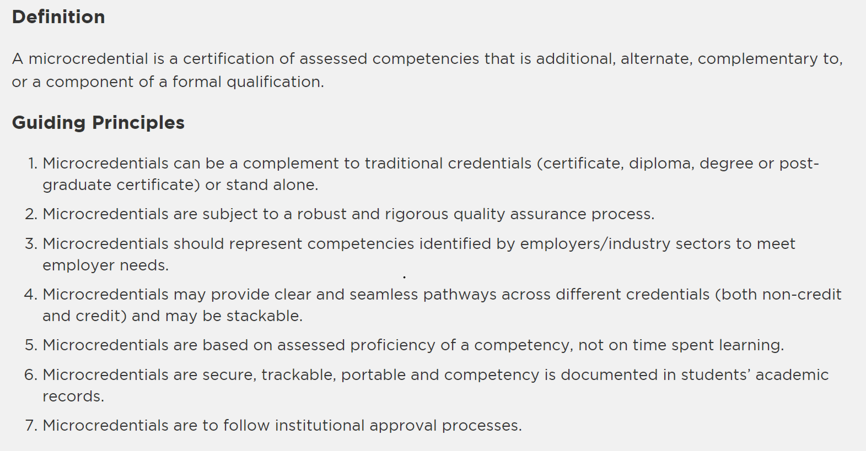
https://www.collegesinstitutes.ca/policyfocus/micro-credentials/
Notes:
I wanted to draw your attention to this particular set of guiding principles with respect to the Canadian landscape for micro-credentials. This set of guiding principles has been developed by CICan which is Colleges and Institutes Canada. CICan is a body that helps to coordinate, to whatever extent possible, post-secondary institutions across Canada. To their credit, they have endeavoured to create some guiding principles in consultation with the post-secondary sector around micro-credentials. You can read through the guiding principles on the slide. They really do capture a lot of the features and characteristics we have been talking about today.
The webinar evaluation is posted in the chat, and we encourage you to complete that as it really helps us plan and prepare for future webinars.
There is also a question about the typical minimum entry requirements for taking a micro-credential. It does vary because it depends on the nature of the micro-credential. Many don’t have prior knowledge requirements but some that are more industry-specific would require prior knowledge. There isn’t a hard and fast way to say everybody requires this or that.

Slide 45
5. Trends and Next Steps in Ontario
Notes:
Let’s focus in on some of the next steps and trends in Ontario. For example, the micro-credential strategy that the Government of Ontario is undertaking. I’ll outline a few features on the next slide.

Slide 46
Trends in Ontario
Ontario government’s investment of $59.5m over 3 years to create Ontario’s first Micro-credential Strategy:
Create an online portal to access micro-credential training opportunities
Create a fund to incent the development of new micro-credentials that respond to regional labour market needs and strengthen partnerships between postsecondary institutions, training providers and employers, distributed through a competitive call for proposals
https://www.universityaffairs.ca/news/news-article/microcredential-programs-on-the-rise-in-canada/
https://budget.ontario.ca/2020/chapter-1c.html#s-9
Notes:
Our government has invested $59.5 million over three years to create Ontario’s first micro-credential strategy. A couple of its features are: creating an online portal to access micro-credential training opportunities (that’s a big deal!); and funding to help promote the development of new micro-credentials. Those might respond to regional labour market needs or partnerships. That has been distributed through a call for proposals. Lots of educational organizations, employers and professional associations have been able to access some of that funding already.

Slide 47
Trends in Ontario
Launch a public awareness campaign to promote micro-credentials among learners and employers
Expand Ontario Student Assistance Program (OSAP) eligibility to include students enrolled in ministry-approved, quality-assured micro-credentials programs
Work with eCampus Ontario and other partners to develop a virtual passport that issues and tracks a person’s learning experiences to set the foundation for lifelong learning.
Notes:
A couple of other features of the micro-credential strategy in Ontario is a public awareness campaign to promote micro-credentials among learners and employers. I don’t think we have seen that rolled out yet. I find the second one interesting: expanding OSAP eligibility to include students enrolled in a particular set of ministry-approved micro-credentials programs. That’s a great boost, because even though micro-credentials are less expensive because they are smaller, there is still a cost associated. The fact that learners may be able to access OSAP for some micro-credentials is a positive thing. The third one goes back to our discussions about the virtual passport or e-portfolio or digital wallet that is a way to track the micro-credentials and badges that somebody has completed. Part of the Government’s micro-credentials strategy is around working with eCampus Ontario and others to develop this virtual passport or wallet to track a person’s learning experiences.
There is a comment in the chat about tracking data and privacy. I don’t think that privacy can be overstated when it comes to tracking anything that we do.

Slide 48
Trends in Ontario
HEQCO “Making Sense of Micro-credentials” May 2021 highlights increased offerings at Ontario’s universities and public colleges.
Identified low rates of awareness among prospective students and employers surveyed
Employers surveyed rated the most favourable features of micro-credentials as “Directly related to the job being applied for”, “Competency based” and “Accredited”
https://www.universityaffairs.ca/news/news-article/microcredential-programs-on-the-rise-in-canada/
https://heqco.ca/pub/making-sense-of-microcredentials/
Notes:
We’ll go back to HEQCO. Their “Making Sense of Micro-credentials” report in May of last year was a research report that looked at some issues and awareness and views of micro-credentials. Not surprisingly, it identified that there isn’t a lot of information out there yet. There are low rates of awareness among prospective students and employers about micro-credentials. In terms of employer feedback, I thought this was a great statement that the most favourable features of micro-credentials were that they they are directly related to the job being applied for, they are competency-based, and they are accredited. This gets right to the root of what a micro-credential is.

Slide 49
What’s happening in Ontario’s public colleges?
Ontario’s public colleges offer (or are developing) micro-credentials
Some examples:
Central Region – Centennial College
Eastern Region – Durham College and St. Lawrence College
Northern Region – Northern College
Western Region - Mohawk College (see earlier slides)
Notes:
Let’s look at what is happening in our colleges. LBS is delivered in the college sector, and we all have connections through the communities where we deliver LBS. They aren’t the only providers of micro-credentials, of course, but here are a few more examples. We already saw the Western Region example from Mohawk earlier. At the last minute, I swapped out Humber for Centennial College, so you’re not going to see anything about Humber, you’re going to see something about Centennial.

Slide 50
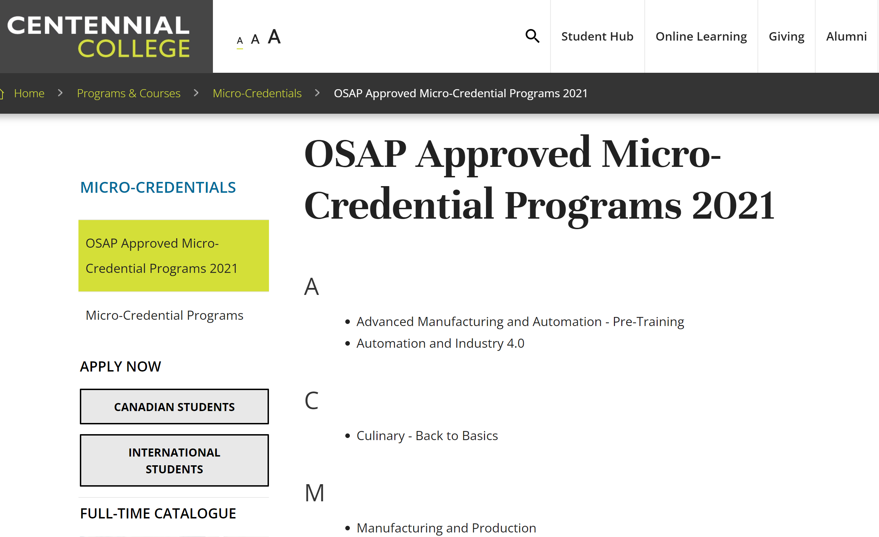
Notes:
I’ve made some screenshots of the web pages from a couple of these colleges. They have their micro-credentials listed on this page; here we see Advanced Manufacturing and Automation Pre-Training, Culinary Back to Basics, Manufacturing and Production. These ones would be in demand in Centennial’s area of the east end of Toronto. Since they are mostly on line, it doesn’t stop anyone from somewhere else in the province taking them.

Slide 51
Notes:
Here is a quick example from Durham College. They have a micro-credential in Graphic Design Photoshop and Illustrator. You can read a bit at the bottom of the slide about what that micro-credential addresses. It basically works in Adobe Creative Suite, so it’s a fairly narrow zone of expertise that is attached to this micro credential as is the intention.

Slide 52
Notes:
Another one from Durham is the Using Construction Tools micro-credential. It is extremely employer-driven as you can see by the description. I can imagine how great that would look on a resume or an e-portfolio for an entry level construction worker. It would probably give them a leg up on someone who doesn’t have the micro-credential or similar training.

Slide 53
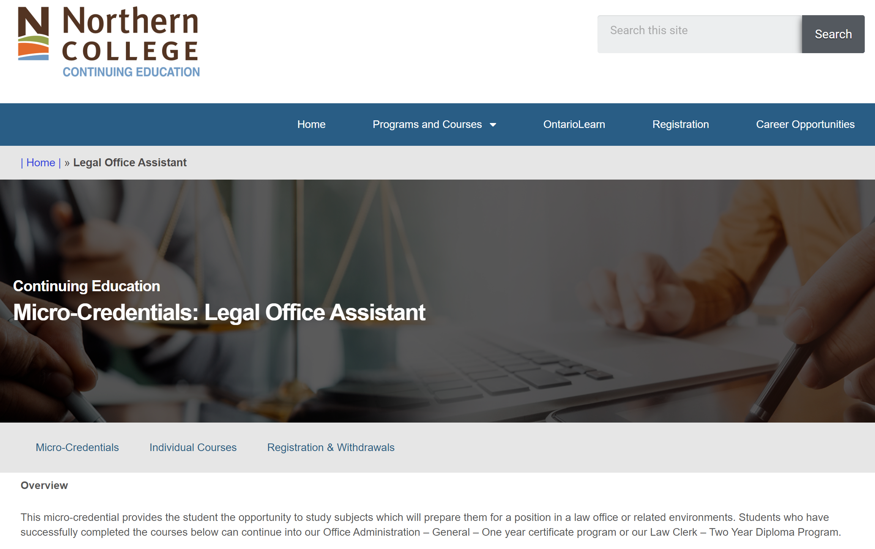
Notes:
From our friends at Northern College, whose main campus is in Timmins with at least nine satellite sites around the North, one of their micro-credentials is Legal Office Assistant. I picked this one because it’s a nice example of a pathway and the ability to stack micro-credentials. At the bottom, you can see a description that students who have successfully completed this micro-credential can continue into their Office Administration general one-year certificate program or the Law Clerk program, which is a two-year diploma. This is a nice example of someone who might start out doing a micro-credential and then might decide that they either have the time, the motivation, or the job opportunities to pursue something more, so this gives them a bit of a leg up on that post-secondary program because they have already done this micro-credential.
There is a question in the chat asking, within the context of micro-credential, what does accredited mean? Accrediting is done by the organization issuing the micro-credential. In the Ontario landscape, it could be a college, a university, an employer association, an industry association, or a school board. Accredited means that someone from industry or an employer agrees with the learning organization that it is accredited.

Slide 54
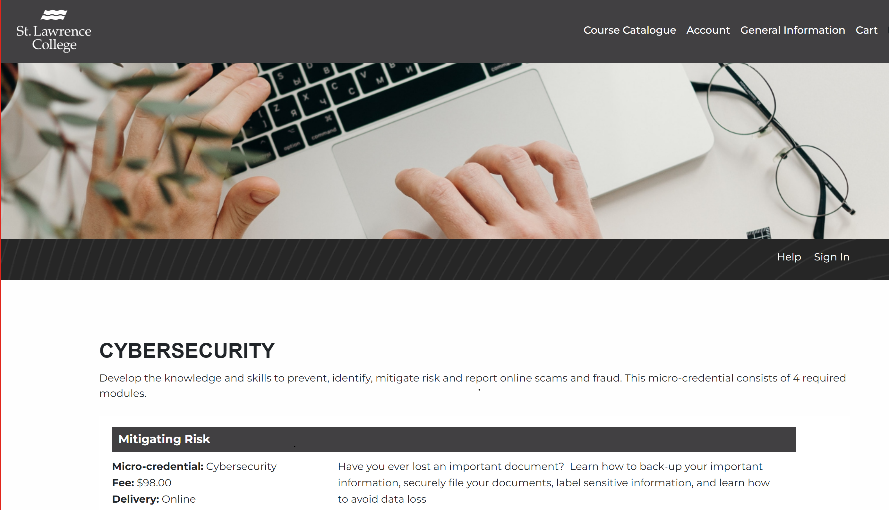
Notes:
Here’s one from St. Lawrence College in Kingston: Cyber Security. I am fascinated by the range of different micro-credentials that are out there. I had to stop myself from looking at all of these, because there is such a fascinating mix. This one is interesting especially around the cost. It’s $98. There are four modules at $98 each, so for about $400 which is of course still a lot of money for many people but compared to a one semester tuition for a college or university program, $400 for four modules isn’t too bad.

Slide 55
6. A Few Thoughts on LBS
Notes:
We have talked a bit about LBS, but let’s talk briefly about LBS now since we are, for the most part, LBS educators.

Slide 56
Can LBS help to promote the MC strategy in Ontario?
Provide information to learners about MCs if appropriate
Help to prepare learners for an MC if they are interested
Could apply to any of the five goal paths
Notes:
I’d be interested in your thoughts around this question. Can we help promote the micro-credential strategy in Ontario. I think we would all agree that the micro-credential strategy isn’t a bad one, but I would like to know your thoughts on how we might be able to help.
There is a comment in the chat that yes! We can help.
There is a comment in the chat that many of the micro-credentials are courses that we already offer at no cost.
There is a question asking if micro-credentials are typically aimed at a post-secondary level. It really depends on the nature of it. For example, going back to CPR First Aid, you definitely don’t need to be at a post-secondary level to take a micro-credential of that nature. Some do require post-secondary readiness but not all of them by any means. Someone who is college-ready can probably handle a micro-credential, but they may not have the industry experience to do so, because those micro-credentials are tied to jobs. If it’s an entry-level micro-credential, perhaps they do have the capacity. If it’s an industry related micro-credential that requires prior knowledge, perhaps the person wouldn’t be ready.
Someone mentions in the chat that through LBS we can create our own micro-credentials referral opportunities. I think it’s key to be aware of micro-credentials and be able to refer our learners to them if appropriate. We can definitely encourage our learners to take them.
Someone else mentions that many of these have no academic pre-requisites, which is right.
Someone else notes that LBS can prepare folks academically to be able to work online, provide space and tutoring assistance. There are a lot of ways at many levels that we can and should assist. I agree. I think that there is a lot that we can do in LBS through our existing delivery framework to help people who are interested in pursuing micro-credentials. Clearly, one does need some literacy skills to pursue micro-credentials, so it’s another way of preparing learners for something.
Someone notes that it would be great if it were offered through Ontario Works. I’m assuming this means that some micro-credentials could be funded through Ontario Works.
Other ideas are sharing the value in taking them with our learners, workplace or workforce literacy micro-credentials, breaking some of our longer courses down into micro-credential length courses.
It’s so interesting to read all of these posts. Someone mentions that it’s a great way to have learners think about education as a series of small, manageable bites. They can be promoted as the next steps in preparing learners to succeed. We can prep people to do just about anything in LBS.
Thank you so much for all of these interesting ideas.
Someone notes that it would be great to have a list of free micro-credentials and encourage learners to engage with them.
I’ve added a few things to the slide that crossed my mind, some of which you have also mentioned. We can provide learners with information, we can help to prepare them, and preparing for a micro-credential could apply to any of the five goal paths given the huge range of micro-credentials out there.

Slide 57
7. Summary and Questions
Notes:
If you have any other questions that haven’t been addressed, please add them to the chat.

Slide 58
Micro-credentials are…
Personalized with the right combination of micro-credentials to meet individual learners’ needs.
Modular and stackable - some micro-credentials are “one off” learning and assessment experiences, while others are modules that can be stacked to create a qualification.
Notes:
By way of a summary, we’ll finish up with a couple of slides. I do have to give credit once more to that excellent Contact North article, “10 Facts You Need to Know About Micro-Credentials”. These last slides encompass a lot of what we’ve talked about today.
Micro-credentials are personalized with the right combination to meet an individual learner’s needs. They are modular and stackable. Sometimes it might be a one-off learning experience, while other micro-credentials are created to be stacked and laddered to create a qualification. They are equally good either way.

Slide 59
Micro-credentials are…
Shareable - the qualification is placed in a digital wallet or e-portfolio the learner can share with employers or education institutions.
In Ontario, it is widely agreed that a micro-credential is “transcriptable” meaning it will appear on a learner’s college or university transcript and will be deposited to her or his digital wallet or e-portfolio
Notes:
Ideally, micro-credentials are shareable because they are placed in a digital wallet so that employers or educational institutions can access them. As I mentioned earlier, in Ontario at least, post-secondary institutions are indicating that they would like micro-credentials to be able to appear on a transcript, which takes some doing because it’s complex to determine what goes on a transcript in those big institutions.

Slide 60
Thank you for participating in today’s webinar!
Please complete the evaluation using the link
in the chat.
Questions?
Notes:
Thank you for attending today. I will check the chat one more time to see if there are any further comments or questions.

Slide 61
The must haves...
Webinar evaluation:
https://surveys.oalcf-echannel-repository.ca/s3/Pop-UP-PD-21-22-Web-6-Micro-credentialing
Register for future webinars at: https://learningnetworks.ca/resources-publications/popuppd/
Webinar resources:
English https://e-channel.ca/practitioners/pop-pd-resources
French https://apprentissageenligne.ca/formateurs/programme-afb-ressources-de-la-communaute-de-pratique-en-ligne
Notes:
I also want to take a moment to remind you that if you are looking for resources for any of the Pop Up PD sessions, you can access them at the eChannel site.
Thanks for all of the positive comments in the chat. I am glad that we were able to get together today and spend some time talking about micro-credentials. It is a current topic that I thought I knew a bit about, but I have learned a lot more, and I hope you have too.

Slide 62
Thank you and acknowledgements
Members of the Pop Up PD for LBS Educators committee:
Contact North for technical support.
Deaf Literacy Initiative for providing ASL interpretation.
COFA for translating the webinar for the Francophone agencies.
And
Adult Education Association (ABEA), College Sector Committee (CSC), Literacy Link Niagara (LLN), Literacy Link South Central (LLSC), Literacy Northwest (LNW), QUILL Learning Network, Tri-County Literacy Network (TCLN).
Notes:
I would like to thank all of the members of the Pop Up PD committee, Contact North, Sarah Stocker for technical support, Deaf Literacy Initiative for today’s interpretation – thank you Rebecca and Caroline for interpreting today and throughout all of our Pop Up PD webinars. COFA will be translating the webinar for Francophone agencies, so thanks to them as well. It takes a bit of time for that translation to happen, but it will happen. Thanks also to our Pop Up PD partners listed on the screen.
Thank you again for the positive comments in the chat. I appreciate your efforts to comment and share via the chat. Imagine what we could have done if we were in the same room. I can’t keep up with all of the comments in the chat, but I will read them all in a few minutes.
With that, I will conclude the formal portion of our webinar and wish everyone a safe and enjoyable rest of your day.

