Slide 2
Statement of Land Acknowledgement
I would like to begin by acknowledging the Indigenous Peoples of all the lands that we are on today. While we meet today on a virtual platform, I would like to take a moment to acknowledge the importance of the lands, which we each call home.
We do this to reaffirm our commitment and responsibility in improving relationships between nations and to improving our own understanding of local Indigenous peoples and their cultures. From coast to coast to coast, we acknowledge the ancestral and unceded territory of all the Inuit, Métis, and First Nations people that call this land home.

Slide 3
About Pop Up PD for Literacy Educators
free webinar series developed by Ontario’s LBS Regional Networks & the Provincial Support Organizations for Literacy
supports LBS practitioners with presentations on topics important to them
English language webinars presented for LBS practitioners annually since 2015-2016; French language transcriptions coming soon!
all webinar presentations, recording links & transcripts here:
Pop Up PD Resources for LBS Educators
webinar topic ideas welcome at: e-channel@contactnorth.ca

Slide 4
Agenda
1. Development Timeline
2. Milestone Refresher
3. The New Milestones
4. Culminating Task Refresher
5. The New Culminating Tasks
6. The Repository
7. Best Practices
8. What’s Next?

Slide 5
Development Timeline

Slide 6
In the Beginning…
6 Culminating Tasks
60 Milestones

Slide 7
In 2014……
12 additional Culminating Tasks
22 adapted Milestones

Slide 8
In 2022
30 New Milestones | 33 New Culminating Tasks
7 Find and Use Information 9 Communicate Ideas and Information 6 Understand and Use Numbers 6 Use Digital Technology 1 Manage Learning 1 Engage with Others | 5 Apprenticeship 4 Apprenticeship – Skills Training 21 Employment 1 Independence 1 Secondary School Credit 1 Postsecondary

Slide 9
Milestone Refresher

Slide 10
What is a milestone?
A milestone is a goal-related assessment activity that learners complete to demonstrate their ability to carry out goal-related tasks. Milestones are aligned to the competencies and complexity levels found in the OALCF curriculum framework and are standard indicators of learner progress towards completion of goal path. Milestones answer the question, “Can learners apply the skills they are developing to purposeful tasks?”
Source: LBS Service Provider Guidelines, March 2020, page 16

Slide 11
“Learners will not be expected to perform every milestone task; they will only perform those tasks that are appropriate to their goal path and reflect what they need to focus on in the LBS Program.”
“Furthermore, milestone tasks are not intended to become the sum total of a learner’s program; instead, they are intended to support program delivery by informing instructional content and by providing common criteria for tracking learner progress.”
Source: Practitioner Guide to Task-Based Programming, Employment Ontario, p. 18

Slide 12
Learners who perform increasingly complex tasks can:
make inferences to determine task requirements
apply background knowledge and experience to carry out unfamiliar tasks
manage tasks with unfamiliar elements
identify a variety of ways to complete tasks
find, integrate and analyze information
experiment and problem solve to achieve desired results
Practitioners work with learners to choose milestones that represent the kind of tasks learners need to be able to do once they transition out of LBS.

Slide 13
What is an “adapted” milestone?
Adapted milestones are intended to support learners with limited reading skills.
Both the original and adapted versions assess abilities at the same level.
Practitioners should review both versions to determine which version suits the individual needs of the learner.
22 of the 60 milestones are available in a version adapted to face-to-face administration.
They are identified in the Milestone Index by the use of “-a” next to the milestone number in the milestone file name.
Source: Milestones User Guide, March 2014, Employment Ontario, p. 11
Notes:
.

Slide 14
Milestones with an Adapted Version
Level 1 | Level 2/3 | No Level
1, 2, 8, 9, 15, 18, 19, 20, 27, 28, 37, 41, 45, 48, 49, 54, 57 | 58, 59 | 14, 36, 60

Slide 15
Milestones and Performance Management
Dimension-Effectiveness (W-50%) Measure #4: Learner Progress (W-30%)
Based on both active and closed service plans
It is the percentage of learners who have successfully completed at least one milestone
Data comes from “attained” competency plan items
2022-2023 target: 60%
• Learner Progress (30%) is a measure of the successful completion of the required milestones on a learner’s goal path.
Source: LBS Service Provider Guidelines, March 2020, p.30

Slide 16
Preparing Learners for Milestones
Does the learner understand the purpose of the milestone and how it relates to their goal?​
Has the learner received instruction on similar tasks? ​
Has the learner successfully completed similar tasks? ​
Does the learner feel ready to try an assessment task?

Slide 17
How many Milestones?

Slide 18
The New Milestones

Slide 19
The New Milestones-Who Did What
Organization | Deliverables
Centre FORA | 6 French language milestones
Coalition ontarienne de formation des adultes (COFA) | 6 French language milestones
College Sector Committee for Adult Upgrading (CSC) | 3 Level 3 milestones
Community Literacy of Ontario (CLO) | 2 Level 1 milestones
Contact North | Contact Nord | Update/undertake revisions to online repository to reflect new indicators (and any related technical work); Support LLO in developing the milestones development instructions.
Continuing Education School Board Administrators (CESBA) | 3 Level 2 milestones
Ontario Native Literacy Coalition (ONLC) | 6 culturally specific milestones
Laubach Literacy Ontario (LLO) | Create a streamlined standard process to guide the development of additional OALCF that includes seeking and reflecting input from key stakeholders to ensure relevance and to support recognition. Coordinate and support the development of additional milestones. As part of finalizing new or redesigned milestones, LLO will ensure that these are reviewed and vetted by a third-party, separate and distinct from the Support Organization that develops them.

Slide 20
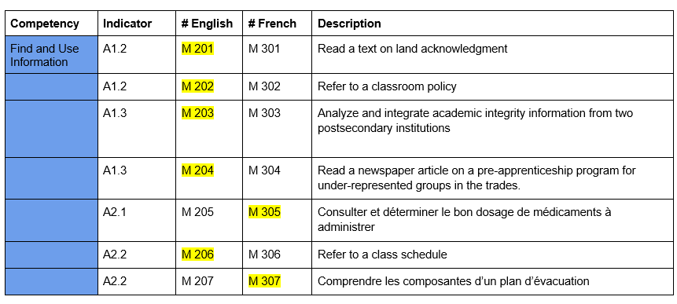
New Milestones- Find and Use Information

Slide 21
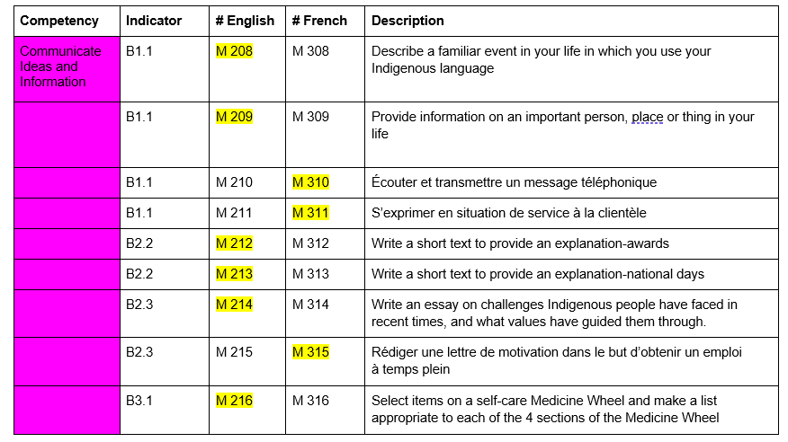
New Milestones- Communicate Ideas and Information

Slide 22
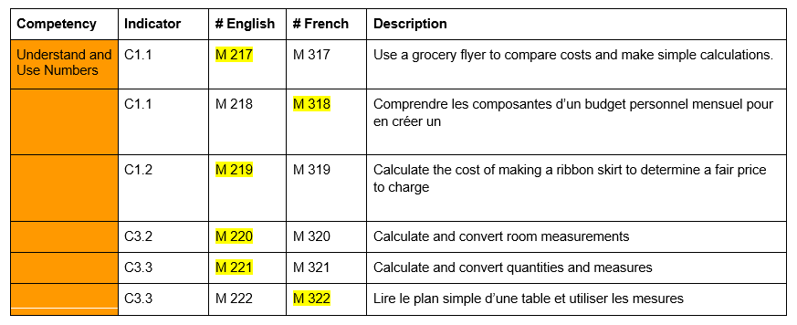
New Milestones- Understand and Use Numbers

Slide 23
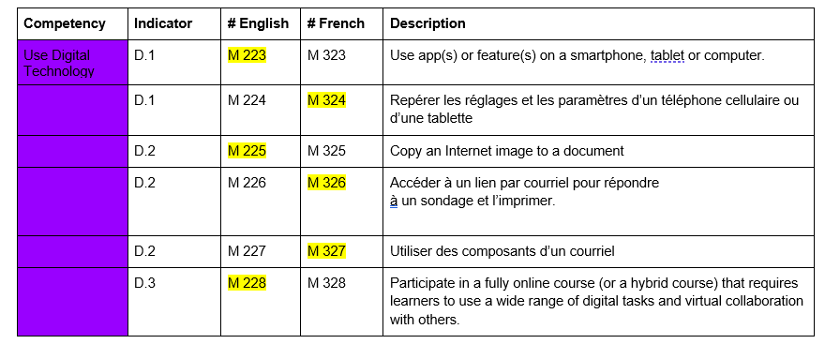
New Milestones- Use Digital Technology

Slide 24
New Milestone- Manage Learning

Slide 25
New Milestone- Engage with Others

Slide 26
New Milestones- What about adapted versions?

Slide 27
Milestones Summary
112 Milestones
60 Original | 22 Adapted | 30 New

Slide 28
Culminating Task Refresher

Slide 29
What is a Culminating Task?
A culminating task is more complex than a milestone task and is also aligned to the OALCF. It reflects a task that a learner could expect to perform upon exiting the LBS program. A culminating task answers the question, “Can the learner manage the expectations of the learning, training, community or work setting after leaving the LBS program?”
Source: LBS Service Provider Guidelines March 2020, p. 16

Slide 30
What is a Culminating Task?
Culminating tasks are representative of the five goal paths in the OALCF.
A complex task.
Incorporates multiple competencies and task groups.
Culminating tasks allow learners to apply their skills and knowledge across competencies in a way that reflects real-life situations.
Culminating tasks represent the end point of a goal path.

Slide 31
Culminating tasks do not replace any credentials, courses, or certifications that learners may need to access their goal destination.

Slide 32
Transition readiness
There are many other elements that are involved in transition readiness including (but not limited to)
completion of any required academic courses/credentials;
completion of any required industry credentials;
stability of the learner’s personal life including health, finances, and family circumstances;
motivation and persistence of the learner
Source: OALCF Culminating Task- User Guide 2013 (EN). p3

Slide 33
Helps the learner answer the question:
“Do I have a reasonable chance of managing the next step in my life/learning/work, and can I transition successfully to my goal destination?”
Successful completion of a culminating task is one way for learners to demonstrate that they may be ready to transition to one of the goal paths.

Slide 34
The culminating task for a learner’s goal path is meant to bring together many elements of the learner plan.
Daily Activities
Tasks/Task-based Activities
Integrated Tasks
Milestones
Culminating
Task

Slide 35
Relationship to milestones
Goal
Culminating Task
Milestones
1
2
3

Slide 36
https://northernliteracynetworks.ca/common-assessment-for-the-oalcf-goal-paths/

Slide 37
The New Culminating Tasks

Slide 38
The New Culminating Tasks -Who Did What
Organization | Deliverables
Adult Basic Education Association (ABEA) Literacy Link Eastern Ontario (LLEO) Literacy Link Niagara (LLN) Literacy Link South Central (LLSC) Literacy Network of Durham Region (LINDR) Literacy Northwest (LNW) Literacy Ontario Central South (LOCS) Metro Toronto Movement for Literacy (MTML) Peel-Halton-Dufferin Adult Learning Network (PHDALN) Project READ Literacy Network Waterloo/ Wellington (Project READ) QUILL Learning Network (QUILL) Rideau-Ottawa Valley Learning Network | Réseau d’apprentissage de la Valée Rideau-Ottawa (ROVLN | RAVRO) The Mid North Network (MNN) Tri-County Literacy Network (TCLN) | Develop 2 culminating tasks for employment, apprenticeship, or skills training
Simcoe/Muskoka Literacy Network (SMLN) | Develop 1 culminating task for employment, apprenticeship or skills training

Slide 39
The New Culminating Tasks -Who Did What
Organization | Deliverables
College Sector Committee for Adult Upgrading (CSC) | Develop 1 specific OALCF culminating task for post-secondary goal path
Community Literacy of Ontario (CLO) | Develop one culminating task of OALCF independence goal path
Contact North | Contact Nord | Update/undertake revisions to online repository to reflect new indicators (and any related technical work); Support LLO in developing the culminating task development instructions.
Continuing Education School Board Administrators (CESBA) | Develop 1 secondary school credit culminating task that will show transition-readiness in line with the Ontario Adult Literacy Curriculum Framework.
Laubach Literacy Ontario (LLO) | Create a streamlined standard process to guide the development of additional OALCF that includes seeking and reflecting input from key stakeholders to ensure relevance and to support recognition. Coordinate and support the development of additional culminating tasks. As part of finalizing new or redesigned culminating tasks, LLO will ensure that these are reviewed and vetted by a third-party, separate and distinct from the Support Organization that develops them.

Slide 40
Apprenticeship Culminating Tasks
NEW | Construction Craft Worker
 | Early Childhood Educator
 | Carpenter
 | Prepare for Certificate of Qualification Exam
 | Heavy Equipment Technician
OLD | Apprenticeship Employment
 | Swimming Pool Construction
 | Training Options

Slide 41
Apprenticeship-Skills Training Culminating Tasks
NEW | Certificate Training
 | Personal Support Worker
 | Hairstyling Apprenticeship
 | Forestry
OLD | Program Research
 | Medical Office
 | Home Renovation

Slide 42
Employment Culminating Tasks
NEW | Delivery Driver | Stock Clerk
 | Retail Associate | Small Business Owner
 | Customer and Information Services Representative | Hospitality/Event Planner
 | High School Equivalency Test Readiness | Labourers Food Beverage
 | Use Digital Technology to Search for Jobs | Material Handler
 | Winery Assistant | Home Support Worker A
 | Light Housekeeping | Home Support Worker B
 | Administrative Assistant | New Employee Orientation
 | Greenhouse Worker | Small Business General
 | Manufacturing Related to Forestry | Natural Resources Industry
 | Shipper/Receiver

Slide 43
Employment Culminating Tasks
OLD | Fire Safety
 | Job Readiness
 | Food Service

Slide 44
Independence Culminating Tasks
NEW | Information on a Medicine Product Label
OLD | Personal Budget
 | Medical Form
 | Newspaper Ad

Slide 45
Secondary School Credit Culminating Tasks
NEW | Growth Mindset
OLD | Planning for a Credit Program
 | Completing a Credit Program
 | Resource Consumption

Slide 46
Post Secondary Culminating Tasks
NEW | Postsecondary Admission
OLD | Child Development
 | Emotional Intelligence
 | Water Use

Slide 47
The Repository

Slide 48
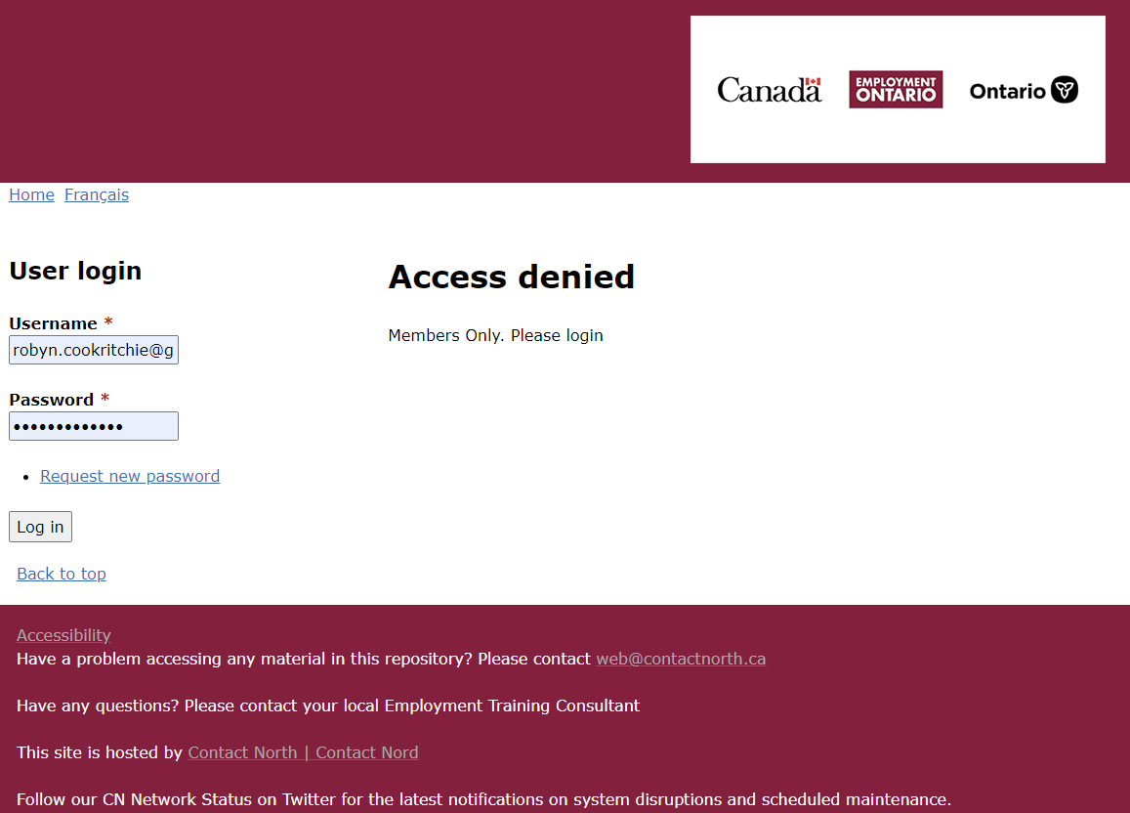
Where do I find Milestones and Culminating Tasks?
https://oalcf-repository.ca/
You need to have username and password to access milestones and culminating tasks.
If you don’t have access but need it contact: Sarah Gauvreau at Contact North: sarahg@contactnorth.ca

Slide 49
REPOSITORY

Slide 50
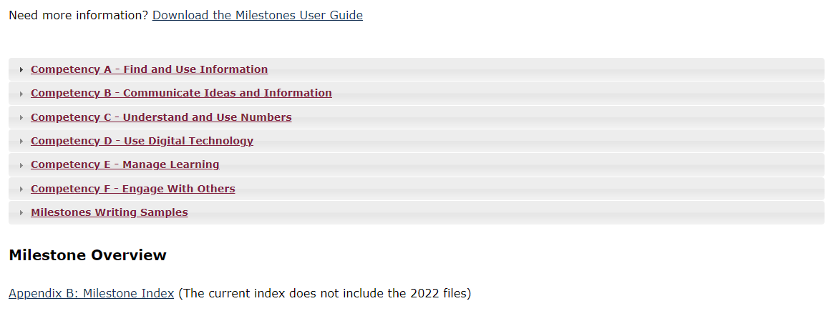
REPOSITORY

Slide 51
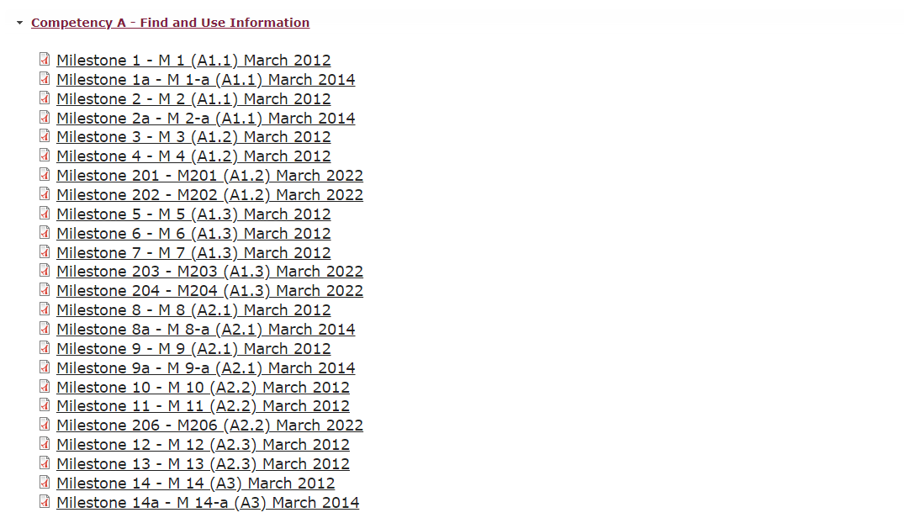
REPOSITORY

Slide 52
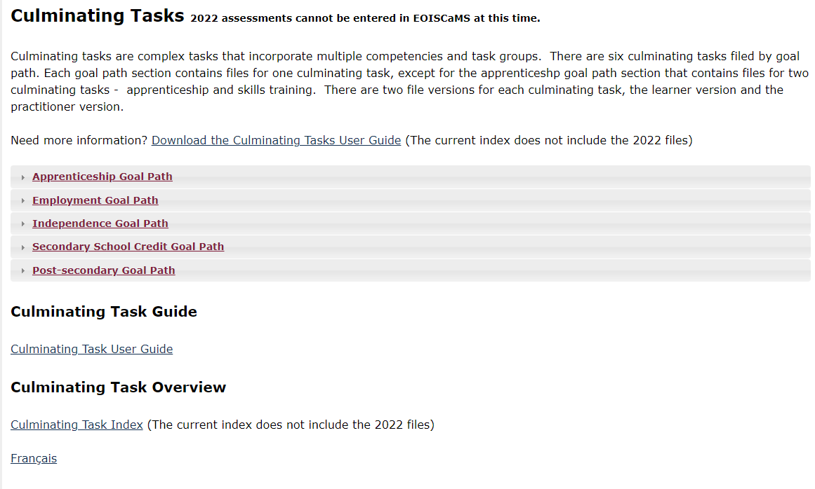
REPOSITORY

Slide 53
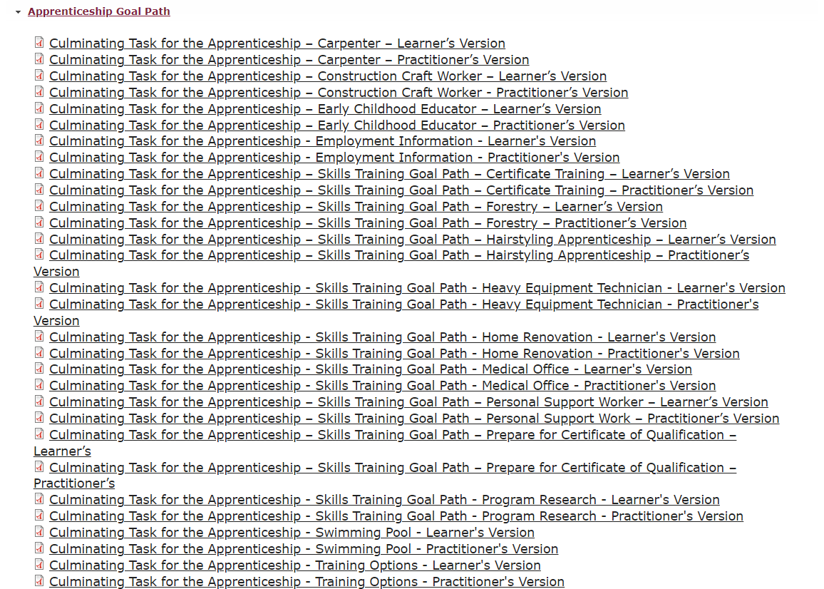
REPOSITORY

Slide 54
Best Practices

Slide 55
Western region best practice interviews “Champions”
https://lbsresourcesandforum.contactnorth.ca/mod/data/view.php?d=10&rid=166
Learner Progress
Completions

Slide 56
General tips for integrating assessment
Introduce the assessment tools and expectations at intake
Review resources that are available to increase learner success (e.g., task-based activities website, assessment resources that support OALCF)
Introduce learning activities that use similar formatting (e.g., layout, spacing, font type, font size, wording, etc.)
Map assessment activities and ongoing learning activities to competencies, task groups and levels associated with an appropriate culminating task
Integrate assessment activities (in addition to milestones) though out program delivery period
Present the learning plan with milestones and a culminating task included so learners understand what is expected

Slide 57
What’s Next?

Slide 58
MLITSD Official Messaging as of September 20, 2022
As part of the LBS Special Initiatives for 2021-22, 29 new milestones and 32 new culminating tasks were developed. The integration of the newly developed OALCF assessment tools into CaMS will not occur until next fiscal year (hoping for April 2023). Therefore, the newly developed milestones and culminating tasks are not available from the current milestone drop-down menu in CaMS.
The ministry has not provided any messaging/direction that service providers should start to use the new milestones. The ministry will communicate when the new milestones are available in CaMS.
Contact North has stated on their website that the milestones will not be placed into CaMS until a later date.
The new milestones have yet to be translated; once we have the English and French versions, they will be posted in CaMS for the 2023-24 fiscal year.

Slide 59
MLITSD Official Messaging as of September 20, 2022, cont’d
Issue / Guidance:
We are advising that LBS SPs do not use the new milestones and culminating tasks, until ministry direction has been provided
If they choose to do so, they will not receive any credit toward the Learner Progress Core Measure and their SQS.
If an LBS SP has used, or uses, one of the new milestones or culminating tasks in the Contact North repository, there is no method to record this in CaMS
If a service provider has already used one of the new milestones in the Contact North repository, the learner would be required to complete a milestone that is already in CaMS in order for it to count towards the Learner Progress Core Measure and their SQS.
The ministry does not advise SPs to select a different or ‘mock’ milestone, as this will skew data reports and not be an accurate reflection of the milestones that are being selected and completed with the learner.

Slide 60
Future Planned Work
Translate the new English tools into French and the French into English
Review original (2011-2014) milestones and culminating tasks to identify and correct errors and add options to maintain or enhance the relevance of milestones
Review and update indexes and guides
Establish a process for monitoring changes or issues with the new set of milestones and culminating tasks created in 2022.

Slide 61
Thank you!
Webinar resources: Pop Up PD Resources for LBS Educators
November 17, 2022 Webinar evaluation: https://tinyurl.com/3m28vhtj

Slide 62
Thank you!
Webinar resources: Pop Up PD Resources for LBS Educators
October 4, 2022 webinar evaluation:
https://app.smartsheet.com/b/form/6d114669e433460fbadd21761368e09d

