Slide 1
Webinar Title
((DATE))
Notes:
Sarah Stocker: Good morning, everyone. This is Sarah Stocker. I would like to welcome you to the first of our 2022/2023 Pop-Up PD webinars. This one will take a look at all of the wonderful resources created for Literacy and Basic Skills in 2021/2022.
I have the pleasure of introducing today’s presenter, Heather Robinet. Heather will be introducing others on our panel today to speak about their resources. Heather is the Executive Director of the QUILL Learning Network serving Huron, Perth, Bruce, Grey and South Georgian Bay. She comes to QUILL after 25 years in Adult Literacy and Basic Skills and English as a Second Language programs with the Avon Maitland District School Board. In addition to managing a face-to-face upgrading and skills readiness program, Heather was also instrumental in starting and coordinating an online provincial Literacy and Basic Skills Program called “The Learning Hub” and a provincial online English as a Second Language Program called “Anytime ESL”. Heather has also worked for Conestoga College and Sioux College as a facilitator/instructor for the Adult Literacy Educator program. Heather earned a Bachelor of Fine Arts Journalism degree from Ryerson Polytechnical Institute and an Adult Literacy Educator certificate from Conestoga College.
Welcome, Heather, and over to you!
Heather Robinet: Thanks Sarah! It’s a pleasure to be here today. I’m usually on the other side, not leading the webinar, but I am looking forward to taking you through a number of new resources and tools that have been developed for the field.

Slide 2
Statement of Land Acknowledgement
I would like to begin by acknowledging the Indigenous Peoples of all the lands that we are on today. While we meet today on a virtual platform, I would like to take a moment to acknowledge the importance of the lands, which we each call home. We do this to reaffirm our commitment and responsibility in improving relationships between nations and to improving our own understanding of local Indigenous peoples and their cultures. From coast to coast to coast, we acknowledge the ancestral and unceded territory of all the Inuit, Métis, and First Nations people that call this land home.
Notes:
I would like to begin by acknowledging the Indigenous Peoples of all the lands that we are on today. While we meet today on a virtual platform, I would like to take a moment to acknowledge the importance of the lands, which we each call home. We do this to reaffirm our commitment and responsibility in improving relationships between nations and to improving our own understanding of local Indigenous peoples and their cultures. From coast to coast to coast, we acknowledge the ancestral and unceded territory of all the Inuit, Métis, and First Nations people that call this land home.

Slide 3
About Pop Up PD for Literacy Educators
free webinar series developed by Ontario’s LBS Regional Networks, Sectors, & the Provincial Support Organizations for Literacy
supports LBS practitioners with presentations on topics important to them
English language webinars presented for LBS practitioners annually since 2015-2016; French language transcriptions are available on COFA’s website!
all webinar presentations, recording links & transcripts here:
https://e-channel.ca/practitioners/pop-pd-resources
webinar topic ideas welcome at: e-channel@contactnorth.ca
Notes:
We’ll start with a bit of information about the Pp Up PD for Literacy Educators. This free webinar series is developed by Ontario’s LBS Regional Networks, Sectors, and the Provincial Support Organizations for Literacy. The webinars support LBS practitioners with presentations on topics important and relevant to them. English-language webinars have been presented for LBS practitioners annually since 2015/2016. French-language transcriptions are available on COFA’s website. All webinar presentations, recording links and transcripts can be found at the link on the slide. Webinar topic ideas are always welcome at the email address provided on the slide.

Slide 4
Today’s Webinar…
Learning Networks of Ontario (LNO) and the Provincial Support Organizations for Literacy (PSOL) create many new resources and tools each year.
This is not an exhaustive list, it’s a refresher.
The presentation will be sent to you after this webinar.
Hyperlinks to all resources are active.
Notes:
The Learning Networks of Ontario and Provincial Support Organizations for Literacy create many new resources and tools for the LBS field each year. Last year the Pop Up PD committee introduced a webinar that showcased resources and tools created in 2020-2021. Due to popular demand, today we offer a similar webinar that showcases tools and resources created during the last fiscal year, 2021-2022.
Many of the support organizations will be delivering their own webinars on selected topics. Watch for all of them, there is a wealth of information in this field, and I know that you will appreciate participating in specific training sessions that will support you in your work.
What you will see today is not an exhaustive list of resources. Many programs are creating their own materials to support learners online. Talk to your Network or Support organization before you start anything, they may know of another program that is willing to share their materials with you.
I am not an expert on all of these resources. This is information that my colleagues sent me to bring to your attention. You may still need to do your own digging into the resources to find the specifics, and I encourage you to do that. Today’s webinar simply provides an opportunity for you to see most of what was created last year, in one place. This PowerPoint will be shared with you after the webinar, so you will have hyperlinks to all the resources.
I’ve tried my best to group tools under appropriate sub-headings, but since many of them could fit under more than one category, that proved to be a challenging task. But let’s proceed as best we can, and hopefully you will be able to make the connections.

Slide 5
Resource – Job Search – PRLN, PHDALC
Virtual Job Search: Skills for Success
Workforce Planning Board of Waterloo Wellington Dufferin in partnership with Project READ Literacy Network and Peel-Halton-Dufferin Adult Learning Network
Profiles defining job search tasks, skill level needed
Identify skills gaps and training opportunities
Notes:
Our first resource is for Job Search - The Workforce Planning Board of Waterloo Wellington Dufferin partnered with Project READ Literacy Network Waterloo-Wellington and Peel-Halton-Dufferin Adult Learning Network to create profiles defining different job search tasks. These profiles aim to clearly identify skill gaps and training opportunities for jobseekers, students and immigrants, so they can work on those skills and improve their success in their job search.
These profiles will also help the Job Developers, employment support workers, and organizations to identify the skills required for a smooth and successful recruitment process in the changing labour market, providing them an opportunity to focus on problem points and enhance employment support. I invite Jane Tuer from Project Read to tell us more about this tool.
Jane Tuer: Thanks, Heather. I am going to try to share my screen. (Transcription Note: The screen sharing can be seen in the YouTube video presentation)
Virtual Job Search: Skills for Success. Every year as part of our business planning, we talk with our Workforce Planning Board. This year, they mentioned that people conduct job searches or join virtual job fairs, but they are struggling. This seemed to be related to lack of skills. I saw this as an opportunity for Literacy and Basic Skills to showcase what we can provide. I offered to do Skills Profiles. Matt from Peel-Halton-Dufferin helped with a lot of the research that went into this.
For those of you who aren’t familiar with Skills for Success, the Essential Skills were changed somewhat. For example, they realized that Document Use was really found within reading, writing and numeracy. That’s why we were always struggling with identifying if something was a Document Use task or a reading task. Computer Use was changed to Digital, because it’s more than just computers now. Thinking becomes Problem Solving. Oral Communication became Communication. Working with Others became Collaboration. Continuous Learning became Creativity, and Adaptability and Innovation.
We held focus groups, surveys and meetings with people who were working in Employment Services, with LBS agencies and with employers. It was quite interesting to hear what people had to say regarding the skills that people actually use and the tasks that they do when they are doing virtual job searches and virtual work. We provided a lot of definitions so people would understand. We explained Levels 1, 2 and 3: Skills for Success uses the same levels as OALCF. We didn’t include Levels 4 and 5, because that’s beyond what we do, and it’s beyond what people need for this. They can learn those things on their own. I gave examples of what the Levels are.
The profiles that we did were Online Job Search and Job Boards, Online Job Application, Resume and Cover Letter on Online Job Applications and Job Boards, Virtual Job Fair and Virtual Job Interview.
There were a lot of things we hadn’t thought about, especially around the Virtual Job Interview. One example is clothing: what are you wearing? Do you wear the same for a business position as you would wear for a retail position. We talked about ensuring that pets wouldn’t interfere with the interview. There were a number of fascinating points brought up that we hadn’t necessarily thought about.
When I presented these profiles to Employment Services and to employers, I emphasized that this is what LBS provides. I would discuss the skills and also provide examples of the actual tasks and complexity levels. (Jane addresses an example that is shown on screen). This addresses the different qualifications that someone would need. Digital is important in any area. Not all Skills for Success areas (Collaboration, Creativity, and Adaptability and Innovation) do not have levels related to them because they haven’t been levelled. They weren’t in the Essential Skills, and they haven’t been in Skills for Success. But they are of course still important. Employers gave us a lot of feedback in this area which is very helpful for us when working with learners on the Employment path. It’s also important for us to be able to articulate that we cover these skills and can help learners build these skills.
All of these profiles that we developed are available on our website (ProjectRead.ca) and on the Training Board’s website.
Heather Robinet: Thank you, Jane. I am sure a lot of people will be exploring this resource. It’s nice to have an overview of it and be able to see the actual resource rather than just a link on a PowerPoint.

Slide 6
Resource – Job Search - MTML
Carlos Gets a Job: Learning Activities for LBS programs
Fillable Form activities related to job search and getting/starting a new job
Wanting a New Job
Reading Job Ads
Applying for a Job
Interviewing for a Job
Practising Job Skills
Completing Forms
Doing Worker Training
Getting Paid
French Translation
Notes:
Our next resource is also on job search. Metro Toronto Movement for Literacy has created learning activities for adult literacy programs focused on helping their literacy learners get a new job. This resource follows a job seeker, Carlos, through the various stages of job search, applying for a job, being hired for a job, and training for a job, with real world tasks provided for each stage.
This resource is also available in French.

Slide 7
Resource – Employment - LLO
GET SET for Health Service Support Jobs – Laubach Literacy Ontario
9 Power Points
Learner Plan Template
Learner Assessment
Learner Workbook
Handouts & Activities
Facilitator’s Guide
*Fillable PDFs for virtual delivery
Notes:
Laubach Literacy Ontario updated several of its resources last fiscal, including its “GET SET for Health Service Support Jobs” targeted training package. This package includes all the materials you need to run a workshop series for learners interested in pursuing health service support occupations, including:
9 PowerPoints
Learner Plan Template
Learner Assessment
Learner Workbook
Handouts and Activities
Facilitator’s Guide
With the update, this series now includes fillable PDFs for virtual delivery
https://www.laubach-on.ca/bookstore/book/get-set-for-health-service-support-jobs

Slide 8
Resource – Employment - LLO
GET SET for Customer Service – Laubach Literacy Ontario
Updated resource
6 Power Points
Learner Self-Assessment
Learner Plan Template
Activities & Handouts
*Fillable PDFs for virtual delivery
Notes:
Like the Health Service Support Jobs training package cited previously, the “GET SET Customer Servic”e targeted training has also been updated to include fillable PDFs for virtual delivery. https://www.laubach-on.ca/bookstore/book/get-set-for-customer-service

Slide 9
Resource – Employment - SMLN
Soft Skills Solutions
Welcome/intro section plus 5 modules
Personal Management, Communication, Collaboration, Problem-Solving, and Success on the Job
Recently updated for inclusivity, diversity and accessibility
Revamped to be delivered online (synchronously) if F2F isn’t possible
Proprietary so have to be a certified facilitator to deliver the training
Notes:
Another employment resource is “Soft Skills Solutions”. This is a 30 hour certificate course developed by the Simcoe Muskoka Workforce Development Board, now amalgamated with the Simcoe Muskoka Literacy Network. It is designed to reinforce employee skills in:
Personal management
Communication
Collaboration
Problem solving
Success on the Job
The course was recently updated for inclusivity, diversity and accessibility, and to allow for synchronous delivery online.
As the program is proprietary, a certified facilitator must deliver the training. LBS agencies can qualify to run Soft Skills Solutions at their centres and can be trained to be facilitators in a one-daytraining that is offered for a nominal fee.
I know that many people are looking for a soft skills curriculum, and I invite you to reach out to Simcoe Muskoka Literacy Network for more information.

Slide 10
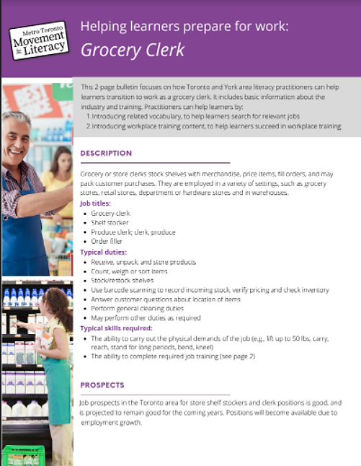
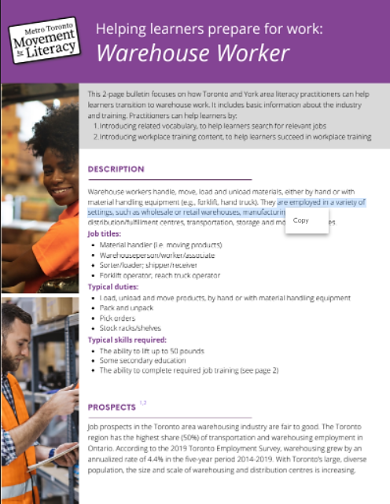
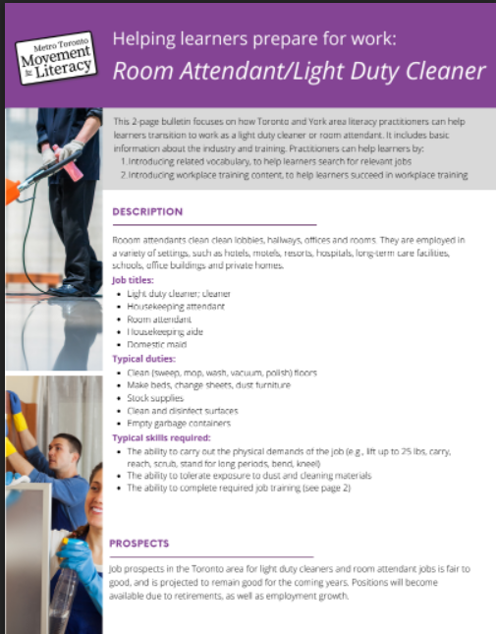
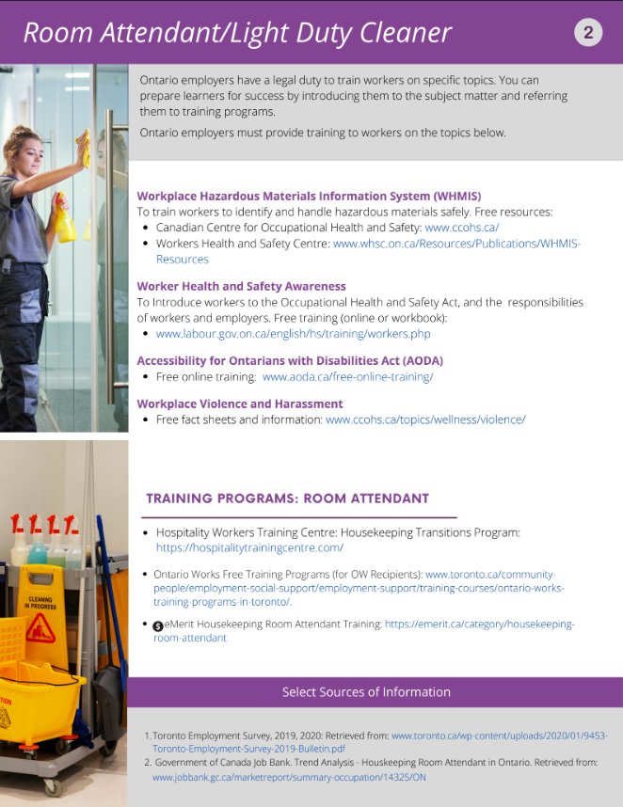
Resource – Employment - MTML
2- page bulletins on Employment-focused Trends
Resources created for practitioners to help learners look for employment focused on trends and training in specified entry-level occupations in the Toronto and York Regions
Warehouse Worker, Grocery Clerk, Room Attendant/Light Duty Cleaner
Notes:
Metro Toronto Movement for Literacy has also created two-page bulletins about three occupations popular in the GTA, specifically Toronto and York. These bulletins contain basic information such as job titles, typical duties, and skills requirements, as well as training information about WHMIS, Worker Health and Safety, Accessibility for Ontarians with Disabilities Act (AODA), Fact sheets about Workplace Violence and Harassment, as well as Information about specific training programs available.
Practitioners can help learners by:
introducing related vocabulary, to help learners search for relevant jobs; and
introducing workplace training content, to help learners succeed in workplace training.

Slide 11
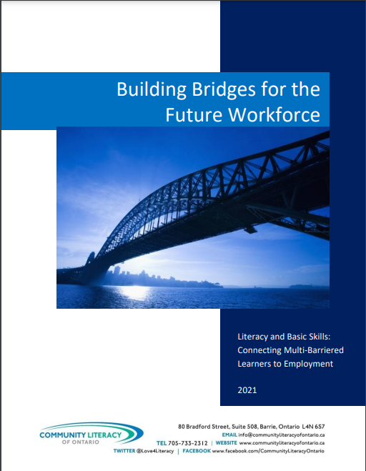
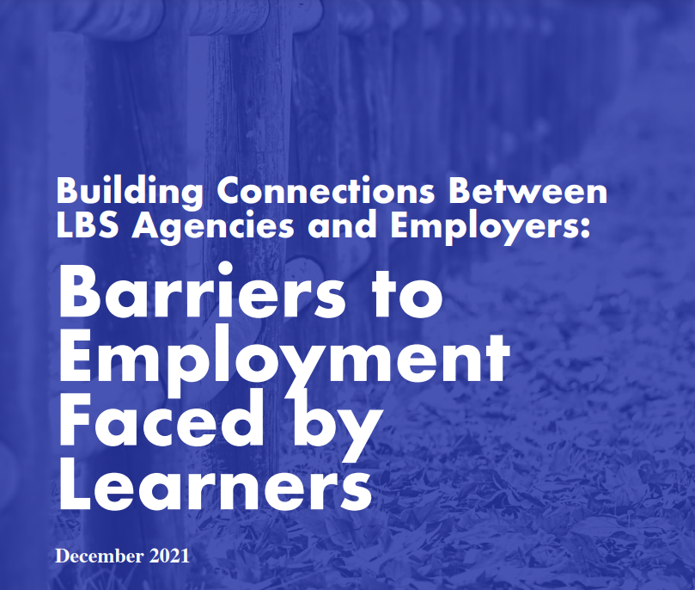
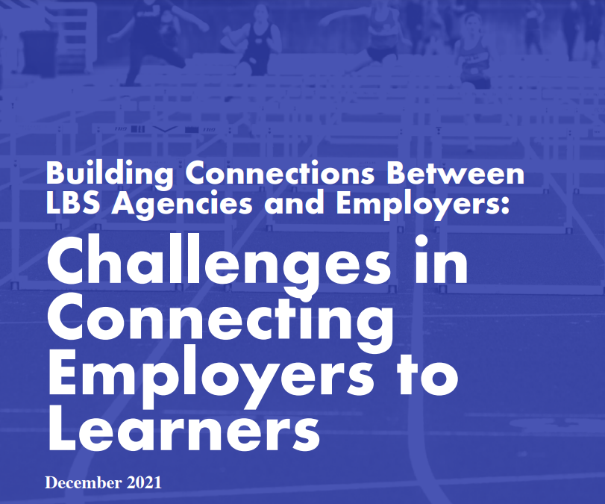
Resource – Employment - CLO
Building Connections Between LBS Agencies and Employers – Fact Sheets
Barriers to Employment Faced by Learners
Challenges in Connecting Employers to Learners
Strategies & Promising Practices
Full report: Building Bridges for the Future Workforce
French translation
Notes:
Ontario’s Literacy and Basic Skills programs serve many adult learners with employment goals. To support these learners, LBS programs often build relationships with local employers in order to connect learners with employment opportunities. Supporting adult learners with employment goals has long been a top priority and focus of literacy educators.
Because of the importance of supporting learners with employment goals, Community Literacy of Ontario has researched and published three factsheets to take a closer look at the barriers, challenges, and
promising practices involved in supporting learners with employment goals. These factsheets are:
Barriers to Employment faced by Learners
Challenges in Connecting Employers to Learners
Strategies and Promising Practices
To learn more, you can read CLO’s full report called: Building Bridges for the Future Workforce, released in February 2021

Slide 12
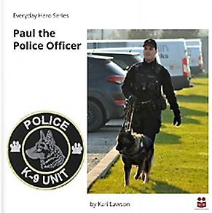
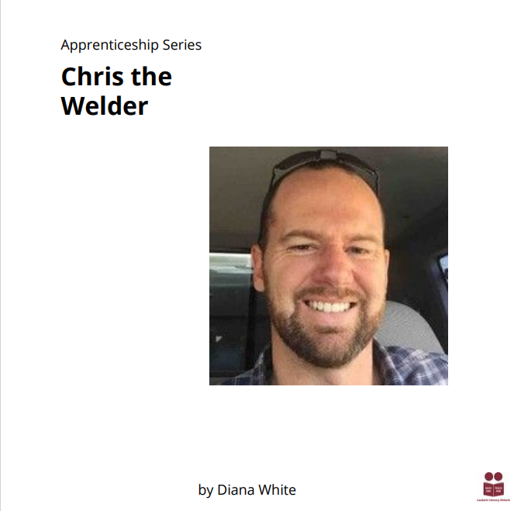
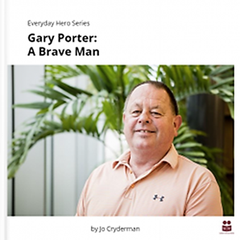
Resource – Reading - LLO
3 new adult readers available
Paul the Police Officer
Gary Porter: A Brave Man
Chris the Welder
Notes:
Laubach Literacy Ontario has also created three new readers. Two are part of its new “Everyday Hero” series, and one is part of a new Apprenticeship series. All readers are low-level, high interest for adults and each is available as a downloadable PDF or can be accessed online. There is a built-in reader for the online version.
Paul the Police Officer (by Kari Lawson) is about a police officer who is part of the canine unit and works as a canine handler.
Gary Porter: A Brave Man (by Jo Cryderman) is the true story of a man with literacy challenges, and how he overcame them.
Chris the Welder (by Diana White) is about a young man who discovered he had an aptitude for fixing things on his family’s farm and turned it into a career.
Stay tuned this fiscal as LLO will be adding downloadable fillable PDF activities to the readers I’ve referenced.

Slide 13
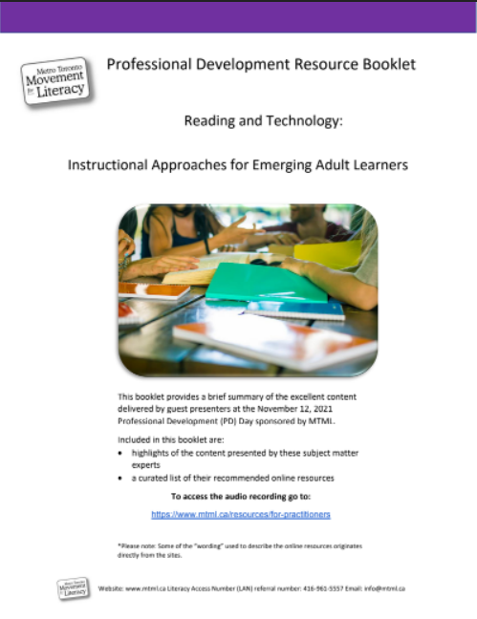
Resource – Online Resources - MTML
Professional Development Resource Booklet: Reading and Technology: Instructional Approaches for Emerging Adult Learners
Summary of content delivered at a November 12, 2021 PD Day sponsored by MTML, including;
Highlights of the content presented by subject matter experts
Curated list of recommended online resources
Audio recording available at: https://www.mtml.ca/resources/for-practitioners
Notes:
The “Professional Development Resource Booklet – Reading and Technology: Instructional Approaches for Emerging Adult Learners” is the by-product of a PD Day Learning Day hosted by MTML in November 2021.
It contains highlights of the content covered at four workshops:
Teaching Lower Level Adult Literacy Learners
Science of Reaching – A workshop for Adult Literacy Teachers
Citizen Literacy: Reading and Writing for Everyone/Using Technology
Digital Literacy Tips for Low-Level Literacy
It also includes a curated list of recommended online resources. It’s a long list, and I encourage you to look more closely at this resource to access that list.

Slide 14
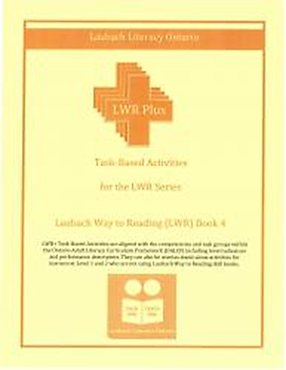
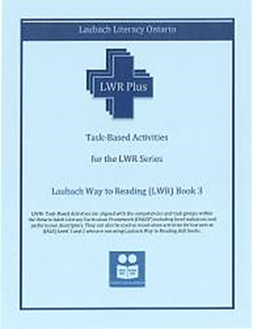
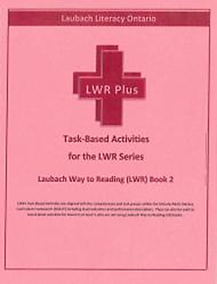
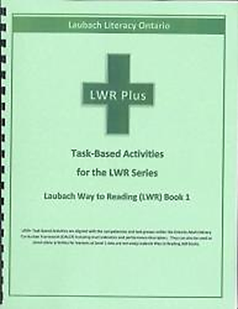
Resource – Digitized Activities - LLO
Laubach Way to Reading series updated
Activities are aligned with the competencies and task groups within OALCF, including level indicators and performance descriptors
Fillable PDFs are now available for virtual use
LWR Book 1 -
LWR Book 2
LWR Book 3
LWR Book 4
Notes:
Also on the topic of reading, Laubach Literacy Ontario has updated its “Laubach Way to Reading Task-based Activities” Workbooks 1-4. Those familiar with these books will know they contain task-based activities aligned to the competencies and task groups within the OALCF, including level indicators and performance descriptors, and are often used in conjunction with LWR skill books. They can also be used as stand-alone activities.
The update means they now include fillable PDF forms for use in online/virtual learning scenarios.

Slide 15
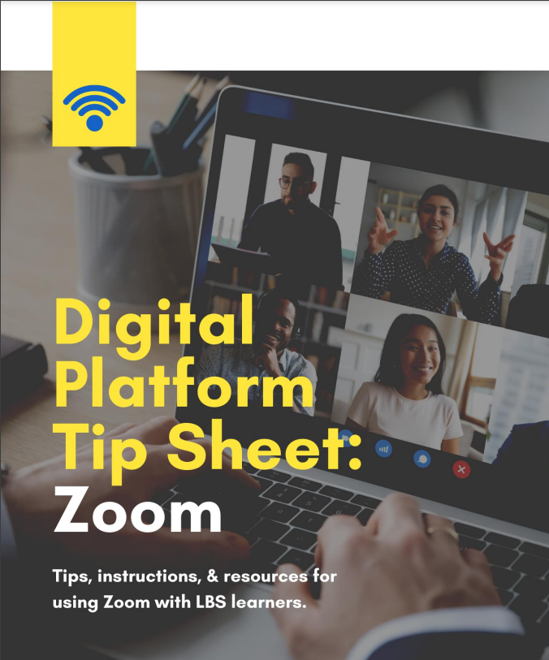
Resource – Digital Platforms - CLO
Digital Platform Tip Sheets for LBS
Contains tips, instructions, resources and success stories on using these technologies
Facebook
Google Classroom
Zoom
Notes:
Community Literacy of Ontario has developed three tip sheets to support community-based LBS agencies learn more about using digital platforms with adult learners. The three technologies covered are Facebook, Google Classroom and ZOOM. Each sheet contains tips, resources and success stories on using these technologies in LBS agencies.

Slide 16
Resource - Apprenticeship - MNN
Skilled Trades Resource Compendium
Notes:
The “Skilled Trades Resource Compendium” was mentioned briefly in last year’s webinar, but has undergone significant updates/upgrades this year, including French translation, and the addition of a tab containing a list of the Top 10 Most Commonly used resources with learners on the Apprenticeship goal path.
Housed in an Excel spreadsheet, this collection of LBS resources and good practices will help you prepare your learners for transition to the skilled trades and is available for all streams.
The Collection is broken down into resources (information, assessments, tools, websites or other materials used with learners), and Good Practices (strategies for using the aforementioned resources), and is sorted by language preference.
Tab 1 presents the User Instructions.
Tab 2 presents the Top 10 Commonly used resources.
Tabs 3 to 5 present the categories:
* Exploring Skilled Trades (English/French)
* Assessment for Readiness (English/French)
* Develop Essential Skills (English/French)
Tabs 6 to 8 present the categories:
* Resources All English
* Resources All French
* Resources All (English and French)

Slide 17
Resource – Apprenticeship - CLO
Apprenticeship/Skilled Trades Resources Guide , March 2021
50 most popular easy-to-access, user-friendly resources
Listed in alphabetical order, with screen shot, brief summary
Also available in French
Notes:
Community Literacy of Ontario also produced an “Apprenticeship / Skilled Trades Resources Guide” to support adult learners with apprenticeship or skilled trades goals. It contains an annotated list of 50 of the most popular resources used by LBS practitioners to support adult learners on the Apprenticeship goal path.

Slide 18
Resource – Apprenticeship – SMLN with LOCS, LLSC, ROVLN, QUILL, ABEA, COFA
The Apprenticeship Connection
E-newsletter designed to provide information on ways LBS can support apprenticeship
Provides examples and links to additional information/resources
Keeps service providers up-to-date on developments and initiatives in the apprenticeship/skilled trades fields
French translations
Issue 1, Issue 2, Issue 3
Notes:
“The Apprenticeship Connection” is an e-newsletter designed to provide information on ways LBS can support apprenticeship (including examples), as well as keep service providers up-to-date on developments and initiatives in the apprenticeship/skilled trades fields. Developed by SMLN in partnership with LOCS, LLSC, ROVLN, QUILL, ABEA, COFA, and LLEO as part of a business plan deliverable, there were three issues produced last fiscal
Pre-apprenticeship partnerships reports, skills assessment tools;
Successful apprenticeship partnerships; and,
Apprenticeship Recruitment.
The e-newsletters can be downloaded from the LNO website or the SMLN website. I encourage anyone who doesn’t feel up to date in Aparenticeship to read through these newsletters. It’s simply explained and identifies where literacy can support Apprenticeship.

Slide 19
Resource – Website - ABEA
Career Ladders Google Site
Result of career ladders created for in-demand positions in Manufacturing and Health Care (Hamilton-Niagara Economic Region)
Has information about entry/mid-level jobs (wages/outlook)
Shows skills needed for these jobs
Lists training available to gain the skills needed
Notes:
The Adult Basic Education Association of Hamilton undertook a Career Ladders Project last fiscal, which resulted in the development of career ladders for in-demand positions in the Manufacturing and Healthcare fields. These ladders show the skills you need for entry-level jobs and how they can lead to mid-level jobs. They are intended to help people explore in-demand jobs and the skills and training needed to get those jobs.
A resource to come out of this project is a Google website site that people can use: https://abea.on.ca/career-ladders/
The site has
job information about entry and mid-level jobs (like wages, outlook, etc.)
the skills needed for those positions
lists of training available to help you gain the skills you need
Stay tuned this year, as ABEA is working on a second phase of this project, which will result in the development of a web tool.

Slide 20
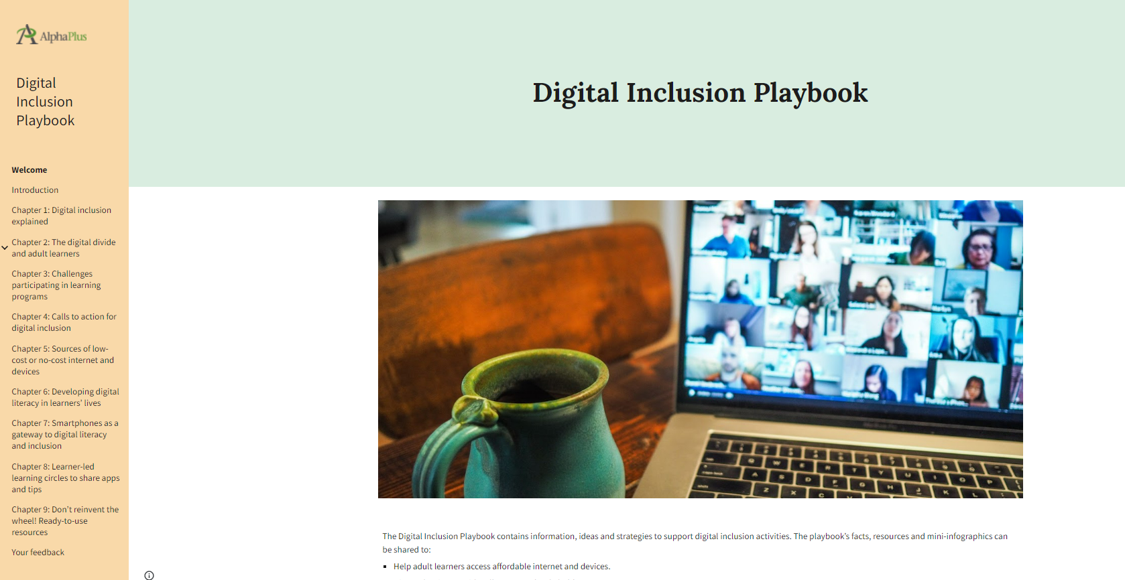
Resource – Website - AP
Digital Inclusion Playbook
Contains information, ideas and strategies to support digital inclusion activities
Notes:
AlphaPlus has developed a “Digital Inclusion Playbook” that is presented on an AlphaPlus microsite.
It contains information, ideas and strategies to support digital inclusion activities. This could mean helping learners access affordable internet and devices, discussing key issues with colleagues and stakeholders, building a case for support with funding partners and community partners, and taking action towards change.
At this time, I’m going to turn over the mic to Christine Pinsent-Johnson from AlphaPlus, who is going to highlight this resource for you.
Christine Pinsent-Johnson: Thanks, Heather. I will share my screen to guide you through a couple of the web pages. (Transcription Note: Screen sharing can be viewed on the YouTube video) We decided to do a microsite, but it is set up book-style; you will see the menu down the side. We did this for flexibility in possible updates and changes. This project came about in response to the pandemic and some of the issues about access that came to the fore. They were always there, but the pandemic exacerbated and highlighted them. We started collecting little bits and pieces of information and decided to bring it into one place where people could find information, resources and graphics that they could use as part of their efforts or conversations they might be having about digital inclusion. This is just one of a dozen different resources that AlphaPlus has produced this year. Our staff would be very happy to connect with you about any of the resources. But this is a unique resource among the various AlphaPlus offerings. I wanted to point out a couple of things that you could do. Everything on here that AlphaPlus has produced is shareable. You can download things such as graphics that you could add to your website or other communications. All of these things have been made shareable.
Learners could get involved in the “Internet for All” campaign run by ACORN. You can learn more about that on the site.
There is a list of sources of low-cost or no-cost internet and devices. You may be aware of some of these, but we have them collected into one central place so you can easily find them.
There is some information about leveraging smartphones. Many learners have smartphones so you can learn about leveraging what they know and how to use them. Again, we have collected some ideas, things you are probably already doing, which we have pulled together in one place. AlphaPlus also has a useful apps collection. There are some comprehensive learning apps that are becoming available. Learners could load these on their phones for some additional learning beyond the program. Chapter 8 is about creating learner-led learning circles to share apps and tips. We find that learners have some good ideas about shortcuts and being savvy with their phones; bringing them together to share that expertise is a great idea.
A good reminder is to not reinvent the wheel. We started putting together of good sites such as GCF LearnFree and other sites you can access. We included Creative Commons resources which have a lot of potential, because you can take these and make them your own, which I think is an exciting area for us to support.
That’s a quick tour of a collection of materials, resources, ideas, data for any digital inclusion efforts. Someone said it might be great for their board members.
We collected some articles that appeared in media. Two of them focused on LBS programs, one in Renfrew County and one in Orillia. This type of media focus could be leveraged for conversations with stakeholders.

Slide 21
Resource – Website - QUILL
Task-Based Activities for LBS
With support from LLSC, the task activities on this website have been re-created as Google forms and fillable PDFs to make them easier to share online with learners. An index has been added to the website.
20 Interactive tasks previously in Flash have been recreated as flash-free versions.
Notes:
Heather Robinet: Thanks, Christine, for that presentation. That’s one of those resources that I think people will be exploring after today to see up close and personal what resources are there and what might be of specific use to individual programs. Thank you also to AlphaPlus for all of the resources and tools that they create for the field.
The digitization of the printable learning activities on QUILL’s Task-Based Activities for LBS website was prompted by a suggestion from Lisa MacArthur at The Literacy Group, aided by a Job Creation Project undertaken by Literacy Link South Central, and continued with QUILL funding after the JCP ended, using accessibility-trained staff from the JCP. The result is that over the last 12 months, 117 activities have been digitized as either a fillable PDF or Google Form or both and uploaded to the task-based activities portal website.
For ease of finding these activities, a chart containing the name of the activity, level indicators, and digitized formats available, as well as a hyperlink to the tasks, has been created and added to the task-based activities website. The plan is to continue to digitize those activities on the TBA portal that can be digitized, revisit and revise those that can’t, and add new digitized tasks whenever possible.
There are also 20 interactive tasks that have been updated and uploaded to the portal. They are also included on the chart I mentioned with a hyperlink to them. All of them are also created in Google Forms. That makes a total of 137 digitized tasks on the portal. We’re hoping to get to more, but a lot of them were written in such a way that they can’t be digitized without a complete overhaul, but we are working on the ones that can be transferred directly, so stay tuned!
Sarah Stocker: Heather, we do have a question from a participant who says they use the Google Forms tasks, but where do the completed forms end up?
Heather Robinet: When you use the QUILL forms, you get prompted to make a copy of them which then is your own version that you can store in your own Google Drive. Once you have your own copy saved in your Drive, you can go in and add an email address for learners to know where to send them. I can send more information on that if that wasn’t clear. Lisa MacArthur might also be able to help with that.

Slide 22
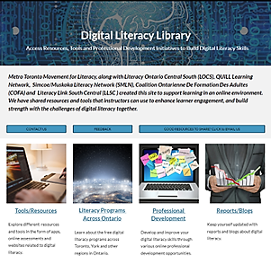
Resource - Website – MTML
Digital Literacy Library
Supports learning in an online environment
Shares resources and tools that instructors can use to enhance learner engagement, strengthen digital literacy skills
Notes:
The Digital Literacy Library was created as a Google site last fiscal by MTML as part of a business plan deliverable, in partnership with LOCS, QUILL, SMLN, COFA, and LLSC. It supports learning in an online environment by sharing online resources and tools that instructors can use to enhance learner engagement while also building their digital literacy skills and those of the learner. I’m now going to call on Ambreen Ahmad of MTML to give us an overview of the digital literacy library.
Ambreen Ahmad: Thank you. I will share my screen (transcription note: screen sharing is visible on the YouTube recording).
To find the link, go on the MTML website and click on “resources”. On that page, you will find the Digital Literacy Library and you can click there to go to the website.
Last year, MTML in partnership with LOCS, QUILL, SMLN, COFA and LLSC, came up with this website to provide tools and resources to practitioners in the LBS field so that they could deal with the digital literacy component.
We tried to make it simple, so we created different tabs for practitioners and learners. I’ll show you an example. When you click on “practitioners”, it is divided into literacy, numeracy and digital technology. Once you click on one of the topic areas, you will see a list of resources that we update regularly. For learners, we have reading, writing, math, and computer literacy. All of the resources are online. We have some online assessments. We have provided some apps and online games that you can use. Just click on the links to go to the appropriate website or app.
Last year, we had quite a few workshops that were delivered by MTML and our partners. AlphaPlus was also involved. We compiled all of those and put up recorded versions under Professional Development. Any handouts provided during the sessions are also available. There is also ASL interpretation.
We have limited resources available in French. If you think more can be added, please forward them to us.
For training resources, we have provided links to tools and resources you can use.
Literacy programs across Toronto are all our partners, and we have included links to their respective websites.
Reports and blogs are being updated according to whatever is new and available, so updating is ongoing.
If you have any questions, please feel free to ask.

Slide 23
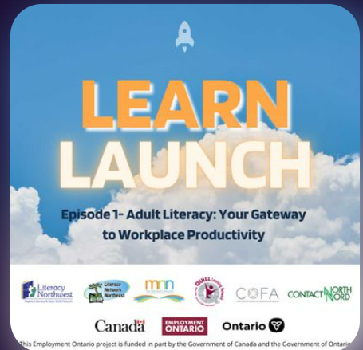
Podcasts – LNW
Adult Literacy: Your Gateway to Workplace Productivity
With support from MNN, LNN, QUILL, COFA and COFA, LLSC and Elgin, Middlesex, Oxford Workforce Planning and Development Board
Focused on how employers can develop and build their own workforce by utilizing local adult learning centres and working with LBS networks
Why workplaces and employees would benefit from skills upgrading and services LBS can provide
French translation
Notes:
Heather Robinet: Thanks for sharing! It is hard to give a brief overview when there is so much to share. Once again, I encourage everyone to log in to this resource and check it out. I know you will find something of value and use!
Another resource that we are starting to see more of is podcasts, and I think we are going to start seeing more of those. This one was produced by Literacy Northwest.
“Adult Literacy: Your Gateway to Workplace Productivity”. This podcast focuses on how employers can develop and build their own workforce by utilizing local adult learning centres and working with Literacy and Basic Skills Networks. It identifies all the reasons employers would/should work with LBS networks, and why workplaces and employees would benefit from skills upgrading and the services that LBS can provide. It’s a great marketing tool. The first time I saw it, I thought everyone should share this with their learners, employers and everyone. It summarizes literacy with an employment focus so well. Use it! It was made to be shared.
This Podcast was part of a business plan deliverable led by Literacy Northwest and supported by the Mid-North Network, Literacy Network Northeast, QUILL Learning Network, Coalition Ontarienne de Formation Des Adults, (COFA) and Contact North. Tamara Kaattari, Executive Director of Literacy Link South Central and Jessica Gowers – Communications Manager for Elgin, Middlesex, Oxford Workforce Planning and Development Board played integral roles in developing the podcast..
It’s my understanding that this is the first of many podcasts to come, so stay tuned this fiscal for more.
The podcast can also be accessed on all available platforms including:
https://music.amazon.com/podcasts/2f580218-61a8-4107-9ea2-b0dee8b828b0/learn-launch
https://podcasts.apple.com/ca/podcast/learn-launch/id1615575581
https://youtu.be/MnNeXL9nD14
https://open.spotify.com/show/4RJl27gApXBmZ1IyJkHrmK

Slide 24
Podcasts - LLN
Getting Connected
For Not-for-Profit professionals who work with adults to reach their learning, employment and life goals
To build more full and multi-faceted goal pathways to benefit clients
Variety of topics last fiscal, continuing this fiscal
Notes:
Literacy Link Niagara was also involved in podcasting last fiscal, delivering 21 “Getting Connected” podcasts over the course of the year. Hosted by Ashley Hoath-Murray & Gay Douglas, these podcasts have continued into this fiscal, and respond to a need post-pandemic to connect more than ever with service providers to build full and multi-faceted goal pathways that will benefit our clients. The Getting Connected podcasts are directed at not-for-profit professionals who work with adults to reach their learning, employment and life goals.
Although hosted in Niagara, the tips, tools and tricks that are shared go beyond regional boundaries so are well worth listening to.
You can link to the podcasts here: https://open.spotify.com/show/1iZ3tbpD4AYwtVnlmYa3I8

Slide 25
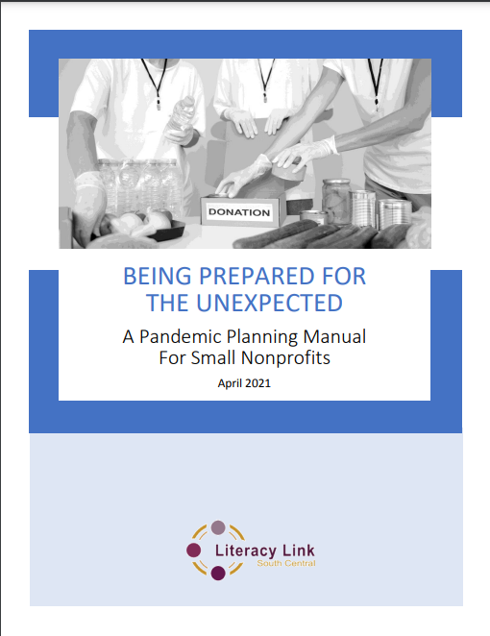
Resource – Manual - LLSC
Being Prepared for the Unexpected: A Pandemic Planning Manual for Small Nonprofits
Up-to-date compendium of resources, information, and general recommendations tailored for LBS nonprofits and other community service nonprofits
Thorough guide designed to help maintain optimal function during challenging times
French translation
Notes:
The :Being Prepared for the Unexpected: A Pandemic Planning Manual for Small Nonprofits” was released at the end of March 2021, so is being included in the list of resources for this year. Although it was created in response to needs generated by the COVID 19 pandemic, this manual contains a lot of great information, tools and strategies that are valuable any time – not just in a pandemic.
For those programs who are wondering how to deliver LBS training currently, there are a lot of suggestions that might help with planning.

Slide 26
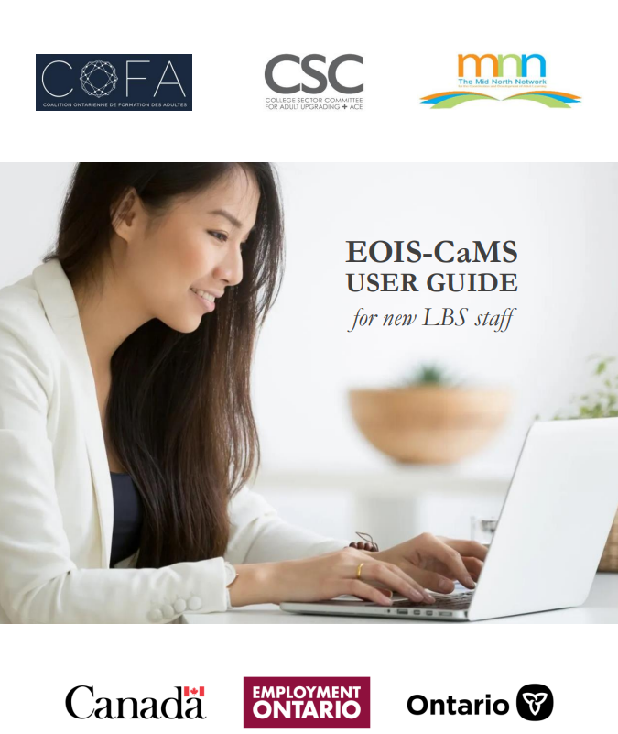
Resource – Manual – MNN, CSC, COFA
EOIS-CaMS User Guide for new LBS Staff
Revised and released in January 2022
Informal guide for new users of the EOIS Case Management System, aka CaMS
Provides details on the functuality of CaMS using screenshots, step-by-step instructions and short explanation
Available in French and English
Notes:
Another manual that was created last fiscal and released recently is the “EOIS-CaMS User Guide for New LBS Staff”. Practitioners have been waiting for an updated CaMS manual that reflects the changes made to the database.
COFA, CSC and Mid North Network collaborated last year to create a new and updated EOIS-CaMS User Guide for new LBS Staff.
The guide provides details on the functionality of CaMS using screenshots, step-by-step instructions and short explanations to make the task of entering learners/clients and their data into the CaMS database easier. A big thank you from the field for this resource! I think this resource is getting a lot of use.

Slide 27
Resource – Professional Development – LNO/PSOL
Pop Up PD for LBS Educators, 2021-2022 series
6 webinars hosted
Loading Up Your Resource Arsenal: A look at the new LBS tools created in 2020/21
Understanding the Detailed Service Quality (DSQ) Report 64
Essential Skills and the OALCF Connection
Workforce Literacy & Pre-Employment Planning
Workplace Literacy: A Snapshot of What’s Happening in the LBS field
Micro-credentials: What? Why? When? And Where?
Playbacks, with ASL interpretation, transcripts, other resources
French translations
Notes:
During the last fiscal, the Pop Up PD committee hosted 6 webinars:
Loading Up Your Resource Arsenal – A look at the new LBS tools created in 2020/21
Understanding the Detailed Service Quality (DSQ) Report 64
Essential Skills and the OALCF Connection
Workforce Literacy & Pre-Employment Planning
Workplace Literacy: A Snapshot of What’s Happening in the LBS Field
Micro-credentials: What? Why? When? And Where?
The information covered in each of these webinars is timeless. For that reason, all of the webinars were recorded, contain ASL interpretation as well as English and French transcripts. You can find the playbacks of all PUPD webinars/resources (dating back to 2015) on the Contact North website (link provided) and also on the COFA website.
https://e-channel.ca/practitioners/pop-pd-resources

Slide 28
Resource – Training – PRLN
Get Set Learn Family Literacy Certification & Training Programs
Designed to help practitioners learn and apply the key components of family literacy to:
Increase the literacy skills and wellbeing of families
Remove barriers and empower families
Now available online
Fee for service
Notes:
Project Read Literacy Network has its ”Family Literacy Certification & Training” programs available online now. Although these are training programs offered for a fee, literacy plays a crucial role in a family’s health and ability to thrive, and many LBS practitioners are taking the GET SET LEARN training and applying the key components of family literacy in their programs in order to increase the literacy skills of their learners and the wellbeing of their families as well. This resource could be helpful for those offering family literacy but also for learners who have young children.
https://projectread.ca/tools-and-resources/practitioner-training-and-development/gsl-family-literacy/

Slide 29
Resource – Website – LLO, CLO, CN
LBS Resources Forum
Notes:
Laubach Literacy Ontario and Community Literacy of Ontario and Contact North invite you to visit the updated “LBS Resources Forum.” It’s one of the few repositories for LBS resources that is pretty inclusive. It contains a large variety of resources from across the field. The site contains an annotated resource library with resources sorted into relevant categories, each with a built in search feature. Resources can be downloaded or linked to directly. You can use the global search button on the upper right hand corner of the page or you can search within each of the categories.
There are many helpful resources on topics such as:
• OALCF Goal Paths • Blended Learning • Marketing • Assessment • Administration, PD and Research
They have recently added many new resources to a key topic area. Be sure to check out the updated Administration, PD and Research section of the Forum. I have also been told that a number of marketing resources have been added to this site.

Slide 30
Report – Apprenticeship – CLO with CSC, CESBA, LLO
Apprenticeship and Skilled Trades Through the Lens of LBS report
Explores Apprenticeship and Skilled Trades through the lens of the different LBS sectors
College, school board, community-based
Focused on universal and individual approaches for supporting learners
Reflects challenges, strategies, success and “big ideas” on how apprenticeship can be supported by LBS
French Translation
Notes:
“Apprenticeship and Skilled Trades through the Lens of LBS” report - In this report, CLO explores Apprenticeship and the Skilled Trades through the lens of different Literacy and Basic Skills (LBS) sectors, focusing on their universal and individual approaches for supporting learners with Apprenticeship or Skilled Trades goals.
Given that Apprenticeship and the Skilled Trades play an important role in the Ontario economy, and the province’s Literacy and Basic Skills (LBS) programs are a valuable support to prospective Apprentices who need to develop the skills to succeed on the job, in-school classes, and as they prepare to write their Certificate of Qualifications (C of Q), CLO used information gathered from the results of a provincial survey, provincial focus group, and interviews with LBS representatives and sector-specific support organizations, to report challenges, strategies, successes, and “big ideas” from across the Community-based, College and School Board sectors to increase our common understanding of how this goal path can be supported in LBS agencies.
It is available in French and in English.

Slide 31
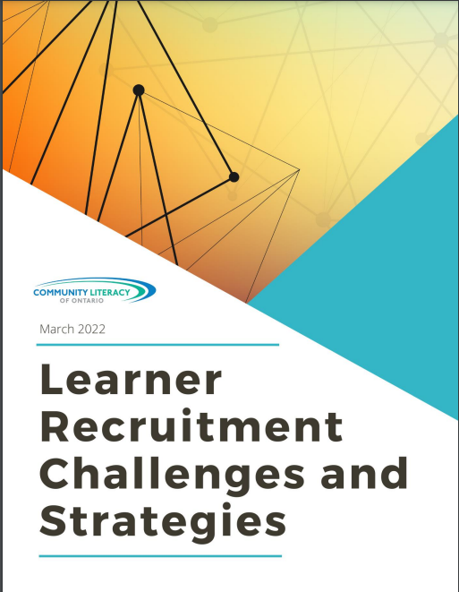
Report – Learner Recruitment - CLO
Learner Recruitment Challenges and Strategies Report , March 2022
Challenges faced and strategies used by community-based LBS agencies to recruit learners
Described in order of popularity
Tried and true methods
New methods due to COVID
Methods no longer working
French translation
Notes:
“Learner Recruitment Challenges and Strategies Report” – March 2022 - In the current climate brought about by COVID-19 and other factors, there is a critical need to share marketing strategies and promising practices amongst LBS programs in Ontario. Accordingly, as one of its business plan deliverables for 2021/22, Community Literacy of Ontario researched (via a provincial survey, focus groups and key informant interviews) and wrote this Learner Recruitment Challenges and Strategies report. The report covers the following topics:
Successful Learner Recruitment Strategies
Stories from the Field – Recruitment in Action
Learner Recruitment Challenges
https://www.communityliteracyofontario.ca/wp/wp-content/uploads/Learner-RecruitmentReport-March-2022-FINAL.pdf
I know that a number of programs are struggling to reach their learner numbers and are looking for new ways to recruit learners.

Slide 32
Report – Supporting Learners - CLO
Supporting LBS Learners Facing Multiple Barriers: Strategies, Strengths, Barriers & Partnerships
Identifies a wide variety of effective strategies to support adult learners with multiple barriers
French translation
Notes:
Ontario’s Literacy and Basic Skills programs have long served adult learners facing multiple barriers to learning. These barriers and vulnerabilities include poverty, education levels, disabilities, lack of social supports, limited access to information, employment status, poor health conditions and more.
As part of its 2020-21 business plan, Community Literacy of Ontario conducted research into how community-based LBS agencies support adult learners facing multiple barriers to learning. They received detailed responses from 30 different agencies. Those responses, plus information gained from an online focus group that discussed particular strengths in serving vulnerable learners, culminated in the writing of this report on Supporting LBS Learners Facing Multiple Barriers. This report is exactly what it is titled to be – a look at a wide range of barriers and vulnerabilities presented by LBS learners, and strategies on how to support the learners who have them.
This resource is also available in French.

Slide 33
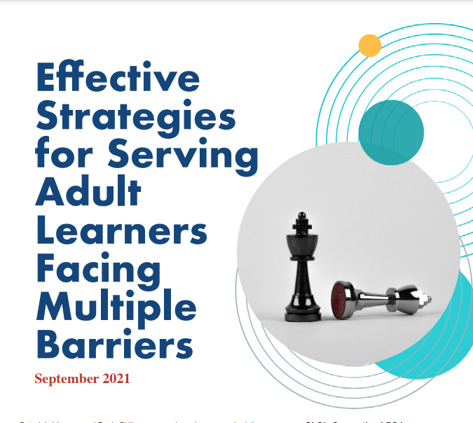
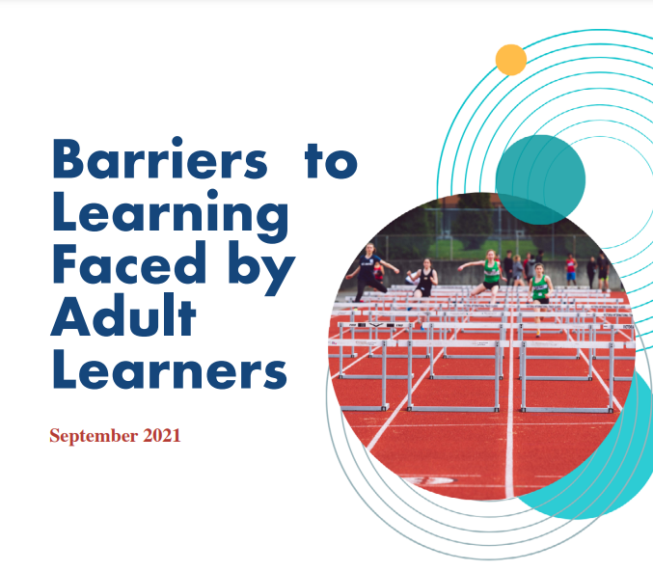
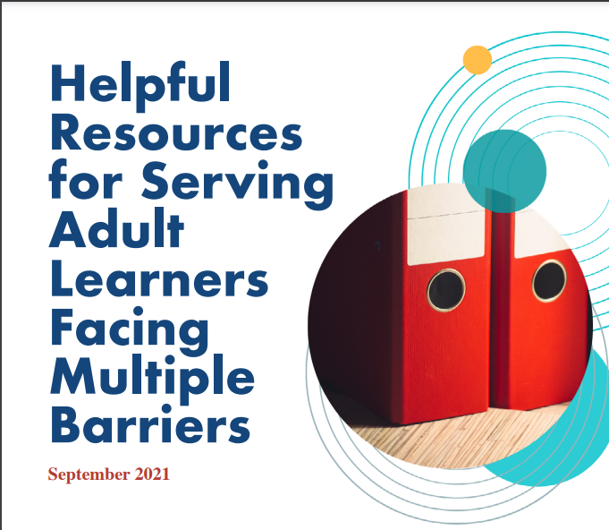
Report – Factsheets - CLO
Supporting LBS Learners Facing Multiple Barriers Factsheets, September 2021
Effective Strategies
Barriers to Learning
Strengths of LBS Programs
Partnerships and Connections
Helpful Resources
Notes:
These five factsheets came on the heels of CLO’s Supporting LBS Learners Facing Multiple Barriers report, referenced on the last slide. In 2021-2022, CLO researched and created five factsheets to create awareness and share strategies and resources to help support vulnerable learners in LBS programs.
CLO’s Supporting LBS Learners Facing Multiple Barriers Factsheets cover the following topics:
• Effective Strategies
• Barriers to Learning
• Strengths of the LBS Program
• Partnerships & Connections
• Resources

Slide 34
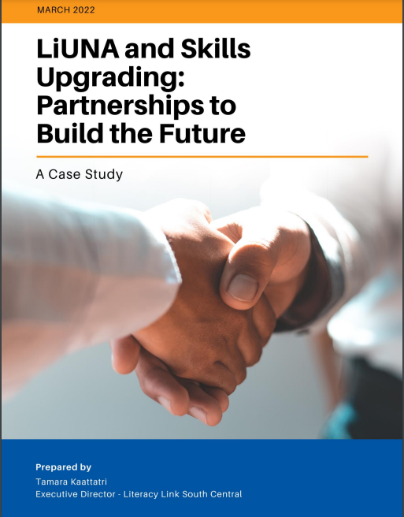
Report – Collaboration - LLSC
LiUNA and Skills Upgrading: Partnerships to Build the Future
Formal relationship in 2021-2022
100 pre-apprentices go through one-on-one skills interviews
Creation of a Math Booster program
Notes:
For decades, apprentices and those whose goal is to get into apprenticeship have sought out adult upgrading (or LBS) programs so they can gain the skills they need to be successful. In a few instances, local trade unions have reached out to adult upgrading programs if they noticed that their pre-apprentices/apprentices needed some skills development support. Such was the case between Literacy Link South Central (LLSC)—a regional adult literacy network— and LiUNA (the Labourers’ International Union of North America) Local 1059. LLSC and LiUNA Local 1059 struck up a formal relationship in 2021-2022—a relationship that saw 100 pre-apprentices go through one-on-one skills interviews and resulted in the creation of a Math Booster program. Learn more about this innovative and rewarding partnership by reading this new report.
I will read a written summary of the partnership from Summer Burton from LLSC, who is unable to attend today’s webinar.
First, I wanted to say that LLSC recognizes that there are other relationships (both formal and informal) between adult literacy programs or networks and trade unions across the province – they aren’t the only ones. That said, recognizing the important role that partnerships like these can play in growing the Skilled Trades, they wanted to produce this case study to share their experiences with LiUNA in the hopes that others can learn from them.
For those who may not be familiar with them, LiUNA is a long-established trade union in Canada. They’ve been operational here for over 100 years and have 100,000 Canadian members representing a wide range of industries including construction and manufacturing. Here in Ontario, there are ten LiUNA Local Unions, many of which offer apprenticeship or pre-apprenticeship training.
While LLSC had worked with LiUNA in the past, hosting meetings at their training centre and welcoming their Training Manager as a member of their Board of Directors, this partnership came about in December of 2020 when the Ministry of Labour, Training and Skills Development (MLTSD) issued a Call for Proposals for Pre-Apprenticeship programs. It specifically encouraged applicants to partner with local adult literacy programs/organizations, and LiUNA Local 1059, which had been running pre-apprenticeship programs for quite some time and was applying again, reached out to LLSC to partner on this specific application.
It was successful, and LLSC supported LiUNA in several deliberate ways as a result, including reviewing the intake process for the pre-apprenticeship program and making additions (like adding a reading
comprehension task). They also agreed to do 1:1 interviews with each pre-apprentice who was accepted to the program. They called the interviews “Skills Check-Ins for Apprenticeship,” and while it would have been faster and less costly to talk to groups of pre-apprentices about the importance of literacy and foundational skills in the trades, providing 1:1 interviews meant each pre-apprentice could talk about their skills in a confidential setting. As we all know, admitting that you struggle with the skills needed to learn and do your job can be difficult to do, and very few people are comfortable disclosing that in front of a group of peers.
So LiUNA Local 1059 recruited 100 pre-apprentices and each of them was provided with a Skills Check-in that lasted between 45 minutes and an hour. Facilitated by an adult educator, these interviews involved a discussion about the pre-apprentices educational and employment histories, their current skills in a host of different areas, and any past or potential learning challenges or barriers. After each interview, LLSC created a written summary or report about the conversation and gave it to the pre-apprentice. In addition to recounting highlights from the one-on-one conversation, the reports provided details on exactly how each pre-apprentice could upgrade their skills to the point where they could be successful, and how they could either demonstrate or earn the minimum educational requirements needed to sign an apprenticeship contract. For construction craftworkers that means Grade 10, and a number of these pre-apprentices were educated outside of Ontario so they needed help to get their educational credentials assessed for acceptance by MLTSD.
LLSC also provided a summary of all these interviews to LiUNA so they knew who might struggle to demonstrate a Grade 10 level of education, who might have specific learning needs, and who might need to upgrade their computer, document use, math, reading comprehension, writing or other literacy skills – including interpersonal or “soft skills,” which are increasingly being identified as barriers to successful employment within the trades. This gave LiUNA the opportunity to provide extra support to those who may need it and encourage them to follow-through with any next educational steps suggested in the report.
To address that last bullet point specifically, during their intake assessment all pre-apprentices were asked to complete a 12-question math assessment that focused primarily on fractions, converting from one unit of measurement to another, and performing basic calculations. Roughly two-thirds of pre-apprentices failed this assessment, and during the 1:1 interviews it became clear that math was a challenge for many pre-apprentices.
After discussing these results with LiUNA, LLSC recruited the Literacy and Basic Skills Program at Fanshawe College to deliver a math program to the pre-apprentices. Staff at this LBS program also
developed a math workbook that was specific to the math that LiUNA tradespeople would need to complete on the job. They called the program a “Math Booster”, and it’s been very successful. None of
the pre-apprentices were forced to take the Math Booster, but they were strongly encouraged by the union to do so. It’s clear that LiUNA’s belief in the importance of skill development resonated with these pre-apprentices because not only did those who failed the math assessment complete the program, but many pre-apprentices who scored well on the math assessment took the program too.
To read more about the work involved in this partnership, we invite you to visit the Literacy Link South Central website at www.llsc.on.ca and click on the Apprenticeship section of the Resources page. I’ll also note that this partnership has been renewed for a second year with an anticipated number of 160 pre-apprentices – and that the Math Booster program is now mandatory for any pre-apprentices who fail the initial math assessment.
If you are a program that works with apprenticeships and trade unions, you may benefit from reading more about how this particular partnership works.

Slide 35
Report – Collaboration – LLSC
Regional Literacy Networks and Workforce Planning Boards – The Partnerships Continue
LLSC in conjunction with PRLN, QUILL, MTML, WPDB
Record of collaborations
Demonstrate how LBS is/can be responsive to local labour market trends and needs
Notes:
Both Regional Literacy Networks and Workforce Planning Boards have been an important part of the Employment and Training System in Ontario for decades. Both types of organizations are unique in that they are networking organizations as opposed to organizations that provide direct services.
Workforce Planning Boards research, examine and report on local labour market trends and facilitate local workforce planning, and Regional Literacy Networks apply local labour market information to the ongoing planning they do with Literacy and Basic Skills agencies.
The goal is to make adult literacy programming responsive to local labour market trends and needs. Clearly, there are reasons for both types of organizations to collaborate. The report "Regional Literacy Networks and Workforce Planning Boards - The Partnerships Continue“ offers you an opportunity to learn about the valuable collaborations in recent years.
Link: https://bit.ly/3Jz1afQ

Slide 36
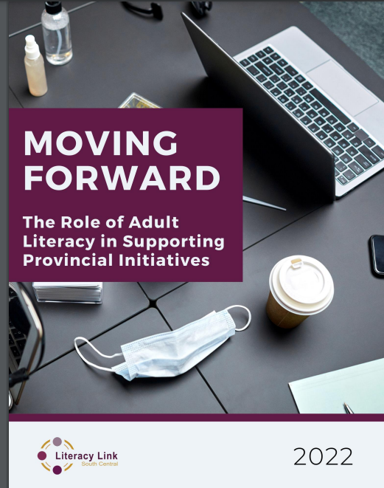
Report – Planning - LLSC
Moving Forward: The Role of Adult Literacy in Supporting Provincial Initiatives
Reflects the essential role LBS programs can play in supporting citizens as they build their resiliency and reach their potential
Demonstrates positioning of LBS to strengthen existing provincial programming and to support the government in proposed initiatives moving forward
Outlines strategic opportunities for the provincial government to consider
French translation
Notes:
“Moving Forward: The Role of Adult Literacy in Supporting Provincial Initiatives” came out of network discussions during Literacy Service Planning about the untapped potential for LBS to play a greater role in supporting learners on all goalpaths.
It reflects the essential role LBS programs can play in helping citizens reach their potential and demonstrates the positioning of LBS to strengthen existing provincial programming and to support the government in proposed initiatives moving forward.
It also outlines some strategic opportunities for the provincial government to consider and possibly implement.

Slide 37
Report – Planning - CLO
Perspectives on Partnering and Planning in LBS , March 2021
Overview of February 2021 webinar that explored service coordination activities and how they interconnect with learner plan development in LBS agencies
Notes:
On February 23, 2021, Community Literacy of Ontario (CLO) hosted a webinar to explore service coordination activities and how they interconnect with learner plan development in Literacy and Basic Skills (LBS) agencies. For those who were unable to attend, the webinar is freely available on CLO’s website at https://vimeo.com/521961800 and this report is a summary that will provide you with an overview of webinar highlights.

Slide 38
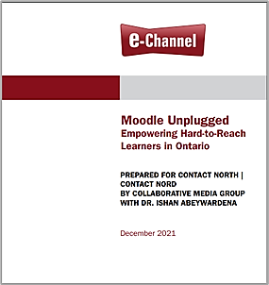
Report – Moodle Unplugged – CN
Moodle Unplugged – Empowering Hard-to-Reach Learners in Ontario
Offline Pilot to address and investigate the needs of learners without consistent Internet access
Comparative review of technologies
Ideal Situation vs. Reality and consequences, proposed solutions
Notes:
“Moodle Unplugged– Empowering Hard-to-Reach Learners in Ontario” is an offline pilot developed to address and investigate the needs of learners in communities that lack adequate and consistent internet access and proposes some some solutions to provide full functionality of Learning Management Systems in an offline environment.
That’s as far as I’m going to go on this topic and will defer to my esteemed colleague Sarah Stocker of Contact North to give us more particulars about this research and subsequent report.
Sarah Stocker: Thank you, Heather. I will share my screen (transcription note: screen sharing can be viewed on the YouTube video). On the e-Channel site, if you go to the practitioner area, you can see a number of the resources that Heather has been speaking about today.
For the “Moodle Unplugged” report, click on LBS Research where you will find this listed at the bottom of the list. It came about because we know that not all of our learners or service providers have adequate access to the internet. Over the past few years, Contact North has tried to exhaustively examine all of the options.
For those interested in using a Learning Management System, Moodle is an open-source software that is free. The main consideration is that when content is planned for delivery off of the internet, it has to be local content, i.e., it can’t have links! This report goes through the considerations and some of the specifics of this system. The instructions for using it are so long; they are not posted here. But if anyone is interested, please reach out to me, and we will be happy to share them with you.
There is also another resource that is not included with the report. For those who might not be considering using a Learning Management System, here is a spreadsheet that shows other options that show some of the considerations including cost and hardware. If that might be useful to you, please let me know.
Heather is going to be sharing some other resources from the e-Channel site, so I will turn it back over to Heather.

Slide 39
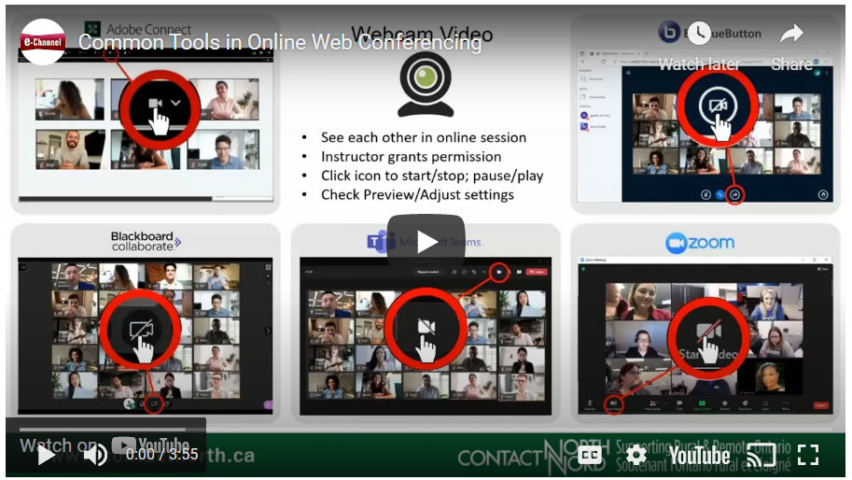
Online Support - CN
Common Tools in Online Web Conferencing video
3:55 minute video
Common tools & features in
Adobe Connect
Webcam Video
Big Blue Button
Blackboard Collaborate
Microsoft Teams
Zoom
Notes:
Heather Robinet: The next few slides focus on some of Contact North’s online support tools. Contact North created this four minute video that looks at the common tools and features of the most common web conferencing applications, and how they differ.
This is a great four minutes spent if you find not every meeting you attend is run through the application you are familiar with. It is also a great prep tool for learners who may also encounter different applications as they transition to work or school..

Slide 40
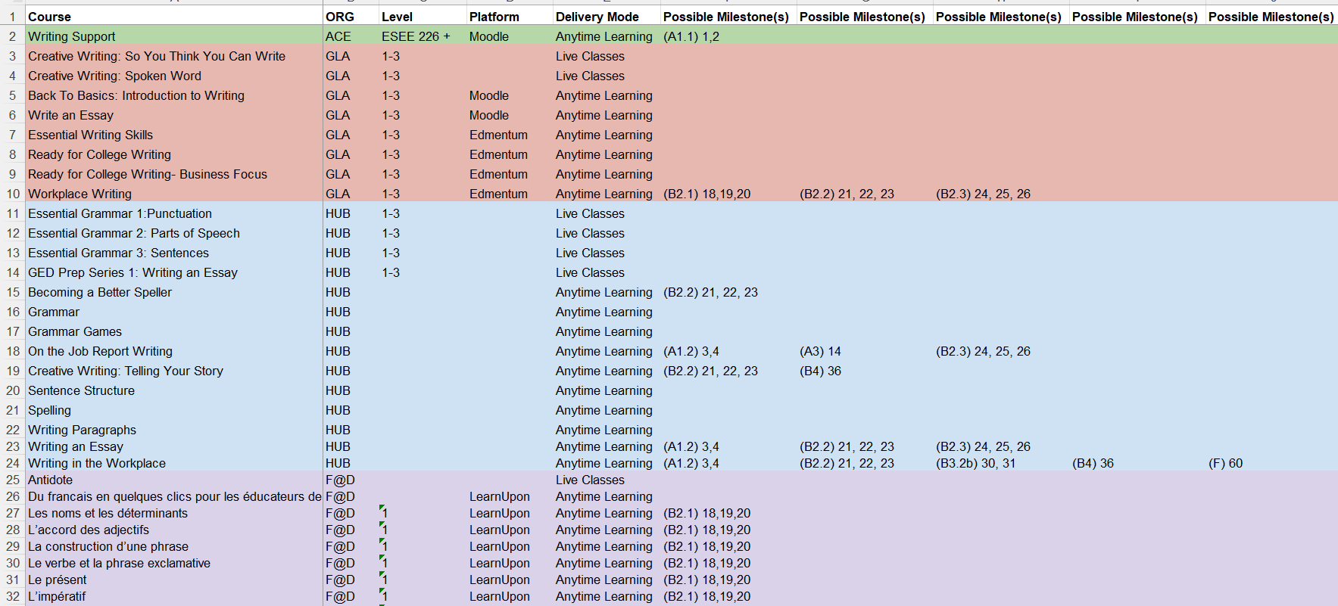
Online Support - CN
E-Channel Curriculum Map with Milestones, March 2022
Excel document
Overview of courses offered by 5 e-Channel providers
Indicates possible milestones and levels
Notes:
This Excel document , also created by Contact North, was last updated in March 2022 and provides an overview of courses (by subject) currently offered by the 5 e-Channel service providers in Ontario.
Where possible the courses indicate possible milestones and levels.
This document is meant to provide guidance only. Additional courses may be available that are not currently listed. Please check with the other e-Channel providers about those.

Slide 41
Online Support - CN
Curriculum Outline to Support Blended Learning
Four sections:
Section 1: Learning Readiness
Section 2: Access to Technology
Section 3: Learner Digital Skills
Section 4: Practitioner Readiness
Notes:
For a learner to be able to access and participate in e-Channel courses, there are several things they need to be able to do. They also need to have adequate access to technology.
Practitioners from face-to-face delivery agencies should understand how to implement blended learning effectively.
The outline in this report provides a checklist of learner proficiencies, technology needs, and practitioner proficiencies that should be in place prior to learners accessing e-Channel courses through a blended learning process. “Learning Readiness” provides a checklist of general learner proficiencies with suggested tools to assess and address gaps. “Access to Technology” is a checklist tool that can be used to identify potential gaps in available technology and make a plan to address those gaps. “Learner Digital Skills” is a checklist of learner digital proficiencies. Suggested curriculum resources and assessments are included. “Practitioner Readiness” provides a list of responsibilities that the face-to-face agency practitioners should be willing to undertake in the blended learning process.

Slide 42
French Resources - La Coalition ontarienne de formation des adultes (COFA)
Fonds de Traduction
COFA has translated many documents, webinars, and resources for the Francophone stream.
Notes:
COFA has translated many documents, webinars and resources into French for the Francophone stream. They can be found on COFA’s website under Fonds de Traduction. Alternatively, links to the French translation may be found alongside the English version on the website of the agency that created the original.

Slide 43
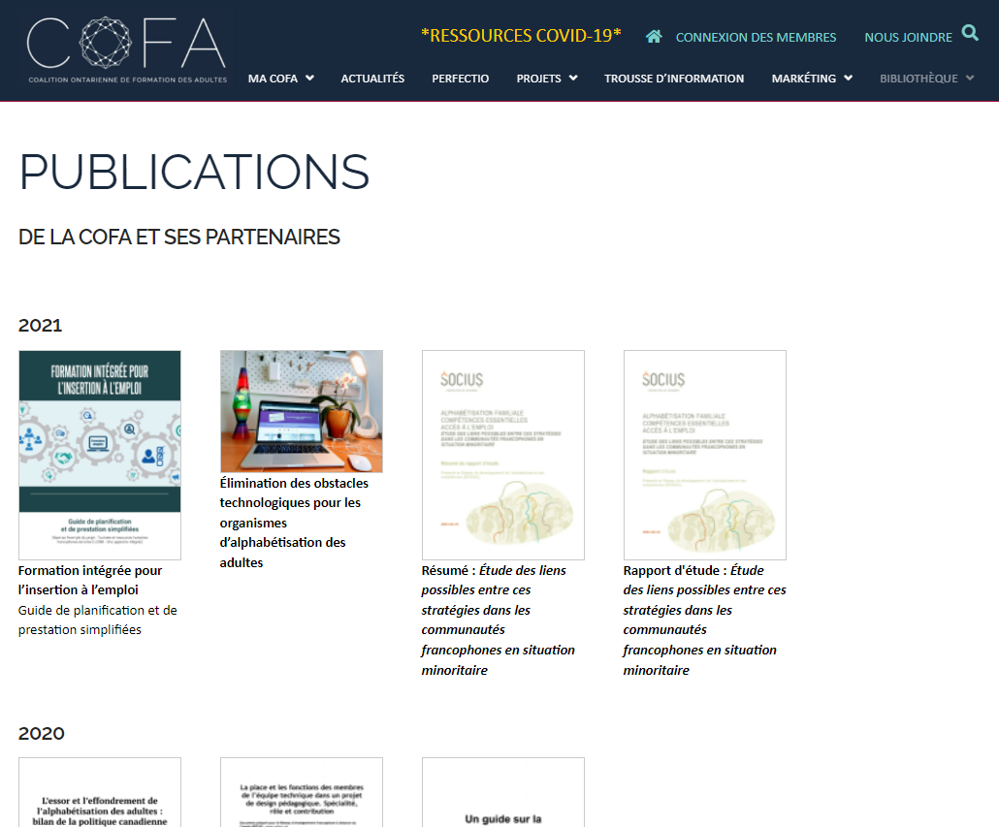
French Resources - La Coalition ontarienne de formation des adultes (COFA)
Resources published yearly are available on the COFA website at: https://www.coalition.ca/bibliotheque/publications/
Webinars available on the COFA website at: https://www.coalition.ca/bibliotheque/webinaires/
Resources available on the COFA website at: https://www.coalition.ca/bibliotheque/ressources/
Recordings of our Sharing community meetings at: https://www.coalition.ca/bibliotheque/communaute-de-partage/
Notes:
La Coalition ontarienne de formation des adultes (COFA)
Resources from COFA’s translation fund can be found on their website at : https://www.coalition.ca/bibliotheque/fonds-de-traduction/
And other resources published yearly are available on our website at: https://www.coalition.ca/bibliotheque/publications/
And webinars available on our website at : https://www.coalition.ca/bibliotheque/webinaires/
And other resources available on our website at: https://www.coalition.ca/bibliotheque/ressources/
And finally the recording of our Sharing community meetings at: https://www.coalition.ca/bibliotheque/communaute-de-partage/

Slide 44
The must haves...
Webinar evaluation: https://tinyurl.com/eckx67ku
Register for future webinars at: https://learningnetworks.ca/resources-publications/popuppd/
Webinar resources:
English https://e-channel.ca/practitioners/pop-pd-resources
French https://apprentissageenligne.ca/formateurs/programme-afb-ressources-de-la-communaute-de-pratique-en-ligne
Notes:
That brings us to the end of today’s webinar. I hope everyone was able to gain some knowledge about resources they can use in their programs.
Stacy has posted the link to the webinar evaluation, and I encourage you to complete it so that we know how we are doing and how we can improve. We also encourage you to register for future webinars at the link provided on the screen.
There will be some marketing tools created for the upcoming Pop Up Webinars which start in September. There will be give. Please look for them! Your learning network will forward them to you.

Slide 45
Thank you and acknowledgements
Members of the Pop Up PD for LBS Educators committee:
Contact North for providing technical support.
Deaf Literacy Initiative for providing ASL interpretation.
COFA for translating the webinar for the Francophone agencies.
And
College Sector Committee (CSC), Literacy Link South Central (LLSC), Literacy Northwest (LNW), QUILL Learning Network, Tri-County Literacy Network (TCLN).
Notes:
Thank you to the members of the Pop Up PD for LBS Educators Committee! Thank you to Contact North for providing technical support. Thank you to Deaf Literacy Initiative for providing ASL interpretation. Thank you to COFA for translating the webinar for Francophone agencies. Thank you to the College Sector Committee, Literacy Link South Central, Literacy Northwest, QUILL Learning Network, and the Tri-County Literacy Network who also make up the Committee.
Sarah Stocker: Heather, thank you today for your presentation and a wonderful review of so many valuable resources.
Heather Robinet: Thank you to everyone who attended for taking the time out of your busy schedules.

