Slide 1
Title of Presentation
Notes:
Barb Glass: Welcome to our second Pop Up PD for Literacy Educators. The first one for this current fiscal year was in June, and that was an overview of some of the resources that had been developed in the field over the previous year.
Today, we’re delving into a pretty big topic, looking at some of the reports in our CaMS system. You might recall that we did some webinars last year around reports, which I will reference in a moment or two.

Slide 2
I would like to begin by acknowledging the Indigenous Peoples of all the lands that we are on today. While we meet today on a virtual platform, I would like to take a moment to acknowledge the importance of the lands, which we each call home.
We do this to reaffirm our commitment and responsibility in improving relationships between nations and to improving our own understanding of local Indigenous peoples and their cultures. From coast to coast to coast, we acknowledge the ancestral and unceded territory of all the Inuit, Métis, and First Nations people that call this land home.
Notes:
I would like to begin by acknowledging that we are coming from many different parts of the province today and a large variety of Indigenous lands. While we meet today on a virtual platform, I would like to take a moment to acknowledge the importance of the lands, which we each call home.
We do this to reaffirm our commitment and responsibility in improving relationships between nations, and to improving our own understanding of local Indigenous peoples and their cultures. From coast to coast to coast, we acknowledge the ancestral and unceded territory of all the Inuit, Métis, and First Nations people that call this land home.

Slide 3
About Pop Up PD for Literacy Educators
free webinar series developed by Ontario’s LBS Regional Networks & the Provincial Support Organizations for Literacy
supports LBS practitioners with presentations on topics important to them
English language webinars presented for LBS practitioners annually since 2015-2016; French language transcriptions coming soon!
all webinar presentations, recording links & transcripts here:
Pop Up PD Resources for LBS Educators
webinar topic ideas welcome at: e-channel@contactnorth.ca
Notes:
If you happen to be new to attending Pop Up PD webinars, there are some points on the screen about our committee and how we work together to develop webinars each year. Quite a few years ago, we called this the Online Community of Practice but decided that didn’t really capture what we were all about, so a couple of years ago we changed the name to Pop Up PD. Many of you have attended prior sessions, but if you haven’t, welcome to your first session. We hope you enjoy it!

Slide 4
With Us Today…
Presenter
Barb Glass, Executive Director, College Sector Committee for Adult Upgrading
Moderator
Wendy Olson, Executive Director, Literacy Northwest
Technical Support
Stacey Ornatowski, Staff Training Specialist, Contact North|Contact Nord
ASL Interpreters
Carolyn Lesonsky and Mike Glover
Special thanks also to Robyn Cook-Ritchie
for sharing some slides for this webinar ☺
Notes:
I always have to make sure that I put my name in a slide, or I forget to introduce myself when I do webinars. I’m happy to be with you today. My name is Barb Glass, and I am the Executive Director of the College Sector Committee for Adult Upgrading, or the CSC as we usually call it. That is one of the sectoral support organizations for LBS in the province.
My colleague, Wendy Olson, is the ED of Literacy Northwest, and she is here today as a moderator. She will help keep an eye on the chat. We may or may not hear from Wendy, but we’re glad she’s in the background.
We have technical support today from Contact North, thanks to Stacey Ornatowski. If you are having technical difficulty, add it to the chat or send it directly to Stacey, and she will help with any technical issues that might come up.
Welcome to our two ASL interpreters, Carolyn Lesonsky and Mike Glover.
Finally, a special thanks to my good friend and colleague Robyn Cook-Ritchie. Many of you know Robyn. She often delivers webinars, and she and I share a lot of resources. We combined our efforts on some of the slides today, and I appreciate her being willing to share that.

Slide 5
Today’s Webinar…
Quick Review
LBS Performance Management Measures
LBS Detailed Service Quality Report #64
Other Reports Available from EOIS-CaMS
Deeper Dive
4. LBS Learner Profile Report #60B
5. LBS Outcomes Report #60B
Quick Preview
6. LBS Case Activity Report #61
Wrap-Up!
Pop Up PD: Grow Your Knowledge of CaMS Reports 60 B & D
Notes:
If you have a question during today’s session, I will be happy to try and address it during the webinar. Just type it into the chat – I have the chat open, as do both Wendy and Stacey. I will try to address questions as they come up. If I miss something, Wendy will jump in. I may also invite your comments on a question, so again just type your responses into the chat, and we’ll share your responses.
We always encourage you to complete a short evaluation at the end of the webinar. Stacey will add the link into the chat later on.
Here is our agenda for today! We will start with a review of our Performance Management Measures in our LBS system, i.e., what we are accountable for to the Ministry. We will also briefly review Report #64, the Detailed Service Quality Report also known as the DSQ64, because it’s very difficult to talk about any other reports unless we talk about these two things first. I will also show you a list of all of the reports available in CaMS.
What we are really here to do today is to talk about #4 and 5 on the agenda – to take a deeper dive into Reports #60B and #60D (there is a typo on the slide).
Finally, we’ll take a quick preview of Case Activity Report #61. This could be a webinar on its own, but we will just take a quick preview.

Slide 6
1. LBS Performance Measures – Quick Review
Dimension | Core Measures Phase 11-A (Current) | Core Measures Phase 11-B (Future?)
Customer Service (40%) | 1. Customer Satisfaction (15%) | 1. Customer Satisfaction (?%)
 | 2. Service Coordination (25%) | 2. Service Coordination (?%)
Effectiveness (50%) | 3. Suitability/Learner Profile (20%) | 3. Suitability/Learner Profile (?%)
 | 4. n/a | 4. Completions (?%)
 | 5. Learner Progress (30%) | 5. Learner Progress (?%)
 | 6. n/a | 6. Learner Gains (?%)
Efficiency (10%) | 7. Learners Served (10%) | Learners Served (10%)
Pop Up PD: Grow Your Knowledge of CaMS Reports 60 B & D
Notes:
The first item on the agenda is a review of our Performance Measures. This may be old hat for some of you, but it may be newer for some. I’ve summarized the Core Measures in our LBS Performance Management System for which we are accountable to the Ministry. I know you are probably familiar with them, so we’ll run through them quickly.
We have Customer Satisfaction, Service Coordination, Suitability, Learner Progress and Learners Served. Notice that #4 and #6 are blank in the Phase II-A column. That is because currently we are not measured on Completions or Learner Gains. There are placeholders in the Ministry’s Performance Management System for those two measures.
Where you see Phase II-B, you will notice that Completions and Learner Gains ARE included. At some future point, the Ministry may decide to move to Phase II-B. But for right now, we are directly responsible for Phase II-A, and these are the measures for which we are evaluated.
The percentages that you see in Phase II-A are current. For example, Customer Satisfaction is currently worth 15% of our monthly Service Quality Measure. The other percentages are listed as they currently apply.
In Phase II-B, however, we don’t know what those percentages might look like. That’s because with two more measures added in at some point, some of the current percentages will change. That’s also why the 40% and 50% numbers at the left side are highlighted. Those numbers are what is currently represented, but that might change in the future.
We don’t have any details about Phase II-B or when it may be implemented.
If you have been working in LBS for a long time, you will probably remember that Completions (#4 in Phase II-B) did originally count during the first approximately two years of the Performance Management System. In 2013/14, the Ministry removed Completions as a core measure, but that data does still feed into our reports. We’ll talk a bit more about that later.

Slide 7
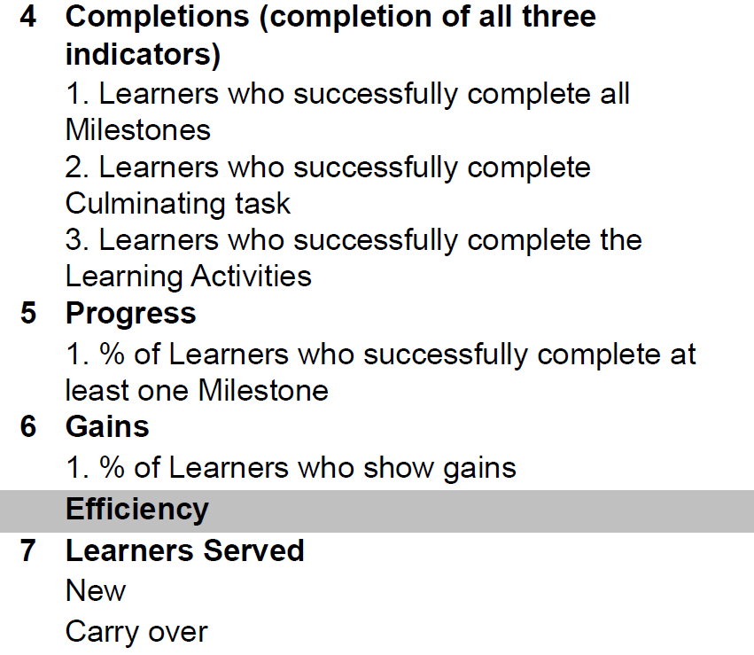
What about #4 and #6?
Note:
Data that feeds into #4 is currently captured in CaMS at exit and appears on the DSQ 64 report, but is not used to measure performance at this time.
#6 does not yet exist, but there is a placeholder in CaMS for Learner Gains data
Pop Up PD: Grow Your Knowledge of CaMS Reports 60 B & D
Notes:
Here is some more information on what #4 and #6 include.
The completion measure has three elements: learners who successfully complete all Milestones; learners who successfully complete Culminating Task; and learners who successfully complete the Learning Activities
#6, the Learner Gains measure, was originally intended to be a pre- and post-test to measure skills gains using Ministry recommended or endorsed tools. That has never come to fruition, but it is technically part of Phase II-B, and we will see if that does get implemented at some point.
As I mentioned before, the data that feeds into #4 does appear on our reports, but it isn’t used to measure performance right now. Similarly, there are placeholders in CaMS for #6, but there is no data for Learner Gains to input.

Slide 8
LBS Performance Measures (Phase II-A Current)
Dimension | Measure | Weight | Standard | SQS Value
Customer Service (40%) | 1. Customer Satisfaction | 15% | 90% | 1.35
 | 2. Service Coordination | 25% | 50% | 1.25
Effectiveness (50%) | 3. Suitability/Learner Profile (all 12 indicators) | 20% | 30% | 0.6
 | 5. Learner Progress | 30% | 60% | 1.8
Efficiency (10%) | 7. Learners Served | 10% | 90% | 0.9
 |  |  | SQS Standard | 5.9
Phase 11-A: Five measures in 2022-23
Notice #4 and #6 are not included
Pop Up PD: Grow Your Knowledge of CaMS Reports 60 B & D
Notes:
Now we’ll take one more look at the Performance Measures in the current iteration (Phase II-A). You can see the weights on the slide. Standard refers to what we are measured against, so for Customer Satisfaction we are supposed to achieve a 90% rate. For Service Coordination, 50% of our service plans should have a referral, and so on.
There is a lot of calculation and data that goes into these measures and how they are presented to us as service providers. The recording of these measures is in the detailed Service Quality Report #64.

Slide 9
2. Detailed Service Quality Report #64
The MOST IMPORTANT report.
The only performance measure report.
This is the report you use to
Monitor your site’s monthly compliance with the 5 Core Measures
Complete your Interim Report and Final Report for the Ministry
Note: 4 of the 5 Core Measures tracked in the DSQ are based on CLOSED files only
Pop Up PD: Grow Your Knowledge of CaMS Reports 60 B & D
Notes:
Let’s move on to #2 on our agenda and talk briefly about the Detailed Service Quality Report #64. It is the most important of our CaMS reports because it is the one that records our achievement of those Performance Measures that we just talked about in the last slide. The Ministry looks at it, and we must look at it, to help make improvements or to give ourselves a pat on the back because we are meeting all or most of the Measures.
It does come out monthly, and we also have to use it as Service Providers to complete our interim and final reports for the Ministry because on those reports you, or your site manager, have to address why you are or aren’t meeting the required targets for those five Core Measures.
My last point about the DSQ #64 is that when you look at that report, you have to remember that it’s based on closed files. We’ll talk later about the difference between active and closed files in our reports. The one measure that is based on both closed and active files is progress, i.e., the number of students who have completed at least one Milestone.

Slide 10
Want to learn more about the DSQ 64 report? Check out this session from last year’s Pop Up PD: https://e-channel.ca/practitioners/pop-pd-resources-previous-years
Notes:
If you would like to learn more about the DSQ reports, I encourage you to look at last year’s Pop Up PD session (https://www.youtube.com/watch?v=4NtOHZFVbQI) which is available on the Pop Up PD website maintained by Contact North. The link on the screen will provide you with both the recording of the webinar along with all associated resources.
That concludes the first two items on our agenda. We have had a look at the Performance Measures we are accountable for, and we have looked at the DSQ #64 report.

Slide 11
3. Reports Available in EOIS-CaMS
Pop Up PD: Grow Your Knowledge of CaMS Reports 60 B & D
Notes:
Now, just a brief reminder of some of the other reports that are available to us as service providers.

Slide 12
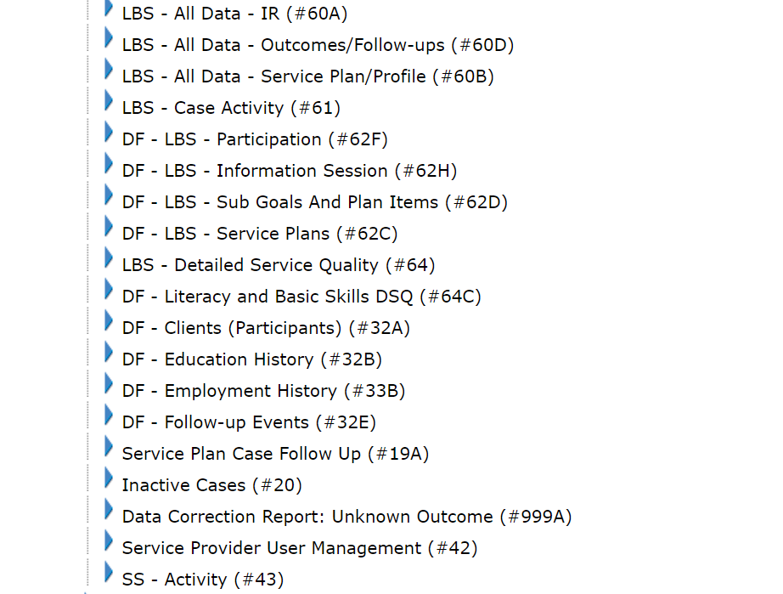
LBS Site Level Reports Currently Available
Pop Up PD: Grow Your Knowledge of CaMS Reports 60 B & D
Notes:
This is a screenshot from the EOIS-CaMS reporting site. I just want to mention that you may or may not have access to any or all of these reports. It depends on your user role and permission level in the CaMS system. Some reports are staff level, some are manager level. If you are a CaMS user, you may or may not have access to all of these reports. The site manager is able to access all of them.
I can make a distinction here to point out that the ones that start with DF are a bit different. DF stands for data files. Those are optional reports that your site manager can request. They have a bit more flexibility to allow us to run our own queries or to try to get different combinations of information. We’re not going to talk about the DF reports today, but just so you know, they are a bit different. They are available by request, not necessarily to everyone.

Slide 13
Provincial/Regional “Roll-up” Reports Currently Available
LBS - All Data - IR (Rollup)- #60AR
LBS - All Data- Outcomes/Follow-ups (Rollup) - #60DR
LBS - All Data- Service Plan/Profile (Rollup) - #60BR
LBS - Detailed Service Quality (Rollup) – #64R
Available for the province or by region:
Central
Eastern
Northern
Western
Pop Up PD: Grow Your Knowledge of CaMS Reports 60 B & D
Notes:
Another interesting piece about the reports is that the four reports listed here are available not just at the level of your site information, but also with a roll up of the regional data for all of the LBS service providers in your region – Central, Eastern, Northern, Western – and there are also roll up reports available for the entire province so that you could look at a provincial report for any of these and see the figures and the data for all 315 LBS sites across Ontario.
In this webinar, there are a few places where I have inserted a bit of the provincial data for interest and comparison.
The reason why some of the other reports are not available as roll ups is because they contain personal data, i.e., student names, birthdates, and so on. Obviously, the Ministry isn’t going to produce provincial reports that have personal data in them. Only the people at your site with access would be able to access those reports.

Slide 14
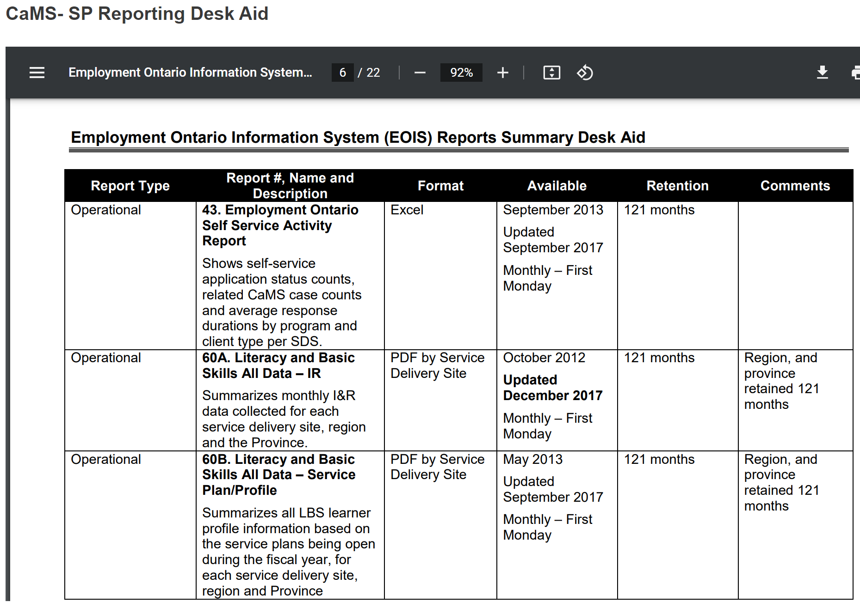
Summary of reports is available on myEOIS: “Desk Aids”
e.g.
60A
&
60B
Notes:
One interesting resource I wanted to point out about reports is this summary document that is available on myEOIS, the portal that service providers can use to access announcements, information and resources about EOIS. You will notice that it is 22 pages long, because it doesn’t just include a list of the LBS reports. It includes a list of all the different reports for all of the Employment Ontario programs. They are in order of number. You can see 60A, for example, and 60B which we will be talking about today. I like this resource because it gives you a quick snapshot of what is in a particular report, the format it is in, and so on. You can find this on myEOIS, under “desk aids”.

Slide 15
Useful Reports
Report 60B
LBS-All Data Service Plan/Profile
Summarizes all profile information
Gives you summary data for 4 of the 5 core measures
Report 60D
LBS-All Data Outcomes/Follow-ups
Summarizes all outcome information
Gives you summary data on completions and outcomes at exit, 3, 6 and 12 months
Report 61
LBS Case Activity
Shows all data related to service plans that are open, approved, active or have been closed (weekly)
This Photo by Unknown Author is licensed under CC BY-NC
Pop Up PD: Grow Your Knowledge of CaMS Reports 60 B & D
Notes:
Today we are going to focus on Reports 60B and 60D. There is also a brief review of Report 61 on the slide. There is also information about what is in 60B and 60D.
60B has all of the profile information about your learners. An interesting component, which we will discuss in the next few minutes, is that it does give you summary data for four of the five core measures that we are measured on: customer satisfaction, service coordination, etc.
60D is outcomes and follow up information. Needless to say, that is generally based on closed files, whereas 60B is based on active files.
61 is a huge Excel report which we couldn’t possibly look at in its entirety today, but we will look at a bit of it. Every single data point that you enter into CaMS appears on Report 61. That is why it is so large and why it appears in Excel. It’s by Service Plan, not by roll up for your site.

Slide 16
Remember the report guides! Available on - EOIS-CaMS Reporting & - myEOIS
Pop Up PD: Grow Your Knowledge of CaMS Reports 60 B & D
Notes:
Before we move into 60B, I do want to remind everyone that, for any of the reports we are talking about, report guides are available on the EOIS reporting site and on myEOIS. It can be a bit harder to find things on myEOIS, because they are still working on how that site is organized. Most of the information that we will be talking about today is directly from the report guides. They can sometimes be a little wordy and hard to read, but there is some quite valuable information. Sometimes I have quoted directly from the report guides in today’s slides. The photo on the slide is the cover page from the report guide for 60A, 60B and 60D.

Slide 17
4. Report 60B: LBS-All Data Service Plan/Profile
Features
Produced as a PDF
Generated monthly
Based on active service plans
Summarizes all service plan/profile information
Gives you summary data for 4 of the 5 core measures for your site
Can be used to monitor progress toward meeting core measures and for planning
Provincial and regional “Rollup” reports are also available
Will not match DSQ 64 report because DSQ draws most data from closed service plans
Pop Up PD: Grow Your Knowledge of CaMS Reports 60 B & D
Notes:
#4 on the agenda is our deeper dive into 60B. This report is produced as a PDF. It is about nine pages long. It is generated in EOIS CaMS every month. It is based on active plans. It summarizes all of our service plan information and learner profile information for active service plans. As I mentioned before, it gives you summary data for four of the five core measures we are accountable for. The DSQ has the exact measures and how we are doing in terms of our core measures. 60B gives you more insight into the data that goes in to the core measures and why the numbers appear as they do on the DSQ.
Remember the important point at the bottom. You can’t look at 60B and at DSQ 64 and assume they will match because most of the information in the DSQ is based on closed service plans whereas 60B is based on active service plans. That’s an important distinction.

Slide 18
Other Tidbits
Closed service plans are included if they were active during the report period and do not have a Closure Reason of “Opened in Error”.
All sections of the report, except for ‘Expenditures’ and ‘Unique Learners Served’, are based on total # of service plans year to date.
If a learner has more than one service plan in the report period, data from each plan is counted.
4. Report 60B: LBS-All Data Service Plan/Profile
Pop Up PD: Grow Your Knowledge of CaMS Reports 60 B & D
Notes:
A couple of other tidbits about 60B. It does include closed service plans if they were active earlier in the year. If I started a new program in May, and I was there until July, then I would appear in 60B from May to July as an active service plan. If my file was closed in August, I will still be counted in the stats in 60B because I was active earlier in the fiscal year.
If I, as a learner, have more than one service plan, each one is counted individually. The report is generating data for individual service plans, not for unique learners. That is another important distinction about how the data is compiled in 60B.

Slide 19
Take a look at some of the data in report 60B…
Pop Up PD: Grow Your Knowledge of CaMS Reports 60 B & D
Notes:
So let’s jump right in and see what 60B actually looks like. Depending on your role in your agency, you might or might not have seen it before.

Slide 20
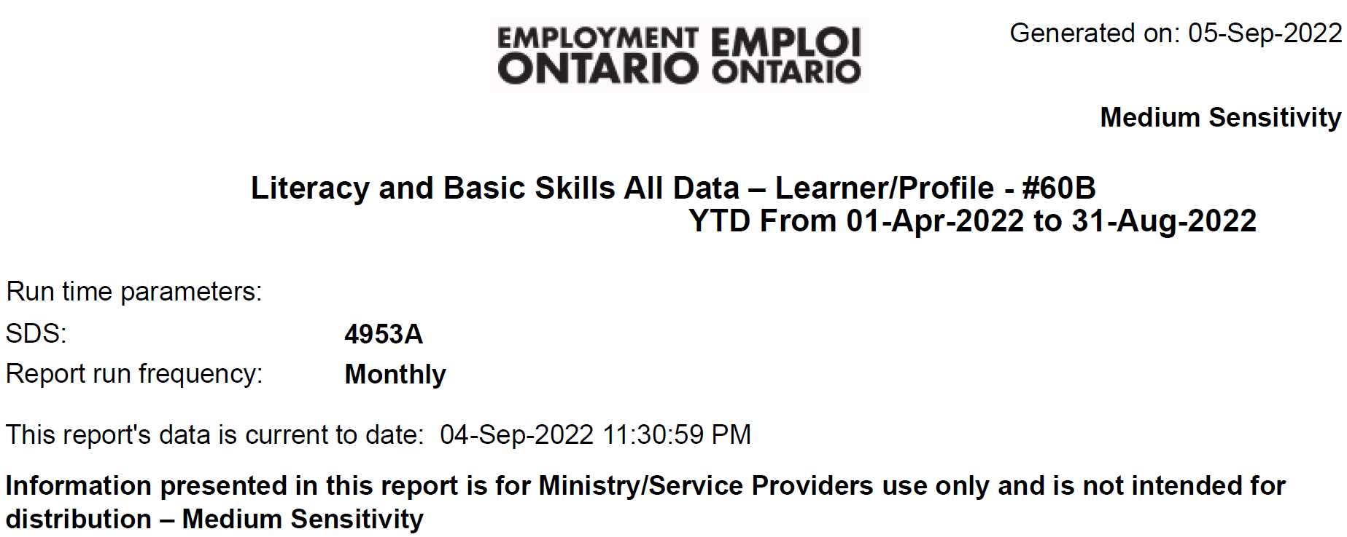
Pop Up PD: Grow Your Knowledge of CaMS Reports 60 B & D
Notes:
Most of the next slides are screenshots from a sample 60B report and later 60D and 61. You might already be familiar with what it looks like. If you aren’t, this is the top of the first page of 60B. Normally, the name of your site would appear, but I deleted it for the purpose of the slides.
<Technical discussion about the chat>
There is a question asking if we have to ask for access to the roll up reports. No, you don’t have to ask. When you log in to the EOIS CaMS, there is a small banner about 1/3 of the way down the screen that says SDS reports (Service Delivery Site Reports). Next to that, it says Roll Up Reports. By default, it goes to the SDS reports, but if you click on the Roll Up Reports link, you will find them.
The last thing I will point out about this slide is the Year to Date. The following screen shots go in order through the report.

Slide 21
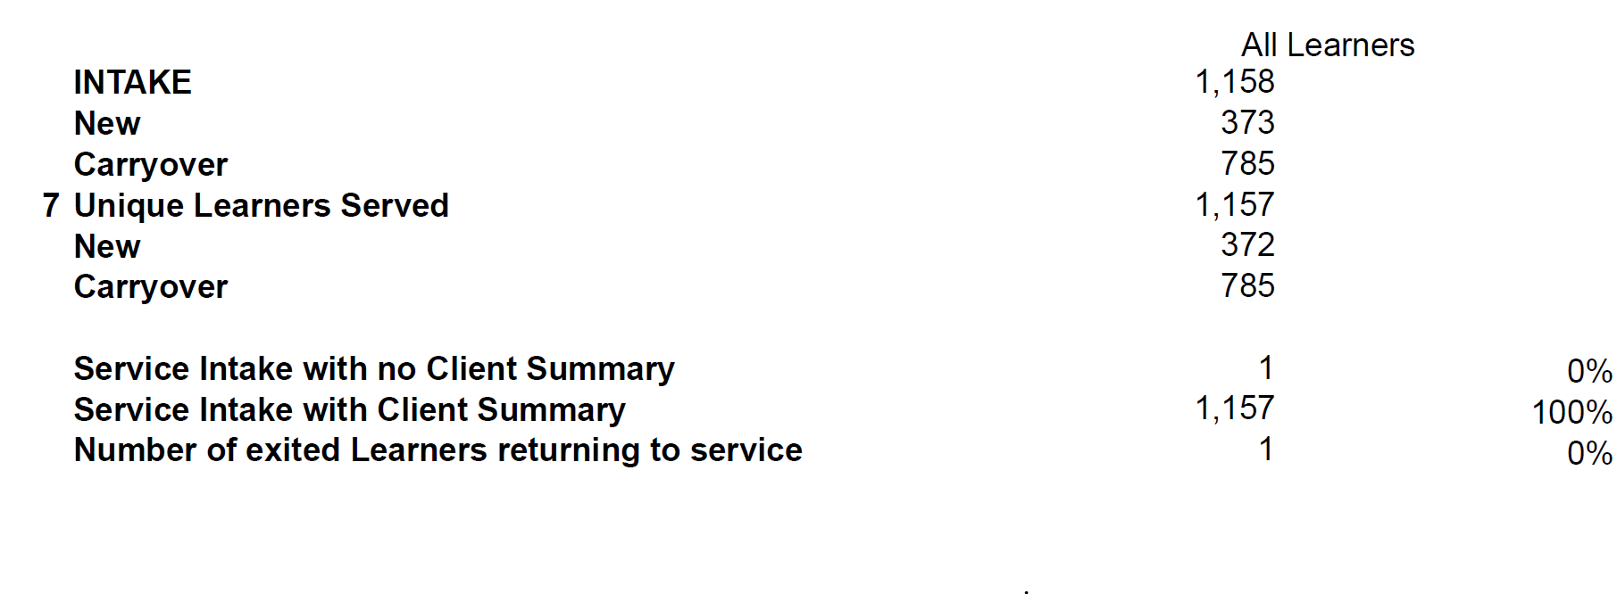
Refers to core measure #7
Pop Up PD: Grow Your Knowledge of CaMS Reports 60 B & D
Notes:
At the top of the report, there is a summary of the New and Carryover status of your service plans. This particular site is a large one, so at the end of August they had 1,158 service plans, 373 of which were new for this fiscal year, and 785 were carryovers. There were 1.157 unique learners served so one of the learners has two service plans. It also tells you if you are part way through entering a file: there is an intake with no client summary yet, probably because it’s in the middle of being activated. It also tells you if you have service plans for someone who has exited and returned since the beginning of the fiscal year.
You will notice, as we look at these slides for 60B, that some of the data points will have a number beside them. Those are the numbers that correspond to the Core Measures for which we are accountable. That’s why this report does directly relate to those core measures. The data points that feed into the Core Measures are numbered. For this particular agency, I know that their annual target is 2,060, so they are currently at 1,157 unique learners served for the year.
There is a question in the chat asking what makes a learner unique. It just means the individual person. So each of us would be a unique learner, but if we had more than one service plan, each of those service plans will be counted but each person is only counted once towards the learners served target. Unique learner is the person, not the number of service plans they have. Even though the reports have all of the service plan data, the number that counts toward your target is the unique learners served.
There is a question asking why you would have more than one service plan. It’s because a learner may come in and out of your LBS program more than once in a fiscal year. Perhaps a learner starts in May and stays until July, and the file is closed when they leave. That is one service plan. If the person returns in October, their file is already closed, and a new service plan will need to be created. Therefore, that unique learner will have both a closed and an active plan.
There is a comment in the chat that it would be more helpful if the header on the number column said “all service plans”. I agree.

Slide 22
$$\frac{1123 ref out}{1158 plans} x 100=97\%$$
$$\frac{11 ref in}{1158 plans} x 100=1\%$$
Pop Up PD: Grow Your Knowledge of CaMS Reports 60 B & D
Notes:
Right after the information about the intake status, we have about a page and a half of referral information. I haven’t taken the full screenshot of the referral lists, because they are very long. The important thing to remember is that all referrals in and out of your program will show early on in this 60B report. It’s categorized as referrals to other programs (there are about 12 in this list, and you would be familiar with many of those as you enter data), there are referrals to other community services (a long list of referral types), and then the different referred in categories. All of the referrals that you record in CaMS go in here.
This agency, for example, had 1,123 referrals to other community services. As you can see, they were all educational/academic services referrals. They didn’t have any referrals in the top category to other programs. They had 1,158 referrals in so that means that every service plan had a referral in.
There is a question from the chat asking about access to a recording and/or slides from this presentation. Yes, the session is being recorded, and it will be posted on the Pop Up PD website hosted by Contact North. You can find that if you Google Pop Up PD.
There is a question asking if word of mouth counts as a referral. It does not, nor does a referral from another LBS provider. You will see them recorded in the Referred In list – the word of mouth referrals do appear – but they don’t count towards your Service Coordination target, nor do referrals from others LBS organizations.
If you see 0s on the report, it just means that you don’t have referrals recorded for those particular categories.
The percentages are calculated, for example, by dividing the number of referrals out by the number of service plans, so 1,123 referrals out based on 1,158 service plans is 97%. Similarly, 11 referrals in from the Apprenticeship Programs divided by 1,158 total service plans gives 1% of referrals from that source.
There is a question asking what counts for referrals in. Generally, anything in the list of referrals in CaMS except for word of mouth referrals and referrals from other LBS organizations. I would encourage everyone to look at the list in the report guide for the full list.

Slide 23
How can the referral in and out numbers help us?
You can you see at a glance
where you are getting referrals in and making referrals out
how many of each ref in/out category you have (or don’t)
if the referral in/out totals make sense based on the activity at your site and in your community
if you may not be recording referrals accurately
It may sound obvious but….if you don’t record the referrals into and out of the program, then they won’t be in your data!
Pop Up PD: Grow Your Knowledge of CaMS Reports 60 B & D
Notes:
Why does it make a difference to look at the referrals in and out numbers? What do they tell us. Type your responses into the chat.
Responses
Seeing how we are doing with service coordination
Work on relationship with referral partners
Gives you an idea of who does and who doesn’t know about your programs
Identify strong partnerships
Outreach
Do your referrals resonate with the profile of your community? Are there places where you can see a strong referral source or are there sources you would like to cultivate? Remember that just because you make a referral, it will only appear in this report if you record it.

Slide 24
Why is this $0?
This site doesn’t use Training Support funds
or
They have not yet entered any Training Support data into their service plans in CaMS
Pop Up PD: Grow Your Knowledge of CaMS Reports 60 B & D
Notes:
The next section in the report is called Expenditures, and it records your training support expenditures for the reporting period if you have put them into CaMS.
This particular reporting site does not use training supports which is why the values are 0. It could also be 0 if they did have training supports but hadn’t entered any information yet. Training supports are entered as a plan item in CaMS.
There is a question asking if it is mandated by the Ministry to report them in CaMS or is having documentation in the file enough. They do like them to go into CaMS. I will say that ETCs have different preferences for how often you are required to keep them up to date. One common practice in the colleges is to enter the total value of training supports when the file is closed. I know of some ETCs who have insisted that training support funds be entered in CaMS weekly or monthly.
I have been asked to explain about the 0 again. Because most LBS agencies received funds to provide learners with travel and child care, there is a place in CaMS to record what you provide to each learner as part of their service plan. For example, did they receive a bus pass worth $50 or $100 for mileage. There is a place in CaMS to make a plan item and enter that amount for each service plan. If this particular agency in the example on the screen had entered training support funds, they would appear here. It would show how much was distributed throughout the year and the average support per learner. The reason that training supports show as 0 in this particular scenario is because this agency doesn’t use any training supports. However, if they did, it might still show 0 because they haven’t actually entered any data yet.

Slide 25
Apologies for the small print on the next slide!
Notes:
My apologies in advance! The next slide contains the service coordination section, and I really wanted to get it all on one screen!

Slide 26
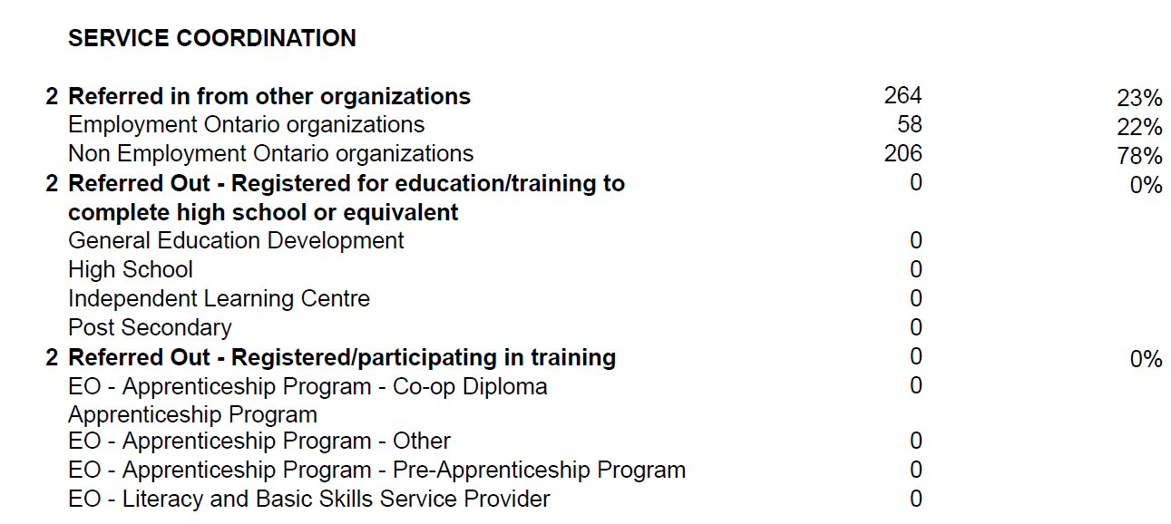
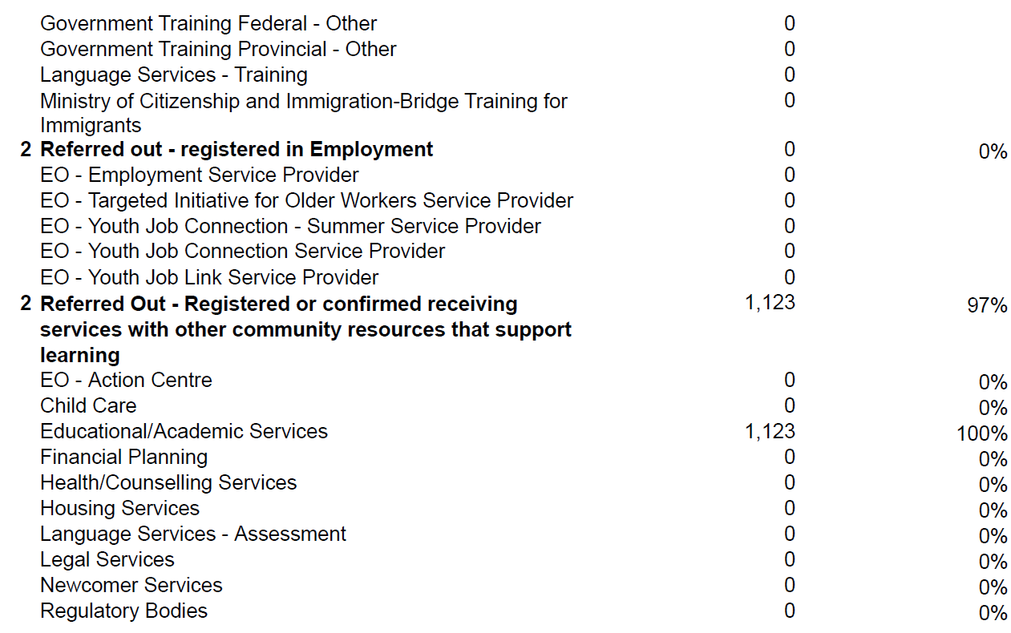
$$\frac{264 ref in}{1158 plans} x 100=23\%$$
Refers to core measure #2
Notes:
I believe this is pages 4/5 in the report. Because all of these 2s are here (left side), these are the referrals that feed into the service coordination measure, which is measure #2. These categories are included in the previous section where all of the individual referrals were listed, but now they are grouped together a bit differently.
Let’s look at how the percentages are calculated. This particular agency had 264 referrals in from other organizations out of a total of 1,158 service plans for a percentage of 23%. If we look down on the slide a bit, we can see that they had a lot of referrals out to community services (the 0s show that there were no referrals out to other organizations to this point – that may change later in the year). Remember that the numbers you see here will not match the DSQ 64 service coordination numbers because this is active files, and the DSQ is based on closed files. You can’t look at this and expect it to be the same as the DSQ.

Slide 27
What does the Service Coordination data tell us?
You can see
if your site is meeting the Service Coordination target
i.e. do at least 50% of your service plans have at least one referral in or out?
if you are accurately recording referrals in and out
Do your referrals reflect your community/learner profiles?
Pop Up PD: Grow Your Knowledge of CaMS Reports 60 B & D
Notes:
What does the Service Coordination data tell us? It tells us most of the same stuff as the general referral information does, but it does allow you to more specifically see if you are meeting the service coordination target in terms of the referrals that do count. You can estimate in your mind, do at least 50% of your service plans have at least one referral in or out? It helps you to see if you are accurately recording referrals in and out and if the referrals reflect the profiles of your learners/community as well as the partnerships you have in place. For example, if you are co-located with Ontario Works, you would expect to have a reasonably large number of OW referrals. If you know you get lots of OW referrals, but you aren’t seeing them in this report, then you might need to double check how you are reporting those referrals in CaMS. It’s business intelligence that you are getting out of this, but business intelligence that feeds into one of the performance measures which is service coordination.
There is a question in the chat about the numbers that refer to core measures and where that core measure chart is found. What you want to look at is the DSQ 64 to see them itemized that way. If you don’t have access to the DSQ 64 report, your site manager should. That’s where those numbered performance core measures are listed.

Slide 28
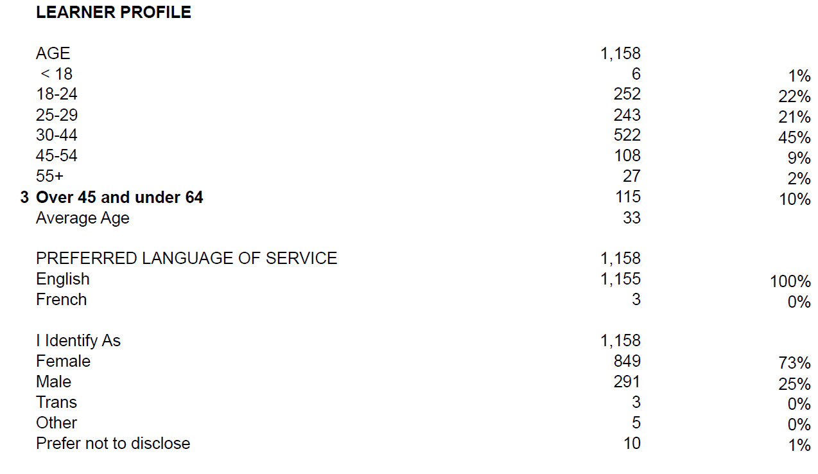
88% are
18 to 44 yrs
Ontario = 71%
Refers to core measure #3 (Suitability)
Refers to core measure #3 (Suitability)
Ontario = 20%
Does not refer to Suitability measure
Pop Up PD: Grow Your Knowledge of CaMS Reports 60 B & D
Notes:
Learner Profile is the next section. There are age ranges with both raw numbers and percentages. There is also preferred language of service and other information.
Note the #3 on the left. We know that one of the suitability indicators under core measure #3 is the number of learners between 45 and 64.
There is no #3 beside preferred language of service. It doesn’t count toward the suitability measure. It’s just a piece of data that is reported in CaMS.
Just a point of interest. At this particular site, 88% of the learners are aged 18 to 44. I get that total by adding up the percentages from the 18-24, 25-29 and 30-44 age ranges. If you look at the Ontario roll up report, you will see that this percentage is 71% across the province as a whole.
45 to 64 as an age range was the result of the 2008 recession when a lot of older workers were laid off. When this performance management framework was developed, in 2010-11, there were a lot of laid-off workers in that age range. That’s not really the current reality in LBS, however.

Slide 29
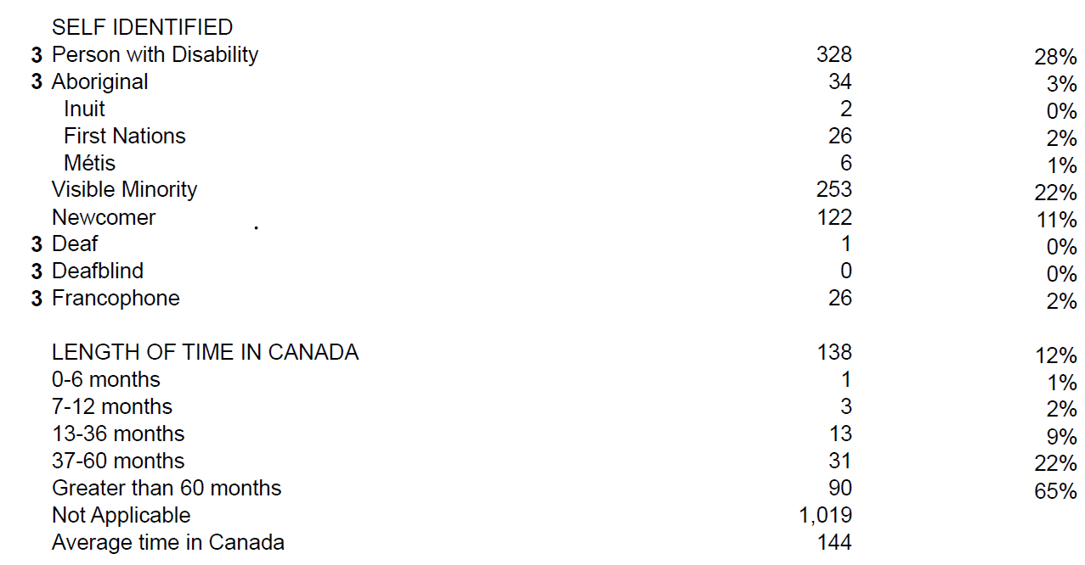
Refers to core measure #3 (Suitability)
Note: ‘Visible Minority’ and ‘Newcomer’ are not Suitability indicators and DO NOT count toward the Suitability measure.
Pop Up PD: Grow Your Knowledge of CaMS Reports 60 B & D
Notes:
The next set of profile information also shows #3s because these are more suitability indicators that make up part of the core measure of suitability, i.e., person with disability, Aboriginal, Deaf, Deafblind and Francophone. Even though visible minority and newcomer are included here, they do not count towards suitability: they don’t have a #3 beside them. They are recorded, and as you can see this agency has 253 people who have self-identified as being a visible minority. This agency also has 328 people who have identified as a person with a disability. We could certainly argue that visible minority and newcomer should count as suitability measures, but they currently aren’t.
Length of time in Canada may be an interesting stat for your agency, particularly if you are in an area where there are a lot of newcomers.

Slide 30
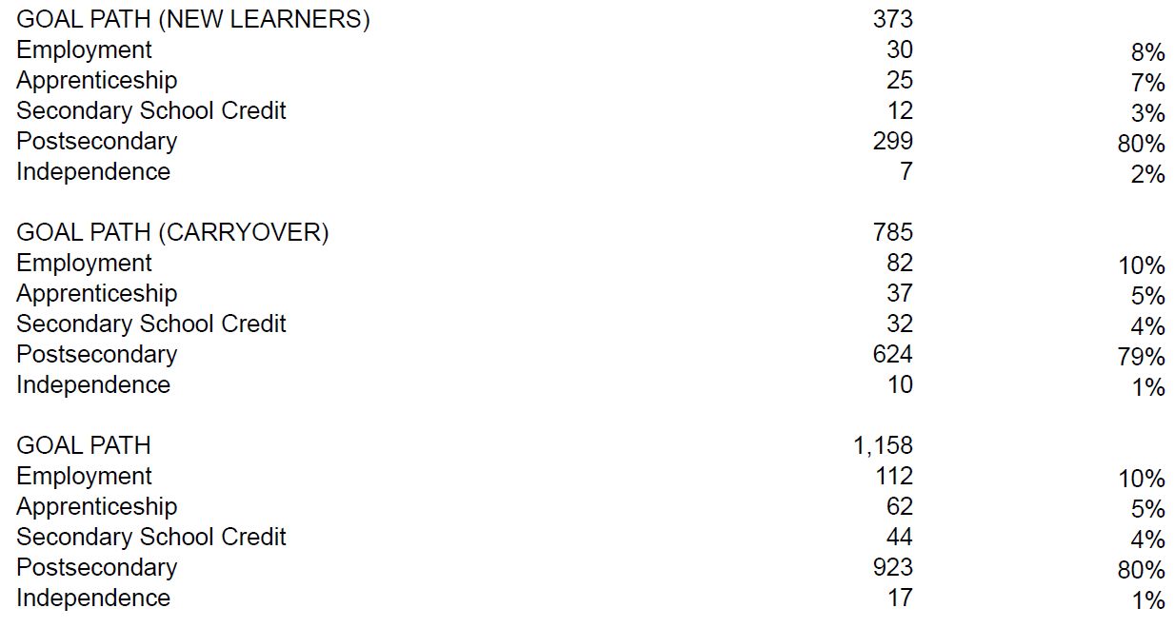
Total of new and carryover
Pop Up PD: Grow Your Knowledge of CaMS Reports 60 B & D
Notes:
Then we have goal path summary information. It’s interesting because it’s divided into information based on new learners and carryover learners. The bottom set of numbers, which is probably the most useful, is a combination of all the goal path data for both new and carryovers.
Once again, we see the total of 1,158 service plans, the breakdown of numbers by specific goal path, and the percentages.
There is a question in the chat asking if someone who receives ODSP income would be part of the “person with disability” group. They should, because if they are receiving ODSP, they have a documented disability. However, those indicators are self-identified, the person doesn’t have to check off that box when filling out their registration, but I think it’s common practice that if they have indicated they are on ODSP, we would also suggest they check the box that says person with disability.
There is a comment in the chat suggesting that newcomers may “count” in the future now that immigration is part of our Ministry. That would make a lot of sense in my opinion.
There is also a comment that typically ODSP learners will select the “person with disability” box, but sometimes they don’t want to be identified that way.
Two people have commented that sometimes there is a stigma attached to self-identifying as having a disability. An approach some of us use is to revisit the suitability indicators with learners after they have been in the program for a time, and a trust relationship has been established. You might also be able to capture that information at exit. A lot of times, we can gather more information at exit than was available at entrance.

Slide 31
Ontario = 34%
Refers to core measure #3 - Suitability
Pop Up PD: Grow Your Knowledge of CaMS Reports 60 B & D
Notes:
Highest level of education completed is next. Note the #3 on the left side again, referring to core measure #3. I included the total Ontario percentage for the subtotal of Grade 11 and less. This particular organization has 13% with Grade 11 and less, whereas the Ontario figure is currently 34%.

Slide 32
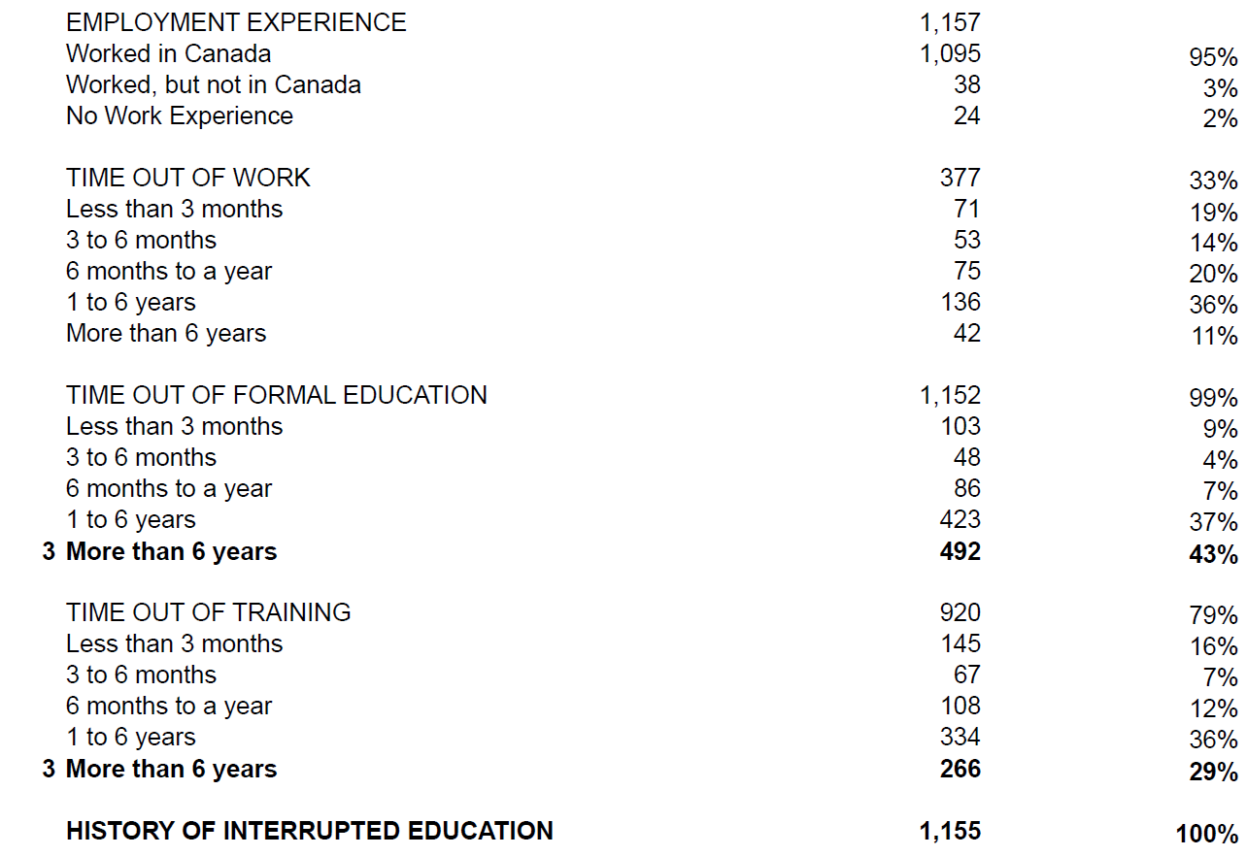
Refers to core measure #3 – Suitability
Should be a “3” here too
Pop Up PD: Grow Your Knowledge of CaMS Reports 60 B & D
Notes:
Here we have employment experience. If you are the person who fills out those entrance forms or enters data in CaMS, these are all of the categories you see on the forms and in CaMS.
There are no numbers on the left margin for the top sections on the slide, but once we get down to more than six years out of formal education, and more than six years out of training, we see that those are suitability indicators.
There is a mistake on this report: History of Interrupted Education is a suitability indicator, but it doesn’t have a 3 beside it when you look at report 60B, but it should have.

Slide 33
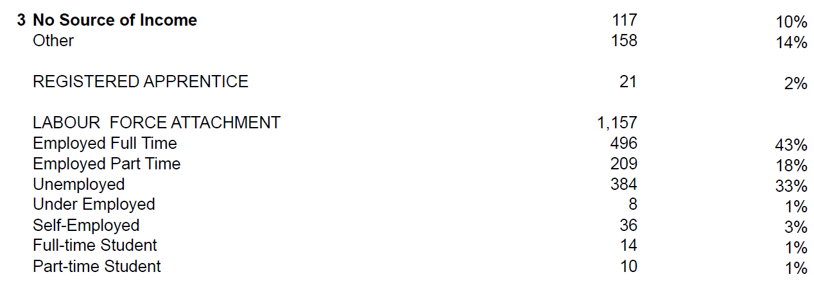
Refers to core measure #3 - Suitability
Ontario = 14% OW
11% ODSP
Ontario = 3%
Ontario = 22% FT
15% PT
Pop Up PD: Grow Your Knowledge of CaMS Reports 60 B & D
Notes:
Next we have source of income where we see more #3s. There are a couple of Ontario figures on the slide for comparison. For example, the Ontario percentage of learners on OW is 14% whereas this agency has 3% of its learners in that category. Also, the provincial percentage for ODSP is 11%, whereas it is 1% for this agency. For registered apprentices, it’s 2% in this agency which is close to the provincial percentage of 3%. Another interesting comparison is labour force attachment. Keep in mind that these numbers are from when learners entered the program. There are quite a few LBS learners in the province who are already employed, either full time or part time.
I will note that the numbers we are looking at are from an e-Channel program (online), so it makes sense that they have a high number of employed learners.
No income is an interesting category. No source of income would tend to be people who are supported by a spouse, living at home with their parents or grandparents and with no source of income of their own.
There is a question in the chat asking how many OW learners there are provincially. I don’t know that number off the top of my head. That number would be available in the roll up report.

Slide 34
(LEARNER GAINS Scores appear here– not currently being used or recorded - future core measure #6?)
Pop Up PD: Grow Your Knowledge of CaMS Reports 60 B & D
Notes:
Assessment information. You will notice that there are a number of assessment tools here. The other category tends to be for those who use in-house developed assessments that aren’t part of this list.
There is a spot here that I didn’t copy in because it’s really long, so I just put in a placeholder for the learner gains score and measures if that ever comes to fruition. Right now, we should all have 0s under learner gains because they aren’t recorded anywhere, and I didn’t want to just put a series of entries with 0 on the slides.
We have the estimated learner time commitment. If you have more employed learners, you may see a lower weekly time commitment.

Slide 35
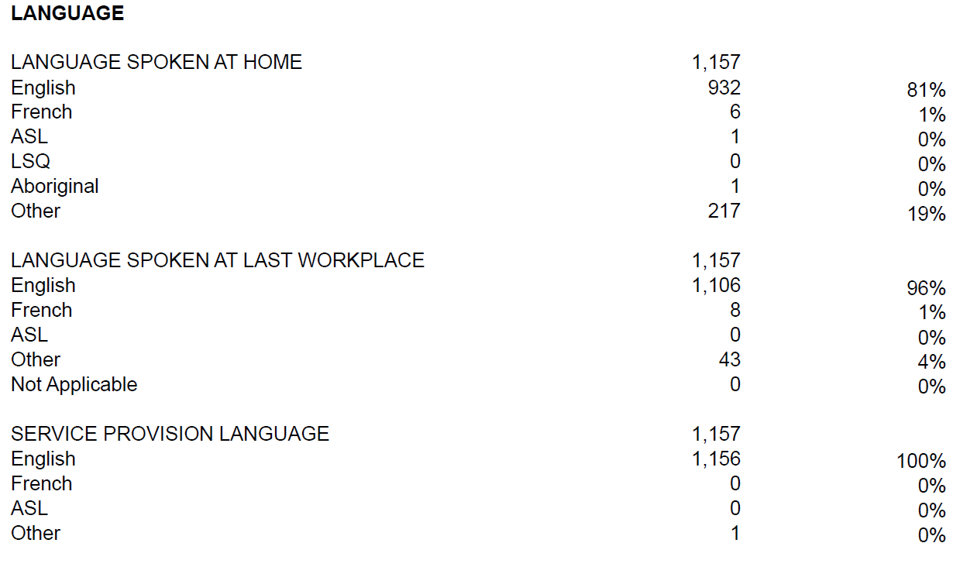
(CANADIAN LANGUAGE BENCHMARK scores appear here, if applicable.)
Pop Up PD: Grow Your Knowledge of CaMS Reports 60 B & D
Notes:
Getting closer to the end of the report, we’ve got language information. In some areas of the province, there may be a number of learners in the “other” category for language spoken at home and at the workplace.

Slide 36
Ontario = 58%
Refers to core measure #5 – Progress
Should line up closely with Progress measure in DSQ 64
END OF REPORT 60B!!
Pop Up PD: Grow Your Knowledge of CaMS Reports 60 B & D
Notes:
At the very end of the report, we come to core measure #5 which is learners who have completed at least one milestone. It should really say “successfully completed” a milestone.
There is a question in the chat asking if learners need to commit to ten hours or is it recommended? It isn’t written anywhere that people have to commit to ten hours.
Out of interest, the Ontario percentage for this core measure was 58%, which is the same as our example agency.
Someone in the chat has discovered that 5,003 learners across the province have no source of income. I think it speaks to the fact that we do have more younger students still living at home and are not employed or spouses who are not working.

Slide 37
What does the Learner Profile info tell us?
You can
estimate if you are meeting the Suitability target
i.e. add up all of the indicators (#3’s)
average of 3 indicators per learner?
use profile information to inform program delivery plans (orientation, curriculum, resources, scheduling, etc.)
e.g. previous education, time out of education, employment status, language spoken
Pop Up PD: Grow Your Knowledge of CaMS Reports 60 B & D
Notes:
Learner profile information tells us a bit about the suitability target and a lot about our program delivery targets, i.e., who we are serving, what their needs are, what their first language is, age range, how long they have been out of school, etc. Do they need more supports because they have been out of school for a long time? Do we need to look at our scheduling because we have a lot of employed learners?
This does give us some business intelligence about our learners and how we are serving them.
If you want to estimate from this report if you are meeting the suitability target, you can add up all of the places where you have the #3 and look for an average of three indicators per service plan to meet the current target of 30% suitability. We don’t have time to delve into that today, but it is explained in the DSQ webinar from last year.
There is a comment in the chat that due to the pandemic, there could be a higher number of people with no source of income right now.

Slide 38
5. Report 60D LBS-All Data Outcomes/Follow-ups
Features
Produced as a PDF
Generated monthly
Based on closed service plans
Gives you summary data on completions and outcomes at exit, 3, 6 and 12 months
Can be used to monitor outcomes and completions for exited learners
Provincial and regional “Rollup” reports are also available
Will usually match DSQ 64 report because DSQ also draws most data from closed service plans
Pop Up PD: Grow Your Knowledge of CaMS Reports 60 B & D
Notes:
We have finished with 60B, so now we will spend a few minutes on 60D. It’s not quite as long and involved.
This report is also produced as a PDF. It’s generated monthly. It’s based on closed service plans, whereas 60B is based on active plans. It gives you lots of summary information on completions and follow-ups at three, six and twelve months. You can use it to monitor outcomes. A roll up report is also available. Most of the data that is in report 60D should match with what you see in the DSQ 64 because they are drawing from closed service plans.

Slide 39
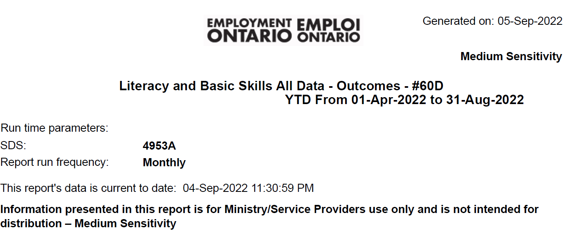
Notes:
Let’s take a look at a few of the features of 60D. It’s a similar title page. It’s monthly. For this one, I have also pulled the year-to-date up to the end of August for this particular site.

Slide 40
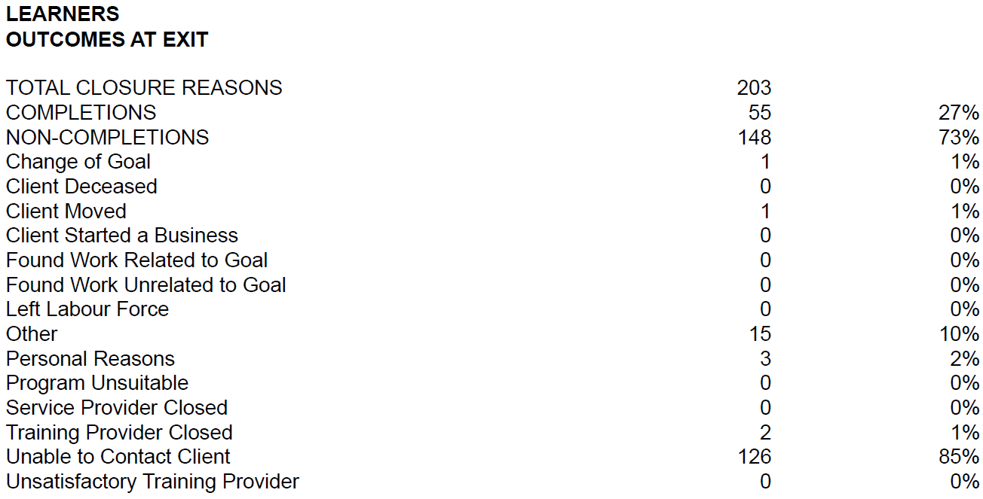
Notes:
If you are familiar with closing files in CaMS and doing the exit forms, you will see all of these closure reasons listed: you have to check off one of them when you close a file. Percentages are arrived at based on closed files. This particular organization had 203 closed files at this point in the fiscal year.
“Unable to contact client” is what we used to call “lost contacts”. That’s a challenge for a lot of us, and I will say that it’s even a bigger challenge for e-Channel. As I mentioned earlier, this report is from an e-Channel agency. It’s hard to get people to respond to those exit and follow-up surveys when you are only serving them virtually, even harder than in person. So there a lot of lost contacts or unknowns at this site.
There is a comment in the chat noting that it’s a good thing we don’t have a target for response rate. Yes, we can see the response rate, but we currently don’t have a target for it, so that’s a good thing.

Slide 41
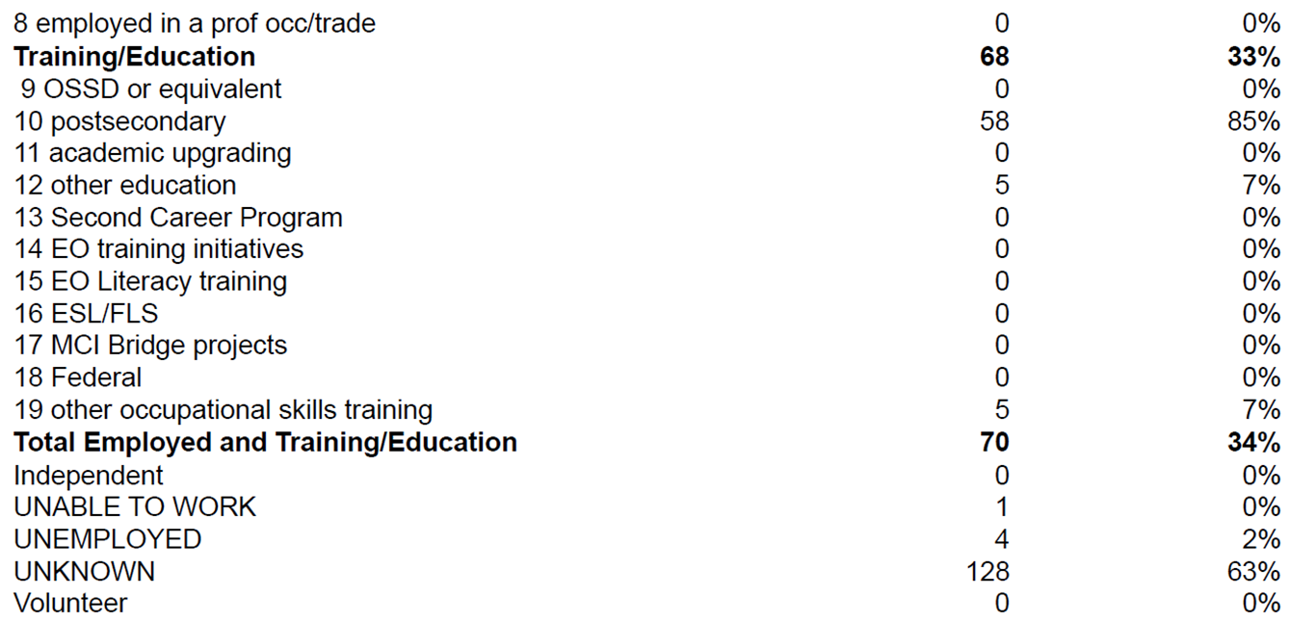
Notes:
The outcomes are also the same as what is on the exit form and in CaMS. So for the 203 files that were closed so far this year, these are the outcomes for this particular organization.

Slide 42
Can also get response rate from the DSQ 64
(LEARNER GAINS Scores appear here– not currently being used or recorded - future core measure #6?)
Notes:
There’s a section on wages. The response rate for exits is listed here. We can also look up the response rate on the DSQ 64. We aren’t measured on the response rate.
We have average milestones completed by goal path. We have a placeholder for learner gains – I didn’t show it here because there isn’t any data currently reported.
A question in the chat asks about service coordination – are there any fields on the registration or exit form or within the learner plan that we should or shouldn’t complete to maximize the service coordination #2 stats? The most important thing about service coordination is to make sure you are recording the referrals in and out in CaMS. I think we have all gotten better at that, but there aren’t any particular tricks and tools other than making sure that your staff are recording the referrals or communicating them to the person who does the CaMS data entry.
There is a question about the topic of referrals. To meet the service coordination measure, it’s only one referral in or out, and then you get your tick box for service coordination. The Ministry has an expectation that we record other referrals on top of the one that counts, but technically we can meet the service coordination measure with just one referral in or out.
Referrals during service also count.
There is a comment that at one time, an agency was told that one referral was counted per learner. So yes, one counts but we are expected to record other referrals as well. Technically, if you only have one referral, you are still going to meet the service coordination measure for that service plan. You need 50% of your service plans with at least one referral to meet the service coordination measure.
I encourage you to go back to the DSQ webinar from last year that talks in more detail about how those measures are calculated.

Slide 43
Province = 6%
Province = 79%
Province = 8%
Province = 70%
Refers to core measure
#4 – Completions
NOT YET measured but data recorded in CaMS
Notes:
About halfway through 60D, we have information about completions. Remember that #4, completion, isn’t currently counted, but the information is recorded in the DSQ and in this report.
I have included some provincial comparisons. For example, “all milestones completed” for this agency is at 70% compared to the provincial average of 79%.
There is a question in the chat asking if referrals in and out are counted equally. Yes, except for the referral categories that don’t count which are referrals in from another LBS service provider and referred in by word of mouth.
Referring back to the DSQ 64 report guide, that itemizes the referrals in and out that count, which is most of them. LBS referrals do count as a referral out (but not in).

Slide 44
Records outcomes at 3, 6, and 12 months in the same way as at exit
Notes:
We also have exactly the same outcomes information at three, six and twelve months as we did at exit, so I didn’t paste them all in here because they are exactly the same list of outcomes that you get from the follow-up surveys.
We aren’t currently measured on three, six and twelve month outcomes or exit outcomes, but the Ministry does track whether we are keeping up to date with our follow-ups. You will get an action item letter if you are falling behind in your follow-ups.

Slide 45
Why do we need to pay attention to outcomes?
They may demonstrate
some of the impacts the LBS program is having on learners
the difference it makes in learners’ independence, further education and especially employability
areas for program/process improvements
value for money (to the Ministry and internally)
It’s important for LBS programs to know where they stand now with the three Completion indicators: completions of all milestones, all learning activities, and a culminating task, especially in the event that the Completion measure is re-introduced.
Pop Up PD: Grow Your Knowledge of CaMS Reports 60 B & D
This Photo by Unknown Author is licensed under CC BY-SA-NC
Notes:
Why do we need to pay attention to outcomes? If we had more time, we could have a discussion about this, but in the interests of time I will add the points to the slide.
Outcomes – the result of what learners do in our programs – are really the impacts of the program. Some of the positive impacts may be reflected in the outcomes. There are lots of good things that learners get from our programs that aren’t listed as outcomes – we know that.
You might be able to find some areas for improvement if there are places where your outcomes are lacking. For a lot of us, lost contacts or unknowns are an area that we struggle with.
Value for money is what the Ministry looks at with outcomes even though we’re not measured on them right now. They are really asking if what the outcomes that you are achieving, based on what the Ministry thinks are important outcomes – which may not be the same thing we would say are important outcomes – is your agency providing value based on the funding that the government is providing?
It’s really important for us to know where we stand with the completion indicators, because even though they don’t count now, we should keep it in the back of our minds that they may in the future

Slide 46
Today’s Webinar…
Quick Reviews
LBS Performance Management Measures
Reports Available from EOIS-CaMS
LBS Detailed Service Quality Report #64
Deeper Dive
LBS Learner Profile Report #60B
LBS Outcomes Report #60B
Quick Preview
6. LBS Case Activity Report #61
Wrap-up!
Pop Up PD: Grow Your Knowledge of CaMS Reports 60 B & D
Notes:
We’re almost at the end. We’ll take a quick look at Report 61. We can’t look at it in detail with the time remaining.

Slide 47
6. Report 61 LBS Case Activity
Features
Produced in Excel
About 85 columns wide and 100’s (or 1000’s) of rows
Generated weekly
Shows all data related to service plans that are open, approved, or active status in the current year, or closed in the current or previous fiscal year
Top of report shows case owner summary
Bottom of report shows subtotals of case activity by status
‘Tip Sheet’ available to assist navigating/sorting data
Pop Up PD: Grow Your Knowledge of CaMS Reports 60 B & D
Notes:
61 is called the Case Activity Report. It’s a very large Excel document. It’s about 85 columns wide and has hundreds or thousands of rows in it. Every individual service plan is a row. It shows all of the data related to the service plans that are not just active, but ones that have a status of open in CaMS, ones that are approved and not yet active, ones that are actually active, and all of the service plans that were closed in the current year or the previous fiscal year. That’s why this is such a big Excel document.
Going back to a point in the chat, for the completion measure – successfully completing all of the milestones – the progress measure is completion of one milestone. So those are two different things. Progress is the measure of how many learners successfully completed one milestone. That’s core measure 5. For the completion measure, in order to get that tick box, all milestones have to be completed. To get the progress measure, just one has to be successfully completed. That’s a bit confusing, but it’s an important distinction.
If at some point in the future all of the completion measures get counted, we will have to look carefully at how and when we enter milestones on service plans in CaMS.

Slide 48
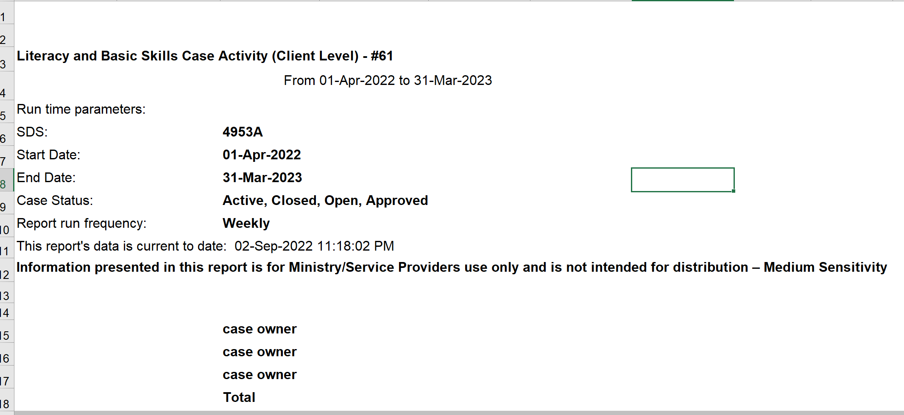
Notes:
Report 61 has a similar header but notice that case status says active / closed / open / approved. Case owners are the people who are entering the data in CaMS.
There is a question in chat asking if learners are expected to complete all milestones on their goal path. In theory, yes, but in reality that doesn’t happen. It is an unrealistic expectation. We could talk a lot about performance measures and how realistic / unrealistic some of them are, but right now the way the completion measure is written, it does say all milestones.

Slide 49
Continues for about 90 columns…
Continues for many rows...
Report 61 guide includes list of column headings, e.g.
PDB = person with a disability
Notes:
This is what the top of the Excel sheet looks like. On the previous slide, you would notice ended at row 18 on the Excel document, so what you are seeing from row 18 on is where the individual data points for each service plan are recorded. There are about 90 columns to the right. On this particular report, because it’s a big program, there are about 2500 rows of data that include all of the different service plans and statuses.
One important point about looking at this report is that you might not know when looking at the column headers what they mean. For example, PDB is “person with a disability”. Inuit, First Nations and Metis are self-explanatory. In some cases, as you scroll to the right, there are abbreviations that you might not be familiar with.

Slide 50
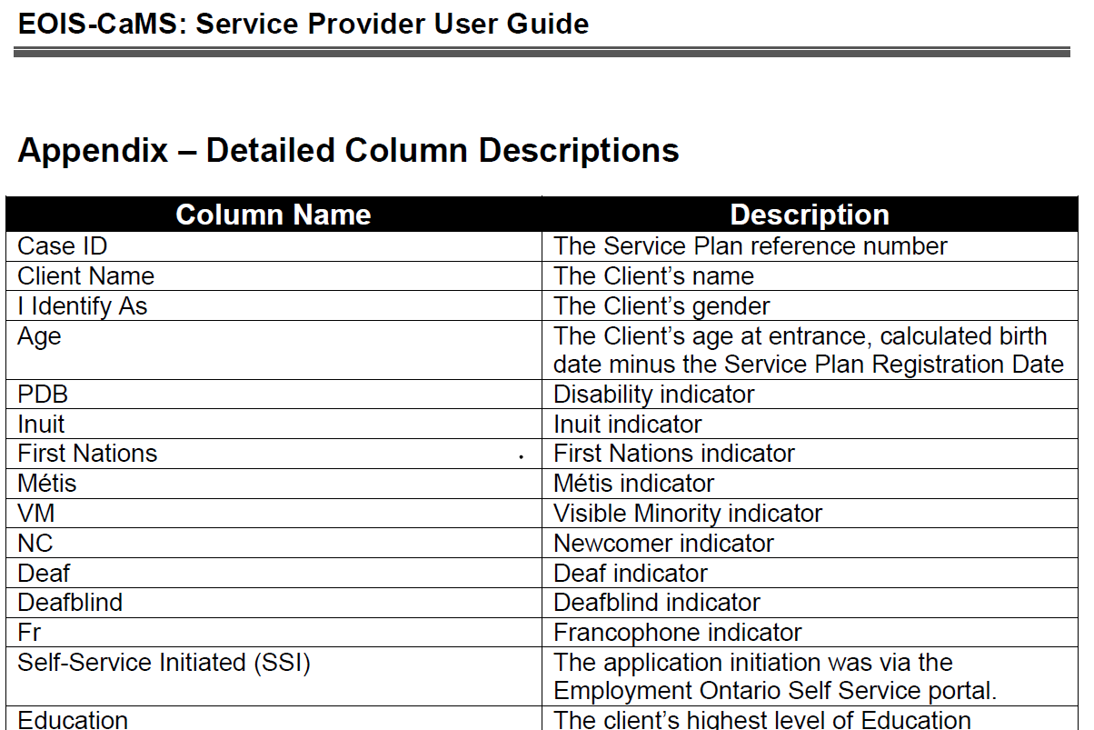
Helpful to consult the Appendix of the report #61 guide to see all of the data points included in the report
Notes:
There is a nice list in the Report 61 guide that tells you what those column names mean. If you are looking at Report 61, and you don’t know what the column name means, look at the guide. It’s a helpful way to see what the short forms stand for at the top of the Excel columns.

Slide 51
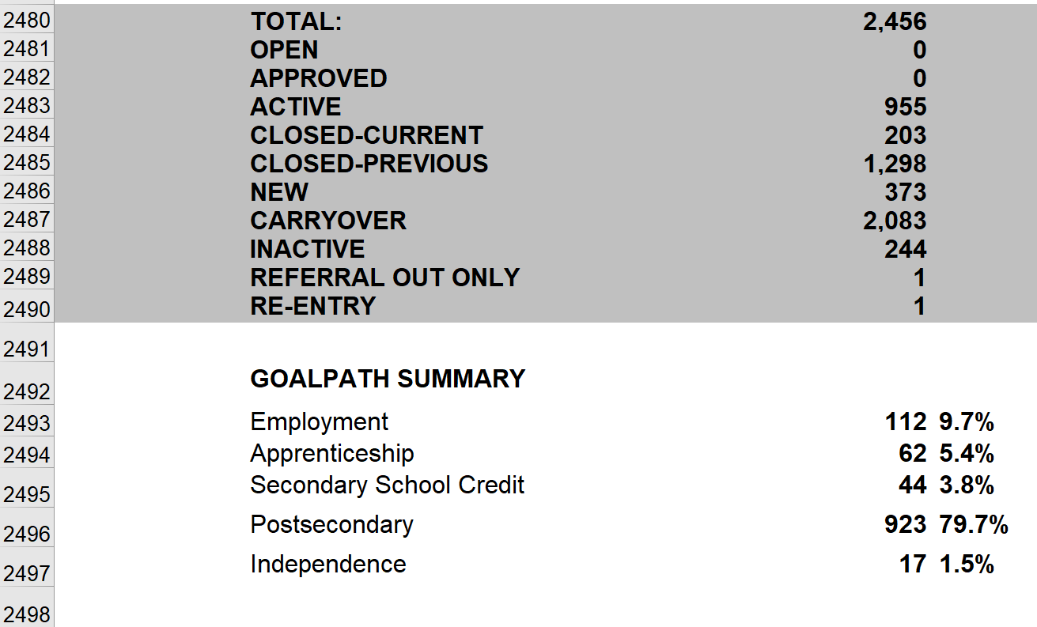
Bottom of report 61 contains these summary figures
Goal path #’s are for active plans and those closed in the current year
Notes:
At the bottom of all of those rows of individual service plan data, there is some summary information. Remember I said that this particular report has about 2500 rows in it – now I have jumped all of the way down to the bottom where it has a summary of the different statuses of the number of plans that are shown on this report for this moment in time, up to the end of August.
It also shows the goal path summary numbers – you might recall that was in 60B as well. The goal path numbers are based on the active plans and those closed in the current year. So the totals don’t add up to the total number of rows (2500), they add up to 1,158 – the number we have seen throughout today’s webinar in the other reports.

Slide 52
Wrap Up!
Report 64
LBS Detailed Service Quality
Summarizes data related to the 5 core performance measures (Customer Satisfaction, Service Coordination, Suitability, Progress, Learners Served)
Report 60B
LBS-All Data Service Plan/Profile
Summarizes all profile information
Gives you summary data for 4 of the 5 core measures
Report 60D
LBS-All Data Outcomes/Follow-ups
Summarizes all outcome information
Gives you summary data on completions and outcomes at exit, 3, 6 and 12 months
Report 61
LBS Case Activity
Summarizes all data related to service plans that are open, approved, active, or have been closed in the current or previous fiscal year
Pop Up PD: Grow Your Knowledge of CaMS Reports 60 B & D
This Photo by Unknown Author is licensed under CC BY
Notes:
Wrapping up, these are the reports that we looked at today. As a brief wrap up, Report 64 is the LBS Detailed Service Quality (DSQ) report, the big one that traces our performance measures monthly. 60B has all of the service plan and profile information for active plans. 60D has the outcome and follow-up information for closed plans. 61 has all of that information together for open, approved, active, and closed plans.

Slide 53
What happens when we don’t record our CaMS information properly and consistently???
Notes:
This is my last attempt at humour for the day.
I hope you have gotten something out of today’s webinar. It’s always nice to have people on the webinar asking questions and getting feedback from others. It’s also nice to have some experienced practitioners online who can add information in to the chat. Thanks for all of the questions and comments that you have all added to the chat.

Slide 54
Thank you to today’s supporting cast!
ASL Interpreters Carolyn Lesonsky and Mike Glover
Deaf Literacy Initiative for providing ASL Interpreters
COFA for French translation
Stacey Ornatowski for technical support
Wendy Olson for moderating
Robyn Cook-Ritchie for sharing some slides
Pop Up PD Committee for planning
Notes:
I would like to once again thank our supporting cast: our interpreters Carolyn and Mike, DLI for arranging for the interpreters, COFA for doing the French translation, Stacey and Wendy for your support today, and the entire Pop Up PD Committee for their support.
Thanks for all of the positive comments in the chat.

Slide 55
Thank you for participating!
Webinar resources: Pop Up PD Resources for LBS Educators
Webinar evaluation: https://tinyurl.com/4fte7mpz
Notes:
Here is a link to all of the webinar resources. You can also use Google to find these resources.
Thanks for participating today!

