Slide 1
Title of Presentation

Slide 2
I would like to begin by acknowledging the Indigenous Peoples of all the lands that we are on today. While we meet today on a virtual platform, I would like to take a moment to acknowledge the importance of the lands, which we each call home.
We do this to reaffirm our commitment and responsibility in improving relationships between nations and to improving our own understanding of local Indigenous peoples and their cultures. From coast to coast to coast, we acknowledge the ancestral and unceded territory of all the Inuit, Métis, and First Nations people that call this land home.

Slide 3
About Pop Up PD for Literacy Educators
free webinar series developed by Ontario’s LBS Regional Networks & the Provincial Support Organizations for Literacy
supports LBS practitioners with presentations on topics important to them
English language webinars presented for LBS practitioners annually since 2015-2016; French language transcriptions coming soon!
all webinar presentations, recording links & transcripts here:
Pop Up PD Resources for LBS Educators
webinar topic ideas welcome at: e-channel@contactnorth.ca
Notes:
Many of you have attended PUPD before…

Slide 4
With Us Today…
Presenter
Barb Glass, Executive Director, College Sector Committee for Adult Upgrading
Moderator
Wendy Olson, Executive Director, Literacy Northwest
Technical Support
Stacey Ornatowski, Staff Training Specialist, Contact North|Contact Nord
ASL Interpreters
Carolyn Lesonsky and Mike Glover
Special thanks also to Robyn Cook-Ritchie
for sharing some slides for this webinar ☺

Slide 5
Today’s Webinar…
Quick Review
LBS Performance Management Measures
LBS Detailed Service Quality Report #64
Other Reports Available from EOIS-CaMS
Deeper Dive
4. LBS Learner Profile Report #60B
5. LBS Outcomes Report #60B
Quick Preview
6. LBS Case Activity Report #61
Wrap-Up!
Pop Up PD: Grow Your Knowledge of CaMS Reports 60 B & D
Notes:
Many screenshots taken from various reports and report guides

Slide 6
1. LBS Performance Measures – Quick Review
Dimension | Core Measures Phase 11-A (Current) | Core Measures Phase 11-B (Future?)
Customer Service (40%) | 1. Customer Satisfaction (15%) | 1. Customer Satisfaction (?%)
 | 2. Service Coordination (25%) | 2. Service Coordination (?%)
Effectiveness (50%) | 3. Suitability/Learner Profile (20%) | 3. Suitability/Learner Profile (?%)
 | 4. n/a | 4. Completions (?%)
 | 5. Learner Progress (30%) | 5. Learner Progress (?%)
 | 6. n/a | 6. Learner Gains (?%)
Efficiency (10%) | 7. Learners Served (10%) | Learners Served (10%)
Pop Up PD: Grow Your Knowledge of CaMS Reports 60 B & D
Notes:
New for some; review for some
Phase 11-B may be implemented at some future date
No firm details on that yet but important to keep in mind

Slide 7
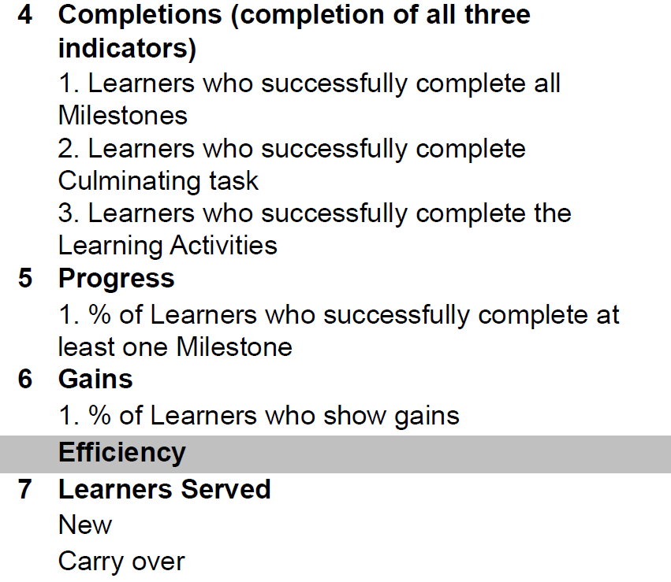
What about #4 and #6?
Note:
Data that feeds into #4 is currently captured in CaMS at exit and appears on the DSQ 64 report, but is not used to measure performance at this time.
#6 does not yet exist, but there is a placeholder in CaMS for Learner Gains data
Pop Up PD: Grow Your Knowledge of CaMS Reports 60 B & D
Notes:
This is what’s included in the proposed Phase 11-B, i.e. #4 and 6

Slide 8
LBS Performance Measures (Phase II-A Current)
Dimension | Measure | Weight | Standard | SQS Value
Customer Service (40%) | 1. Customer Satisfaction | 15% | 90% | 1.35
 | 2. Service Coordination | 25% | 50% | 1.25
Effectiveness (50%) | 3. Suitability/Learner Profile (all 12 indicators) | 20% | 30% | 0.6
 | 5. Learner Progress | 30% | 60% | 1.8
Efficiency (10%) | 7. Learners Served | 10% | 90% | 0.9
 |  |  | SQS Standard | 5.9
Phase 11-A: Five measures in 2022-23
Notice #4 and #6 are not included
Pop Up PD: Grow Your Knowledge of CaMS Reports 60 B & D
Notes:
These three dimensions (customer service, effectiveness and efficiency) are weighted to indicate their value when combined to measure overall service quality.
Within each dimension of service quality, core measures of performance are identified and weighted.
We’ll refer back to these core measures frequently during the webinar
The standard is what you measure your agency performance against – what we are expected to achieve to be compliant with these measures

Slide 9
2. Detailed Service Quality Report #64
The MOST IMPORTANT report.
The only performance measure report.
This is the report you use to
Monitor your site’s monthly compliance with the 5 Core Measures
Complete your Interim Report and Final Report for the Ministry
Note: 4 of the 5 Core Measures tracked in the DSQ are based on CLOSED files only
Pop Up PD: Grow Your Knowledge of CaMS Reports 60 B & D
Notes:
Important to ensure your site reviews the DSQ 64 every month to see how you are doing with meeting the 5 core measures
And the overall Service Quality Standard (SQS) score

Slide 10
Want to learn more about the DSQ 64 report? Check out this session from last year’s Pop Up PD: https://e-channel.ca/practitioners/pop-pd-resources-previous-years
Notes:
Copy the link into the chat

Slide 11
3. Reports Available in EOIS-CaMS
Pop Up PD: Grow Your Knowledge of CaMS Reports 60 B & D

Slide 12
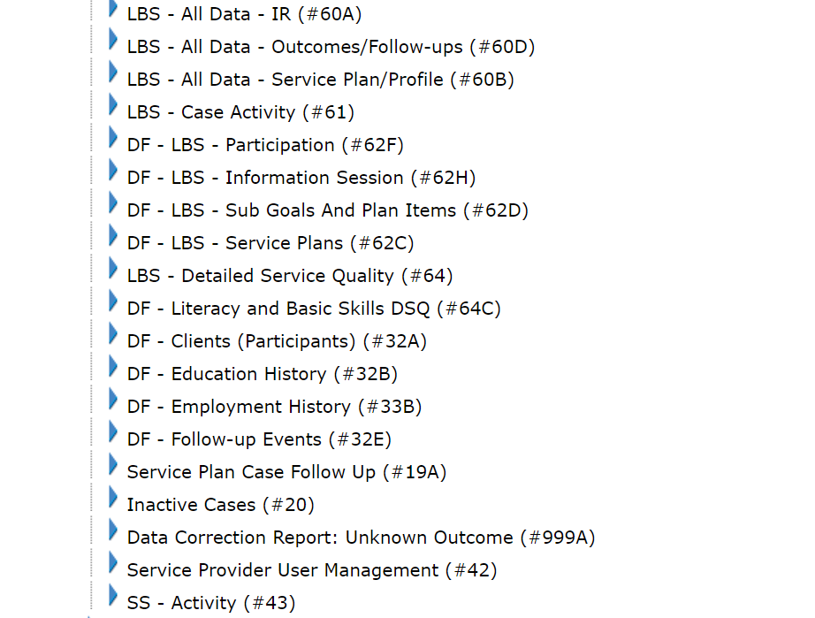
LBS Site Level Reports Currently Available
Pop Up PD: Grow Your Knowledge of CaMS Reports 60 B & D
Notes:
19 reports currently available for LBS; some of the same for ES
Your user role in CaMS determines which reports you have access to
DF = data files – optional resource to allow SPs to run their own queries
See EOIS-CaMS Chapter 4 – Service Provider Information and User Management
Data Files (optional)
Data files are provided as an optional resource in addition to the above reports. For more information on how to receive data files, refer to EOIS-CaMS Chapter 4 – Service Provider Information and User Management. Seven Comma Separated Values (CSV) data files mimicking Case Management System structure will be provided for each service delivery site on a weekly basis, allowing service delivery sites to run their own queries for research and evaluation purposes. Utilizing these data files requires some advance database knowledge and may require assistance from your IT support.
DF – Codes and descriptions- Individual files are created for each service delivery site, for clients, service plans, subgoals/plan items, employment history, education history, follow-up review events and aggregate data. There are two files created across the province – a code table with descriptions for lookup and a provincial employer data file. All files will have column headers. All non-closed service plans plus closed service plans with a last system update date within the current fiscal year and their related information are included in these data files. This determination is due to the fact that the service plan is what is associated to the service delivery site, not the client.

Slide 13
Provincial/Regional “Roll-up” Reports Currently Available
LBS - All Data - IR (Rollup)- #60AR
LBS - All Data- Outcomes/Follow-ups (Rollup) - #60DR
LBS - All Data- Service Plan/Profile (Rollup) - #60BR
LBS - Detailed Service Quality (Rollup) – #64R
Available for the province or by region:
Central
Eastern
Northern
Western
Pop Up PD: Grow Your Knowledge of CaMS Reports 60 B & D
Notes:
Use roll up reports to compare where your SDS is in comparison to your region and the entire province.
No roll up reports for reports containing personal data, e.g. names in report 61
In this webinar I’ve inserted some provincial values for interest.

Slide 14
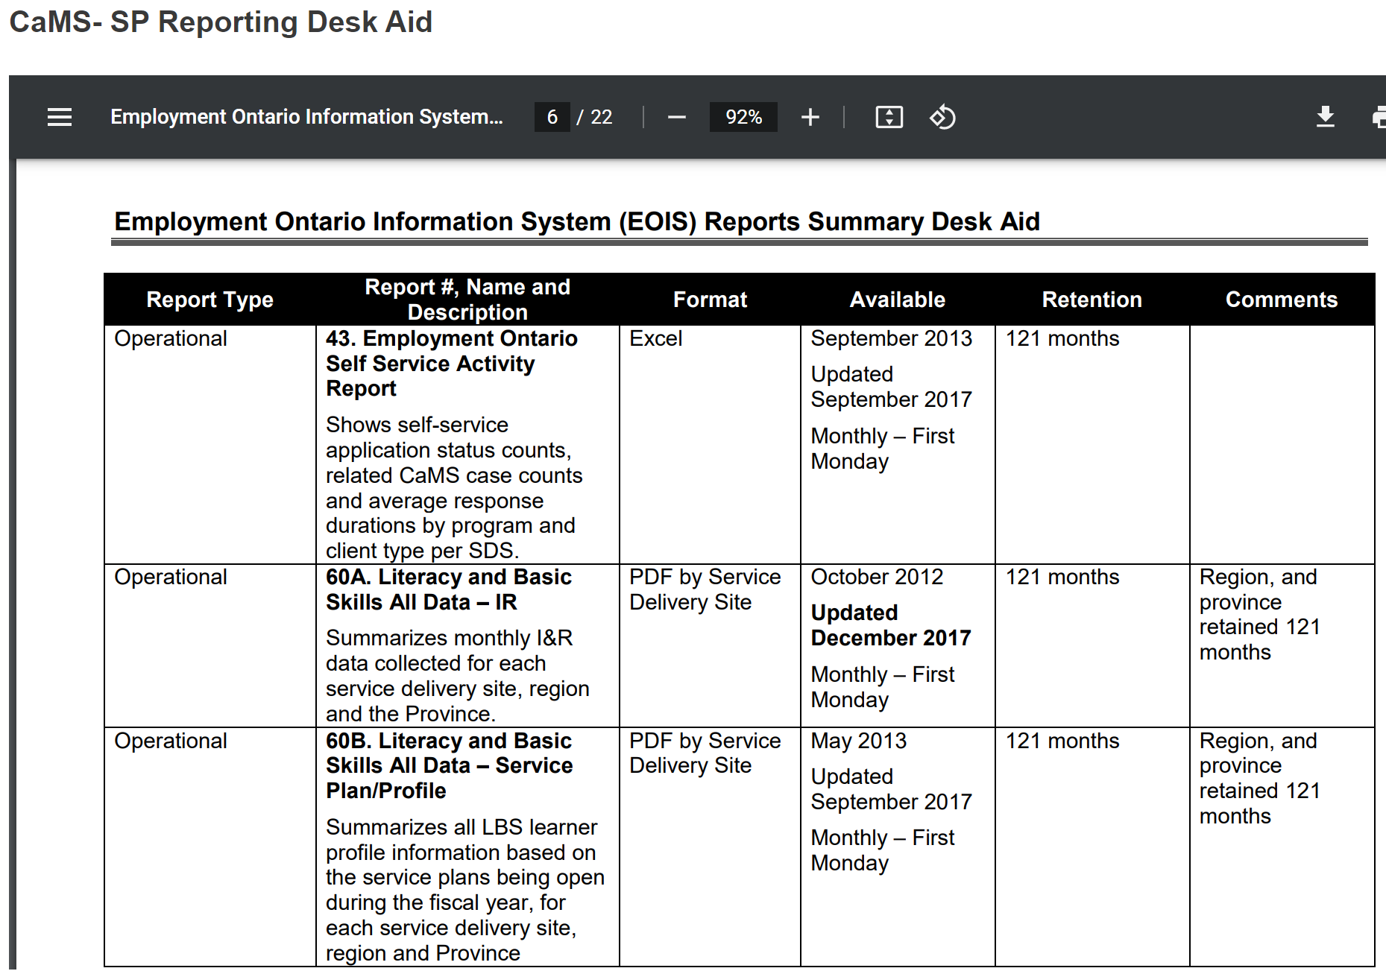
Summary of reports is available on myEOIS: “Desk Aids”
e.g.
60A
&
60B
Notes:
Reports listed by number, not by program so need to scroll through

Slide 15
Useful Reports
Report 60B
LBS-All Data Service Plan/Profile
Summarizes all profile information
Gives you summary data for 4 of the 5 core measures
Report 60D
LBS-All Data Outcomes/Follow-ups
Summarizes all outcome information
Gives you summary data on completions and outcomes at exit, 3, 6 and 12 months
Report 61
LBS Case Activity
Shows all data related to service plans that are open, approved, active or have been closed (weekly)
This Photo by Unknown Author is licensed under CC BY-NC
Pop Up PD: Grow Your Knowledge of CaMS Reports 60 B & D
Notes:
Reminder: 60B and 60D both produce roll up reports as well
Not 61 b/c it contains personal data

Slide 16
Remember the report guides! Available on - EOIS-CaMS Reporting & - myEOIS
Pop Up PD: Grow Your Knowledge of CaMS Reports 60 B & D
Notes:
Most of the information in our webinars on reports is taken from the report guides!

Slide 17
4. Report 60B: LBS-All Data Service Plan/Profile
Features
Produced as a PDF
Generated monthly
Based on active service plans
Summarizes all service plan/profile information
Gives you summary data for 4 of the 5 core measures for your site
Can be used to monitor progress toward meeting core measures and for planning
Provincial and regional “Rollup” reports are also available
Will not match DSQ 64 report because DSQ draws most data from closed service plans
Pop Up PD: Grow Your Knowledge of CaMS Reports 60 B & D

Slide 18
Other Tidbits
Closed service plans are included if they were active during the report period and do not have a Closure Reason of “Opened in Error”.
All sections of the report, except for ‘Expenditures’ and ‘Unique Learners Served’, are based on total # of service plans year to date.
If a learner has more than one service plan in the report period, data from each plan is counted.
4. Report 60B: LBS-All Data Service Plan/Profile
Pop Up PD: Grow Your Knowledge of CaMS Reports 60 B & D
Notes:
As with any report, it’s important to understand exactly where the data in the report is coming from and what it represents in terms of active/closed files

Slide 19
Take a look at some of the data in report 60B…
Pop Up PD: Grow Your Knowledge of CaMS Reports 60 B & D

Slide 20
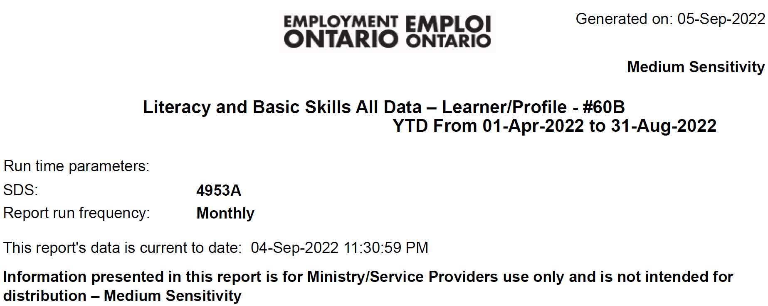
Pop Up PD: Grow Your Knowledge of CaMS Reports 60 B & D
Notes:
First report we’re looking at more in-depth today
Site name removed
Note reporting period and ‘current to’ date
The following screen shots of the report go in order as they appear in the report (9 pages)

Slide 21
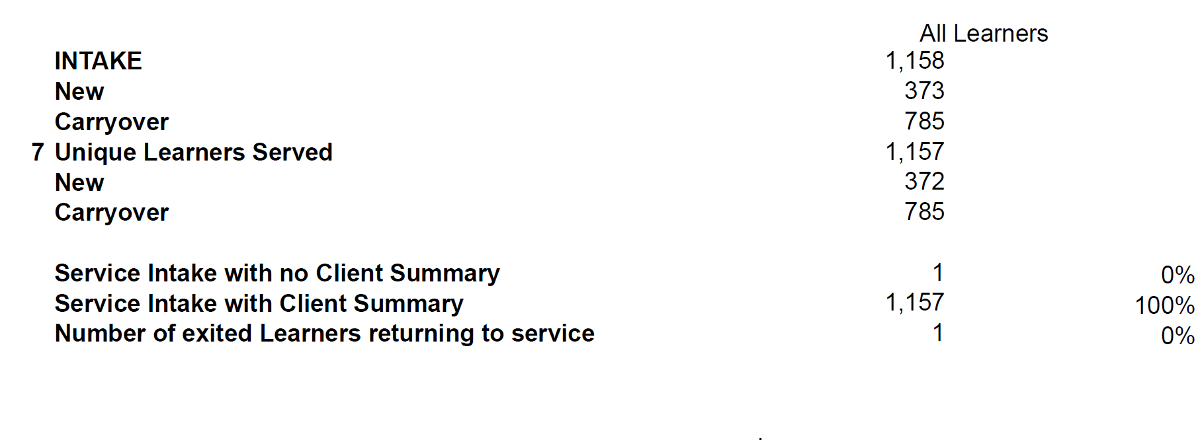
Refers to core measure #7
Pop Up PD: Grow Your Knowledge of CaMS Reports 60 B & D
Notes:
INTAKE number is service plans, not unique learners (large site)
“7” is showing because Unique Learners Served is core measure #7
All of the 1158 plans are either currently active or were active during this report period, i.e. since April 1, 2022

Slide 22
$$\frac{1123 ref out}{1158 plans} x 100=97\%$$
$$\frac{11 ref in}{1158 plans} x 100=1\%$$
Pop Up PD: Grow Your Knowledge of CaMS Reports 60 B & D
Notes:
All referrals in and out for the reporting period are tallied by type and shown as a # and % of total service plans for the reporting period
If you don’t have any referrals for a particular category, it shows as zero for both # and %

Slide 23
How can the referral in and out numbers help us?
You can you see at a glance
where you are getting referrals in and making referrals out
how many of each ref in/out category you have (or don’t)
if the referral in/out totals make sense based on the activity at your site and in your community
if you may not be recording referrals accurately
It may sound obvious but….if you don’t record the referrals into and out of the program, then they won’t be in your data!
Pop Up PD: Grow Your Knowledge of CaMS Reports 60 B & D
Notes:
Ask the participants
E.g. collocated with OW? Expect to see more of those in referrals in…
E.g. partnership with ES? Expect to see more of those referrals in and/or out

Slide 24
Why is this $0?
This site doesn’t use Training Support funds
or
They have not yet entered any Training Support data into their service plans in CaMS
Pop Up PD: Grow Your Knowledge of CaMS Reports 60 B & D

Slide 25
Apologies for the small print on the next slide!

Slide 26
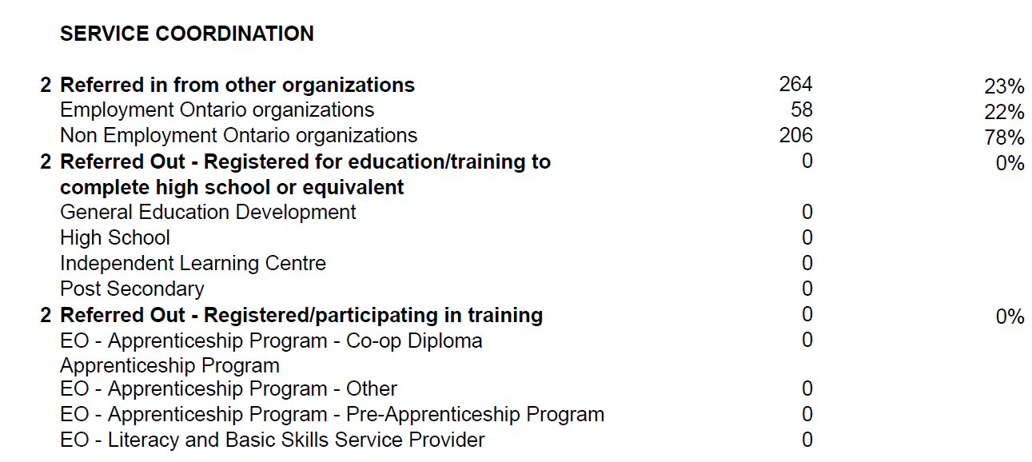
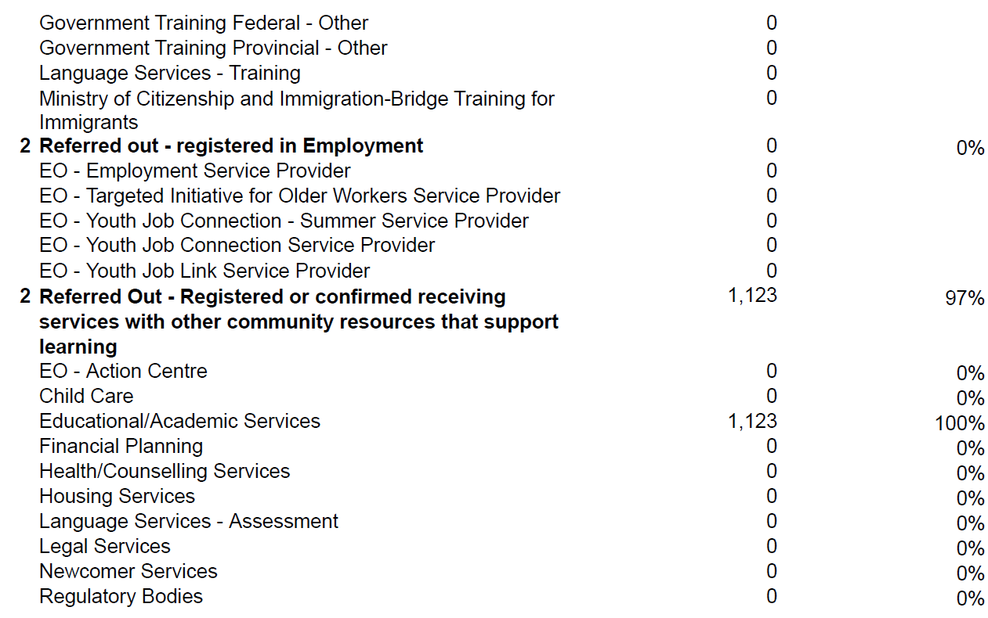
$$\frac{264 ref in}{1158 plans} x 100=23\%$$
Refers to core measure #2
Notes:
Remember not all referrals in/out count toward the Service Coordination measure
The ones listed in this part of the report count
Doesn’t match the DSQ because these show active plans, not closed plans

Slide 27
What does the Service Coordination data tell us?
You can see
if your site is meeting the Service Coordination target
i.e. do at least 50% of your service plans have at least one referral in or out?
if you are accurately recording referrals in and out
Do your referrals reflect your community/learner profiles?
Pop Up PD: Grow Your Knowledge of CaMS Reports 60 B & D
Notes:
E.g. collocated with OW? Expect to see more of those in referrals in…
E.g. partnership with ES? Expect to see more of those referrals in and/or out

Slide 28
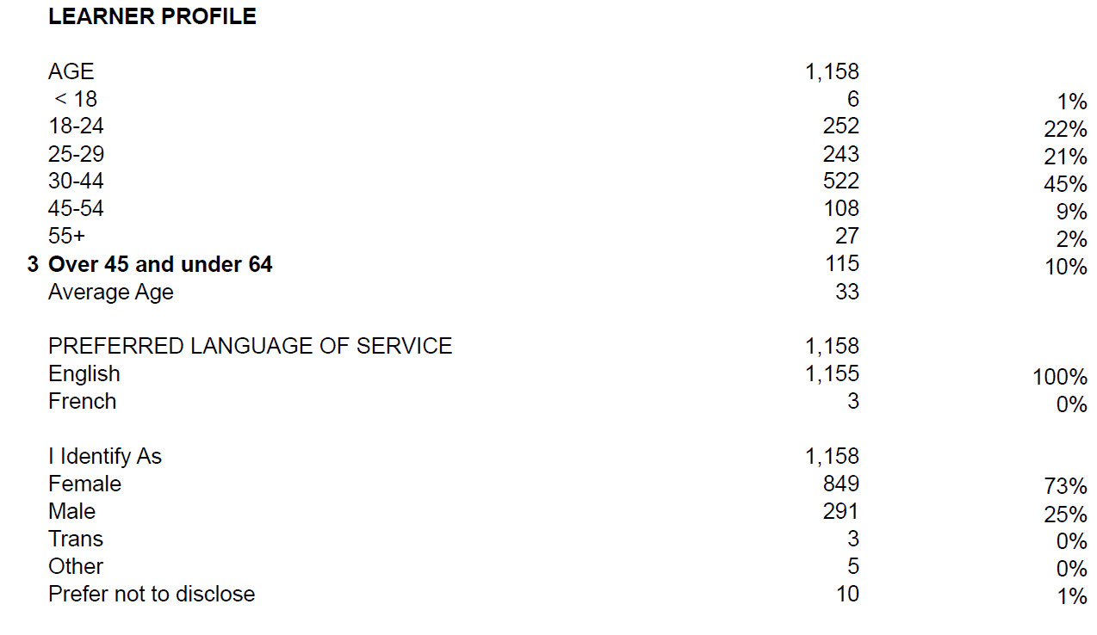
88% are
18 to 44 yrs
Ontario = 71%
Refers to core measure #3 (Suitability)
Refers to core measure #3 (Suitability)
Ontario = 20%
Does not refer to Suitability measure
Pop Up PD: Grow Your Knowledge of CaMS Reports 60 B & D
Notes:
The Learner Profile section has many categories
Those identified with “3” are the indicators that count toward core measure 3 – Suitability
Watch for more #3’s in the coming slides
Average age may be interesting
At this site 88% are less than 45 yrs; provincial 71%

Slide 29
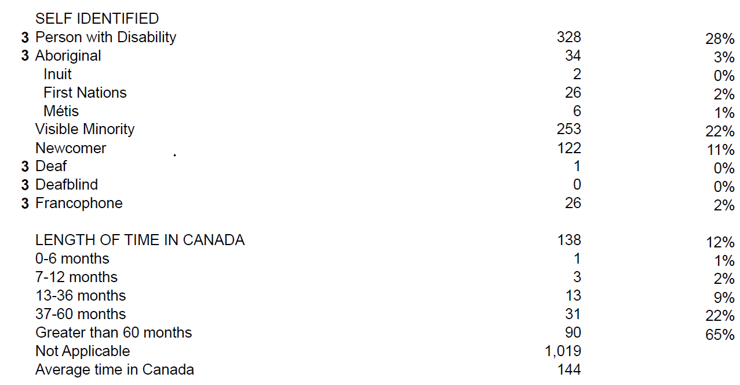
Refers to core measure #3 (Suitability)
Note: ‘Visible Minority’ and ‘Newcomer’ are not Suitability indicators and DO NOT count toward the Suitability measure.
Pop Up PD: Grow Your Knowledge of CaMS Reports 60 B & D
Notes:
Visible minority and Newcomer do not count toward Suitability but are recorded
Length of time in Canada influences overall program profile and often depends on geographic region of the province

Slide 30
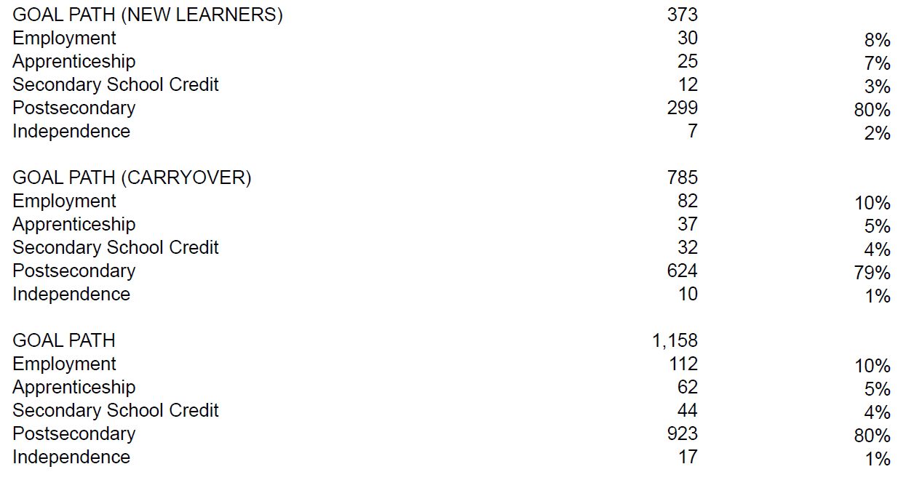
Total of new and carryover
Pop Up PD: Grow Your Knowledge of CaMS Reports 60 B & D

Slide 31
Ontario = 34%
Refers to core measure #3 - Suitability
Pop Up PD: Grow Your Knowledge of CaMS Reports 60 B & D
Notes:
87% gr. 12 or more; provincial 66%
Country data may be interesting re newcomer/immigrant populations
Cultural sensitivity/awareness in your program?

Slide 32
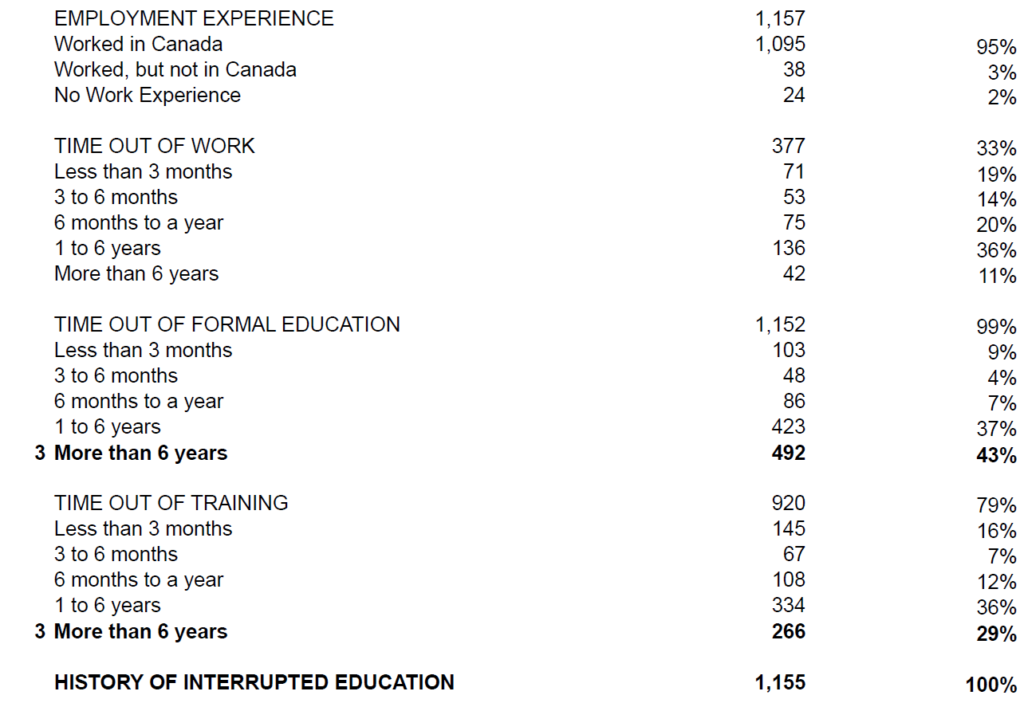
Refers to core measure #3 – Suitability
Should be a “3” here too
Pop Up PD: Grow Your Knowledge of CaMS Reports 60 B & D
Notes:
Employment experience may inform program planning
Time out of education may also inform – do you have supports in place?
History of interrupted ed (K to 12 only) – missing “3”

Slide 33
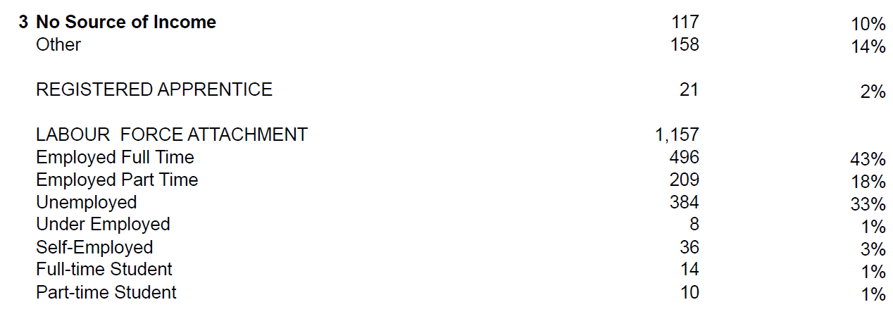
Refers to core measure #3 - Suitability
Ontario = 14% OW
11% ODSP
Ontario = 3%
Ontario = 22% FT
15% PT
Pop Up PD: Grow Your Knowledge of CaMS Reports 60 B & D
Notes:
OW/ODSP always a Ministry priority
No source of income: supported by parent, guardian, spouse, etc.
Do you serve registered apprentices?
Labour force at time of reg – not necessarily while in program

Slide 34
(LEARNER GAINS Scores appear here– not currently being used or recorded - future core measure #6?)
Pop Up PD: Grow Your Knowledge of CaMS Reports 60 B & D
Notes:
‘Other’ assessment is usually for in-house tools; can only pick one tool
More employed learners may mean lower time commitment

Slide 35
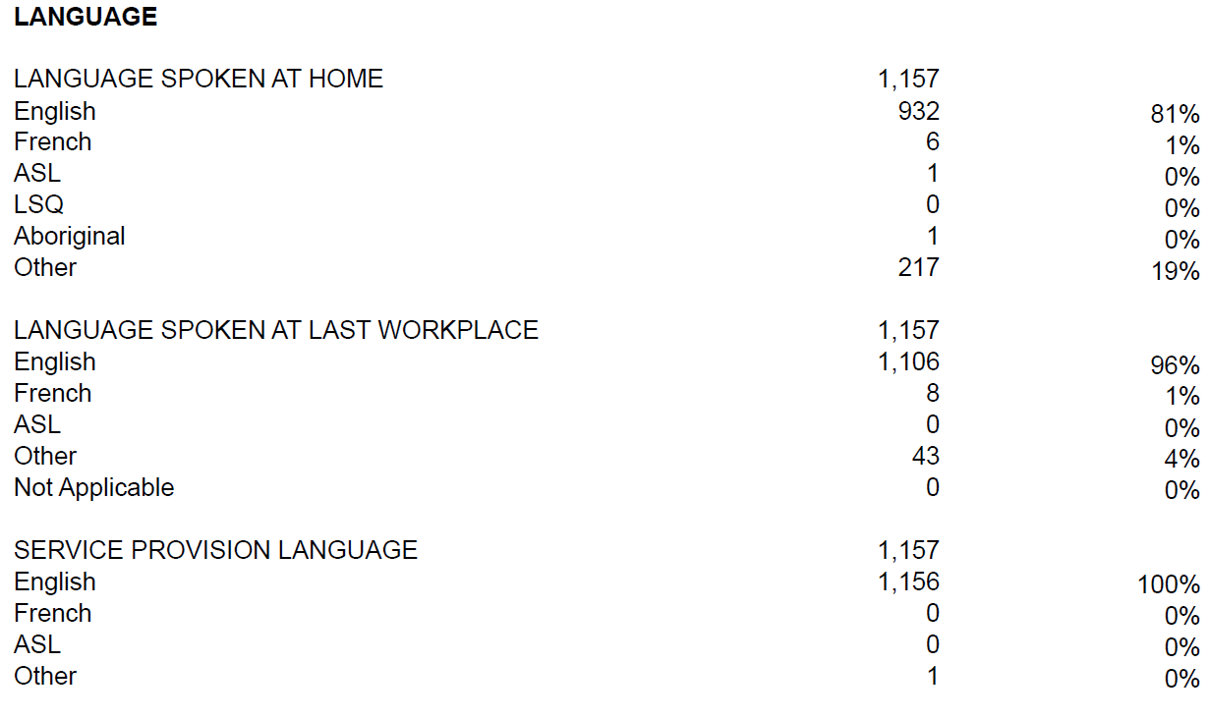
(CANADIAN LANGUAGE BENCHMARK scores appear here, if applicable.)
Pop Up PD: Grow Your Knowledge of CaMS Reports 60 B & D
Notes:
The “1” under other may be a data entry error

Slide 36
Ontario = 58%
Refers to core measure #5 – Progress
Should line up closely with Progress measure in DSQ 64
END OF REPORT 60B!!
Pop Up PD: Grow Your Knowledge of CaMS Reports 60 B & D

Slide 37
What does the Learner Profile info tell us?
You can
estimate if you are meeting the Suitability target
i.e. add up all of the indicators (#3’s)
average of 3 indicators per learner?
use profile information to inform program delivery plans (orientation, curriculum, resources, scheduling, etc.)
e.g. previous education, time out of education, employment status, language spoken
Pop Up PD: Grow Your Knowledge of CaMS Reports 60 B & D
Notes:
Ask the group
E.g. collocated with OW? Expect to see more of those referrals in…
E.g. partnership with ES? Expect to see more of those referrals in and/or out

Slide 38
5. Report 60D LBS-All Data Outcomes/Follow-ups
Features
Produced as a PDF
Generated monthly
Based on closed service plans
Gives you summary data on completions and outcomes at exit, 3, 6 and 12 months
Can be used to monitor outcomes and completions for exited learners
Provincial and regional “Rollup” reports are also available
Will usually match DSQ 64 report because DSQ also draws most data from closed service plans
Pop Up PD: Grow Your Knowledge of CaMS Reports 60 B & D

Slide 39
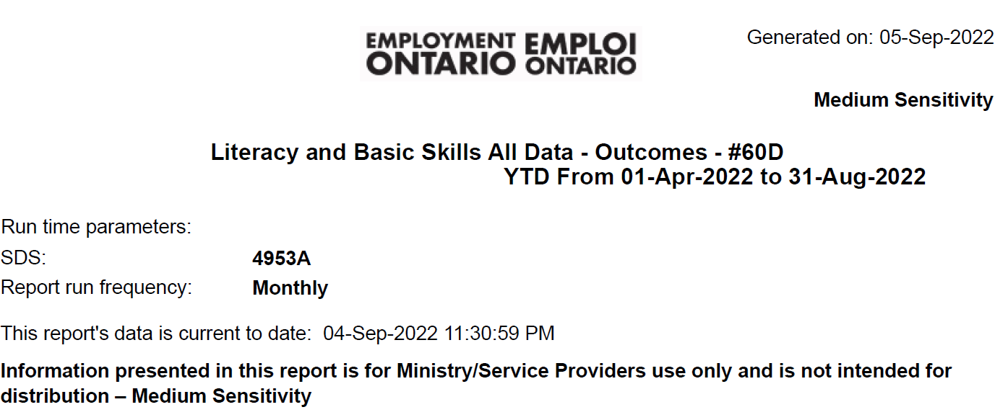

Slide 40
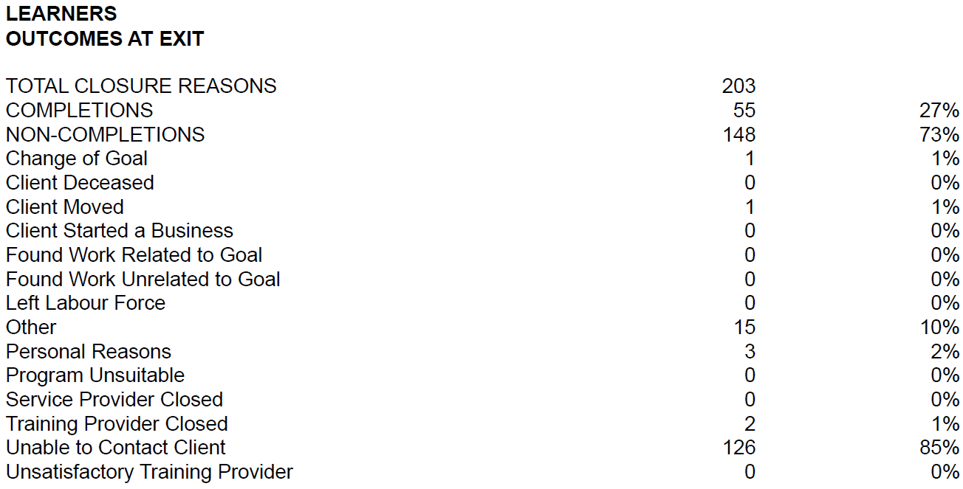
Notes:
Provincial numbers

Slide 41
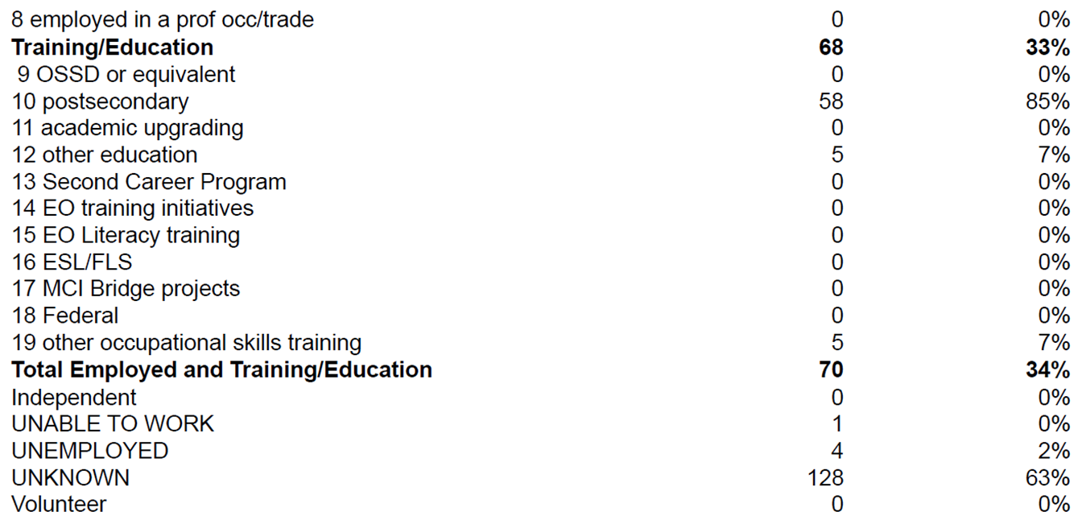

Slide 42
Can also get response rate from the DSQ 64
(LEARNER GAINS Scores appear here– not currently being used or recorded - future core measure #6?)
Notes:
Not currently measured on response rate but good to know and try to improve
Average program duration may be interesting

Slide 43
Province = 6%
Province = 79%
Province = 8%
Province = 70%
Refers to core measure
#4 – Completions
NOT YET measured but data recorded in CaMS

Slide 44
Records outcomes at 3, 6, and 12 months in the same way as at exit
Notes:
Not currently measured on 3, 6, and 12-month outcomes but they must be kept up to date – Ministry tracks this

Slide 45
Why do we need to pay attention to outcomes?
They may demonstrate
some of the impacts the LBS program is having on learners
the difference it makes in learners’ independence, further education and especially employability
areas for program/process improvements
value for money (to the Ministry and internally)
It’s important for LBS programs to know where they stand now with the three Completion indicators: completions of all milestones, all learning activities, and aculminating task, especially in the event that the Completion measure is re-introduced.
Pop Up PD: Grow Your Knowledge of CaMS Reports 60 B & D
This Photo by Unknown Author is licensed under CC BY-SA-NC
Notes:
Ask the group
E.g. collocated with OW? Expect to see more of those in referrals in…
E.g. partnership with ES? Expect to see more of those referrals in and/or out

Slide 46
Today’s Webinar…
Quick Reviews
LBS Performance Management Measures
Reports Available from EOIS-CaMS
LBS Detailed Service Quality Report #64
Deeper Dive
LBS Learner Profile Report #60B
LBS Outcomes Report #60B
Quick Preview
6. LBS Case Activity Report #61
Wrap-up!
Pop Up PD: Grow Your Knowledge of CaMS Reports 60 B & D

Slide 47
6. Report 61 LBS Case Activity
Features
Produced in Excel
About 85 columns wide and 100’s (or 1000’s) of rows
Generated weekly
Shows all data related to service plans that are open, approved, or active status in the current year, or closed in the current or previous fiscal year
Top of report shows case owner summary
Bottom of report shows subtotals of case activity by status
‘Tip Sheet’ available to assist navigating/sorting data
Pop Up PD: Grow Your Knowledge of CaMS Reports 60 B & D

Slide 48
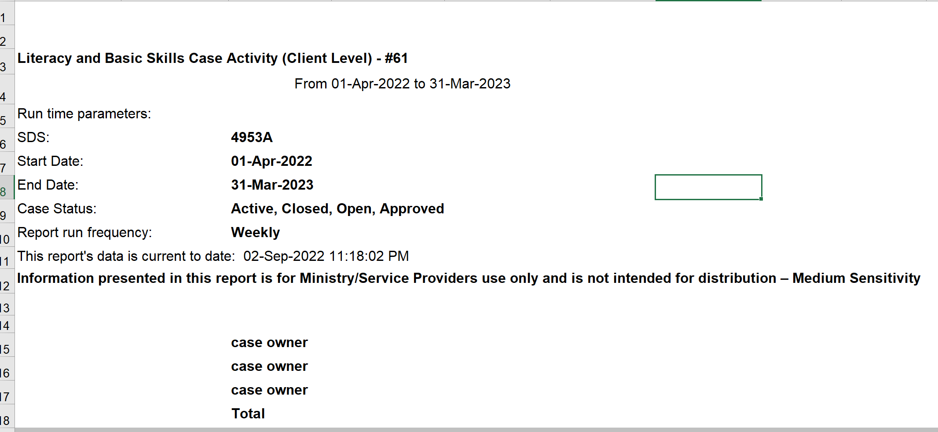
Notes:
Contains every data point recorded in CaMS, by service plan for open, approved, active, closed in current/previous fiscal yea

Slide 49
Continues for about 90 columns…
Continues for many rows...
Report 61 guide includes list of column headings, e.g.
PDB = person with a disability
Notes:
Starting from row 18 (where previous slide left off)

Slide 50
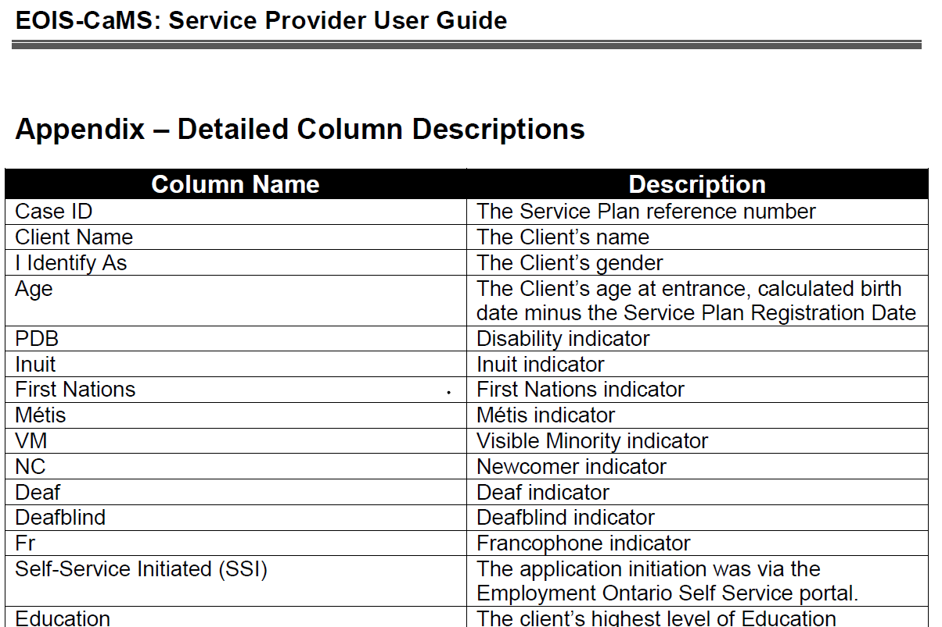
Helpful to consult the Appendix of the report #61 guide to see all of the data points included in the report
Notes:
Report 61 guide has a list of column names and descriptions – helpful to consult before/while viewing the report

Slide 51
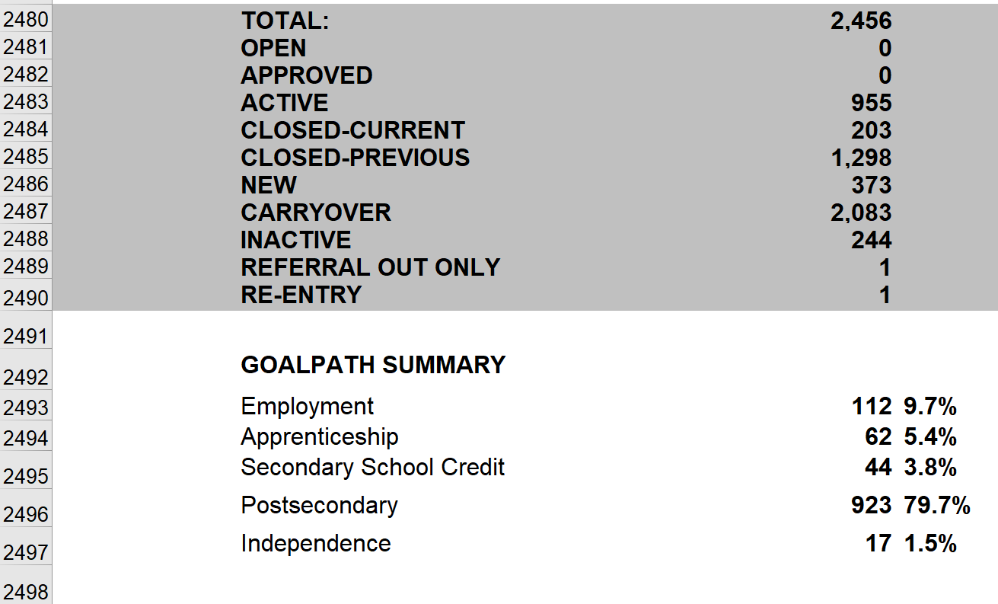
Bottom of report 61 contains these summary figures
Goal path #’s are for active plans and those closed in the current year
Notes:
Almost 2500 rows of learner data in this particular report (for a very large site)

Slide 52
Wrap Up!
Report 64
LBS Detailed Service Quality
Summarizes data related to the 5 core performance measures (Customer Satisfaction, Service Coordination, Suitability, Progress, Learners Served)
Report 60B
LBS-All Data Service Plan/Profile
Summarizes all profile information
Gives you summary data for 4 of the 5 core measures
Report 60D
LBS-All Data Outcomes/Follow-ups
Summarizes all outcome information
Gives you summary data on completions and outcomes at exit, 3, 6 and 12 months
Report 61
LBS Case Activity
Summarizes all data related to service plans that are open, approved, active, or have been closed in the current or previous fiscal year
Pop Up PD: Grow Your Knowledge of CaMS Reports 60 B & D
This Photo by Unknown Author is licensed under CC BY

Slide 53
What happens when we don’t record our CaMS information properly and consistently???

Slide 54
Thank you to today’s supporting cast!
ASL Interpreters Carolyn Lesonsky and Mike Glover
Deaf Literacy Initiative for providing ASL Interpreters
COFA for French translation
Stacey Ornatowski for technical support
Wendy Olson for moderating
Robyn Cook-Ritchie for sharing some slides
Pop Up PD Committee for planning

Slide 55
Thank you for participating!
Webinar resources: Pop Up PD Resources for LBS Educators
Webinar evaluation: https://tinyurl.com/4fte7mpz

