Slide 1
Loading Up Your Resource Arsenal
June 25, 2021

Slide 2
About Pop Up PD for Literacy Educators
free webinar series developed by Ontario’s LBS Regional Networks, Sectors, & the Provincial Support Organizations for Literacy
supports LBS practitioners with presentations on topics important to them
English language webinars presented for LBS practitioners annually since 2015-2016; French language transcriptions are available on COFA’s website!
all webinar presentations, recording links & transcripts here:
https://e-channel.ca/practitioners/pop-pd-resources
webinar topic ideas welcome at: e-channel@contactnorth.ca

Slide 3
Today’s Webinar…
Learning Networks of Ontario (LNO) and the Provincial Support Organizations for Literacy (PSOL) create many new tools each year.
When asked what topics practitioners wanted information on, 65% of the respondents replied that they wanted a webinar on the resources created in the last fiscal year.
This is not an exhaustive list, it’s a refresher.
This presentation will be sent to you after this webinar, hyperlinks to all resources are all active.

Slide 4
Orientation to LBS - Simcoe/Muskoka Literacy Network
Orientation for New LBS Managers and Program Co-ordinators
This self-directed, self-study module gives an overview of how LBS-funded agencies in Ontario operate and the job of an LBS program. It is housed on the Community Literacy of Ontario Literacy Basics website.

Slide 5
Skilled Trades - Mid-North Network
Skilled Trades Resource Compendium
This collection of LBS resources and good practices will help you prepare your learners for their transition to the skilled trades. It is an Excel sheet with all the links to the resources listed. It is also on the Skilled Trades and Apprenticeship Google site.

Slide 6
Skilled Trades - Laubach Literacy Ontario
GET SET for Manufacturing
This targeted training series has all the materials needed to run training for learners interested in pursuing a career in manufacturing. Soft skills, essential skills, and technical skills are integrated.

Slide 7
Skilled Trades - Laubach Literacy Ontario
GET SET for Health Service Support Jobs
This targeted training package includes all the materials you need to run a workshop series for learners interested in pursuing health service support occupations.

Slide 8
Skilled Trades - Community Literacy of Ontario
Warehouse Worker/Material Handler
Landscape and Grounds Maintenance Worker
Apprenticeship/Skilled Trades Resource

Slide 9
Skilled Trades - QUILL Learning Network
Skilled Trades and Apprenticeship resources - includes PSW resources
This Google site includes electronic resources for some skilled trades sectors prevalent in the QUILL region. We also added information to help prepare learners going into the Personal Support Worker field this year.
Personal Support Worker

Slide 10
Employment - Literacy Northwest
A Collection of Workforce and Workplace Literacy Resources
This collection of workforce and workplace literacy resources was developed by Literacy Northwest. They also acknowledge the work of other organizations that have pulled together relevant workforce and workplace materials to support adult literacy practitioners in Ontario.

Slide 11
Employment - Literacy Link South Central
Soft Skills Assessment Tool for Manufacturing can be used to measure the top soft skills required in a manufacturing environment. It's a 2-part assessment that includes a Life Effectiveness Questionnaire (LEQ) and a Situational Judgement Test (SJT) offering nine real-life workplace scenarios along with possible response options. There is both a Guidebook on how to use the tool and interpret the results, and a Scoring Package as well. There are also several reports related to the project that produced this tool that are available at the link above.
The Soft Skills Assessment Tool for Manufacturing webinar is about how the assessment was developed, and how to administer it and interpret the results.

Slide 12
Employment - Literacy Link South Central
Fabricating the Future: Building Tomorrow’s Manufacturing Workforce is a series of 5 modules to help people learn more about what the manufacturing field has to offer. All 5 modules (Manufacturing: It’s Made for You, Essential Skills for Manufacturing, Apprenticeship in Manufacturing, Manufacturing Job Postings, and Dinner Is Served: An Introduction to Food Processing) are also available on the LLSC Skills for Work page on their website.

Slide 13
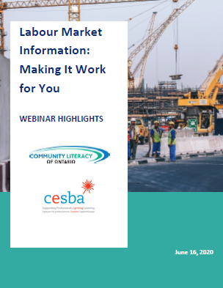
Employment - Community Literacy of Ontario
LMI: Making it Work
Employment Resources Guide
LBS EO Skill Building Providers chart

Slide 14
Employment - Literacy Link South Central
Game Changer for Soft Skills Development is a series of play-based soft skills training modules to help people develop critical skills like conflict resolution, observation skills, verbal communication, and problem solving using a combination of facilitated lessons, participatory activities, research, and games.
Game Changers Train the Trainer is a webinar about how to facilitate Literacy Link South Central’s Game Changers curriculum, which helps develop critical soft skills through facilitated lessons, activities, and play.

Slide 15
Employment - Growing Your Workforce Conference - Tri-County Literacy Network
TCLN facilitated the Local Solutions for Upskilling LBS panel on February 9, 2021 with thanks to panelists Lori Bruner of Brant Skills Centre, Elaine Maerz of Lambton Kent District School Board, and Tina Baksh of Conestoga College. Here’s a link to the recording of the LBS panel on Local Solutions for Upskilling.
A workforce tab was created on the Learning Networks of Ontario (LNO) website with resources that the Learning Networks of Ontario-Western Region developed for the Conference. During the Local Solutions for Upskilling LBS panel, participants were referred to it for further information and follow up. See: https://learningnetworks.ca/workforce/.

Slide 16
Best Practices - QUILL Learning Network
We're All in this Together
This resource includes best practices on how LBS supported learners and staff during the first year of COVID 19, as well as the report, tip sheets, and webinar recordings. Check out the chat report.
Tip sheets and the report were translated into French by COFA.

Slide 17
Best Practices - Literacy Link South Central
The Pandemic Planning Manual was created to support community-based nonprofits across the Province of Ontario, using learning from the COVID-19 pandemic to prepare a series of recommendations and fill-in-the-blank policies and procedures to deal with similar issues should they arise in the future.
The Pandemic Planning Manual webinar that launched the manual, talks about the process of putting it together, and explains what you can find inside.

Slide 18
LBS Resources Forum - LLO, CLO, Contact North

Slide 19
Digital Skills - Community Literacy of Ontario
A full list of their resources can be found on their website at - http://www.communityliteracyofontario.ca/about-us/news/ .
Supporting LBS Learners - Barriers
Popular Digital Learning Resources
Digital Literacy Success Stories

Slide 20
Digital Skills - QUILL Learning Network
Digital Skills Promotion Toolkit
With SMLN, QUILL researched the entry level digital skills needed in 8 sectors and created a resource kit to support LBS service providers in marketing their expertise in assisting learners to gain those skills.

Slide 21
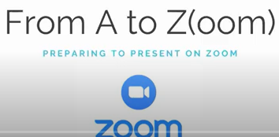
Digital Skills - Literacy Link South Central
From A to Z(oom): The Zoom Host Experience is focused on the pre-meeting and in-meeting settings you need to make your Zoom session a success.
From A to Z(oom): Preparing to Present on Zoom looks at how to put together a presentation, set your workstation up for success and professionalism, and engage your audience before, during and after your session.
Learning Activities for the Local Jobs Hub Platform is a webinar introducing a series of 20 activities developed to help people learn how to navigate the Local Jobs Hub. While this tool is specific to the Elgin, Middlesex and Oxford region, there are tools based on the same platform (which work exactly the same way) across the province - they're just branded differently.

Slide 22
Training - LNO and PSOL
Pop Up PD for LBS Educators - 2020-21 series All webinar recordings are available and include information on how to serve learners remotely, Skills Advance Ontario projects, and updates on Essential Skills and resources for Workforce and Workplace literacy.
Webinars back to 2015 are also available on this page.

Slide 23
Resources - QUILL Learning Network
Task-Based Activities for LBS
With support from Literacy Link South Central the task activities on this website are being re-created as Google forms and fillable PDFs to make them easier to share online with learners.
Any interactive tasks that were in Flash have been updated.

Slide 24
Resources - Mental Health
Mental Health Campaign Resources October 2020

Slide 25
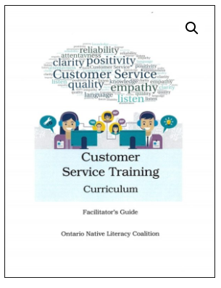
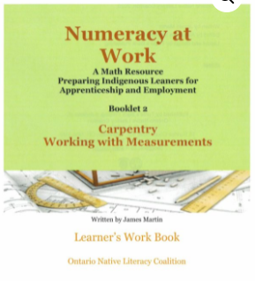
Resources - Turtle Back Publishing - ONLC
Order resources from Turtle Back Publishing

Slide 26
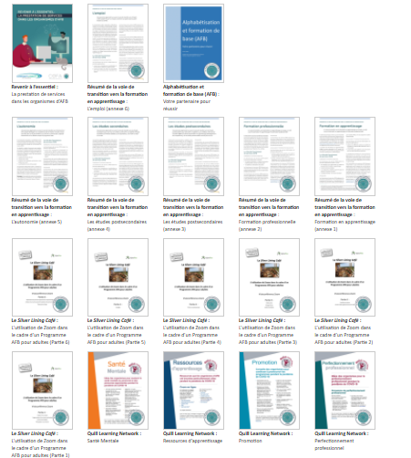
Resources - La Coalition ontarienne de formation des adultes (COFA)
Fonds de Traduction
COFA has translated many documents for the Francophone stream and recently held a webinar highlighting this work.

Slide 27
Resources - La Coalition ontarienne de formation des adultes (COFA)
Resources published yearly are available on the COFA website at: https://www.coalition.ca/bibliotheque/publications/
Webinars available on the COFA website at: https://www.coalition.ca/bibliotheque/webinaires/
Resources available on the COFA website at: https://www.coalition.ca/bibliotheque/ressources/
Recordings of our Sharing community meetings at: https://www.coalition.ca/bibliotheque/communaute-de-partage/

Slide 28
Online Support - Contact North
Performance Measures for Online Programs Report
https://e-channel.ca/practitioners/lbs-research/performance-measures-for-online-programs-report
Adobe Connect Help Site in English and French https://echannelconnect.contactnorth.ca/help/
Zoom Resources for:
Hosts
English - https://teachonline.ca/training-opportunities/free-resources-teaching-with-zoom;
French - https://teachonline.ca/fr/la-formation-et-les-ressources-en-mati%C3%A8re-de-zoom-%C3%A0-l%E2%80%99intention-du-corps-professoral-et-du-personnel-enseignant
Participants
English -https://teachonline.ca/training-opportunities/zoom-resources-students;
French - https://teachonline.ca/fr/les-ressources-en-mati%C3%A8re-de-zoom-%C3%A0-l%E2%80%99intention-des-%C3%A9tudiantes-et-%C3%A9tudiants

Slide 29
Learning Networks of Ontario

Slide 30
Thank you!
Webinar resources:
English https://e-channel.ca/practitioners/pop-pd-resources
French https://apprentissageenligne.ca/formateurs/programme-afb-ressources-de-la-communaute-de-pratique-en-ligne
Webinar evaluation:
https://surveys.oalcf-echannel-repository.ca/s3/Web-1-Loading-Up-your-Resource-Arsenal
Register for future webinars at: https://learningnetworks.ca/resources-publications/popuppd/

