Slide 1
Webinar Title
((DATE))
Notes:
Sara Gill: Welcome, everyone, to today’s Pop Up PD session. Today, we are focused on workforce literacy and pre-employment planning. My name is Sara Gill; I am the Executive Director of the Adult Basic Education Association in Hamilton, and I will be your host for today.

Slide 2
Statement of Land Acknowledgement
Hamilton Health Sciences
Notes:
I would like to begin by acknowledging the Indigenous Peoples of all the lands that we are on today. While we meet today on a virtual platform, I would like to take a moment to acknowledge the importance of the lands, which we each call home. We do this to reaffirm our commitment and responsibility in improving relationships between nations and to improving our own understanding of local Indigenous peoples and their cultures. From coast to coast to coast, we acknowledge the ancestral and unceded territory of all the Inuit, Métis, and First Nations people that call this land home.

Slide 3
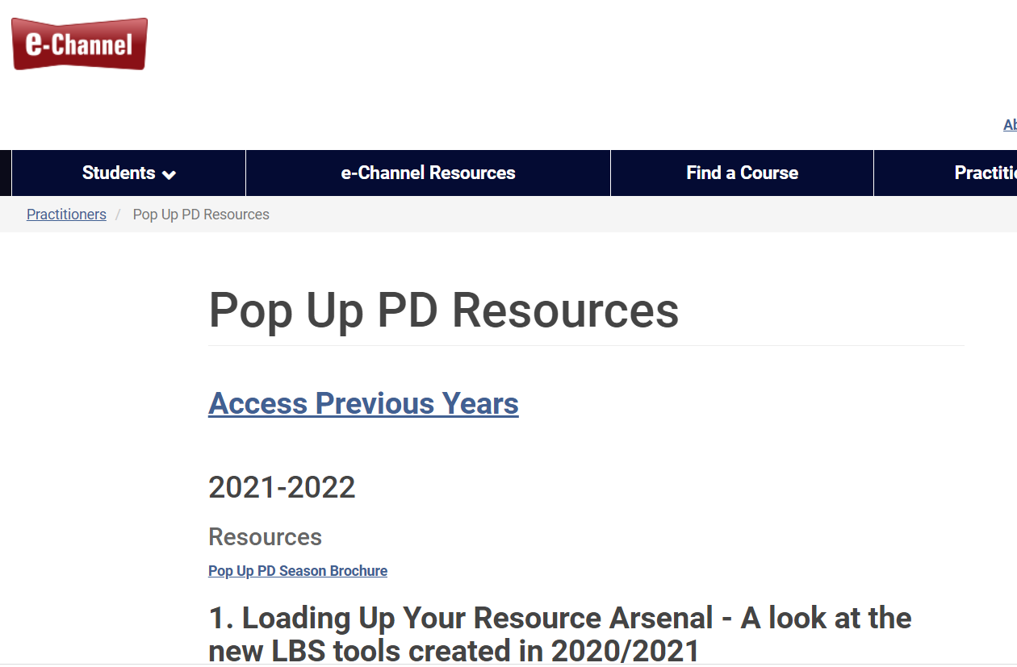
About Pop Up PD for Literacy Educators
https://e-channel.ca/practitioners/pop-pd-resources
e-channel@contactnorth.ca
Notes:
Pop Up PD for Literacy Educators is a free webinar series developed by Ontario’s LBS Regional Networks, Sectors, & the Provincial Support Organizations for Literacy.
It supports LBS practitioners across the province with presentations on topics important to them.
All webinar presentations, recording links and transcripts can be found on the Pop Up PD Resources page on the Contact North website – the url is on the slide for you. You can find all of the registration information on the Learning Networks of Ontario website on the Pop Up PD Webinar page.
Webinar topic ideas are always welcome. Please send them along to the email on screen.

Slide 4
Thank you and acknowledgements
Members of the Pop Up PD for LBS Educators committee
Contact North (technical support)
Deaf Literacy Initiative (ASL interpretation)
COFA (French translation)
Adult Education Association (ABEA), College Sector Committee (CSC), Literacy Link Niagara (LLN), Literacy Link South Central (LLSC), Literacy Northwest (LNW), QUILL Learning Network, Tri-County Literacy Network (TCLN)
Notes:
Thank you to the members of the Pop Up PD for LBS Educators committee for their continued work on this series.
English language webinars have been presented for LBS practitioners since 2015-2016; French language transcriptions are available on COFA’s website and I’d like to extend my thanks to them for their continued support.
I would also like to extend a thank you to Deaf Literacy Initiative who coordinates the ASL interpretation for the sessions. We don’t have ASL interpretation available in the session today. However, ASL interpretation will be available in the recording that is posted on Contact North’s Pop Up PD site.
Technical Support for this series of webinars is provided by Contact North
The work of the Pop Up PD committee is funded by the Ontario Ministry of Labour, Training and Skills Development.
I’d also like to give a shout out to Sarah Stocker from Contact North and Heather Robinet who will be assisting me this afternoon.

Slide 5
Workforce Literacy and Pre-Employment Planning
In today’s webinar you’ll
get an overview of what’s happening in the labour market
learn about the role of planning boards and the work they are currently doing to support your work
hear from Employment Services about their services and special programs
explore employment goal path resources
Notes:
Many learners you are working with may be preparing for work, but what is the landscape out there as we recover from the pandemic?
In today’s webinar, you’ll hear from panelists Justin Falconer of Workforce Windsor Essex; Rachel Hunt, an Employment Service Manager at Goodwill Career Centre in Hamilton; and Lidia Siino, an Employment Counsellor at YWCA Hamilton. You can tell I brought my colleagues with me today from Hamilton, and thankfully Justin was able to join us today as well.
In today’s webinar, you will get an overview of what’s happening in the labour market – an Ontario perspective. You will learn about the role of Planning Boards and the work they are currently doing to support your work, because there is some amazing stuff out there that you really need to see. You are going to hear from Employment Services about their services and special programs, and you will explore employment goal path resources if we have time.
We aren’t going to take a formal break during the session, so please feel free to step away if you need to. We encourage you to participate throughout by adding your comments and questions in the chat; we will be sure to address them. You can also raise your hand if you want to offer a comment.
As with all of the Pop Up PD webinars, there is an evaluation for today’s session, and the link to the evaluation will be posted in the chat near the end of the webinar. The link will also be sent out in an email after the webinar. Please take a few minutes to complete it. Your feedback is really important, because we need to understand what is happening for planning next year’s sessions as well as your feedback on today’s session.

Slide 6
Our Panelists
Justin Falconer, Workforce Windsor Essex
Rachel Hunt, Employment Service Manager, Goodwill Career Centre, Hamilton
Lidia Siino, Employment Counsellor, YWCA Hamilton
Notes:
I would like to take a moment to introduce our panelists for today. Justin Falconer is the CEO of Workforce Windsor Essex. He has eighteen years of experience working in government and community roles including eleven years in management positions. In addition to his CEO responsibilities, Justin leads the organization’s public communications and employment planning work including the Local Board project and the We Data Tools initiative which is exactly why we have him here today.
Rachel Hunt has been working for Goodwill for the last four years. She graduated from McMaster University with a Bachelor’s Degree in Sociology and decided to pursue further education at Sheridan College with a Diploma in Outreach and Development. Shortly after graduation, Rachel’s adventurous spirit led her to travel throughout South America for nine months. Her passion for working with diverse communities landed her a job at Goodwill, where she began her career as a Job Developer, eventually leading to her becoming Employment Service Manager of Goodwill’s Upper Gage location here in Hamilton.
Lidia Siino is an Employment Counsellor for the Strategic Training Employment Program, or STEP, at the YWCA Hamilton. Her background includes career development, adult learning and facilitation. She enjoys teaching career development topics to learners of all ages. Lidia is also skilled in all phases of leadership development, personal branding, communication in the workplace, and social media. She lives in Hamilton and enjoys juggling and singing karaoke – two of the things we won’t ask her to do for us today, but it would be awesome. In spite of these hobbies, she isn’t in danger of quitting her day job.
Welcome and thank you so much for being here today and bringing your expertise to the literacy field. I am going to assume that we will have lots of questions and comments and great engagement, so without further ado, I will stop sharing my screen and turn it over to Justin.

Slide 7
WORKFORCE BOARDS:
YOUR LABOUR MARKET PARTNER
PRESENTATION
Notes:
Justin Falconer: Thank you, Sara, for the introduction and the opportunity to come and show you a bit of the work that the Workforce Boards are doing. Hopefully, you’ve heard about some of this work in your regions across Ontario, and perhaps I can speak to it a bit further today. It’s a real pleasure to be here, so thank you to everyone making this happen.
My name is Justin Falconer, and I’m here presenting on behalf of all of the Workforce Planning Boards across Ontario. It’s my pleasure to talk a bit about our work and, more importantly, how our work can intersect and support you in your day-to-day work with your clients. The more I think about it, if we’re not making your jobs easier, there’s something wrong. Hopefully what I am showing you today will be helpful and make those time-consuming tasks a bit faster, or you will now know where you can get some local resources when you need to.
I’m going to share my screen and go through a PowerPoint. Please know that I’m open to comments and questions along the way.

Slide 8
ABOUT WORKFORCE BOARDS
Founded in 1997, Workforce Planning Boards have been an integral part of their communities across Ontario for nearly 25 years.
Workforce Planning Boards help improve the understanding of labour market indicators and to coordinate community responses at the local and regional level to improve employment levels and skills matching with available jobs.
As a source for place-based labour market data, research, planning, and development initiatives for identifying the skills gaps and labour shortages across all sectors.
25
years
Notes:
Let’s start with Workforce Planning Boards. I assume you all know who your Workforce Planning Board is in your region, have worked with them in the past or know at least one staff member. We’ve been operating since 1997; some of us are a little newer such as in Windsor, but the network was founded in 1997 with the original Workforce Planning Boards. We’re essentially here to help the community understand what is happening in the labour market and to help coordinate responses at the community level when it comes to skills gaps or labour gaps or labour issues that with a lot of goodwill from different partners can hopefully overcome.
We are a source for place-based labour market data, which is a fancy way to say local data. So although we may be different in our regions and do different things, at our core, when it comes to the Local Board network, we do research, some planning, and some development initiatives. Boards operate a little bit differently in each region: some are hands on with training while others are not.

Slide 9
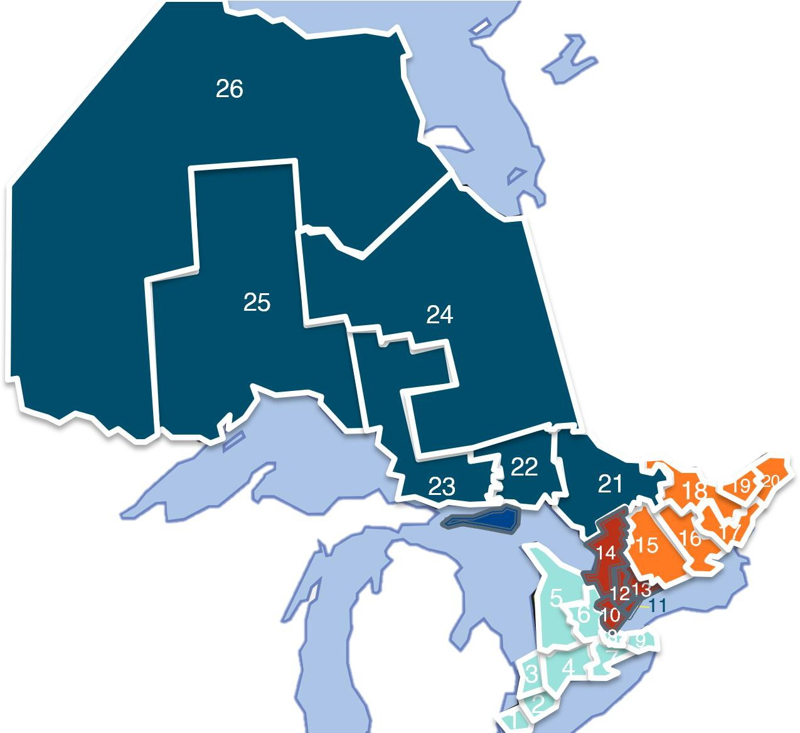
WESTERN REGION:
W O R K F O R C E
Windsor-Essex
Chatham-Kent
Sarnia-Lambton
Elgin-Middlesex-Oxford-London
Bruce, Grey, Huron & Perth
Waterloo-Wellington-Dufferin
Brant-Brantford-Haldimand- Norfolk
Hamilton
Niagara Region
CENTRAL REGION
Peel-Halton
Toronto
York Region
Durham Region
Simcoe-Muskoka
B O A R D S
EASTERN REGION
Peterborough-Northumberland- Kawartha Lakes-Haliburton
Hastings-Prince Edward-
Lennox-Addington
1000 Islands
Lanark-Renfrew
Ottawa
Eastern Ontario
I N
NORTHERN REGION
Nipissing-Parry Sound
Sudbury-Manitoulin
Sault Ste. Marie
Far Northeast
North Superior
Northwest
O N T A R I O
www.workforceplanningontario.ca
Notes:
Here’s the map of the 26 Workforce Planning Board regions across Ontario. Hopefully you can find yours and acquaint yourself to the region. I didn’t list all of the names, but know that you can go to workforceplanningontario.ca to get a full list and links to their websites if you haven’t had the opportunity to connect yet. Hopefully after today’s presentation, you’ll see that there is good reason why you should be making these connections if you haven’t already.

Slide 10
Is our economy
recovering? Can people find jobs?
Let’s look at employment figures.
Notes:
One of the first questions I wanted to put out there is, “is our economy recovering from COVID and can people find jobs?” So let’s look at the employment figures.

Slide 11
HOW IS THE JOB RECOVERY GOING IN ONTARIO?
Total Employment in Ontario for 15 to 64 year olds
7,101.70
8,000.00
7,264.90
2-Year Change
Nov 2019 to Nov 2021
Mar-21, 6,873.00
7,000.00
6,000.00
Jan-21, 6,646.20
5,000.00
Apr-20, 6,033.90
Full-time
+156,800
4,000.00
3,000.00
Part-time
+6,400
2,000.00
1,000.00
Total
+163,200
0.00
15 to 64 years
Source: Stats Canada Labour Force Survey, Table 14-10-0017-01
Note: Population is estimated to have changed by +94,600 between November 2019 and November 2021
The 15-24 year old population fell by 25,800 between November 2019 and 2021; however overall employment increased by 8,700.
Notes:
What I am showing you is employment for all of Ontario for people aged 15-64. Certainly those 65 and up could be working, but for the purposes of these data, I wanted to show you the traditional working years and the extent to which we have recovered.
We are actually about 163,000 net new jobs from where we were two years ago for this age demographic, so there has been some improvement. You can see on the graph at the low end when the pandemic was first materializing, we had lost 1.1 million jobs in Ontario. Over the last 18 months, we have been recovering those jobs and are now over the job count where we started.
Some people will point out that population changes, which is true. Population during this period increased by 94,000, but we gained 163,000 jobs, most of which were full time. Overall, I think there is some good news here that people have returned to work. There are still people who are personally impacted by COVID who have not returned to work, but there are now more people working now than there were two years ago.
I wanted to point out the 15 to 24 year old population, which I thought was interesting. Only a couple of months ago, this was a negative number, but when I ran the numbers again, it showed that in this age group the population had fallen almost 26,000 but overall more of those folks are working now. 8,700 net new people from that group are working. I thought this was interesting, and it made me wonder whether or not it could be true that young people are having to go into the workforce to help with household expenses, the cost of inflation and some of the other things in ways that they may have been less likely to be involved prior to the pandemic. I thought it was interesting; I don’t know everything that is happening behind the scenes, but it is interesting that the population could fall but the number of people employed (either full or part time) has increased.

Slide 12
How can Educators and
Workforce Boards help learners make pre- employment plans?
Show them how to find the facts
about careers & the labour market.
Notes:
So we are really here today to talk about how educators and Workforce Boards can help learners make pre-employment plans. Show them the facts, show them how they can explore careers, and show them how they can access the local labour market information.
Sara Gill: There is a question asking what would make the 15 to 24 year old age group fall so much? Is it because they aged out and weren’t replaced by younger people aging in?
Jason Falconer: That’s a good question. I don’t think there is an exodus out of Ontario for this group. It could be that there are fewer in-person international students because of the pandemic. Yes, the 15-24 year old group is now 17-26, but I’m not sure that explains it.

Slide 13
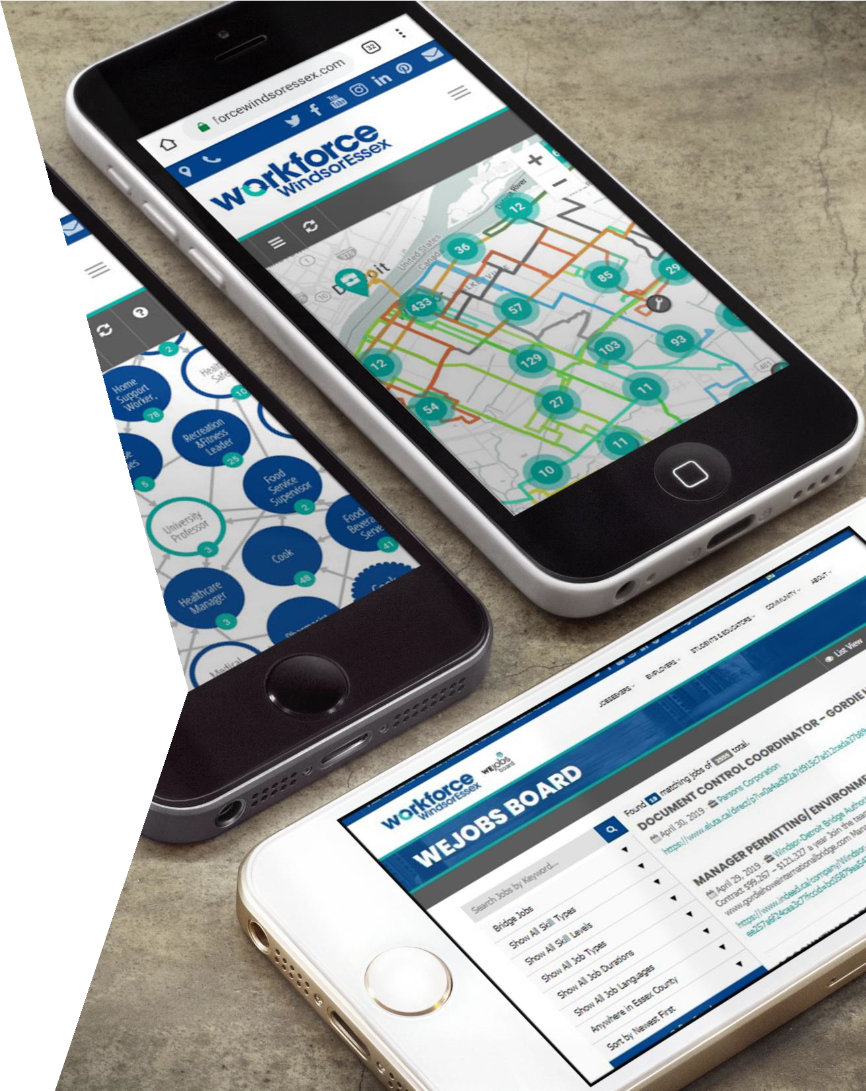
WE DATA TOOLS
Workforce WindsorEssex started developing digital labour market tools for our own community beginning in April 2016.
Our first tool was a career path tool called WEexplore careers. Since then, we have launched a dozen other innovative data tools and reports that disseminate and collect labour market information in real-time.
Although some regions are still in the setup phase, 24 of 26 Workforce Boards in Ontario will be operating the same job data platform. Toronto and the Far North East do not use the platform yet.
Notes:
Workforce Windsor Essex has created some of these place-based labour market tools that I want to show you today. Over the last two years, we have been sharing them all across Ontario with the different Workforce Planning Boards and sometimes with Economic Development groups so that they can be offered and available locally. We are the creators and knowledge holders of this, so I am pleased to be able to be here today to show you a bit about these tools.
One thing to note is that we now have 24 of the 26 Workforce Board regions covered using this tool, so pretty much everywhere across Ontario a version of these tools will exist.

Slide 14
JOB BOARD
Workforce Boards operate the largest job board in your area because it is an aggregated job board that includes national, provincial, and local job boards.
Job board adds new job postings as often as
every hour & closes inactive job postings daily.
Job board de-duplicates job postings to avoid duplicate postings from appearing in your system.
Search using Boolean expressions or sort by Skill Type, Skill Level, Job Type, Job Language, Job Duration, and Job Location.
Filter can show apprenticeship jobs, remote working jobs, etc.
Notes:
The world does not necessarily need another job board, but what the world probably needs is an aggregated job board because there are so many job boards. We are now aggregating 250 job boards across Ontario. That data is coming into our systems, and it’s deduplicating, so it removes the same job posted in multiple places. We’re also classifying these jobs according to NOC codes, and we are increasingly adding in other data sets such as what employers are looking for in terms of knowledge, skills, tools and technologies, and what industry codes are relevant to each employer.
Each Workforce Board in these 24 regions are operating an aggregated job board where essentially you hit “go to job post”, and it will refer the job seeker to the job board that the employer chose to post with. We’re not trying to change employer behaviour. We’re just trying to make the connection to where the job is and make that a bit easier for the job seeker.
But why is this important? I know that you are thinking about pre-employment planning and getting your clients to the point where they may be in a position to succeed in the workforce, and job search might be coming up in their plans with you. By running this job board, we’re getting really great data on who is hiring, what skills are in demand, posting durations, frequency of posting, seasonality, who is hiring and so on. We’re getting great data insights, but we are also helping people along the way. In my region in Windsor, there are probably five or six thousand people a month who use our job finding tools. Now that you know these tools exist, hopefully you will refer friends, family and learners to them. People can be discouraged when they see the same job posting on one job board that they saw on another job board. Employers can post wherever they would like based on the features and responses they get, and some of them may post in more than one place, but it doesn’t mean that the rest of the postings underneath that duplicate are not new. It’s the opposite. A lot of the postings on the various job boards are unique and new, but what we are trying to do is to deduplicate all of that.
You can use Boolean search expressions as well as the “or” or “and” language in the search bars, so you can hopefully get at what you are looking for with some of the keyboard searches.
Check it out if you haven’t already. I will give you links at the end of the presentation as to where all of the job tools are in your region and what website you should be going to. Some are on the Workforce Board’s website. Some have been a standalone website that the Workforce Boards operate.

Slide 15
JOB MAP
Helps jobseekers search job postings visually by location on a map.
Displays key services that are relevant to jobseekers, such as child care, transit, employment services, education, apprenticeship training sites, etc.
Helps users plan their commute by car, transit, and/or walking to any job posting or service.
Job postings show as large clusters when zoomed out and begin mapping to their exact location as you zoom in.
Notes:
You can get jobs on the job board and go through the list view, but we thought it would be helpful if we could put the jobs on a map, because sometimes where people work is just as important as what they are doing. Sometimes proximity to services such as adult literacy services, child care, language training, schooling or other key services is an important consideration when they are choosing where they might want to work, especially with some occupations that let you work anywhere.
We have mapped all of the job postings according to employer addresses, and we have allowed you to toggle on or off so you can find what you are looking for on the map. You can click on these things and interact with them. If you are looking for a service such as Literacy and Basic Skills, you can click right on the marker, and it will give the contact information for that organization. We are trying to facilitate referrals to services. The nice thing is that you can toggle it to what you are trying to show; that could be child care, or just jobs or maybe language training. You can copy and paste the URL and send it to somebody, and the map will pre-load with what you have left it at. It’s a great way to share community resources if a client is trying to find something close to home, to their work or to wherever they travel. Because it is a map powered by Google, you can do driving, walking, transit or biking directions. You can also zoom in and out to get detailed information.
Sarah Gill: There is a question in the chat asking if any of the tools are available in French.
Justin Falconer: Yes! All of the tools have been built to be translated in the browser. I know that’s not an official translation by any means, but the good news is that browsers these days have a lot of capabilities and have improved their translations. The tools will translate based on your browser settings, so if you say you would like to view websites in French, all of the content will translate to French on the website, including the headers and icons and everything. It’s fully translatable in the browser. It’s not a perfect translation, but it would be really hard to strive for that. We don’t have the capacity to translate everything ourselves. We have had over a million job postings that we have collected across the regions. I am mindful of the fact that we have isn’t perfect.
Sara Gill: As a follow up question, do you ever receive job postings in French?
Justin Falconer: Yes. If the employer posts them in French, they come into the system in French. If your browser is set to French, it will appear in French. If your browser is set to English, but the job comes into the system as French, the browser will translate it to English for you.
Sara Gill: Here is another question. Can you sort according to pay scale, industry or work field?
Justin Falconer: Yes, and I’m going to get to some of those features coming up, but let me deal with the pay scale one because that’s newer. We have just started implementing a new tagging system, so we are about to implement some front-facing filters so if people want to search by pay range or scale, they could. Right now, we are collecting it, and we have found that about 30% of job postings include wage or salary information. As we move through the presentation, you’ll see ways that you can dive deeper into industry or occupation.

Slide 16
JOB DEMAND REPORT
Job posting data collected from 35+ major job boards, including Indeed, Canada’s Job Bank, Workopolis, Charity Village, Jobillico, Adzuna, Wowjobs, Simplyhired, Kijiji, etc.
Job posting data collected from 200+ local job
boards throughout Ontario as well.
Uses Google Data Studio reports to display a 6 to 20 page monthly job demand report that is printer-friendly and interactive.
Report details job demand by geography, sector, and common characteristics (such as skill type, skill level, and job type).
Notes:
Every month, the Workforce Boards produce these job demand reports that can tell you what the employer hiring activity is like in your region. The reports are generally between 13 and 21 pages long, depending if they have sector industry information. There are pages of information by four-digit NOC codes, by location, etc. The first page of these reports is basically a giant filter, so even if your geography doesn’t match perfectly with the Workforce Board boundary, you can filter to a geography within the Workforce Board boundary to get something more specific. If you want to change the entire report to just a sub-community of the region, you can do that. For example, Waterloo region is large and you can focus the report just to where you need. These reports are available for free on the Workforce Board websites.

Slide 17
JOB SEARCH REPORT
Job search data collected from users who search for jobs on platform.
Displays number of people who used the tools as well as how many interactions/clicks each tool garnered.
Allows you to analyze how job search differs by age and gender.
Indicates top employers and top occupations associated with job postings that were clicked.
Uses Google Data Studio reports to display job search reports.
Notes:
We also publish a job search report. This allows us to share just what people are using on our site, where they are clicking and so on. This report can tell you, for example, what youth are interested in, or middle-aged workers, or females, etc. You can load a job search report that will show you which employers are getting traction, which occupations people are looking at. We even use some of the Google analytics such as where people are from when they are clicking, so you will see a list of communities that IP addresses are associated with. It isn’t perfect, but it does provide a level of insight into the behaviour on the site in case it can inform grants, applications, community discussions, etc.

Slide 18
CAREER EXPLORER
A career path tool for students, educators, jobseekers, and employment counsellors.
About half of the workforce board regions offer this tool on their website.
Browse in-demand jobs in your region, along with jobs that lead into and out of those in- demand jobs by following the career path lines.
Resize circles to reflect salary or active job postings in the system.
Filter by sector, get wage/salary information, skills, and access career profiles by following the link to the relevant Career Library tool to learn more.
Notes:
About half of the regions in Ontario are using this tool, and this will probably be one of the tools that will catch your eye. You will the circles that represent jobs, and the arrows between those circles were intended to represent typical career pathing that happens between occupations. This was done through an employer engagement consultation where we printed out maps with lines, put them on tables and asked people to draw connections and tell us how people in your workplace move between jobs. What are these career paths?
You will also notice that some of the circles are different sizes. They all start out the same size, but you can change the sizes to show which jobs pay more or which jobs post more. Within each circle, you will see a number which represents the actual number of live job postings in the system that hour. Our system pulls in jobs from most of the boards every hour (in some cases, daily), and the system refreshes constantly and adds new content.
You can click on any one of these circles to open a panel with more information about the job, wage, skills, etc. as well as a link to even more information which is the next slide.

Slide 19
CAREER LIBRARY
A searchable career research tool displaying active job postings and hiring companies by 1- digit, 2-digit, 3-digit, and 4-digit National Occupation Classification (NOC) codes.
Tool features custom geographic Statistics Canada and platform generated data, such as job postings, companies that hire, career paths, expected salaries, and more.
View top 10 in-demand NOCs according to your job board, as well as view historically in-demand jobs in list format.
Notes:
You can link to something we call the Career Library where you can do a deep dive on an occupation. It’s one thing to apply for a job, but you may also want to research that job, so we put this career library together which contains 500 career profiles plus other goodies. In here, you can get detailed information about every NOC code. On the screen, you can see one of the sub-pages for salary and income details for administrative assistants. We have extracted wage samples out of job postings. It shows the highest observed wage, the lowest observed and everything in between as well as the average wage. It’s great information if you are wondering about the going rate for a particular job in your region. It’s all local: all of the data associated with the postings including the wages, the skills required, it’s all hyper-local.
About half the Workforce Boards are running this tool. The others could be running it if there were interest from community partners, such as you! Just reach out and let them know if this would be of use to you. There is a small cost that goes into maintaining the tools.
One of the new features that we added to this particular tool in the last monthly update was skilled trades which I know is a topic of high interest. You can browse the 150 skilled trade codes in Ontario. You can view them by NOC code, and you can see which trades fall under which NOC. You can filter by Red Seal, voluntary or not, etc. There are great ways in which you can find information about skilled trades.

Slide 20
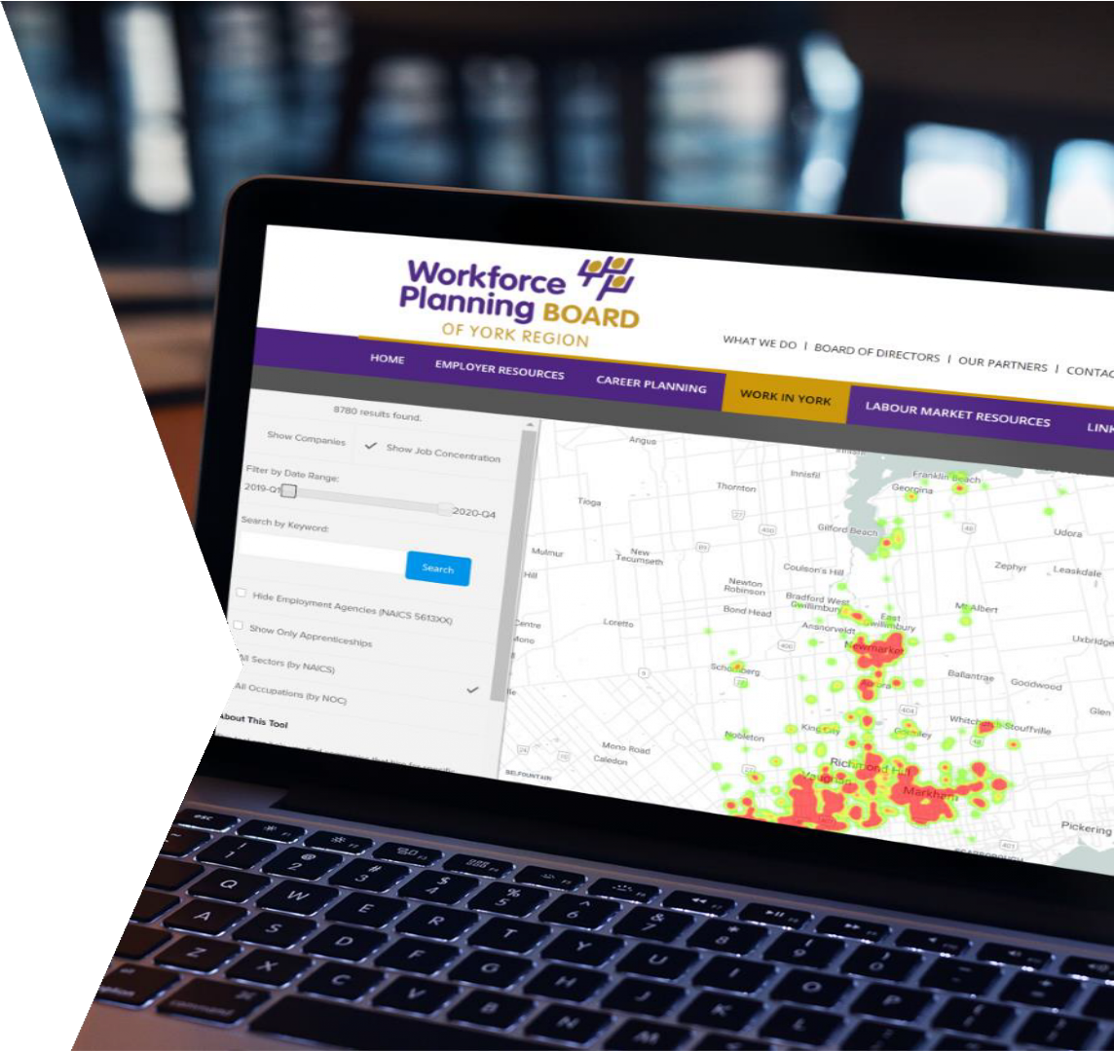
SECTOR MAP
Displays job posting concentration and publicly available company data on a map.
Users can toggle between heatmap (historical job posting concentration) and company view, which connects users to the respective company profile on your site.
Users can filter by up to 6-digit industry code, up to 4-digit NOC code, and using a time period.
Allow users to find what companies hire which
occupations and where they are located.
Notes:
I’ll go quickly through the sector map tool. The job map shows you active job postings today; the sector map is intended to show you historically where the jobs have been. It could be up to and including today, but it could also be as old as the past two years. It creates a heat map for where job posting concentration is, and then you can filter the criteria to be within a certain time period (a quarter is the smallest level), or you can filter it to show just certain occupations or certain industries. For example, you could say “managers in healthcare” to find out where those jobs are concentrated, and then you could zoom in on the map.
You can also toggle it from the heat map view to the show companies view. The colours will disappear, and icons will appear. We have mapped every single company, so you can click on one and read about information such as their hiring history, etc.

Slide 21
SECTOR LIBRARY
A searchable sector/industry research tool displaying active job postings and hiring companies by 2-digit, 3-digit, 4-digit, 5-digit, and 6-digit NAICS code.
Tool features platform data, such as job postings
and companies that hire.
Notes:
For Workforce Boards who have gone through the work of categorizing all of their companies into six-digit industry codes, you will be able to access the sector library in those regions. That means that you can look at the local employers in any industry code you are looking for, and you can click on every one of these employers to see detailed information about them such as their address, the industry we have associated with them, their job posting history, etc.
For example, the page you can see on the screen is showing you wineries, and you could look for active job postings in the winery sector. You just click on the left side menu where it says active job posts, and you see just job posts within the winery sector. So for those who are looking to get into a certain sector, you can be as specific as wineries or as unspecific as manufacturing when you are browsing.

Slide 22
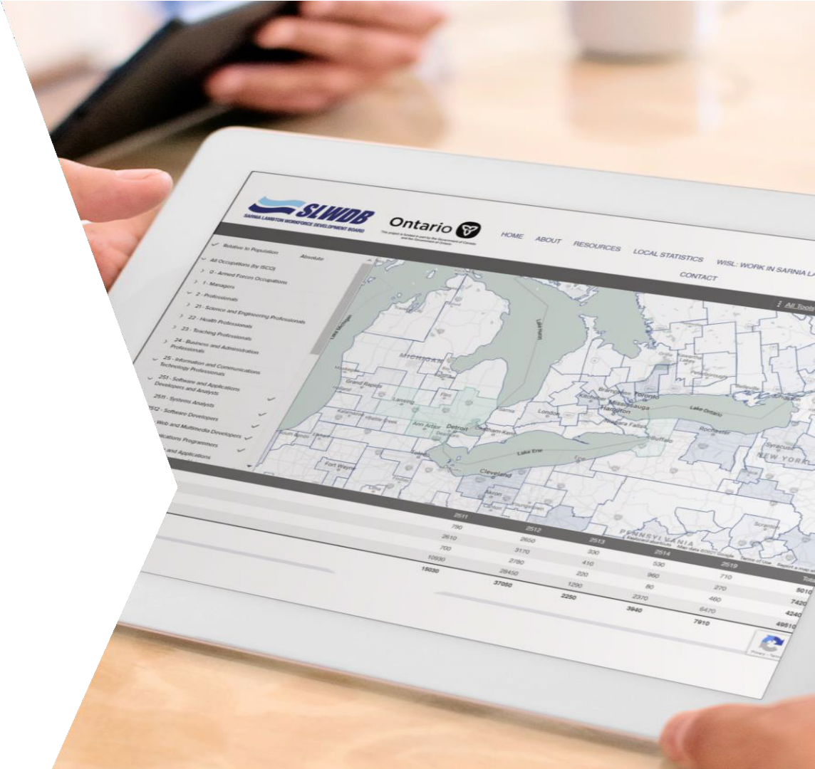
TALENT MAP
An online mapping tool that assists local employers, recruiting firms, and communities in geo-targeting talent attraction campaigns for hard-to-fill occupations.
Displays occupational data at Census Division level for eight countries including Canada, USA, UK, Ireland, Australia, Lativa, Sweden, and South Africa.
Uses publicly available occupational data reported by national statistics bodies and classifies it against the International Standard for Classifying Occupations (ISCO).
Workers tend to be located near businesses that employ them. If they want to stay local, how prevalent is the worker concentration of their preferred career in their local area? The greater the concentration, the greater the chance of starting a career and laddering in that region.
Notes:
There is a talent map that we built. This allows employers to find where workers are concentrated internationally for some occupations that they are struggling to fill. We took publicly available data in Canada, the US, the UK, Ireland, Australia, Latvia, Sweden and South Africa and mapped it so we can actually pinpoint concentrations of these workers. The darker the colour, the higher the concentration of workers. If you are an employer looking to recruit someone because you can’t find anyone locally, you would know where to start looking.
It's a neat tool for employers or head hunters or agencies looking to fill some hard to fill occupations. If you have every wondered where astronomers work, that tool would show you.

Slide 23
SKILL DEMAND REPORT
This interactive report can summarize the absolute or relative use of more than 29,000+ unique knowledge, skills, and tools/technology (KST) terms found in local job postings.
Users can customize the report by adjusting the time period, region, occupation, and sector to identify the exact knowledge, skills, and tools/technology that is being demanded by local employers in a region.
For example, search by occupation to find the key words that you should be using in your resume.
Results appear in graph and table format.
Notes:
The Skill Demand Report is a new tool. Whenever a job posting comes into the system, we are scanning it for 29,152 different terms. We are working on and building out a taxonomy where it’s knowledge, skills, tools and technology. Right now, it’s a flat structure.
You can run a report for a custom time period in the Workforce Board region and either show absolute or relative numbers, and you could pick one or more occupations or one or more sectors and search what employers are looking for in that sector or occupation within the last year. This will literally spit out the data from the job postings.

Slide 24
CAREER CALCULATOR
Our newest tool!
The career calculator helps people understand the return on investment, payback period, and lifetime earning potential for entering a specific career or going back to school to pursue a second career.
It also shares real-time labour market information about the demand for workers in the target occupation by displaying active job postings, companies that hire the occupation, and historical hiring demand.
The tool is expected to help the current and future workforce make informed career decisions that will lessen the skills gap locally, improve employment outcomes of local post- secondary graduates, and increase the number of qualified jobseekers gaining meaningful employment.
Notes:
The Career Calculator might be a fascinating tool for you. This is a brand new tool. Only three or four regions are running it: the Four County Board, London, Elgin Oxford, and a couple of others. What is neat about this is that it will show you the return on investment for going back to school to be trained in a certain occupation and leave your occupation. It will literally tell you the dollars and cents of whether it is worth it. In most cases, it is worth it, and you will get a huge return on investment.
The payback period is calculated for you. In some cases, if you are in a certain occupation, you stop working and go back to school and pursue a new occupation, how will your income change during the time in school and beyond? And what is the payback period? What is the break-even point? It may be 7.1 years or 3.2 by the time you recover all of the money you gave up to go back to school, and from that point on you are making net new dollars.
What Workforce Boards need to do to make this tool work is to put in the full-time education programs at the local college and university and then associate occupation codes with those programs. Then, when someone chooses an interest, it will show an academic program and its associated costs and do the payback calculation for you.
It’s a great tool. You will have to try it to see. It also shows the companies who hire the chosen occupation as well as active job postings which can help you determine if it is in demand or not. You can also see if you would be able to work locally if you pursued this.
Thanks to Libro Credit Union who helped us get it off the ground.

Slide 25
BOARD
JOB TOOL WEBSITES
W O R K F O R C E
WESTERN REGION:
WESTERN REGION
Windsor-Essex
Chatham-Kent
Sarnia-Lambton
Elgin-Middlesex-Oxford-London
Bruce, Grey, Huron & Perth
Waterloo-Wellington-Dufferin
Brant-Brantford-Haldimand- Norfolk
Hamilton
Niagara Region
www.workforcewindsoressex.com
www.chathamkentjobs.com
www.slwdb.org
www.workforcedevelopment.ca
www.connect2jobs.ca
www.findyourjobs.ca
www.workforceplanningboard.org
8.
9. www.nwpb.ca
Launching in January 2022 on http://workforceplanninghamilton.ca/
CENTRAL REGION
Peel-Halton
Toronto
York Region
Durham Region
Simcoe-Muskoka
CENTRAL REGION
10. www.peelhaltonworkforce.com/hub
11.
Not yet operating the platform
B O A R D S
www.wpboard.ca
www.durhamworkforceauthority.ca
Simcoe – www.workinsimcoecounty.ca Muskoka – www.wdb.ca
EASTERN REGION
www.wdb.ca
EASTERN REGION
Peterborough-Northumberland- Kawartha Lakes-Haliburton
Hastings-Prince Edward-
Lennox-Addington
1000 Islands
Lanark-Renfrew
Ottawa
Eastern Ontario
16.
Launching soon on www.cfwd.ca!
https://www.workforcedev.ca/jobs/
https://jobs.labourmarketgroup.ca/
https://jobs.ottawaemploymenthub.ca/
https://yournextjob.ca/
I N
NORTHERN REGION
Nipissing-Parry Sound
Sudbury-Manitoulin
Sault Ste. Marie
Far Northeast
North Superior
Northwest
NORTHERN REGION
www.readysethired.ca
www.planningourworkforce.ca
www.awic.ca
O N T A R I O
24.
Not operating the platform
www.nswpb.ca
www.ntab.on.ca
Notes:
Where can you find these tools? Here is the list. The left column is the region, and the ride side lists the websites where the tools are hosted. There are a couple that are in the process of launching. There are some that we haven’t had conversations with. Toronto is interested in it; we are applying for a Skills Development Fund grant, and if we get it, they will be included.

Slide 26
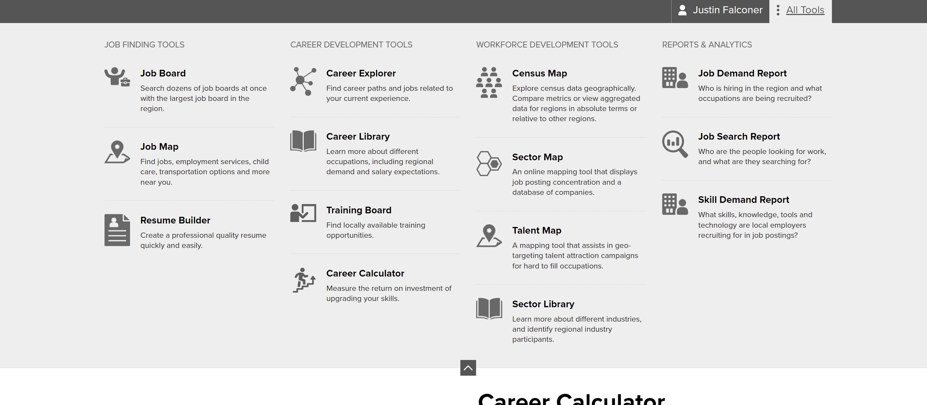
REAL-TIME LMI TOOLS FOR COMMUNITY-USE
Notes:
Once you are in any one of our tools, there is a grey bar that appears at the top on any of the websites you are on. If you open it up, you will see exactly which tools are on that local website. That’s just a helpful tip. Just hit the “all tools” button on the right side; it will open up and will show you what tools are available on that site.
Sara Gill: I just want to share a comment from someone who is singing your praises and uses these tools for things I hadn’t thought about before in terms of business planning, funding proposals and informing programming when looking for skill gaps. Those are some innovative ideas in terms of how to use those data reports and conditioning those tools to filter accordingly.

Slide 27
Employment Services Program
Eligibility
16 or over
Legally able to work in Canada
Working under 20 hours/week
Not in full time school/training
Suitability
Job searching
Available to participate in workshops and employment counselling
Notes:
No slide, Sara on screen
Many of the practitioners in the session this afternoon might be thinking that’s cool, but my day-to-day is really about supporting learners. You can see some application to learner plan development; some of those tools would be really critical, particularly the skill demand reports which I think would be great to link to learning activities. We’ll be talking a bit later about some tools that will assist as well, but you can see that this gives us a real appetite for the work that employment counsellors do, and there are two amazing folks who are going to talk about that. It might be the case where you say you are going to check out those tools and use them to some degree, but you might also want to get learners jazzed about what employment services can offer and the supports that they can provide. Perhaps you can work with the local provider around this and ask what everyone is using and how that could support your clients.
Next up is Rachel who will take us through what is going on in Employment Services. Here in Hamilton, we are in a service system manager region, so she is going to talk a bit about what is going on and the changes that she is seeing.
Slide 27 - Rachel Hunt: Thank you, Sara. It’s a pleasure to be here today. Looking at our general employment services program and discussing eligibility, to be eligible for the program, it’s 16 or older or as I like to say, 16 to 150. You must be legally able to work in Canada, working under 20 hours per week, and not in full-time school or training. When it comes to suitability, you must be job searching or looking at a second career potentially, and be available to participate in workshops and employment counselling so having that availability to meet with the case manager in order to move forward to employment or training and education.
Sara Gill: This makes perfect sense to us, and I just wanted to make a note that LBS is one of those rare programs where you can have a service plan open for both employment services and LBS. This is critical to talk about, because they can work alongside each other.
Rachel Hunt: Yes, we often refer to you and get referrals from you as well.

Slide 28
ODSP Employment Support Program
Eligibility
16 or over
Legally able to work in Canada
Working under 20 hours/week
Not in full time school/training
Have a substantial physical or mental disability that is expected to last a year or more, and makes it hard for you to find or keep a job
Suitability
Job searching
Available to participate in workshops and employment counselling
Notes:
In terms of the ODSP employment supports program, eligibility is 16 or over, legally able to work in Canada, working under 20 hours a week, not in full-time school or training, and have a substantial physical or mental disability that is expected to last a year or more and that makes it hard for you to find or keep a job.
Suitability is job searching and available to participate in workshops and employment counselling.
So when a client comes in and registers for employment services or the ODSP program, they complete an intake, and they will be able to receive resumé help, interview assistance, career path planning, information about Second Career. They will have access to job developers, the hidden job market, job boards, networking, workshops, job matching, potential placements with employers, and potential client supports to assist them if they find a job (example: work boots, clothing, etc.)

Slide 29
OEAS (Ontario Employment Assistance Services)
Eligibility
16 or over
Legally able to work in Canada
Unemployed-working less than 20 hours/week
Persons with disabilities
Program Overview - Helps people with disabilities return to work through the following activities
Assessment
Case management
Counselling
Life skills
Diagnostic services
Job development and job coaching
Notes:
The eligibility for OEAS is 16 or older, legally able to work in Canada, unemployed or working less than 20 hours per week, and also be a person with disabilities.
This program helps people with disabilities return to work through the following activities: assessment, case management, counselling, life skills, diagnostic services, and job development and job coaching.

Slide 30
Changes to Employment Services
Common Assessment
Questionnaire discussing client skills and experience, education and barriers to employment
Employment Action Plan
Determine how to support clients
What are the long and short term goals, employment support and life stabilization supports required
Notes:
As Sara mentioned, there are some changes to Employment Services in Hamilton and our catchment: Hamilton, Brantford, Niagara, Haldimand, and Norfolk. Just to go over some changes that took place almost a year ago now.
First and foremost is the common assessment. When clients come in, they participate in an intake, and they complete a common assessment with their case managers. It’s a lengthy questionnaire discussing the client’s skills and experience, education, and barriers to employment. It goes into their life stabilization, if they have child care issues, if they have any disabilities, their confidence and motivation to obtain work and those types of questions. This is to assess if they can be more independent or if they are highly barriered in terms of finding employment opportunities.
Next in the intake, they complete an employment action plan, so this determines how to support a client. What are their long- and short-term goals, employment supports and life stabilization supports required? This is an active document; it continuously gets updated as the client moves through the program. It involves resumé interview preparations, participation in workshops, life stabilization, referrals to community partners if needed, clients supports, etc. They follow the employment action plan throughout the program.

Slide 31
Changes to Employment Services
Circle of Support
Evolving range of wrap around services provided by community-based, faith-based, and mission-based organizations
Provides services and resources to clients and their families to aid in attaining sustained employment, health, safety, and overall well-being
Notes:
Circle of Support is also new. It’s an evolving range of wraparound services provided by community-based, faith-based, and mission-based organizations. It provides services and resources to clients and their families to aid in attaining sustained employment, health, safety and overall well-being.
In the database, service providers are able to share with different community partners on the common database, so we are able to look on this database now and find the community partners in and around the area to help best assist clients with life stabilization or other supports that employment service providers can’t necessarily assist them with, but we can refer out.

Slide 32
Changes to Employment Services
Client portal
A tool available for independent Job Seekers
Provides self-serve access to commonly used resources and tools
Job search tracking
Resume building
Notes:
The client portal is for independent clients specifically. This is a tool available for independent job seekers. It provides self-serve access to commonly used resources and tools. There is job search tracking, resumé writing/building, and job searching on this tool that a more independent job seeker can utilize, so they don’t necessarily need ongoing one-on-one support from a case manager, but they can use this tool to help organize and maintain their job search until they find employment.

Slide 33
Changes to Employment Services
Power of Possible Workshops
Workshop cohort - 10 half days or 5 full days
For clients requiring additional support
Motivation and confidence
Resume building
Interview Prep
Job Search techniques
Notes:
The “Power of Possible” workshops. This is a big change to our employment services here, and it has been very effective. This workshop is for our most highly barriered clients. It’s a workshop cohort. It can be ten half days or five full days, depending on the service provider. (Goodwill does ten half days.) It’s for clients requiring additional support. This workshop really focuses on motivation and confidence, resumé building, interview preparation, and job search techniques. It creates a community within the cohort; they help each other finding job opportunities, they look at the hidden job market. It has been beneficial at motivating and helping clients gain confidence in job searching and interviewing and all of the necessary things needed to find employment.
Sara Gill: I just want to add that it is possible that depending where you are in the province, you might not necessarily have all of these programs, but what is also important is that as the Service System Manager prototype areas expand, some of these could be coming into your region. They might not be named the same thing, but a lot of these components will be in your region.
With the “Power of Possible” workshop, there is a potential opportunity to connect with those that are offering it to ask if they are addressing educational gaps and how, find out what the assessment looks like, and to start to partner early to find intersections and referral triggers where LBS could work alongside. It’s a short, intense workshop, but I’m guessing that it leads to other service, so that may be a good intersection for us to think about.
Rachel Hunt: Yes, that’s a great point. I think I saw a question in the chat.
Sara Gill: Yes: Are these workshops in-person or online?
Rachel Hunt: The “Power of Possible” workshops are currently online. Every service provider is doing this differently, but we are doing it completely virtual. If a client doesn’t have access to technology, we do have resource computers that we can set up for them because we are open to the public, but we have to maintain the numbers. Most people participate virtually, but if someone doesn’t have access to technology, we can accommodate in that way.

Slide 34
Changes to Employment Services
Retention
Follow clients for 1 year after finding a job
Client will be contact at 30, 90, 180, 270 and 365 days and will be eligible for milestone gift card if they are working 20+ hours/week
If client is not working at milestone, Service Provider will continue to work with them to find sustainable employment
Notes:
An additional change to employment services is the retention piece. This is a big change to the way we have done employment services. When a client finds employment, or is no longer job searching, instead of closing them in our database, we continue to follow them for a year so we are continuously reaching out and touching base with these clients at 30, 90, 180, 270 and 365 days. If they are eligible, they could potentially get a $60 gift card if they are working 20+ hours a week, but they have to provide us with proof of that, which is usually in the form of a pay stub. This is also to check to see how they are doing, making sure they are still working; if they aren’t still working, then we can provide them with additional support. They don’t have to re-register; we can just continue working with them to find suitable, sustainable employment.

Slide 35
Second Career
You can get new skills – those needed for jobs in demand now – and financial support if you qualify for Second Career.
Apply for up to $28,000 for costs including
tuition
books
manuals, workbooks or other instructional costs
transportation
basic living allowance (maximum up to $500 per week)
Additional funding may be available for
childcare
disability-related supports during school
Notes:
That’s it for the changes to employment services, and now we’ll move on to Second Career where you can get new skills – those needed for jobs in demand now – and financial support if you qualify. If the people you are working with are interested in Second Career, this is potentially what they could qualify for. They can apply for up to $28,000 for costs including tuition; books; manuals, workbooks or other instructional costs; transportation; and basic living allowance to a maximum of $500 per week. Additional funding may be available for childcare and disability-related supports during school. This is UP TO $28,000, and it is all based on family income so there is no guarantee as to what a client will receive through Second Career, but that is discussed in the application process when they register for employment services.

Slide 36
How to Qualify for Second Career
As a start, you qualify for Second Career if
you have been laid off and have not been working
you have been laid off and are working a temporary job just to cover costs
you’re receiving Employment Insurance (EI), or have in the past, you can still apply
Notes:
How to qualify for Second Career. You have to be laid and have not been working or you have to be laid off and are working a temporary job just to cover costs or you have been receiving Employment Insurance or have in the past. Basically, Second Career is for individuals who have been laid off. As you can imagine, there has been an increase in individuals who have been laid off due to the pandemic so we have seen a large increase in Second Career applications in the past year which has been beneficial, I think, because it is allowing people to reassess where they want to go in terms of their careers.

Slide 37
Second Career Applications
When preparing your application, you also have to show
how long you have been unemployed, or working your temporary job, and looking for work
places you have applied and positions you have applied for (for example cover letters, CVs or resumes, and responses from potential employers)
level of education obtained
previous employment, how long you worked there, and skills that were required
what skills you want to obtain and where you can get trained in them
Notes:
When preparing your application, you also have to show how long you have been unemployed or working at your temporary job and looking for work, places you have applied and positions you have applied for. For example, cover letters, resumés and responses from potential employers to show that you have been job searching. You need to show your level of education obtained, previous employment including how long you worked there and skills that were required, what skills you want to obtain and where you can get trained in them. You have to show that you have been accepted at a school in order to move forward with Second Career, and second careers can now not be longer than 52 weeks in length.
Sara Gill: I just noted in the chat that there is a lot of connections with Literacy and Basic Skills organizations, particularly if you have a Second Career applicant who has been out of school for a long time, unsure of their skills, not knowing if they have the current Essential Skills. It’s one thing to have your Grade 12 diploma or any other certification that you need for the job, but it’s another thing entirely to do all of those current skills with regards to Essential Skills as they go in.

Slide 38
Skills Advance Ontario
Eligibility
Over 18
Unemployed or working less tat 20 hours/week
Eligible to work in Canada
Program Overview
Sector-focused
Client gains essential, technical, and employability skills
Employment
Notes:
Rachel Hunt: Additional programs under Employment Ontario include Skills Advance Ontario. The eligibility for this program is that you are over 18, unemployed or working less than 20 hours a week, and eligible to work in Canada.
The program is sector-focused. For example, Goodwill does a food manufacturing Skills Advance Ontario which includes a 5-week training program where the participants get micro-certifications and are then introduced to employers within the food manufacturing sector.
Clients gain essential skills, technical skills, and employability skills. The goal at the end is employment in the specific sector.

Slide 39
Youth Job Connection
(no longer in Hamilton)
Eligibility
15 to 29 years old at time of registration
A resident of Ontario
Eligible to work in Canada
Unemployed
Not participating in full-time training or education
Program Overview
60 hours of pre-employment training
Paid job placements with supports for participants, and hiring incentives for employers
Placement monitoring and retention support
Employment or Education
Notes:
Youth Job Connection is no longer in my catchment area, because it isn’t part of the Fed Cap model, but it is in other areas. The eligibility criteria are that clients are between 15 and 29 years old at time of registration, resident of Ontario, eligible to work in Canada, unemployed, and not participating in full-time training or education. It involves 60 hours of pre-employment training, paid job placements with supports for participants and hiring incentives for employers, placement monitoring and retention support, and the ultimate goal is employment or education.

Slide 40
Youth Employment – Pathways to Employment
Eligibility
15-30
Identify as having a disability
Not in school or working full time
Eligible to work in Canada
Program Overview
Complete 150 hours of paid pre-employment training
12 week paid job placements with supports for participants, and hiring incentives for employers
Placement monitoring and retention support
Employment or Education
Notes:
There is also a program under Youth Employment Skills Strategy which is funded by Service Canada. There are different programs in and around Ontario that I know of, but Goodwill has Pathways to Employment in Halton and Hamilton. The eligibility is 15 to 30 years old, the client identifies as having a disability and is not in school or working full-time, and is eligible to work in Canada.
During the program, the client completes 150 hours of paid pre-employment training, has a 12 week paid placement with supports for participants and hiring incentives for employers, placement monitoring and retention support, and the ultimate goal is employment or education.

Slide 41
Connecting with Service Providers
https://www.ontario.ca/page/employment-ontario
Notes:
The easiest way to connect with service providers is through Employment Ontario. Individuals can register on the website on the screen to connect to a service provider that they choose. They can complete a service provider application, and it will go directly to the service provider they have specified.
Sara Gill: You can also pick up the phone or email your local Employment Service. I say that because when we are working with Literacy and Basic Skills adult learners, navigating an Employment Ontario website and doing the application might not be as warm as potentially creating a partnership.
Maybe participants could add their innovative connections with employment services in the chat and how they go about this. Whether that was in 2019 or now in late 2021, sometimes the difference is in-person vs online, but I know that there are lots of great examples of partnerships where there is that seamless connection between those two programs where referrals are happening, clients are being supported, and they don’t feel like they are “leaving the nest”. Sometimes adult learners get comfortable with the service because they are making connections and relationships with the service provider. Sometimes it’s difficult to encourage them to go outside of that safe space to get some other services that they might need.
Thank you so much, Rachel, for giving us that overview and shining a spotlight on some of the changes that are happening with the Service System Manager and employment transformation but also some of those keystone programs that everyone has in their communities and how we can better align and partner for those referral relationships.
I would also like to talk about the amazing things going on in your community that aren’t necessarily employment service funded specific, and that’s why we have Lidia with us today to give us a few more comments about the amazing things, what you do in your program to find those, the innovative partnerships you have outside of the more traditional network.

Slide 42
Employment Services from a Broader Lens
Notes:
Lidia Siino: Than you Sara and Rachel. Having worked in Employment Ontario for four years, I certainly respect the awesome work that is being done in our community with the new Service System Manager. My role today is to look at employment services from a broader lens. We have heard about Employment Ontario and the great work that is being done there, but I want to speak from the perspective of how employment services, regardless of where we belong in terms of funding and those mechanisms, how we can benefit all job seekers.

Slide 43
Some Assumptions
If a client is actively working with an Employment Ontario organization they cannot access supports outside of that organization from both clients and service providers
Duplication/replication of service
Service is streamlined/ outcomes based
Thinning out my case load
Notes:
In terms of some assumptions that typically will occur – and this is from personal observations from peers. If a client is actively working with an Employment Ontario organization, they cannot access supports outside of that organization. Sadly, that’s an assumption from not only a client but also sometimes service providers feel that there may be a perception of some type of conflict of interest. If I have a client, you can’t have a client, and that’s definitely untrue.
There is also the concept of duplication and replication of services. While different smaller markets might have the same pool of resources, it’s always good to see how you can share those resources. Duplication: I don’t want to talk to this person if I have already talk to that person, could also be a negative perspective.
The concept that services are streamlined and strictly outcomes-based, that information needs to be expedited and the client isn’t really being serviced because it’s more about the numbers and stats, can be an assumption especially when you have that frame of mind from a client’s perspective where nobody accesses employment services when everything is going okay professionally. You come there when there is some type of hindrance or barrier, so of course you are seeing clients at their worst.
The last point or assumption is the concept of thinning out my case load or passing the buck, trying to get rid of those barriered clients, the ones who have been on my caseload for x amount of time so I will do a referral, I have done my due diligence, and now I want to close the file and move forward.

Slide 44
Providing Additional Supports for Clients
Clients of EO have access to additional programs without conflict with existing service
Service is customized to individual’s needs
Not defined by time constraints
Ability to expand and strengthen relationships
Notes:
In terms of providing additional supports for clients, this is what can happen when employments services combine and collaborate with Employment Ontario. Clients of Employment Ontario do have access to additional programs without conflict with existing service. I want to inform and enforce that because I think there is a perception that from a client perspective or from a service provider perspective, we typically all want the same things as career development practitioners. We’re all in this field for a reason, and that’s for the betterment of our clients and make sure that they in turn are supported in service the best ways possible.
We also have the ability outside of that Employment Ontario lens to open things up. We have a bit more flexibility and perhaps more time and freedom to hone in on service and customize to the client’s individual needs and tailor information. You can collaborate with service providers; we have done that many times in the past. Through YWCA Hamilton, we offer a wide variety of employment services to the area, and we have collaborated with service providers and community-based resources to understand and have a pre-meeting with the career specialist to see what the individual’s needs are. It’s more of a warm exchange as opposed to just learning something new again.
We are not defined by time constraints, and a lot of times that is super helpful in understanding the parameters of certain service providers in Employment Ontario. We certainly understand that, but ultimately we do have this collaboration that gives us the ability to expand and strengthen these relationships, not only amongst ourselves but our respective networks, and the more knowledge we have, the better service we can provide.

Slide 45
When collaboration occurs, the client feels…
informed
supported
empowered
Notes:
This is what we strive for when collaboration occurs. Like everyone in the human services field and professions, we want our clients to feel informed. Service providers can assist clients with making these educated decisions about career plans because they have serviced from a holistic perspective. That’s why this is more or less a bit of a plate. Clients can also feel supported. Knowing that service is being provided from a multi-tiered approach can leave a client feeling really like they aren’t in it alone. We truly are in it together, and we’re here to make the client succeed as much as possible. Last and certainly not least, once you have your information and your resources, you feel supported and ultimately we want our clients to feel empowered.
When a client can access multiple resources and make these informed choices, it gives that client their power back. Suddenly, the lack of self-confidence, having the awareness of the resources provided to them in addition to what they initially attended a service provider for, can be very beneficial. In addition to the pre-employment service, building confidence in their abilities, service providers can be fulfilled in knowing that we are making an impact, and the collaboration in and of itself has also made an impact.

Slide 46
As service providers, now is the perfect time to reacquaint ourselves with the resources available in our respective communities.
Notes:
As service providers, I truly believe that now is the perfect time for us to reacquaint ourselves with the resources available in our communities. As our clients are reacquainting themselves with the return to this “new world of work”, we too can familiarize ourselves with community supports and resources outside of our own comfort zones. What I mean by that is that most of us have what we consider our “back pocket” referrals. We tend to refer to the same two or three resources because we are comfortable with that process; it’s an easier exchange. I would like to challenge everyone to take the time to commit ourselves to learn a bit more about the additional service providers in your community. With that being said, as a career practitioner, I may not always have the answer for a client, but through the knowledge of resources and collaborating, we can certainly get there.
There is a question in the chat asking about how we explore new service providers. It can be as simple as opening the emails that you get and reading them! You can also join social media platforms, attend trainings like this, going to information sessions and participating, reading blogs, produce content on social media (don’t just be a consumer). Within our own community, it is really collaborative in that we have had clients from Path Employment, the Hamilton Regional Indian Centre, Goodwill and all over. It’s kind of neat because all of these service providers do different things, but we ultimately want to succeed in assisting and providing that assistance.
Sara Gill: Thank you, Lidia. I pose those questions to get people thinking about what their current connections are, what out-of-the-box referrals have they made, what kind of research have they done? We have all worked with very unique clients that would benefit from a referral to a type of service we hadn’t thought about before and then have to find it. I know that a lot of communities are doing some incredible things.
Thinking back to Justin’s tools, there are so many incredible ways to find resources through the WE Data tools, but what is available in your community? We have the Red Book here in Hamilton that I think relies on the 211 databases. We have all sorts of different types of things, but we also have key community networking meetings that bring either frontline practitioners together or managers together, funders together, etc. Can we tap into those and be a bit more visible?
What’s available in your community that isn’t going to be a huge make-work project, because we know that you don’t have time. How do we make sure that you can get the information that you need? Is there a great newsletter? Is there an updateable something so that you can really understand what those resources are so that when your learner is in that mode of referral, you have something top of mind to suggest.
I do just want to pause and see if there are any comments or questions for any of our panelists. I do have a couple of websites that I would love to touch on before we leave you today.
Rachel Hunt: I just wanted to add that a great place to start is with your local service provider to find out what services are out there or even referring your client to an employment service program, for example, because I can speak for Goodwill, but we are always looking for what is the best fit for the client. At intake, if they are looking for a career in food manufacturing, for example, or they are a youth with a disability, that is a referral that we will make out. It’s a tight-knit community, so we understand the programs that are out there. It’s important to get them started somewhere.
Sara Gill: The nature of some of the programming is that you have to be super informed, because sometimes, for example, with a pre-apprenticeship program which is an amazing workforce program that everyone wants to take advantage of, they come and go so you really have to get on it. You have to understand the landscape of service and how to tap into those networks so that when those opportunities arise, you are ready to refer your learners.
There are a couple of comments in the chat: learn about the free programs that are available within our community, often researching out to employment services.
Listen to the learners that I work with and jot down the resources that I might not be familiar with so I can refer to it later on if need be. Colleagues and learners are amazing resources, because they are probably going to tell you stuff that you didn’t know before. I have certainly had this experience over and over again.
There was a question asking if Justin could briefly show the presentation slides that there wasn’t enough time for him to show. I am going to finish up my part and then turn it over to Justin.

Slide 47
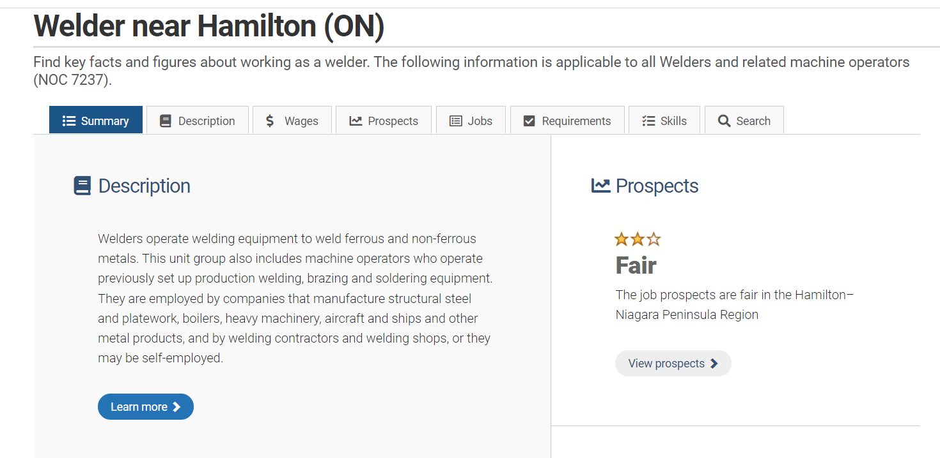
Job Bank – Essential Skills
https://www.jobbank.gc.ca/trend-analysis/search-occupations
Notes:
This stuff makes me really excited: community partnership and enabling you as practitioners to make those connections.
I want to go back to where Justin was talking about skills and how important it is to understand if someone is on the employment goal path or a longer-term goal path of employment which the majority of our learners are on even if they are thinking credit right away or post-secondary. Trying to identify the on-the-ground skills that will be required for those occupations is so critical. We often talk about the Essential Skills profiles. I’m going to continue to call them Essential Skills profiles because they haven’t been updated yet to Skills for Success, but that change is coming.
I wanted to provide you with the URL to the Job Bank and where to find it. If you go to the trend analysis, there are a couple of ways to get there, but this is what I do every day. I would go here and go under “search occupations”, and I would plug in the information. It asks you for the job title or you can search by NOC code. You select it and give them your city, and then it gives you this dashboard for that job.

Slide 48
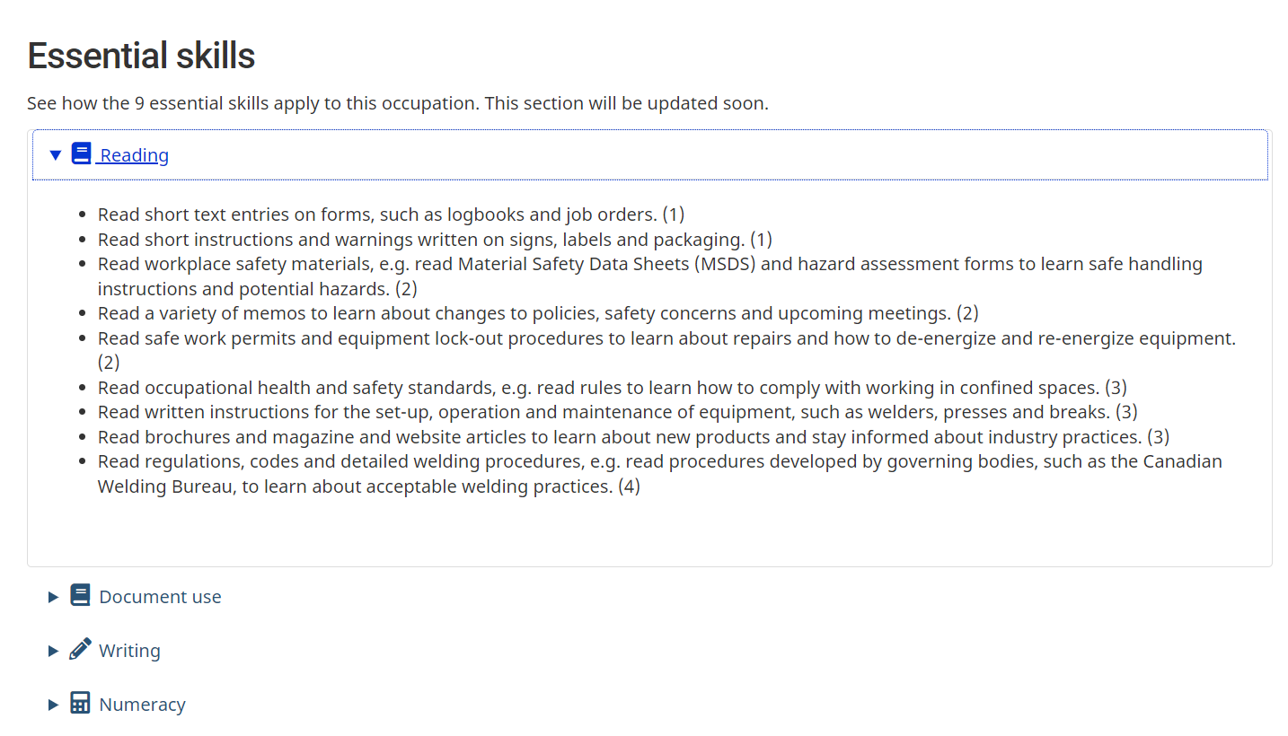
https://www.jobbank.gc.ca/marketreport/skills/23242/39078
Notes:
If you click on the skills icon, it brings you to some overarching skills, but then it will give you the drop down list for the Essential Skills profile, all nine of them. You can PDF this, print it out and send it to your learner. This is an easy way for them to self-identify what skills they already have and what is new and where they will need to focus.
Perhaps you can look at the complexity level of these skills and identify where they are comfortable completing tasks at LBS levels and where these skills could be transferrable to on-the-job skills. How can you tackle those skills at the higher levels? That could form a learner plan or a learning activities section. I just wanted to highlight that, because I think it’s important.

Slide 49
https://www.ontario.ca/page/labour-market
Notes:
The other one is the Ontario Labour Market. Again, to Justin’s point about some of the reports, these are a bit more static. Justin, you are probably much better to address this than I am, but as I was looking here, I thought the labour market reports might be interesting as well as the monthly snapshots.

Slide 50
https://abea.on.ca/labour-market-information-and-essential-skills-for-lbs-and-es-practitioners/
https://taskbasedactivitiesforlbs.ca – Search Employment Goal Tracker
Notes:
Finally, I wanted to share some of the work that we have done over the last couple of years here at ABEA. We developed an employment goal tracker. The purpose of it is to be a portfolio document as a learning activity on a learner plan. It takes them through a series of tasks which is why you also have a link to the task-based activities for LBS website. The goal tracker was broken up into four different tasks and is on the task-based portal so you can either get it through the ABEA website which is the first URL on the screen or you can visit the task-based activities for LBS website and get it there.
Essentially, it is a series of activities that a learner would go through to tackle identifying their employment goal. They would do some career exploration and some analysis of that exploration. The point of it is to make connections with employment services. There are check-in points in that employment goal tracker where you actually document, with your instructor, your contact with employment services.
I have to think that is cool because we worked on it, and I do think it’s cool, so go check it out.

Slide 51
The must haves...
Webinar evaluation
https://surveys.oalcf-echannel-repository.ca/s3/Pop-UP-PD-21-22-Web-4-Workforce-Literacy-Pre-employment-Planning
Register for future webinars
https://learningnetworks.ca/resources-publications/popuppd/
Webinar resources
English https://e-channel.ca/practitioners/pop-pd-resources
French https://apprentissageenligne.ca/formateurs/programme-afb-ressources-de-la-communaute-de-pratique-en-ligne
Notes:
Before I leave it to Justin, I just want to tackle this slide because it has key information.
Sarah has been kind enough to post the evaluation link in the chat, so please make sure that you do that.
There is also a link about registering for future webinars. There is one coming up in January on workplace literacy in the LBS field. You will see examples of how LBS organizations are embedded with employers which will be an interesting follow up to today.
There are also links for webinar resources in English and French

Slide 52
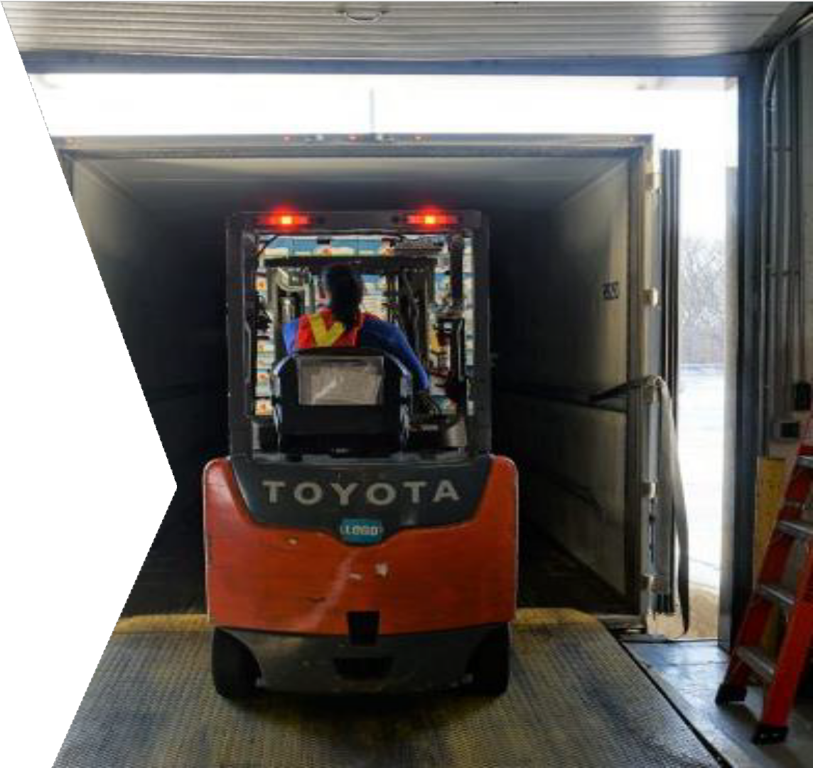
What careers are in-demand?
Let’s look at job posting data.
Notes:
Justin Falconer: I finished up for the most part with the tools. I probably only went through about half of them; in some regions there will be more. Check out your local Workforce Board’s website to see what tools they are running. If you need any sort of one-on-one presentations, I would love to get out and meet you and your team and walk you through them.
What careers are in demand?

Slide 53
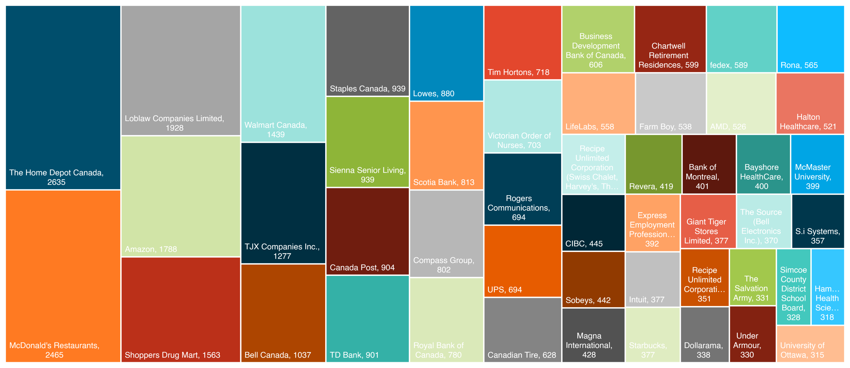
TOP 50 HIRING EMPLOYERS IN NOVEMBER 2021
Notes:
According to job postings, for the month of November, the number one hiring employer in Ontario (excluding Toronto and the Far Northeast because they aren’t running our system) is Home Depot Canada. Number two would be McDonald’s. Number three is Loblaws. You can see the number of job postings that each one of these employers are responsible for. You get a good sense of the extent of who is actually hiring and what the overall hiring numbers look like. You don’t often read about these folks in the newspaper. You tend to read about the manufacturer in your c

Slide 54
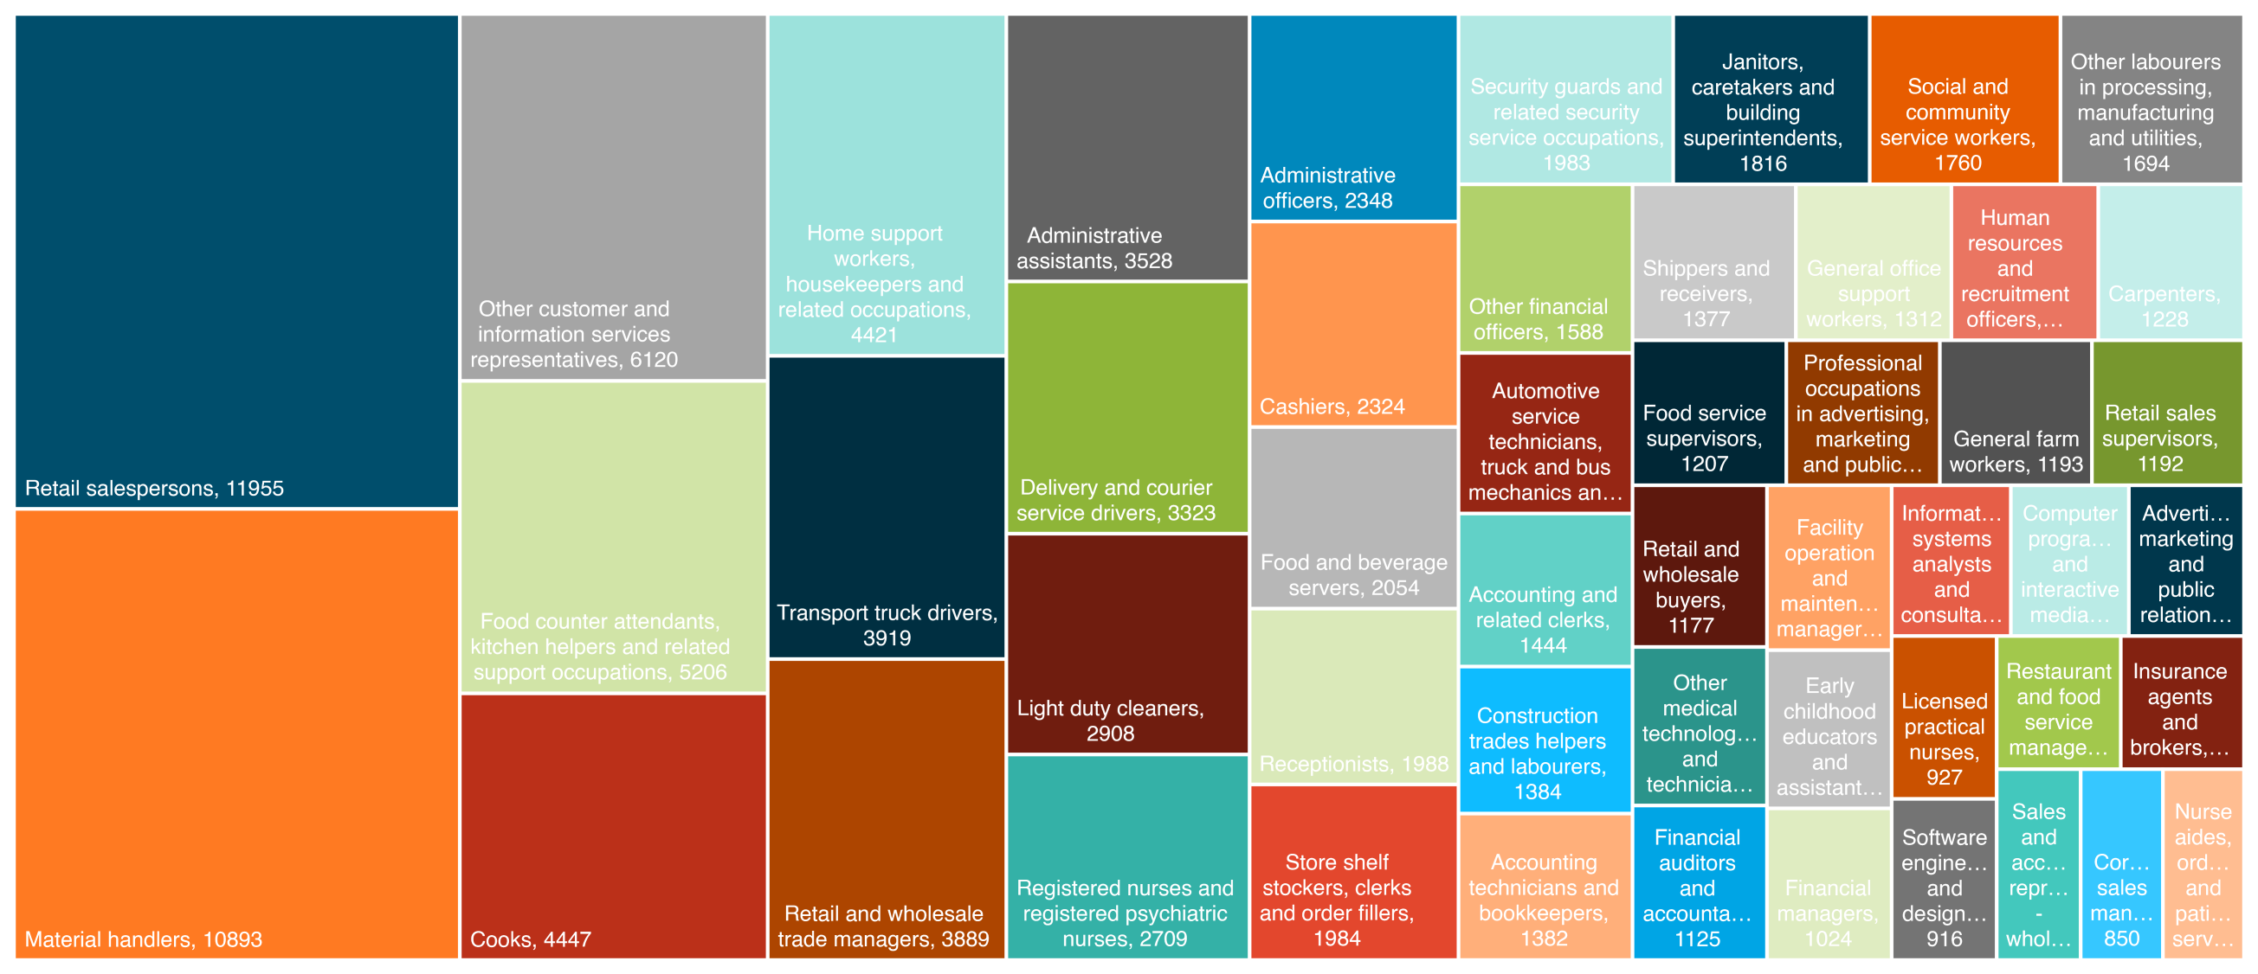
TOP 50 OCCUPATIONS IN NOVEMBER 2021
Notes:
We did the same thing for occupations. What are the top 50 occupations? Interestingly enough, even though 50 occupations is only about 10% of the NOC codes, it actually represents about 2/3 of all the job postings in our system. These are definitely some of the more in-demand occupations across Ontario and probably in your communities.
As you can see here, these are interchangeable depending on the time of year, but either retail sales people or material handlers, which covers everything from shipping to trading.
Sara Gill: Justin, did you mention what region you are talking about. Does this capture rural areas?
Justin Falconer: This is all of Ontario except Toronto and the Far Northeast. Every other region from Cornwall to Owen Sound is included in these numbers.
You can see here what the typical occupations are that are most in demand. A lot of these are great entry level occupations. These are the ones that if people were to be retrained there is always demand for these occupations.

Slide 55
MONTH OVER MONTH CHANGE IN DEMAND
 | OCCUPATION | Active Job Postings October 2021 | Active Job Postings November 2021 | Change | % Change
1 | Retail salesperson | 12,608 | 11,955 | -653 | -5.2%
2 | Material handlers | 15,330 | 10,893 | -4,437 | -29%
3 | Other customer and information service representatives | 6,154 | 6,120 | -34 | -0.6%
4 | Food counter attendants, kitchen helpers and related support occupations | 5,272 | 5,206 | -66 | -1.3%
5 | Cooks | 4,457 | 4,447 | -10 | -0.2%
6 | Home support workers, housekeepers and related occupations | 4,410 | 4,421 | +11 | +0.3%
7 | Transport truck drivers | 3,820 | 3,919 | +99 | +2.6%
8 | Retail and wholesale trade managers | 4,049 | 3,889 | -160 | -4%
9 | Administrative assistants | 3,578 | 3,528 | -50 | -1.4%
10 | Delivery and courier service drivers | 3,413 | 3,323 | -90 | -2.6%
Notes:
The last slide I will show you is a snippet of what happens month to month. I have put a column for October’s numbers and November’s numbers. Sometimes they go down, sometimes they go up. In general, we saw November posting numbers fall from October. October was a high in pretty much every local region that we serve, but November was still pretty high although it did fall overall.
It is interesting to see how these things change from time to time.
Sara Gill: What happened to the material handlers?
Justin Falconer: Good question. Amazon probably hired enough people for the Christmas season, so the postings are down.

Slide 56
THANK YOU
Questions?
JUSTIN FALCONER
CEO, Workforce WindsorEssex jfalconer@workforcewindsoressex.com 226-674-3220 ext. 854
www.workforcewindsoressex.com
Notes:
I’m happy to answer any questions.
One other thing that I wanted to mention. At the beginning, I mentioned that our job boards aggregate information. If Employment Ontario’s office or community employment programs have job boards that they run on their own websites, we can integrate those into the tools and refer people to you when they are interested in those job postings. You will want to connect with your local Workforce Board to find out if your EO or non-EO program job board is connected to the system. We would love to make sure that people find out about the jobs on your site.
Sara Gill: There are lots of positive comments in the chat. A huge thank you to all of our panelists today. It’s been great, and we are getting the feedback to say that it was a good use of people’s time.

Slide 57
Thanks so much for joining us today!
Questions/Comments
Notes:
I wish everyone an amazing day, and thank you for participating.

