Slide 1
Webinar Title
((DATE))
Notes:
Andrea Dickinson: Welcome to today’s Pop Up PD Webinar, Workplace Literacy: A Snapshot of What’s Happening in the LBS Field. I’m Andrea Dickinson, Executive Director of the Tri-County Literacy Network in Chatham, and it’s my please to be your host today.

Slide 2
Statement of Land Acknowledgement
I would like to begin by acknowledging the Indigenous Peoples of all the lands that we are on today. While we meet today on a virtual platform, I would like to take a moment to acknowledge the importance of the lands, which we each call home. We do this to reaffirm our commitment and responsibility in improving relationships between nations and to improving our own understanding of local Indigenous peoples and their cultures. From coast to coast to coast, we acknowledge the ancestral and unceded territory of all the Inuit, Métis, and First Nations people that call this land home.
Notes:
I would like to begin by acknowledging the Indigenous Peoples of all these lands that we are on today. While we meet on a virtual platform, I would like to take a moment to acknowledge the importance of the lands which we each call home. We do this to reaffirm our commitment and responsibility in improving relationships between nations and to improving our own understanding of local Indigenous Peoples and their cultures. From coast to coast to coast, we acknowledge the ancestral and unceded territory of all the Inuit, Métis and First Nations people that call this land home.

Slide 3
About Pop Up PD for Literacy Educators
free webinar series developed by Ontario’s LBS Regional Networks, Sectors, & the Provincial Support Organizations for Literacy
supports LBS practitioners with presentations on topics important to them
English language webinars presented for LBS practitioners annually since 2015-2016; French language transcriptions are available on COFA’s website!
all webinar presentations, recording links & transcripts here:
https://e-channel.ca/practitioners/pop-pd-resources
webinar topic ideas welcome at: e-channel@contactnorth.ca
Notes:
The Pop Up PD for Literacy Educators is a free webinar series developed by Ontario’s LBS Regional Networks, Sectors, and Provincial Support Organizations for Literacy. It supports LBS practitioners across the province with presentations on topics important to them. All webinar presentations, recording links and transcripts can be found on the Pop Up PD Resources Page on the Contact North website. The URL is on the slide for you. You can find all of the registration information on the Learning Networks of Ontario website on the Pop Up PD Webinar page.
Webinar topic ideas are always welcome, so please send them along to the email on the screen.

Slide 4
Thank you and acknowledgements
Members of the Pop Up PD for LBS Educators committee:
Contact North for providing technical support.
Deaf Literacy Initiative for providing ASL interpretation.
COFA for translating the webinar for the Francophone agencies.
And
Adult Education Association (ABEA), College Sector Committee (CSC), Literacy Link Niagara (LLN), Literacy Link South Central (LLSC), Literacy Northwest (LNW), QUILL Learning Network, Tri-County Literacy Network (TCLN).
Notes:
Thank you to the members of the Pop Up PD for LBS Educators committee for their continued work on this series. English language webinars have been presented for LBS practitioners since 2015-2016. French language transcriptions are available on COFA’s website, and I would like to extend my thanks to them for their continued support. I would also like to extend a thank you to Deaf Literacy Initiative, who coordinates the ASL interpretation for the sessions. We have ASL interpretation available in the session today. Thank you to the ASL interpreters.
Technical support for this series of webinars is provided by Contact North. Thank you to them.
The work of the Pop Up PD committee is funded by the Ontario Ministry of Labour, Training and Skills Development. I would like to thank them as well, and I would also like to give a shout out to Sarah Stocker from Contact North and Debera Flynn, who will be assisting me this afternoon.

Slide 5
Workplace Literacy and Pre-Employment Planning
In today’s webinar you’ll
learn about some workplace literacy programs and activities happening in Ontario
hear about the funding for these programs
find out how to connect with employers to promote and offer workplace literacy programs and activities
Notes:
In today’s webinar, you will learn about some workplace literacy programs and activities happening in Ontario, hear about the funding for these programs and find out how to connect with employers to promote and offer workplace literacy programs and activities. We will not be taking a formal break during the session, so please feel free to step away if needed. We encourage you to participate: please add your comments and questions in the chat, and we’ll be sure to address them at the end of the presentation sessions.
As with all the Pop Up PD webinars, there is an evaluation for today’s session. The link to the evaluation will be posted in the chat near the end of the webinar. The link will also be sent by email after the session. Please take a few minutes to complete it as we really appreciate your feedback, and it’s very important to us to continue to offer these sessions.

Slide 6
Our Panelists
Kim Redford and Barb Duguay, Instructor and Administrator,
Valley Adult Learning Association (VALA)
Chris Prosser, Executive Director,
The Literacy Group of Waterloo Region (TLG)
Kerry Halliday, Manager of the Skills Upgrading Program (SUP),
Upper Grand District School Board
Notes:
Now, I would like to introduce our panellists. We are very fortunate to have Barb Duguay and Kim Redford with us today. They have been working together for the past 22 years in LBS. Barb is an administrator, and Kim is an instructor at the Valley Adult Learning Association in Fort Frances. Over the past 22 years, they have completed several projects involving workforce and workplace literacy, and they look forward to sharing their experiences.
Chris Prosser has been with The Literacy Group of Waterloo Region since 2013, and he is the Executive Director after immigrating from Hertfordshire, UK. Chris joined adult literacy after a career of teaching English at the high school level and as an ESL instructor in China and Vietnam. Chris has two young children that keep him very busy, but when time allows, he enjoys reading, sports, and carpentry.
Kerry Halliday is an instructor who has worked alongside learners on factory conference and lunch tables as they built their numeracy and literacy skills to gain advancement within their company or to attain their diplomas. Kerry has been the manager of the Skills Upgrading Program for ten years and has been working in adult education with the Upper Grand District School Board for 30 years. Kerry genuinely loves the career she stumbled into and says the fact that she might play a role in guiding someone to built their skills and fulfill their education dreams makes it such a rewarding career. I think that’s a common feeling amongst people in the LBS field.
I would now like to pass it over to Kim Redford and Barb Duguay.

Slide 7
Workplace Vs Workforce
Valley Adult Learning Association
Barb Duguay- Administrator
Kim Redford- Instructor
Notes:
Kim Redford: I’m the instructor here at Valley Adult Learning Association. With me, as always, is Barb. We have been working together for 22 years in the literacy field. We have had a lot of adventures and experiences during our time together, and we want to share some of them with you.

Slide 8
VALA’s Interpretation Workplace – Employer driven Workforce – Learner driven
Workforce
Workplace
Authentic training driven by the employer
Can be off-site or on-site
Employer determines learning objectives
Employer provides learners
Authentic training driven by the employee
Learner determines the work skills needed to be successful
Learner may be working already or looking for employment
Can be on-site or off-site
*my employee needs to learn
Employer referral
*I need to learn
Self Referral
Notes:
Today, we want to talk about what workplace literacy vs workforce literacy. These are words you hear a lot in the field, and we thought it was important to interpret which is which because it can be confusing. We came up with a definition for each. We consider that workplace is an employer referral. The employer has stated that they want authentic training, and it’s the employer driving the referral. This can be onsite or offsite, but the employer determines the learning objectives. Usually, the employer provides the learners – they call us and say their employees need to learn. We define workforce as authentic training that is driven by the employee. The learner themself determines the work skills needed to be successful. They might be working already or they might be looking for employment, but even then it could be onsite or offsite. You can see the boxes at the bottom where we have stated that workplace is an employer referral and workforce is a self-referral.

Slide 9
Workplace Examples
Super 8 Essential Skills Training
OTEC – Customer Service Results (CSR)
Intro to Administration
Specific Employer Requests
Notes:
Barb Duguay: Here are some of the examples of workplace that we have accomplished over the last 22 years here at VALA. The first one is the Super 8 Hotel where we did Essential Skills training. OTEC was a customer service results, and Intro to Administration and Specific Employer Requests. We’re going to go into each one of these on the follow slides in more depth.

Slide 10
Super 8 Essential Skills Training Project
Essential Skills project
Run in conjunction with Super 8 hotel in 2010
To address essential skills needs in the workplace
Super 8 staff required skills upgrading in digital technology in order to transition into new computer management system
17 staff members participated
6 month computer training course (2 days per week to alternate staff)
Staff paid wages by Super 8 during training
“Manager at the Super 8 is pleasantly surprised at the increase in the staff camaraderie and problem solving abilities. Staff were able to complete the training online after completing the computer training”
--Wanda Barker
Notes:
We had a call from the supervisor at the Super 8 hotel. She wanted to move some of her cleaning staff up to the front desk so that they would be versatile and work different areas. We started with an Essential Skills project. We addressed Essential Skills needs in the workplace. There were many meetings with the employer. We determined that Super 8 staff required upgrading in digital technology in order to transition to the new computer management system. 17 staff members participated. It was over a 6 month period. The course was flexible; it was two days per week. Staff was paid wages during the training, so that was a bonus. Wanda Barker, the manager, was fantastic to work with.

Slide 11
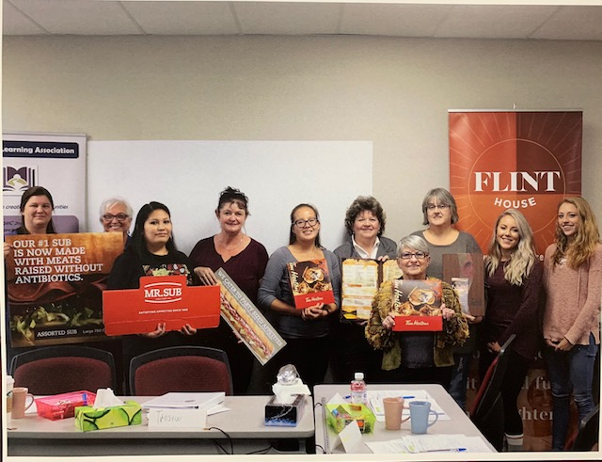
OTEC- Customer Service Results
OTEC (Ontario Tourism Education Corporation) provided curriculum, staff training and facilitator
VALA required to provide 10 Learners at Management level and 10 learners at Line level (front line workers) in hospitality sector
Management CSR training = 2 full days of training, Line Level = 3 full days of training
Lunches provided out of LBS budget and patronized the restaurants which participated- reimbursed by OTEC
Outreach worker established contact with local hospitality employers and marketed program.
Recruitment was intense and took approx. 1 month, 3 days/wk
Monetary incentive paid to participants (reimbursed by OTEC) to cover lost wages during training
“I think the biggest thing that I learned through the course was just how important communication is, whether it is the words you’re speaking or just how you’re presenting yourself”
--Diane Gibson
Manager at Copper River Inn
Notes:
OTEC stands for the Ontario Tourism Education Corporation. I went to Toronto where I participated in a training with OTEC for a week. This was not easy training. I brought it back to VALA. There were 10 learners at a management level and 10 learners at a line level (frontline). This was in the hospitality sector. The management was two full days of training; the line level was three days. The recruitment was very difficult and hard to pin down employers. It was such a fantastic program that I really wanted it to work. Lunches were provided out of our LBS budget, and we patronized the restaurants that participated in the training.
We had an outreach worker who established contact with local employers and marketed the program. She worked very diligently and kept up with recruitment. Recruitment was intense; it took just over one month. Monetary incentives were paid to participants by OTEC to cover lost wages during the training program.

Slide 12
Intro to Admin
Ontario Works First Nation requested an Administration course for recipients
OW determined the schedule- 4 days per week, 10:00 – 2:00 for 3 weeks. Schedule was created to accommodate daycare, schooling and transportation in from community
OW paid for lunches to be brought in and arranged transportation
Training included digital technology, office technology, Computer training, policies and procedures, Workplace communications, Dress for success, Employer Expectations
Incentives provided by OW and VALA
All participants were on Methadone so training needed to work around medical appointments
Participants set their own policies for the course
Certificate upon completion given in a graduation ceremony
Notes:
Kim Redford: Another program that we run here fairly often is something we call Intro to Administration. In one case in particular, it was a First Nations community who requested this. We consider that an employer referral – they called us and said what they wanted to be taught in the course. They determined the schedule of four days/week from 10 to 2 for three weeks. This was created with their specific clients in mind to accommodate for daycare, school, transportation and medical appointments.
Ontario Works paid for lunches to be brought in and arranged for transportation. We did training in digital technology, office technology, computer training, policies and procedures, workplace communications, soft skills, dress for success and employer expectations. They provided incentives which we contributed to. For most of these things, we try to partner up as much as possible with agencies and employers for funding to help facilitate the training. We do put these into LBS milestone, and we incorporate milestones into the training so they can be LBS learners. But if we can partner with an agency to provide lunch, that doesn’t have to come out of our budget.
In this case, all of the participant were on methadone, so training needed to work around those medical appointments, and of course we let them set their own policies and gave them a certificate upon completion.
Barb Duguay: I just want to mention that Kim and I did take some training on work with methadone participants before we started the program.

Slide 13
Specific Employer Requests
Sometimes employers will contact us directly to request specific skills training for employees. Examples are:
Power point and presentation training for an employee new to a team leader role requested by the Gold Mine
Excel training for Administrative employees requested by the Town of Fort Frances
Office program training for a secretary who was newly hired requested by UNFC
Onsite computer training for employees using in house templates requested by the Fort Frances Jail
Small business owners requiring computer upgrading to effectively run their business- Wasaw foods
Notes:
Kim Reford: We have had specific employer requests when an employer has called us and tells us what they need. For example, there was an individual who transitioned into a new role as a team leader and was required to do presentations to his team. This was a skill set that was challenging for him, so he came in and we were able to help with that.
The Town of Fort Frances has sent people over to have training in Excel. Another employer hired a secretary, and they wanted us to help her learn some office programs and become more proficient. We had an individual at the Fort Frances jail who required computer upgrading for the forms they were using. This is where the onsite/offsite gets confusing. In that case, due to confidentiality issues, we couldn’t bring her into our agency, we had to go onsite to help her. But we still put it as a workplace issue because the employer had referred her. We have had a couple of small business owners who required computer training in order to effectively run their businesses.

Slide 14
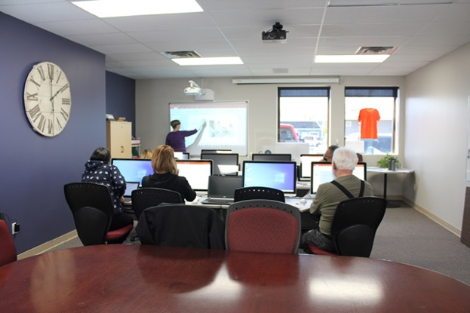
Workforce Examples
Excel and Computer Training
On-site computer support at Fort Frances Jail
Employee support at Safeway and Fort Frances Clinic
Cash register training
Customer service skills training
Notes:
Barb Duguay: Let’s move on to workforce which is learner driven. The learner could be already working or could be looking for employment. These are some of the examples that we have had over the years. We’ll go into more detail in the next slides. Excel and Computer Training, Onsite computer support at the Fort Frances Jail, Employee support at Safeway ad Fort Frances Clinic, cash register training, and customer service skills training.

Slide 15
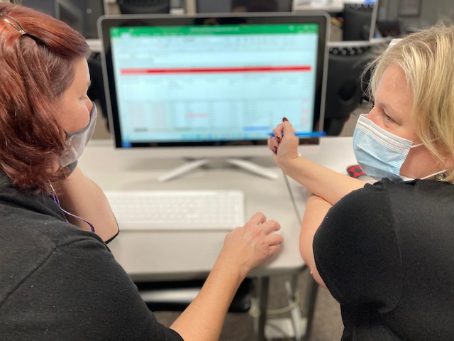
Excel and Computer Training
Learner working at RRDSSAB, moved into a new positon. Requires skills upgrading in Excel
Excel is very popular as workforce training due to its requirement for most office positions Self referrals from many employees/learners for work specific skills training
Referrals in from NCDS for workforce skills training (advantageous for job search)
Notes:
Kim Redford: We get a lot of people referring themselves in for Excel or computer training in general. In the picture shown here, this learner works at Rainy River District Social Services Administration Board. She had moved into a new position that required her to use Excel in a way that she hadn’t used it before, so she cam in to get specific training on how to use these forms. Excel is one of our most popular workforce trainings, because most office positions tend to use Excel, so we do get a lot of self-referrals for that. We also get a lot of referrals from NCDS for this. We consider Northern Community Development Services as our EO partner, and we consider that a workforce because it is employees who self-identify that they need skills upgrading to transition into a job.

Slide 16
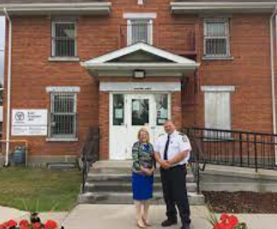
On-Site Computer Support at Fort Frances Jail
Receptionist requested assistance with computer training (self Referral)
Training had to be on-site due to sensitive materials which could not be removed from the office
Training needed for upwards mobility into new position as Rehabilitation Support Officer
Notes:
We had someone from the Fort Frances Jail. This was actually the same individual mentioned earlier, but this time we considered it workforce because this time it was a self-referral. It was sensitive material, so once again we had to go on site. But in this situation, the person that we had worked with earlier now had the opportunity to move into a new position. She wanted some upward mobility, there was a position available as a Rehabilitation Support Officer. She thought she could move from being a Receptionist if she had a bit of extra training, so she called us in to help her with that, which we were able to do.

Slide 17
Employee Support at Safeway and Fort Frances Clinic
Self Referrals – Not Employer Referrals
Employee at Safeway in Bakery with low literacy skills facing challenges to write on cakes. Literacy upgrading provided at VALA to improve reading and writing in order to remain in that position
Employee at Safeway running labelling machine for bread with low reading skills. Could not read the bread labels in the manual. On-site support provided to teach bread names on the job
After hours cleaner at Fort Frances Clinic with low reading skills could not read instructions left by employer. On site training provided to help her improve job performance
Notes:
Barb Duguay: All three of these examples are self-referrals, and all three were newcomers. Their speaking and listening were good, but they needed help with reading and writing. The first one was an employee at Safeway, and in order to keep his job in the bakery, he needed to take orders and write on the cakes. We brought him into the office to improve his reading and writing in order to remain in his position. The second one was an employee at Safeway who ran the label machine for bread, but he had low reading skills so he couldn’t read the bread labels in the manual. We went on site to help. The third one is an after-hours cleaner at Fort Frances Clinic with low reading skills. We helped her onsite with that.

Slide 18
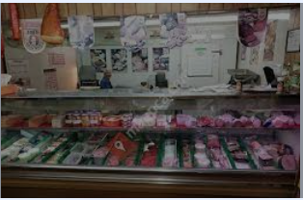
Cash Register Training
Learner was a referral from NCDS for workforce skills upgrading
Learner was on ODSP, had low skills and no work experience. Wanted to work in a retail store but was nervous about using a cash register
Local small grocery mart-Einar’s- worked with VALA to allow learner to upgrade skills by working in an authentic working environment
VALA instructor went on site to Einar’s with the learner to train in cash register, making change, customer service and bagging
Learner was able to obtain confidence, skills and employment at Safeway
Notes:
Kim Redford: We have had some cash register training as well. We had a referral from NCDS for someone who didn’t have any skills or work experience. He was on ODSP. He wanted to work in a retail store but was very nervous about using a cash register. At the time, our agency was located right above a small grocery store. They let us come in and work with the learner onsite, so we were able to training him on a cash register, making change, customer service and bagging. He was able to gain confidence and enough skills that he found employment at Safeway.

Slide 19
Customer Service Skills Training
Self Referrals – VALA advertised the course and employees called in to register
VALA offered a Customer Service Training Course
Employees from Pharmasave attended.
During the course, VALA approached Pharmasave to enquire about valued customer service skills in the business
VALA incorporated that feedback into the training
VALA was able to monitor learners in workplace after training completion in partnership with Pharmasave
Notes:
We decided to include this customer service skills training on the workforce side even though we ended up working with an employer for it. This is where we find there is so much overlap that it can get confusing. In this case, we advertised for a customer service skills training course. We had a number of people register, and it was only after they registered that we found out that they were all employees of one business in town, the pharmacy. Once we knew that, we were able to connect with the employer and find out what they would consider to be valuable customer service skills. We then incorporated that into the training which made it much more relevant. The employer was very willing to participate. We still count it as workforce because the individuals themselves signed up for the course.

Slide 20
VALA’s Interpretation Workplace – Employer driven Workforce – Learner driven
Workplace
Workforce
Authentic training driven by the employer
Can be off-site or on-site
Employer determines learning objectives
Employer provides learners
Authentic training driven by the employee
Learner determines the work skills needed to be successful
Learner may be working already or looking for employment
Can be on-site or off-site
*my employee needs to learn
Employer referral
*I need to learn
Self Referral
Notes:
Barb Duguay: This is the end of our presentation, and we’ll just go back to the definitions of how workplace is employer drive, and workforce is learner driven.

Slide 21
To contact us
Valley Adult Learning Association
www.vala.ca
kim@vala.ca
barb@vala.ca
Notes:
Kim Redford: This is us, so if you have any questions or want to talk to us about anything after the presentation, we’re at Valley Adult Learning Association. We are on the furthest end of the province, close to the Manitoba border, but interestingly where Yonge St. ends.
Andrea Dickinson: Thank you very much for that informative presentation. Now I’ll turn it over to Chris Prosser.

Slide 22
Literacy in the Workplace
Barriers to delivering programs on site
TLG
The Literacy Group
Workplace Wise
Literacy Solutions for Business Results
Notes:
Chris Prosser: Good afternoon, and thank you for having me. It’s my pleasure to speak on what The Literacy Group has been doing in terms of our workplace training.

Slide 23
10 Year Journey
2010 – On site programs in partnership with volunteers who ran for-profit businesses
2015 – On site programs through networking with for-profit partnerships
2019 – Programs ran with community partners and for-profit organizations through grant programs
2021 – Social enterprise or set model of delivery created
Notes:
The Literacy Group has been working with both fee-for-service and workplace training through our LBS program for a long time. It’s my pleasure to see that my predecessor is here on the call today so there goes my plan for taking the credit for everything ☺
It has been a ten year journey that we have taken to get where we are today. I can also say that we can do so much more in this field, and we look forward to doing more. It really has been a discovery journey. As we know, Rome wasn’t built in a day, and a lot of literacy is building on skills; that’s the nature of the game. This is how we deliver our workplace training and our fee-for-service training is no different.
As you can see, we started off in 2010 when we delivered onsite programs, working with volunteers who had for-profit businesses in the area. That was a very close personal relationship, and we were able to build those programs for the small groups of their employees. Then we started to take that model that we created and move it out through the networks. This message and our marketing about how we delivered our programs got further out to a point now where we’re at with a solid social enterprise platform with a marketing strategy and a business plan. If it weren’t for the pandemic, we would be doing it now.

Slide 24
Creating Workplace Wise
Social Enterprise Funding supported by Investment Readiness Program, through Kitchener Waterloo Community Foundation.
Gain training from a specialized consultant
Analyze the market and create a business plan
Test product through consortium support
Notes:
What I would like to share with you today is the creation of this social enterprise that we have created. You can use what you need for your organization.
We created a sub-training called “Workplace Wise”. It started off from some social enterprise funding we received from the Investment Readiness Program. Thanks to that funding, we were able to partner with a specialized consultant. We analyzed the market and created a business plan. With the consultant, we were able to access a number of consortium supports, which goes on to this day.
Using what we did in the past throughout that 10 year journey and the number of programs that we’ve done with other networks and Waterloo region corporate businesses, we have been able to create this tool, but it has been a bit of a journey.

Slide 25
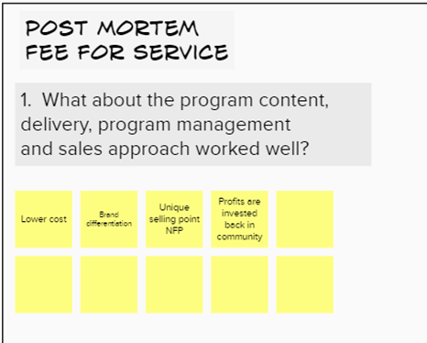
Creating a Strategy
Fire bullets before cannon balls
1. Complete a post mortem and SWAT analysis of completed programs.
2. Understanding what a win looks like in clear messaging.
3. Get an early idea of how to win and what will be our Brand Differentiation and Unique Selling Point
4. Prepare to make decisions and keep to them, other than the more flexible Non-for-Profit style.
Notes:
First of all, we needed to create a strategy. Some of you, who have worked both in the not-for-profit and profit world, it’s a bit like oil and water. Coming from an education system straight to a nonprofit, I had never had the benefit of working in a for profit corporation, so I had to learn a whole new language.
So when it came from starting off at the beginning and taking a not-for-profit LBS program and then run it both successfully and fruitfully in the corporate world, we really had to start at the beginning and think about our messaging, think about the mistakes we had made, think about our strengths, think about threats – obviously I am talking about SWOT – as well as opportunities. The most important thing is firing bullets before firing cannon balls.
A big piece of what I learned is that along with running a small not-for-profit literacy program with its contract with the Ministry and other programs and supporting all of that, often we find that lack of funding means that we have to run additional programs off the side of our desk. For me to jump in and take on an Amazon training project, in terms of fee-for-service and getting learners, I would definitely be interested. However, this program really did teach me to say no! The training that I got from the consultancy did teach me to say no and to be selective about who we wanted to work with. That took a while for me to learn, so I was firing bullets before firing cannon balls.
More importantly, as well as learning to say no, or at least “not today”, it was important to learn what a win for us looks like. What does a partnership with community-based adult literacy within the Waterloo region look like? Who is our partner going to be? What do we share? Are they interested in working with a not-for-profit? Do they have a community heart? Are our mission and values similar? That is really the only way you will see success – that element of sharing your LBS program with the corporate program. That’s something we had from the get go: is that what a winning partnership looks like?

Slide 26
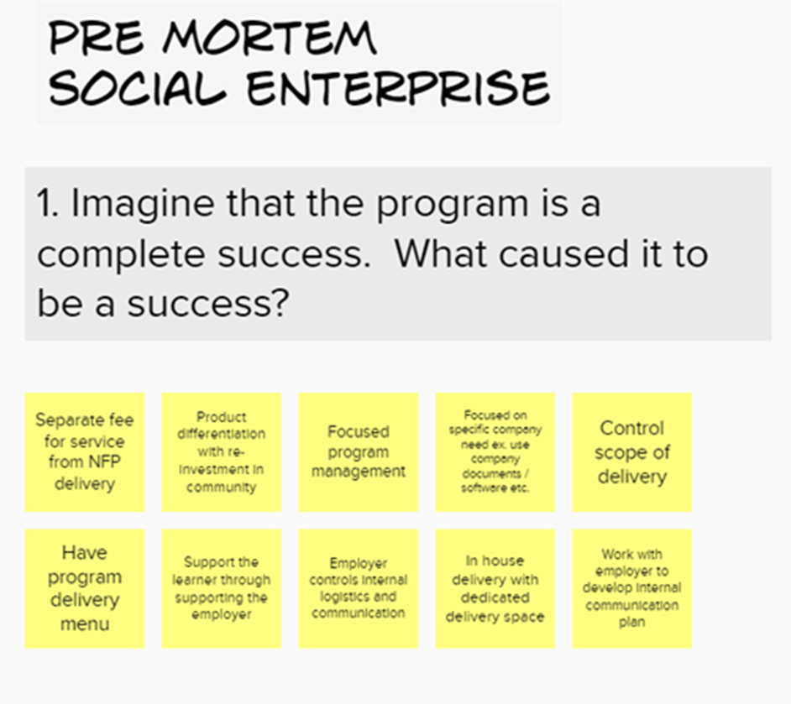
Notes:
Another question we had to look at before starting to develop a program was to imagine what success looks like. We looked at successes in the past and analyze it. The same applies to failure. The big part of our learning was to learn from past failure. Sadly, we had more failures than successes, but that also means there were more learning opportunities, so it really was quite interesting over the time while we broke it down, looked at the analysis, learned what worked and what didn’t. In terms of a logic model, we really got to understand what our assets were, looking for where to play, looking at what a win looks like, and learning where to say no.

Slide 27
Understanding the Corporate Playing Field
Switching from Nonprofit to Profit mindset.
Selling and running a product/service vs. Running a community program.
Finding a largely common corporate need.
Translate LBS language in our delivery to that of the corporate world.
Develop an impact statement.
Start to form a delivery model to present how to make change happen.
Notes:
As well as that, I was also learning what it means to play on a corporate field, switching from a nonprofit to a profit mindset. There was a whole new set of acronyms, a new language to learning, selling and running a program rather than running a community-based program, finding a large corporate need as opposed to a community-based need. Looking at those needs is incredibly different but confusingly similar at the same time. Not to use too much LBS language and Skills for Success language or the Essential Skills and all of those other wonderful pieces that are second nature to us but may be unfamiliar in the corporate world.
As we develop these programs and get more excited about them, you’ll see that the LBS terminology and the skill set terminology comes out, and I can’t count how many meetings I have been in with a corporate partner, and their face has gone blank when I started to talk about the Curriculum Framework and milestones. I had to rethink and find that dictionary of common knowledge.
Developing an impact strategy with the corporate field was a challenging thing to do, because as much as I wanted those corporate partners to be on board with supporting the community, I did have to understand as well that there was some corporate messaging that also needed to go into the strategy.
Finally, we had to start to create a delivery model that presents change. We’re looking at different timelines to see change. As you know, sometimes we can be looking at one to five years with a learner to reach a goal and see change. I learned that saying we could be working with employees from on to five years could get the door slammed in my face quite quickly. I had to change my messaging before I broke the news saying it wasn’t going to happen overnight.

Slide 28
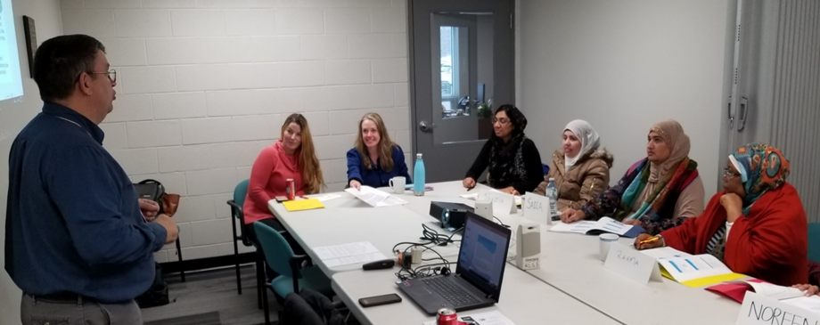
Communicating to Corporate World
Whole corporate training Individualized learning
Very little attention to basic skills Basic skills assessment – CAMERA
Very little attention to soft skills Soft skills assessment and inclusive training
Very little barrier recognition Early signal assessment and referrals
Delivery of corporate designed materials Specifically designed curriculum from adult literacy resources
Notes:
I quickly found out that the corporate world of training is very different to our world of training, but I also found out that they found the way we could deliver training was very appealing. I was surprised that, within these corporate circles, it never occurred to them that it could be this way. They say the corporate training, especially with language, literacy and basic skills upgrading as very whole training. There was very little attention given to basic skills; it was always very much the specific skills of the job or qualification. There was little attention given to soft skills – I’m sure over the last couple of years and especially pre-COVID, we have heard more from employers who need soft skills, so they appreciated that we could speak to that. At the same time, the materials used in their training was at a higher level, so when we talk about things like clear language and layout suitable for LBS learners, they were nowhere that.

Slide 29
Finding the Common Need
More engagement
Reduction in turnover
Employee Retention
Developing front line employees
Support employees to become contributing team members
Help employees apply thinking
Support employers discover and grow their next middle management
Empower employees with the skills needed to become stable and independent
Reduce risk and costly errors
Notes:
It took about a month to get this list together. It was longer originally, but we have condensed it now. It’s about finding the common need of what we can provide and hat the corporate needs. This was our situation in 2019; who knows what it’s going to be like when we moved out of the COVID situation. At that time, we learned that employers needed more engagement from their staff; they needed to lower turnover and had an incredible issue of employee retention.
They saw the benefit of and wanted to develop their frontline employees, but there were barriers to doing that. They wanted to support employees towards becoming contributing team members. They did understand that it’s their business, but they knew there was a lot of benefit coming from the front team on how to run and improve the business, but they found it very difficult to get that connection, open communication, and develop and train a team member to be a contributor. It is actually difficult to do: how do you develop someone on the front line to be a contributor?
They wanted to help employees apply their own thinking. They wanted to support employees in discovering their next middle management and encourage that step up. When we talk about front line employees having five to ten years’ experience and moving into that supervisory position, that was a benefit that they wanted to use.
Empowering employees with the skills needed to become more stable and independent. We worked with an organization that hired a lot of newcomers to Canada, and the turnover was incredible because of the barriers they faced in the Waterloo region at the time. It was everything from not having a job to travel to housing to 101 different things. They were restricted with workplace policies, and a lot of them had to be let go because of issues that were not their fault.
Reducing risks and costly errors. Undercutting or overcutting of material, mistakes being made, waste management: all of those pieces can come from communication and basic literacy skill mistakes.

Slide 30
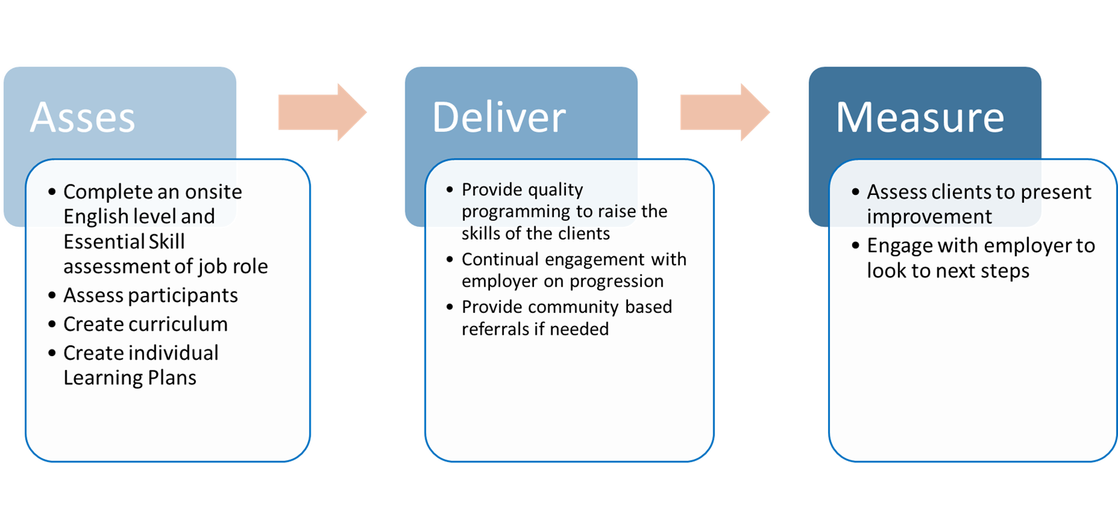
Notes:
We kept it simple. We developed a sweet and short process that was able to be provided by a small LBS provider and understood by a corporate provider. We would do an assessment, we would deliver the program, and then we would measure. This does actually go loop to loop because as we measure, we may also be assessing again and changing deliver and then measuring once more. We use our Essential Skills assessment, we use the NOC (National Occupational Classification). We assess participants using CAMERA and other things. We develop the curriculum piece based on the existing skills and levels of the employees along with the job requirements and the Essential Skills needed. We create individual learning plans. We do that stuff every day.
We deliver the programming based on the employer’s needs so that could be at lunchtime or before or after work. Those are all questions to discuss with the employer, along with discussing where the training will happen, who pays, will they pay extra hours, etc. The more the employer is involved, the better. It’s based on continual engagement with the employer, they need to have some piece of it, whether that’s checking or managing attendance or adding to wages. The employer needs to be seen as having a piece of the program and its progress.
And of course we do what we do so well: we provide wraparound service with referrals if needed.
Finally, we do a post-assessment using CAMERA or something else, and we engage with the employer to look at next steps. How did they do? Have they shown improvement? Are they ready to do the job that was planned? Are they ready to take on a supervisory role? Are they giving back? Are they being more productive … whatever the goals were.

Slide 31
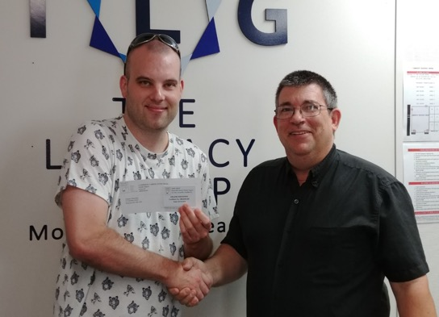
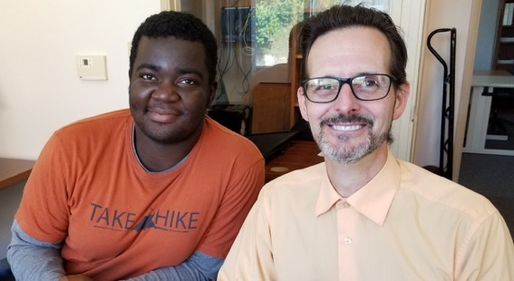
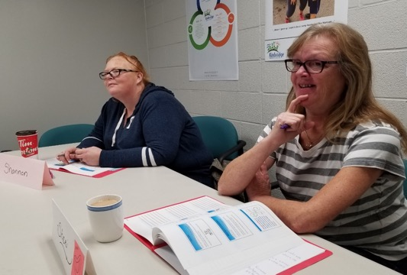
The Literacy Group has served Waterloo Region for over 20 years, specializing in the individual assessment and skills upgrading of adults with a goal to improve their workplace skills.
Discovering a need and suppling the creative programming
Communicating within a network towards a common goal
Providing wrap around individualized service
Assessing and evaluating skills
Notes:
The Literacy Group has been doing this work for 20 years with individual assessment and a goal to improve adult workplace services. When I was working with these employers, telling them that we do this for a living and have done this with some of the most vulnerable and challenging adults in the community, we were quickly deemed the expert. It was great to be able to go in to the corporate partners and tell them that we have been doing this for years, we are experts at discovering the need and creating a program from scratch, we’re experts at communicating with a network of partners all working towards a common goal, providing a wraparound service individualized to our learners/employers/employees, and we are experts in assessing and evaluating skills. When you put it on paper, that’s what a corporate partner needs to know. It’s important that once you take away the LBS language, these are my selling points and why people are interested and being asked to come in once COVID is over for further discussion.

Slide 32
Successful Partners
“The Literacy Group provided English Language instruction to our new, low-level English employees, incorporating our workplace terminology into their curriculum, helping these employees better navigate their new employment more effectively than could otherwise have been achieved.”
J. Sanders. Tigercat Industries Inc.
Notes:
Here are a couple of successful partners. Two of them were arranged by my predecessor who is online today, so thank you. We’re looking to go back to Tigercat soon when we get some people onsite. Tigercat does a lot of work in the US, so they haven’t been that busy hiring people, but as things start opening up, we’ll be doing that.
We did hire extra staff to provide corporate training. We have some internal volunteers with the right experience and skill set, but for a couple of the jobs we needed some ESL skills, so that’s when the corporate fee for service piece came in.

Slide 33
Forming Relationships with Corporate Partners
Not a sell – it’s about conversations! - Socratic method
Ask key questions
Listen and understand and target needs
Use their own key phrases
Use we and combining statements, “we can partner here” and “TLG can support you with that”
Not a transaction business, it is relationship. This is a service, not a product.
The nature of training is developing a service, not a one size fits all product.
Notes:
A couple of things to wrap up. When it comes to the formal relationships with partners, I learned very quickly that it’s not a sell job, it’s a conversation. Maybe a wonderful salesperson could do it well, but I’m not a salesperson so I found out that I had to have a conversation about what we do and how we do it.
Establishing key questions is important. You have about a ten minute window with a lot of corporate partners or maybe a couple of emails, so find key questions and be proactive. Listening and understanding to their needs and their targets, using their language and getting an understanding of that. I found it useful to talk about combining strengths and how we could support them. Remember, it’s not a transaction, it’s a relationship. It’s a service, not a product.
Again, I learned that it wasn’t about going into the corporate world and selling a product. That isn’t what they were after. We have to remember that the nature of our training is developing and creating an individualized program which is unlike a lot of the corporate training that they are used to, where one size is supposed to fit all. It was quite rewarding to see that the way we want to deliver was a way they hadn’t thought about training before.

Slide 34
Questions To Ask
What conditions does TLG insist on for a good partnership?
Can they provide paid or rewarded training time?
Is the training location secure, accessible and not prone to being double booked?
Is there a clear communication process with employer to trainer?
Are the expectations of the learners managed by employer or trainer?
Is there a clear process to deal with absences and behavioral issues?
Is training treated like the workplace?
Would we be a good fit?
What is the company’s mission statement?
How does the company treat their staff and do they have other employee programs?
Why do they see the benefit of the training?
Notes:
I think I’ve covered all of this, so we can move on to the next slide.

Slide 35
What We Need
Impact Statement
Developing front line employees with the essential skills needed to become stable and contributing employees.
Where to play
Who is the customer?
Size of business
Type of business
The geographic zone
Metaphor or Analogy
Shares messaging and communication without using terms possibly not known by others
Delivery Process
Visual logic model style
Impact of turnover
Cost of turnover and error caused by lack of skill vs. cost of training
Marketing
Success stories, pictures and quotes
Notes:
What we started off with was having an impact strategy and learning about where to play. We talked about telling our story through a metaphor, i.e., in the human body, the body is the worker and the brain is the employer and how that all fits and works together. Analogies, metaphors and visual pieces worked well with employers.
We have an easy to follow visual logic model that shows progress with no particular timeline but with processes. We talked about the cost of turnover and errors vs the cost of investing in training. We continuously collect marketing stories, pictures and quotes, and the more we collect, we use it to keep upgrading our marketing.

Slide 36
Investing in Your Community
This program runs as a Social Enterprise format.
Funds raised with this program will directly support the FREE services that TLG runs in the community.
Partnering with us will make you a supporter of:
Keeping our free services open to the community
Increasing adult skill levels in the region
Decreasing poverty levels
Supporting the real barriers we see on our doorsteps
Increasing the amount of skilled labour in the hiring pool in Waterloo region.
Notes:
Last but not least, I want to finish off and say that it’s a real benefit to be a not-for-profit. A lot of organizations who have come to us have liked the fact that if they pay us to deliver training to them, that money doesn’t go into profits, it goes straight into the community-based literacy program. With some good communication, you can demonstrate that their investment in their staff is going back into the community and making a difference locally and training people that they can hire in the future, knowing they will have basic skills. It’s a win win situation, decreasing barriers and investing in a hiring pool for them to tap into.
I want to leave you with this: 95% of the consortiums that I worked with said that they would work with a community-based training provider simply to put on their Twitter or to present to their board of directors to as part of their job postings, because they do see the youth of today wanting to work for an organization that has roots in the community and gives back. We recognize that as a strength so we use that!
Thank you very much. I appreciate your time this afternoon, and if there are any questions, I will be around at the end.
Andrea Dickinson: Thank you very much Chris for that excellent presentation. Now I will turn it over to Kerry Halliday.

Slide 37
skillsupgradingprogram@ugconed.ca
serving learners in:
Guelph, Fergus, Drayton, Mount Forest, Dundalk, Shelburne, Orangeville as well as remotely
Notes:
Kerry Halliday: I’m going to tell you a bit about the Skills Upgrading Program. We are part of the Upper Grand District School Board, housed under Continuing Education. There has been an LBS or upgrading program for over 30 years. It has morphed through the different ministries, but the majority of our work revolves around upgrading learners towards secondary credit, but we have also had some workplace workshops in the past.
We are a unique school board program because we have so many satellite locations. We are housed within Wellington and Dufferin Counties, and we have four school locations, but we are also housed in an Employment Resource Centre in Shelburne, a Community Health Centre in Dundalk, two churches in rural Wellington. Our presence is around the county.

Slide 38
St. George’s Centre for English as a Second Language
Adult Day Credit Programming
Night School
MEI- Educational Travel Program
Summer School
General Interest - Fee for Service Programming
Skills Upgrading Program
School within a Factory/ Work and Learn Program-Adult Co-op
PSW Certificate Course
Serving Wellington and Dufferin Counties
Notes:
Under Continuing Education, which is its own business within the Upper Grand District School Board, we have an ESL (English as a Second Language) program, adult day credit programming, credit programming through e-learning via correspondence, and a night school. There is an educational travel program, summer school, a general interest fee-for-service programming, our program, school within a factor, and the work and learn adult co-op program. For the last three years, we have had a PSW high school program.

Slide 39
Skills Upgrading Learner Profile
Pre Credit preparation
95% of learners working towards goals related to Secondary School Credit
Focus preparation for Junior PLAR assessments and senior secondary credit towards obtaining OSSD
Pre PSW preparation
Notes:
Most of our learners are in pre-credit preparation, and this is a recent reflection of our current situation. Normally, we are in the high 80s between our two sites, but right now 95% of our learners are working towards secondary credit goals. The focus of our classrooms and with our learners – who are all on individual programming – is to prepare for the Junior PLAR as well as to prepare for the senior secondary credits.
We call ourselves the Adult High School, and our credits begin at Grade 11. To prepare to get those junior credits, our learners do preparation to write the Junior PLAR. We are mostly a September to June program, but we do workshops or boot camps in late august to prepare our learners to go into full credit programming.
We have run a limited amount of remote programming over the past two summers during COVID, which has met with varied success, but it does work well for our learners who are employed. We have also run a pre-PSW preparation program for our PSW course. I’d like to give a shoutout to Karen M with St Louis who shared her resources for the pre-PSW program. It was very helpful to have us working through that.

Slide 40
Integration of Programming
Learners transitioning from one program to another within Continuing Education regularly
ESL into SUP into Credit
Credits can be delivered multiple ways, day credit, correspondence, elearning, night school,summer school, adult co-op through the Work and Learn Program
Notes:
How does this play in to workforce literacy? Currently the majority of our learners are employed. Our geographical area is a second or third landing site for a large immigrant population. Guelph has an incredibly healthy manufacturing focus in Wellington and Dufferin Counties. The manufacturers want to keep their employees, and they see the benefits of encouraging employees to improve their skills.
New immigrants might go through our ESL program to build enough skills to go into the workforce within manufacturing. They might come to us, or they might be referred to the Work and Learn Program. When they are working with our credit programming, they can earn credits for the work that they are doing with their workplace as long as it has been approved by the workplace.

Slide 41
SWAF
School Within a Factory started in 2015 with a partnership with Linamar Corporation
Over 300 learners served through SWAF
Employer Partners at year 5:
In Guelph, SWAF partnered with Linamar Corporation, DENSO Manufacturing, Poly-Nova Technologies, Cascades Containerboard Packaging-Bird and Lovett Signs, as well as other smaller employers working in neighbouring facilities. In North Wellington (Arthur, Mount Forest, Palmerston), SWAF partnered with Musashi Auto Parts Inc., Dana Incorporated, TG Minto Corporation, Viking Cives and Golden Valley Farms Inc. In Dufferin, SWAF partnered with KTH Shelburne Manufacturing Inc.
Notes:
In 2015, School Within a Factory was founded. It was a partnership with the Upper Grand District School Board and Linamar Corporation. In the last five years, they have served over 300 learners. They have partnered with all of these companies that you see on the slide, with Linamar being the largest supporter. They truly believed that, by improving the skills of their workforce, they would be able to maintain more employees.

Slide 42
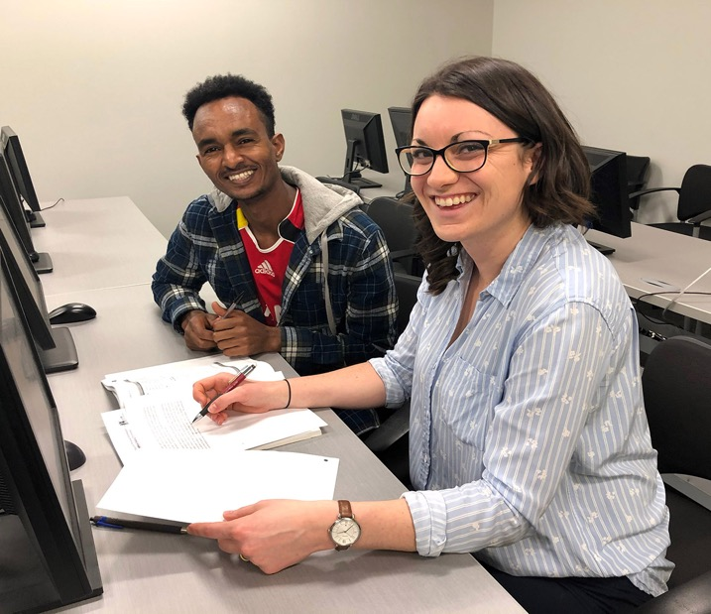
Pre COVID- SWAF
Notes:
In pre-COVID times, services were provided in a centralized location or on site in board rooms or lunch rooms. That’s where the Math, English and Co-op Credits were the focus of the program. It was available for both graduates as well as those who were not yet graduates. Learners who were graduates might be transitioning from workplace level to college level because they had different goals than when they originally graduated.
Credit support was provided by certified teachers. Learners were using correspondence booklets or elearning resources. Co-op credits were earned based on hours worked within the workplace setting. Learners were referred to SWAF either through HR or through job fairs that were held onsite. This is when we were allowed on site. HR managers/staff recommended the program to potential learners and employees. People would see their friends going to the program after work or before shift, and they would recommend this as an option to their friends.

Slide 43
2021-2022 Work and Learn Program
Rebranding of SWAF
Not located in particular places
Instructors work more remotely
Established relationships re-established
Adult Co-op programming
Still referring to upgrading program when they see skills are not where they need to be.
Notes:
In 2020/21, our SWAF instructors were seconded to another location. SWAF had to be shut down. If a learner was working in LBS, they were supported through our programming. As of September 2021, we were rebranded to the Work and Learn Program. We are no longer located in any particular factories. Instructors work remotely as well as in person. They are meeting in coffee shops and in libraries. They are also using our Skills Upgrading locations to meet with learners, so that’s where integration comes in. If the Work and Learn program gets contacted by a learner who is interested in completing their high school, they will do an education plan for them. If they have been out of school for any amount of time and have a history of not great marks or a history of interrupted education, they will be referred to our Skills Upgrading program, and we would build their skills to a point where they are ready to attempt those Junior PLAR if that was needed, or they are ready to attempt credit programs. Credit programs are separate from the Skills Upgrading Program. If we see a learner that is already working, and we see in their education plan or their job has changed and they have the opportunity, we will refer them to the Work and Learn program as a means of having support when they get into the senior secondary credits.

Slide 44
PSW Preparation
Thank you to St. Louis for sharing
Potential candidates into PSW pre screened
Determined to need more work to be able to be successful
Offered PSW Preparation to improve skills
If successful in PSW prep, allowed to enter PSW program
Notes:
For the PSW program – and again, I would like to thank St Louis for sharing their resources with us – our potential candidates are pre-screened. In the screening process, if it is determined that language is an issue or they don’t have the reading comprehension skills needed, they are referred to our LBS program to upgrade their skills. We have more of a defined program for this, where we have to make sure that the learner can handle the information in a tight schedule. We put it down to eight weeks. We assigned work to them. We used Google classrooms to work remotely. If they were able to keep up, we gave them the recommendation to enter the PSW program in the fall.
We have learned from this program that a lot of learners do not have the language skills, particularly if English is a second language, in order to be able to keep up with the pace of the PSW prep program, so now if someone is interested, the pre-screening starts at the very beginning, and we’re going to try and improve those skills as soon as we possibly can and then be able to make a decision closer to the time when the PSW program starts.

Slide 45
Remote Service for SUP
Allows us to have later meeting times with learners who are working
Flexibility for shift workers
Instructors hired specifically for these time periods
No travel time involved
Notes:
So, what has remote service for Skills Upgrading done? It has allowed us to meet with learners in a more flexible timeframe. We have onboarded more instructors who are working evenings and are more comfortable with Google classrooms. We are able to work with the flexibility in workers’ schedules so we can see them at multiple times during their week. It has taken away the travel time. Even though we have lots of remote and satellite locations, there is still travel time. If you are spending an hour of your day travelling to and from school, it cuts down on the amount of time you have for upgrading. Through COVID, we have increased our ability to work remotely with our learners, and we are serving those learners who have goals to obtain high school diplomas in most cases.

Slide 46
skillsupgradingprogram@ugconed.ca
serving learners in:
Guelph, Fergus, Drayton, Mount Forest, Dundalk, Shelburne, Orangeville as well as remotely
Notes:
That is it about our school board program that focuses on high school credits in preparation for school credits does with a workforce!

Slide 47
The must haves...
Webinar evaluation:
https://surveys.oalcf-echannel-repository.ca/s3/Pop-UP-PD-21-22-Web-5-Workplace-Literacy
Register for future webinars at: https://learningnetworks.ca/resources-publications/popuppd/
Webinar resources:
English https://e-channel.ca/practitioners/pop-pd-resources
French https://apprentissageenligne.ca/formateurs/programme-afb-ressources-de-la-communaute-de-pratique-en-ligne
Notes:
Andrea Dickinson: Thank you very much, Kerry. Thank you for an excellent presentation. Thank you to all our panelists this afternoon. Before we get to the question and answer, we would very much appreciate you completing the evaluation. There is also information in chat about registration for future webinars and information about webinar resources.

Slide 48
Thanks so much for joining us today!
Questions/Comments
Notes:
Now we will open up to some question and answer.
Debera Flynn: The panel was very good at responding to questions in chat as we went along so we have covered off the questions we have had, but people can add more questions now if they like. We’re getting a lot of thank you’s coming in. It was an excellent presentation today. All of the presenters did a great job of explaining their programs and the intricacies and detail they had to consider and the benefit of it all.
The recordings will be available as usual on the Contact North website. Sarah Stocker will send out a notice with that information.
Sarah Stocker: There is a question asking how people determine pricing for businesses accessing services.
Chris Prosser: I can share some resources with the group. There isn’t a straight answer, it’s a conversation based on costs per learner and so on. You have to show how it’s going to be a quality piece, but I have some examples that can explain this.
Andrea Dickinson: If people have direct questions, please reach out directly to Chris at The Literacy Group.
Thank you to all of our participants. We appreciate you taking the time out of your day to be part of our session. We hope that you found it helpful, and you will be able to apply it to your programs. We look forward to your feedback.

