Slide 1
Webinar Title
((DATE))

Slide 2
Statement of Land Acknowledgement
I would like to begin by acknowledging the Indigenous Peoples of all the lands that we are on today. While we meet today on a virtual platform, I would like to take a moment to acknowledge the importance of the lands, which we each call home. We do this to reaffirm our commitment and responsibility in improving relationships between nations and to improving our own understanding of local Indigenous peoples and their cultures. From coast to coast to coast, we acknowledge the ancestral and unceded territory of all the Inuit, Métis, and First Nations people that call this land home.

Slide 3
About Pop Up PD for Literacy Educators
free webinar series developed by Ontario’s LBS Regional Networks, Sectors, & the Provincial Support Organizations for Literacy
supports LBS practitioners with presentations on topics important to them
English language webinars presented for LBS practitioners annually since 2015-2016; French language transcriptions are available on COFA’s website!
all webinar presentations, recording links & transcripts here:
https://e-channel.ca/practitioners/pop-pd-resources
webinar topic ideas welcome at: e-channel@contactnorth.ca

Slide 4
Thank you and acknowledgements
Members of the Pop Up PD for LBS Educators committee:
Contact North for providing technical support.
Deaf Literacy Initiative for providing ASL interpretation.
COFA for translating the webinar for the Francophone agencies.
And
Adult Education Association (ABEA), College Sector Committee (CSC), Literacy Link Niagara (LLN), Literacy Link South Central (LLSC), Literacy Northwest (LNW), QUILL Learning Network, Tri-County Literacy Network (TCLN).

Slide 5
Workplace Literacy and Pre-Employment Planning
In today’s webinar you’ll
learn about some workplace literacy programs and activities happening in Ontario
hear about the funding for these programs
find out how to connect with employers to promote and offer workplace literacy programs and activities

Slide 6
Our Panelists
Kim Redford and Barb Duguay, Instructor and Administrator,
Valley Adult Learning Association (VALA)
Chris Prosser, Executive Director,
The Literacy Group of Waterloo Region (TLG)
Kerry Halliday, Manager of the Skills Upgrading Program (SUP),
Upper Grand District School Board

Slide 7
Workplace Vs Workforce
Valley Adult Learning Association
Barb Duguay- Administrator
Kim Redford- Instructor

Slide 8
VALA’s Interpretation Workplace – Employer driven Workforce – Learner driven
Workforce
Workplace
Authentic training driven by the employer
Can be off-site or on-site
Employer determines learning objectives
Employer provides learners
Authentic training driven by the employee
Learner determines the work skills needed to be successful
Learner may be working already or looking for employment
Can be on-site or off-site
*my employee needs to learn
Employer referral
*I need to learn
Self Referral

Slide 9
Workplace Examples
Super 8 Essential Skills Training
OTEC – Customer Service Results (CSR)
Intro to Administration
Specific Employer Requests

Slide 10
Super 8 Essential Skills Training Project
Essential Skills project
Run in conjunction with Super 8 hotel in 2010
To address essential skills needs in the workplace
Super 8 staff required skills upgrading in digital technology in order to transition into new computer management system
17 staff members participated
6 month computer training course (2 days per week to alternate staff)
Staff paid wages by Super 8 during training
“Manager at the Super 8 is pleasantly surprised at the increase in the staff camaraderie and problem solving abilities. Staff were able to complete the training online after completing the computer training”
--Wanda Barker

Slide 11
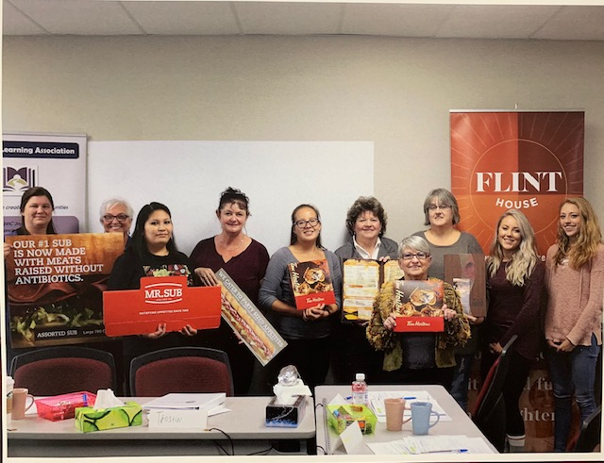
OTEC- Customer Service Results
OTEC (Ontario Tourism Education Corporation) provided curriculum, staff training and facilitator
VALA required to provide 10 Learners at Management level and 10 learners at Line level (front line workers) in hospitality sector
Management CSR training = 2 full days of training, Line Level = 3 full days of training
Lunches provided out of LBS budget and patronized the restaurants which participated- reimbursed by OTEC
Outreach worker established contact with local hospitality employers and marketed program.
Recruitment was intense and took approx. 1 month, 3 days/wk
Monetary incentive paid to participants (reimbursed by OTEC) to cover lost wages during training
“I think the biggest thing that I learned through the course was just how important communication is, whether it is the words you’re speaking or just how you’re presenting yourself”
--Diane Gibson
Manager at Copper River Inn

Slide 12
Intro to Admin
Ontario Works First Nation requested an Administration course for recipients
OW determined the schedule- 4 days per week, 10:00 – 2:00 for 3 weeks. Schedule was created to accommodate daycare, schooling and transportation in from community
OW paid for lunches to be brought in and arranged transportation
Training included digital technology, office technology, Computer training, policies and procedures, Workplace communications, Dress for success, Employer Expectations
Incentives provided by OW and VALA
All participants were on Methadone so training needed to work around medical appointments
Participants set their own policies for the course
Certificate upon completion given in a graduation ceremony

Slide 13
Specific Employer Requests
Sometimes employers will contact us directly to request specific skills training for employees. Examples are:
Power point and presentation training for an employee new to a team leader role requested by the Gold Mine
Excel training for Administrative employees requested by the Town of Fort Frances
Office program training for a secretary who was newly hired requested by UNFC
Onsite computer training for employees using in house templates requested by the Fort Frances Jail
Small business owners requiring computer upgrading to effectively run their business- Wasaw foods

Slide 14
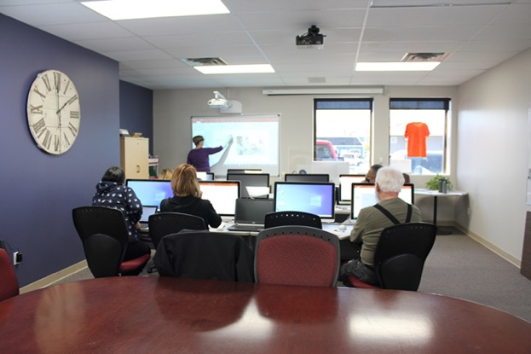
Workforce Examples
Excel and Computer Training
On-site computer support at Fort Frances Jail
Employee support at Safeway and Fort Frances Clinic
Cash register training
Customer service skills training

Slide 15
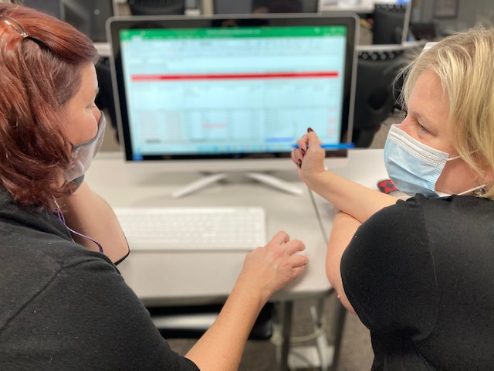
Excel and Computer Training
Learner working at RRDSSAB, moved into a new positon. Requires skills upgrading in Excel
Excel is very popular as workforce training due to its requirement for most office positions Self referrals from many employees/learners for work specific skills training
Referrals in from NCDS for workforce skills training (advantageous for job search)

Slide 16
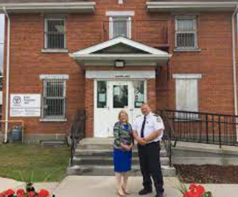
On-Site Computer Support at Fort Frances Jail
Receptionist requested assistance with computer training (self Referral)
Training had to be on-site due to sensitive materials which could not be removed from the office
Training needed for upwards mobility into new position as Rehabilitation Support Officer

Slide 17
Employee Support at Safeway and Fort Frances Clinic
Self Referrals – Not Employer Referrals
Employee at Safeway in Bakery with low literacy skills facing challenges to write on cakes. Literacy upgrading provided at VALA to improve reading and writing in order to remain in that position
Employee at Safeway running labelling machine for bread with low reading skills. Could not read the bread labels in the manual. On-site support provided to teach bread names on the job
After hours cleaner at Fort Frances Clinic with low reading skills could not read instructions left by employer. On site training provided to help her improve job performance

Slide 18
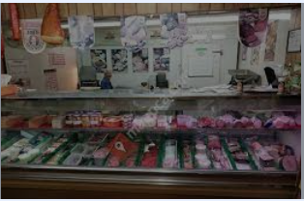
Cash Register Training
Learner was a referral from NCDS for workforce skills upgrading
Learner was on ODSP, had low skills and no work experience. Wanted to work in a retail store but was nervous about using a cash register
Local small grocery mart-Einar’s- worked with VALA to allow learner to upgrade skills by working in an authentic working environment
VALA instructor went on site to Einar’s with the learner to train in cash register, making change, customer service and bagging
Learner was able to obtain confidence, skills and employment at Safeway

Slide 19
Customer Service Skills Training
Self Referrals – VALA advertised the course and employees called in to register
VALA offered a Customer Service Training Course
Employees from Pharmasave attended.
During the course, VALA approached Pharmasave to enquire about valued customer service skills in the business
VALA incorporated that feedback into the training
VALA was able to monitor learners in workplace after training completion in partnership with Pharmasave

Slide 20
VALA’s Interpretation Workplace – Employer driven Workforce – Learner driven
Workplace
Workforce
Authentic training driven by the employer
Can be off-site or on-site
Employer determines learning objectives
Employer provides learners
Authentic training driven by the employee
Learner determines the work skills needed to be successful
Learner may be working already or looking for employment
Can be on-site or off-site
*my employee needs to learn
Employer referral
*I need to learn
Self Referral

Slide 21
To contact us
Valley Adult Learning Association
www.vala.ca
kim@vala.ca
barb@vala.ca

Slide 22
Literacy in the Workplace
Barriers to delivering programs on site
TLG
The Literacy Group
Workplace Wise
Literacy Solutions for Business Results

Slide 23
10 Year Journey
2010 – On site programs in partnership with volunteers who ran for-profit businesses
2015 – On site programs through networking with for-profit partnerships
2019 – Programs ran with community partners and for-profit organizations through grant programs
2021 – Social enterprise or set model of delivery created

Slide 24
Creating Workplace Wise
Social Enterprise Funding supported by Investment Readiness Program, through Kitchener Waterloo Community Foundation.
Gain training from a specialized consultant
Analyze the market and create a business plan
Test product through consortium support

Slide 25
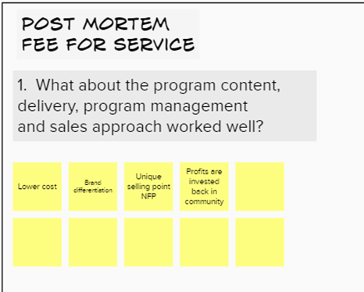
Creating a Strategy
Fire bullets before cannon balls
1. Complete a post mortem and SWAT analysis of completed programs.
2. Understanding what a win looks like in clear messaging.
3. Get an early idea of how to win and what will be our Brand Differentiation and Unique Selling Point
4. Prepare to make decisions and keep to them, other than the more flexible Non-for-Profit style.

Slide 26
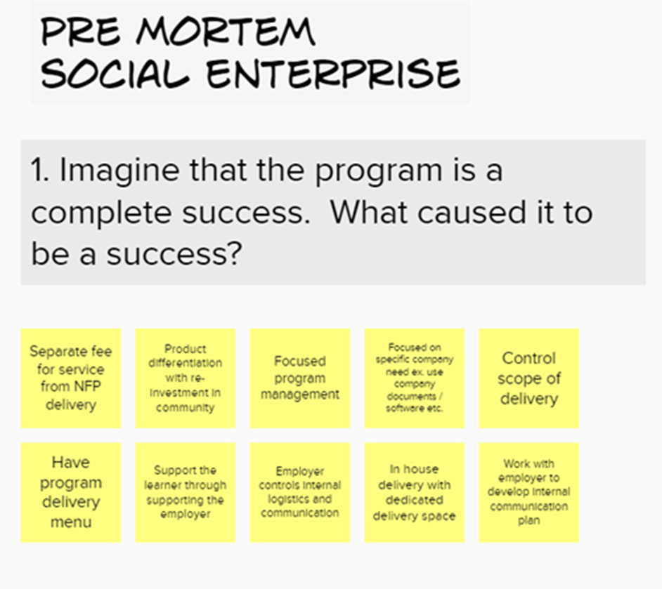

Slide 27
Understanding the Corporate Playing Field
Switching from Nonprofit to Profit mindset.
Selling and running a product/service vs. Running a community program.
Finding a largely common corporate need.
Translate LBS language in our delivery to that of the corporate world.
Develop an impact statement.
Start to form a delivery model to present how to make change happen.

Slide 28
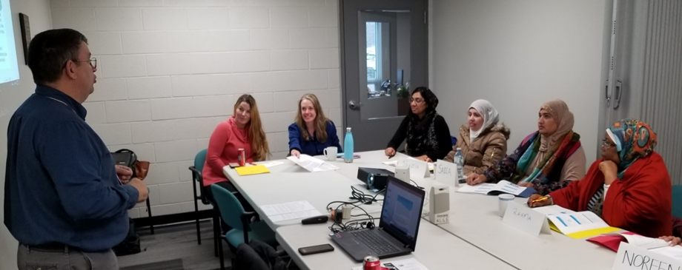
Communicating to Corporate World
Whole corporate training Individualized learning
Very little attention to basic skills Basic skills assessment – CAMERA
Very little attention to soft skills Soft skills assessment and inclusive training
Very little barrier recognition Early signal assessment and referrals
Delivery of corporate designed materials Specifically designed curriculum from adult literacy resources

Slide 29
Finding the Common Need
More engagement
Reduction in turnover
Employee Retention
Developing front line employees
Support employees to become contributing team members
Help employees apply thinking
Support employers discover and grow their next middle management
Empower employees with the skills needed to become stable and independent
Reduce risk and costly errors

Slide 30
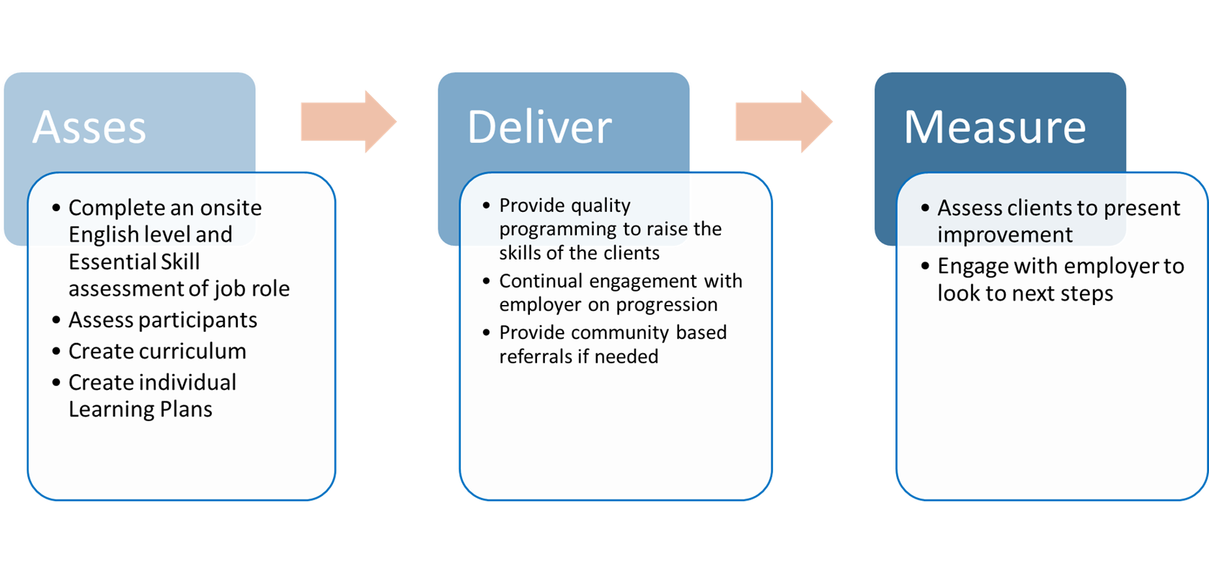

Slide 31
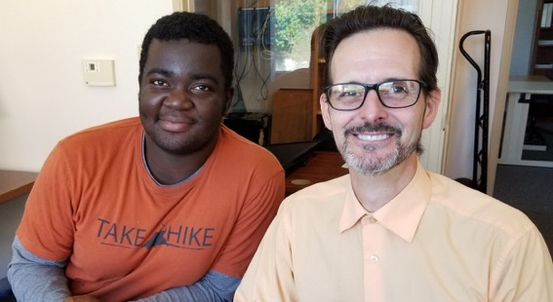
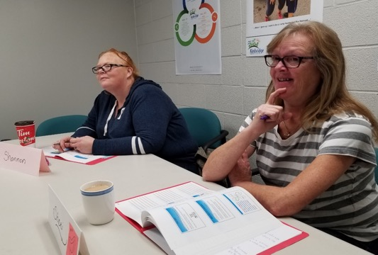
The Literacy Group has served Waterloo Region for over 20 years, specializing in the individual assessment and skills upgrading of adults with a goal to improve their workplace skills.
Discovering a need and suppling the creative programming
Communicating within a network towards a common goal
Providing wrap around individualized service
Assessing and evaluating skills

Slide 32
Successful Partners
“The Literacy Group provided English Language instruction to our new, low-level English employees, incorporating our workplace terminology into their curriculum, helping these employees better navigate their new employment more effectively than could otherwise have been achieved.”
J. Sanders. Tigercat Industries Inc.

Slide 33
Forming Relationships with Corporate Partners
Not a sell – it’s about conversations! - Socratic method
Ask key questions
Listen and understand and target needs
Use their own key phrases
Use we and combining statements, “we can partner here” and “TLG can support you with that”
Not a transaction business, it is relationship. This is a service, not a product.
The nature of training is developing a service, not a one size fits all product.

Slide 34
Questions To Ask
What conditions does TLG insist on for a good partnership?
Can they provide paid or rewarded training time?
Is the training location secure, accessible and not prone to being double booked?
Is there a clear communication process with employer to trainer?
Are the expectations of the learners managed by employer or trainer?
Is there a clear process to deal with absences and behavioral issues?
Is training treated like the workplace?
Would we be a good fit?
What is the company’s mission statement?
How does the company treat their staff and do they have other employee programs?
Why do they see the benefit of the training?

Slide 35
What We Need
Impact Statement
Developing front line employees with the essential skills needed to become stable and contributing employees.
Where to play
Who is the customer?
Size of business
Type of business
The geographic zone
Metaphor or Analogy
Shares messaging and communication without using terms possibly not known by others
Delivery Process
Visual logic model style
Impact of turnover
Cost of turnover and error caused by lack of skill vs. cost of training
Marketing
Success stories, pictures and quotes

Slide 36
Investing in Your Community
This program runs as a Social Enterprise format.
Funds raised with this program will directly support the FREE services that TLG runs in the community.
Partnering with us will make you a supporter of:
Keeping our free services open to the community
Increasing adult skill levels in the region
Decreasing poverty levels
Supporting the real barriers we see on our doorsteps
Increasing the amount of skilled labour in the hiring pool in Waterloo region.

Slide 37
skillsupgradingprogram@ugconed.ca
serving learners in:
Guelph, Fergus, Drayton, Mount Forest, Dundalk, Shelburne, Orangeville as well as remotely

Slide 38
St. George’s Centre for English as a Second Language
Adult Day Credit Programming
Night School
MEI- Educational Travel Program
Summer School
General Interest - Fee for Service Programming
Skills Upgrading Program
School within a Factory/ Work and Learn Program-Adult Co-op
PSW Certificate Course
Serving Wellington and Dufferin Counties

Slide 39
Skills Upgrading Learner Profile
Pre Credit preparation
95% of learners working towards goals related to Secondary School Credit
Focus preparation for Junior PLAR assessments and senior secondary credit towards obtaining OSSD
Pre PSW preparation
Notes:
These stats are reflective of being a school board program, but are also reflective of the current COVID situation and uncertainty of GED writing dates
September to June program with workshops or bootcamps to prepare over the summer for fall credit programming
in the past 3 week math boot camps
have run limited remote programming over the past two summers with varying degrees of success
St. Louis- Karen Morgan Boyer shared their PSW program with us to help us

Slide 40
Integration of Programming
Learners transitioning from one program to another within Continuing Education regularly
ESL into SUP into Credit
Credits can be delivered multiple ways, day credit, correspondence, elearning, night school,summer school, adult co-op through the Work and Learn Program
Notes:
How does this play in to workforce literacy?
Currently the majority of our learners are employed
Our area is a second or third landing site for new immigrants- Eritrean immigrant population is very large
Guelph has an incredibly healthy manufacturing focus- manufacturers want to keep their employees

Slide 41
SWAF
School Within a Factory started in 2015 with a partnership with Linamar Corporation
Over 300 learners served through SWAF
Employer Partners at year 5:
In Guelph, SWAF partnered with Linamar Corporation, DENSO Manufacturing, Poly-Nova Technologies, Cascades Containerboard Packaging-Bird and Lovett Signs, as well as other smaller employers working in neighbouring facilities. In North Wellington (Arthur, Mount Forest, Palmerston), SWAF partnered with Musashi Auto Parts Inc., Dana Incorporated, TG Minto Corporation, Viking Cives and Golden Valley Farms Inc. In Dufferin, SWAF partnered with KTH Shelburne Manufacturing Inc.
Notes:
The SWAF staff assessed the learners, created education plans when learners did not meet the necessary requirements for their required or requested credits, SUP recommended to get them up to speed. In some cases they came to SUP locations in others we went into the factories to help build the pre credit skills.

Slide 42
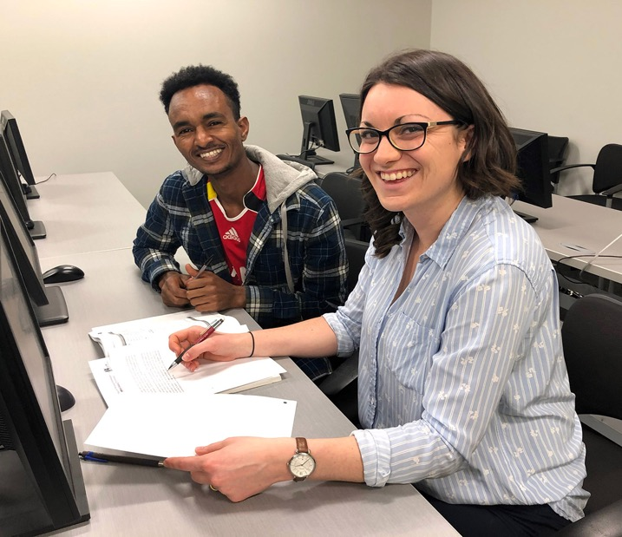
Pre COVID- SWAF
Notes:
Services were provided in a centralized location or on site in board rooms or lunch rooms
Math, English and Co-op Credits were the focus of the program
Available for both graduates as well as those who were not yet graduates.
Credit Support: Learners were using correspondence booklets or elearning resources to work on the course work
Co-op credits were earned based on hours worked within the workplace setting
HR managers/staff recommended the program to potential learners and employees. They saw this as an opportunity to grow their skilled workforce
Those seeking apprenticeships with current employers were directed to SWAF
2020-2021 instructors succonded to remote school- manufacturers closed their doors to outsiders
SWAF basically closed or at least the one on one support that learners were receiving in their credits ended

Slide 43
2021-2022 Work and Learn Program
Rebranding of SWAF
Not located in particular places
Instructors work more remotely
Established relationships re-established
Adult Co-op programming
Still referring to upgrading program when they see skills are not where they need to be.
Notes:
Referrals go both ways as we see learners fine tune their next steps in SUP
If working can get Co-op credits as well as receive credit support on their graduating credits if connected to WLP

Slide 44
PSW Preparation
Thank you to St. Louis for sharing
Potential candidates into PSW pre screened
Determined to need more work to be able to be successful
Offered PSW Preparation to improve skills
If successful in PSW prep, allowed to enter PSW program
Notes:
Lessons learned
some learners could not handle the speed of the preparation program, so would not be good candidates for the PSW program
we would start earlier- if people are interested in our PSW program- this would be expected of everyone to help with overall completion of the PSW program
higher ESL levels needed overall for success in the PSW program

Slide 45
Remote Service for SUP
Allows us to have later meeting times with learners who are working
Flexibility for shift workers
Instructors hired specifically for these time periods
No travel time involved
Notes:
Increasing number of employed learners
remote allows us to serve more learners who are working

Slide 46
skillsupgradingprogram@ugconed.ca
serving learners in:
Guelph, Fergus, Drayton, Mount Forest, Dundalk, Shelburne, Orangeville as well as remotely

Slide 47
The must haves...
Webinar evaluation:
https://surveys.oalcf-echannel-repository.ca/s3/Pop-UP-PD-21-22-Web-5-Workplace-Literacy
Register for future webinars at: https://learningnetworks.ca/resources-publications/popuppd/
Webinar resources:
English https://e-channel.ca/practitioners/pop-pd-resources
French https://apprentissageenligne.ca/formateurs/programme-afb-ressources-de-la-communaute-de-pratique-en-ligne

Slide 48
Thanks so much for joining us today!
Questions/Comments

