Slide 1
Demystifying Apprenticeship
December 12, 2019

Slide 2
About Pop Up PD for Literacy Educators
free webinar series developed by Ontario’s LBS Regional Networks, Sectors, & the Provincial Support Organizations for Literacy
supports LBS practitioners with presentations on topics important to them
webinars presented for LBS practitioners annually since 2015-2016; French language transcriptions coming soon!
all webinar presentations, recording links & transcripts here:
https://e-channel.ca/practitioners/pop-pd-resources
webinar topic ideas welcome at: e-channel@contactnorth.ca

Slide 3
Important Meaningful Work the World Can See

Slide 4
A Few Words About Today Session…
Since late 2018, the Ontario government has been committed to modernizing and reforming apprenticeship training in Ontario.
This webinar focuses on general information about apprenticeship that is of interest to adult learners and educators.
At the time of this webinar, apprenticeship reform in Ontario is ongoing, so it will be important to watch for updates or changes in the near future.

Slide 5
Some Topics to Demystify and Questions to Answer
What is apprenticeship training
…and what is it not?
What occupations offer apprenticeship training?
What are the academic requirements to apply for an apprenticeship?
What financial help is available to apprentices?
What are the steps to follow to obtain an apprenticeship?
What’s involved in the
in-school training component?
What are some important terms to be familiar with?
Is there any help available to find an employer/sponsor?

Slide 6
Some terms to clarify…
Apprentice –
An individual who is learning a trade and has a formal training contract with a sponsor (employer)
Employer/Sponsor –
The employer hires (sponsors) the apprentice and signs a Registered Training Agreement with the Ministry of Labour, Training, and Skills Development and the apprentice
Journeyperson –
An individual who is fully certified in the trade, can perform work without supervision, and can train apprentices
Training Delivery Agent (TDA) –
An approved deliverer of in-school apprenticeship training
Ontario College of Trades (OCoT) –
The [former] regulatory body for skilled trades and apprenticeship in Ontario; wind-down in progress

Slide 7
Apprenticeship training is…
A work-based training program that provides access to well-paying jobs that require a high level of skill, judgement and creativity
A postsecondary education pathway leading to many high-demand occupations
A combination of on-the-job training (about 90% ) and classroom training (about 10% )
A salary-paying job while you are learning, where wages increase with skill level:
‘earn while you learn’

Slide 8
Apprenticeship training is NOT…
A short cut to getting an education and a career
Just for people interested in traditional skilled trades
Only for people of a certain age or gender

Slide 9
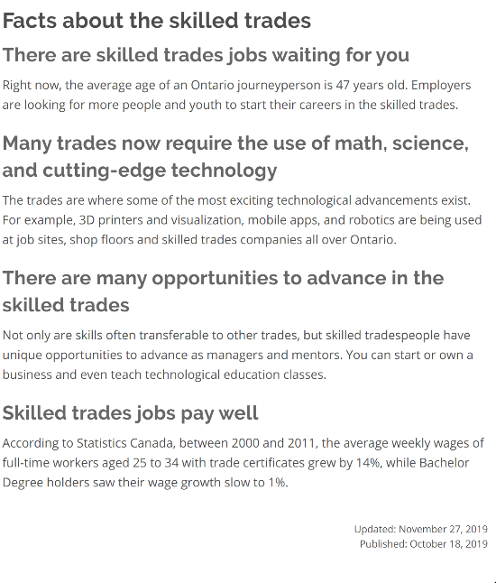
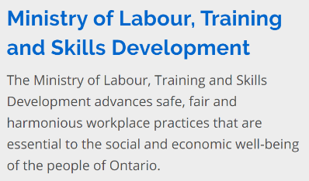
Source: https://www.ontario.ca/page/list-skilled-trades-ontario

Slide 10
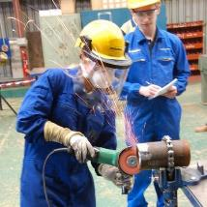
Which occupations/trades offer apprenticeship training?
In Ontario, there are over 140 occupations for which you can train as an apprentice.
Those occupations are organized into four categories called ‘sectors’.
Construction
Industrial
Motive Power
Service

Slide 11
A few occupations within each sector
Construction (over 40 occupations) Floor Covering Installer Hazardous Materials Worker Construction Millwright General Carpenter Powerline Technician Electrician – Construction and Maintenance | Industrial (over 50 occupations) Entertainment Industry Power Technician Ski Lift Mechanic Locksmith Welder General Machinist Industrial Electrician

Slide 12
A few occupations within each sector
Service (almost 40 occupations) Chef Child and Youth Worker Hairstylist Information Technology – Hardware Technician Pool, Hot Tub, and Spa Installer Educational Assistant | Motive Power (almost 20 occupations) Turf Equipment Technician Autobody Repairer Tire, Wheel, and Rim Mechanic Marine Engine Technician Automotive Service Technician Truck and Coach Technician

Slide 13
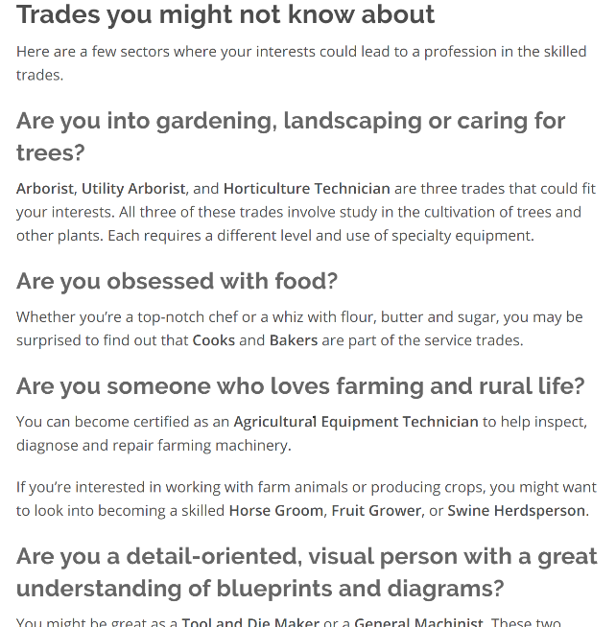
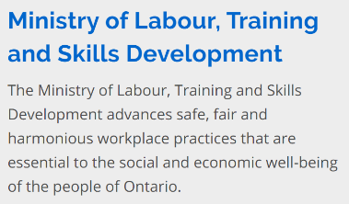
Source: https://www.ontario.ca/page/list-skilled-trades-ontario

Slide 14
More Terms! Compulsory, restricted, and voluntary trades
Compulsory (or restricted) trades –
require a registered apprentice or licensed journeyperson to perform the work and practice in the trade
Voluntary trades –
do not require an apprenticeship or licensed journeyperson to perform the work
Examples of compulsory/restricted trades:
□ construction maintenance electrician □ automotive service technician
□ auto body repairer □ plumber
□ hairstylist □ truck and coach technician

Slide 15
…And Red Seal Trades
Some trades also offer a “Red Seal” certification.
This is an inter-provincial designation enabling journeypersons to be “licensed” across Canada.
Approximately 55 trades are recognized nationally as Red Seal Trades.
Red Seal certification allows a journeyperson to work anywhere in Canada.

Slide 16
Apprenticeship and the Concert Industry
Yes, we’re talking about music!
Trades at Concert Venues – Video
http://www.earnwhileyoulearn.ca/tunein

Slide 17
Who can become an apprentice?
To qualify for an apprenticeship in Ontario you must:
be at least 16 years of age
have legal permission to work in Canada (for example, have a valid social insurance number)
meet the educational requirements for your chosen trade
have a sponsor (employer) in Ontario

Slide 18
ALERT! An important clarification
To start an apprenticeship:
You DO NOT apply to a college or other training provider.
You DO apply to an employer for a position as an apprentice.
Applying for an apprenticeship is the same as any
other job search.

Slide 19
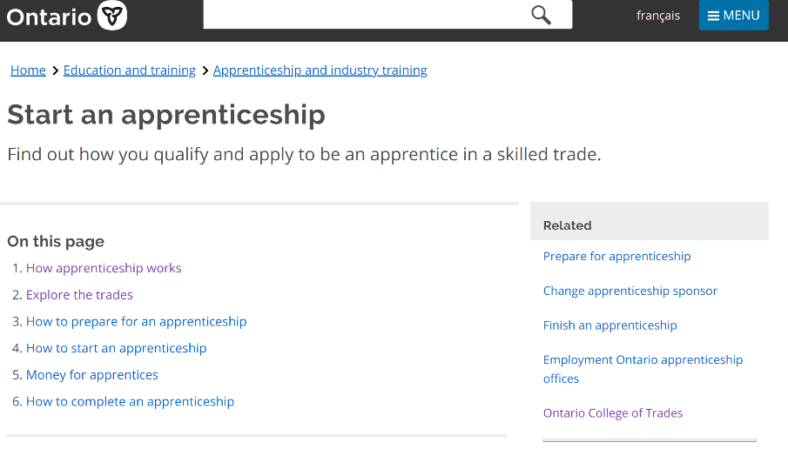
Source: https://www.ontario.ca/page/start-apprenticeship#section-1

Slide 20
How long does it take to complete an apprenticeship?
Apprenticeship programs can range in length from about two to five years.
They generally require three levels of in-school training:
Level 1 (Basic)
Level 2 (Intermediate)
Level 3 (Advanced)
Apprentices alternate their time between working/learning on the job (90%) and going to in-school training (10%).

Slide 21
What education do I need to become an apprentice?
An Ontario Grade 12 diploma or equivalent is required for most trades in the industrial, service and motive power sectors.
For entry into most construction sector trades, completion of grade 10 is the minimum requirement BUT..
Most employers are looking for apprentices with grade 12 or equivalent.
Employers are permitted to ask for academic qualifications that are beyond the minimum when they are hiring apprentices.
A strong foundation in math, sciences, and communications is usually important along with problem-solving, critical thinking, communication, teamwork and digital skills.

Slide 22
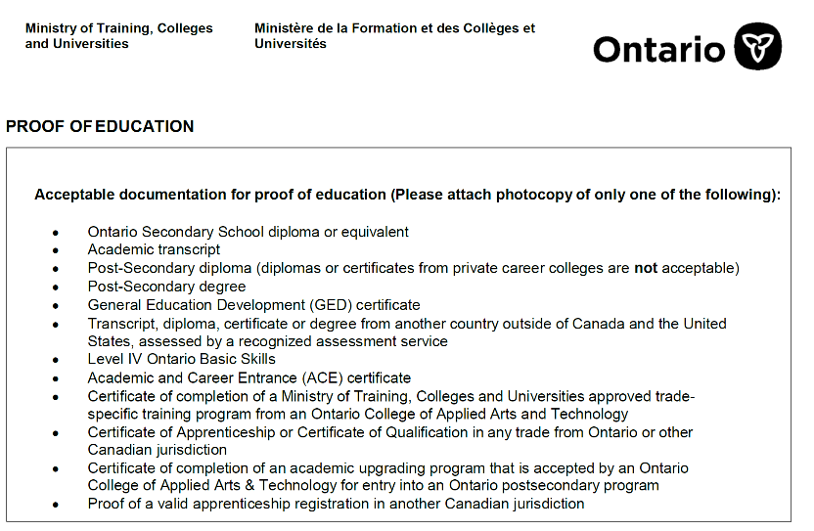
What are acceptable grade 12 equivalent credentials?

Slide 23
What are the steps to becoming an apprentice?
Step 1:
Research the trades/occupations you’re interested in to learn more about the
types of work and working conditions
job opportunities available in your area
demand for that trade/occupation
education is required
wages
Talking to someone who works in the occupation(s) you’re interested in is a great source of first-hand information!
This Photo by Unknown Author is licensed under CC BY-NC-ND

Slide 24
What are the steps to becoming an apprentice?
Step 2:
Upgrade your skills/education if necessary, to meet the academic requirements.
Step 3:
Search for an employer who will hire you as your ‘sponsor’.
Finding a position as an apprentice is just like any other job search.
Visit your local Employment Services provider to help you find an employer!
This Photo by Unknown Author is licensed under CC BY-SA
This Photo by Unknown Author is licensed under CC BY-SA-NC

Slide 25
What are the steps to becoming an apprentice?
Step 4:
Apply online on the ministry’s “Start an Apprenticeship” website once you have found an employer that has agreed to hire you.
Step 5:
Sign the legal training agreement with your employer and the ministry.
Step 6:
Start working as an apprentice!

Slide 26
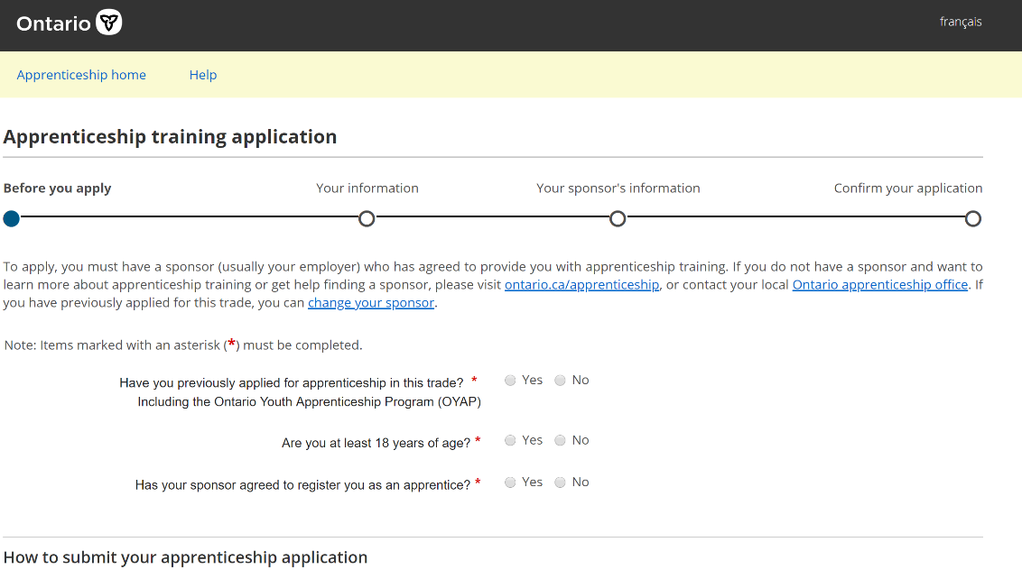

Slide 27
What credentials does apprenticeship provide?
– Certificate of Apprenticeship –
issued to an apprentice by the Ontario government for successful completion of all requirements of their training program
– Certificate of Qualification –
issued by the Ontario College of Trades* for successful completion of all apprenticeship training and the trade-specific qualification exam
*subject to change

Slide 28
Is there any financial help available for apprentices?
Apprenticeship Incentive Grant | Apprenticeship Completion Grant | Apprenticeship Incentive Grant for Women | Canada Apprentice Loan
a taxable cash grant of $1,000 per year or level, for a lifetime maximum amount of $2,000 per person. | a one-time taxable cash grant lifetime amount of $2,000 per person for registered apprentices who complete their apprenticeship training and obtain their journeyperson certification. | a taxable cash grant of $3,000 per year/level up to a maximum amount of $6,000 per person. | a government loan that can help apprentices get the money they need to achieve their goals.

Slide 29
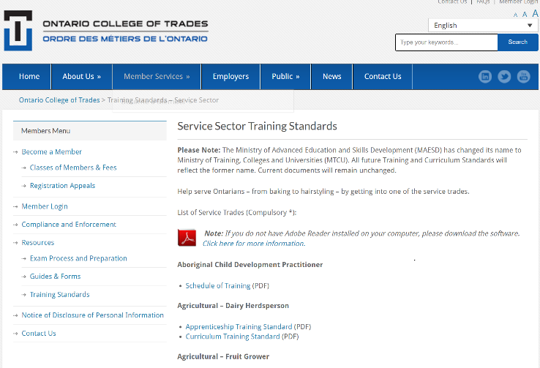
How do I know what I will learn and study?
The Apprenticeship Training Standards, including curriculum/courses, can currently be found on the OCoT website.
On the next slide is the table of contents for the “Baker and Patissier” apprenticeship in-school curriculum.

Slide 30
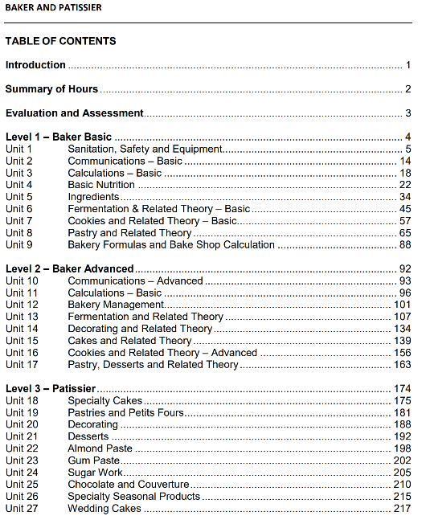

Slide 31
How does the “in-school” training component work?
The ministry is responsible for
keeping records of apprentices and their training levels completed
purchasing in-school training seats from approved TDA’s
working with the TDA’s across the province to schedule the different levels of training across all the trades/occupations

Slide 32
How does the “in-school” training component work?
In most apprenticeships, each level of in-school is 240 hrs; some are 360 hrs.
The apprentice pays a classroom fee of about $400 per level.
There are different ways that the in-school training may be scheduled:
block release (you attend full-time, for a set number of weeks, usually 8)
day release (you attend one day per week)
part-time (you attend a night-school program)
alternative delivery (you do online training)
You can normally get Employment Insurance benefits when you are in a ‘block release’ in-school training program.

Slide 33
Routes to Apprenticeship: What are they?
What | How | When
Traditional or Direct Route | Find an employer who will hire and sponsor you Sign a Contract of Apprenticeship and receive a Training Standards book Pay a classroom fee (approx. $400) fee and the apprenticeship training period officially begins | Available year-round, whenever an employer and a candidate agree to sign an apprenticeship contract In-school training subsequently scheduled
Pre-apprenticeship programs provide training to prepare for an apprenticeship | Upgrade your academic skills if you do not have the academic requirement (grade level) Complete your Level 1 in-school training and a work placement | May start at any point during the year, pending funding approvals

Slide 34
Routes to Apprenticeship: What are they?
What | How | When
College Full Time or Part Time Programs provide theoretical and hands-on training in the skilled trades | After graduation, market yourself to employers willing to hire you as an apprentice Apply to the college program via OCAS | Generally start in September, January or May
Co-op Diploma Apprenticeship Program (CODA) combines a college diploma program and apprenticeship training | Complete both diploma courses and apprenticeship in-school training in a related occupation Must meet all eligibility criteria for both the college diploma program and the apprenticeship training Apply to the program via OCAS Complete remaining on-the-job training upon graduation in order to qualify for journeyperson status | Generally start in September, January or May

Slide 35
Routes to Apprenticeship: What are they?
What | How | When
Union or Industry Approved Training is available through some unions and trade associations | Must be sponsored (hired) by a union and sign the Contract of Apprenticeship with a Local Apprenticeship Committee (LAC) | May take place at various times of the year
Ontario Youth Apprenticeship Program (OYAP) | Be a full-time high school student entering Grade 11 and at least 16 yrs Work towards a career in the while completing high school diploma and receiving credit for skills gained with an employer | During the high school academic year

Slide 36
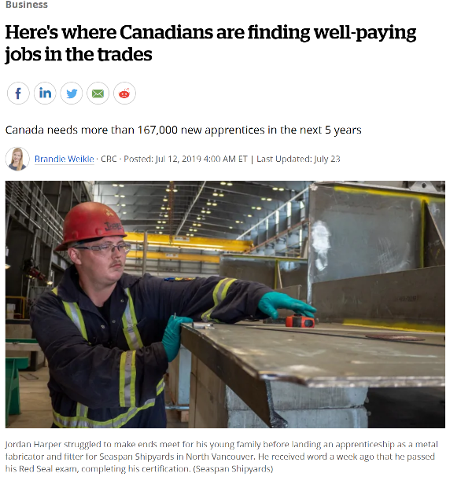
“According to a recent report put together by Statistics Canada and the Canadian Apprenticeship Forum, Canada needs to attract 167,739 new apprentices over the next five years just to keep pace with current demand.”
“In the first quarter for 2019, there were 60,170 job vacancies in Red Seal trades, an increase of 14 per cent from a year earlier, according to Statistics Canada's job vacancy and wage survey. ”
“Looking at hourly earnings in 2018 among certified tradespeople and apprentices still working on their certifications, rig technicians averaged $38.90, boilermakers $38, steamfitters/pipefitters $35.10, ironworkers $33.50 and agricultural equipment technicians $33, according to LMIC calculations based on data from Statistics Canada's labour force survey. ”
Source: https://www.cbc.ca/news/business/canadian-tradespeople-1.5198394

Slide 37
Resources
Apprenticeship Training Standards (currently hosted by Ontario College of Trades)
http://www.collegeoftrades.ca/training-standards
Canadian Apprenticeship Forum
http://caf-fca.org/
Earn While You Learn (currently hosted by Ontario College of Trades)
http://www.earnwhileyoulearn.ca/
Financial Assistance for Apprentices (Government of Canada)
https://www.canada.ca/en/employment-socialdevelopment/services/apprentices/grants.html
Here’s Where Canadians are Finding Well-Paying Jobs in the Trades (CBC Business News)
https://www.cbc.ca/news/business/canadian-tradespeople-1.5198394
Knowledge of and Interest in Apprenticeships Among Hamilton’s Literacy and Basic Skills Learners (McMaster University and Adult Basic Education Association)
https://macsphere.mcmaster.ca/bitstream/11375/24561/3/McMaster%20Research%20Shop%20Report%20-%20Adult%20Basic%20Education%20Association%20Hamilton.pdf
Red Seal Trades (Canadian Council of Directors of Apprenticeship)
http://www.red-seal.ca/
Skilled Trades in Ontario (Ministry of Labour, Training and Skills Development)
https://www.ontario.ca/page/list-skilled-trades-ontario
Starting an Apprenticeship (Ministry of Labour, Training and Skills Development)
https://www.ontario.ca/page/start-apprenticeship
Trades at Concert Venues – Video (currently hosted by Ontario College of Trades)
http://www.earnwhileyoulearn.ca/tunein

Slide 38
Important Meaningful Work the World Can See

Slide 39
Thank you!
Coming soon:
webinar resources: https://e-channel.ca/practitioners/pop-pd-resources
webinar evaluation:
https://surveys.oalcf-echannel-repository.ca/s3/Pop-UP-PD-Web-4-19-20
registration link for our next webinar:
https://connect.contactnorth.ca/pop_up_5/event/registration.html

