Slide 1
Literacy and Essential Skills as a Poverty Reduction Strategy
September 26, 2019
Notes:
Sarah Stocker: I’d like to welcome our webinar moderator, Annemarie Wesolowski, Executive Director of Literacy Northwest. Annemarie, welcome, and I’ll turn it over to you.
Annemarie Wesolowski: Thank you Sarah. Good afternoon everyone and welcome to the first webinar in our pop-up PD series. We’re very excited to be providing you with the slate of webinars for this year’s series. The first webinar, as the title on the screen indicates, is Literacy and Essential Skills as a Poverty Reduction Strategy.
It’s my pleasure today to introduce you to Angela Briscoe. Angela is the Director of Program Development at Frontier College, Canada’s original literacy organization. It has quite a long history! Frontier College recruits, trains and supports thousands of volunteers to deliver literacy programs. They help children, youth and adults reach their full potential.
Together with her team, Angela leads program and revenue development with government, corporations and other foundations in Canada. She holds degrees from Trent University and from Concordia University.
Before Angela begins her presentation, I would like to point out that myself, as well as Barb and Sarah, are monitoring the text chat area and keeping track of the comments and questions that you may have. Depending on where Angela is in her presentation, if we feel that it’s appropriate we may interrupt and provide her with some of those comments and questions. However, some of them may be left until the end of the webinar. We do want to make sure that we cover the entire webinar.
So again, welcome everyone and welcome Angela!
Angela Briscoe: Hi everyone. Thank you so much for the introduction and for the invitation to join your group today.

Slide 2
About Pop Up PD for Literacy Educators
free webinar series developed by Ontario’s LBS Regional Networks, Sectors, & the Provincial Support Organizations for Literacy
supports LBS practitioners with presentations on topics important to them
English language webinars presented for LBS practitioners annually since 2015-2016; French language transcriptions posted for 2018-19
all webinar presentations, recording links & transcripts here:
https://e-channel.ca/practitioners/pop-pd-resources
webinar topic ideas welcome at: e-channel@contactnorth.ca (or address of your choice)

Slide 3
Today’s Webinar…
Literacy and Essential Skills as a Poverty Reduction Strategy
Notes:
I am very pleased to be here to share the results of some research that we have been able to develop with the Social Research and Demonstration Corporation (SRDC) with funding from the federal government’s Office of Literacy and Essential Skills.

Slide 4
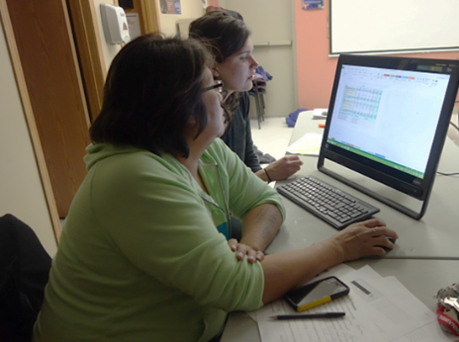
Objectives
Background and context
Research highlights
Key recommendations
Discussion – Q & A
Notes:
The goals of our talk today are to share the background and context for the research, to share some of what came out in the findings, and the key recommendations, and to hopefully have a bit of a discussion or at least a chance to get feedback from the field about what’s resonating, what’s missing, and how does this really relate to your work and your practice in the field.
I’ve added some links in the chat box to the research that I’ll be referencing today, and I wanted to invite you if you haven’t already looked at the research that we’ll be going over, there’s a summary report available which you’ll see is the second link in the chatbox, and that gives you a roll-up of the findings and the recommendations. At the end of the presentation, my plan is to share with you the key recommendations for discussion, but I also want to keep it very closely related to practice in the field and getting input about your experience and how you can use the research. I would invite you to have those findings handy for reference as we move through the material.
I will be going through the high level results as we move through the slides, and they will be shared afterwards.

Slide 5
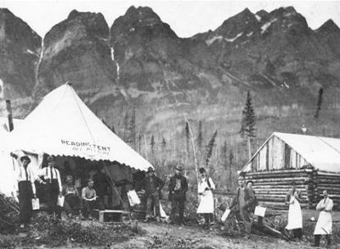
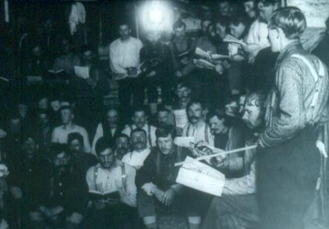
Frontier College: Over a century of service in literacy
In the beginning: railway and lumber gangs, mining camps, homesteads
Notes:
I’ll just start with a very brief overview. I’ll keep it as brief as possible. Frontier College is a very old organization, established in 1899. We are currently active in nine provinces and three territories, so almost coast to coast to coast. As mentioned, we work with volunteers, and we serve children, youth and adults. Today, we’re focusing on the adult learners that we work with across the country and that our field works with here in Ontario.

Slide 6
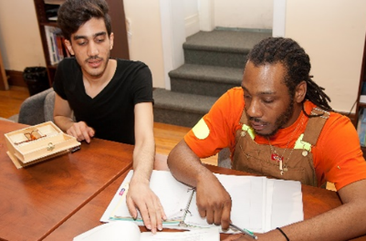
Frontier College: Over a century of service in literacy
Today : Inner city neighbourhoods, northern and Indigenous communities, prisons, workplaces, schools, community centres, shelters, and online
Notes:
We’re in 167 communities this year. Many of you will know that we deliver Indigenous summer literacy camps in Northern Ontario. As part of that program nationally, we work in many First Nations and Inuit communities. We are in about 30 urban and rural centres as well. We work in lower income and marginalized remote communities where access to programming is limited. We’re focused on workforce development, employability, but always at the core working with those at the lowest skill levels who are working on basic skills.

Slide 7
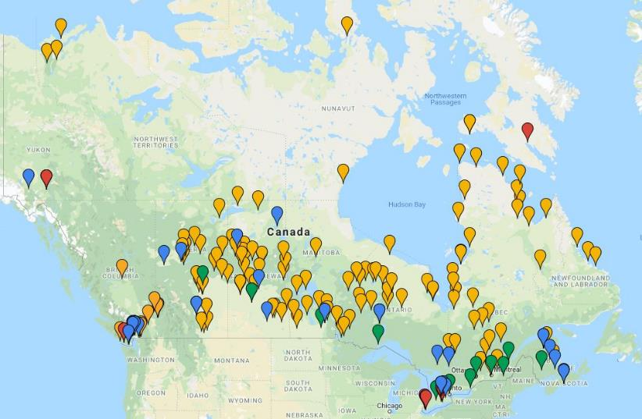
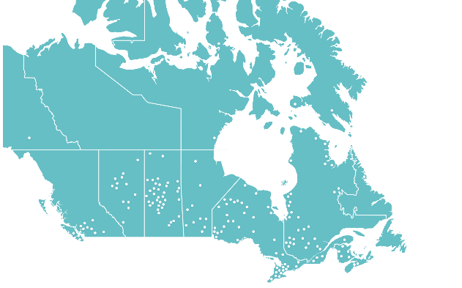
Literacy in Canada
About half of working-aged Canadians (49%) struggle with long or complex text.
Almost one in five (17%) have extremely low literacy.
Scope of literacy issue not well understood.
Growing demand for services and support.
Frontier College is currently active in 167 communities from coast to coast to coast. Last year, we reached over 40,000 children, youth and adults.
7
Notes:
I’ll just show you a map. This is Frontier College programs across Canada. It gives a picture of the spread of programming available through one organization, but we know if we were to fill in all of the country’s work, there would be many more dots, and particularly in Northern Ontario. Ultimately, I want this presentation to support those who are joining by providing research, by providing some support for your case in developing funding requests, in developing partnerships, delivery improvements … however this can support your work that’s really the goal. Some of this will be known to you, and many of the findings of the research will be familiar because the participants were really those content experts from the field: the practitioners and leaders of literacy and poverty reduction organizations that were sharing with us their expertise on the state of the field and their needs. These slides can support that kind of advocacy work, program development and partnerships.

Slide 8
Adult Literacy Partners in Ontario
LBS & Pre-GED
Eva’s Phoenix, Youth Opportunities Unlimited, Thunder Bay Indian Friendship Centre, Ottawa Public Library
Academic upgrading for trades
Central Ontario Building Trades, Ontario Masonry Training Centre
Workplace literacy and essential skills
Leamington/Kingsville/Essex area farms, DeBeers Victor Diamond Mine (completed)
Prison literacy
Bath Institution, Collin's Bay Institution-Medium Unit, John Howard Society (Restart)
8
Notes:
In terms of our Frontier College programs in Ontario, just to give you an idea of some of the different models and organizations that we work with. The purpose is to orient participants to what we do, but the presentation is not about Frontier College!

Slide 9
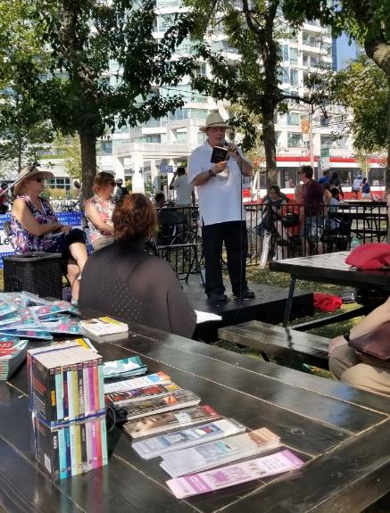
What do Canadians think?
90% agree that strong literacy skills are essential
to attaining a high quality of life.
86% believe poor literacy skills negatively impact
employment prospects.
87% believe that more should be done to
improve literacy rates in Canada.
Yet only 76% believe that poor literacy skills
increase the likelihood of poverty.
Environics Research (2017)
9
Notes:
This is the first of our slides that starts to get into the new research we have been able to develop over the last two years about the state of literacy, and particularly adult literacy, in Canada. In 2017, we did a research survey with Environics. We commissioned a study, and everyone should feel free to access the page and reference this. Clearly, Canadians have an appreciation that weak literacy skills can limit our quality of life and our employment prospects, but it was really interesting to see that 87% believe that more should be done to improve literacy levels, and of course we agree. But what’s curious is that we know there is a huge amount of work to be done around raising awareness of the literacy issue among Canadians. So that’s an interesting piece for us to consider and to continue to build our understanding of that dichotomy. We know that Canadians support the work that we do, but we also know that they don’t fully appreciate the full extent of the need for it.
One of the things that I wanted to refer you to in the chatbox is the very newly published piece called “Busted: 11 Enduring Literacy Myths” which has a lot to do with the public opinion results that we are seeing here. I invite you all to take a look.
We’ll see in the coming slides that raising awareness of the issue is also really important for the learners that we serve. That has come out as one of the biggest priorities, and perhaps that will be an area that we want to discuss more in the Q&A period. The main point to take away from this slide is that Canadians do see the connection of literacy to quality of life and employment, but we had a 10 to 14 point drop when asked to connect low literacy to the likelihood of experiencing poverty. That is concerning, and that is what we are here to talk about today.

Slide 10
Literacy & Poverty
Low literacy and poverty are strongly correlated:
In 2012, about 13% of Canadians were in the two highest categories of literacy skills (levels 4 and 5), yet 17% of Canadian adults were in level 1 and below, meaning that they could only find single pieces of information in shorts texts or only had a basic vocabulary.
Average earnings for an adult with “less than high school” are $23,000, compared to $60,000 for adults with a university degree.
From 2003 to 2012, Canadian literacy scores declined while the OECD average increased, a disturbing trend as the need for low-skilled workers declines.
Research has confirmed that investments in literacy and essential skills provide exponential returns.
Sources: “Insights on Canadian Society: The association between skills and low income.” Statistics Canada. 2016.
“How Essential Skills Training Unlocks Business Value” CB Insights ABC Life Literacy Canada, Canadian Literacy
and Learning Network. 2014.
10
Notes:
Of course, as we all know, low literacy and poverty are interconnected. They can be mutually reinforcing, and we know that from our own experience and from the data, some of which is here. I’m going to leave this slide for a moment and ask two questions before going any further into the results of the research. Sarah will launch the questions for us to see who is online today and what is your familiarity with this research. You’ll see in the top left corner, we’d like to know if you or someone in your organization participated in the Frontier College research, either by doing a key informant interview or by doing a survey.
Sarah, can you help me interpret the results. Are we seeing that 100% of the participants today did not participate in the research?
Sarah Stocker: Yes, that is what the results are showing.
Angela Briscoe: Thank you. I’m looking at the second poll now – it’s so cool to watch the results change in real time. It looks like roughly 20% did see either see or attend the launch of this research. I’m glad to see that the majority did not. So some of the slides today will be familiar to a few of you, but our perspective will be somewhat different today because we are talking and thinking about it through a practitioner lens, moreso that a policy audience that was more of the target for the launch.

Slide 11
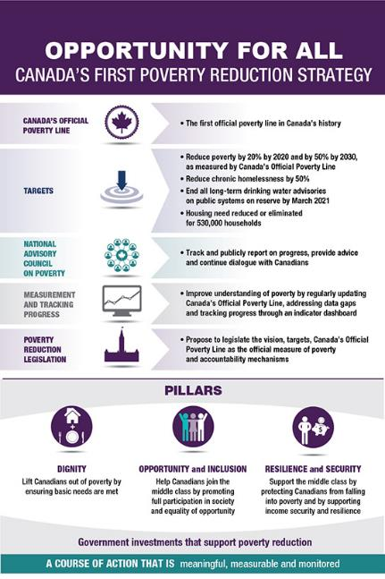
Poverty Reduction Strategies
Literacy is a means to tackle poverty.
Literacy is a key indicator of poverty reduction.
Most provincial/territorial strategies acknowledge the value of literacy, education, or skills training in alleviating poverty but literacy support as a foundational and broad-reaching tool is represented unevenly, especially for adults.
11
Notes:
Just to give some background on the genesis of the work, this started probably in 2016 when one of our funding partners approached us about focusing in our annual national forum, which is supported by Canada Life. So our partners at Canada Life suggested that we should dedicate our next annual forum to a discussion of the intersections between literacy and skills and poverty reduction, given that municipalities and provinces across the country, as well as the federal government, were all in the process of developing their strategies. So what we did was a review of those strategies and really found that although literacy and education are recognized as being important, they were not integrated consistently, and particularly literacy as opposed to education which doesn’t guarantee skills development. We wanted to ensure that basic literacy was going to be included as a metric. The other types of things that tended to be always common to these poverty reductions strategies were measures to support with income assistance, tax breaks and benefits, employment programs, early childhood education, affordable housing, and access to health services. Those areas were well represented. But as we know, many of the learners that we work with may not have the level of skills that they need to be able to navigate and access these system solutions that are in place. Again, we wanted to pose the question, “where is literacy” to make sure that everything else can be effectively implemented.
Together with ABC Life Literacy and Frontier College, we met with Minister Duclos’ staff at Employment and Social Development Canada, who were leading the Canadian Poverty Reduction Strategy. We made the case to support literacy as a foundational and broadreaching tool to alleviate the experience of poverty. We were very happy to get a phone call the day that the strategy was launched to say that our advice had been heard and that literacy was included as a key performance indicator to track Canada’s progress in the years to come. The indicator will be monitoring youth literacy levels.

Slide 12
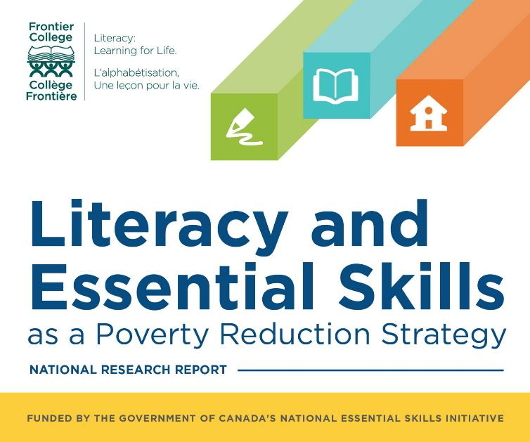
12
Notes:
We are very happy for that success to have been able to come together through organizations that were there for the cause not for any funding questions or competition between organizations but rather to advance the profile of literacy in general.
That was part one: the launch of the strategy and the inclusion of literacy as an indicator. We had the opportunity to make a proposal to do this research to further support the policy development and modernization of the funding framework to address literacy and essential skills among adults, especially those that are further from the labour market and to look at focusing on how to improve the way that we support adults with lower skills and particularly adults from communities that need either cultural or linguistic accommodations.

Slide 13
Research Objectives
1. Articulate key factors underlying the positive relationship between literacy and poverty;
2. Highlight a series of best practices in the delivery of literacy programming for lower skilled adults living in poverty; and,
3. Consult with a broad range of stakeholders to identify challenges and new innovative approaches in the delivery of literacy and poverty reduction programs for Canadians.
Notes:
The objectives of the project were to get at the key factors, to understand how literacy programming can contribute to a cross-sectoral poverty reduction strategy for Canada. We wanted to articulate the key factors that corelate literacy and poverty. What is it that connects the two? What do we see in the research and what do we know?
Highlight best practices in the delivery of programming.
Consult with a broad range of stakeholders to identify challenges and innovations in order to better serve Canadians, especially those with multiple barriers.

Slide 14
Research Methodology
3
2
National Research Survey
A diverse sample of over 400 organizations from across Canada participated in the survey.
The survey sought the opinions and expertise of those working with adult learners, especially marginalized or multi-barriered adults.
1
Key Informant Interviews
30 interviews with key informants from a range of backgrounds, expertise, and experiences
Interviews explored best practices, challenges, and innovations in literacy programming for adults living in poverty
Literature Review
Review of publications by governments, service providers, academics, and other sources.
Document the state of knowledge on the relationship between literacy and poverty
Notes:
With those objectives at the outset, we contracted with SRDC to carry out the work. They did a literature review, they had key informant interviews with 30 informants. My apologies that some of the text is cut off for #2. It says, “interviews explored best practices, challenges and innovations in literacy programming for adults living in poverty”. The 30 key informant interviews were completed with a wide range of stakeholders, including literacy and poverty reduction organizations, but also policy makers and employers.
There was also a survey done with over 400 organizations, and we were thrilled with the response. The survey started with a basic distribution list and then used a snowball approach, and we invited maximum participation and ended up with 400 responses. We were very pleased with that as a very good representative sample.

Slide 15
Survey Sample
Proportion of Respondents Offering Services in Various Regions
Proportion of Respondents by Community Type
15
Notes:
In terms of regional representation, all provinces and regions of the country were included, including Northern Canada. Stakeholders from all provinces and territories and a good mix of urban, rural and remote communities and on reserve.

Slide 16
Survey Sample
Proportion of Respondents Providing Services to Targeted Learner Groups
16
Notes:
In terms of the sample, these are the characteristics of the learners or individuals that are served by each of the participating organizations. Low income and low literacy skills along with unemployment are right at the top in terms of groups served. They were invited to select all that apply, so you see a cross section of the groups served here.

Slide 17
Research Findings
Clear, well-established relationship between literacy skills and poverty
Many studies have shown a strong positive relationship between literacy skills, employment, and earnings.
Recent evidence shows a positive causal relationship between literacy upgrading and employment, earnings, and longer-term job retention.
The experience of poverty is about more than a lack of employment; it is about exclusion
Literacy is a critical step on the pathway to not only employment, but also broader social inclusion
Basic literacy skills are necessary to ensure the full participation in society and the well-being of all Canadians.
Notes:
I would encourage everyone to take a look at the full technical report. It is beautifully written. There are great testimonials and quotes from the interviews and really compelling information about what’s known in the research and what’s being done on the ground with case studies or examples of different programs that are running across the country.
I’ll summarize the results. We know that there is a clear and well-established relationship between literacy skills and poverty. SRDC found over 25 years of correlational studies in Canada and internationally that demonstrate a strong, positive relationship between literacy, employment and earnings. Those with low literacy are unemployed at significantly higher rates, have lower earnings and higher reliance on income supports. Beyond the studies, recent evidence has also emerged in the last five years from high quality experimental design sponsored by the federal government which demonstrate a clear causal relationship that literacy upgrading has a positive impact on skills, on employment, on earnings, and on long-term job retention and self-sufficiency.
We have strong compelling evidence that low skills are tied to poverty, but we also have strong evidence that our whole field can be putting forward about the proven return on investment: that literacy upgrading involves cost-effective investments for governments and employers, and that there are ultimate benefits to the wellbeing and poverty alleviation that can be achieved. Poverty is discussed in terms of relationship to the low income cut-off, but the theoretical framework in the report also looks at the degrees of poverty reduction. There’s alleviation, there’s reduction, and there’s prevention. The severity of the conditions of poverty can be offset by other types of wellbeing factors like access to a community or a network, ability to access government supports. Those are just a couple of examples, but it’s really a valuable way to understand poverty and to speak about it in relation to skills and literacy.
That points to the second point that it’s about more than lack of employment. It’s about social exclusion and literacy programming and outreach is a critical first step to broaden social inclusion. Literacy liberates and empowers individuals to participate not only in the labour market but in other valued dimensions of life and society including social, civic and political engagement. This is critical to health, wellbeing and quality of life for all Canadians.

Slide 18
Research Findings
Employment and education related outcomes are commonly tracked instead of short-term milestones related to the personal development of learners, which are better indicators of progress and achievement.
18
Notes:
To continue a bit with the findings. In terms of the survey research, survey respondents were asked when assessing the impacts of their programs, what do they consider as indicators of success. This chart shows what success looks like.
One of the main things that came out of the research was that the outcomes that are used to monitor the performance of literacy programs are often too narrow in scope and exclude key indicators of success. What we see in this list is a broader spectrum of success indicators which connect with other non-skills-based gains (non-cognitive). Instead, there are indicators of psychological capital such as self-confidence or self-efficacy (82%), positive attitudes towards learning which is a foundational piece of any pathway to success, and improvements in mental health. For about half of participants, that’s a key indicator of success. We’re looking at a very holistic approach. As I’m sure everyone on this session knows, literacy is holistic work that we do with learners. We need to look at the whole person and the holistic process of development that is in progress.
To flag the last point that was really valuable in the research was the evidence around indicators about improved relationships and trust in others. That as well is an aspect of the severity of poverty or how that experience of poverty can be reduced by beginning to participate with peers and in the community. In the report, it is actually stated that literacy practitioners are often seen as the trusted intermediary, where they are the ones that can provide assistance and a safe space to address the various needs that learners have.

Slide 19
Research Findings
A range of best practices have emerged in recent years in the delivery of literacy upgrading and wrap-around supports to reduce the effects of poverty
Learner-centric approaches to instruction
Holistic assessments of learner needs
Contextualizing program content within relevant frameworks (e.g. occupational, cultural)
Customization of learning materials to learner objectives
The importance of wrap-around supports and service provider partnerships
19
Notes:
The research was focused on identifying best practices and innovation. Here we have some of the best practices that rose to the surface. Many of them will not be a surprise, I am sure, because it was folks like yourselves and your colleagues that answered the survey and gave us all of their best experience and best advice for what to be recommending and investing in for the best results.

Slide 20
Research Findings
The most pressing challenge identified by stakeholders is in raising awareness and increasing accessibility of programming
Improving awareness and accessibility of services was identified as the most important priority by all stakeholders across all targeted learner groups
Especially necessary for programs serving low-income learners (72%), persons with disabilities (59%), newcomers (56%), and Indigenous Peoples (55%)
20
Notes:
The most pressing challenge, as I mentioned earlier, was the issue of awareness and accessibility of programming. In the previous slide, we saw the best practices that deliver the best results for learners, but we know that there are real barriers and challenges. Part of the goal here was to bring those with out with data to be able to make the case for whatever types of solutions that are needed and that the field can be advocating for.
The most pressing barrier identified by the stakeholders was raising awareness. It was identified as the most important priority by all groups and across all targeted learner groups, by all stakeholder respondent groups. Awareness and access was the biggest one. It’s a personal addition to the research, but I think that one of the main pieces in there is around stigma, because it’s much more challenging to raise awareness when we need to ensure that programming is welcoming and non-stigmatizing for folks who would benefit.
This is all especially important for programs that serve low-income learners, persons with disabilities, newcomers and Indigenous peoples. Those were the groups where the need to raise awareness and access was greatest. Increasing access includes geographical accessibility, so improving options for rural and remote learners. Physical accessibility is also important, supports for those with disabilities to enhance learning engagement. While it did include geographic and physical accessibility, it also extends to other types of constraints on access, so the need for greater investments in culturally relevant and adapted learning options. As well, approaches to language barriers in literacy for newcomers. That’s an area where more work will need to be done and increasingly so over the coming years. Also addressing capacity constraints for small organizations, especially the ones that are in a workplace training context.

Slide 21
Research Findings
Project-based funding has increased innovation, but imperilled the sustainability of service providers
Stakeholders emphasized the need for funding arrangements with expanded mandates that:
combine literacy and poverty reduction objectives (76 %),
allow for more expansive delivery of wrap-around supports (76 %), and
provide more flexibility in the use of resources (69 %)
Single-access points with integrated service delivery can make it easier for individuals to find and access needed programs and services
Siloed approaches to service delivery often limit the kinds of supports that LES providers can provide
Navigating systems with multiple access points is an additional barrier for adults with low-literacy skills
The majority of stakeholders (77 per cent) identified greater intergovernmental coordination in the delivery of literacy and poverty programming as a crucial priority
21
Notes:
Moving on to the final slide about the findings, and then we can look at the recommendations together. The final points to highlight here are some of the findings around funding structures and funding models for adult literacy and poverty reduction. Respondents emphasized the need for a funding model with an expanded mandate that will combine literacy and poverty reduction objectives into a streamlined effort, that will allow more expansive delivery of wraparound supports. We need investments that will allow us to properly set up systems for wraparound services and referral systems. Finally, a funding model that has an expanded mandate that could provide more flexibility in the use of resources. We know that literacy work is creative. Learning can happen in any context, and there are many creative ways that we can engage with our learners and produce engaging materials and programming for adult learners. We definitely need more investment that allows for that kind of innovation and experimentation and give the experts in the field the leeway to work as they need to for success.
Some of the other related challenges that were identified were the project-based funding model which has encouraged competition instead of collaboration in many cases. We also have many great cases of partnerships and collaboration across the country. I think the adult literacy field has been turning a new page in terms of how we all work together. There have been a couple of national groups sets up. We have these of connectivity points through this PD pop-up series. As well, OLES has been engaging the field more in providing our best advice for impact evaluation, for assessment frameworks. This is bringing the field together again. I hope I’m not overly optimistic to think that we’re at the start of a new chapter.
The most important thing that came out in terms of the funding structure was identified by 77% of respondents for the need within government for better coordination for literacy and poverty programming. That is one of the classic challenges in working with government and the various mandates of different departments where we are dealing with issues of cross-sectoral or cross-departmental relevance. We know what is needed, but the machinery of government can make it difficult for even bureaucrats with the best of intentions to achieve the kind of collaboration that we need.

Slide 22
11 Key Recommendations - Policy
1. Governments should recognize literacy as a basic human right.
2. Literacy should be recognized as a policy priority requiring cross-departmental and cross-jurisdictional cooperation.
3. Literacy should be a central pillar within any comprehensive poverty reduction strategy.
4. Policies and funding models should encourage collaboration rather than competition between service providers.
5. Funding for literacy and essential skills programming should be sustainable and predictable, while also fostering innovation.
6. Governments should facilitate partnerships and support knowledge translation and exchange (KTE) among providers of literacy and poverty reduction services.
22
Notes:
As a result of the findings, SRDC identified eleven key recommendations. Six recommendations were related to policy and five to program delivery. I’ll go through these ones quickly.
Literacy is a human right that requires cross-jurisdictional and cross-departmental cooperation. They recommend that as part of a comprehensive poverty reduction strategy, the policy and funding approach needs to foster collaboration rather than competition with resourcing that is sustainable, predictable and innovative. Those two do not need to be mutually exclusive. Looking at partnerships and knowledge translation, I do want to give kudos to OLES for working to engage the field and to support collaboration across organizations and partnerships. We still have a ways to go in terms of bringing together literacy and poverty reduction.

Slide 23
11 Key Recommendations – Program Delivery
7. Raising awareness and accessibility of existing services and programs should be a key priority for improvement.
8. Learner-centred approaches should be used to maximize engagement in literacy programming.
9. Literacy programs should be contextualized to the goals of learners.
10. Greater integration of services should be a primary objective to improve the quality of literacy and poverty reduction services.
11. Outcomes frameworks used to evaluate success should be expanded to include indicators of life skills and psychological capital.
23
Notes:
In terms of program delivery recommendations, the top of this list is raising awareness and accessibility. Learner-centred approaches and customized programming, that it relates to the context of individual learners and their goals. A better approach to wraparound and investments in wraparound services. Outcomes frameworks – performance measurement where we in the field can be tracking our results based on what success really looks like with the individuals that we serve.
What I’ll do now is to flip to a final Q&A slide. I want to put a few questions out to the virtual room, and then I’ll flip back to this program delivery slide so that you can be looking at it and considering any questions or comments. Again, I would invite you to look at the summary of findings.
*Transcription Note: All of the Q&A is documented on the Q&A slide

Slide 24
Discussion – Q & A
What are the implications of this research for your work –
partnerships, funding, program delivery, other?
What surprised you or stood out about the research? Anything missing?
What are known barriers to implementing best practices that
this network should focus on?
Any other comments or observations?
24
Notes:
In terms of questions, we of course hope to answer any questions you might have. In terms of a discussion, we’re really interested in knowing your reactions in terms of the implications for your work: partnerships, funding, program delivery or any other aspect of your work. What stood out or surprised you about the research? Were there questions that you wanted answered that you haven’t seen addressed? We know what the best practices are, but what are the known barriers that may keep us from implementing those that the network could focus on. Any other comments or observations?
*Note: On screen, the visual returns to the previous slide, but the transcription will continue below.
Annemarie Wesolowski: You have provided a lot of insight through the report and the findings. When we’re thinking about the recommendations and their impact on program delivery, I think we can see that there are a number of things that we can do ourselves that we have control over within our program delivery, but there are other things that we either don’t have control over or have the capacity to do.
The first question is: With regards to barrier, the word “literacy” is watered down. How can we promote something when the term itself is unclear. We have a second comment that says, I feel the same way with life skills definition.
Angela Briscoe: Agreed completely. We spent some time at the National Forum on Literacy and Civic Engagement last Tuesday. WE spent quite a bit of time talking about a modern definition of literacy. I think there are a few really good ones circulating. They all seem to contain a simple, essential definition that learners, instructors or government funders would all agree to. It’s about the ability to interpret and use information, to achieve goals or success in life work, in the community and at home. There are many ways to capture that concept, but here at Frontier College we think a lot about how we don’t want literacy to become diluted in terms of all of the other types of literacy that are proliferating, i.e., health literacy, digital literacy, financial literacy. All of those we tend to approach as an extension of the basic literacy skills that are required in order to pursue information, make informed choices, use technology. I think this is a great point that the field can rally around.
Annemarie Wesolowski: I see that someone has added that the province’s education system needs to improve in regards to literacy, so that we are pumping out more literate graduates and not having as many adults needing upgrading. Another participant asks how can LES service providers better share resources? Sometimes it’s difficult to find employment-based resources, and we end up creating programs, including manuals. We hear that a lot.
Angela Briscoe: This is one of the things that even within Frontier College, we have different program areas that are doing their own work of customizing manuals and resources and content. While the customization is so important for effectiveness, we’re also thinking about how we streamline this work a bit better as a field. In terms of the two national networks that are in place right now, I’m wondering if that could be some part of the solution in terms of better resource sharing. That’s one option, to take the conversation to the national networks. Those include regional organizations and local organizations. The other thing to consider is whether there is a need for us to raise the profile, like this research suggests, of the need for funding to customize resources. I’m not sure to what extent funding is an issue, but if things could be developed with government funding, and the mandate is to share it broadly with the field, then we’re all further ahead with each iteration, and with each resource we can all be moving forward together.
Annemarie Wesolowski: I know the topic of resources and individuals and/or agencies reinventing the wheel so to speak has been an ongoing issue. Literacy Northwest just had its two day PD event in Thunder Bay this week, and we put out on display the recent employment-related curriculum documents that were created in partnership between Community Literacy of Ontario and Literacy Link Eastern Ontario: clerical and office admin support, pre-medical personal support workers, etc. The practitioners in the room said that if they hadn’t come to the PD session they wouldn’t have been aware of this, because they do not have the time to go searching all of the support organizations or the regional network websites to find all of these wonderful resources. We need to find a central repository, for lack of a better word, where we can post these and promote them throughout the field.
Angela Briscoe: I think this is a very achievable goal for us. My understanding is that there was a bit of a dip in the centralization and access to resources with a lot of the funding cuts that happened five years ago or so. However, with the national networks being reconnected, there are a couple of places that resources are being held now. I think Copian moved over to another organization, and two of the Quebec-based organizations just completed some research. There’s also a new research study that is still embargoed, so I didn’t share it in this presentation, but it will be a retrospective on the adult literacy field in Canada with interviews and program and policy highlights to correct what feels like a loss of history with turnover and funding cuts. That research project led to something like 150 documents being centralized in a repository. I think we should add this discussion of resource sharing to a broader national conversation about how to centralize what has already been produced so that we can use valuable but scarce resources to keep moving things forward for everyone.
Annemarie Wesolowski: From a participant, in addition to the comment about the loss of NALD and/or Copian, another resource is the Ontario Native Literacy Coalition. Absolutely – again, one of the provicincial support organizations. But, as service providers have said, they don’t have the time to research and check out everyone’s websites about the great resources that are available. Another participant notes that she likes the idea of taking the conversation outside of the lens of being just a tool for employment.
Angela Briscoe: That is part of the national agenda right now. If anyone wants to join these networks, feel free to contact me, and I can connect you with the organizers. I think there is a focus on challenging the close tie between literacy and employment. We’re reminding policy makers and Canadians that literacy is a basic human right, that it’s part of basic health, wellbeing and dignity of every Canadian. The narrowing of it to just purely a labour market issue is not accurate, and it doesn’t reflect the true needs of the field. At the national level, we are raising that flag and trying to keep the conversation alive while the whole future skills conversation is moving forward, trying to make sure that literacy and basic skills remain front and centre.
The other thing that I wanted to mention on this point of resource sharing and the national networks, ABC Life Literacy are also national, and they do participate on both of the groups. They participate on the national network, and they lead a group called the Programs and Research Committee. They are always looking for new participants on that network. They’ve recently shared that they’ve updated their mandate to focus on supporting practitioners and focusing on curriculum development, customization. I just want to flag that they may have some capacity supporting work going forward. Any needs or requests or possible chances to move this work forward, feel free to contact me or go straight to ABC, and we can try to keep it all moving nationally.
Annemarie Wesolowski: Good suggestion. We have another comment: I think it would be amazing if there was a list somewhere with the literacy organizations by province that links to their social media accounts so we can link with one another. This might also help raise awareness of literacy programs.
Angela Briscoe: That’s a great suggestion. Maybe ABC can put it on their website! We’ll be meeting with them soon, and I’m going to add it to the list of things we’ll be chatting about.
Annemarie Wesolowski: The whole topic of service integration. Recommendation #10 is the greater integration of service being a primary objective to improve the quality of literacy and poverty reduction services. There seems to be a huge barrier to service integration in general. Just look at the past number of years trying to improve service integration within the Employment Ontario system. There has been different levels of success from community to community, but it has been a struggle. Never mind reaching outside of Employment Ontario and trying to connect with other service providers, particularly those that work within poverty reduction services.
Angela Briscoe: What were the success factors in cases where it did work? As an alternative, there was talk with Kathleen Wynne’s government about the community hub model, and I’m curious what folks think about that.
Annemarie Wesolowski: We were very excited in Northwestern Ontario about exploring the community hub and trying to roll it out wherever and whenever possible. Everyone felt encouraged that it would support service coordination. A participant comments that they are co-located with an employment centre, and it has really made a difference for learners. We have also heard that from agencies within the Northwest region as well. Some agencies are now co-located with employment services, and others have set up itinerate sites under the roof of employment service agencies, and they have said that is helping to build stronger relations and supporting service integration. The participant also added that they have new Ontario Works hires come to their centre to learn about their programs and services. The community hub approach is ideal, but we find in smaller communities that it can be difficult to house multiple service providers at one time, which will be an ongoing challenge. Perhaps the idea of providing services under the roof of another service provider might be more attainable for us, as opposed to a physical structure that houses multiple service providers.
Angela Briscoe: That’s one of the key ways that Frontier College works. We embed ourselves in other organizations that are already offering programs or services so that we don’t have bricks and mortar. I don’t know if that means we are itinerate – would that fit the definition? Our volunteers are at other community sites and in some cases our staff too. Very few of our programs or learners are exclusively Frontier College. That is an approach that works well. Not only does it make it easier in terms of things like geography and the cost of travel, but it’s also a more welcoming environment where there is hopefully more familiarity and trust.
Annemarie Wesolowski: Comment from a participant: Our students have access to employment services, counselling, accessibility services, admissions and Pathways advisors who come to our location. Again, another excellent example of bringing services under your own roof so that the learners that you serve have better access to the variety of services and/or wraparound supports that they need.
Angela Briscoe: I know that in one of our satellite offices, we are also co-located with an employment service for newcomers so we get a lot of referrals that way. We also have better retention because individuals are coming for multiple services at once.
Annemarie Wesolowski: The whole issue of promotions, raising awareness and accessibility to programs is also an issue. Agencies don’t have a lot of resources. Their funding is meagre so they find it is very expensive to advertise in traditional ways like radio, etc. They are using social media more, but it does take a lot of time, and time is also money unless you are able to get volunteers to help you promote your agency in the community.
Participant Comment: integration doesn’t have to mean co-location, right? You’re right, there could be other ways and perhaps willingness – that may be what it comes down to.
Participant Comment: we provide services in a location that has better access for learners with mobility issues.
Participant Comment: bringing your services where they are needed and more accessible as opposed to having people come to you if that’s a challenge
Participant Comment: I do not think that service integration needs to be co-located to work. We are part of a program that has participants to out to community programs to ensure that learners know where the service is located. It also helps learners feel more comfortable accessing the services because they have been there.

Slide 25
Let’s keep the conversation going!
Angela Briscoe
Director, Program Development
abriscoe@frontiercollege.ca
www.frontiercollege.ca
Notes:
Angela Briscoe: I’m aware of the time, and I don’t want to keep people later than scheduled. I would like to say thank you again for the opportunity to join Literacy Northwest and the Learning Networks of Ontario for their pop-up PD. It’s really valuable to hear your thoughts and feedback. It sounds like some of the points really did resonate. I’ve learned some things today as well, which is great. Thanks to Annemarie and Barb and Sarah!
Annemarie Wesolowski: Thank you so much, Angela, for sharing your knowledge and information with us today. Especially the links to the various reports and documents. It makes it much easier for us to access them. It’s also encouraging to see that, through the research report, although the literacy field is aware of the strong link between literacy skills levels and poverty, that your research report has confirmed that. I encourage all of today’s participants to review the Literacy and Essential Skills as a Poverty Reduction Strategy report. It’s very insightful and important. And it’s a good read!
I

Slide 26
Thank you!
Coming soon:
webinar resources: https://e-channel.ca/practitioners/pop-pd-resources
webinar evaluation: https://tinyurl.com/y3po6bfh
registration link for our next webinar:
https://connect.contactnorth.ca/pop_up_2/event/registration.html
Notes:
I also encourage everyone to register for the next two webinars on this topic. The next one is on October 24, and it is Better Research for Better Practice: Understanding the Characteristics, Experiences and Trajectories of Ontario Works Clients in Toronto. The third webinar on the topic of poverty is Skills Upgrading Programs: Supporting People Living in Poverty on November 28. Please check out those links and register!
Thank you all for participating, and thank you Angela for presenting, and Sarah and Barb for all the background to make it possible.
Angela Briscoe: Just a reminder that the slides will be shared after the session.
Annemarie Wesolowski: The slides will be posted along with the recordings, and we’ll circulate that information.
Sarah Stocker: Thank you everyone for joining us today. Watch for an email with the links to the recording and the registration form and more information. We hope to see you at the next webinar.

