Slide 2
About Pop Up PD for Literacy Educators

Slide 3
Presentation Overview

Slide 4
Introduction

Slide 5
Background and Context

Slide 6
Purpose of the Singles Study

Slide 7
Overview of Analytic Approach

Slide 8
Quantitative Analysis

Slide 9
Singles now make up the largest percentage of the caseload

Slide 10
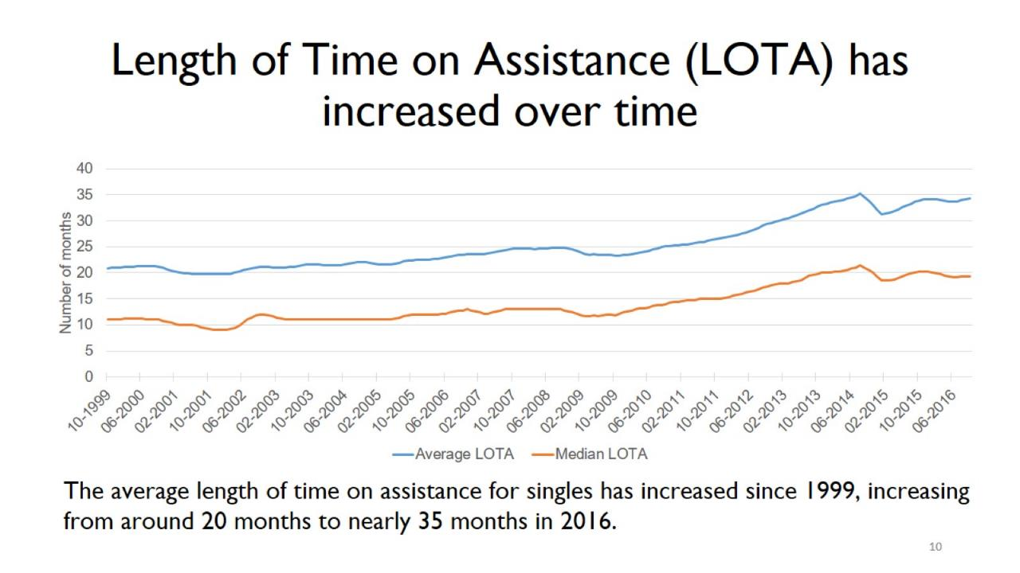
Length of Time on Assistance (LOTA) has increased over time

Slide 11
Quantitative Highlights: 2016 Caseload Profile

Slide 13
Factors that impact exiting OW for employment

Slide 14
Qualitative Analysis

Slide 15
Why Detailed Interviews?

Slide 16
Interview Highlights: Deep Poverty and the Struggle to Make Ends Meet

Slide 17
Interview Highlights: Key Challenges & Concerns

Slide 18
Interview Highlights: Multiple Layers of Disadvantage

Slide 19
Interview Highlights: Positive Impacts

Slide 20
Participant Narratives: No one single and no one path onto or off assistance

Slide 21
Key Takeaways & Areas of Application

Slide 22
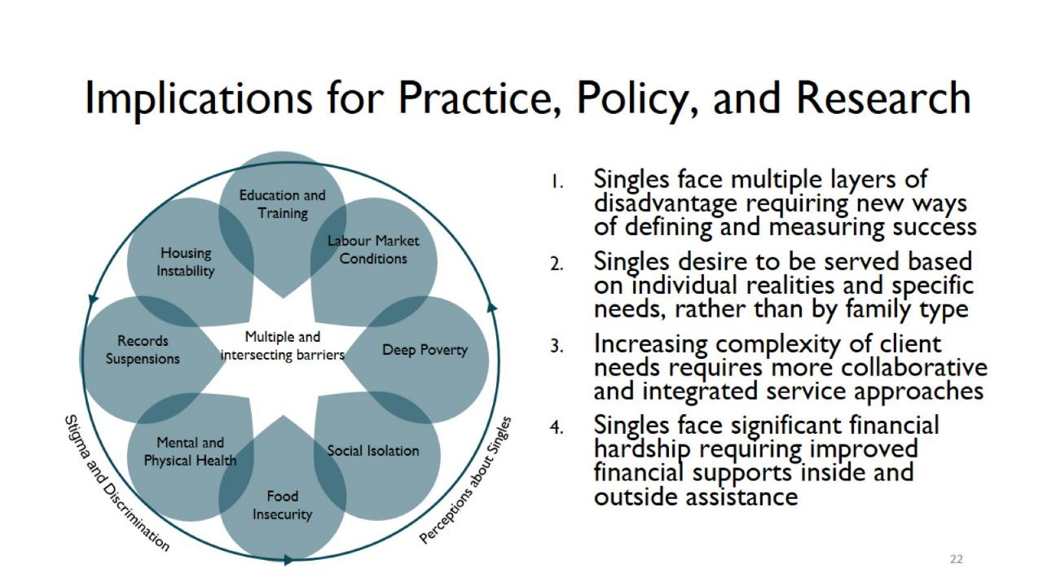
Implications for Practice, Policy, and Research

Slide 23
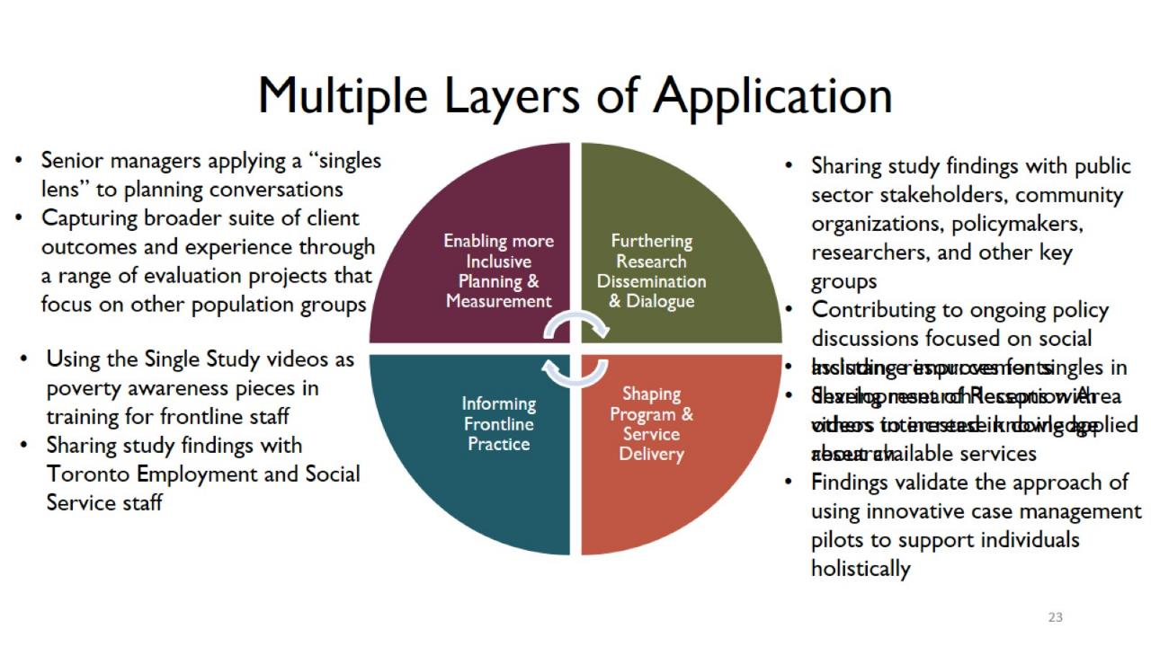
Multiple Layers of Application

Slide 24
Leavers Study Overview and Preliminary Findings

Slide 25
Background and Motivation

Slide 26
Study Objectives and Approach

Slide 27
Profile of Survey Respondents

Slide 28
Preliminary Analysis and Potential Lines of Inquiry

Slide 29
Wrap Up and Next Steps

Slide 30
Next Steps

Slide 31
Thank you! For more information about the two research studies please get in touch with us.

Slide 32
Acknowledgments

Slide 33
Singles Study Working Reports & Videos

Slide 34
Q&A Discussion

Slide 35
Thank you!
https://tinyurl.com/y4tdosle
https://connect.contactnorth.ca/pop_up_3/event/registration.html

