Slide 1
LBS Performance management what’s hot
Claire Ramsay
Contact North Webinar
4 March 2016

Slide 2
Introduction
Chair, Academic Access Centre since 2009
Three sites - different data sets
  Nepean: 700+, postsecondary
  Smiths Falls: 140, rural community, employment
  ACElinks: 60, working with the John Howard Society of Ottawa
Presented at CESBA, CSC, CLO and network events
Making Sense of your LBS Data webinars and data tracking tools available on cscau.com

Slide 3
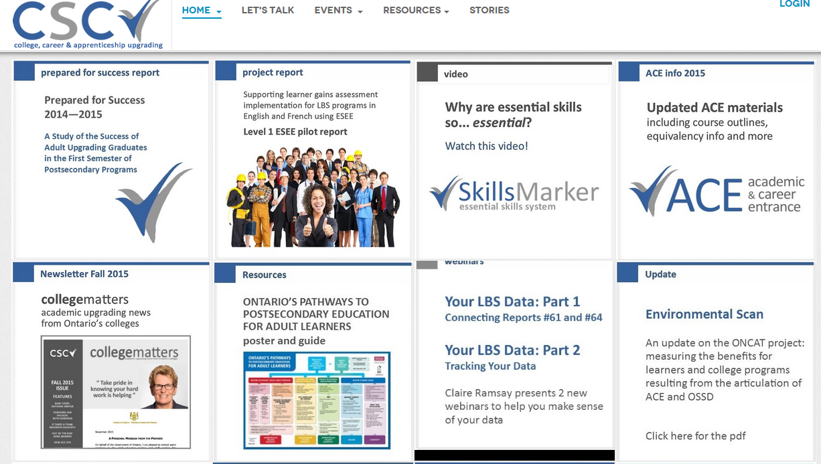
Webinars
Notes:
Anyone before?
Fall training?
Not recording to facilitate questions

Slide 4

Agenda
QSAR
Current Issues
LBS Contract Management
Learner Follow Ups
  Why is it an issue
  Reports
New and Carryover Learners
Questions
DSQ
PMS
EOIS
CaMS
Follow ups
Notes:
How many

Slide 5
Current issues

Slide 6

What’s been happening?

Slide 7
What’s been happening?
LBS Program evaluation by Cathexis is underway
Learner Gains Research Project is underway
SP-Connect to sign and submit the 2016/17 contracts
New round of contract management compliance
One month to go in the current fiscal year
  See webinars on CSC website for tools and suggestions to clean up data and start the new fiscal year off right
Auditor-General Value for Money Audit of Employment and Training Division’s programs and services

Slide 8
LBS Results as at 31 January 2016
Note: Learner served target in 2014/15 was 41,075. In 2015/16 is 45,898

Slide 9
LBS contract management

Slide 10
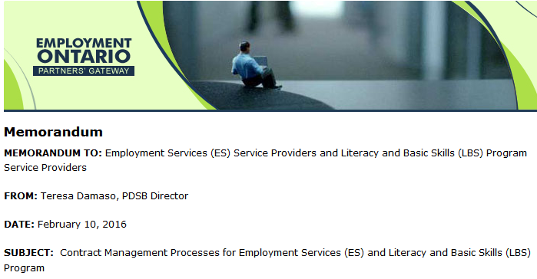
Contract Management: February 2016

Slide 11
Contract Management: February 2016
Learner Follow Up
  3, 6 and 12 month follow ups
Financial Forecasting
  Variance between EER and SRER
Late Reporting
  Estimate of Expenditure Report (EER)
  Statement of Revenue and Expenditure Report (SRER)
  Auditor’s Report

Slide 12
Learner follow up

Slide 13
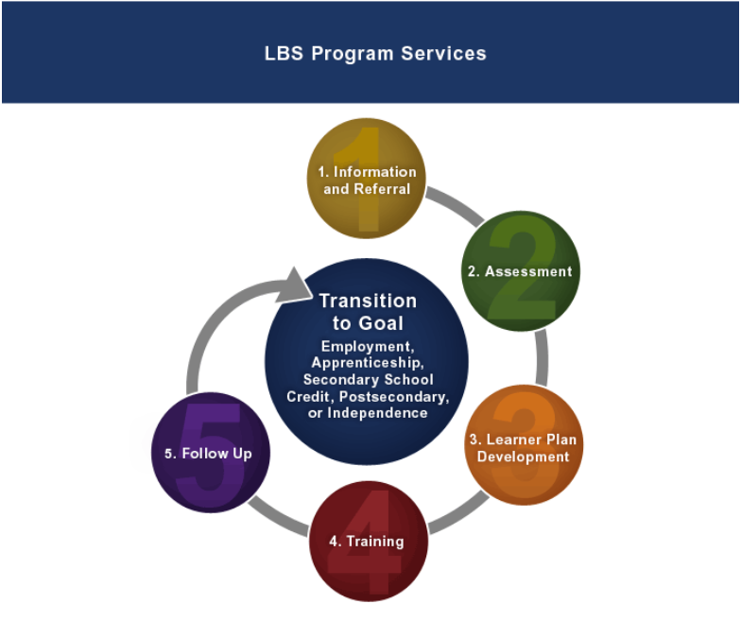

Slide 14

Learner Follow Up
Required as per Article 15 of Schedule A of your LBS Service Agreement:
    “The recipient shall contact Learners at exit and at three, six and twelve months after they leave the LBS Program in order to document their outcomes.”
Documents the value and effectiveness
of the four other services

Slide 15
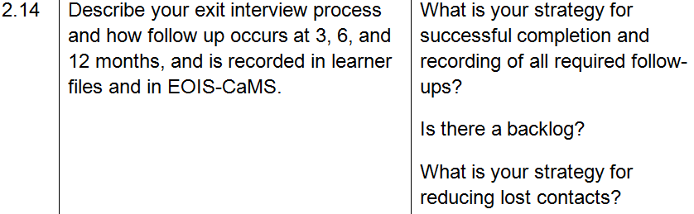
Learner Follow Up
In the compliance self-assessment questionnaire
Not in the QSAR
Not in the Performance Management Framework so doesn’t impact the Service Quality Standard (SQS)

Slide 16
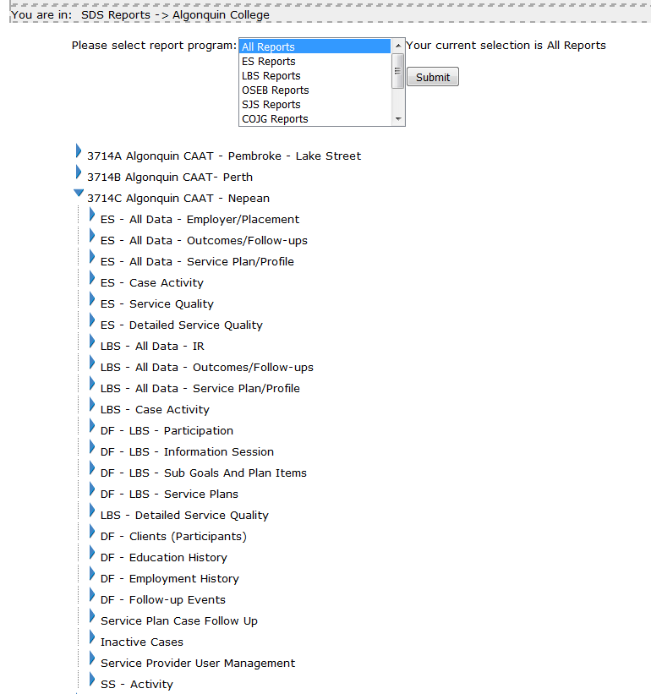
Learner Follow Up – Reports in CaMS
LBS All Data – Outcomes/Follow Ups
Report #60D
Monthly
LBS Case Activity
Report #61
Weekly
Service Plan Case Follow Up
Report #19A
Weekly

Slide 17
LBS All Data – Outcomes #60D

Slide 18
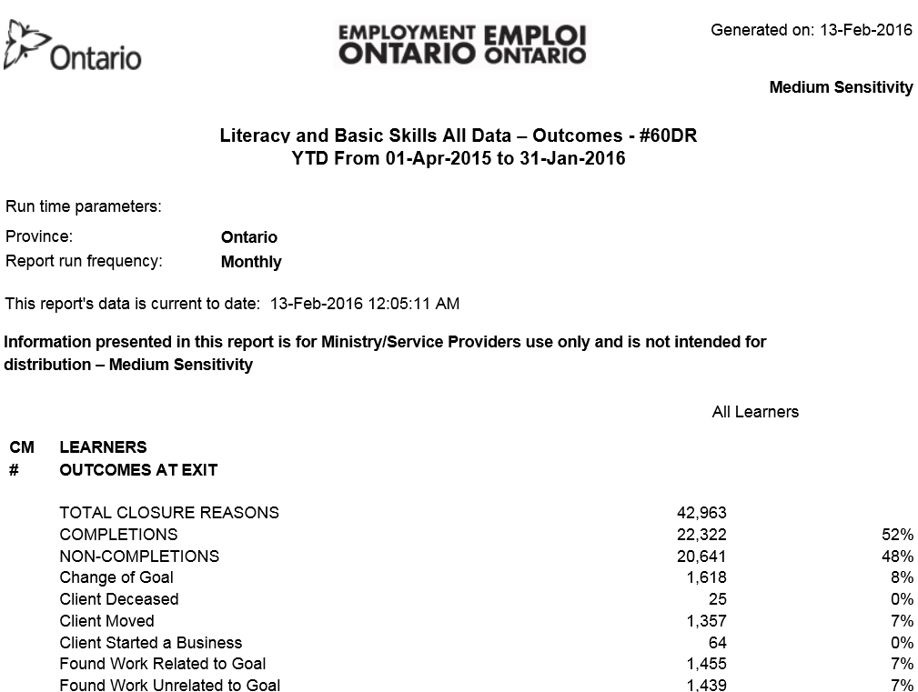
Learner Follow Up:
LBS All Data – Outcomes #60D

Slide 19
Learner Follow Up:
LBS All Data – Outcomes #60D
Ontario data over three years
  January 2014, January 2015 and January 2016
Learner Outcomes at 3, 6 and 12 months
Learner Outcomes of:
  Employed and Training/Education key outcome for MTCU
  Unknown – no information on how effective the training was
        – problem in terms of “selling” value of LBS program
Notes:
Independence about 2%

Slide 20
Learner Outcome:
Employed and Training/Education
  More individuals have an outcome of Employed and Training/Education at each of the 3, 6 and 12 month follow ups
  But…..

Slide 21
Learner Outcome: Unknown
  We also see that in January 2016, more individuals have an outcome of Unknown at each of the 3, 6 and 12 month follow ups than in previous year.
  In-year, not much difference between 3, 6 and 12 month results.

Slide 22
Learner Outcome:
Employed and Training/Education
  As a percentage of total outcomes, Employed and Training/Education has decreased at each of the 3, 6 and 12 month follow ups
  In-year, not much difference between 3, 6, and 12
  (e.g. Jan16: 47%, 46%, 44%)

Slide 23
Learner Outcome: Unknown
  As a percentage of total outcomes, Unknown has increased at each of the 3, 6 and 12 month follow ups
  In year, more significant difference between 3, 6 and 12 (e.g. Jan16: 35%, 37%, 40%)

Slide 24
Learner Follow Up:
LBS All Data – Outcomes #60D
How does your program data compare year over year?
To find out:
  Print three reports: LBS All Data – Outcomes #60D
    January 2014, January 2015 and January 2016
  In the 3 month follow up section
    Highlight Total Employed and Training/Education
    Highlight UNKNOWN
  Repeat for the 6 and 12 month follow up sections of each report
  Compare the values in a table

Slide 25
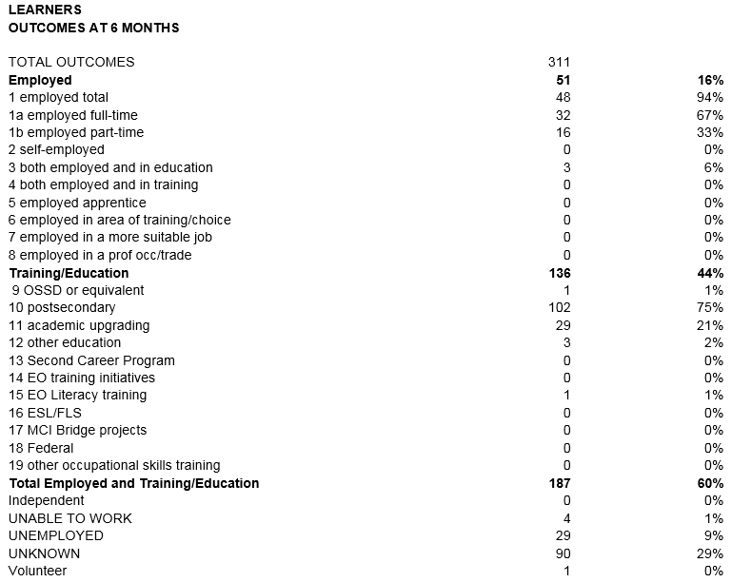
Client Follow Up:
LBS All Data – Outcomes #60D
Learner Outcome Total E and TE
Learners | Jan-14 | Jan-15 | Jan-16
3 months | 168 | 171 | 206
6 months | 187 | 205 | 296
12 months | 119 | 210 | 260
Learner Outcome UNKNOWN
Learners | Jan-14 | Jan-15 | Jan-16
3 months | 129 | 122 | 123
6 months | 90 | 130 | 99
12 months | 63 | 122 | 163

Slide 26
Learner Follow Up:
LBS All Data – Outcomes #60D
How does your program data compare to the province or your region?
Compare percentages

Slide 27
Client Follow Up:
LBS All Data – Outcomes #60D
  Outcome of E and TE: Site compared to the Province
E and TE | Jan-14 |  | Jan-15 |  | Jan-16
Percent | Site | Province | Site | Province | Site | Province
3 months | 50% | 55% | 52% | 50% | 53% | 47%
6 months | 60% | 54% | 55% | 49% | 69% | 46%
12 months | 59% | 50% | 58% | 46% | 57% | 44%
Except for 3 month follow up at January 2014, E and TE outcome is higher than provincial percentage

Slide 28
Client Follow Up:
LBS All Data – Outcomes #60D
  Outcome of Unknown: Site compared to the Province
Unknown | Jan-14 |  | Jan-15 |  | Jan-16
Percent | Site | Province | Site | Province | Site | Province
3 months | 38% | 26% | 37% | 31% | 32% | 35%
6 months | 29% | 29% | 35% | 34% | 23% | 37%
12 months | 31% | 34% | 34% | 38% | 36% | 40%
Except for two instances, percentage of Unknown at all three follow ups is lower than provincial average

Slide 29
Case activity report (#61)

Slide 30
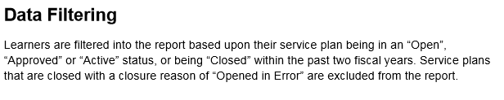
Learner Follow Up: Case Activity #61
As of 3 October 2015 – service plans that require follow up in the current fiscal year are included in the Case Activity report
October 2015 User Guide

Slide 31
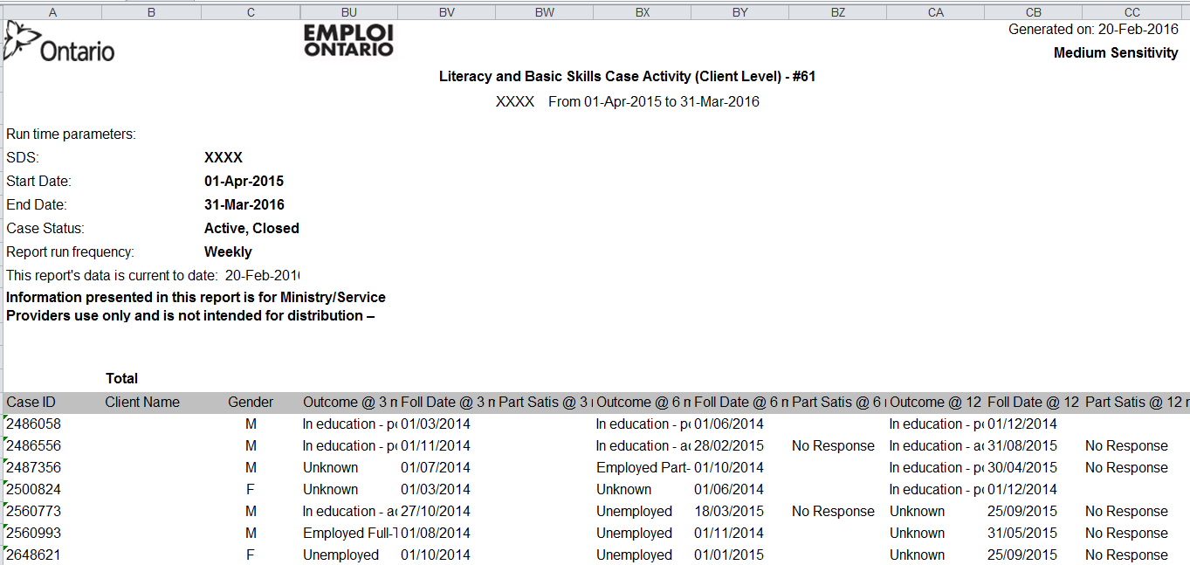
Learner Follow Up: Case Activity #61

Slide 32
Service plan case follow up (#19A)

Slide 33
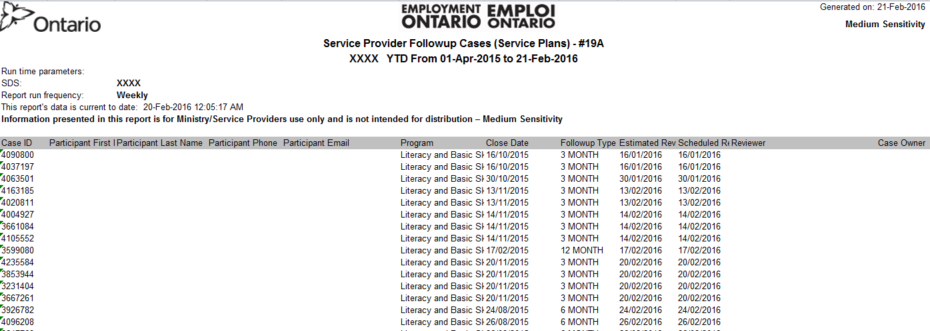

Learner Follow Up:
Service Plan Case Follow Up #19A
L
The Estimated Review Date tells you which reviews are overdue
Have not been entered into CaMS

Slide 34
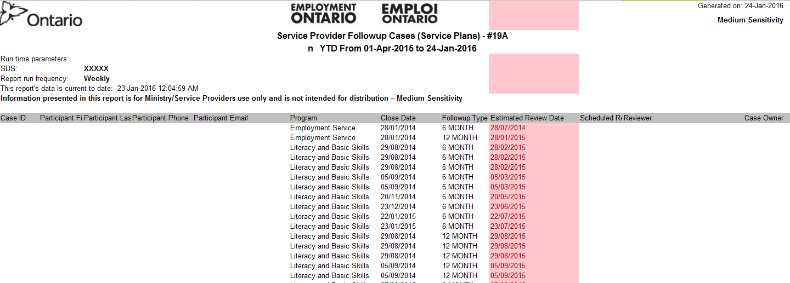

Learner Follow Up:
Service Plan Case Follow Up #19A
It didn’t always look so good:

Slide 35
Learner follow up backlog?

Slide 36

Learner Follow Up Backlog?
Action Plan including timeline will be required to address issue
Review follow up data collection and entry processes
  What policies do you have in place?
  Have they been given enough priority?
Review your other data collection and entry processes
  Anything you are doing too much of or can stop doing to reallocate resources to follow up?
Staff turnover
  Are there any LBS service providers near you who could spend time training, passing on best practices to your new staff?

Slide 37
New and Carryover learners

Slide 38
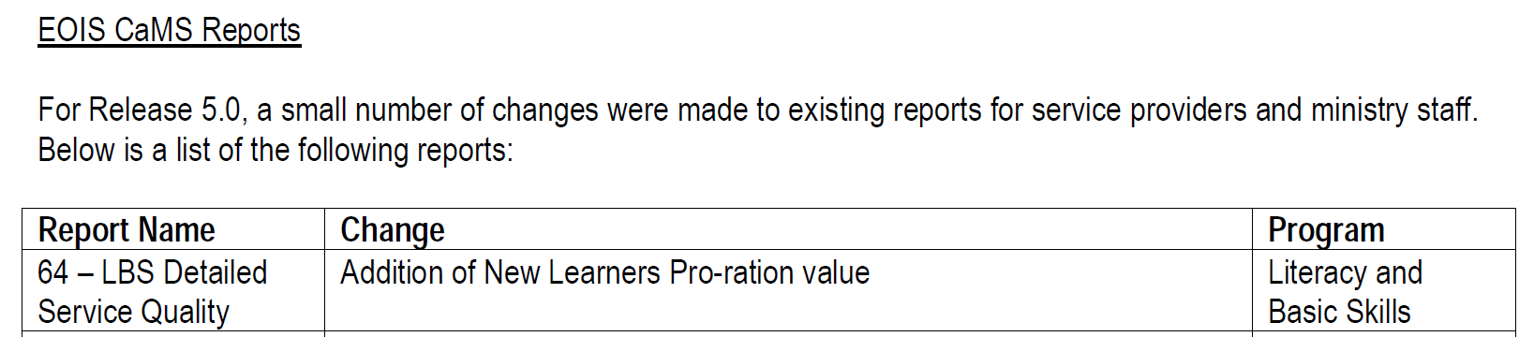

New Learners
May 2015 - Release 5.0
No Revised User Guide yet.

Slide 39
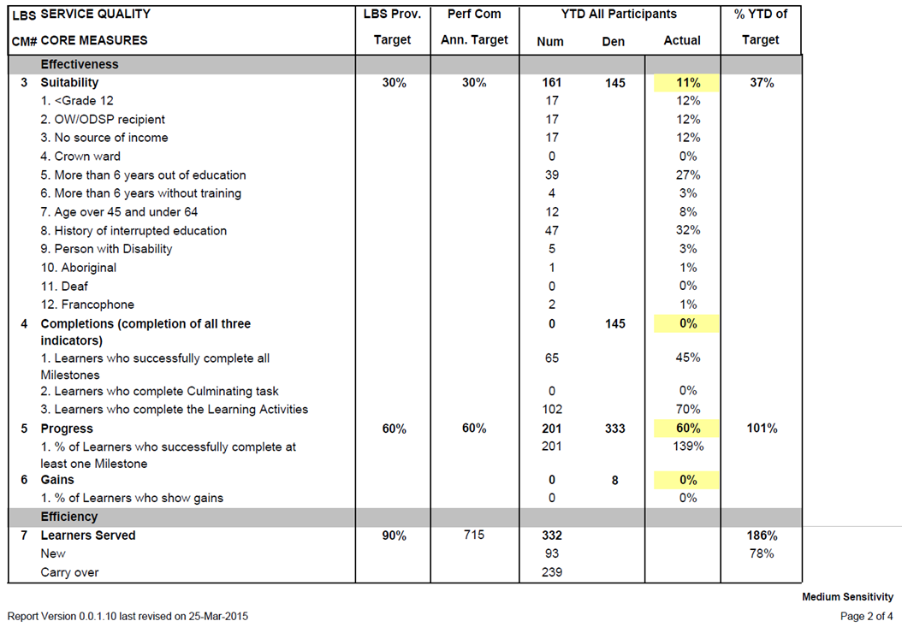
New Learners
Re
What is it?

Slide 40
New Learner Pro-Ration Value
My Take on It
  N = number of new learners needed per month to meet
      Learner Target
  = (Learner Target – Carryover Learners)/12
At end of January, 10 months into fiscal year, number of new learners “should” be at 10 x N
More than 10 x N, the pro-ration value will be more than 100%
Less than 10 x N, the pro-ration value will be less than 100%

Slide 41
New Learner Pro-Ration Value
My Take on It
  Example: End of January, my DSQ looks like:
  New learners needed per month:
  (Target – carryover learners)/12 = (715 – 239)/12
  = 35.16
  10 months into the fiscal year so should have
  35.16 x 10 = 352 new learners
  Actual new learners is 347
  Pro-ration value is 347/352 = 87%

Slide 42
Carry Over Learners
In April will have
the 2015-16 carryovers as a percentage of total learners
2016-17 carry over learners
Carry Over Learners | ON | East | Central | North | West
2014-15 | 16,189 | 2,781 | 6,016 | 3,015 | 4,376
As % of Total Learners | 43% | 41% | 42% | 46% | 43%
2015-16 | 14,650 | 2,501 | 5,471 | 2,717 | 3,957
Difference | -1,539 | -280 | -545 | -297 | -419

Slide 43
Carry Over Learners – Your Site?
Carry Over Learners | ON | Site A | Site B | Site C
2014-15 | 16,189 | 229 | 18 | 29
As % of Total Learners | 43% | 35% | 21% | 50%
2015-16 | 14,650 | 239 | 29 | 28
As % of Total Learners | ? | ? | ? | ?
In April, look for
  the 2015-16 as % of total learners in April to compare year over year
  number of carry over learners going into 2016-17

Slide 44
Contact:
Claire Ramsay
ramsayc@algonquincollege.com
613 7274723 ext. 5477

