Slide 1
Lesbian Gay Bi Transgender Queer
Awareness for LBS
Karleen Pendleton Jiménez
Associate Professor
School of Education
Trent University
March 7th, 2017

Slide 2
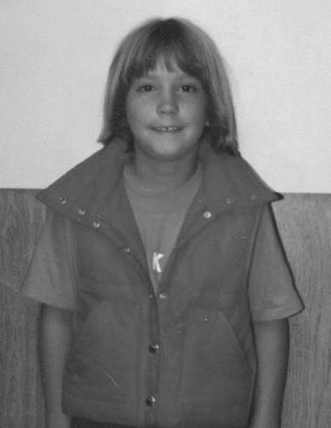
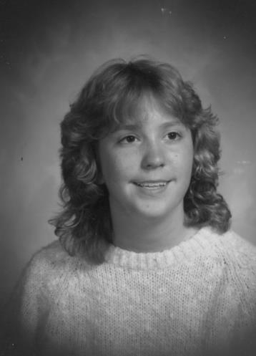
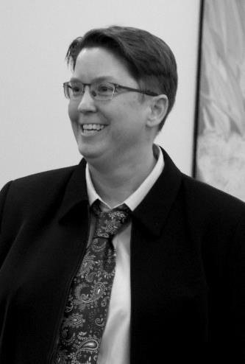
How does a queer
grow up?

Slide 3
Vocabulary
1. Sexual orientation: refers to a person's sexual attraction. It means who we desire sexually, with whom we want to become intimate, and with whom we want to form emotional relationships. May be lesbian, gay, bisexual or heterosexual.
2. Gender Expression: refers to the ways in which we each manifest masculinity or femininity.
3. Gender Identity: refers to a person’s internal, deeply-felt sense of being either male, female, something other, or in between.

Slide 4
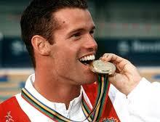
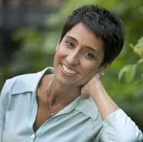
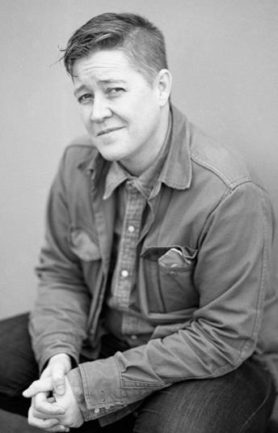
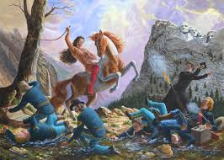
The Queer Alphabet
4. LGBTTQI2S = Lesbian, Gay, Bisexual, Transgender, Transsexual, Queer, Intersex, Two-Spirited

Slide 5
Vocabulary
5. Lesbian: a woman who forms sexual and loving relationships with other women
6. Gay: a person who forms sexual and loving relationships with those of the same gender; often used to refer to men only, but many women also use this term to identify themselves.

Slide 6
Vocabulary
7. Bisexual: an individual, male or female, who is attracted to and may form sexual and loving relationships with both men and women; does not usually mean non-monogamy.
8. Transgender: a person whose gender identity, gender presentation or expression, and/or physical appearance or anatomy do not fit into conventional expectations of male and female. If a person transitions from male to female, or from female to male with the help of hormones and/or surgery, she or he may self-identify as Transsexual.
9. Queer: Sometimes used as an umbrella term for LGBTTQI2S people. Sometimes embraced by those who do not feel like a single category within LGBTTQI2S accurately describes them. Sometimes spoken as an insult against LGBTTQI2S people.

Slide 7
Vocabulary
10. Intersex: A general term used for a variety of conditions in which a person is born with a reproductive or sexual anatomy that doesn’t seem to fit the typical definitions of female or male.
11. Two-Spirited: an umbrella term sometimes used for Indigenous North Americans who fulfill one of many mixed gender roles.

Slide 8
Vocabulary
12. Heterosexism: a system of attitudes, bias, and discrimination in favour of opposite-sex sexuality and relationships. It can include the presumption that everyone is heterosexual or that opposite-sex attractions and relationships are the only norm and therefore superior. It may be an unconscious act or one that is actively practiced.
13. Homophobia: fear and hatred of lesbian and gay people, often exhibited by prejudice, discrimination, harassment, and acts of violence.
14. Transphobia: An irrational fear of, and/or hostility towards, people who are transgender or who otherwise transgress traditional gender norms.

Slide 9
Climate in Secondary Schools
From the 2008 Egale Canada First National Climate Survey on Homophobia and Transphobia in Canadian High Schools—in a survey of 1200 participants from every province and territory in Canada

Slide 10
70% of all participating students, LGBTQ and non-LGBTQ, reported hearing expressions such as “that's so gay” every day in school and almost half (48%) reported hearing remarks such as “faggot,” “lezbo,” and “dyke” every day in school.

Slide 11
20% of LGBTQ students and almost 10% of non-LGBTQ students reported being physically harassed or assaulted about their perceived sexual orientation or gender identity.

Slide 12
More than a third (37%) of youth with LGBTQ parents reported being verbally harassed about the sexual orientation of their parents.

Slide 13
Almost 10% of LGBTQ students reported having heard homophobic comments from teachers daily or weekly

Slide 14
Grade 9-10
Dear Mom and Dad
this is the way I am. i am bisexual i Love my sexual. and i am Fine with it. i am also a tomboy i Don’t Like Dresses or make-up I should be able to wear whatever i want or date Whoever i want to and yes i like to wear pink but i Like Pants and running shoes. Hair short. With gel. I Like to hang out with guys. I Don’t Like to paint my nails. I like school and I want to be a chef. I want you to accept that

Slide 15
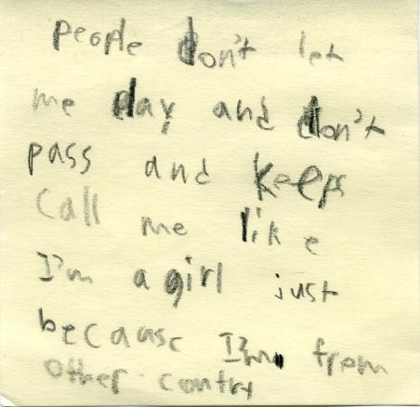
Double Oppression & Harm Grade 5 student in rural Ontario
People leaves me out because I’m new kid and from other country.
If boys and girls don’t need to be called why separate washrooms?

Slide 16
What can you do to get people to stop bullying?
Someone said “suck it” and then said “wait you have nothing there,” to me
People keeps bullying me because I’m from other country.
What do you do if people leave you out and call you names
People pushes me and call me names

Slide 17
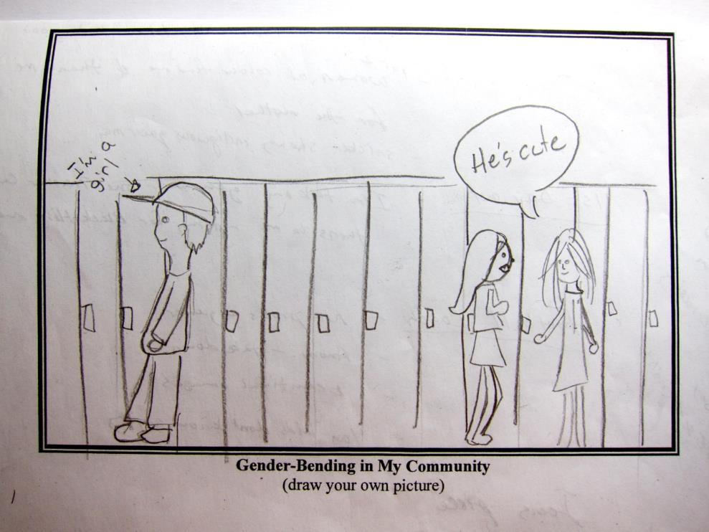
Grade 8

Slide 18
Grade 11-12
My past is a part of me. This is because of how I acted as a toddler and how it affected me throughout every year of school.
As a child, I played with lots of toys. Some mine, some my sister’s. I would play with toy cars and Barbie dolls with my little brother and my older sister. Because of this, I had no social identity for if I acted like a boy or acted like a girl. This is what led to my childhood depression that I am continuing to fight.

Slide 19
Grade 11-12 continued
During my first year of public school, I was made fun of for the way I acted because I would always talk to the girls and not the guys. I was called rude names and was even labeled gay during my last year at that school.
In 2005, I moved to Ontario hoping to get a fresh start but failed at doing so which ultimately led to my past issues coming back even worse.

Slide 20
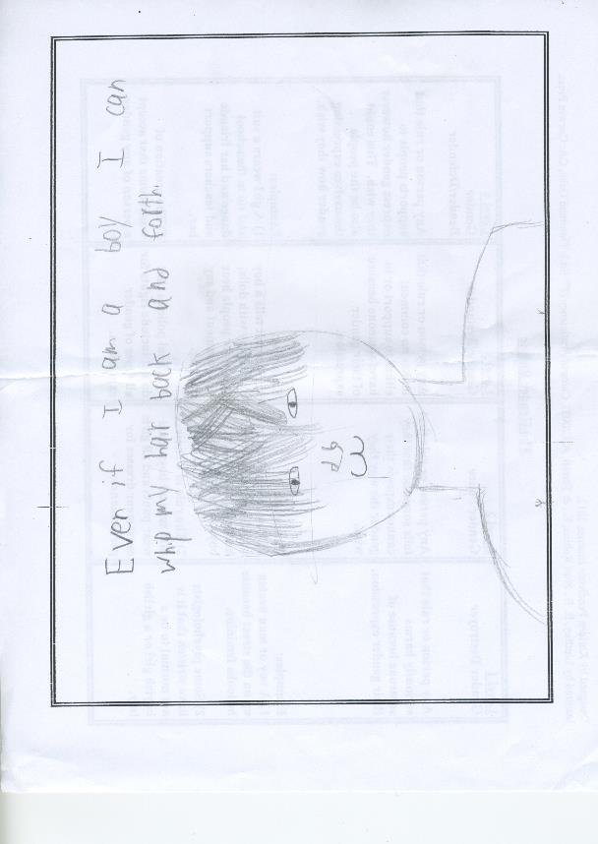
Grade 8

Slide 21
My flowered Jeans (grade 8)
The object I would choose is my flowered jeans, because I normally don’t like jeans but these I thought were different because all along the side of the legs there are rows of string that end up being stems of flowers that are blooming.
These jeans make me feel happy because they represent the sort of feminine side to me and at the same time show my masculine side. They also make me feel like I’m a part of a large force that stands up to bullying and criticism to express themselves and to show the world that our lives have meaning.

Slide 22
If somebody were to tell me that I couldn’t wear my favourite jeans I would stand up to everything they’re trying to criticize and tell them that they had no say in what I wear and certainly have no say in what I believe in.
When people see me they might ask me what I have on my leg and I would clearly say and explain what it was and it’s a horrible thing that I notice them mocking me about it, but if I were a girl they still might ask me, but they wouldn’t care because to them it would be ok.
In my point of view everybody should have the right to express who they are as a whole and not have to hide a very important part of who they are. Everybody should just live their lives the way they want to and people should leave them.

Slide 23
Rationale
It’s the law. All members of the program, faculty, staff and students are legally obliged to follow the Ontario Human Rights Code. Gender identity, gender expression, and sexual orientation are protected grounds. If we do not provide a workplace free of discrimination and harassment we are breaking the law. If we do not address and challenge homophobia and transphobia in our courses, then we are sending students into jobs where they may unknowingly break the law.

Slide 24
Rationale
2. Safety is a primary component of teaching. Homophobia and transphobia are dangerous.
Homophobia and transphobia are irrational, sometimes unconscious, hatred and fear. When people act out in irrational and unconscious ways, others, and even sometimes the perpetrator himself/herself/themselves, can be harmed. Education about LGBTTTQI2S lives, and about the consequences of homophobia and transphobia, can reduce irrational fear and hatred.

Slide 25
What would you do?
If a student calls someone a “fag” in class?
If a colleague tells you a gay joke?
How would you create a lesson that focused on some aspect of LGBTTQI2S experiences?

Slide 26
Tips
Approach topic with humility
Include LGBTTQI2S content in curriculum (Don't wait until a homophobic incident occurs;
Don’t let a gay joke, the word “fag” or describing something as, “That’s so gay,” go unchecked/unchallenged

Slide 27
More Tips
If teaching about famous LGBTTQI2S people and their work, include their sexual orientation in the autobiographical information you provide (e.g. Shakespeare, Michelangelo, Alan Turing, Sally Ride, Mark Tewksbury etc.).
6. Organize anti-homophobia workshops for faculty and students.
7. Bring in guest speakers that reflect diverse perspectives and experiences within the LGBTTQI2S communities.
8. Provide literary and visual representations of LGBTTQI2S people and culture in your classroom

Slide 28
Last Tips
9. Seek out and make friends with other faculty and administrators who are interested in social justice and equity.
10. Laughing in relation to sexuality does not necessarily mean students are being hurtful. It could mean they’re nervous. Talking about sexuality often makes people nervous. However, such laughter can feel hurtful. Is there a way you can ask about the laughter and open a discussion?
11. Incorporate case studies, examples and scenarios that reflect various family structures and that draw on LGBTTQI2S experiences, in ways that are age-appropriate.

Slide 29
Writing about Gender fulfills “B2.1 Write brief texts to convey simple ideas and factual information”
1. Pick an object or activity that you think really represents how you see your gender. Write it in the blank.
My _________________________________ is a part of me.
2. Describe your gendered object or activity.
3. How does your object or activity make you feel?
4. What would you do if anyone ever tried to take it away from you?

Slide 30
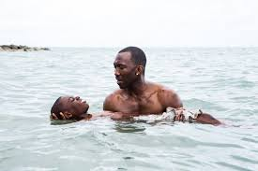
Queer Intersectional Learning A1.2 Read texts to locate and connect ideas and information
Bring Wikipedia page about the new best picture movie Moonlight
Found at https://en.wikipedia.org/wiki/Moonlight_(2016_film)
Ask questions about the movie (e.g.):
What awards did it win?
What topics did the film discuss?
Who was the first Muslim
to win an acting Oscar?

Slide 31
Image Web pages
Adult image of Karleen provided by Anderson Coward
http://olympic.ca/team-canada/mark-tewksbury/
https://www.thestar.com/news/insight/2011/06/10/the_prime_of_ms_irshad_manji.html
http://www.ivancoyote.com/
http://www.kentmonkman.com/
http://www.thefader.com/2016/10/20/moonlight-barry-jenkins-film-roundtable

