Slide 1


Slide 2
Statement of Land Acknowledgement
I would like to begin by acknowledging the Indigenous Peoples of all the lands that we are on today. While we meet today on a virtual platform, I would like to take a moment to acknowledge the importance of the lands, which we each call home.
We do this to reaffirm our commitment and responsibility in improving relationships between nations and to improving our own understanding of local Indigenous peoples and their cultures. From coast to coast to coast, we acknowledge the ancestral and unceded territory of all the Inuit, Métis, and First Nations people that call this land home.

Slide 3
About Pop Up PD for Literacy Educators
free webinar series developed by Ontario’s LBS Regional Networks & the Provincial Support Organizations for Literacy
supports LBS practitioners with presentations on topics important to them
English language webinars presented for LBS practitioners annually since 2015-2016; French language transcriptions coming soon!
all webinar presentations, recording links & transcripts here:
  Pop Up PD Resources for LBS Educators
webinar topic ideas welcome at: e-channel@contactnorth.ca

Slide 4

Topics for Today
1. Essential Skills
2. Skills for Success (SFS)
3. SFS and OALCF
4. SFS Phase 1 for LBS
5. SFS Phase 2 for LBS
6. Next Steps
7. Wrap-Up
Brief Review Only!

Slide 5

1. Essential Skills
…for work, learning, and life
This Photo by Unknown Author is licensed under CC BY-SA-NC
Notes:
In the first part I am going to talk a bit about the original 9 Essential Skills, how they came to be, and how they are connected to the Ontario Adult Literacy Curriculum Framework.

Slide 6
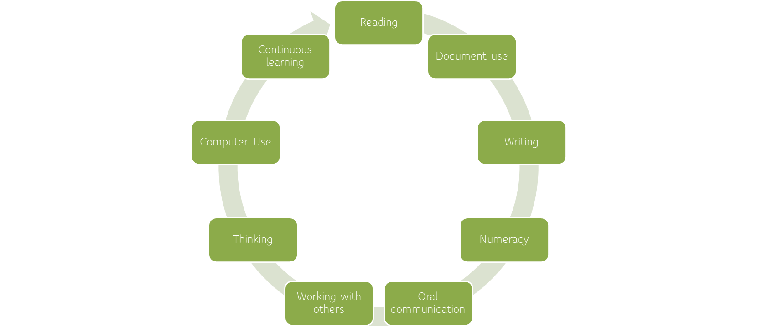
NINE Original Essential Skills

Slide 7
Essential Skills
1980’s to 2020
Human Resources Development Canada (HRDC)
National Occupation Classification (NOC Codes)
Essential Skills Profiles

Slide 8
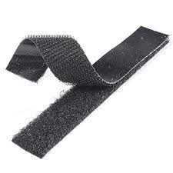
Essential Skills are the ‘Velcro’ to which all other education and training ‘sticks’.
Notes:
You might have heard this expression in other presentations over the years. I still like this analogy whether they are called Essential Skills, Foundational Skills or Skills for Success – they are indeed the Velcro to which all other training and education sticks. So any of us – learners, employees, instructors or at any time in our daily life – if we have stronger Essential Skills, we will be more likely to be successful at other kinds of training and education. It stands to reason when you think about some of the simpler Essential Skills such as reading, writing and numeracy. If those skills are stronger, then we are better able to engage in other kinds of training and education, and employment.

Slide 9

2. Skills for Success
(…also for work, learning and life!)

Slide 10


Slide 11

Notes:
Announcing the new Skills for Success! This graphic is from the federal government’s website. I’ll be showing you a bit more that website in a few minutes. There’s some interesting differences in the way this graphic presents the new Skills for Success. For example, they are presented as a circle rather than as a list. I think that has interesting implications for both education and work as well as life in that there aren’t firm start and stopping points, but rather they work together as a group of skills to help all of us improve our ability to engage in work, learning and life. That part hasn’t changed.
Starting from the top, we have communication, numeracy, writing, adaptability, collaboration, digital, reading, problem solving, creativity and innovation.

Slide 12

From the Skills for Success website:
Source:https://www.canada.ca/en/services/jobs/training/initiatives/skills-success.html
Notes:
Some of you may have already had a look at the federal government’s new website. Formerly, it was the Office of Literacy and Essential Skills website, and now it’s the Skills for Success website. This is the landing page. I’ve placed the link at the bottom, but you can always Google “Skills for Success” to find it if you want to have a look at the site.
I think it’s interesting to look at the statement on this page. It is still really fundamental to all of the things that Robyn told us about the original Essential Skills research project and the impetus for creating and using those nine Essential Skills. ”Skills for Success provide Canadians with everyday skills needed for work, learning and life.” That emphasis on those three dimensions is still at the forefront. “Improving them will help you succeed in today’s and tomorrow’s workplace”. There is a bit more emphasis on the workplace piece, but it’s always important to recognize that there are meaningful connection to work, to learning and to life.

Slide 13

Help
Help workers target the right skills to take advantage of new and emerging opportunities as part of upskilling/reskilling strategies
Support
Support the inclusion of vulnerable groups to get the skills needed to adapt to labour market changes
Facilitate
Facilitate entry of individuals facing skills barriers into skilled trade occupations
Meet
Meet anticipated increased demand for digital skills with enhanced guidance for that skill-set
Address
Address enduring gaps in foundational skills and respond to demands for new tools and supports to build social-emotional skills
Impact of Skills for Success on workers and the changing labour market
Notes:
Here is a bit more about the impact of the Skills for Success on workers in the labour market. I would say that these bullets are like a wish list of the Office of Skills for Success regarding what they hope will be the outcomes and implications of the new framework.

Slide 14
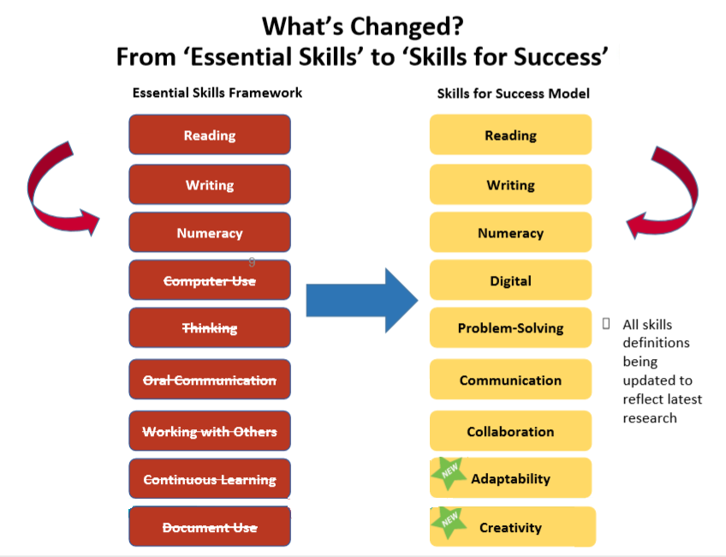
Notes:
So here’s the comparison chart. What has changed in terms of the actual skills from the Essential Skills framework to the Skills for Success framework can be seen here.
Reading has stayed as reading as have writing and numeracy. Not surprisingly, computer use has been renamed as digital. Thinking has been renamed and redefined as problem solving. Oral communication is now more broadly known as communication. Working with others is now collaboration, which I think is a neat term to include as the name of a skill. Continuous learning has been folded into a newly named skill called adaptability. Document use hasn’t been directly translated as creativity, but creativity has been added, and document use has been removed as a discrete Essential Skill.
As I mentioned earlier, all of the definitions related to these skills have been updated.

Slide 15

3. Skills for Success and OALCF

Slide 16
Some Possible connections to the OALCF?
Reading
Writing
Digital
Creativity
Communication
A. Find and Use Information
Notes:
We could take any of the six OALCF competencies and create these bubbles as to where the Skills lor Success could integrate with them. The next few slides are just that. We won’t spend a lot of time talking about each one individually, but the purpose of the next few slides is to help make that connection between the very broad competencies of the OALCF and where some of the Skills for Success can integrate with or relate to the OALCF. We could have done this with the old Essential Skills too. In the next few slides, there is no correlation between the size of these bubbles and their level of importance.
In “find and use information”, we would probably all agree that these are some of the Skills for Success that would be integrated into this competency.

Slide 17
Some Possible connections to the OALCF?
Reading
Writing
Digital
Creativity
Collaboration
Communication
B. Communicate Ideas and Information
Notes:
Competency B is “communicate ideas and information”. I put in “collaboration” here. It could also be used in “find and use information”. Digital skills, creativity, and of course reading and writing because they are fundamental.

Slide 18
Some Possible connections to the OALCF?
Reading
Problem Solving
Digital
Creativity
Collaboration
Writing
Numeracy
C. Understand and Use Numbers
Notes:
Understand and use numbers. I have included problem solving here, but that could certainly relate to many competencies.

Slide 19
Some Possible connections to the OALCF?
Reading
Writing
Digital
Creativity
Collaboration
Adaptability
Problem Solving
Numeracy
D. Use Digital Technology
Notes:
Digital Technology. I put eight skills here, but the ninth one would also probably apply because, as we all know, the use of digital technology incorporates so many areas of skill.

Slide 20
Some Possible connections to the OALCF?
Reading
Writing
Digital
Creativity
Collaboration
Adaptability
Problem Solving
E. Manage Learning
Notes:
Manage learning. These are the bubbles I attached for this presentation. I didn’t include communication, but it is almost implicit in any of them.

Slide 21
Some Possible connections to the OALCF?
Reading
Communication
Digital
Creativity
Collaboration
Adaptability
Problem Solving
F. Engage With Others
Notes:
Engage with others. Certainly, one need some adaptability when engaging with others. We talked about that in different contexts in the workplace and in learning and in relationships.

Slide 22


4. Skills for Success Phase 1 for LBS

Slide 23
Skills for Success Funding for LBS – Phase 1
In Fall 2022, the Ontario Ministry of Labour, Immigration, Training and Skills Development (MLITSD) received funding from the federal government’s “Skills for Success” program.
(Employment and Social Development Canada - ESDC)
Phase 1: 2022-23
Phase 2: 2023-24

Slide 24
Phase 1
SFS funding for LBS is related to these 5 themes:
Apprenticeship Integration
Better Jobs Ontario Integration
Expanding and Enhancing
Digital Delivery
Supporting
Underrepresented Groups
Workplace Delivery

Slide 25

The 10 provincial LBS support organizations and the 16 LBS regional networks received SFS funding in November 2022 to conduct different activities for Phase 1
Provincial Support Organizations for Literacy

Slide 26
Eight of the 10 provincial LBS support organizations received funding in November 2022 to develop ‘curriculum resources’ under 4 of the 5 SFS themes:
Expanding and Enhancing
Digital Delivery
Supporting Apprentices
Supporting
Underrepresented Groups
Workplace Delivery

Slide 27
Expanding and Enhancing
Digital Delivery
Two of the 10 provincial LBS organizations were invited to apply for Phase 1 SFS funding under Expanding and Enhancing Digital Delivery:
          AlphaPlus
    Contact North
Contact North is the support organization for the 5 LBS e-Channel (fully online) programs

Slide 28
“Curriculum resource” is very broadly defined for the purpose of this project:
- modules
- courses
- assessments
- other…
- new or updated
Can be for LBS learners, educators, or stakeholders
Expanding and Enhancing
Digital Delivery
Supporting Apprentices
Supporting
Underrepresented Groups
Workplace Delivery

Slide 29
There are almost 200 resources currently being developed or updated by the provincial LBS support organizations.
You may have be involved in developing, reviewing, and/or piloting new resources
All Phase 1 development must be completed by March 31, 2023
New resources will be posted on a provincial repository.
Expanding and Enhancing
Digital Delivery
Supporting Apprentices
Supporting
Underrepresented Groups
Workplace Delivery

Slide 34
The 16 provincial LBS regional networks received funding in November 2022 to conduct community integration projects under 4 of the 5 SFS themes:
Integration of LBS
to Support Apprenticeship
Integration of LBS
to Support Better Jobs Ontario
Services for
Underrepresented Groups
Workplace Delivery

Slide 35
“Enhance local planning and coordination to support the integration and alignment of LBS services with Apprenticeship”
“Enhance local planning and coordination to support the integration and alignment of LBS services with Better Jobs Ontario”
Integration of LBS
to Support Apprenticeship
Integration of LBS
to Support Better Jobs Ontario

Slide 36
“Enhance local planning and coordination to support service delivery pilots focused on underrepresented groups”
“Develop processes and tools to support the completion of organizational needs assessments to support workplace service delivery pilots”
Services for
Underrepresented Groups
Workplace Delivery

Slide 37

Communities of Practice (CoP)
“Communities of practice are groups of people who share a
concern or a passion for something they do and learn how
to do it better as they interact regularly.”
- Etienne Wenger

Slide 38

Communities of Practice (CoP)
All organizations participating in Phase 1 have been required to participate in one or more CoPs.
CoPs have been meeting monthly.

Slide 39

Communities of Practice (CoP)
There are five CoPs at this time:
Provincial LBS Support Organizations:
1 CoP for all five SFS themes
Regional LBS Literacy Networks:
1 CoP for each of four themes
Apprenticeship Integration
Better Jobs Ontario Integration
Supporting Underrepresented Groups
Workplace Literacy

Slide 40
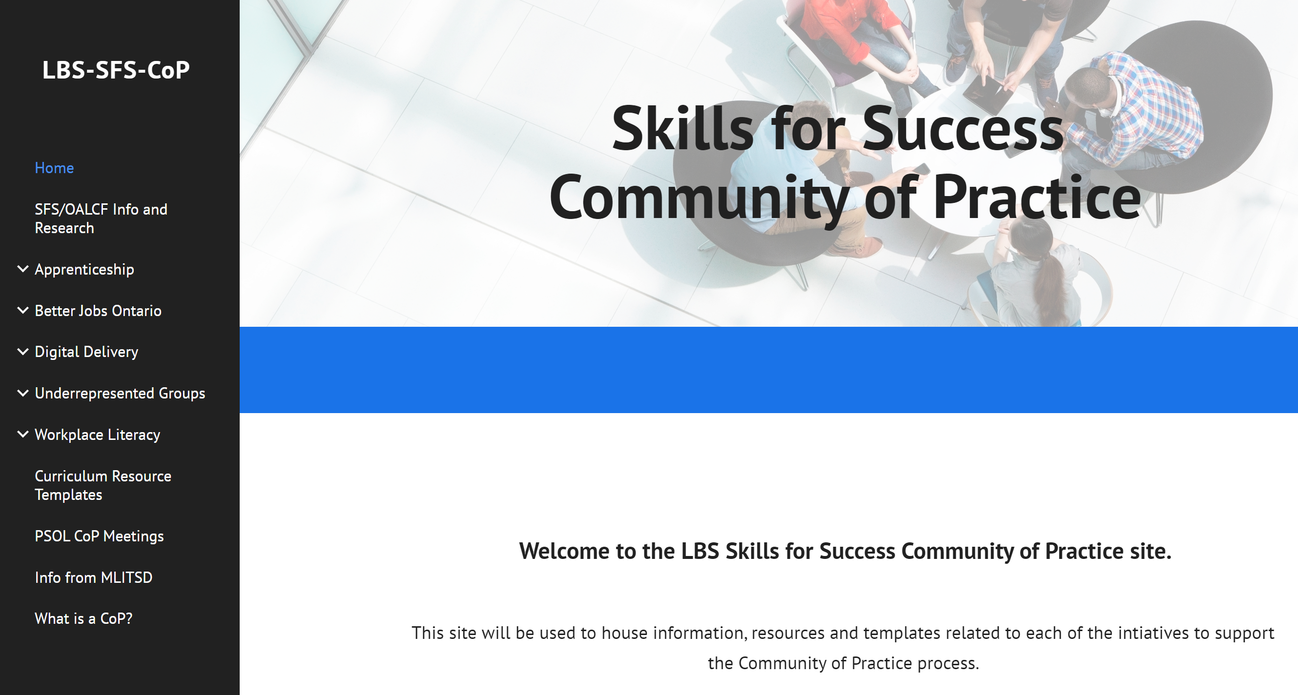
https://sites.google.com/laubach-on.ca/lbs-sfs-cop/home?pli=1

Slide 41


5. Skills for Success Phase 2 for LBS

Slide 42
Who could apply for Phase 2 Funding?
The 10 provincial LBS support organizations
The 16 LBS regional networks
All LBS service providers
Funding applications were submitted through the LBS business planning process for 2023-24
Applying for Phase 2 funding is voluntary.

Slide 43
For Phase 2, 8 of the 10 provincial LBS support organizations were again invited to apply for more curriculum resource development under
3 of the 5 SFS themes:
Supporting Apprentices
Supporting
Underrepresented Groups
Workplace Delivery

Slide 44
Expanding and Enhancing
Digital Delivery
Two provincial LBS organizations were again invited to apply for Phase 2 SFS funding under Expanding and Enhancing Digital Delivery:
          AlphaPlus
    Contact North
Contact North is the support organization for the 5 LBS e-Channel (fully online) programs

Slide 45
For Phase 2, the 16 LBS regional literacy networks were invited to apply for more community integration projects under
4 of the 5 SFS themes:
Better Jobs Ontario Integration
Apprenticeship Integration
Supporting
Underrepresented Groups
Workplace Delivery

Slide 46
For Phase 2, all LBS service providers were invited to apply for service delivery pilots under 3 of the 5 SFS themes:
Better Jobs Ontario Integration
Supporting
Underrepresented Groups
Workplace Delivery

Slide 47

SFS Phase 2 Service Delivery Pilots
Must relate to one of the 3 themes for service delivery on previous slide
Total funding for a delivery pilot must not exceed the Ministry’s “maximum cost per learner” for the applicable cultural stream
If funding exceeds maximum cost per learner, rationale must be provided
Can not include curriculum development costs

Slide 48

MLITSD Priorities related to SFS Projects
Inform the development of a funding model for LBS – how much does program development and delivery really cost?
Inform the full implementation of the LBS performance management framework
Support LBS renewal

Slide 49

Wrap-up & Questions
1. Essential Skills
2. Skills for Success (SFS)
3. SFS and OALCF
4. S4S Phase 1 for LBS
5. S4S Phase 2 for LBS
6. Next Steps
7. Wrap-Up
Brief Review Only!

Slide 50

Thank you!
Webinar resources: Pop Up PD Resources for LBS Educators
Webinar evaluation: https://tinyurl.com/4sd868dn

