Slide 1

Notes:
Barb Glass: Welcome, everyone. This is our sixth of the six Pop Up PD sessions for the fiscal year 2022-23. Many of you have attended other sessions. It’s always great to get together virtually since we can’t get together quite as easily in person.

Slide 2
Statement of Land Acknowledgement
I would like to begin by acknowledging the Indigenous Peoples of all the lands that we are on today. While we meet today on a virtual platform, I would like to take a moment to acknowledge the importance of the lands, which we each call home.
We do this to reaffirm our commitment and responsibility in improving relationships between nations and to improving our own understanding of local Indigenous peoples and their cultures. From coast to coast to coast, we acknowledge the ancestral and unceded territory of all the Inuit, Métis, and First Nations people that call this land home.
Notes:
Welcome. We are gathered today from many different places across the province, and I would like to begin by acknowledging the Indigenous Peoples of all the lands that we are on today. While we meet today on a virtual platform, I would like to take a moment to acknowledge the importance of the lands, which we each call home.
We do this to reaffirm our commitment and responsibility in improving relationships between nations and to improving our own understanding of local Indigenous peoples and their cultures. From coast to coast to coast, we acknowledge the ancestral and unceded territory of all the Inuit, Métis, and First Nations people that call this land home.

Slide 3
About Pop Up PD for Literacy Educators
free webinar series developed by Ontario’s LBS Regional Networks & the Provincial Support Organizations for Literacy
supports LBS practitioners with presentations on topics important to them
English language webinars presented for LBS practitioners annually since 2015-2016; French language transcriptions coming soon!
all webinar presentations, recording links & transcripts here:
  Pop Up PD Resources for LBS Educators
webinar topic ideas welcome at: e-channel@contactnorth.ca
Notes:
In case you are new to Pop Up PD, this is a series of presentations, webinars, PD sessions that are collectively organized each year by a group of our provincial support organizations for LBS and our regional literacy networks. Most of us have been on the committee for some time. COFA, our Francophone partner, translates the webinars. We also thank Deaf Literacy Initiative for providing the interpreters for these webinars. I would like to welcome Carolyn and Rebecca who are with us today.
If you are interested in looking at any past sessions, you can access previous resources at the link. If you type “Pop Up PD Resources” in Google, the link will come up.
If you have any other ideas for new webinars for the coming year, we always welcome your suggestions. You can email us at the address on the screen.
One more housekeeping item is that an evaluation will pop up when you exit the webinar. This helps us as we plan for next year.

Slide 4

Topics for Today
1. Essential Skills
2. Skills for Success (SFS)
3. SFS and OALCF
4. SFS Phase 1 for LBS
5. SFS Phase 2 for LBS
6. Next Steps
7. Wrap-Up
Brief Review Only!
Notes:
Here is an overview of today’s session. We’re going to start with a brief review of these first three items: the Essential Skills framework that Canada has been working with for the last 30 years or so, a brief introduction to the new Skills for Success framework from the federal government, and a brief review of the connections between Skills for Success and the OALCF. We did a webinar on this earlier in the year, and we did one last year on the transition from Essential Skills to Skills for Success.
Then we will get into the main discussion for today which is #4 and #5, our Ministry’s Skills for Success projects that we are involved with this year and next. That will lead us into the next steps and then a wrap up.
I do have my chat box open as I like to try to address questions as they come up, and Heather Robinet from the QUILL Network will help me keep an eye on that along with Stacey from Contact North.

Slide 5

1. Essential Skills
…for work, learning, and life
This Photo by Unknown Author is licensed under CC BY-SA-NC
Notes:
We will start off with a brief review of what is now the “old” Essential Skills Framework from the Government of Canada. This was originally developed in the 1980s, and many of you are familiar with it.

Slide 6
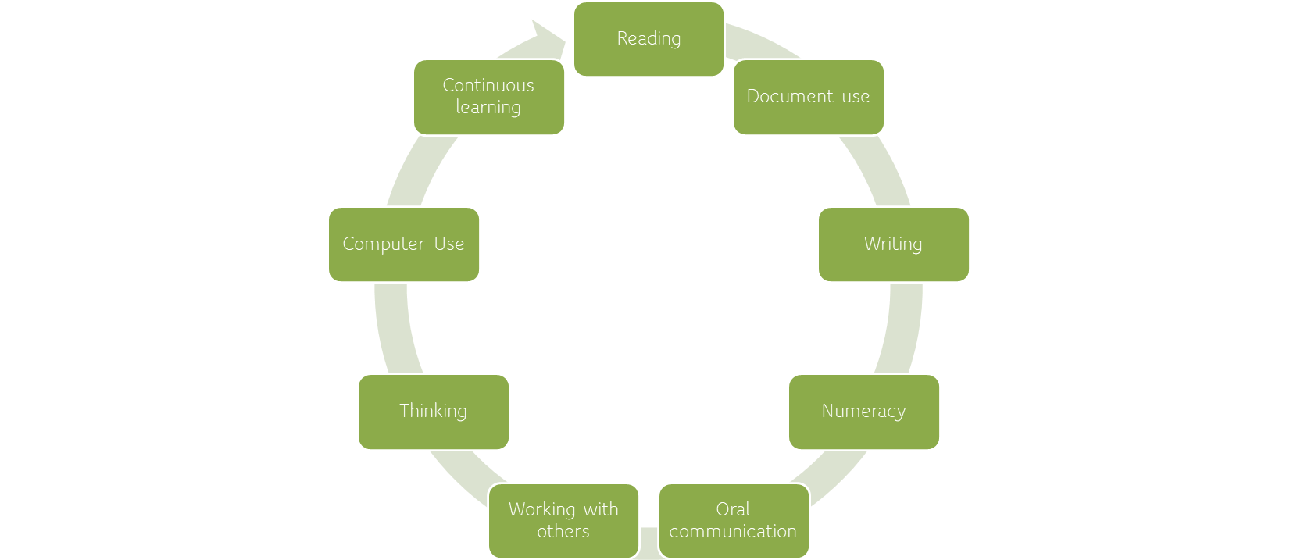
NINE Original Essential Skills
Notes:
When this Framework was developed, it identified nine Essential Skills: reading, document use, writing, numeracy, oral communication, working with others, thinking, computer use, and continuous learning. Many of you in LBS and in other areas have worked with the Essential Skills in many ways.
The Essential Skills have been in existence for 25-30 years.

Slide 7
Essential Skills
1980’s to 2020
Human Resources Development Canada (HRDC)
National Occupation Classification (NOC Codes)
Essential Skills Profiles
Notes:
When the Essential Skills Framework was originally developed, the federal organization responsible was Human Resources Development Canada, or HRDC. That organization no longer exists; it is now ESDC.
Along with the actual Essential Skills Framework, there was all kinds of work and research that went into developing resources and the Essential Skills Job Profiles. A lot of work and resources were tied to the Essential Skills Framework.
You may also be familiar with the National Occupation Classification, or NOC, codes. These accompanied the Essential Skills Framework and described different jobs and job categories in Canada.
All of that existed for a long time. Not much of it is currently available online, and if you try to search for it, you won’t find much.

Slide 8

Essential Skills are the ‘Velcro’ to which all other education and training ‘sticks’.
Notes:
One of my favourite catch-phrases back when I first started working with Essential Skills was this one: Essential Skills are the “Velcro” to which all other education and training sticks. No matter whether we call them Essential Skills or Skills for Success, Employability Skills or Workplace Learning Skills, I think this captures the essence of what they are. If you have strong skills in areas such as reading and writing, digital, communication, etc., any other kind of training or education you undertake will be that much easier to assimilate and move forward with.
This quote was from an organization called The Essential Skills Group, and I heard it in the mid-90s at a conference. Currently, my organization (CSC) is a partner with The Essential Skills Group for a number of things.
I realize that I forgot to introduce myself. My name is Barb Glass, and I am the Executive Director of the College Sector Committee for Adult Upgrading which is the LBS provincial support organization for the college sector. In the CSC, we have a number of other business we undertake. One of those is as a service provider for e-Channel. We administer and run the ACE distance LBS program.

Slide 9

2. Skills for Success
(…also for work, learning and life!)

Slide 10

Notes:
Before we talk about the Skills for Success, I would like to put in a promo for another upcoming webinar. Community Literacy of Ontario is delivering this one. CLO’s webinar on March 7 is going to take a look at the federal Skills for Success website and some of the strategies and resources available there. It’s different from this webinar because we aren’t going to look at that government website today. We’ll be talking about our own LBS projects.

Slide 11

Notes:
Earlier we looked at the nine original Essential Skills. Now we can look at the new Skills for Success! You will see that some of the skills are the same but others are different. In a few minutes, I will give you a side-by-side comparison of the two sets of skills. Creativity and innovation, for example, is a newly named skill. Collaboration and Adaptability are also newly named skills. Communication, reading and writing are similar to the originals.

Slide 12

From the Skills for Success website:
Source:https://www.canada.ca/en/services/jobs/training/initiatives/skills-success.html
Notes:
This slide is from the government’s website. This is the landing page for the Skills for Success website. This is the site that the March 7 webinar will explore. The government does seem to be adding to this website regularly.

Slide 13

Help
Help workers target the right skills to take advantage of new and emerging opportunities as part of upskilling/reskilling strategies
Support
Support the inclusion of vulnerable groups to get the skills needed to adapt to labour market changes
Facilitate
Facilitate entry of individuals facing skills barriers into skilled trade occupations
Meet
Meet anticipated increased demand for digital skills with enhanced guidance for that skill-set
Address
Address enduring gaps in foundational skills and respond to demands for new tools and supports to build social-emotional skills
Impact of Skills for Success on workers and the changing labour market
Notes:
This slide is from a webinar that I did about 18 months ago. It was provided by the federal government as a brief overview of how they see the impact of the Skills for Success on workers in the labour market. This was created just before the pandemic, but fortunately these impacts are still relevant today, perhaps even more so than before COVID.
Helping workers target the right skills, supporting the inclusion of vulnerable groups, facilitating the entry of individuals who are facing barriers into skilled trade occupations, meeting anticipated increased demand for digital skills, and addressing enduring gaps in foundational skills – I feel that is a good description of what we do in LBS as we know that there are enduring gaps in people’s skills, and we help them build those and move on.
A bit later on, I will refer back to this, particularly around some of the descriptions around vulnerable groups, around the skilled trades, and around digital skills.

Slide 14
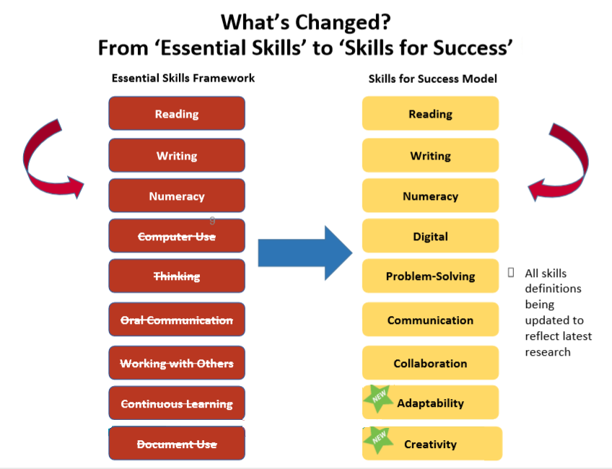
Notes:
So here’s the comparison chart. What has changed in terms of the actual skills from the Essential Skills framework to the Skills for Success framework can be seen here.
Reading, writing and numeracy exist with the same label. Not surprisingly, computer use has been renamed as digital which makes sense as it is a lot more than just using computers. Thinking has been renamed and redefined as problem solving, which also makes sense as problem solving encompasses a lot more than just thinking. Oral communication is now more broadly known as communication. Working with others is now collaboration, which I think is a neat term to include as the name of a skill. Continuous learning has been folded into a newly named skill called adaptability. Document use hasn’t been directly translated as creativity, but creativity has been added, and document use has been removed as a discrete Essential Skill. Instead, it has been embedded into some of the other skills.
As I mentioned earlier, all of the definitions related to these skills have been updated.

Slide 15

3. Skills for Success and OALCF
Notes:
For our last section of brief review, we will look at some of the connections between Skills for Success and OALCF. In case there is someone online today from outside of LBS, OALCF stands for the Ontario Adult Literacy Curriculum Framework which was modelled on that original Essential Skills Framework. It isn’t identical, but it is similar. The OALCF Framework is what we use in Literacy and Basic Skills programs.

Slide 16
Some Possible connections to the OALCF?
Reading
Writing
Digital
Creativity
Communication
A. Find and Use Information
Notes:
On this series of slides, you will see the OALCF competencies in the light orange coloured circles. The circles coming out of those competencies represent the new Skills for Success. The green circles don’t represent the only Skills for Success that relate back to the competency, they just show some of them.

Slide 17
Some Possible connections to the OALCF?
Reading
Writing
Digital
Creativity
Collaboration
Communication
B. Communicate Ideas and Information
Notes:
Competency B is “communicate ideas and information”. I put in “collaboration” here. It could also be used in “find and use information”. Digital skills, creativity, and of course reading and writing because they are fundamental.

Slide 18
Some Possible connections to the OALCF?
Reading
Problem Solving
Digital
Creativity
Collaboration
Writing
Numeracy
C. Understand and Use Numbers
Notes:
Understand and use numbers. I have included problem solving here, but that could certainly relate to many competencies. This competency involves almost every one of the Skills for Success.

Slide 19
Some Possible connections to the OALCF?
Reading
Writing
Digital
Creativity
Collaboration
Adaptability
Problem Solving
Numeracy
D. Use Digital Technology
Notes:
Digital Technology. I put eight skills here, but the ninth one would also probably apply because, as we all know, the use of digital technology incorporates so many areas of skill.

Slide 20
Some Possible connections to the OALCF?
Reading
Writing
Digital
Creativity
Collaboration
Adaptability
Problem Solving
E. Manage Learning
Notes:
Manage learning. These are the bubbles I attached for this presentation. I didn’t include communication, but it is almost implicit in any of them.

Slide 21
Some Possible connections to the OALCF?
Reading
Communication
Digital
Creativity
Collaboration
Adaptability
Problem Solving
F. Engage With Others
Notes:
Engage with others. Certainly, one need some adaptability when engaging with others. We talked about that in different contexts in the workplace and in learning and in relationships.

Slide 22


4. Skills for Success Phase 1 for LBS
Notes:
For the rest of today’s presentation, we will talk about our own LBS Skills for Success projects, how they came about and what they are.

Slide 23
Skills for Success Funding for LBS – Phase 1
In Fall 2022, the Ontario Ministry of Labour, Immigration, Training and Skills Development (MLITSD) received funding from the federal government’s “Skills for Success” program.
(Employment and Social Development Canada - ESDC)
Phase 1: 2022-23
Phase 2: 2023-24
Notes:
About a year ago, the Ministry of Labour, Immigration, Training and Skills Development applied for funding from the federal government’s Skills for Success program that could be used in LBS. The Ministry met with the support organization Executive Directors and with some of the literacy networks to let us know that they had applied for this funding and that they were hoping to be able to start allocating it in April of 2022. However, a provincial election happened, and during an election the government can not give out funding or make any announcements. Therefore, it wasn’t until several months later that the Ministry got this funding from Employment and Social Development Canada. That meant that the work that Ministry hoped could get done between April 2022 and March 2023 had to be condensed into a five-month period.

Slide 24
Phase 1
SFS funding for LBS is related to these 5 themes:
Apprenticeship Integration
Better Jobs Ontario Integration
Expanding and Enhancing
Digital Delivery
Supporting
Underrepresented Groups
Workplace Delivery
Notes:
In November 2022, the Ministry did make some funding available for what they are calling Phase 1 of their Skills for Success project. The Phase 1 funding, which did not go to service providers, relates to these five themes: Apprenticeship integration, Better Jobs Ontario integration, expanding and enhancing digital delivery, supporting underrepresented groups, and workplace delivery. Some of you are familiar with Better Jobs Ontario, but most of you are probably much more familiar with its predecessor, the Second Career program. Second Career was redesigned over the last couple of years and relaunched as Better Jobs Ontario (BJO).
These are the themes that our ministry identified as being important areas related to the Skills for Success funding. They didn’t consult with us, but they had to look at the federal funding requirements and how they could best integrate that into funding that could be applied to LBS.
Remember the slide about the impacts of the Skills for Success? Some of those items are important to these themes. For example, supporting people to get into skilled trades links with Apprenticeship integration. Enhanced digital delivery relates to the third theme. The term “vulnerable groups” is used which relates to supporting underrepresented groups. Those are some of the ways our provincial Skills for Success projects relate back to the broader federal government’s Skills for Success priorities.

Slide 25

The 10 provincial LBS support organizations and the 16 LBS regional networks received SFS funding in November 2022 to conduct different activities for Phase 1
Provincial Support Organizations for Literacy
Notes:
With the funding that was made available in November, the ten provincial LBS support organizations (including the CSC) and all of the sixteen LBS regional networks received Skills for Success funding to conduct different activities for Phase 1. I’ll describe those more in a minute.
I’m sure all of you are familiar with the regional LBS network in your area. The support organizations are related to the school board, community-based, colleges, cultural streams, Francophone, Indigenous and Deaf. We also have Laubach Literacy Ontario, Contact North and AlphaPlus. All of these organizations are who the Ministry came to do some development work with Phase 1 funding.

Slide 26
Eight of the 10 provincial LBS support organizations received funding in November 2022 to develop ‘curriculum resources’ under 4 of the 5 SFS themes:
Expanding and Enhancing
Digital Delivery
Supporting Apprentices
Supporting
Underrepresented Groups
Workplace Delivery
Notes:
Eight of the provincial support organizations received funding in November to develop curriculum resources. We were invited to apply under four of the five themes: digital, supporting apprentices (potential or current), supporting underrepresented groups, and workplace delivery. All of the support organizations indicated they wanted to participate. It was a lot of work in a short time. As a support organization ED, I would say that we are all still trying very hard to get all of this work done before the end of March.

Slide 27
Expanding and Enhancing
Digital Delivery
Two of the 10 provincial LBS organizations were invited to apply for Phase 1 SFS funding under Expanding and Enhancing Digital Delivery:
          AlphaPlus
    Contact North
Contact North is the support organization for the 5 LBS e-Channel (fully online) programs
Notes:
As I mentioned, eight of the ten support organizations received funding for curriculum resource development. The other two were invited to apply for Phase 1 funding under Expanding and Enhancing Digital Delivery. AlphaPlus – our digital and technology support organization – and Contact North were able to get some funding around the digital delivery theme. Contact North is here today because they host our Pop Up PD webinars. They are also the support organization for the five LBS e-Channel programs.
AlphaPlus’s funding was more in line with providing professional development opportunities as opposed to resources. You might have attended some of their PD sessions over the last few months. Contact North’s funding was related to the five LBS e-Channel programs to do some resource development.
There is a question in the chat about the theme that didn’t get funding – the Better Jobs Ontario integration. As you will see in the next slide, it did get funded through the regional networks.

Slide 28
“Curriculum resource” is very broadly defined for the purpose of this project:
- modules
- courses
- assessments
- other…
- new or updated
Can be for LBS learners, educators, or stakeholders
Expanding and Enhancing
Digital Delivery
Supporting Apprentices
Supporting
Underrepresented Groups
Workplace Delivery
Notes:
We’ll talk about the regional networks in a minute, but first we will finish on the curriculum resources topic. For the purposes of this Skills for Success funding and the requirement to develop resources, the term “curriculum resource” was very broadly defined. That was good, because we had such a short timeline to get these resources developed. The Ministry didn’t put a lot of parameters around what we could develop. In some cases, they are modules, they might be short courses, they might be assessments, they might be updating old resources that needed a refresher. There is quite a variety of things that have been developed in these last few months by the support organizations under the term “curriculum resource”. They were all developed under one of these four themes, and in a minute I will show you examples of some of the titles of those resources. They can be used not just for LBS learners but for our practitioners and educators or for other stakeholders who work closely with LBS. It was nice that there was a very broad definition of curriculum resources and who they could be developed for.

Slide 29
There are almost 200 resources currently being developed or updated by the provincial LBS support organizations.
You may have be involved in developing, reviewing, and/or piloting new resources
All Phase 1 development must be completed by March 31, 2023
New resources will be posted on a provincial repository.
Expanding and Enhancing
Digital Delivery
Supporting Apprentices
Supporting
Underrepresented Groups
Workplace Delivery
Notes:
Believe it or not, there are almost 200 resources currently being developed or updated by the provincial LBS support organizations. As I mentioned earlier, you or your support organization might have participated in some of that development work. We had to very quickly go out and hire people to do this work. The CSC, for example, was contracted to develop 27 resources. Community Literacy of Ontario was contracted to develop 35. CESBA, the school board sectoral organization, was also contracted for 27. That is only three out of the ten who were contracted to do this development work. When all of these resources are completed, we are looking at almost 200 new ones under the four themes you can see on the screen.
The Ministry is also working with Contact North to arrange a repository or a website as a place where we can access all of these new resources once they are completed. It won’t be the same as the OALCF portal where we go to retrieve the milestones and culminating tasks, it will be a different location.

Slide 30
Notes:
Let’s cut to the chase. On the next few slides, I will show you some examples of the approximately 200 resources that are being developed. Let’s look first under the Apprenticeship theme. Resources are being developed in both official languages and in ASL. I tried to pick examples to show the range of the resources that are being developed. The third one is for LBS educators as opposed to learners. The rest of the resources listed are for learners.
There is also a range in levels. The resources go from OALCF Level 1 to Level 3, depending on the organization who is developing them, their key stakeholders and the learners who would most often be associated with those sectors and streams.

Slide 31
Notes:
This is a sample of some of the digital resources being developed. The third one in this list is for LBS educators. The second last one is related to updating links on the Laubach Literacy Ontario website. Again, there is a range of topics that I have pulled out.
There is a question in the chat asking if these resources will be easily accessible once they are fully developed. Yes, the Ministry is arranging for them to all be posted on an easily accessible website once they are completed. Our colleagues at Contact North will be involved in the creation of that website and access to it. I don’t know when. The resources have to be developed by the end of March. The Ministry did say that organizations were welcome to share the resources to their respective groups before they are posted centrally, and I expect most of us will do that. For example, in the College sector, I will probably make those resources available before the Ministry’s site is up and running. There is no need for us to wait to share them, but it will be a while before they are all posted together on the site that the Ministry is creating in partnership with Contact North.

Slide 32
Notes:
Underrepresented Groups. This is one of the larger themes when it comes to the number of resources being developed. Again, a couple of these resources are directed towards educators, although most of them are directed towards learners. There is a variety of levels, depending on the organization that produces the resource.

Slide 33
Notes:
Here are some sample resources from the Workplace theme. As you can see, some are specific to an occupation. For example, Retail and Material Handling. Most are a little broader, as you can see from the resources in this list.

Slide 34
The 16 LBS regional networks received funding in November 2022 to conduct community integration projects under 4 of the 5 SFS themes:
Integration of LBS
to Support Apprenticeship
Integration of LBS
to Support Better Jobs Ontario
Services for
Underrepresented Groups
Workplace Delivery
Notes:
We just talked about the work of the ten provincial LBS support organizations. The sixteen regional networks also received funding in November 2022. Their work was not about creating resources; it was about creating, enhancing, discovering and building some community integration processes under the four themes on the right hand side of the slide. Integration to support apprenticeship, integration to support Better Jobs Ontario (previously Second Career), services for underrepresented groups, and workplace delivery.
You will recall that the support organizations were not funded to develop Better Jobs Ontario resources because it isn’t really a resource category, it’s more of a process and integration category. The regional networks were not funded to do anything around digital delivery because that is more of a resource-based theme.
I’ll describe briefly what the regional networks have been working on under these four themes.

Slide 35
“Enhance local planning and coordination to support the integration and alignment of LBS services with Apprenticeship”
“Enhance local planning and coordination to support the integration and alignment of LBS services with Better Jobs Ontario”
Integration of LBS
to Support Apprenticeship
Integration of LBS
to Support Better Jobs Ontario
Notes:
You will see quite a similarity in the definitions that I am showing on the slide. You can see in both descriptions that the work of the regional networks is about local planning and coordination. The Ministry asked them to branch out a bit and look in their regions and communities at possibilities for better integrating LBS to support apprentices and to support Better Jobs Ontario clients. Their work has been concrete but not in the sense of developing resources. It has been about communication, coordination, planning, developing new partnerships or enhancing existing partnerships around these themes with the ultimate goal of being able to better integrate LBS with them.

Slide 36
“Enhance local planning and coordination to support service delivery pilots focused on underrepresented groups”
“Develop processes and tools to support the completion of organizational needs assessments to support workplace service delivery pilots”
Services for
Underrepresented Groups
Workplace Delivery
Notes:
The other two themes under the regional networks’ funding are underrepresented groups and workplace. Again, there is a similar definition in terms of local planning and coordination to support services for underrepresented groups. That can look very different depending on where in the province you are located. I am in the North, and our MidNorth Network for Adult Learning would have a different set of underrepresented groups or different priorities for those groups than Metro Toronto Movement for Literacy would. Their priorities for underrepresented groups are going to be quite different, but that’s fine because the regional networks were asked to focus on the underrepresented groups and the needs of those groups within their own regions.

Slide 37

Communities of Practice (CoP)
“Communities of practice are groups of people who share a
concern or a passion for something they do and learn how
to do it better as they interact regularly.”
- Etienne Wenger
Notes:
Those slides describe what the work has been around Phase 1 of the Skills for Success funding that our Ministry received from the federal government. Another requirement of the support organizations and the regional networks was to create and participate in one or more communities of practice related to the themes of the project. I have included a definition on the slide: “Communities of practice are groups of people who share a concern or a passion for something they do and learn how to do it better as they interact regularly.” The Ministry felt it was important that we establish communities of practice. They didn’t establish them for us. They told us to figure out what that would look like related to the work on the Skills for Success project.

Slide 38

Communities of Practice (CoP)
All organizations participating in Phase 1 have been required to participate in one or more CoPs.
CoPs have been meeting monthly.
Notes:
We have five different communities of practice that are currently in place related to this project. I will list them on the next slide. We have been meeting monthly to discuss our work and to share information and to try to develop the actual community of practice, because it doesn’t just happen. As a group of people with a shared topic or passion, it takes some time to figure out what the community of practice looks like and what it might do. Given the short timelines we are working with, we have not been able to delve as deeply into things as what a community of practice normally would do. But they have been great meetings to share and support one another during this development work.

Slide 39
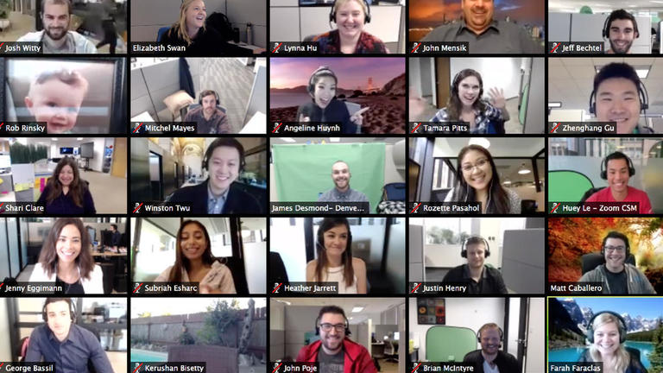
Communities of Practice (CoP)
There are five CoPs at this time:
Provincial LBS Support Organizations:
1 CoP for all five SFS themes
Regional LBS Literacy Networks:
1 CoP for each of four themes
Apprenticeship Integration
Better Jobs Ontario Integration
Supporting Underrepresented Groups
Workplace Literacy
Notes:
Right now, as I mentioned, there are five of them. The ten provincial LBS support organizations have one community of practice for all of the Skills for Success themes, no matter what we are working on. The regional networks decided they would establish a separate community of practice for each of the four themes that they are working on. They each have a lead person. For Apprenticeship, Matt Shulman from Peel Halton Dufferin Network is the lead. For Better Jobs Ontario, it’s Adult Basic Education in Hamilton (Sara Gill) leading that one. The underrepresented groups community of practice is being led by the Rideau Ottawa Valley Literacy Network, and Lisa Ambaye is the chair. For workplace literacy, Literacy Link South Central has provided the lead (Tamara Kaattari). To be a lead for a community of practice was strictly voluntary, there was no extra funding. These people stepped up to lead and coordinate the communities of practice.
For the support organizations, myself and Robyn Cook-Ritchie, the ED of Laubach Literacy Ontario, are the leads for those communities of practice. We do interact and go to each other’s meetings. Three times during the project, all of the leads have met with the Ministry, because they are interested in following the work of the communities of practice as well. We have one more meeting with the Ministry coming up before everything wraps up.

Slide 40
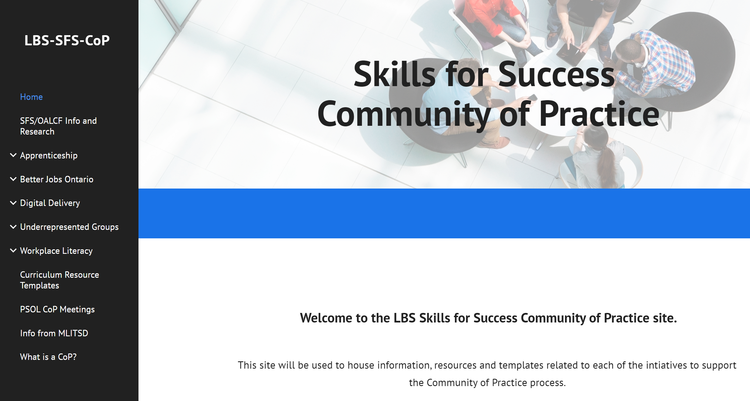
https://sites.google.com/laubach-on.ca/lbs-sfs-cop/home?pli=1
Notes:
We do have a website related to the Skills for Success Community of Practice. The link is on the screen. It’s not an official Ministry site or an official site at all. Robyn created this site so that we, as people working on Phase 1, would have a place to go to post information, meeting notes, etc. You are welcome to have a look. There is nothing private on it. You can see on the menu on the left the various topic areas. There is information about the work that is going on. We add to the website as things develop, and I would say that it will continue to exist into Phase 2.

Slide 41


5. Skills for Success Phase 2 for LBS
Notes:
Now let’s talk about Phase 2 of the project. Phase 1 will be wrapped up by March 31. So what will Phase 2 look like? It’s the same funding from the federal government. Phase 2 is the 2023-2024 fiscal year. Work hasn’t begun yet, but in the next few slides I will describe what it will look like.

Slide 42
Who could apply for Phase 2 Funding?
The 10 provincial LBS support organizations
The 16 LBS regional networks
All LBS service providers
Funding applications were submitted through the LBS business planning process for 2023-24
Applying for Phase 2 funding is voluntary.
Notes:
Who could apply for Phase 2 funding? The ten provincial support organizations were invited to apply for more curriculum resource development. The sixteen regional networks were invited to apply for more of that local planning, coordination and integration work under the different themes.
What is different about Phase 2 is that all LBS service providers were invited to apply for funding. Some of you may be with organizations that applied.
Funding applications for Phase 2 work were part of the annual business planning process for LBS. If you are involved in that process, you will know that those plans were due January 27. Business planning happens every year, and they are how we apply for the next year’s funding. This year, in addition to the regular business plan process, the Ministry put a portion of the business plan to include being able to apply for Phase 2 funding for the Skills for Success projects. This was completely voluntary; no one had to apply.

Slide 43
For Phase 2, 8 of the 10 provincial LBS support organizations were again invited to apply for more curriculum resource development under
3 of the 5 SFS themes:
Supporting Apprentices
Supporting
Underrepresented Groups
Workplace Delivery
Notes:
If you think back to my description of Phase 1, eight of the ten support organizations were invited to apply under four of the five themes. This time, for resource development, we were invited to apply under three of the five themes. This year, we were not invited to apply under digital delivery. I think of those eight, everyone has applied for more curriculum resource development. In addition to the 200 resources being developed in Phase 1, there will be more in Phase 2. It won’t be another 200, but I don’t know just what will be funded.

Slide 44
Expanding and Enhancing
Digital Delivery
Two provincial LBS organizations were again invited to apply for Phase 2 SFS funding under Expanding and Enhancing Digital Delivery:
          AlphaPlus
    Contact North
Contact North is the support organization for the 5 LBS e-Channel (fully online) programs
Notes:
Similar to Phase 1, both AlphaPlus and Contact North were invited to apply under the digital delivery theme. This slide is identical to one I showed you earlier, except that it says Phase 2 instead of Phase 1. The five e-Channel providers can get funding for resource development through Contact North’s funding for this project. AlphaPlus will again be involved in some development work and PD and training related to expanding and enhancing digital delivery.

Slide 45
For Phase 2, the 16 LBS regional literacy networks were invited to apply for more community integration projects under
4 of the 5 SFS themes:
Better Jobs Ontario Integration
Apprenticeship Integration
Supporting
Underrepresented Groups
Workplace Delivery
Notes:
Let’s move on to what the regional networks were invited to apply for. They were invited to apply for more of the community integration work under the same four themes: Better Jobs Ontario, Apprenticeship, supporting underrepresented groups, and workplace.
I glossed over the workplace delivery piece a bit when I was talking about Phase 1. Let me just go back to that, because Phase 2 is a continuation of Phase 1. The regional networks were funded to do something called organizational needs assessments with interested employers in their local areas. These are intended to help employers identify training needs for their employees, and then by extension, the regional networks could suggest ways in which LBS could provide some of that workplace training, if the LBS agency in that area was interested. The workplace delivery theme for the regional networks is a lot about organizational needs for employers in their area.

Slide 46
For Phase 2, all LBS service providers were invited to apply for service delivery pilots under 3 of the 5 SFS themes:
Better Jobs Ontario Integration
Supporting
Underrepresented Groups
Workplace Delivery
Notes:
Here is the new piece for Phase 2. Service providers were invited to apply for service delivery pilots under three of the five Skills for Success themes: integration with Better Jobs Ontario, supporting underrepresented groups, and workplace delivery. As I mentioned earlier, some of you may have been involved with preparing that application for Phase 2 funding. Some of you may not have heard about it at all! A number of service delivery providers did apply for pilots. That work would take place some time between April 1, 2023 and March 31, 2024. Currently, the Ministry is looking at the applications to determine who will be funded for what in Phase 2.

Slide 47

SFS Phase 2 Service Delivery Pilots
Must relate to one of the 3 themes for service delivery on previous slide
Total funding for a delivery pilot must not exceed the Ministry’s “maximum cost per learner” for the applicable cultural stream
If funding exceeds maximum cost per learner, rationale must be provided
Can not include curriculum development costs
Notes:
What do the service delivery pilots look like? There weren’t a lot of requirements around service delivery pilot applications other than that they had to relate to one of the three themes that we saw on the previous slide. The LBS service provider was allowed to ask for funding to cover all of the costs of the service delivery pilot, so everything from staffing to technology to training supports, textbooks if they were needed, laptops, etc. There was really no restriction on what one could ask for except that service providers could not include curriculum development costs in their application.
The total funding for a delivery pilot was limited only by the Ministry’s maximum cost per learner for each applicable cultural stream. In LBS, we have four cultural streams: Anglophone, Francophone, Indigenous and Deaf. A few years ago, in the absence of a funding model for LBS, the Ministry looked at the funding that was being provided to service providers and the number of learners served, targets associated with that funding, and all of the different cultural streams. They came up with two things: one figure was the average cost per learner in a cultural stream, and the other was the maximum cost per learner. The application to apply for the Phase 2 Skills for Success funding had the one requirement that the total funding a service provider was asking for couldn’t exceed the maximum cost per learner for their cultural stream. For example, in the Anglophone stream the maximum cost per learner is $2500. If I wanted to do a pilot project with ten learners, then the maximum amount of money I could ask for is $25,000. If I wanted to ask for more than that, I would have had to provide a rationale as to why.
That’s a short version of what the requirements for service delivery pilots were. The nice thing is that it wasn’t too prescriptive, i.e., the Ministry didn’t put a lot of requirements around what could or couldn’t be done. Work just had to relate to one of the three themes, and funding was related to the maximum cost per learner.

Slide 48

MLITSD Priorities related to SFS Projects
Inform the development of a funding model for LBS – how much does program development and delivery really cost?
Inform the full implementation of the LBS performance management framework
Support LBS renewal
Notes:
In terms of the Ministry’s priorities related to the Skills for Success projects, what they have communicated to support organizations and regional networks is that around all of the themes, they are trying to use the costs associated with the Phase 1 and 2 Skills for Success work to inform what we don’t have right now. We don’t have a funding model for LBS, and we never had. The Ministry has said that they don’t really know how much it costs to deliver and support LBS and to do program development work. They are trying to get a handle on the real costs through these projects.
The second thing that the Ministry is prioritizing is the full implementation of the LBS Performance Management Framework. Some of you work with LBS performance measures every day, depending what your role is in your organization. They are looking at doing further work with our Performance Management Framework, but they haven’t given us any details on what that might look like.
Overall, they are trying to provide some renewal to LBS with this project funding from the federal government. We know, as LBS providers, that the LBS program has not received much attention at all in its 25 years of existence, so some would say that this is a nice thing to have this injection of funding into LBS right now.

Slide 49

Wrap-up & Questions
1. Essential Skills
2. Skills for Success (SFS)
3. SFS and OALCF
4. S4S Phase 1 for LBS
5. S4S Phase 2 for LBS
6. Next Steps
7. Wrap-Up
Brief Review Only!
Notes:
This is the original agenda that I should you at the beginning of today’s webinar. We took some time to review the Essential Skills, the new Skills for Success framework, and the links between Skills for Success and OALCF. We talked about Phase 1 of the Skills for Success funding related to resource development work by the support organizations and more community integration work from the regional networks. Phase 2 is about those two things again but also has the service delivery pilot opportunities attached to it.
Next steps will be for the Ministry to determine who gets funding for Phase 2 based on the applications they received through the business planning process. The most immediate next step for those of us involved in Phase 1 is to finish up that work.
Thanks to Rebecca and Carolyn, our ASL interpreters. Thanks to Deaf Literacy Initiative for providing the interpreters. Thanks to COFA for French translation. Thanks to Heather for moderating and being in the background and to Stacey for technical support.
Thanks to all of you for attending today. I hope you have gotten some new information, and I hope to see you at the next Pop Up PD.

Slide 50

Thank you!
Webinar resources: Pop Up PD Resources for LBS Educators
Webinar evaluation: https://tinyurl.com/4sd868dn
Notes:
There is a question in the chat asking about the lead for the Better Jobs for Ontario Community of Practice. That is Sara Gill, Executive Director of the Adult Basic Education Network in Hamilton.

