Slide 1
MILESTONES & CULMINATING TASKS
WHERE ARE WE NOW?
Presented by Barb Glass & Robyn Cooke-Ritchie
culminating
&
milestones
tasks
The new milestones and culminating tasks developed in 2021-22 are now available
for use by LBS programs and translation between French and English is complete.
In this webinar, we’ll provide an overview of these new ones and how to access them,
along with the new user guides and indexes that are currently being updated for both milestone and culminating task administration.
OCTOBER 26 @ 2—3:30PM
& REPEATED NOVEMBER 30 @ 10—11:30AM

Slide 2
STATEMENT OF RECOGNITION
While we meet today on a virtual platform, let’s take a moment to recognize, respect and acknowledge the importance of the lands we occupy and from which we benefit.
Today, let’s reaffirm our commitment and responsibility to improve relationships between nations -- and our own understanding of local Indigenous peoples and their cultures.
Let’s remind ourselves that, wherever we are, we live on the ancestral and unceded territory of Inuit, Métis, and First Nations people.

Slide 3
ABOUT POP UP PD FOR LITERACY EDUCATORS
free webinar series developed by Ontario’s LBS Regional Networks & the Provincial Support Organizations for Literacy
supports LBS practitioners with presentations on topics important to them
English language webinars presented for LBS practitioners annually since 2015-2016
all webinar presentations, recording links & transcripts here:
Pop Up PD Resources for LBS Educators
webinar topic ideas welcome at: e-channel@contactnorth.ca

Slide 4
Topics
Development Timelines
Milestones
Culminating Tasks
The Repository
Next Steps and Wrap-Up

Slide 5
Development Timeline
2011
22 Milestones are adapted
12 new Culminating Tasks
2022
2014
7 Milestones adapted for the Deaf/Deafblind stream
Original 60 and 22 adapted milestones updated
Milestone Guide updated
2024
Original 6 plus additional 12 Culminating Tasks being updated
Culminating Task Guide being updated
2022-2023
6 Culminating Tasks
33 new Culminating Tasks
30 new Milestones
60 Milestones

Slide 6
In 2022
30 New Milestones | 33 New Culminating Tasks
7 Find and Use Information 9 Communicate Ideas and Information 6 Understand and Use Numbers 6 Use Digital Technology 1 Manage Learning 1 Engage with Others | 5 Apprenticeship 4 Apprenticeship – Skills Training 21 Employment 1 Independence 1 Secondary School Credit 1 Postsecondary

Slide 7
Milestones
A milestone is a goal-related assessment activity that learners complete to demonstrate their ability to carry out goal-related tasks. Milestones are aligned to the competencies and complexity levels found in the OALCF curriculum framework and are standard indicators of learner progress towards completion of goal path. Milestones answer the question, “Can learners apply the skills they are developing to purposeful tasks?”
Source: LBS Service Provider Guidelines, March 2020, page 16

Slide 8
“Learners will not be expected to perform every milestone task; they will only perform those tasks that are appropriate to their goal path and reflect what they need to focus on in the LBS Program.”
“Furthermore, milestone tasks are not intended to become the sum total of a learner’s program; instead, they are intended to support program delivery by informing instructional content and by providing common criteria for tracking learner progress.”
Source: Practitioner Guide to Task-Based Programming, Employment Ontario, p. 18

Slide 9
Learners who perform increasingly complex tasks can:
make inferences to determine task requirements
apply background knowledge and experience to carry out unfamiliar tasks
manage tasks with unfamiliar elements
identify a variety of ways to complete tasks
find, integrate and analyze information
experiment and problem solve to achieve desired results
Practitioners work with learners to choose milestones that represent the kind of tasks learners need to be able to do once they transition out of LBS.

Slide 10
What is an “adapted” milestone?
Adapted milestones are intended to support learners with limited reading skills.
Both the original and adapted versions assess abilities at the same level.
Practitioners should review both versions to determine which version suits the individual needs of the learner.
22 of the 60 milestones are available in a version adapted to face-to-face administration.
They are identified in the Milestone Index by the use of “-a” next to the milestone number in the milestone file name.
Source: Milestones User Guide, March 2014, Employment Ontario, p. 11

Slide 11
Milestones with an Adapted Version
Level 1 | Level 2/3 | No Level
1, 2, 8, 9, 15, 18, 19, 20, 27, 28, 37, 41, 45, 48, 49, 54, 57 | 58, 59 | 14, 36, 60

Slide 12
Deaf/Deafblind Stream Milestones
In 2023, seven of the new 2022 milestones were adapted for use with the Deaf/Deafblind stream.
Competency/Task Group/Level | Milestone # | Description
Find and Use Information (A1.2) | 202-d | Refer to a classroom policy
Communicate Ideas and Information Interact with Others (B1.1) | 208-d | Describe a familiar event or experience related to Deaf/Deafblind culture or communities.
Communicate Ideas and Information Interact with Others (B1.1) | 209-d | Provide information person, place or thing in your life
Communicate Ideas and Information Write Continuous Text (B2.2) | 212-d | Write a brief story to describe the context from an ASL video
Communicate Ideas and Information Write Continuous Text(B2.3) | 214-d | Write an essay on challenges Deaf/Deafblind people have faced in recent times, and what values have guided them through
Understand and Use Numbers Manage Money (C1.2) | 219-d | Calculate the cost of making a De’VIA art piece sculpture of ASL handshapes to determine a fair price to charge
Digital Technology (D.1) | 223-d | Use app(s) or feature(s) on a smartphone, tablet or computer

Slide 13
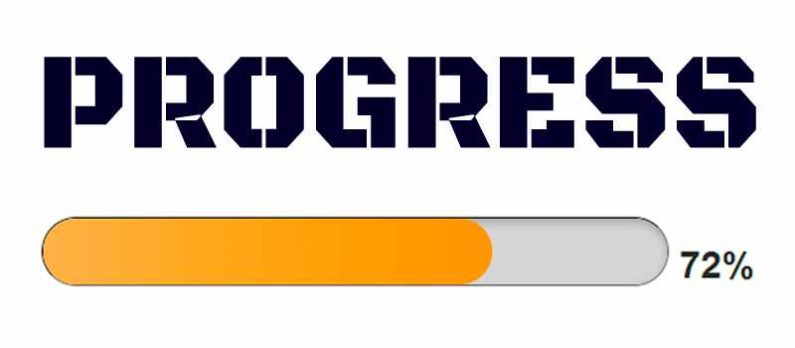
Milestones and Performance Management
Dimension-Effectiveness (W-50%) Measure #4: Learner Progress (W-30%)
Based on both active and closed service plans.
It is the percentage of learners who have successfully completed at least one milestone.
Data comes from “attained” competency plan items.
2023-2024 target: 60%
• Learner Progress (30%) is a measure of the successful completion of the required milestones on a learner’s goal path.
Source: LBS Service Provider Guidelines, March 2020, p.30

Slide 14
Preparing Learners for Milestones
Does the learner understand the purpose of the milestone and how it relates to their goal?​
Has the learner received instruction on similar tasks? ​
Has the learner successfully completed similar tasks? ​
Does the learner feel ready to try an assessment task?

Slide 15
How many Milestones?
This Photo by Unknown Author is licensed under CC BY

Slide 16
The New Milestones-Who Did What?
Organization | Deliverables
Centre FORA | 6 French language milestones
Coalition ontarienne de formation des adultes (COFA) | 6 French language milestones
College Sector Committee for Adult Upgrading (CSC) | 3 Level 3 milestones
Community Literacy of Ontario (CLO) | 2 Level 1 milestones
Contact North | Contact Nord | Update/undertake revisions to online repository to reflect new indicators (and any related technical work); Support LLO in developing the milestones development instructions.
Continuing Education School Board Administrators (CESBA) | 3 Level 2 milestones
Ontario Native Literacy Coalition (ONLC) | 6 culturally specific milestones
Laubach Literacy Ontario (LLO) | Create a streamlined standard process to guide the development of additional OALCF that includes seeking and reflecting input from key stakeholders to ensure relevance and to support recognition. Coordinate and support the development of additional milestones. As part of finalizing new or redesigned milestones, LLO will ensure that these are reviewed and vetted by a third-party, separate and distinct from the Support Organization that develops them.

Slide 17
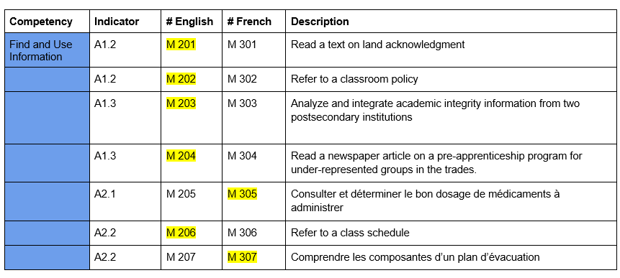
New Milestones- Find and Use Information

Slide 18
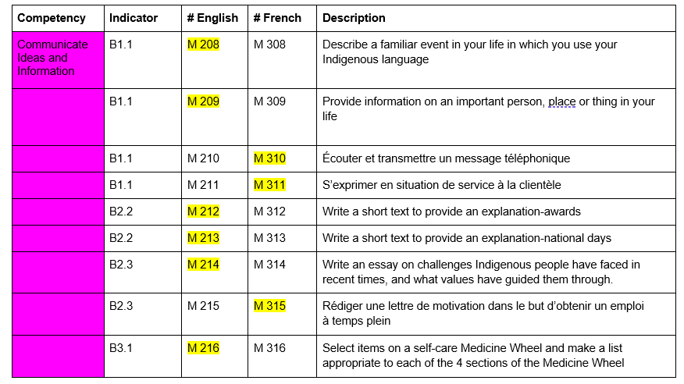
New Milestones- Communicate Ideas and Information

Slide 19
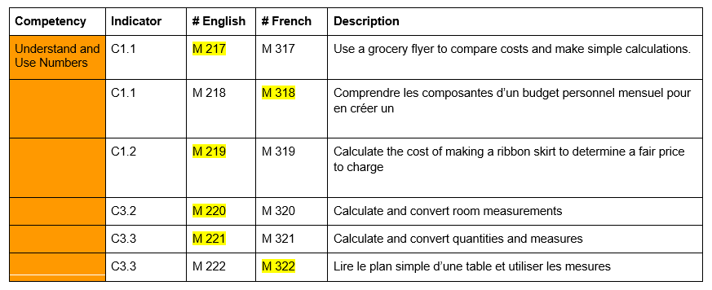
New Milestones- Understand and Use Numbers

Slide 20
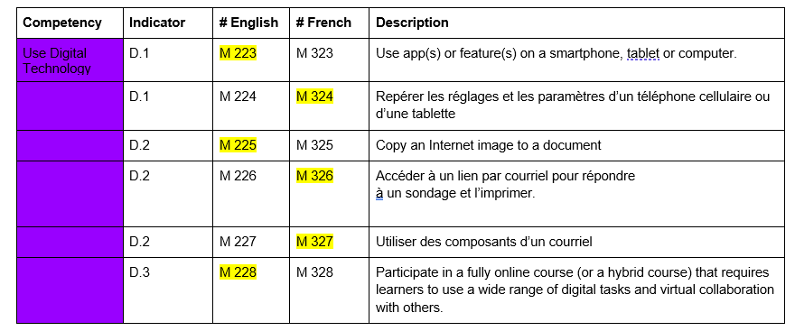
New Milestones- Use Digital Technology

Slide 21
New Milestone- Manage Learning

Slide 22
New Milestone- Engage with Others

Slide 23
2022 Milestone Revisions
Original 60 milestones + 22 adapted milestones were reviewed and revised.
Milestone Guide and Index updated to include all 119 Milestones
Updated in all Milestones | Corrections in some Milestones | Content changes in some Milestones
Replaced gender person pronouns and possessive adjectives with gender neutral alternatives as long as it did not change of affect clarity Updated logo and copyright in footer Removed “on the next page” from first instruction under “Scoring” | Minor corrections to capitalization, articles, prepositions, spelling, spacing, etc. Corrected punctuation in list structures for consistency | Updated references to technology Updated inputs that were outdated Revised instructions in adapted (-a) milestones to make tasks parallel to the original milestones

Slide 24
119 Milestones
60 Original
22 Adapted for learners with limited reading skills
30 New
7 Adapted for the Deaf/ Deafblind Stream

Slide 25
Culminating Tasks
A culminating task is more complex than a milestone task and is also aligned to the OALCF. It reflects a task that a learner could expect to perform upon exiting the LBS program. A culminating task answers the question, “Can the learner manage the expectations of the learning, training, community or work setting after leaving the LBS program?”
Source: LBS Service Provider Guidelines March 2020, p. 16

Slide 26
What is a Culminating Task?
Culminating tasks are representative of the five goal paths in the OALCF.
A complex task.
Incorporates multiple competencies and task groups.
Culminating tasks allow learners to apply their skills and knowledge across competencies in a way that reflects real-life situations.
Culminating tasks represent the end point of a goal path.

Slide 27
Culminating tasks do not replace any credentials, courses, or certifications that learners may need to access their goal destination.

Slide 28
Transition readiness
There are many other elements that are involved in transition readiness including (but not limited to)
completion of any required academic courses/credentials;
completion of any required industry credentials;
stability of the learner’s personal life including health, finances, and family circumstances;
motivation and persistence of the learner
Source: OALCF Culminating Task- User Guide 2013 (EN). p3

Slide 29
Helps the learner answer the question:
“Do I have a reasonable chance of managing the next step in my life/learning/work, and can I transition successfully to my goal destination?”
Successful completion of a culminating task is one way for learners to demonstrate that they may be ready to transition to one of the goal paths.

Slide 30
The culminating task for a learner’s goal path is meant to bring together many elements of the learner plan.
Culminating
Task
Milestones
Integrated Tasks
Tasks/Task-based Activities
Daily Activities

Slide 31
Relationship to milestones
Goal
Culminating Task
Milestones
1
2
3

Slide 32
The New Culminating Tasks Who Did What?
Organization | Deliverables
Adult Basic Education Association (ABEA) Literacy Link Eastern Ontario (LLEO) Literacy Link Niagara (LLN) Literacy Link South Central (LLSC) Literacy Network of Durham Region (LINDR) Literacy Northwest (LNW) Literacy Ontario Central South (LOCS) Metro Toronto Movement for Literacy (MTML) Peel-Halton-Dufferin Adult Learning Network (PHDALN) Project READ Literacy Network Waterloo/ Wellington (Project READ) QUILL Learning Network (QUILL) Rideau-Ottawa Valley Learning Network | Réseau d’apprentissage de la Valée Rideau-Ottawa (ROVLN | RAVRO) The Mid North Network (MNN) Tri-County Literacy Network (TCLN) | Develop 2 culminating tasks for employment, apprenticeship, or skills training
Simcoe/Muskoka Literacy Network (SMLN) | Develop 1 culminating task for employment, apprenticeship or skills training

Slide 33
The New Culminating Tasks Who Did What?
Organization | Deliverables
College Sector Committee for Adult Upgrading (CSC) | Develop 1 specific OALCF culminating task for postsecondary goal path
Community Literacy of Ontario (CLO) | Develop one culminating task of OALCF independence goal path
Contact North | Contact Nord | Update/undertake revisions to online repository to reflect new indicators (and any related technical work); Support LLO in developing the culminating task development instructions.
Continuing Education School Board Administrators (CESBA) | Develop 1 secondary school credit culminating task that will show transition-readiness in line with the Ontario Adult Literacy Curriculum Framework.
Laubach Literacy Ontario (LLO) | Create a streamlined standard process to guide the development of additional OALCF that includes seeking and reflecting input from key stakeholders to ensure relevance and to support recognition. Coordinate and support the development of additional culminating tasks. As part of finalizing new or redesigned culminating tasks, LLO will ensure that these are reviewed and vetted by a third-party, separate and distinct from the Support Organization that develops them.

Slide 34
Apprenticeship Culminating Tasks
NEW | Construction Craft Worker
 | Early Childhood Educator
 | Carpenter
 | Prepare for Certificate of Qualification Exam
 | Heavy Equipment Technician
OLD | Apprenticeship Employment
 | Swimming Pool Construction
 | Training Options

Slide 35
Apprenticeship-Skills Training Culminating Tasks
NEW | Certificate Training
 | Personal Support Worker
 | Hairstyling Apprenticeship
 | Forestry
OLD | Program Research
 | Medical Office
 | Home Renovation

Slide 36
Employment Culminating Tasks
NEW | Delivery Driver | Stock Clerk
 | Retail Associate | Small Business Owner
 | Customer and Information Services Representative | Hospitality/Event Planner
 | High School Equivalency Test Readiness | Labourers Food Beverage
 | Use Digital Technology to Search for Jobs (also adapted for the Deaf stream) | Material Handler
 | Winery Assistant | Home Support Worker A
 | Light Housekeeping | Home Support Worker B
 | Administrative Assistant | New Employee Orientation
 | Greenhouse Worker | Small Business General
 | Manufacturing Related to Forestry | Natural Resources Industry
 | Shipper/Receiver

Slide 37
Employment Culminating Tasks
OLD | Fire Safety
 | Job Readiness
 | Food Service

Slide 38
Independence Culminating Tasks
NEW | Information on a Medicine Product Label
OLD | Personal Budget
 | Medical Form
 | Newspaper Ad

Slide 39
Secondary School Credit Culminating Tasks
NEW | Growth Mindset
OLD | Planning for a Credit Program
 | Completing a Credit Program
 | Resource Consumption

Slide 40
Post Secondary Culminating Tasks
NEW | Postsecondary Admission
OLD | Child Development
 | Emotional Intelligence
 | Water Use

Slide 41
Revision of Original 18 Culminating Tasks

Slide 42
2023 Culminating Task Revisions
Original 18 CTs were reviewed and are undergoing some revisions
Culminating Task User Guide and Index also being updated
In all 18 original CTs | Revisions in some CTs | Content changes in a few CTs
Replaced gender person pronouns and possessive adjectives with gender neutral alternatives as long as it did not change or affect clarity Changed names where applicable to promote equity/diversity Updated logo and copyright in footer | Several shortened/condensed Adjusted suggested completion time Updated/replaced prompts, sources, tables, dollar values, etc. updated to make them current in 2023 Adjusted questions/tasks to match updated sources and values Corrected punctuation in list structures for consistency | If source articles/activities were quite outdated, completely new CTs are being developed One in Apprenticeship & two in Postsecondary goal path

Slide 43
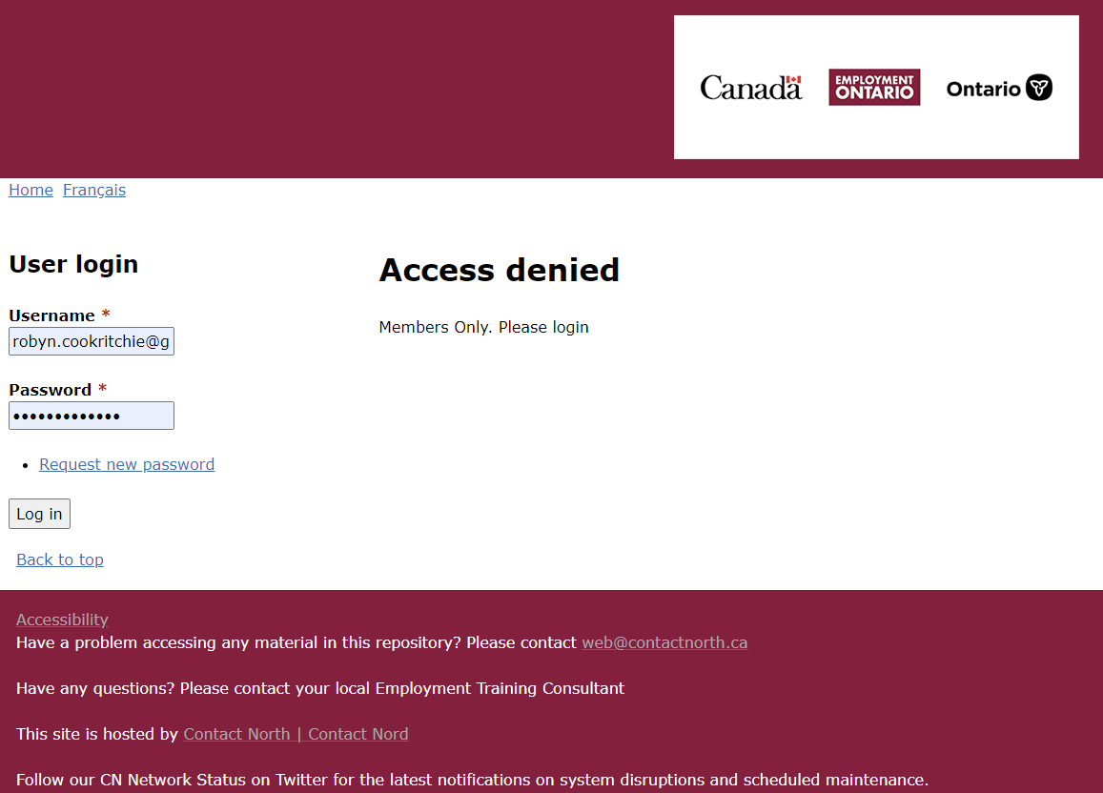
The Repository
https://oalcf-repository.ca/
You need to have username and password to access milestones and culminating tasks.
If you don’t have access but need it contact: Sarah Gauvreau at Contact North: sarahg@contactnorth.ca

Slide 44
To ensure that the milestones retain their integrity as an assessment tool and remain secure and confidential, milestones documents should be accessed directly from the repository.

Slide 45
REPOSITORY

Slide 46
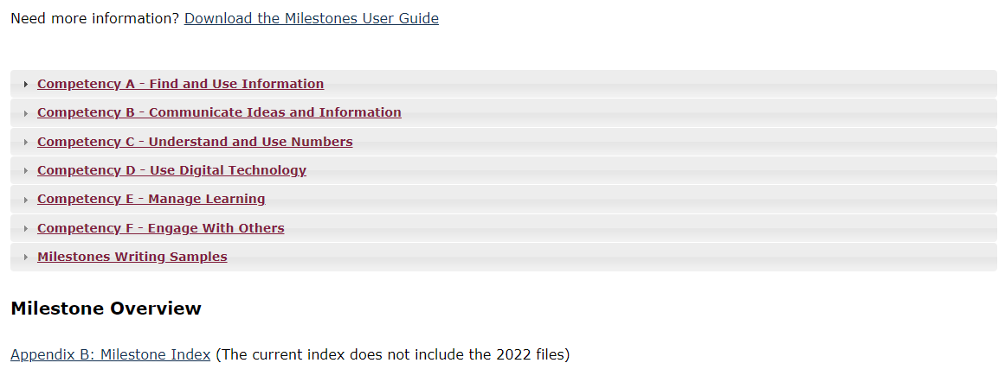
REPOSITORY

Slide 47
REPOSITORY

Slide 48
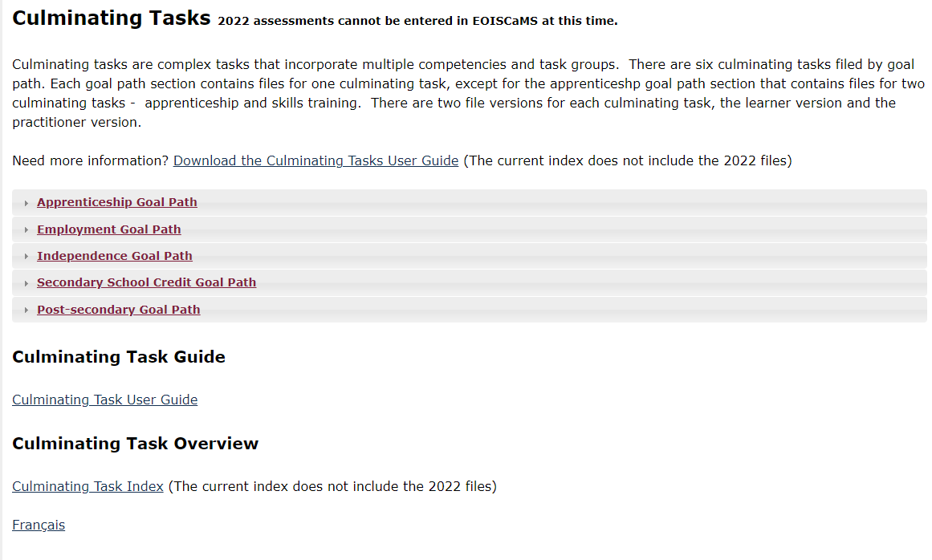
REPOSITORY

Slide 49
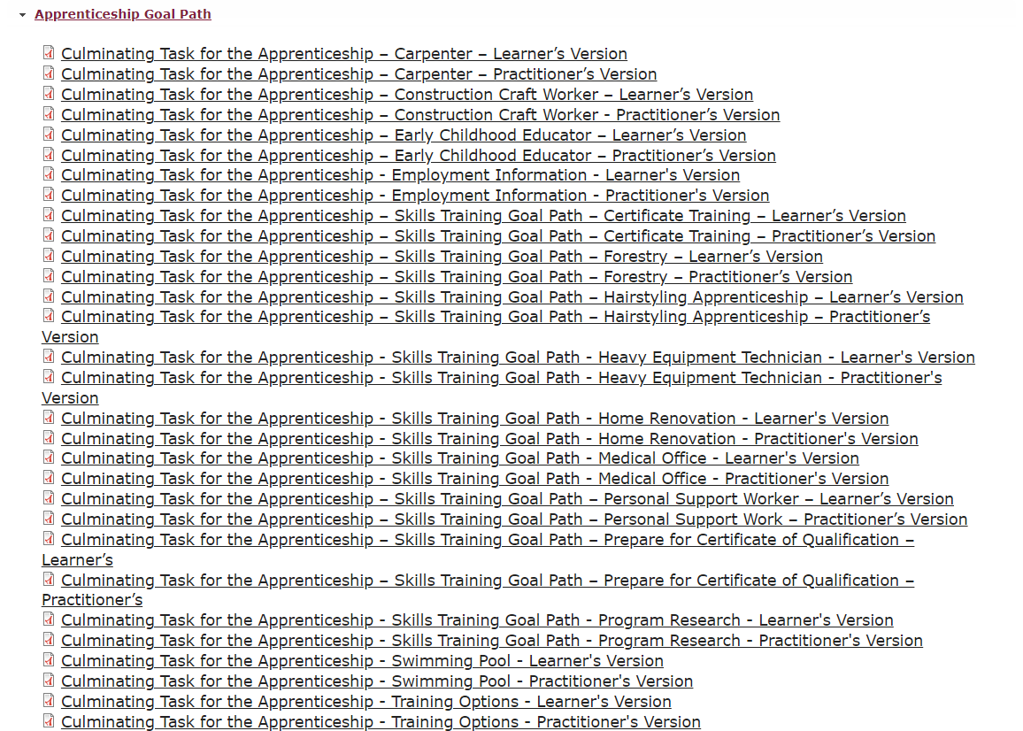
REPOSITORY

Slide 50
Going forward milestones and culminating tasks will be fixed or revised on an ongoing basis.
If you discover a mistake, error, issue, or omission when using a milestone or culminating task, please report it immediately using the form in the repository.

Slide 51
Assessment for Learners Accessing Multiple LBS Sites
when learners attend more than one in-person LBS service delivery site
when programs utilize a blended learning approach, by complementing in-person programming with LBS e-Channel service delivery
in either case the learner is co-registered with 2 LBS service providers
When more than one service delivery site contributes to a learner successfully completing an assessment, it is acceptable for one service provider to conduct the assessment with the learner and for both service delivery sites to document the achievement in their reporting to the ministry.
Source: MTCU LBS Memo, 2014: Clarification regarding the Administration of Milestone and Culminating Task Assessments for learners accessing multiple LBS sites

