Slide 1
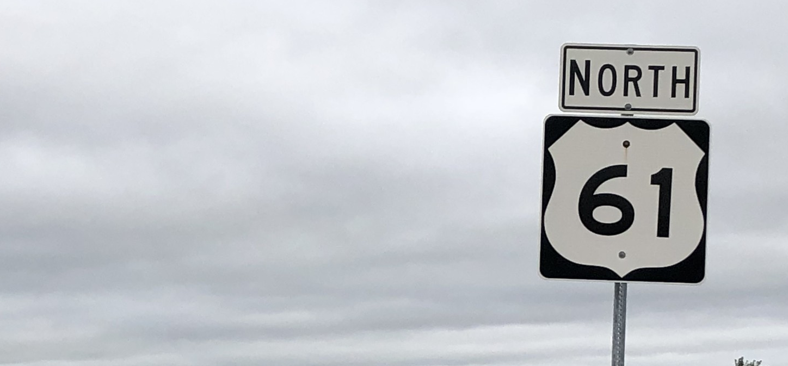
CaMS REPORT 61
HOW TO UNDERSTAND & USE YOUR LBS CASE ACTIVITY DATA
The CaMS Case Activity Report 61 is one of the most complex but most useful of the LBS CaMS reports. Join this webinar to learn more about sorting and accessing the case activity data in Excel so that you can better use and analyze it to support your LBS program and performance measures.
We will also look at specific examples of issues and anomalies in some sample case activity data to illustrate how it can be used to promote data integrity and consistency within your program.
SEPTEMBER 21 2:00—3:30PM

Slide 2
STATEMENT OF RECOGNITION
While we meet today on a virtual platform, let’s take a moment to recognize, respect and acknowledge the importance of the lands we occupy and from which we benefit.
Today, let’s reaffirm our commitment and responsibility to improve relationships between nations -- and our own understanding of local Indigenous peoples and their cultures.
Let’s remind ourselves that, wherever we are, we live on the ancestral and unceded territory of Inuit, Métis, and First Nations people.

Slide 3
ABOUT POP UP PD FOR LITERACY EDUCATORS
free webinar series developed by Ontario’s LBS Regional Networks & the Provincial Support Organizations for Literacy
supports LBS practitioners with presentations on topics important to them
English language webinars presented for LBS practitioners annually since 2015-2016
all webinar presentations, recording links & transcripts here:
Pop Up PD Resources for LBS Educators
webinar topic ideas welcome at: e-channel@contactnorth.ca

Slide 4
TODAY’S WEBINAR
QUICK REVIEW
1. LBS Performance Management Measures
2. LBS Detailed Service Quality Report #64
3. Other Reports Available from EOIS-CaMS
REPORT #61: LBS CASE ACTIVITY
4. Why Use Report #61
5. Navigating Report #61
5. Prepare a Copy for Easier Analysis
6. Dive into the Details
7. Taking it Further
WRAP UP

Slide 5
OTHER USEFUL RESOURCES
https://e-channel.ca/practitioners/resources/pop-up-pd/2021-2022-pop-up-pd-resources/
https://e-channel.ca/practitioners/resources/pop-up-pd/2022-2023-pop-up-pd-resources/

Slide 6
1. LBS PERFORMANCE MEASURES – QUICK REVIEW
Dimension | Core Measures Phase 11-A (Current) | Core Measures Phase 11-B (Future?)
Customer Service (40%) | 1. Customer Satisfaction (15%) | 1. Customer Satisfaction (?%)
 | 2. Service Coordination (25%) | 2. Service Coordination (?%)
Effectiveness (50%) | 3. Suitability/Learner Profile (20%) | 3. Suitability/Learner Profile (?%)
 | 4. n/a | 4. Completions (?%)
 | 5. Learner Progress (30%) | 5. Learner Progress (?%)
 | 6. n/a | 6. Learner Gains (?%)
Efficiency (10%) | 7. Learners Served (10%) | Learners Served (10%)

Slide 7
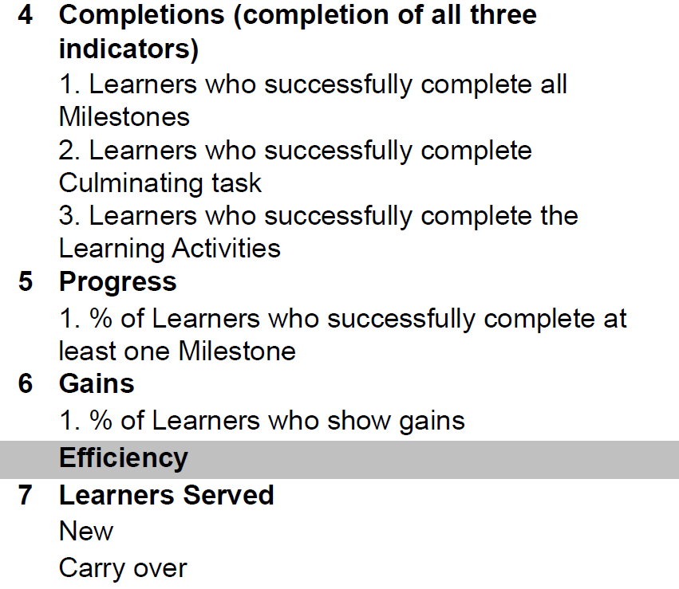
WHAT ABOUT #4 AND #6?
NOTE:
Data that feeds into #4 is currently captured in CaMS at exit and appears on the DSQ 64 report, but is not used to measure performance at this time.
#6 does not yet exist, but there is a place-holder in CaMS for Learner Gains data

Slide 8
LBS PERFORMANCE MEASURES (PHASE II-A CURRENT)
Dimension | Measure | Weight | Standard | SQS Value
Customer Service (40%) | 1. Customer Satisfaction | 15% | 90% | 1.35
 | 2. Service Coordination | 25% | 50% | 1.25
Effectiveness (50%) | 3. Suitability/Learner Profile (all 12 indicators) | 20% | 30% | 0.6
 | 5. Learner Progress | 30% | 60% | 1.8
Efficiency (10%) | 7. Learners Served | 10% | 90% | 0.9
 |  |  | SQS Standard | 5.9
PHASE II-A: FIVE MEASURES IN 2022-23
Notice #4 and #6 are not included

Slide 9
2.
DETAILED SERVICE QUALITY REPORT #64
The MOST IMPORTANT report.
The only performance measure report.
This is the report you use to:
Monitor your site’s monthly compliance with the 5 Core Measures
Complete your Interim Report and Final Report for the Ministry
NOTE: 4 of the 5 Core Measures tracked in the DSQ are based on CLOSED files only

Slide 10
OTHER USEFUL REPORTS
REPORT 60B: LBS-ALL DATA SERVICE PLAN/PROFILE
PDF: Monthly
Summarizes all plan/profile information for the current fiscal year
Gives you summary data for 4 of the 5 core measures
Available by site as well as regional and provincial rollup reports
REPORT 60D: LBS-ALL DATA OUTCOMES/FOLLOW-UPS
PDF: Monthly
Summarizes all outcome information for the current fiscal year
Gives you summary data on completions and outcomes at exit, 3, 6 and 12 months
Available by site as well as regional and provincial roll up reports
REPORT 61: LBS CASE ACTIVITY
Excel: Weekly
Shows all detailed data for all service plans that are “Open”, “Approved” or “Active” in the current fiscal year
Also includes data for service plans that are “Closed” within the current or previous fiscal year
Available by site
LBS Service Providers only – Ministry does not normally use this report.

Slide 11
OTHER USEFUL RESOURCES
https://e-channel.ca/practitioners/resources/pop-up-pd/2021-2022-pop-up-pd-resources/
https://e-channel.ca/practitioners/resources/pop-up-pd/2022-2023-pop-up-pd-resources/

Slide 12
4. WHY USE REPORT #61: LBS CASE ACTIVITY?
As a Service Provider, Report #61 is your quality assurance report.
The detail provided for each service plan allows you to find issues that are otherwise buried in the EOIS-CaMS system. You can then take corrective action.
If data is wrong or missing from this report, it will be wrong or missing in the other LBS reports.
In addition to improving data integrity, Report #61 data can allow you to gain insights into your learners, program and processes.

Slide 13
Report #61 contains (almost) every detail about each service plan.
The 114 columns (!) are fields that for the most part come from:
LBS Participant Registration Form*
Learner Profile
Referred In
Intake Assessment
Goal Path
First Plan Items
Training delivery
Competencies
Milestones
Learning activities
Referrals out
LBS Exit and Follow Up Form*
Exit
3 months
6 months
12 months
* Forms are updated periodically by the Ministry. Is your program using the latest versions?
Other fields, like Program Duration, are generated by the system.

Slide 14
LBS Participant Registration Form
Learner Profile
Referred In
Intake Assessment
Goal Path
First Plan Items
Training delivery
Competencies
Milestones
Learning activities
Referrals out
LBS Exit and Follow Up Form
Exit
3 months
6 months
12 months
Are there issues with data collection?
Data Entry in EOIS CaMS
Are there issues with data entry?
Timeliness
Accuracy
Completeness
Understanding which reasons to use in which situation
#60B: LBS Service Plan/Profile
#61: LBS Case Activity
#60D: LBS Outcomes/Follow Ups
#64: Detailed Service Quality
No issues? Time to celebrate!

Slide 15
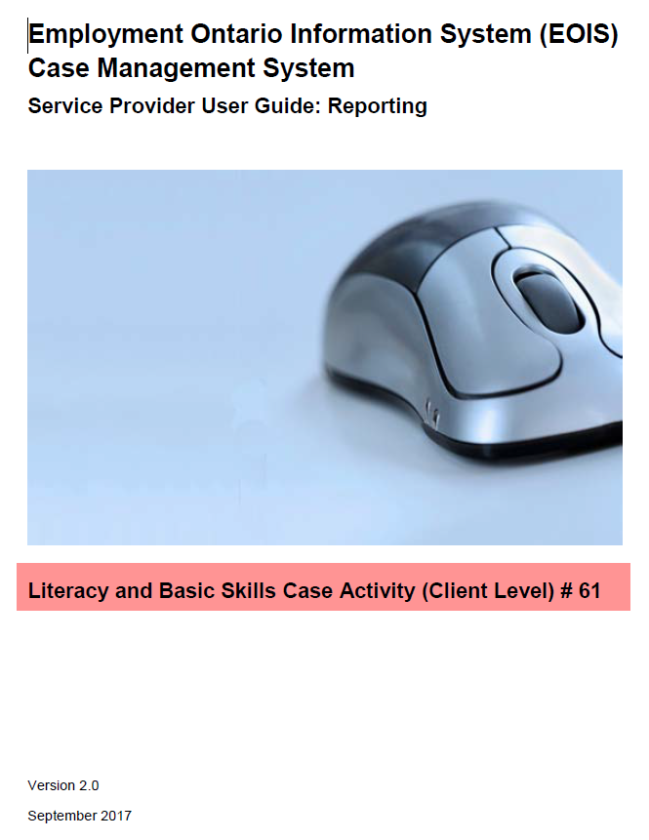
NAVIGATING REPORT #61
No need to be intimidated by the 114 columns and the hundreds of rows. While the report is large, there is some logic to its layout!
Remember the Service Provider User Guide for the report is available on myEOIS. The guide includes descriptions of the columns.
Now let’s get into Report 61 itself. (Some intentional data entry errors are included to show different things to look for.)

Slide 16
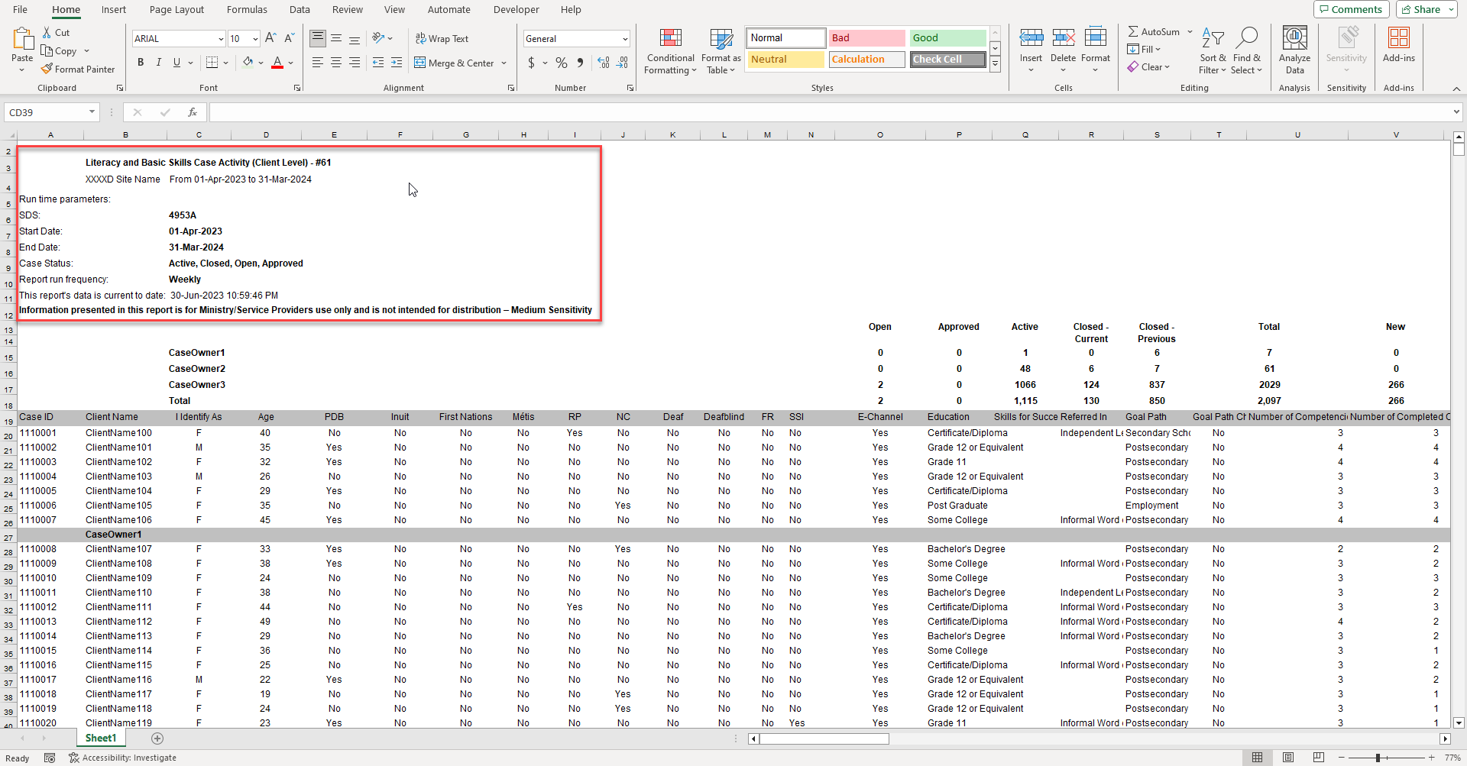

Slide 17
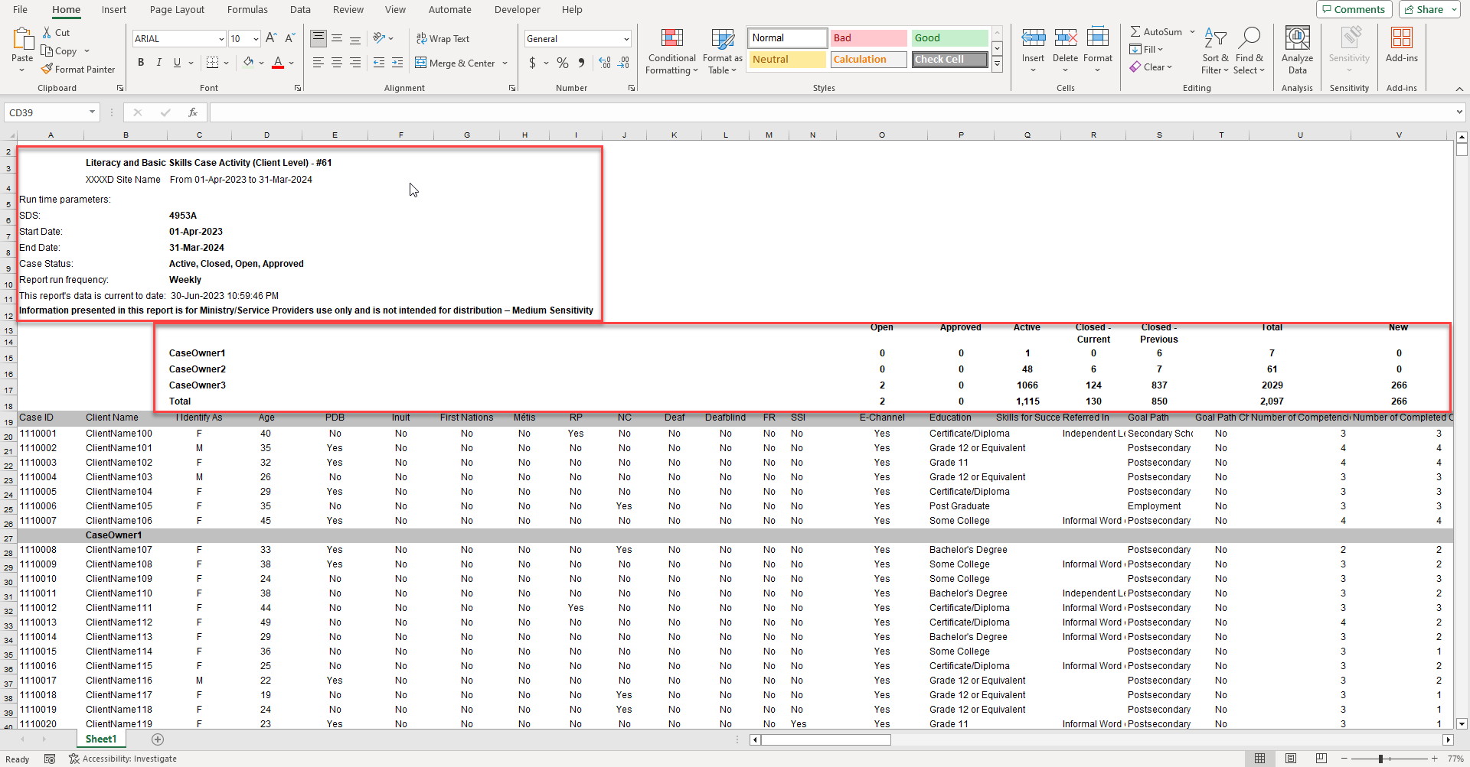

Slide 18
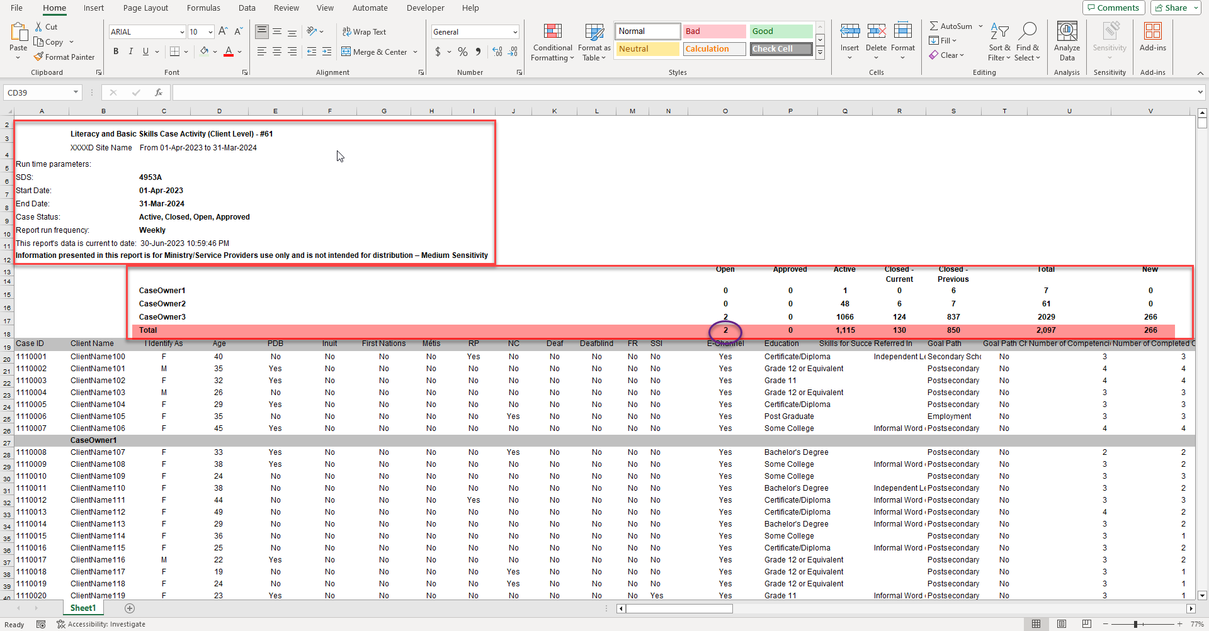

Slide 19
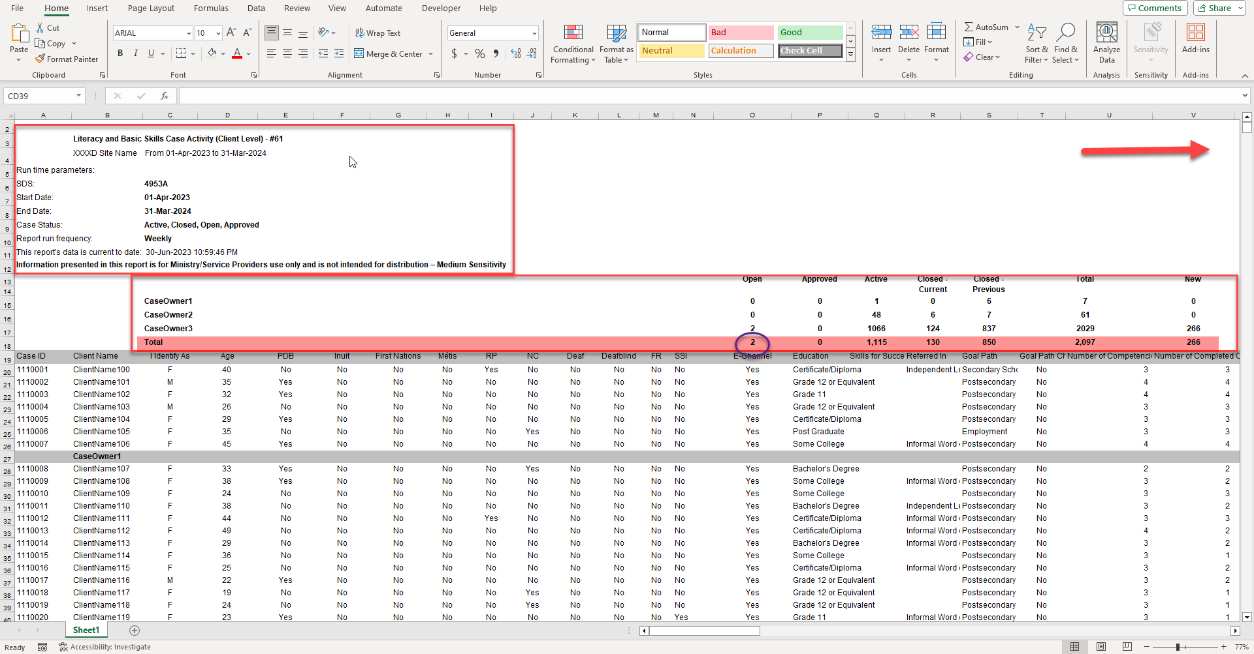

Slide 20
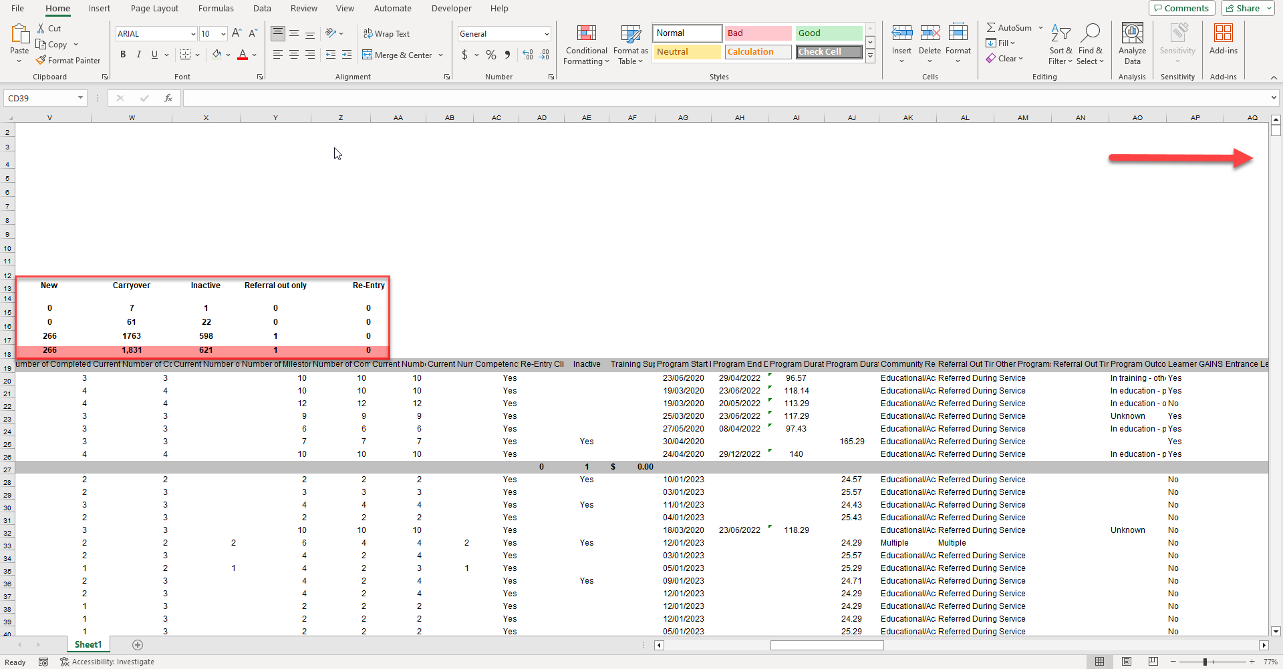

Slide 21
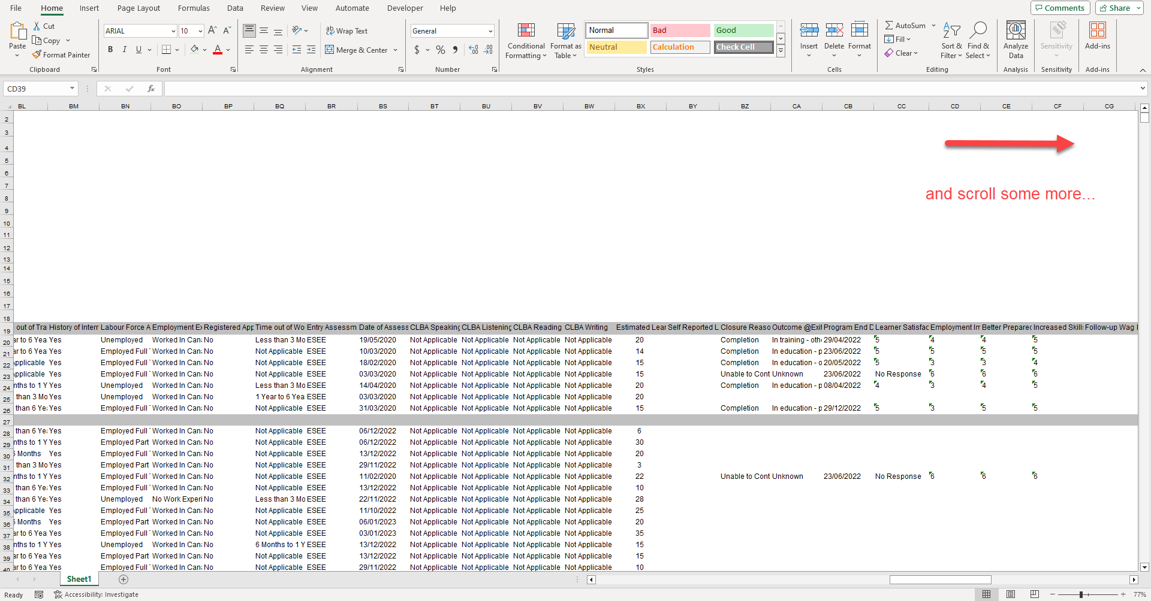

Slide 22
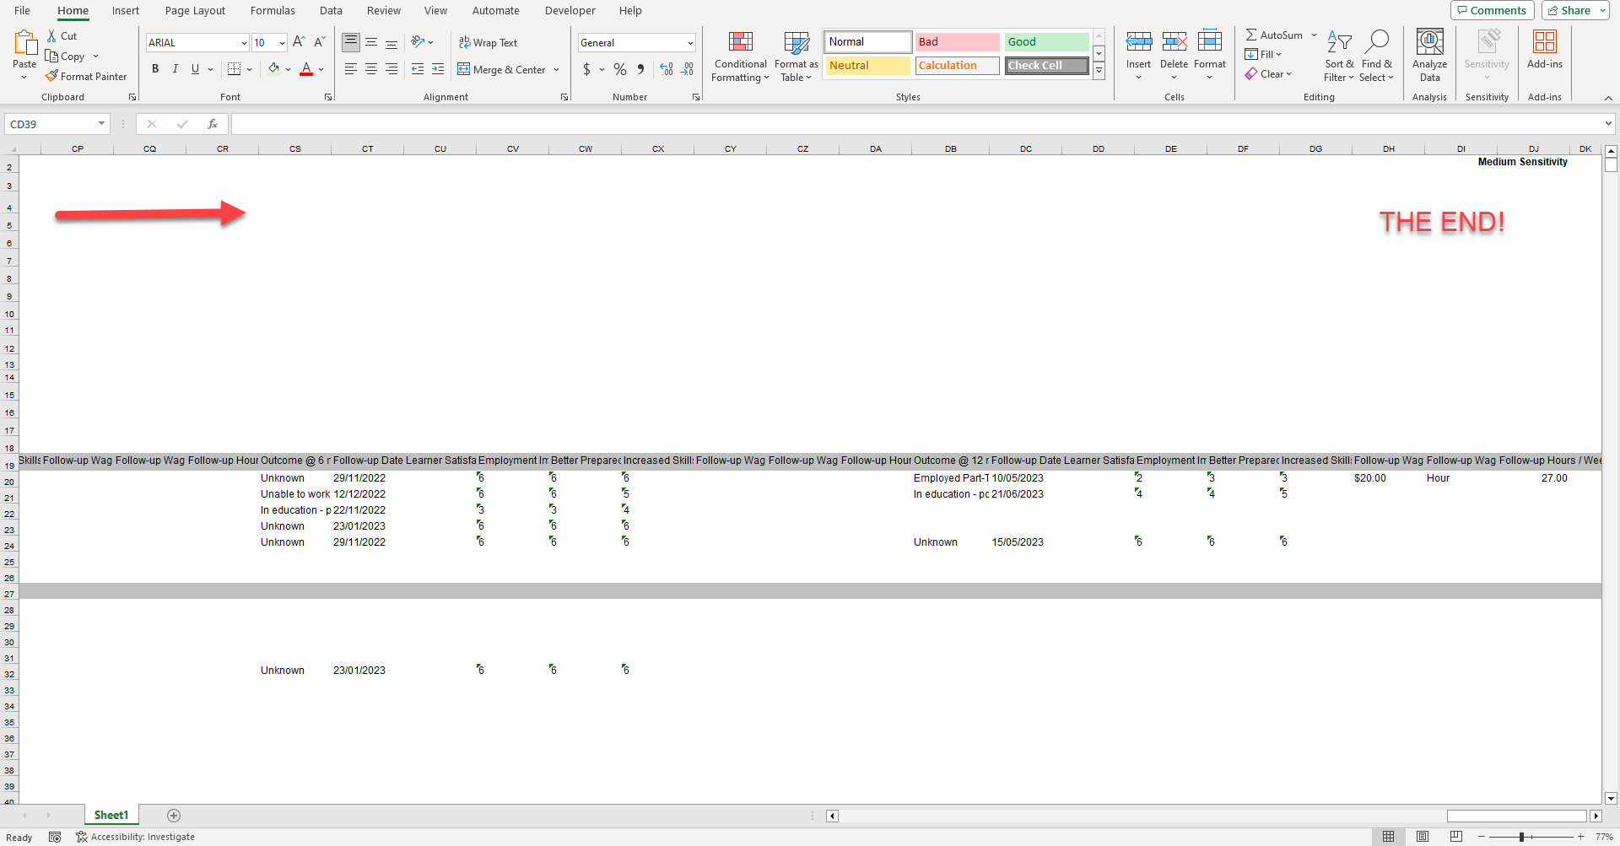

Slide 23
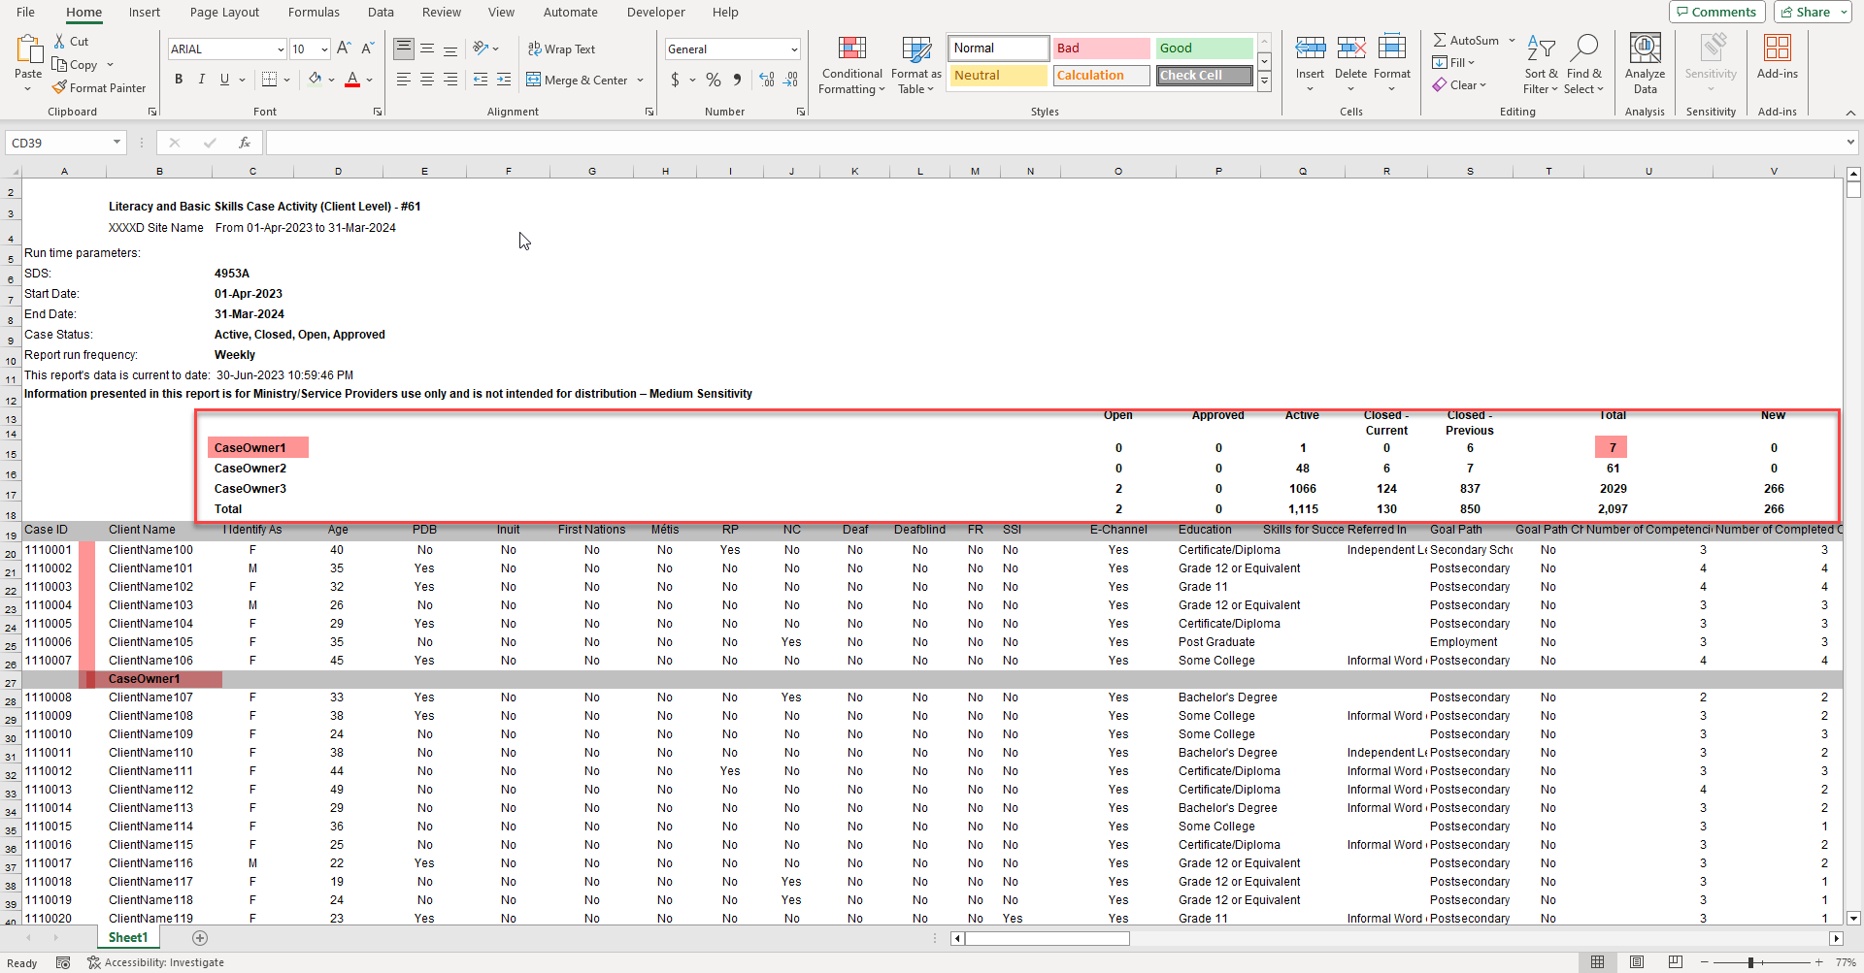

Slide 24
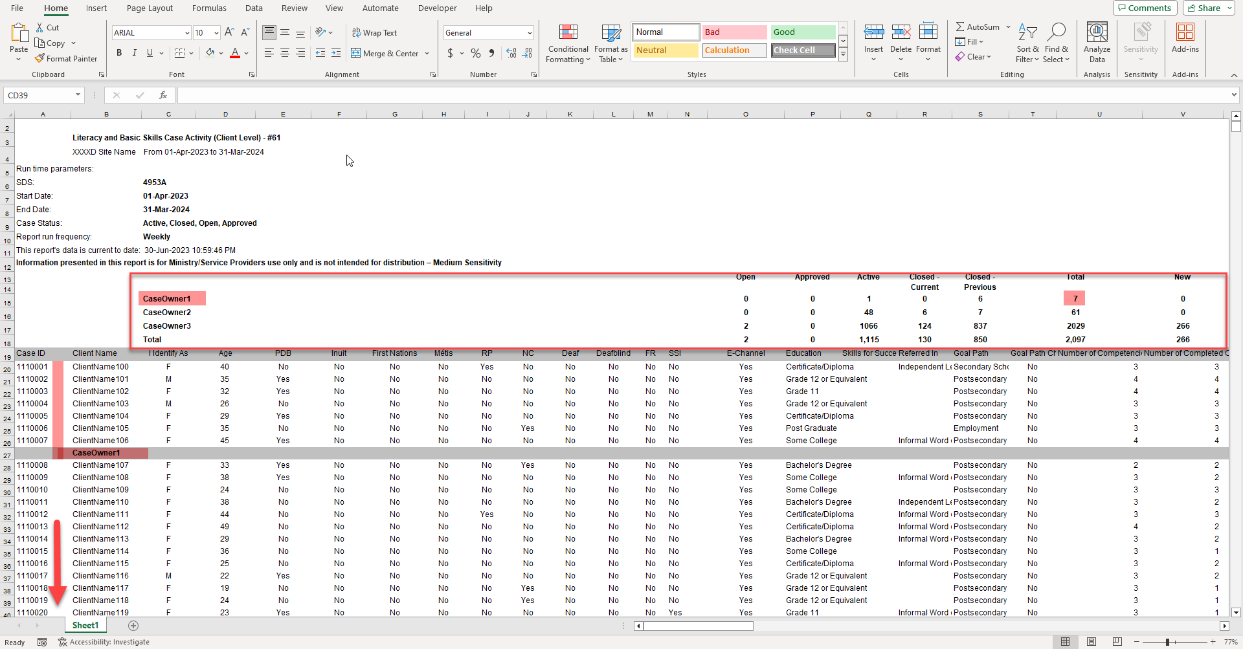

Slide 25
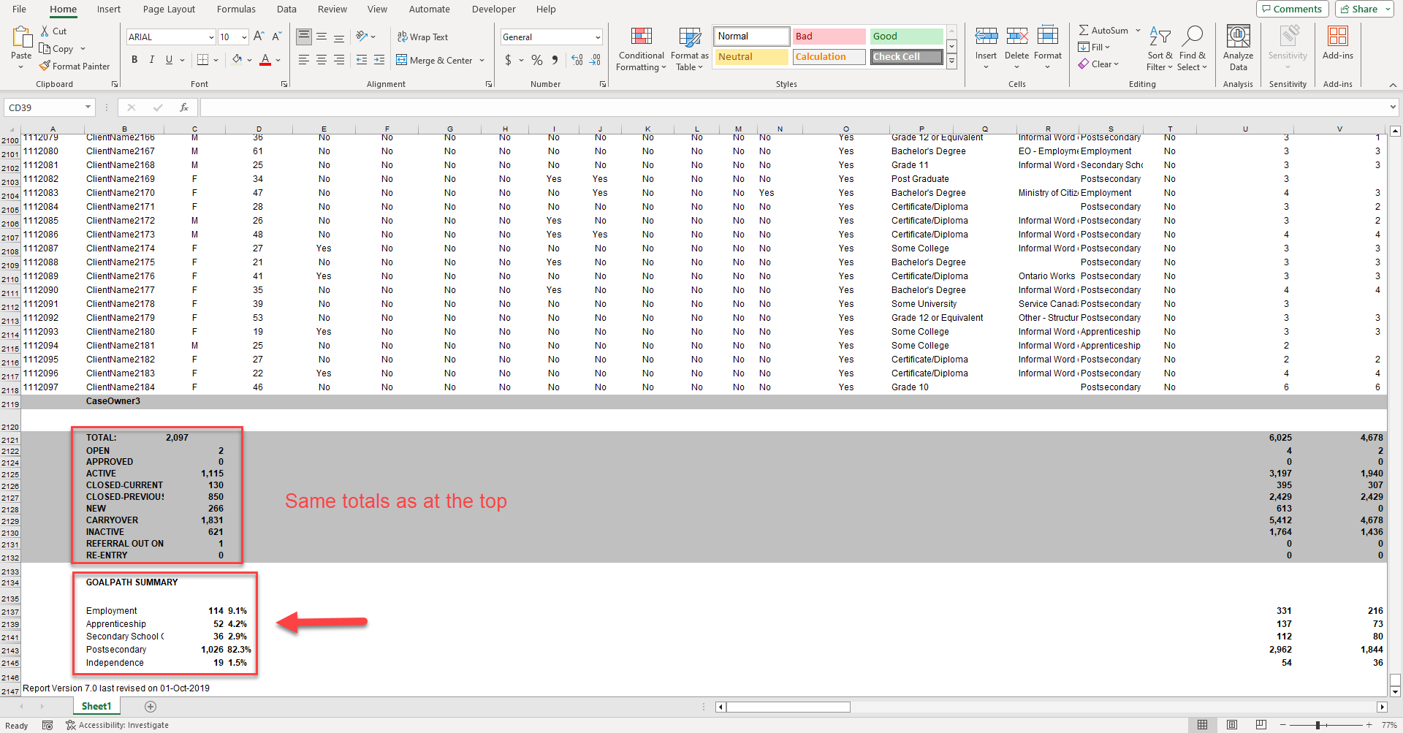

Slide 26
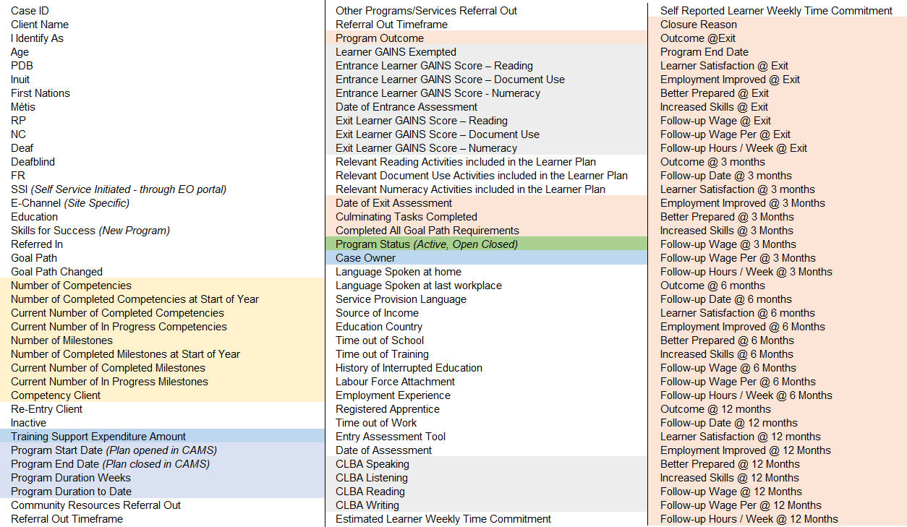
5. NAVIGATING REPORT #61: A CLOSER LOOK AT THE COLUMNS
Program Status is a key column for filtering data
There is no column to identify if a learner’s SIN is entered.

Slide 27
PREPARE A COPY FOR EASIER ANALYSIS
Report #61 is unwieldy. Taking a copy and making a few adjustments to the layout and view can make it easier to work with. We’ll go through these steps one at a time.
Make a copy of the Excel sheet
Delete the rows in the report header
Make the column names legible
Move the Program Status to the first column (Col A)
Add filters
Freeze panes - first three columns and the first row
Tip: Excel Online doesn’t have all the tools we’ll need, so use a desktop version if you can.

Slide 28
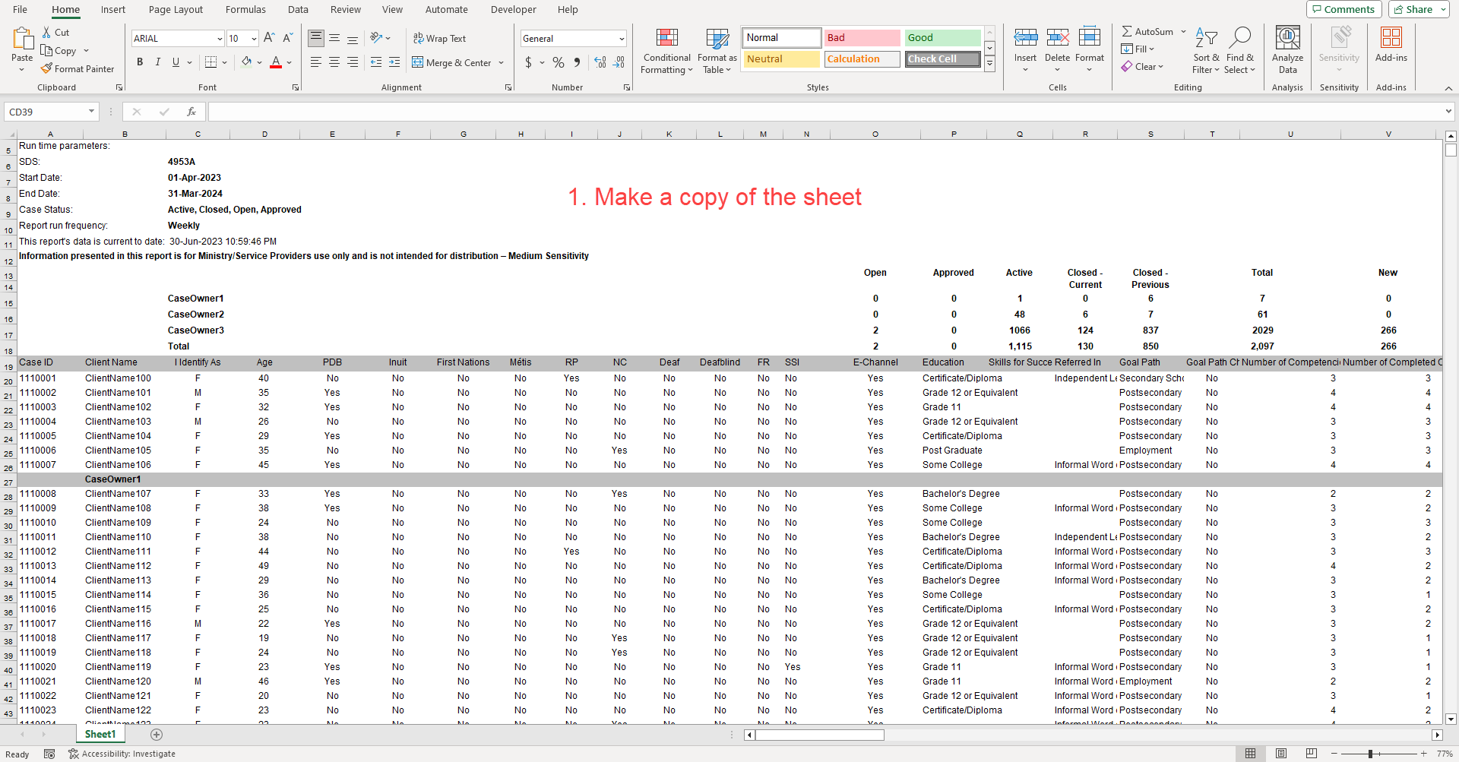
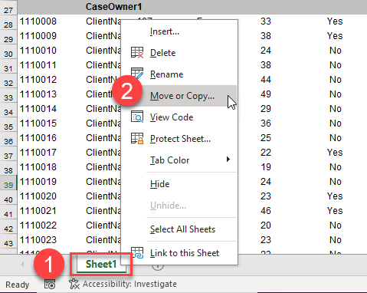

Slide 29
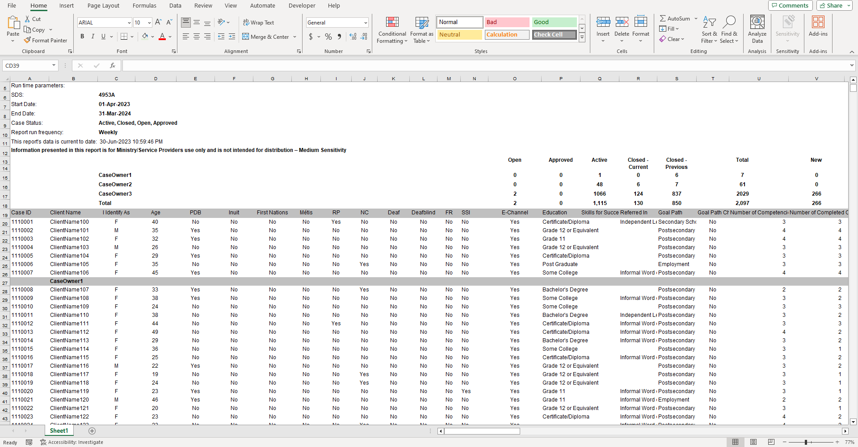
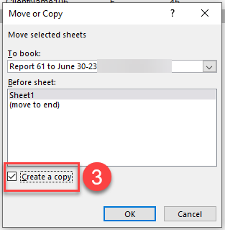

Slide 30
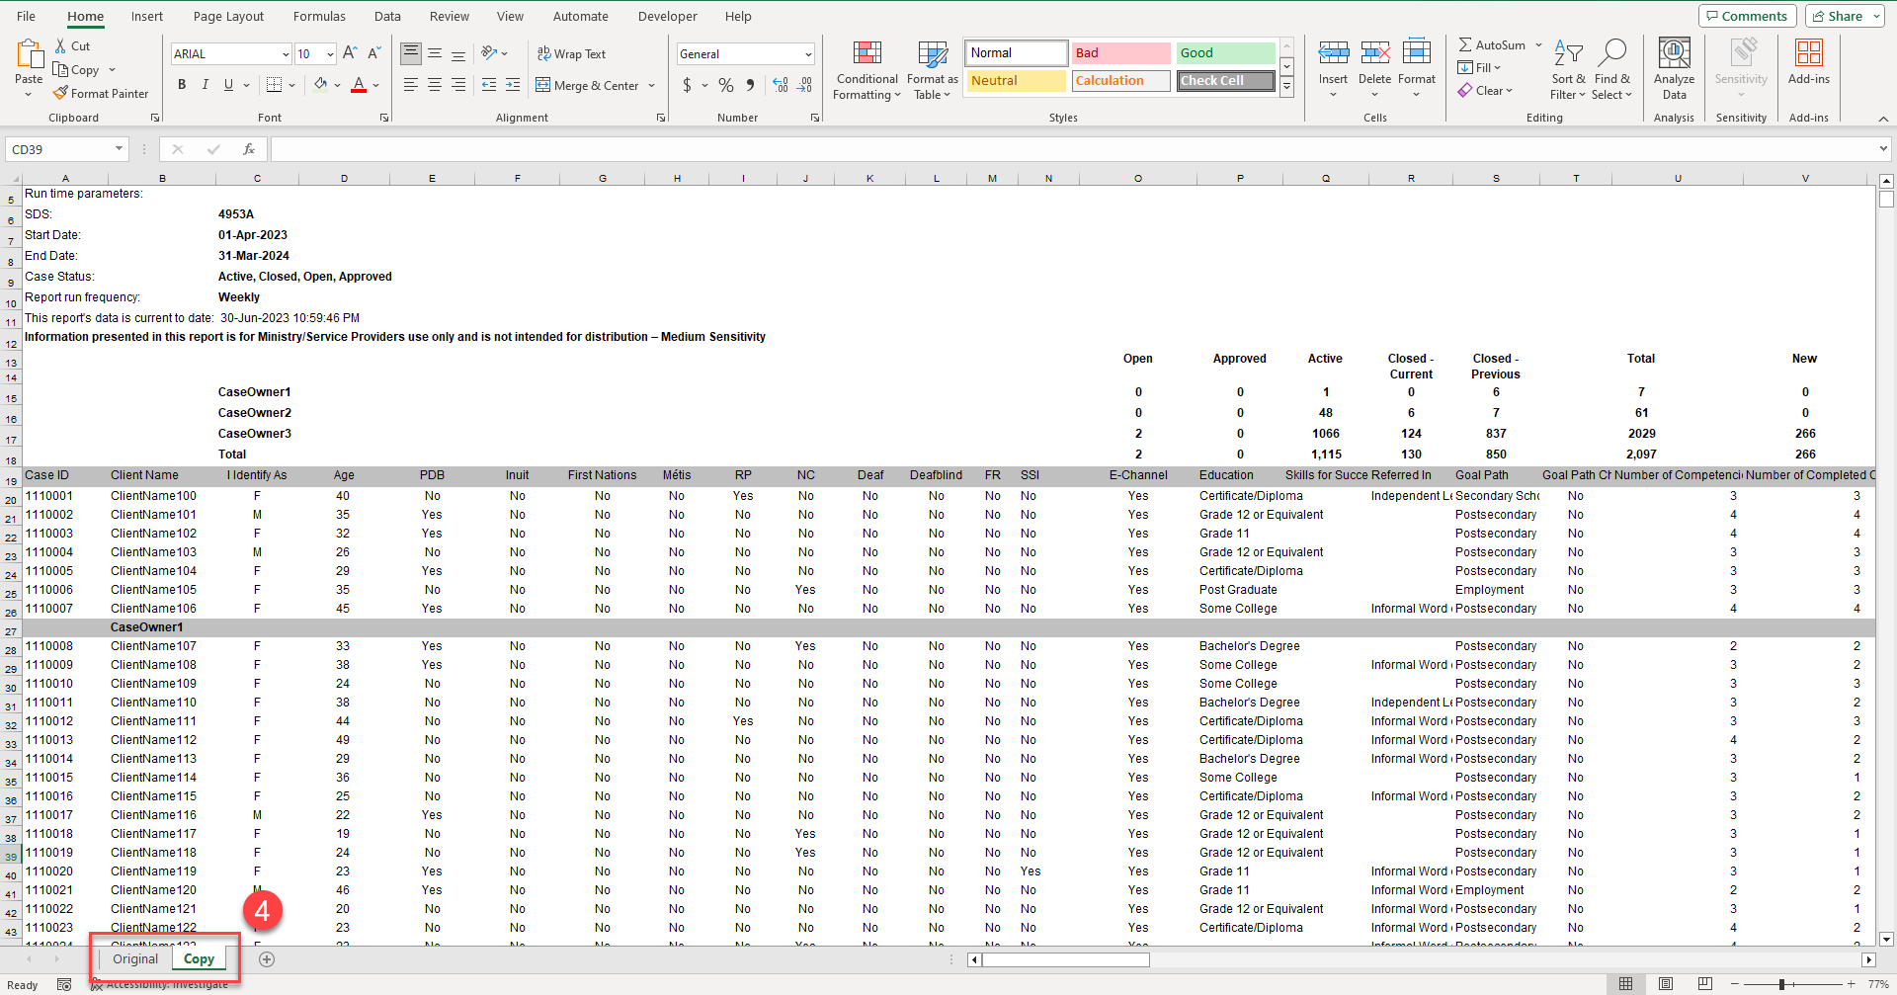
Rename the sheet.
Just use the “Copy” sheet to do your analysis.

Slide 31
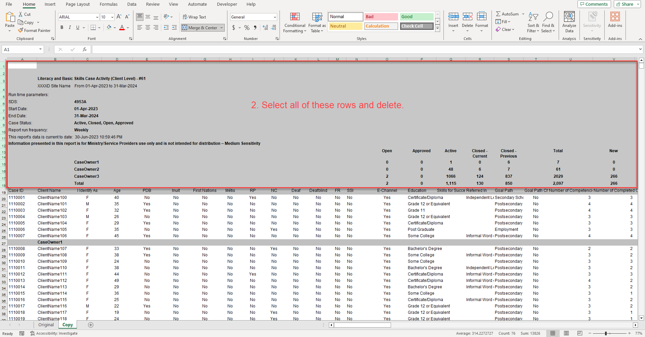
(Delete the EO logosat the top right too!)

Slide 32
3. Make the column names legible.

Slide 33
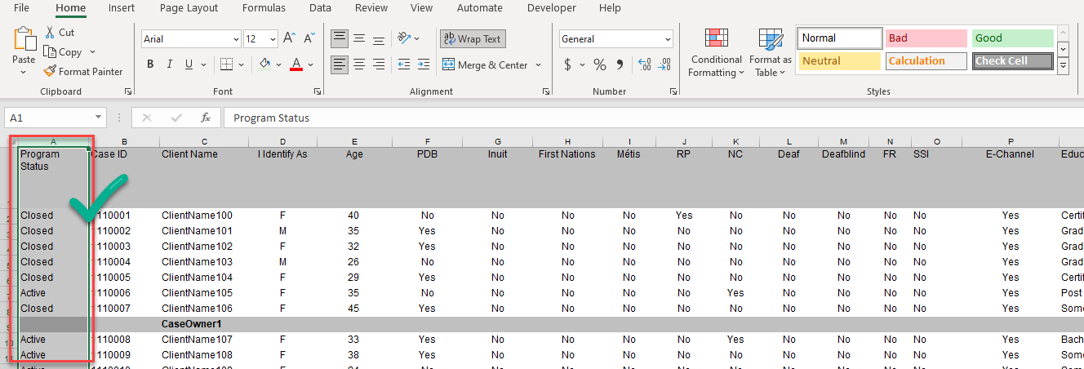
4. Move the Program Status column to the left to become the first column (col A)

Slide 34
5. Add filters

Slide 35
6. Freeze Panes

Slide 36
DIVE INTO THE DETAILS!
Use the filters to work your way through the columns looking for anything odd, missing or interesting within the context of your learners, program and processes.
Note, this isn’t a full audit for data accuracy against the learner file, but it will point you to files you may want to check in more detail.
It may also point to issues in your data collection and/or data entry processes.

Slide 37
DIVE INTO THE DETAILS!
Open the filter
Choose the value you want to filter on
Format the cell that is “interesting”
Select the row and give it a background colour
Clear the filter and move to the next column
Repeat…1- 6.
Clear all filters
Filter Program Status by colour – this give you the rows (service plans) with “interesting” entries to investigate.

Slide 38
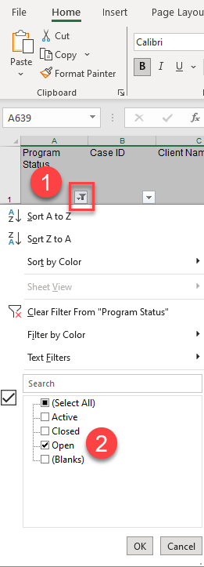
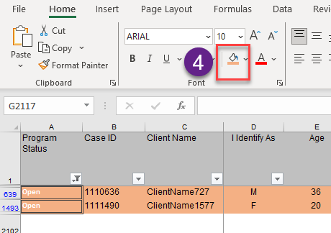
7.1 PROGRAM STATUS: OPEN
Two Open cases were identified in the report summary. Open cases are not counted in the core measures, so they are worth investigating.
1. Open the filter
2. Choose the filter value
3. Format the interesting cells
4. Select and colour the rows
Clear the filter and move on…

Slide 39
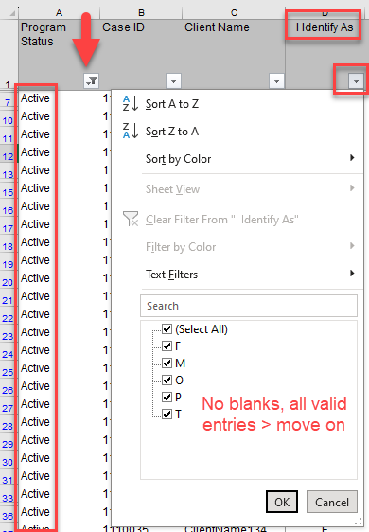
7.2 PROGRAM STATUS: ACTIVE + “I IDENTIFY AS”
Cases in the Active status can be edited to correct data issues.
Set the Program Status filter as Active
Open I Identify As for a second filter
No blanks, all valid entries
Nothing of note
Move on to Age

Slide 40
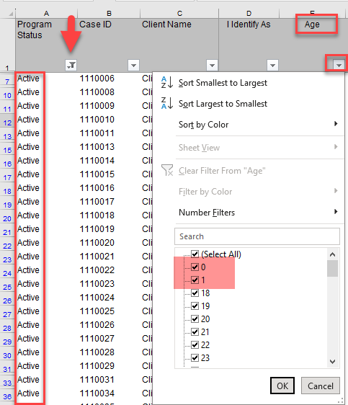
7.3 PROGRAM STATUS: ACTIVE + “AGE”
A bit young for LBS.
Possible data entry issue in the Date of Birth field
Filter on 0 and 1 to find the effected service plans.
Format the cells
Colour the rows
Clear the Age filter
Left uncorrected, these learners will continue to roll up in the “<18” age category in Report #60B Learner Profile.
May be missing out on having these learners count in the Suitability core measure if they are 45 - 64 years.

Slide 41
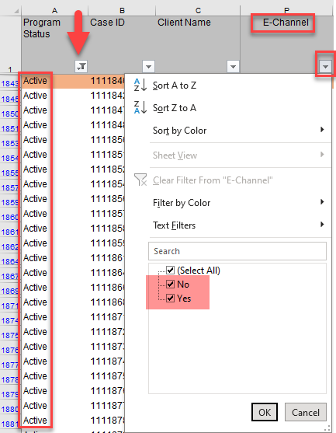
7.4 PROGRAM STATUS: ACTIVE + …
Continue through the next columns…
SSI: Self-Service Portal – do any learners find their way to your program through the portal?
E-Channel: each program should only have one valid answer Yes or No.
There are both answers here. For this site, the answer should be Yes so: Filter on No, format the cells, colour the rows, clear the filter, and move on to Education.

Slide 42
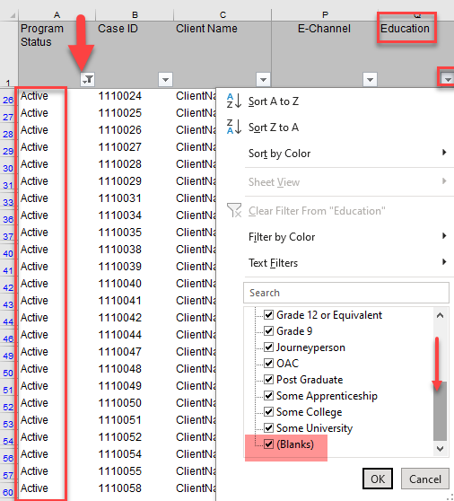
7.4 PROGRAM STATUS: ACTIVE + …
Education: scroll down to the bottom of the filter options to see that there are some Blanks. For some fields it is OK for there to be no entry, but Education should have an entry (from the LBS Participant Registration form). Filter on (Blanks), format the cells, colour the rows, clear the filter and move on to…
Skills for Success: New field for the Ministry-funded pilot projects for this year only. It should only be populated if your site has a funded Skills for Success pilot project. Skills for Success learners do not count towards the site’s LBS core measures.
Keep moving through the columns until you get to Number of Competencies.

Slide 43
7.4 PROGRAM STATUS: ACTIVE + …
Looking at columns V – AC on their own doesn’t serve much purpose.
We’ll come back to the Milestone section.
Competency Client is important. For a service plan to count, the learner must have at least one competency and sub-goal with a status of “In Progress” or “Completed” in their learner plan.
(Excludes sub-goals that are “Learning Activities”, and excludes “Cancelled” plan items
Open the filter for Competency Client to see if there are any service plans with No.

Slide 44
7.5 PROGRAM STATUS: ACTIVE + COMPETENCY CLIENT
Competency Client filtered as “No” is indeed showing no information in the Competency columns.
The plans for the learners were all entered in CaMS on April 26, 2023 and they have been in the program for over 9 weeks (at the date this report was run).
An issue to investigate.
Format the No cells, colour the rows, clear the filter and move on…

Slide 45
7.6
PROGRAM STATUS:
ACTIVE + …
Re-Entry Client: In this sample report, there is no data in this column even though there are learners with multiple plans. We will show a different way to identify these learners.
Inactive: Service plan hasn’t been touched in EOIS-CaMS for 60 days. It doesn’t mean the learner hasn’t been doing anything, just that no updates have been made to their CaMS file in 60 or more days… which can be an issue to investigate.
Learner Gains Exempted: Should all be blank since Learner Gains measure is not currently used.
Service Provision Language: Check for consistency. Should only be one choice and no blanks.
Learner Profile and Assessment columns: Check for blanks

Slide 46
7.7
PROGRAM STATUS:
CLOSED + …
After reviewing the columns for Active service plans, change the filter on Program Status to show Closed plans.
While Closed plans can not be edited, it is important to know what data issues might be in this data so that you:
Can see what issues there might be in the data from the past
Identify any missed opportunities or skewed results because of these issues
Are prepared for questions that might be asked during a Ministry file audit
Closed plans have additional columns filled in such as: Program End Date, Program Duration Weeks, Completed All Goal Path Requirements, Closure Reason, Outcome at Exit, Follow Up @ 3, 6 and 12 month etc. This data for closed service plans is summarized in report #60D: LBS All Data Outcomes

Slide 47
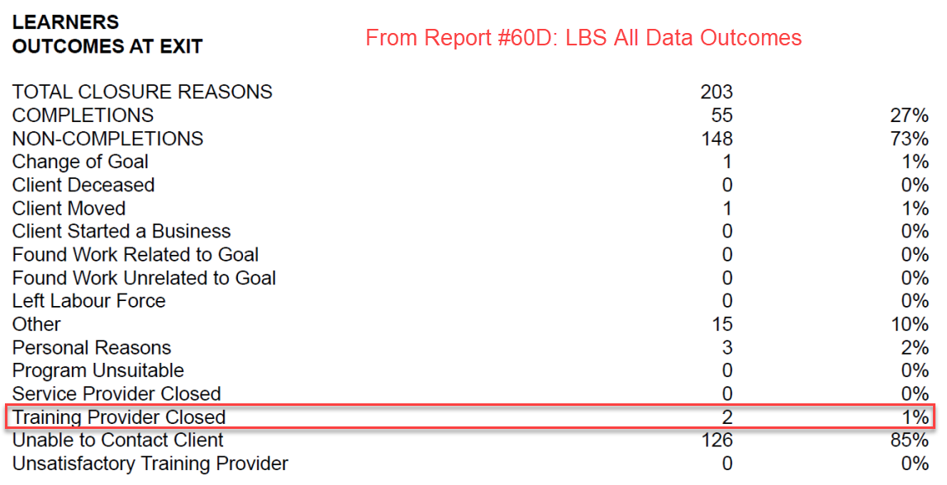
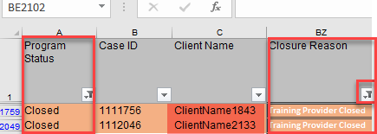
7.7 PROGRAM STATUS: CLOSED + …
Opening the filter for the Closure Reason column shows that the reason: “Training Provider Closed” was used in two cases. It is worth investigating why it was chosen. These entries also show up in the monthly Report #60D.
*Report #61 allows you to trace back from the summary reports
(60B and 60D) to the specific cases/service plans*

Slide 48
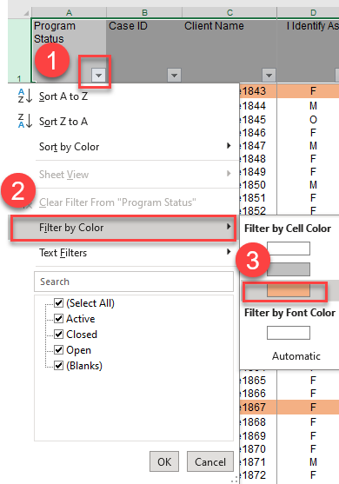
7.8 IDENTIFY ALL THE SERVICE PLANS TO INVESTIGATE
After clearing all filters, filter Program Status using Filter by Cell Colour (Steps 1 -3 shown).
The resulting list shows the service plans and cells that have been identified for investigation. Gaining an understanding of the reasons behind the issues allows for the development of appropriate solutions.

Slide 49
TAKING IT FURTHER
After tackling data accuracy, completeness and consistency in data entry across case owners, Report #61 data can be used to gain further insights into your program.
Three examples:
1. Learners with more than one service plan
2. Milestones completed this year (Learner Progress)
3. Program duration profile

Slide 50
8.1
LEARNERS WITH MORE THAN ONE SERVICE PLAN
Learners leaving and returning to training is a characteristic of LBS programming. These learners can be identified in Report #61. It’s good to know:
If a learner has multiple service plans in the same year, they count as one learner in the Learners Served core measure.
If a learner has multiple exits and returns, are there any actions that can be taken to help them succeed on their next attempt?
If the Closure Reason is given as Completion but they keep returning, this might be questioned in a file audit.

Slide 51
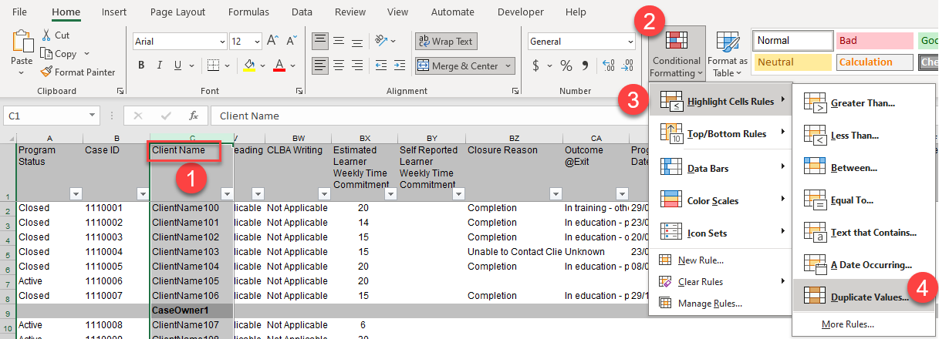
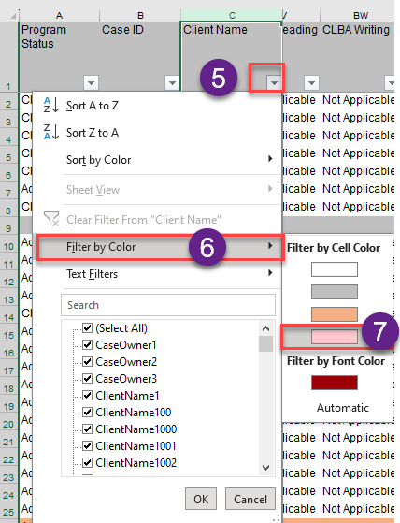
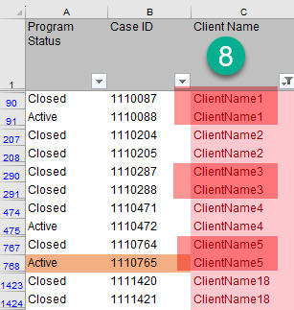
8.1 LEARNERS WITH MORE THAN ONE SERVICE PLAN
After clearing all filters:
Select the Client Name column
Click the Conditional Formatting tool
Click Highlight Cell Rules
Choose Duplicate Values and a colour
Open the Client Name filter
Choose Filter by Color
Choose the colour
Review the list

Slide 52
8.2
MILESTONES COMPLETED THIS YEAR
For a service plan to count towards the Learner Progress core measure, it must have at least one milestone “attained” in the current fiscal year. Report #61 has columns related to milestones, but as none provide this specific information, we can make one. After clearing all filters,
Insert a new column to the right of Current Number of Completed Milestones
Name the new column Milestones Completed This Year
Enter the formula: AB2 – AA2 (current # completed - # completed at start of year)
Copy the formula down the column
Filter Program Status by Active to see current learners only
Filter Milestones Completed This Year with zero (0).
Review the list

Slide 53
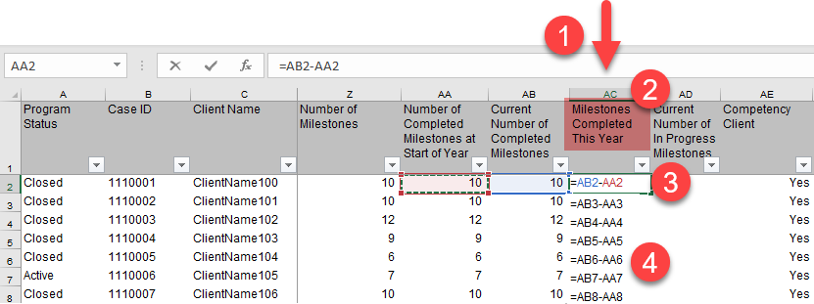
8.2 MILESTONES COMPLETED THIS YEAR
Early in the fiscal year, Learner Progress is not expected to be at the 60% target, as it takes time for learners to prepare to attempt a milestone.
Towards the end of the fiscal year, it is helpful to know which learners have yet to complete a milestone and identify if they are likely to complete one by March 31, to give you an idea of the year-end result to expect for the Progress measure.

Slide 54
8.3
PROGRAM DURATION
These columns can be used to see how long learners stay in the program:
Program Start Date – date the service plan was opened in EOIS-CaMS
Program End Date – date the service plan was closed in EOIS-CaMS
Program Duration Weeks (populated for Closed service plans)
Program Duration to Date (populated for Active service plans)
Note: Duration is only as good as the data entry practices. If there is a significant lag between an actual start/end date and the time the data is entered in EOIS-CaMS, the Duration measures won’t be as accurate as they would otherwise be.
Similarly, if the practice is to “save up” the learner information, entering and closing service plans within a short time frame, rather than entering data bit by bit as the learner progresses, the Duration measure will also be skewed.

Slide 55
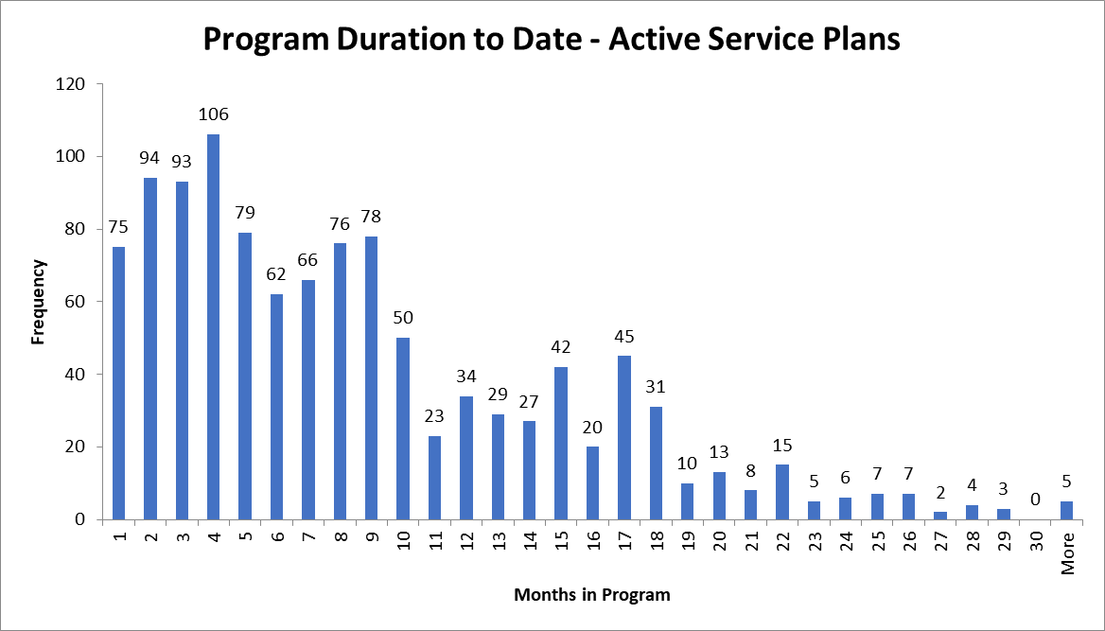
8.3 PROGRAM DURATION - TO DATE
75 active service plans in the last month
Fewer active plans from 11 – 18 months ago.
Plans more than 24 months (two years) old – filter Program Duration column to find them, they could be worth a closer look.
Different LBS programs will have different profiles. Does the profile for your program/learners make sense?
Step by step instructions to make a histogram like this are available at Excel Easy.

Slide 56
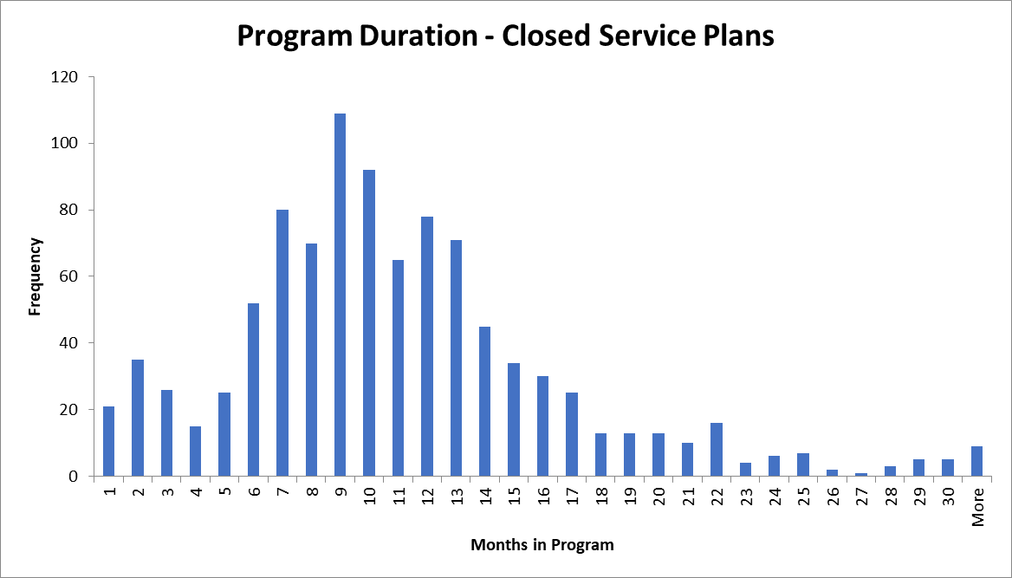
8.3 PROGRAM DURATION
2% stayed less than one month
Most common duration is 9 months
Average is 10 - 11 months
Majority is between 6 – 14 months
Some two years and more
Again, different LBS programs will have different Program Duration profiles. Does the profile for your program/learners make sense?
The same chart could be used to look at the Training Support allowance data.
Step by step instructions to make a histogram like this are available at Excel Easy.

Slide 57
WHAT WE COVERED TODAY
Quick Review
1. LBS Performance Management Measures
2. LBS Detailed Service Quality Report #64
3. Other Reports Available from EOIS-CaMS
Report #61: LBS Case Activity
4. Why Use Report #61
5. Navigating Report #61
5. Prepare a Copy for Easier Analysis
6. Dive into the Details
7. Taking it Further
Wrap up

Slide 58
MERCI
MEEGWETCH THANK YOU
Webinar resources: Pop Up PD Resources for LBS Educators
Webinar evaluation: https://tinyurl.com/4sd868dn

