Slide 1
TRANSITIONING
ESL LEARNERS TO LBS
Facilitated by HEATHER ROBINET, Executive Director, QUILL Learning Network
A panel discussion about best practices, strategies, tools & resources that LBS programs are using to meet the unique training needs of this under-represented group.
FEBRUARY 22 @ 2—3:30PM
Notes:
https://youtu.be/veV9iOBx79s

Slide 2
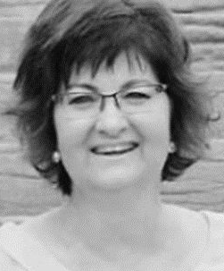
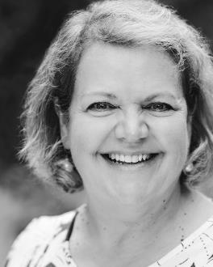
YOUR HOST
FACILITATOR HEATHER ROBINET is the Executive Director of the QUILL Learning Network, serving Huron, Perth, Bruce, Grey and South Georgian Bay. She comes to QUILL after 25 years in adult Literacy and Basic Skills (LBS) and English as a Second Language (ESL) programs with the Avon Maitland District School Board.
In addition to managing a face-to-face Skills Upgrading and Readiness Program there, Heather was instrumental in starting and managing the online provincial LBS e-Channel program called The LearningHUB as well as a provincial online ESL program called Anytime ESL.
Heather has also worked for Conestoga College and Sault College as a facilitator/instructor for the Adult Literacy Educator program. Heather earned a Bachelor of Applied Arts Journalism degree from Ryerson Polytechnical Institute, and an Adult Literacy Educator certificate from Conestoga College.

Slide 3
STATEMENT OF RECOGNITION
While we meet today on a virtual platform, let’s take a moment to recognize, respect and acknowledge the importance of the lands we occupy and from which we benefit.
Today, let’s reaffirm our commitment and responsibility to improve relationships between nations -- and our own understanding of local Indigenous peoples and their cultures.
Let’s remind ourselves that, wherever we are, we live on the ancestral and unceded territory of Inuit, Métis, and First Nations people.

Slide 4
ABOUT POP UP PD FOR LITERACY EDUCATORS
free webinar series developed by Ontario’s LBS Regional Networks & the Provincial Support Organizations for Literacy
supports LBS practitioners with presentations on topics important to them
English language webinars presented for LBS practitioners annually since 2015-2016
all webinar presentations, recording links & transcripts here:
Pop Up PD Resources for LBS Educators
webinar topic ideas welcome at: e-channel@contactnorth.ca

Slide 5
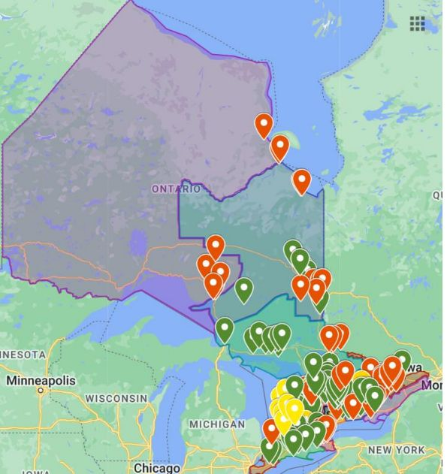
ESL learners in LBS classrooms research project
Undertaken by a committee of regional literacy networks, including QUILL, LLSC, and PRLN
Analyzed data and discovered LBS programs were filling the gap in training for English language learners
Received data from 31 agencies who were serving ESL learners; and 21 agencies who would if they felt they could

Slide 6
Transitioning ELLs to LBS
Susan Damon, Program Coordinator, The Literacy Group of Waterloo Region
With input from Chris Prosser (Executive Director), Lisa McArthur (Program Manager) and Wendy Teahen (Group Facilitator)

Slide 7
The Old…

Slide 8
The New…

Slide 9
Intake policy at TLG re CLBs…
*For all of our programs, we have leaned heavily on “able to receive instruction in English”
*For our Kitchener and Cambridge core literacy programs (reading, writing, math), we have stuck to CLB6 for Speaking and Listening with some exceptions
*No minimums for Reading and Writing—our niche among area LBS programs
*Our rural programs (in the four Waterloo Region townships) have always been exceptions

Slide 10
What’s changed for TLG?
Explosive regional growth, including many newcomers to Canada.
Changing demographics = changing community needs
Expanded, more diverse programming (especially short-term modular programs focused on employability skills):
Grammar Boot Camp
Writing for Success
Computer Basics
Understanding Your Paycheque
Your Skills Your Success
Writing Effective Emails
Customer Service Excellence…and more!
Modular programs that are accessible to learners with lower CLBs (e.g. CSE)

Slide 11
Why do we still require CLB 6 for S/L in core programs?
Importance of vocabulary for learning phonics
Importance of vocabulary for reading comprehension
Importance of oral language for communication with tutors and group facilitators (typically not TESOL-trained) and with classmates
Importance of oral language for being able to keep pace with non-ELLs in an LBS class
Importance of oral language skills (vocabulary, usage, grammar, syntax) for learning to write
Importance of oral language skills for understanding math word problems
In short, strong oral language skills (CLB 6 in S/L) are required to effectively “receive instruction in English” in an LBS classroom

Slide 12
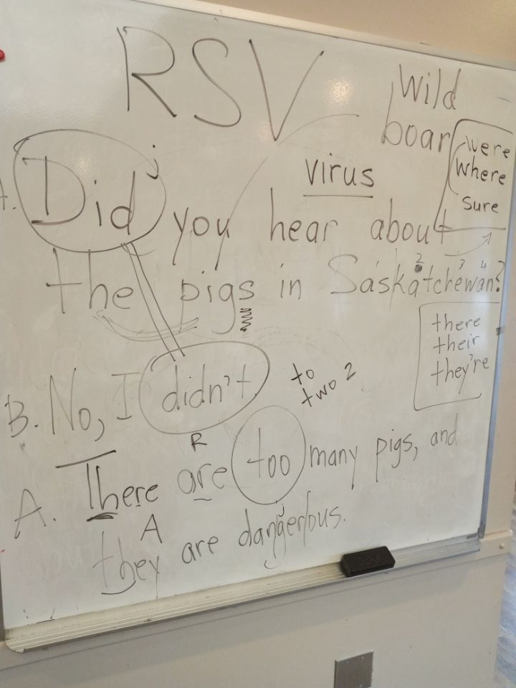

Slide 13
Rural programs…our exceptions
TLG has a long history (20+ years) of running or supporting programs in Waterloo Region’s rural townships
Learners in these programs have had S/L CLBs as low as 1
These programs have been Ministry-approved exceptions because nothing else is available to these rural learners.

Slide 14
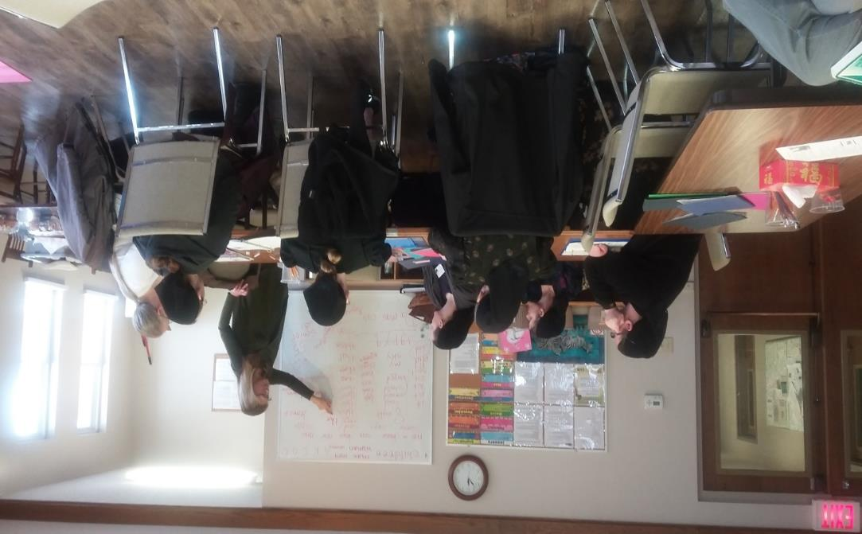
Flagship TLG rural program: St. Jacobs English School

Slide 15
SJES…
Has been running for 20+ years
Serves Low German-speaking (Mennonite) women
Administered by Woolwich Community Services (Low German Family Support Program)
Other partners: Woolwich Community Health Centre, YMCA’s EarlyON, and St. Jacobs Mennonite Church (YMCA and Health Centre have discontinued participation)
Runs weekly from October to June, currently 2 hours per week on Thursdays
Childcare and activities for preschoolers are provided
Prior to October 2023:
CaMS registration criterion was ability to complete the registration process without translation assistance
A registration rationale was included in the learner’s file
CLB assessment was not possible, so we relied on “able to receive instruction in English”

Slide 16
In 2023, a change in policy…
As of October 2023, TLG no longer registers SJES learners in CaMS, UNLESS they fit the profile of an LBS rather than an EL learner (e.g. S/L CLBs 6 or higher) and are able to commit to regular, long-term attendance
Why?
Transience of the LG community (between Mexico and Canada)
Inconsistent attendance due to issues related to childbirth, family responsibilities and transportation
In short, file administration (registration, progress assessment, exit follow-ups, etc.) had become unmanageable
TLG now treats the SJES program as community outreach
TLG provides three instructors (one staff member and two volunteers) and learning resources. All else is provided by Woolwich Community Services and St. Jacobs Mennonite Church.

Slide 17
Transitioning learners from local ESL programs to our LBS program…
ELLs frequently approach TLG looking for…
1-1 tutoring or small-group instruction (not available in ESL programs)
The opportunity to study with native English speakers
We assess S/L language levels
Formal language assessment by YMCA Language Assessment Centre
Length of residence in Canada
Educational and employment history
Customer Service Excellence is sometimes a test-ground for core program readiness
A number of learners in ESL programs also attend our LBS program for instruction not available in ESL programs (e.g. 1-1 writing instruction)

Slide 18
Resources used in our St. Jacobs program…
Customized lessons at two levels (S/L focus and R/W focus)
The Oxford Picture Dictionary, Canadian Edition https://www.amazon.ca/Oxford-Picture-Dictionary-Canadian-Monolingual/dp/0195431162
Ultimate Phonics pdf resource https://s3.amazonaws.com/sl-us-standard/resources/ultimate-phonics-word-lists.pdf
Sentence-writing resource
Low-German Mennonite history books https://www.plettfoundation.org/publications

Slide 19
Resources used with ELLs in our Kitchener program (1-1s)
Online resources for reading and writing:
ABC English https://www.abceng.org
Ultimate Phonics (free pdfs or downloadable interactive program with audio for a fee) https://spencerlearning.com
ReadWorks https://www.readworks.org
InferCabulary https://infercabulary.com
CommonLit https://www.commonlit.org/en/library?initiatedFrom=library
Quill (grammar and writing) https://www.quill.org
SpellZone https://www.spellzone.com

Slide 20
Print resources suited to ELLs: Laubach Way to Reading https://www.laubach-on.ca/bookstore/laubach-way-to-reading Patterns in Spelling https://www.laubach-on.ca/bookstore/patterns-in-spelling

Slide 21
For more information…
Program Information: Lisa McArthur, Program Manager lisa@theliteracygroup.com
Resource Information: Sue Damon, Program Coordinator suedamon@theliteracygroup.com

Slide 23
Erin Paakkunainen – LBS Program Advisor Huron County and North Perth (Listowel)
Avon Maitland District School Board – school board sector
6 locations – Centres for Employment and Learning
Clinton
Exeter
Goderich
Listowel
Seaforth
Wingham
Notes:
For those of you who are not familiar with Huron County, we are north of London, Ontario.

Slide 24
Classroom – in person and hybrid service delivery

Slide 25
Gaps in classroom ESL programming

Slide 26
Workplaces with multiple vacancies
Notes:
Screen share digitized assessment: https://survey.alchemer-ca.com/s3/50171180/Currency-Assessment

Slide 27
What was successful
eager to engage in skills training to build confidence, especially for the workplace
positive feedback – both employer and employee
McDonalds provided transportation – reduced strain on limited LBS training supports budget
delivery during classroom hours – no additional funds for staffing required
Did not overlap or duplicate existing ESL programming
Currency assment: https://survey.alchemer-ca.com/s3/50171180/Currency-Assessment

Slide 28
Challenges
higher level ESL learners –did not make relevant gains
consistent staff turnover– both outreach, management staff, and recruited staff
small percentage of repeat learners
lower suitability

Slide 29
Next steps
lean on this experience when developing partnerships with organizations dedicated to supporting newcomers and immigrants
lean on this experience when developing relationships with businesses who are experiencing staffing shortages
lean on this experience to implement a collaborative approach to blend ESL and LBS programming

Slide 30
YMCA – Muskoka LBS ESL Programming – Nancy West, former Team Leader​ Learning Services​ YMCA of Simcoe Muskoka

Slide 31
ESL Involvement Timeline
The YMCA LBS program has been receiving supplemental funds from the Muskoka Novel Marathon since the YMCA was awarded the Literacy and Basic Skills Contract for Huntsville in 2011.​
In 2016, the Syrian Refugee Crisis prompted using these dollars to start an ESL Program in Huntsville, as there were no local supports or Government ESL/Immigrant programs. There were a number of Syrian families in the Huntsville area, sponsored by several churches and other community groups. ​
With the funding, the YMCA was able to hire a PT ESL instructor. They were able to teach ESL to quite a few Syrians, as well as a few other nationalities.

Slide 32
The Challenge…
COVID hit, and classes abruptly stopped. Students did not want to meet online. They wanted to wait until in-person classes started up again.
The Muskoka Novel Marathon also stopped fundraising for a couple of years.​

Slide 33
The Challenge Continued…
When Ukrainian refugees started coming into the area in 2022, it was obvious that the YMCA had to act.​ Employers were coming to us asking for help!
The Muskoka Novel Marathon was raising funds again but nowhere near the level seen pre-pandemic.
It became obvious that we needed more money. We applied for Skills Development fund money, but where our sister site in Parry Sound was approved for funding, our Muskoka site was not.​

Slide 34
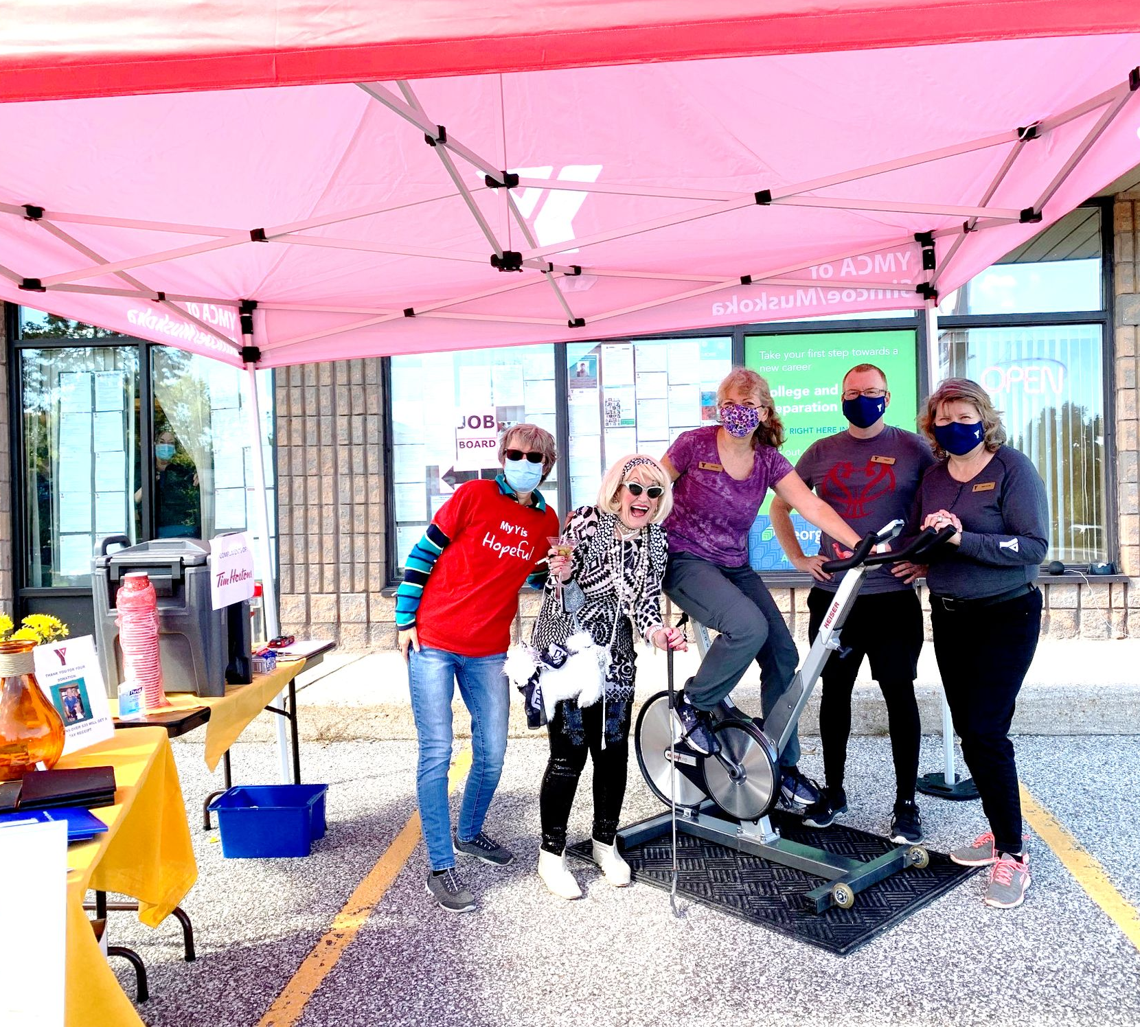
Innovate!
Staff decided to put a huge effort into fundraising – we got spin bicycles and put them outside in front of our office during the YMCA's annual fundraiser called Move to Give.
We kept our bicycles going for 6 hours and got the community involved.
Another thing that was different between the Syrian Refugee Crisis and the Ukrainian/Russian war is that we also gained an LBS contract in South Muskoka

Slide 35
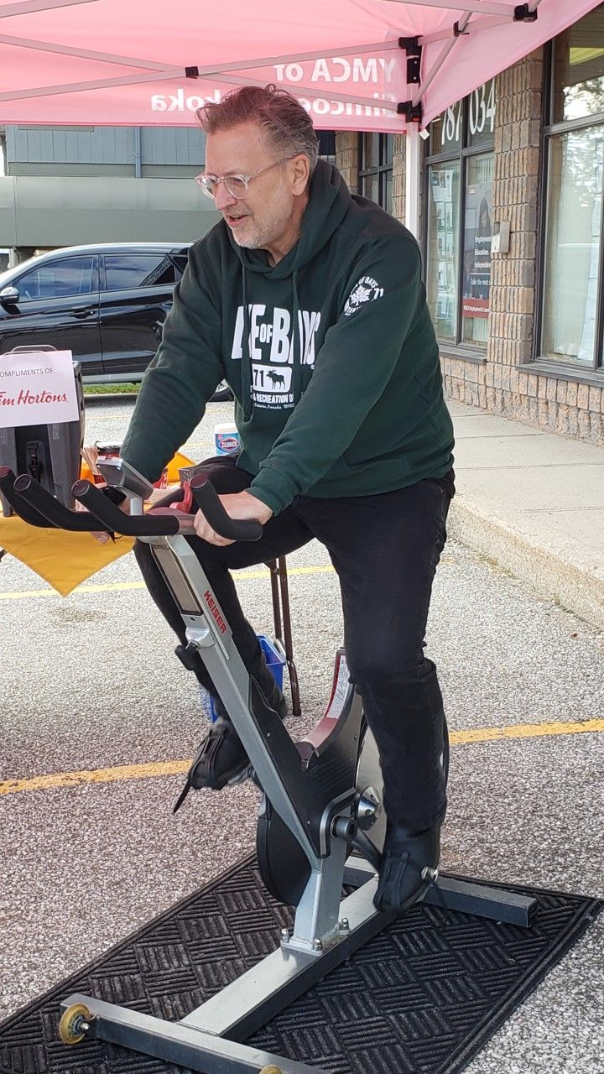
Innovate!
Over the 3 years we’ve held the event, We had learners, firefighters, police, ambulance drivers, Mayors and Deputy Mayors, and media reps jump on the bikes with us. We've raised of thousands of dollars this way
Terry Glover, Lake of Bays Mayor

Slide 36
Volunteers & Added Support
We also have been extremely fortunate to have incredible volunteer ESL instructors, along with paid staff.
Although Muskoka is in “no man’s land” in terms of settlement services, we acquired support for our students with English Language Assessments from the Thunder Bay Multicultural Association, and on-site settlement services from the Welcome Centre in Newmarket

Slide 37
Looking to the Future
In Muskoka District, municipalities are currently sending letters to the federal government expressing the need for an immigration plan in the region.
The District chair proposed establishing a Local Immigration Partnership in Muskoka back in September and municipalities are coming on board.
Muskoka reported more than 5,000 immigrant residents in the 2021 census
Muskoka had a 21 per cent increase in first-generation Canadians from 2016 to 2021

Slide 38
Classes!
Once ESL students were able to understand enough English to function in an LBS classroom, and they could make themselves understood verbally, we could move them to our regular LBS program.

Slide 39
Thank you!
Questions?

Slide 40
YMCA of Simcoe/Muskoka Learning Services
Ashley McGee
Team Leader of Learning Services

Slide 41
Brief Location History
Parry Sound, ON
A small tourist town with a population size of 7,000
Traditionally not very diverse with minimal newcomer supports
In a housing crisis and with many food insecure households
April 2022
The war in Ukraine sparked an influx of newcomers to the area
May 2022
Team Leader of Employment Services did an express TEFL course in order to fill the need in our community as a volunteer
July 2022
By this time we had over 100 Newcomers arrive to the area where roughly half needed language support
Our volunteer efforts were quickly overrun

Slide 42
What Happened Next?
Our call to MLITSD
We asked for an exception to our LBS guidelines in order to take on ESL Learners under our current program funding
They said YES!
We hired an ESL Instructor
Who also spoke Ukrainian/Russian/Mandarin
Partnership with the Thunder Bay Multicultural Centre was reignited post-Covid
Through this partnership we were able to get regular visits from a settlement worker out of North Bay
In November/December 2022 we ended up becoming a proctor location for the Achev Language Assessments
We applied to Skills Development Fund
Our proposal targeted the higher levels of language support needs (CLB 4-6)
This was, at the time, our under served community who needed that concentrated push after hours or on weekends
This allowed us to hire 2 remote workers to offer more intensive training to that underserved group

Slide 43
What Does ESL Look Like Today?
Teachers
We now have 5 part-time ESL teachers
They are all TEFL or TESL trained
Together they cover Pre-CLB to CLB 6 levels as well as test prep
Teaching Blocks
We have 2 month long teaching blocks
Once a teaching block has begun, no new students can join
This allows for students to progress together
Milestones/Learning Activities
They are delivered at the end of the teaching block to determine whether they are ready to graduate to the new class level or remain at their current level

Slide 44
Questions?

Slide 45
Bridging LINCs to Achievement

Slide 46
Presenters
Bruce Lindsay- ESL Instructor
Sandra Scott- Manager, Employment Ontario Programs

Slide 47
About the Program
BLTA is a collaboration between Skills on Demand and Language Instruction for Newcomers to Canada (LINC) programs offered at Fleming
Bases of the program taken from the Strategies for College and the Workplace curriculum which was created with support from the CSCAU-Skills for Success funding

Slide 48
About the Program Continued…
Designed to prepare learners from ESL courses to move into academic upgrading to work towards their post-secondary, apprenticeship or employment goals (“Learning to Learn”)
Emphasis on soft-skills and employment/educational skills
This was a project originally started under the leadership of Michael Andrews

Slide 49
Course Topics
Empower Communication Skills
Sharpen communication, collaboration, and written and digital communication skills
Effective Learning Techniques
Discover essential tips and strategies for efficient learning and acquire valuable post-secondary skills
Self-Awareness & Personal Growth
Cultivate self-awareness and take charge of individual personal development journey

Slide 50
Course Topics
Critical Thinking & Problem-Solving:
Enhance your critical thinking and problem-solving skills
Navigating Community Resources:
Gain insights into the valuable resources within the community to support individual journeys in Canada
Career Advancement Strategies:
Explore effective employment strategies and the Canadian workplace culture

Slide 51
Program Outcomes
E-Portfolio
Education/ Career Plan
Resume
Digital portfolio showcasing achievements, skills, and projects
Create an effective resume, aligning skills and experiences with individual goals
Set clear actionable steps towards education or career goals

Slide 52
Program Logistics
Logistics
Weekly program (including a break over the holidays)
Class once a week, for three hours
Offered at two different sites (Peterborough and Cobourg)
In person teacher lead classes with a Skills on Demand Instructor and an ESL Qualified faculty
Individual 1:1 session also available for those who need extra assistance

Slide 53
Enrollment Criteria
English is not the learners first language
19 years of age and older
Canadian Language Benchmark of 6
Listening and speaking are most important
Proof is not required - self-declaration system
Participants with lower proficiency may encounter challenges while participating in the course

Slide 54
Targets
10 Learners in Cobourg and 15 in Peterborough
Referrals accepted from all community agencies, as well as self referraling
All participant are registered as AU learners with Fleming IDs and emails
Each learner participates in a group or individual registration session with a Student Advisor
Current Enrollment:
12 in Peterborough
4 in Cobourg
Both sites have more referrals coming in

Slide 55
Insights and Students
Student participation
Lessons learned
Success story

Slide 56
Questions?
Sandra Scott- Manager EO Programs
sandra.scott@flemingcollege.ca

Slide 57
GET SET for ESL
Grand Erie District School Board
Bridges to Success (LBS) and English Language Classes (LINC/ESL) Partnership
Target Audience #1
Target Audience #2
Target Audience #3
Clients that had been asssessed and were on the wait list for service.
Clients unable to access ESL due to schedules.
“Bring a friend”

Slide 58
Challenges
Learning curve for staff
Distrust from other staff
Capacity
Easier than expected-attendance!

Slide 59
Just do it
Communication is key
Manage expectations (e.g. pilot)

Slide 60
THANK YOU!
Webinar resources: Pop Up PD Resources for LBS Educators
Webinar evaluation: https://tinyurl.com/9pw3h2p5

