Slide 1
AI & Accessibility

Slide 2
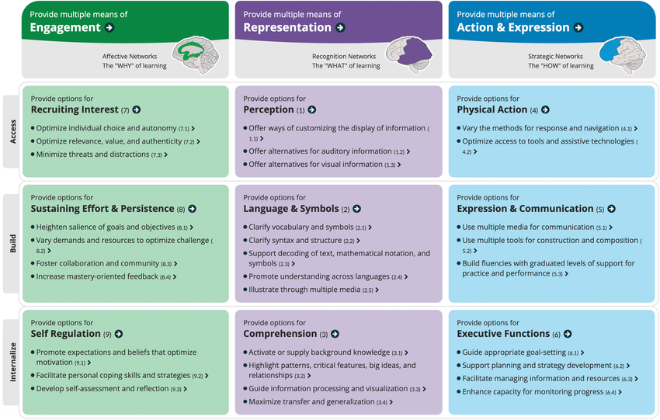

Slide 3
LBS Chatbot
The POE LBS chatbot is an excellent way to apply the CAST Guidelines as a lens for curriculum design.
https://poe.com/LBS-Assistant
Keep it simple!

Slide 4
Sources
Slide 2:
CAST, Inc. (n.d.). The UDL guidelines. https://udlguidelines.cast.org/

