Slide 1
Large Language Learning Model
A (very) brief introduction

Slide 2
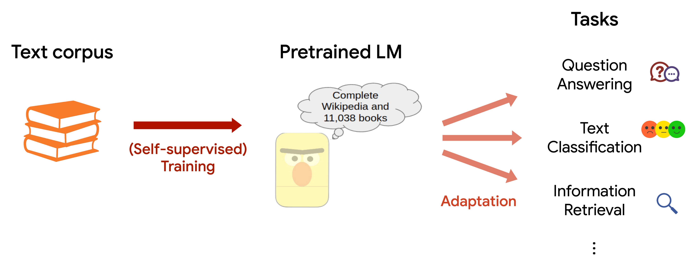

Slide 3
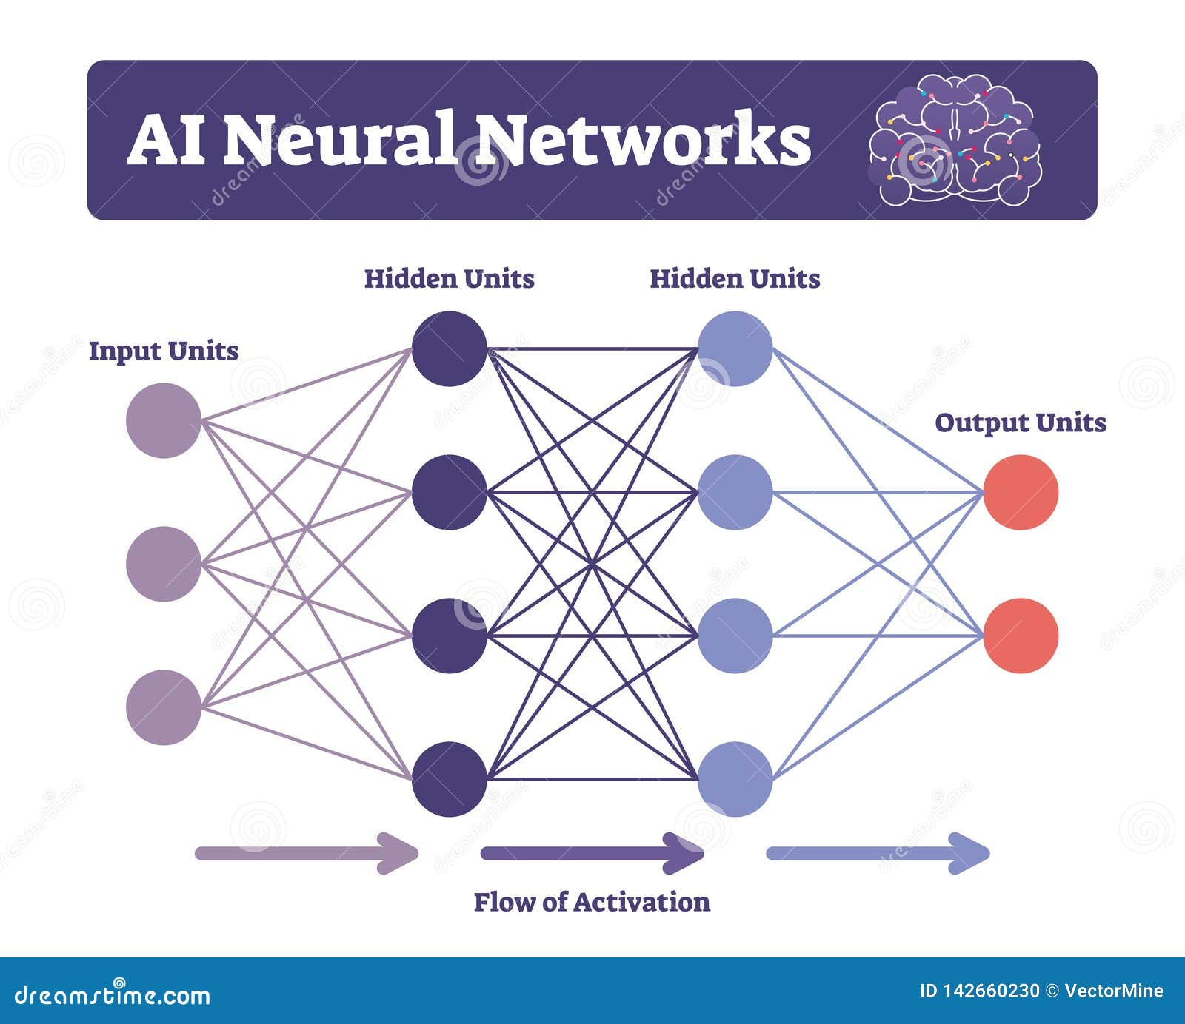

Slide 4
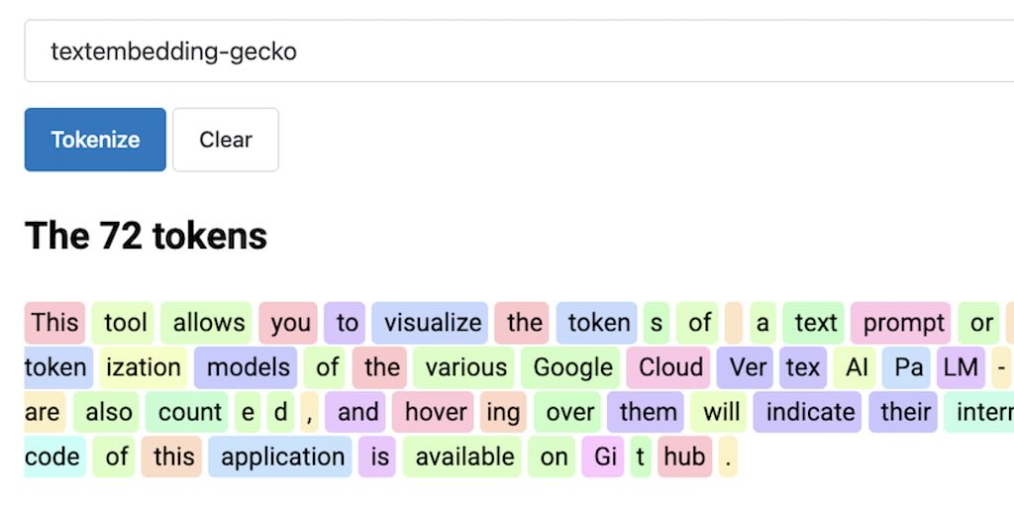

Slide 5
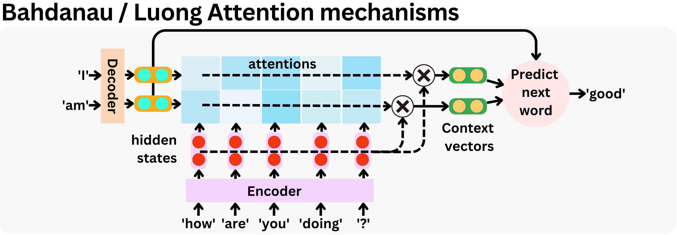

Slide 6
Attention Mechanism demonstration
Example: “She gave him a gift because he helped her.”
The Attention Mechanism means the model knows that “he” refers to the helper and not “him” (the receiver of her help).
This is an innovation in linguistic interpretation because the Large Language Model can “attend” to the right words to interpret the sentence properly.

Slide 7
Sources
Slide 2, Stanford University (n.d.) LLM Diagram. AI Stanford.edu Blog. https://ai.stanford.edu/blog/assets/img/posts/2022-05-31-linkbert/intro.png
Slide 3, AI Neural Networks. (2025). DreamsTime.com. https://www.dreamstime.com/ai-neural-networks-vector-illustration-labeled-connectionist-system-scheme-computing-mind-signals-constitute-like-biological-image142660230
Slide 4, The 72 Tokens. (2025). glaforge.dev. https://glaforge.dev/img/gemini/token-viz.jpg

Slide 8
Sources
Slide 5,
Bahdanau/Luong Attention mechanisms. (2023, April 3). The AiEdge Newsletter. https://substackcdn.com/image/fetch/f_auto,q_auto:good,fl_progressive:steep/https://substack-post-media.s3.amazonaws.com/public/images/c55cd0d7-8eed-4cdc-a20f-d6a4d7f145d1_3370x1176.png

Slide 9
AI & Instructor Bandwidth

